Slide 1
Pumping Lemma for CFL

Slide 2
Intuition
Recall the pumping lemma for regular languages.
It told us that if there was a string long enough to cause a cycle in the DFA for the language, then we could “pump” the cycle and discover an infinite sequence of strings that had to be in the language.

Slide 3
Intuition
For CFL’s the situation is a little more complicated.
We can always find two pieces of any sufficiently long string to “pump” in tandem.
That is: if we repeat each of the two pieces the same number of times, we get another string in the language.

Slide 4
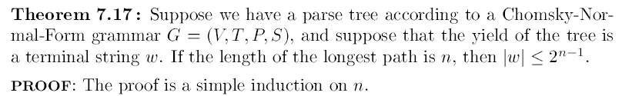
The size of Parse Trees

Slide 5

The size of Parse Trees
If $\left|w\right|>2^{n−1}, \text{then} \text{the} \text{longest} \text{path} \text{is}>n$

Slide 6

The size of Parse Trees
If $\left|w\right|>2^{n−1}, \text{then} \text{the} \text{longest} \text{path} \text{is}>n$
Let $\left|V\right|=m$

Slide 7
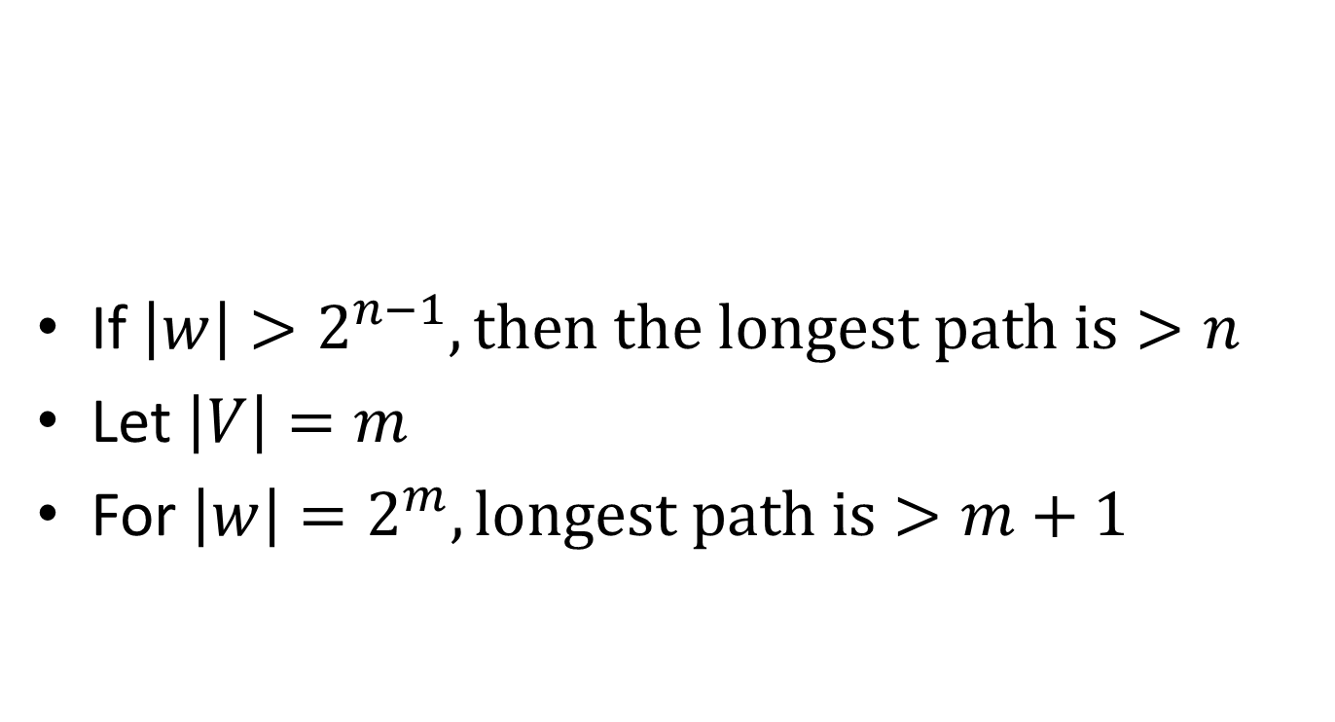
The size of Parse Trees
If $\left|w\right|>2^{n−1}, \text{then} \text{the} \text{longest} \text{path} \text{is}>n$
Let $\left|V\right|=m$
For $\left|w\right|=2^{m}, \text{longest} \text{path} \text{is}>m+1$

Slide 8
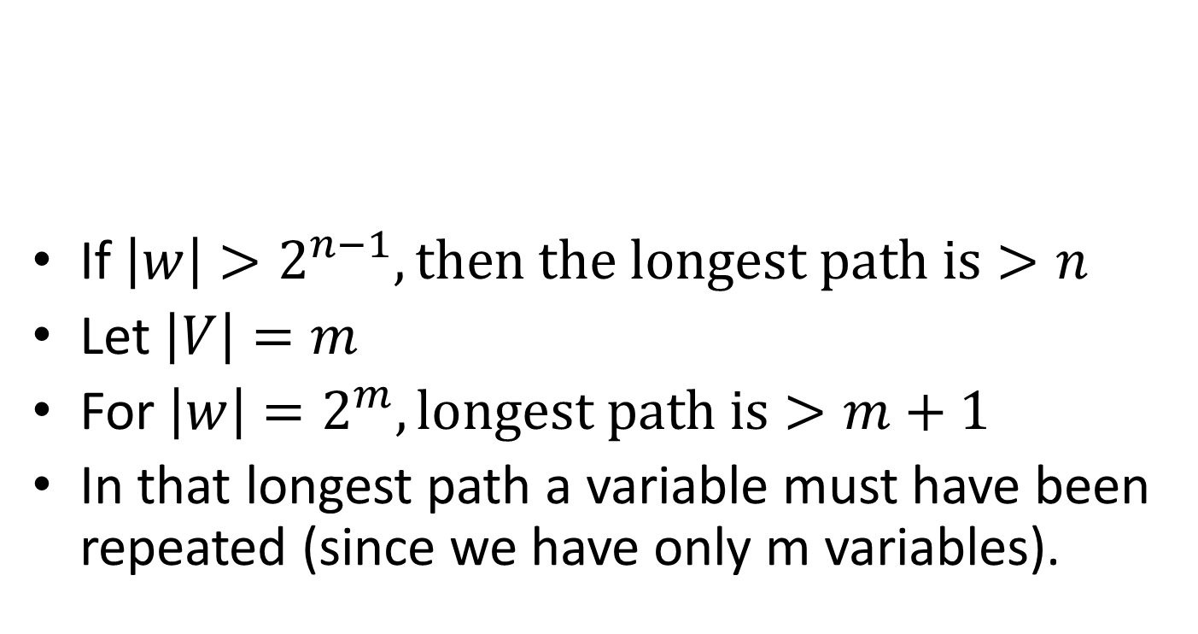
The size of Parse Trees
If $\left|w\right|>2^{n−1}, \text{then} \text{the} \text{longest} \text{path} \text{is}>n$
Let $\left|V\right|=m$
For $\left|w\right|=2^{m}, \text{longest} \text{path} \text{is}>m+1$
In that longest path a variable must have been repeated (since we have only m variables).

Slide 9
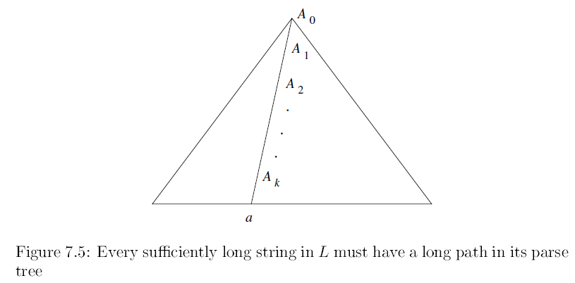

Slide 10
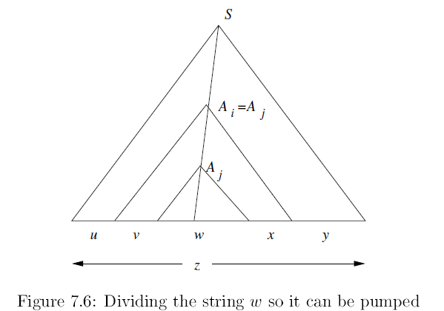

Slide 11
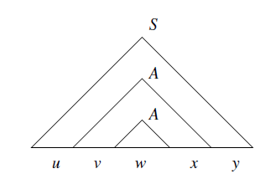

Slide 12
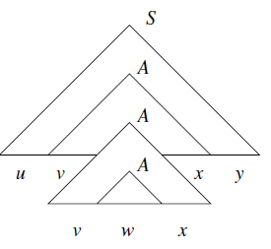

Slide 14
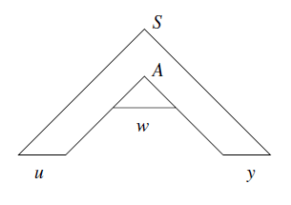

Slide 15
Parse Tree in the Pumping-Lemma
Can’t both
be ε. (Why?)
A
A
u
v
w
x
y

Slide 16
Parse Tree in the Pumping-Lemma
Both are ε means, there is no repetition of A !!
Can’t both
be ε. (Why?)
A
A
u
v
w
x
y

Slide 17
Pump Zero Times
A
A
A
w
u
v
x
y
u
y
w

Slide 18
Pump Twice
A
A
A
A
A
u
v
x
y
u
v
x
y
w
v
w
x

Slide 19
Pump Thrice
Etc., Etc.
A
A
A
A
A
u
v
x
y
u
v
x
y
w
A
v
x
v
w
x

Slide 20
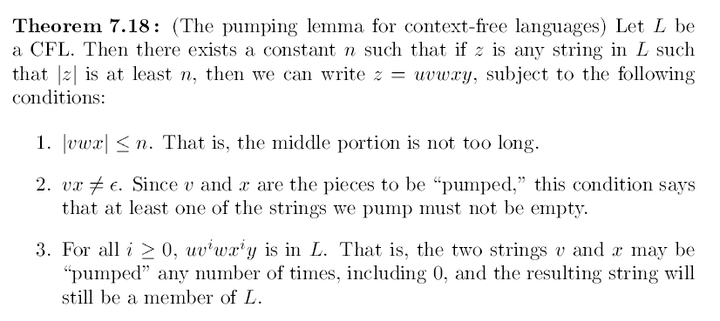
Statement

Slide 21
Statement
For every context-free language L
There is an integer n, such that
For every string z in L of length > n
we can write z = uvwxy such that:
|vwx| < n.
|vx| > 0.
For all i > 0, uv^{i}wx^{i}y is in L.

Slide 22
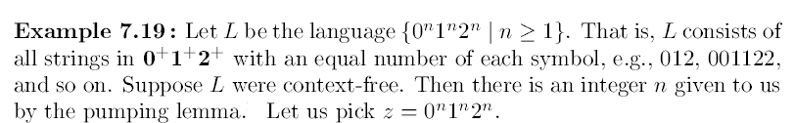

Slide 24


Slide 25
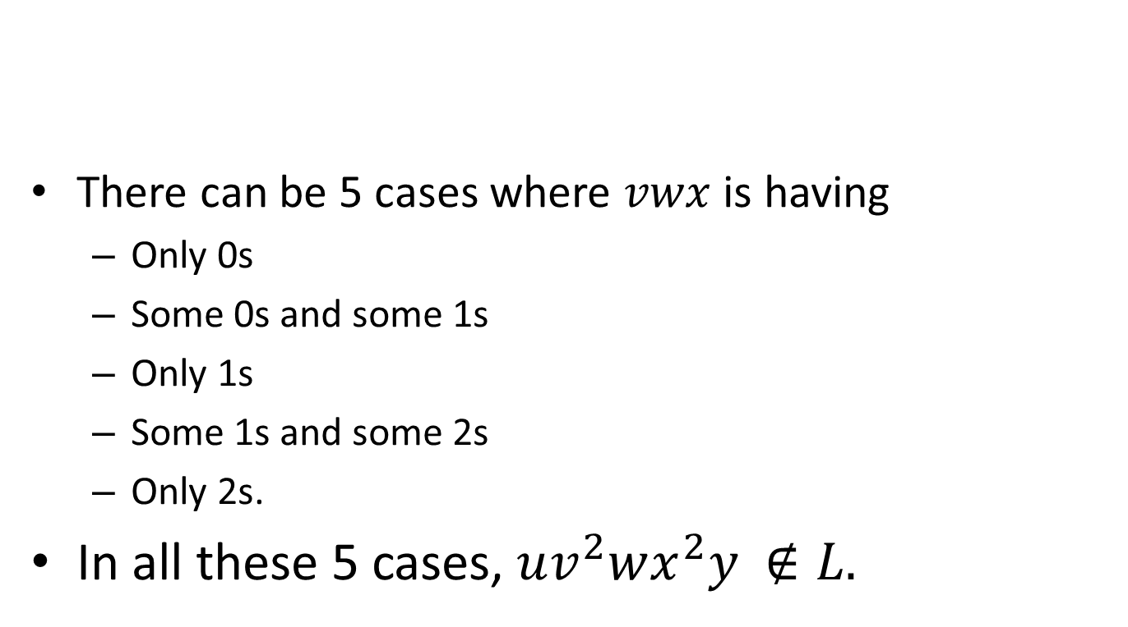
There can be 5 cases where $vwx$ is having
Only 0s
Some 0s and some 1s
Only 1s
Some 1s and some 2s
Only 2s.
In all these 5 cases, $uv^{2}wx^{2}y$ $∉L.$

Slide 26

Show L is not a CFL.
Note, $\left\{ww^{R}\right|w∈{\left\{0,1\right\}}^{∗} \}$ is a CFL.
How can you prove this??

Slide 27
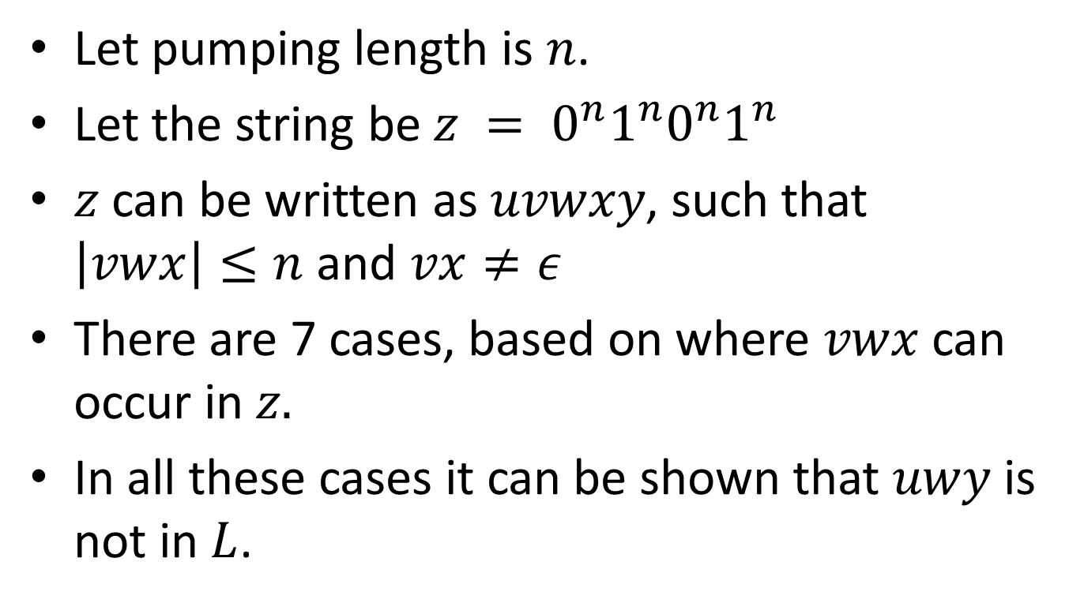
Let pumping length is $n$.
Let the string be $z = 0^{n}1^{n}0^{n}1^{n}$
$z$ can be written as $uvwxy$, such that $\left|vwx\right|≤n$ and $vx≠ε$
There are 7 cases, based on where $vwx$ can occur in $z.$
In all these cases it can be shown that $uwy$ is not in $L$.

Slide 28
Using the Pumping Lemma
{0^{i}10^{i} | i > 1} is a CFL.
We can match one pair of counts.
Can you give CFG??

Slide 29
Using the Pumping Lemma
{0^{i}10^{i} | i > 1} is a CFL.
But L = {0^{i}10^{i}10^{i} | i > 1} is not.
We can’t match two pairs, or three counts as a group.
Proof using the pumping lemma.
Suppose L were a CFL.
Let n be L’s pumping length.

Slide 30
Using the Pumping Lemma
Consider z = 0^{n}10^{n}10^{n}.
We can write z = uvwxy, where |vwx| < n, and |vx| > 1.
Case 1: vx has no 0’s.
Then at least one of them is a 1, and uwy has at most one 1, which no string in L does.

Slide 31
Using the Pumping Lemma
Consider z = 0^{n}10^{n}10^{n}.
We can write z = uvwxy, where |vwx| < n, and |vx| > 1.
vwx can contain either initial 0s or final 0s. {it cannot contain both initial 0s and final 0s}.
So pumping at least once, that is, i = 2, will make imbalance in number of initial zeros and final zeros.

Slide 32
Using the Pumping Lemma
Still considering z = 0^{n}10^{n}10^{n}.
Case 2: vx has at least one 0.
vwx is too short (length < n) to extend to all three blocks of 0’s in 0^{n}10^{n}10^{n}.
Thus, uwy has at least one block of n 0’s, and at least one block with fewer than n 0’s.
Thus, uwy is not in L.

Slide 33
In other words…
z = 0^{n}10^{n}10^{n}.
vwx is too short (length < n) to extend to all three blocks of 0’s in 0^{n}10^{n}10^{n}.
Thus, uv²wx²y is not in the form (since either initial 0s or Final 0s will be more)

