Slide 1
Closure properties of CFLs

Slide 2
There are some differences when compared with regular languages.
We deviate from both text books (to simplify the things).
We want to skip homomorphism.

Slide 3
CFLs are --
Closed under
Union
Concatenation
Kleene star
Reversal
Intersection with regular languages
Not closed under
Intersection
Difference
Complement
Repetition

Slide 4

CFLs are closed under Union
$L_{1}\text{and} L_{2}$ are CFLs $⇒L_{1}∪L_{2}$ is a CFL.

Slide 5

CFLs are closed under Union
$L_{1}\text{and} L_{2}$ are CFLs $⇒L_{1}∪L_{2}$ is a CFL.
Proof: Let the CFG for these are $G_{1}=(V_{1},T_{1},P_{1},S_{1})$ and $G_{2}=(V_{2},T_{2},P_{2},S_{2}).$

Slide 6
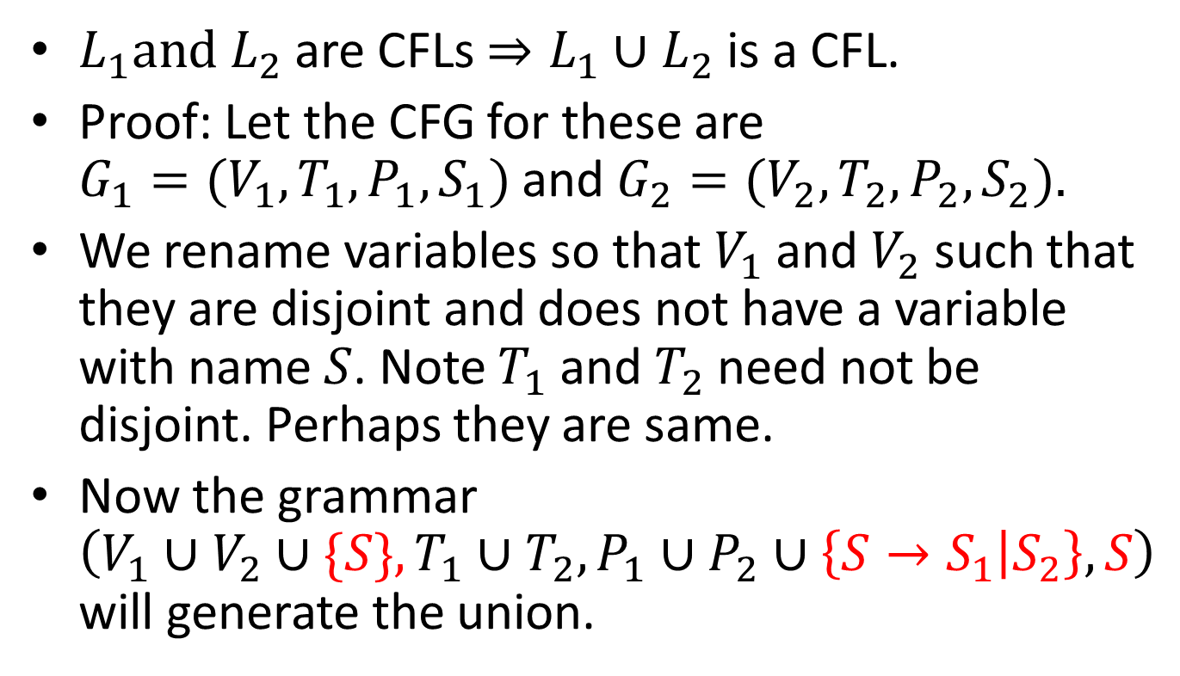
CFLs are closed under Union
$L_{1}\text{and} L_{2}$ are CFLs $⇒L_{1}∪L_{2}$ is a CFL.
Proof: Let the CFG for these are $G_{1}=(V_{1},T_{1},P_{1},S_{1})$ and $G_{2}=(V_{2},T_{2},P_{2},S_{2}).$
We rename variables so that $V_{1}$ and $V_{2}$ such that they are disjoint and does not have a variable with name $S$. Note $T_{1}$ and $T_{2}$ need not be disjoint. Perhaps they are same.
Now the grammar $\left(V_{1}∪V_{2}∪\{S\}, T_{1}∪T_{2}, P_{1}∪P_{2}∪\left\{S→S_{1} | S_{2}\right\}, S\right)$ will generate the union.

Slide 7

Closed under concatenation
Add the production $S→S_{1}S_{2}$

Slide 8

Closed under Kleene star
Add productions $S→S_{1}S|ε$

Slide 9
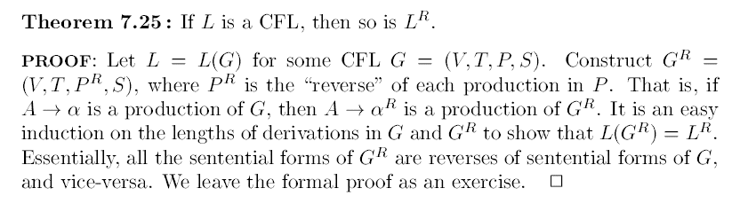
Closed under reversal

Slide 10
Not closed under intersection☹

Slide 11
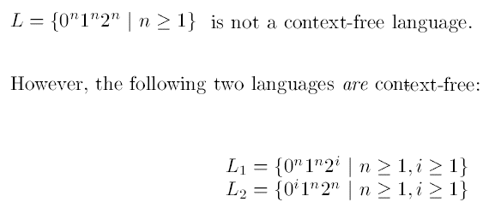

Not closed under intersection☹
Proof [by counter example]:
And, $L=L_{1}∩L_{2}$

Slide 12
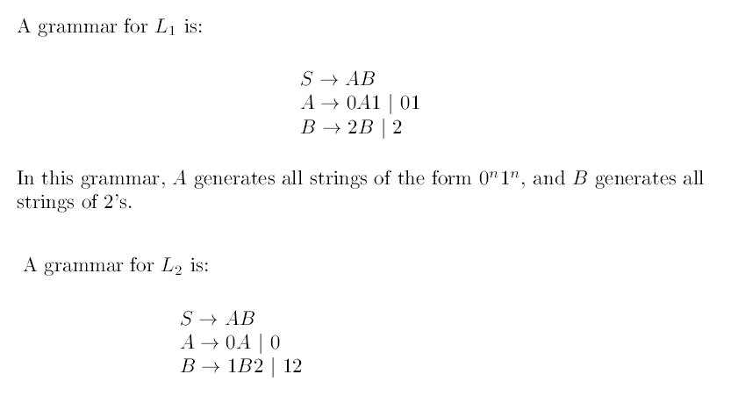

Slide 13
CFLs are closed when intersected with regular languages

Slide 14
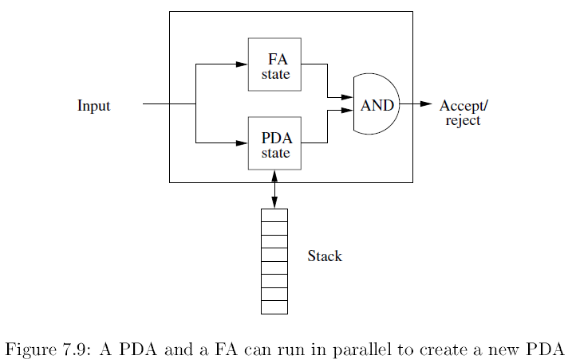
CFLs are closed when intersected with regular languages

Slide 15
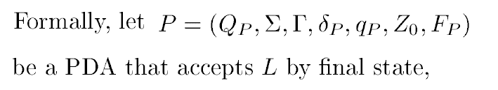

Slide 16


Slide 17
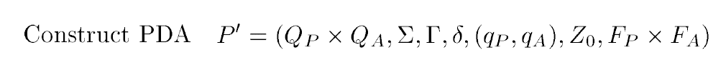

Slide 18

We need to define $δ$ for the PDA.

Slide 19
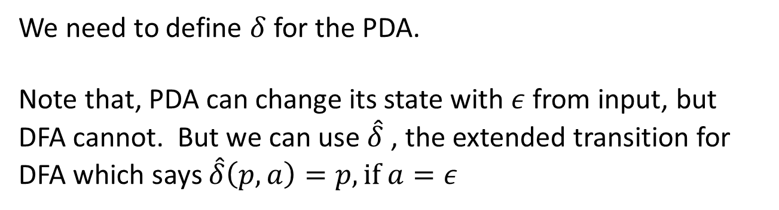
We need to define $δ$ for the PDA.
Note that, PDA can change its state with $ε$ from input, but DFA cannot. But we can use $\hat{δ}$ , the extended transition for DFA which says $\hat{δ}\left(p,a\right)=p, if a=ε$

Slide 20
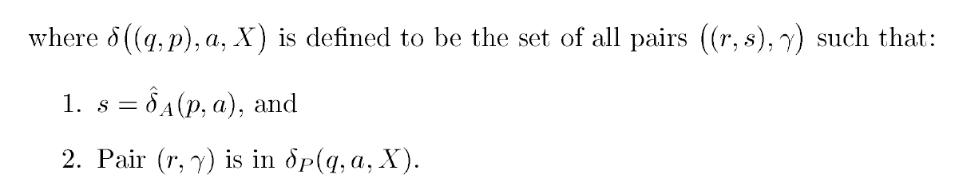

Slide 21

We are allowing $a$ to be $ε$

Slide 22
We are allowing $a$ to be $ε$
We could have taken NFA for R instead of a DFA, But the things will be more complicated (it can be done). Note, product of DFAs is simple; can be extended to NFAs also, but things are complicated !!

Slide 23
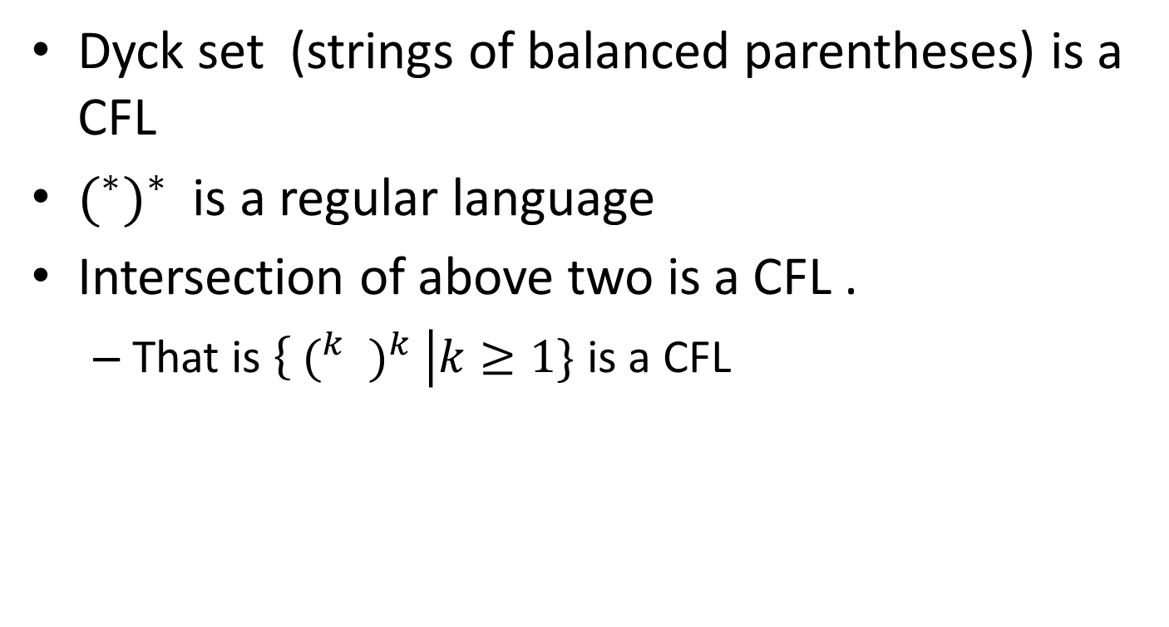
An application
Dyck set (strings of balanced parentheses) is a CFL
$(^{∗})^{∗}$ is a regular language
Intersection of above two is a CFL .
That is $\left\{{ (^{k} )}^{k} \right|k≥1\}$ is a CFL

Slide 24
To show “not CFL”
The language L where each string has equal number of 0s, 1s and 2s (may be interleaved) is not CFL.

Slide 25
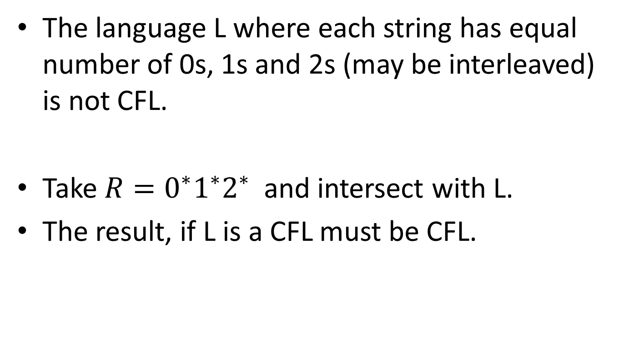
To show “not CFL”
The language L where each string has equal number of 0s, 1s and 2s (may be interleaved) is not CFL.
Take $R=0^{∗}1^{∗}2^{∗}$ and intersect with L.
The result, if L is a CFL must be CFL.

Slide 26
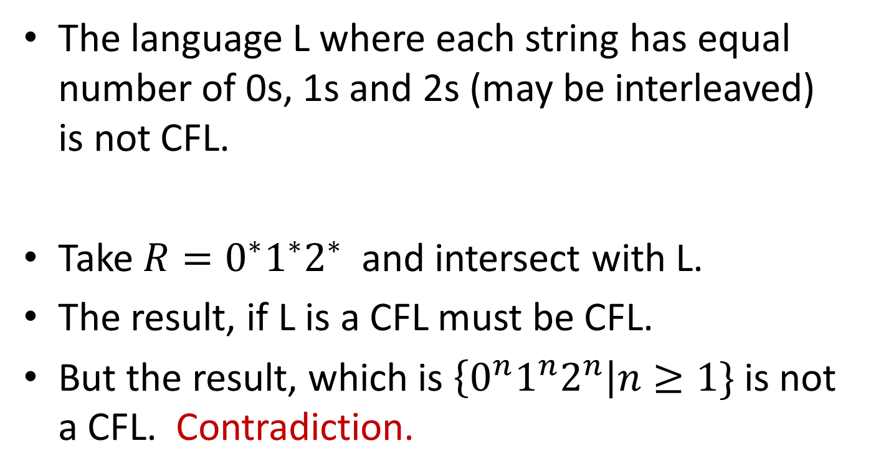
To show “not CFL”
The language L where each string has equal number of 0s, 1s and 2s (may be interleaved) is not CFL.
Take $R=0^{∗}1^{∗}2^{∗}$ and intersect with L.
The result, if L is a CFL must be CFL.
But the result, which is $\left\{0^{n}1^{n}2^{n}\right|n≥1\}$ is not a CFL. Contradiction.

Slide 27
To show “not CFL”
The language L where each string has equal number of 0s, 1s and 2s (may be interleaved) is not CFL.
Take $R=0^{∗}1^{∗}2^{∗}$ and intersect with L.
The result, if L is a CFL must be CFL.
But the result, which is $\left\{0^{n}1^{n}2^{n}\right|n≥1\}$ is not a CFL. Contradiction.
Of course, pumping lemma for CFLs can directly applied on L and shown to fail.

Slide 28

CFLs are not closed under complementation
We know $L=\left\{ww\right|w∈{\left\{0,1\right\}}^{∗} \}$ is not a CFL.

Slide 29

CFLs are not closed under complementation
We know $L=\left\{ww\right|w∈{\left\{0,1\right\}}^{∗} \}$ is not a CFL.
But its complement is a CFL !!
This is a proof by counter example.

Slide 30
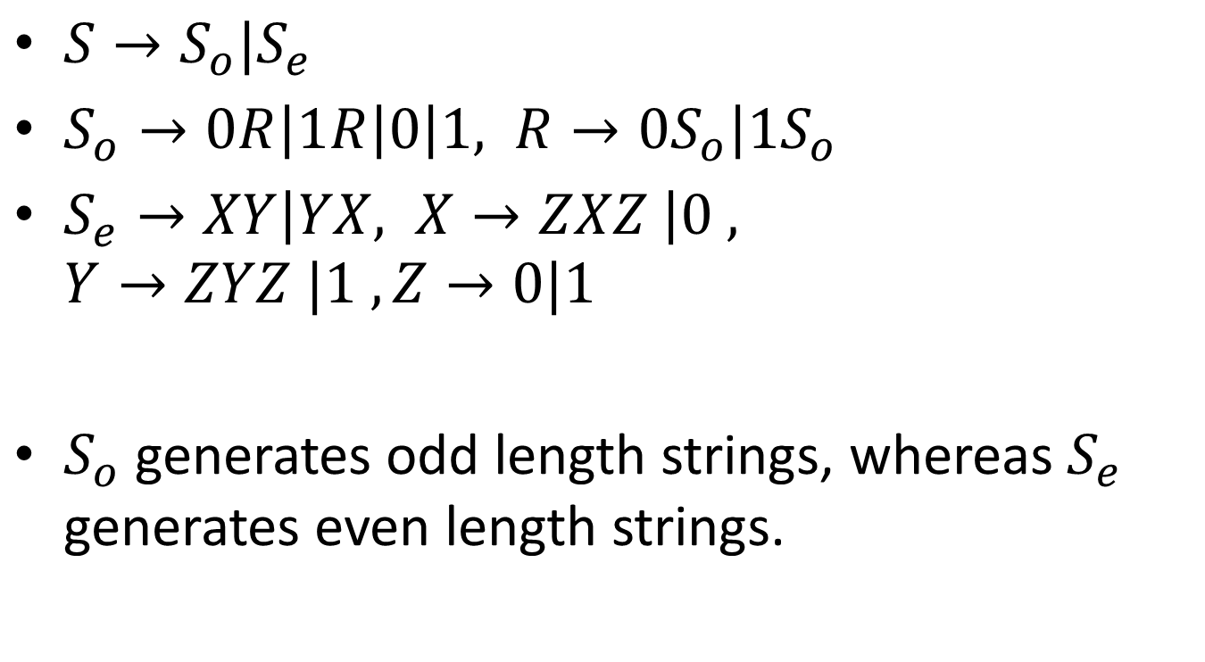

CFG for the $\overline{L}$
$S→S_{o}|S_{e}$
$S_{o}→0R\left|1R\right|0\left|1, R→0S_{o}\right|1S_{o}$
$S_{e}→XY\left|YX, X→ZXZ \right|0 , Y→ZYZ |1 , Z→0|1$
$S_{o}$ generates odd length strings, whereas $S_{e}$ generates even length strings.

Slide 31
Other proof
Other proof is through contradiction.
If it is closed under complementation then it has to be closed under intersection.

Slide 32

Other proof
Other proof is through contradiction.
If it is closed under complementation then it has to be closed under intersection.
Depends on the identity

Slide 33
Not closed under set difference
Proof by contradiction.
If closed under set difference, then it has to be closed under complementation.

Slide 34
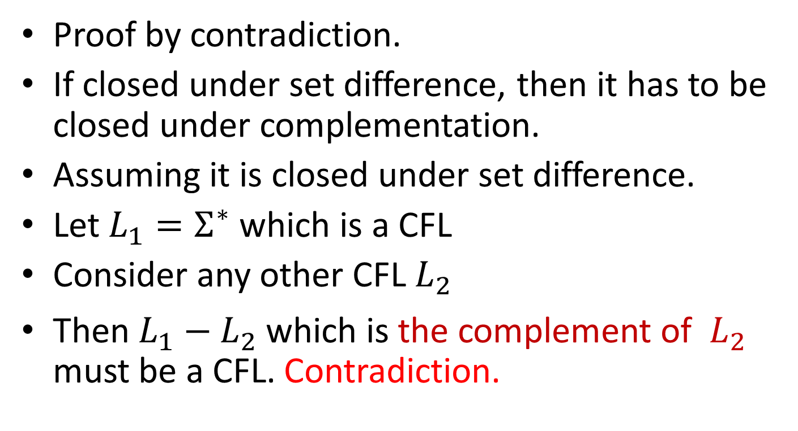
Not closed under set difference
Proof by contradiction.
If closed under set difference, then it has to be closed under complementation.
Assuming it is closed under set difference.
Let $L_{1}=Σ^{∗}$ which is a CFL
Consider any other CFL $L_{2}$
Then $L_{1}−L_{2}$ which is the complement of ${ L}_{2}$ must be a CFL. Contradiction.

Slide 35

Set difference with regular is okay☺
If $L$ is a CFL and $R$ is a regular language, then $L−R$ is a CFL.
$L−R=L∩\overline{R}$
If $R$ is regular then $\overline{R}$ is regular.

