Slide 1
Decidable properties of CFL
Several undecidable are there …

Slide 2
Membership question.
Empty?
Infinite/not ?

Slide 3
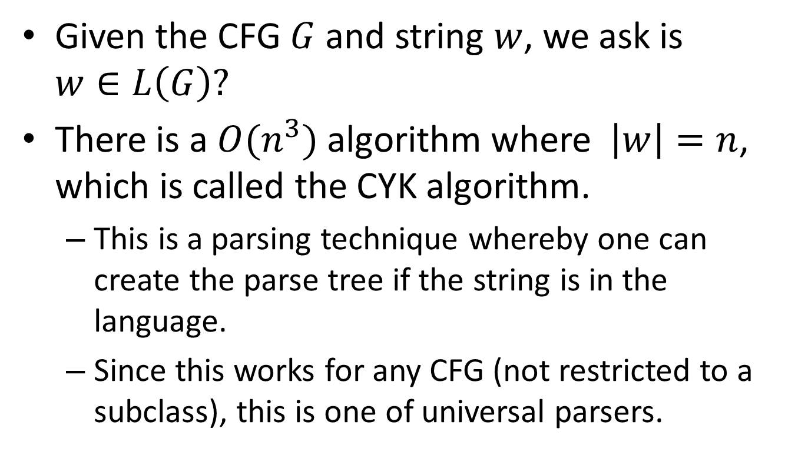
Membership question
Given the CFG $G$ and string $w$, we ask is $w∈L\left(G\right)?$
There is a $O(n^{3})$ algorithm where $\left|w\right|=n$, which is called the CYK algorithm.
This is a parsing technique whereby one can create the parse tree if the string is in the language.
Since this works for any CFG (not restricted to a subclass), this is one of universal parsers.

Slide 4
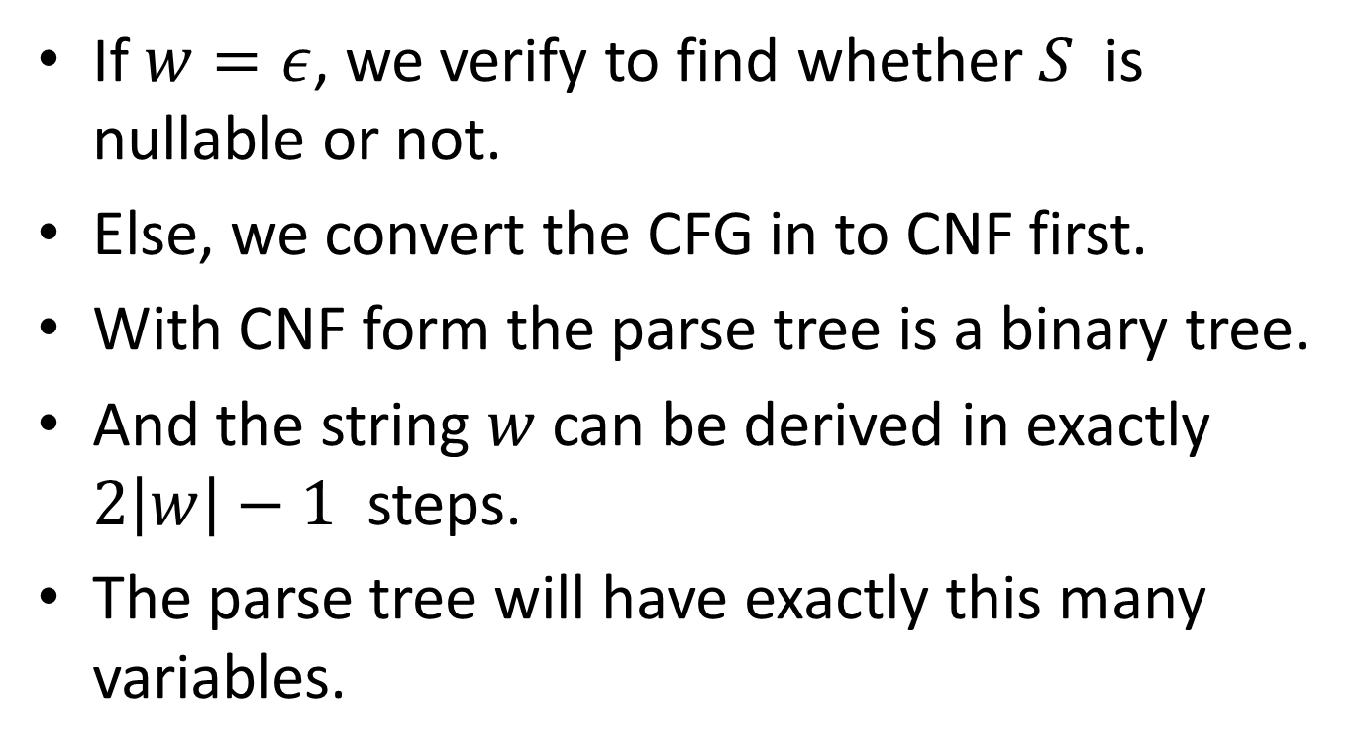
If $w=ε$, we verify to find whether $S$ is nullable or not.
Else, we convert the CFG in to CNF first.
With CNF form the parse tree is a binary tree.
And the string $w$ can be derived in exactly $2\left|w\right|−1$ steps.
The parse tree will have exactly this many variables.

Slide 5

We can list all possible derivations having $2\left|w\right|−1$ steps.
We verify whether, any, gave the string.
But, this is an exponential time algorithm.

Slide 6
There is a much more efficient technique based on the idea of “dynamic programming”.
This is called the CYK algorithm.
Also called the table-filling or tabulation algorithm.

Slide 7
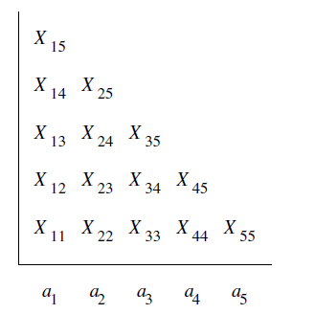


CYK algorithm
Let $w=a_{1}a_{2}⋯a_{n}$ be the given string.
We fill a table, as shown, for example when $w=a_{1}a_{2}⋯a_{5}$

Slide 8

If $S∈X_{1n}$ then $S\underset{⇒}{∗}w$
To find $X_{1n}$ we need to fill the table, in a bottom-up fashion.

Slide 9
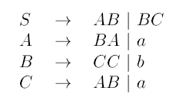

Slide 10
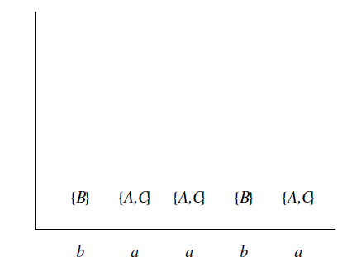

Slide 11


Slide 12


Slide 13


Slide 14


Slide 15
Parse tree
Parse tree can be found by keeping track of some side information.

Slide 16
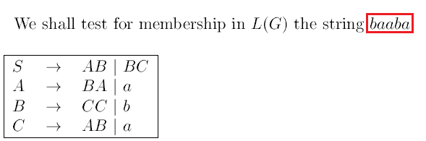

Slide 17
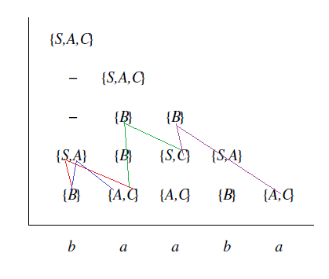

Slide 18
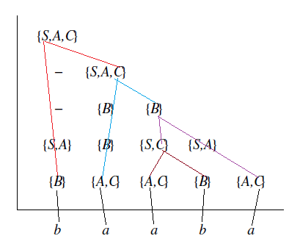

Slide 19
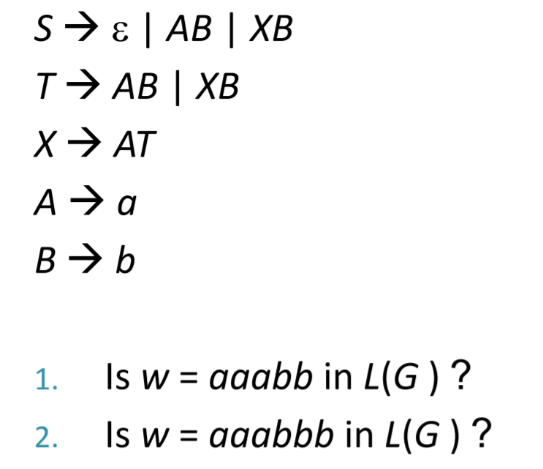

Slide 20
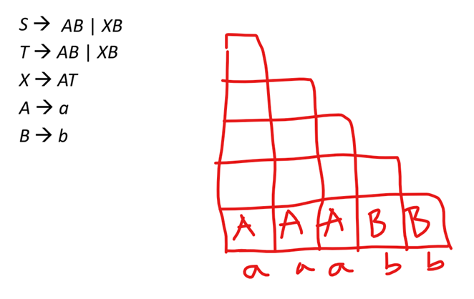
The given string is aaabb.
The grammar is CNF is :
Complete this..

Slide 21

Time complexity of CYK
$O\left(n^{3}\right)$

Slide 22
Empty ?
This is easy.
Is S generating ?

Slide 23
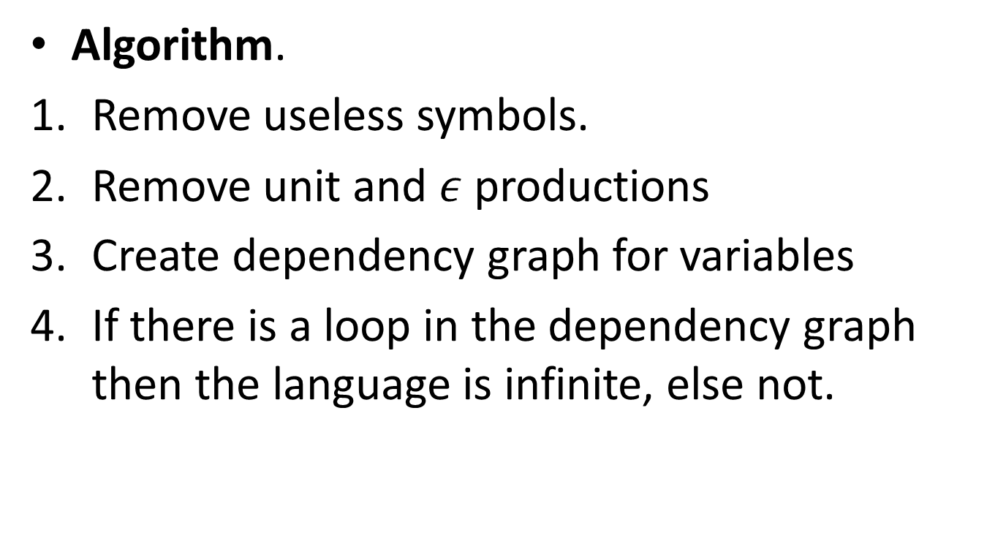
Infinite or not?
Algorithm.
Remove useless symbols.
Remove unit and $ε$ productions
Create dependency graph for variables
If there is a loop in the dependency graph then the language is infinite, else not.

Slide 24

Example
$S→AB, A→aCb\left|a, B→bB\right|b, C→cBS$

Slide 25
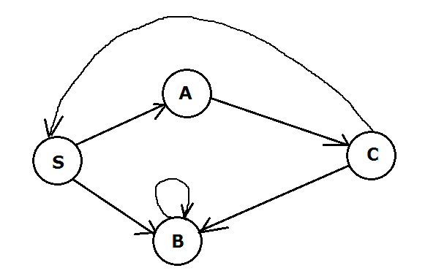
Example
$S→AB, A→aCb\left|a, B→bB\right|b, C→cBS$

Slide 26
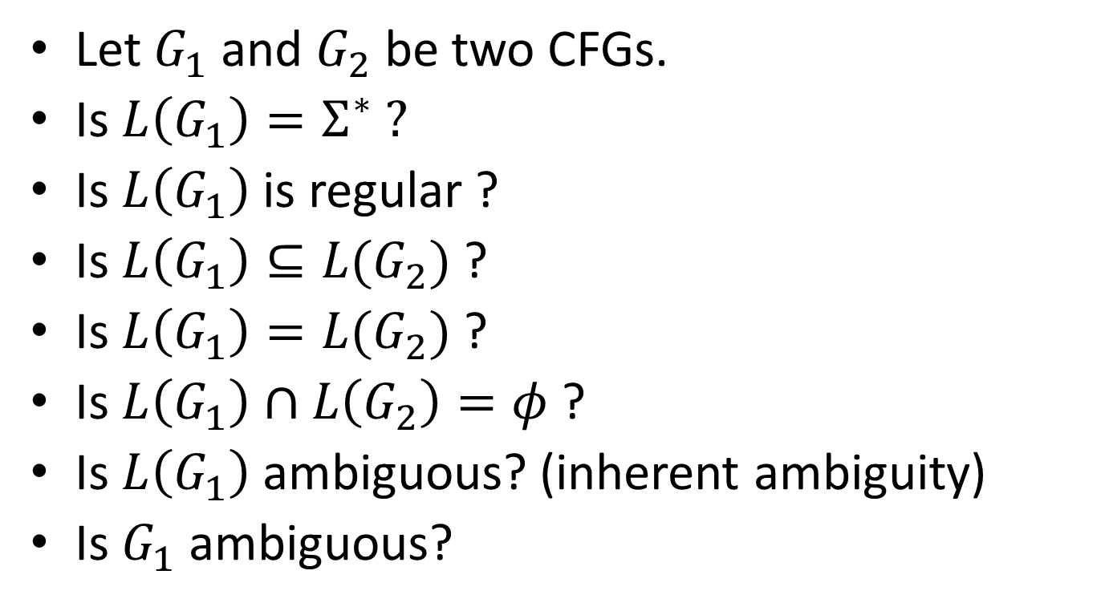
Some undecidable properties ☹
Let $G_{1}$ and $G_{2}$ be two CFGs.
Is $L\left(G_{1}\right)=Σ^{∗} ?$
Is $L\left(G_{1}\right)$ is regular ?
Is $L\left(G_{1}\right)⊆L(G_{2})$ ?
Is $L\left(G_{1}\right)=L(G_{2})$ ?
Is $L\left(G_{1}\right)∩L\left(G_{2}\right)=φ$ ?
Is $L\left(G_{1}\right)$ ambiguous? (inherent ambiguity)
Is $G_{1}$ ambiguous?

