Slide 1
Theory of Computation
Introduction

Slide 2
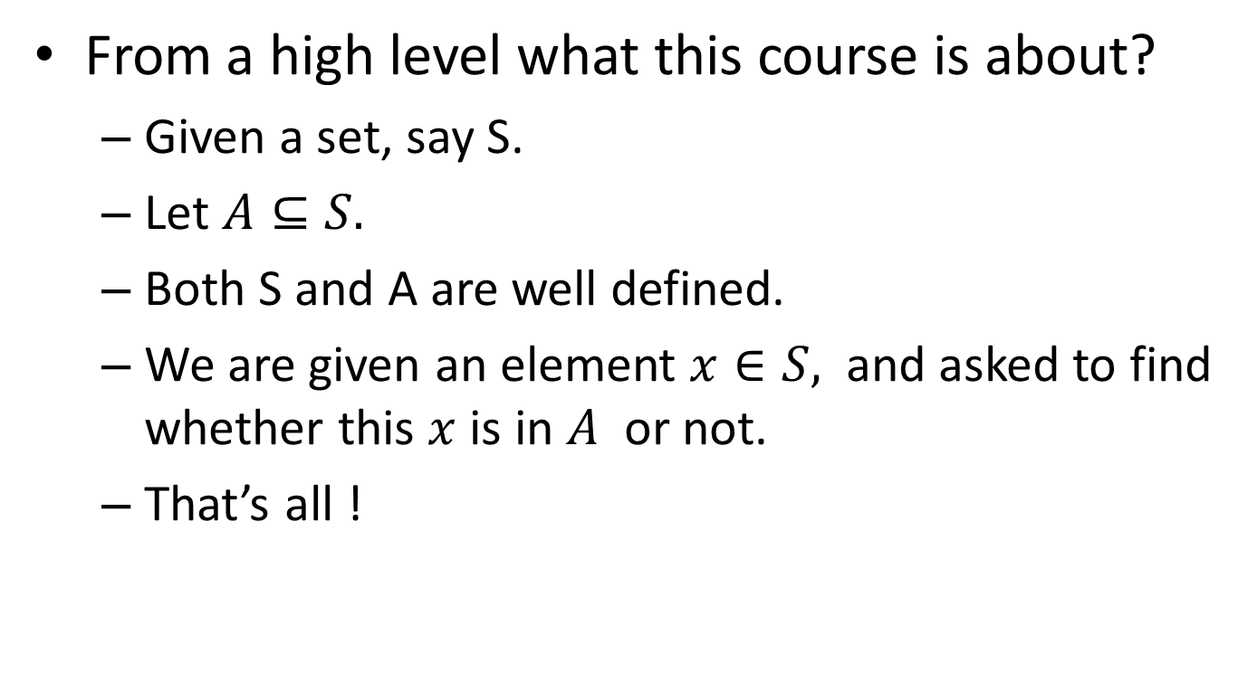
From high level
From a high level what this course is about?
Given a set, say S.
Let $A⊆S.$
Both S and A are well defined.
We are given an element $x∈S,$ and asked to find whether this $x$is in $A$ or not.
That’s all !

Slide 3
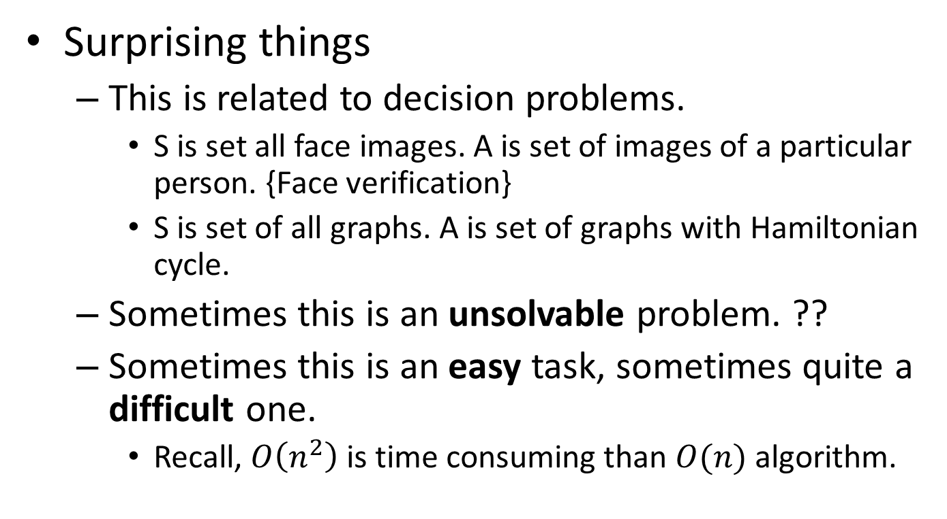
Surprises !!
Surprising things
This is related to decision problems.
S is set all face images. A is set of images of a particular person. {Face verification}
S is set of all graphs. A is set of graphs with Hamiltonian cycle.
Sometimes this is an unsolvable problem. ??
Sometimes this is an easy task, sometimes quite a difficult one.
Recall, $O\left(n^{2}\right)$ is time consuming than $O(n)$ algorithm.

Slide 4
We want general enough set
Set of strings over some alphabet like {0,1}.
For example set of strings that end with a 0, {0, 00, 10, 000, 010, 100, 110, …}
Eg2: Each string in the set can be seen as a positive binary number and let the set be the set of prime numbers.
Given a number (binary string of 0s and 1s) you want to find whether this is in the set (prime) or not (not a prime).

Slide 5
Why strings are chosen?
Any data element like number or image or any thing can be represented as a string.
Can we say DNA code represents a human being?
Even a method which solves a problem can be represented as a string.
A proof can be represented as a string.
So strings over an alphabet gives us power to represent the things… that is we have languages of strings to represent the things.

Slide 6
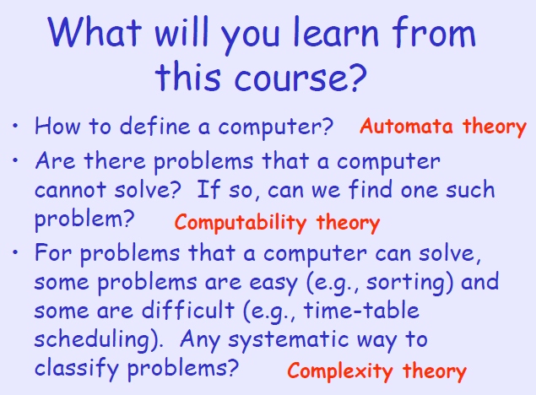

Slide 7
Syllabus
Syllabus:
Unit – 1 [8 Hours]: Introduction - Alphabets, Strings and Languages, Automata and Grammars; Deterministic finite Automata (DFA) - Formal Definition, Simplified notation, State transition graph, Transition table, Language of DFA; Nondeterministic finite Automata (NFA) - NFA with epsilon transition, Language of NFA, Equivalence of NFA and DFA, Minimization of Finite Automata, Distinguishing one string from other
Unit – 2 [8 Hours]: Regular Expression (RE) - Definition, Operators of regular expression and their precedence, Algebraic laws for Regular expressions; Relation with FA - Regular expression to FA, DFA to Regular expression; Non Regular Languages - Pumping Lemma for regular Languages, Application of Pumping Lemma; Properties - Closure properties of Regular Languages, Decision properties of Regular Languages, Applications and Limitation of FA
Unit – 3 [8 Hours]: Context Free Grammar (CFG) - Definition, Examples, Derivation, Derivation trees; Ambiguity in Grammar - Inherent ambiguity, Ambiguous to Unambiguous CFG; Normal forms for CFGs - Useless symbols, Simplification of CFGs, CNF and GNF; Context Free Languages (CFL) - Closure properties of CFLs, Decision Properties of CFLs, Emptiness, Finiteness and Membership, Pumping lemma for CFLs
Unit – 4 [8 Hours]: Push Down Automata (PDA) - Description and definition, Instantaneous Description, Language of PDA; Variations of PDA - Acceptance by Final state, Acceptance by empty stack, Deterministic PDA; Equivalence of PDA and CFG - CFG to PDA and PDA to CFG
Unit – 5 [8 Hours]: Turing machines (TM) - Basic model, definition and representation, Instantaneous Description; Variants of Turing Machine - TM as Computer of Integer functions, Universal TM; Church’s Thesis; Language acceptance by TM - Recursive and recursively enumerable languages;
Unit – 6 [8 Hours]: Decidability - Halting problem, Introduction to Undecidability, Undecidable problems about TMs; Complexity - Time Complexity, Problem classes - P, NP, NP-Hard, NP-Complete.

Slide 8
Text Books
Text Books:
John E. Hopcroft, Rajeev Motwani and Jeffrey D. Ullman, Introduction to Automata Theory, Languages and Computation, Pearson Education, 3rd edition, 2014, ISBN: 978-0321455369
Michael Sipser, Introduction to the Theory of Computation, Cengage Learning, 3rd Edition, 2014, ISBN: 978-8131525296
Reference Books:
John C. Martin, Introduction to Languages and the Theory of Computation, McGraw-Hill Education, 4th edition, 2010, ISBN: 978-0073191461
Bernard M. Moret, The Theory of Computation, Pearson Education, 2002, ISBN: 978-8131708705

Slide 9
Evaluation
Quiz: Best (n-1) 20 marks
Mid1: 20 marks
Mid2: 25 marks
Endsem: 35 marks
Can be updated (and will be informed).

