Slide 1
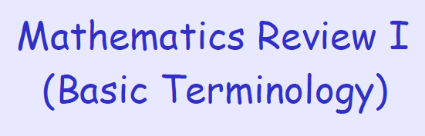

Slide 2
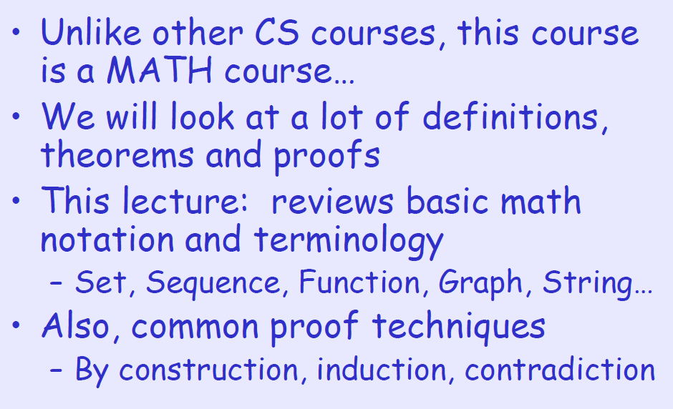

Slide 3
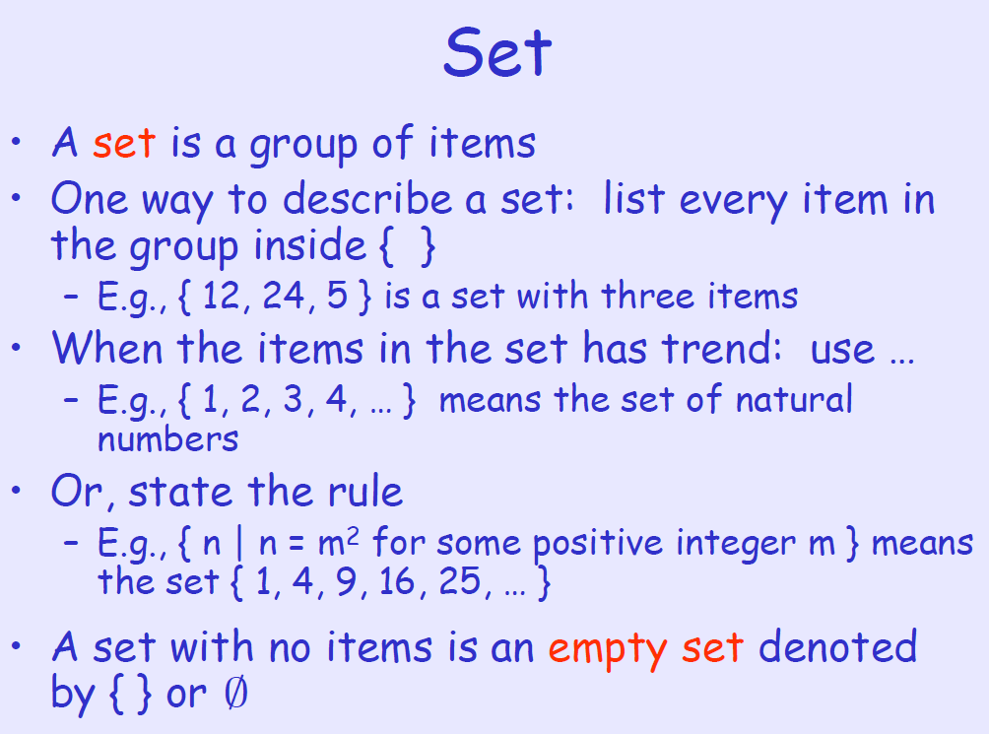

Slide 4
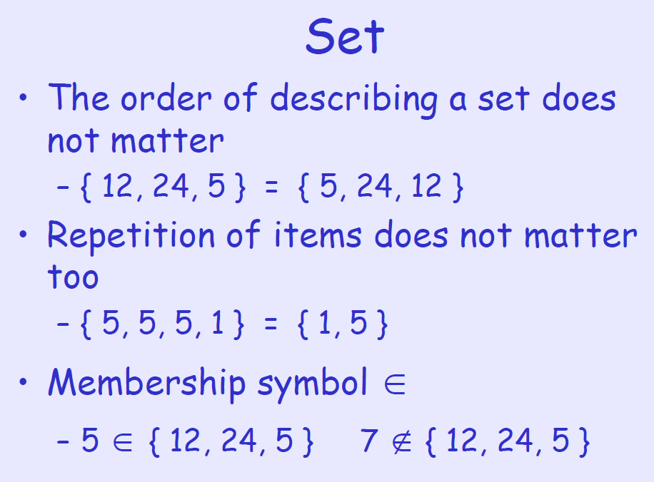

Slide 5
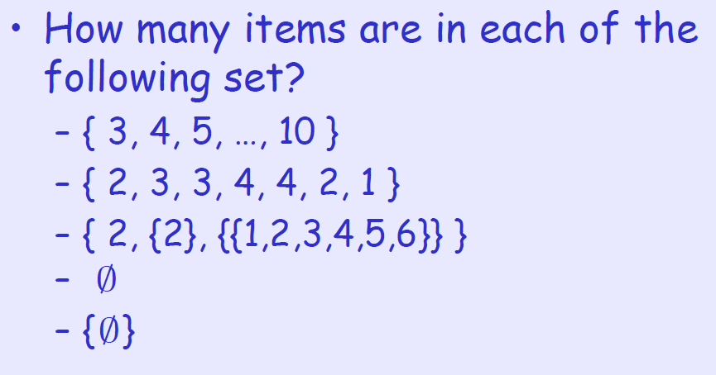

Slide 6
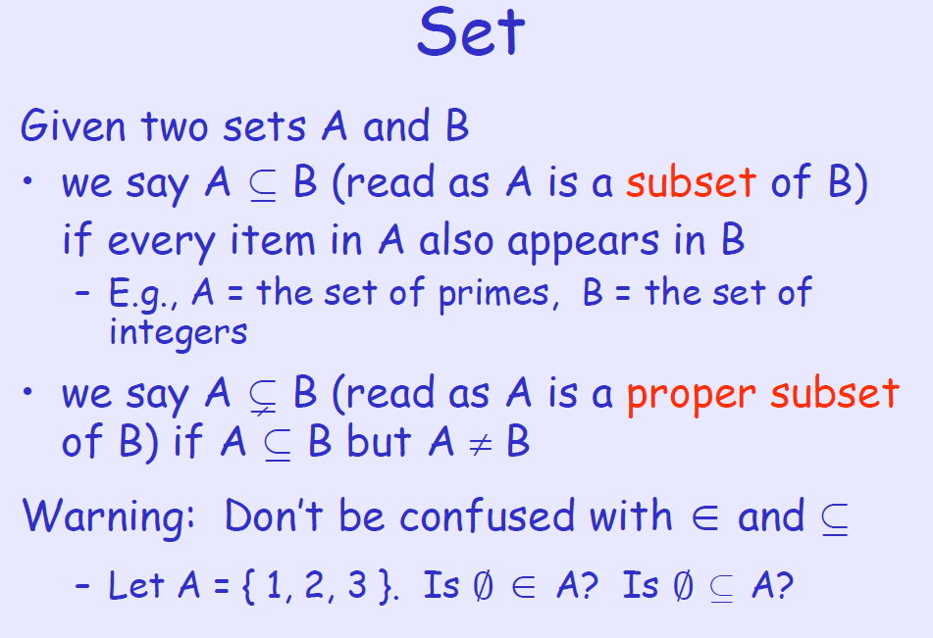

Slide 7
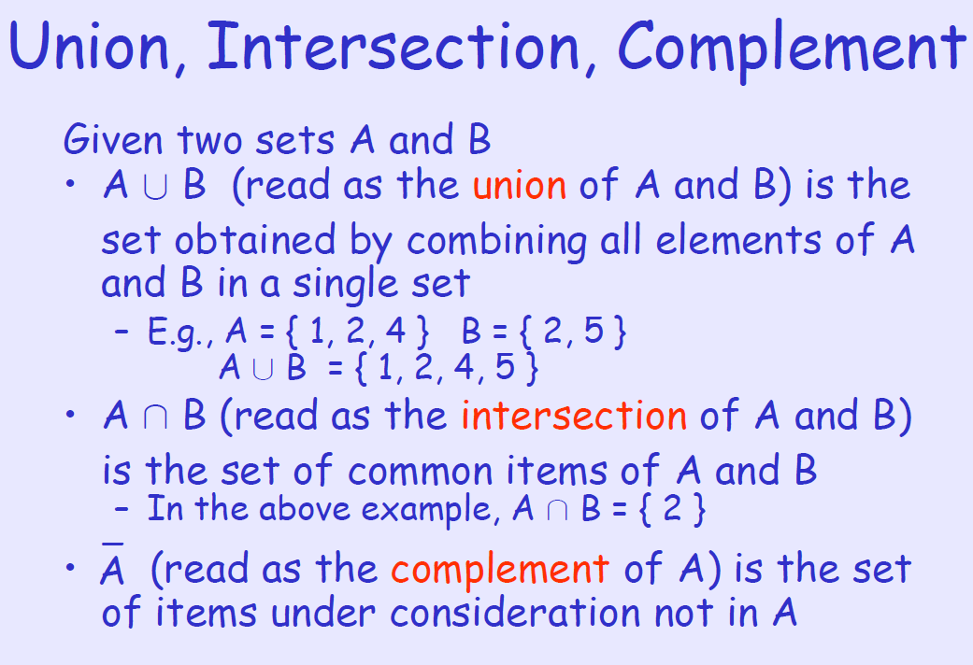

Slide 8
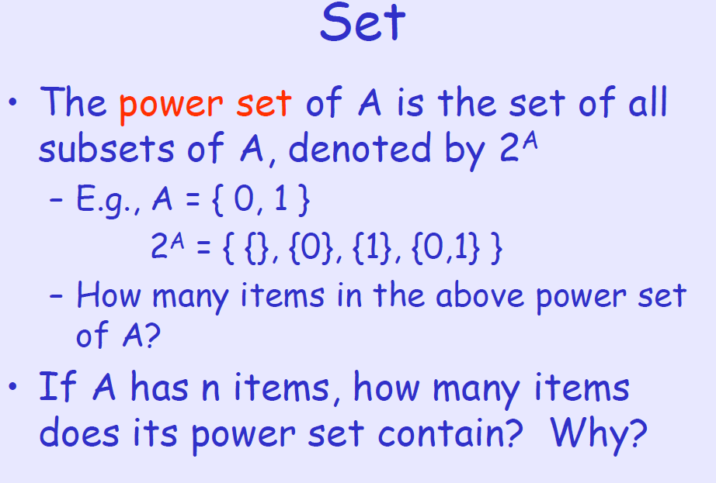

Slide 9
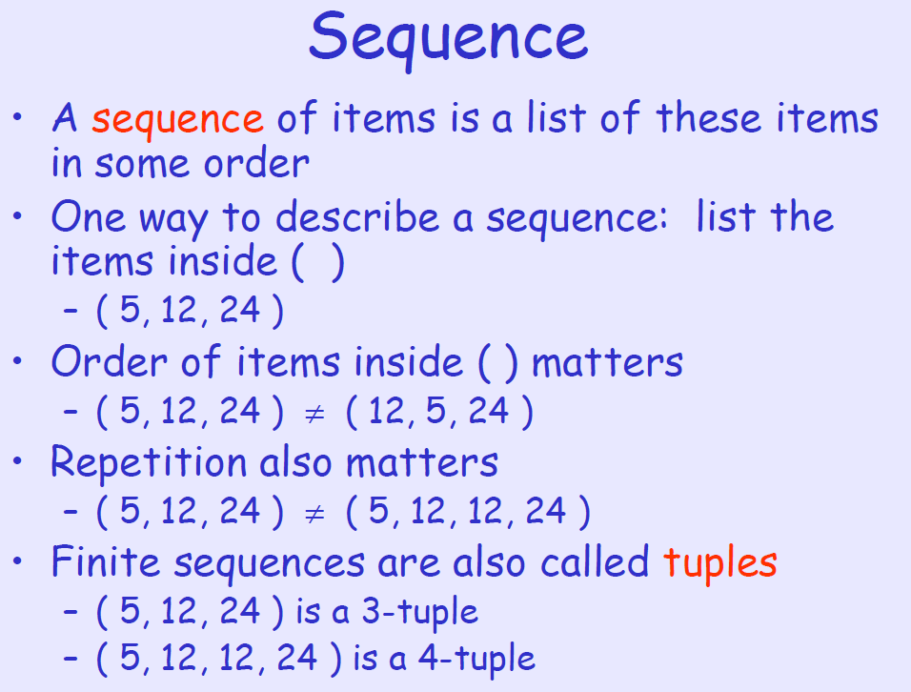

Slide 10
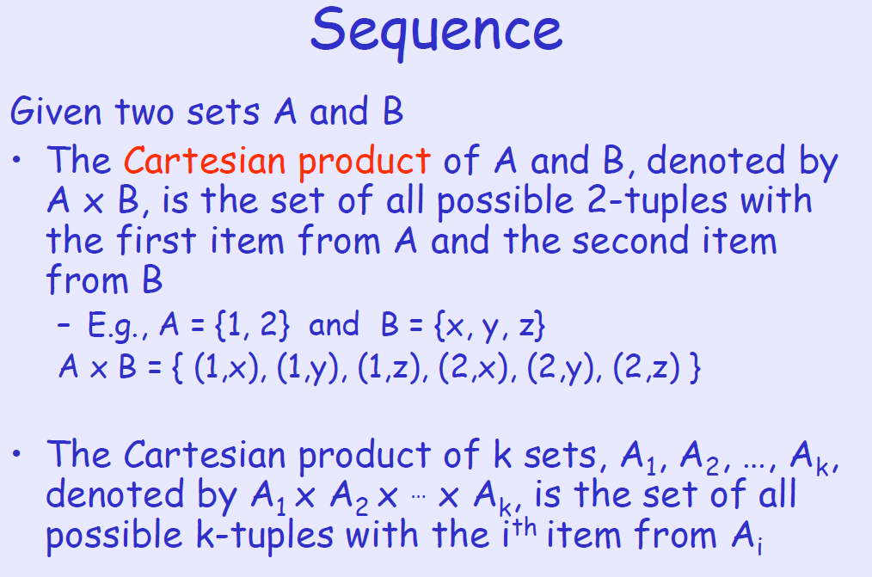

Slide 11
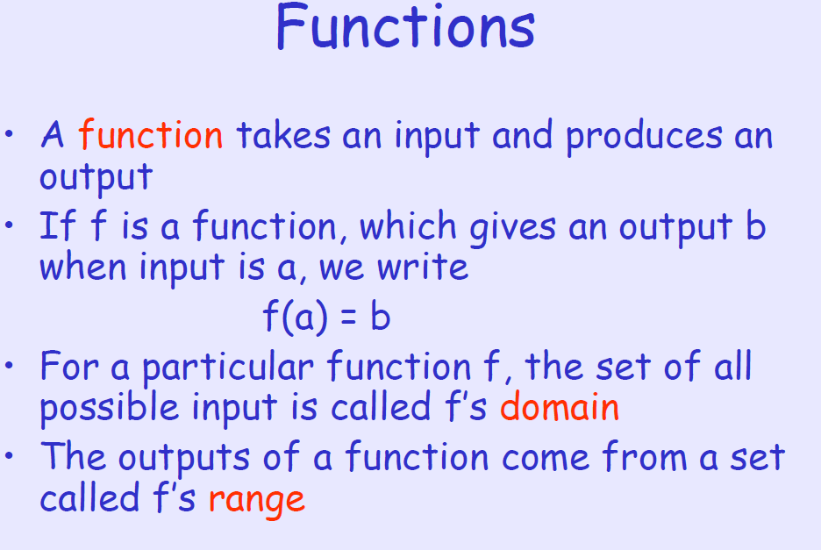

Slide 12
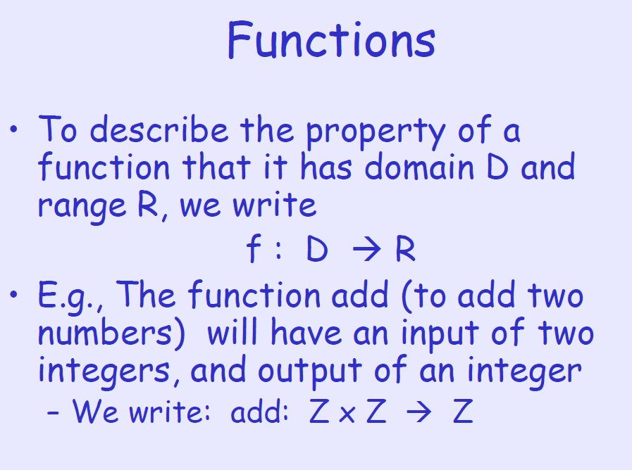

Slide 13
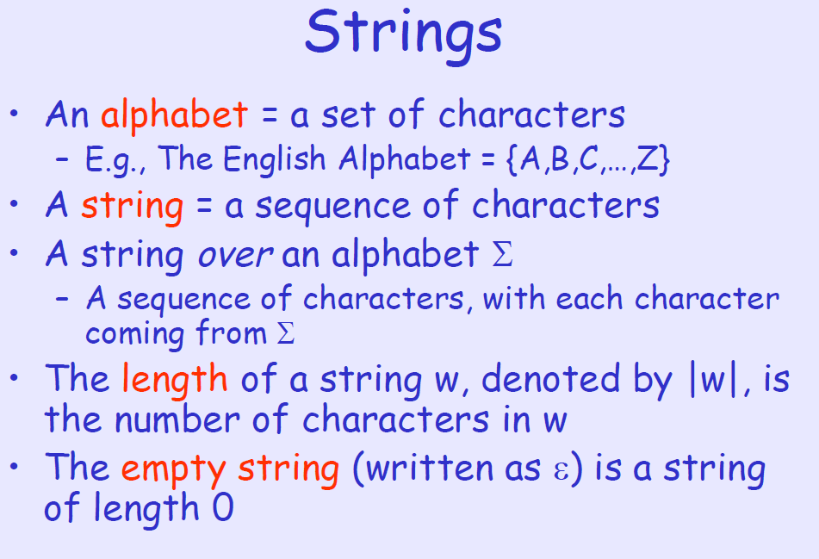

Slide 14
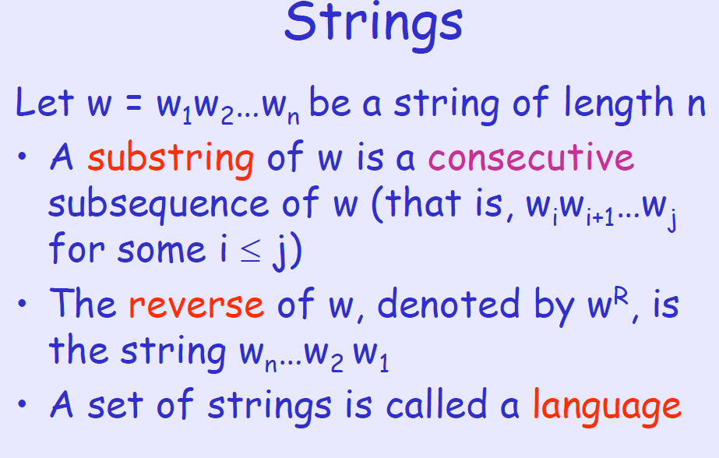

Slide 15
PROOF TECHNIQUES

Slide 16
We look at
Proof by contradiction
Proof by construction
Proof by induction

Slide 17
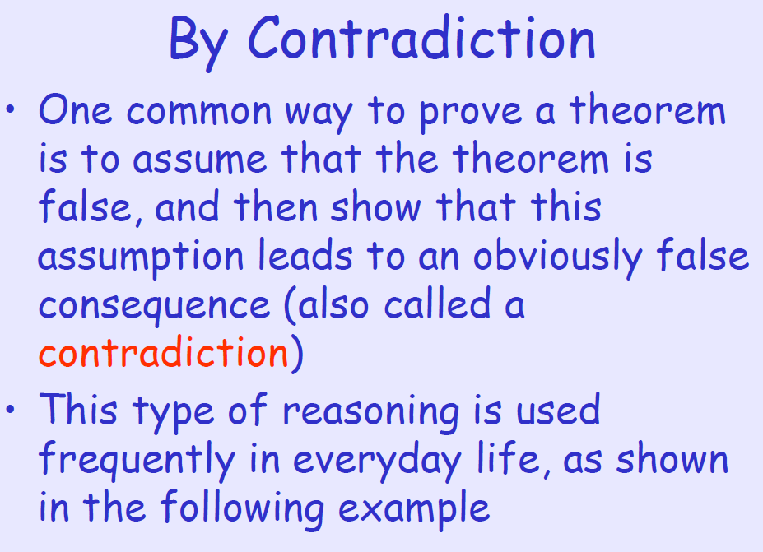

Slide 18
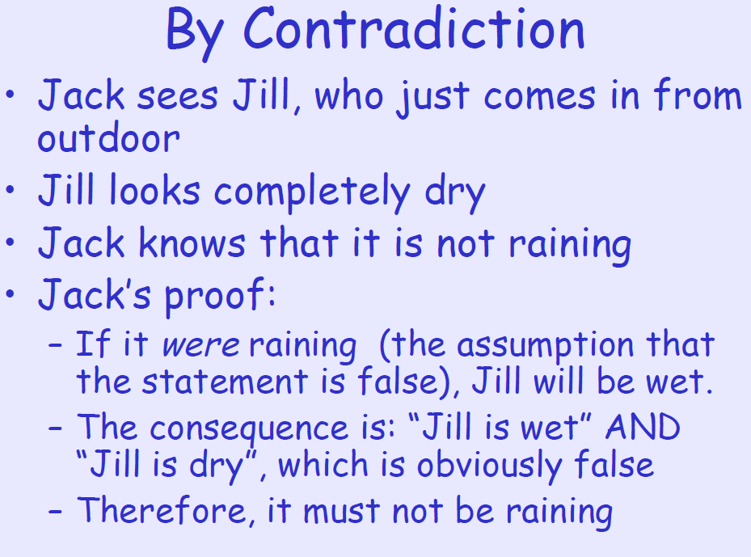

Slide 19
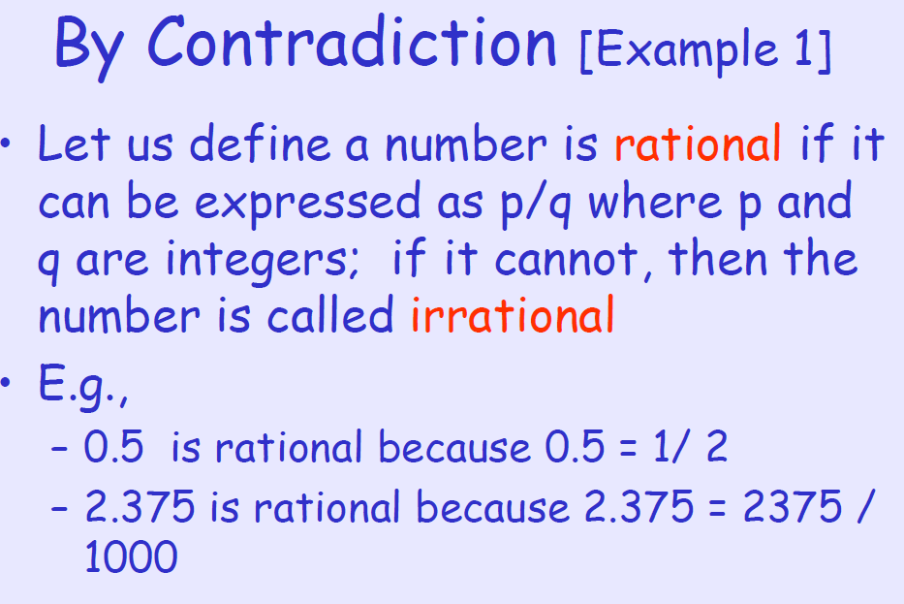

Slide 20
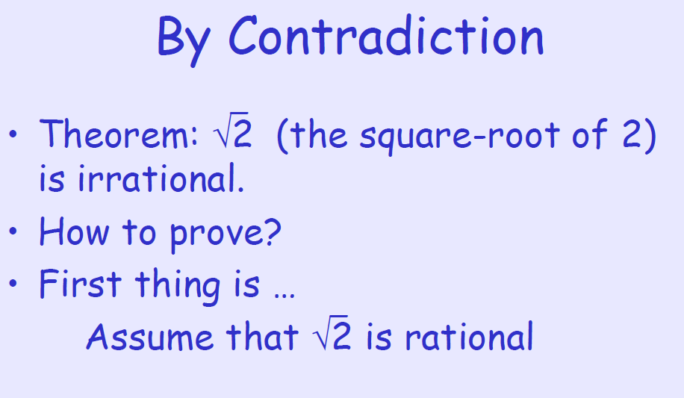

Slide 21
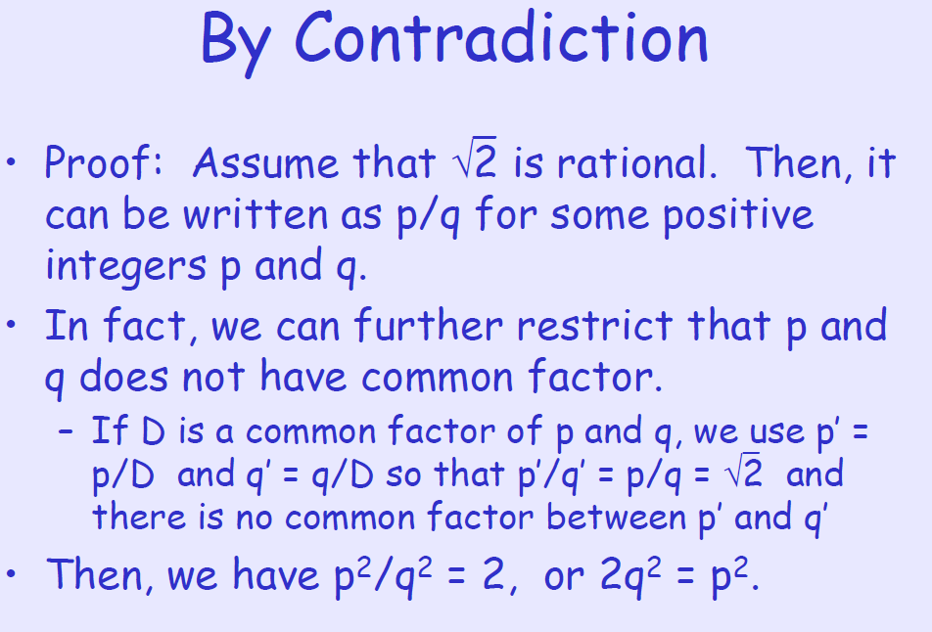

Slide 22
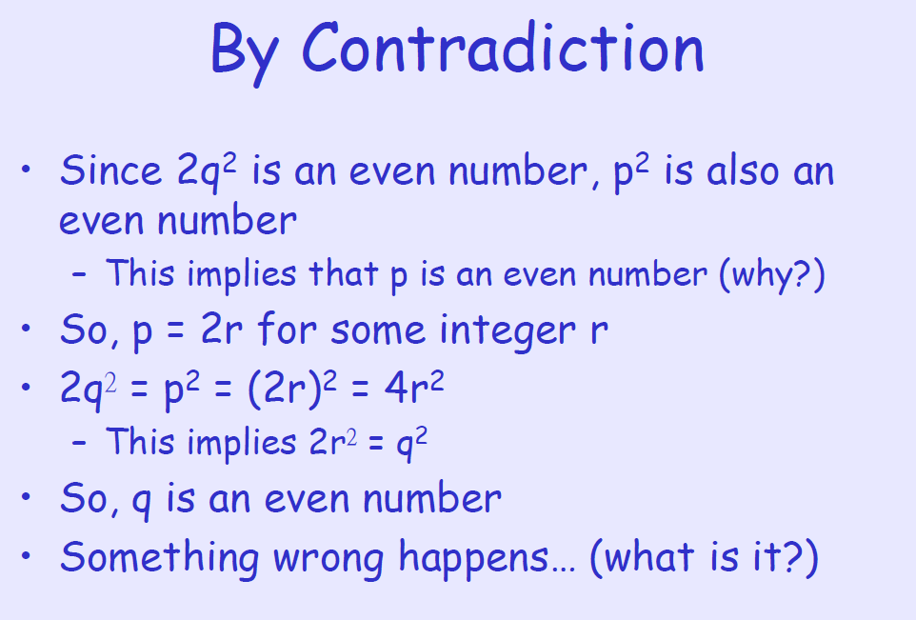

Slide 23
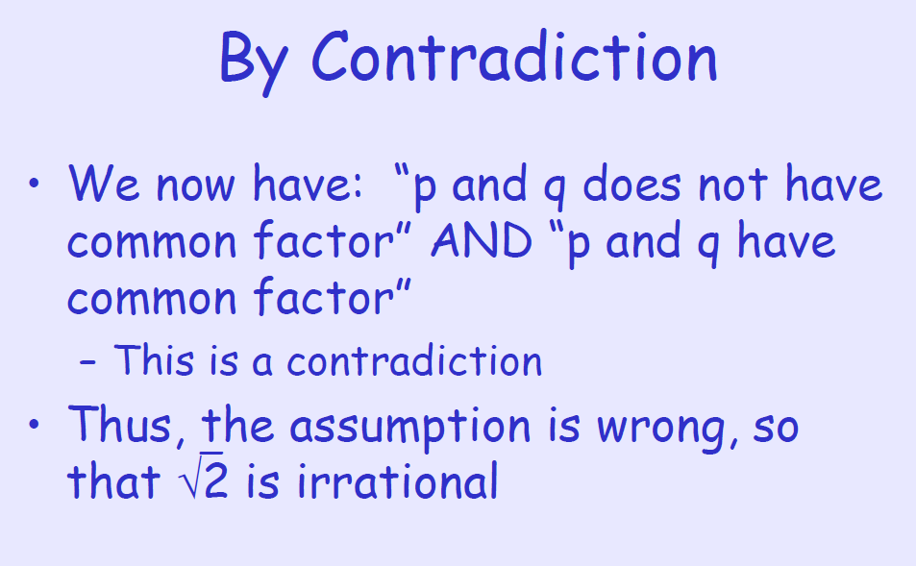

Slide 24
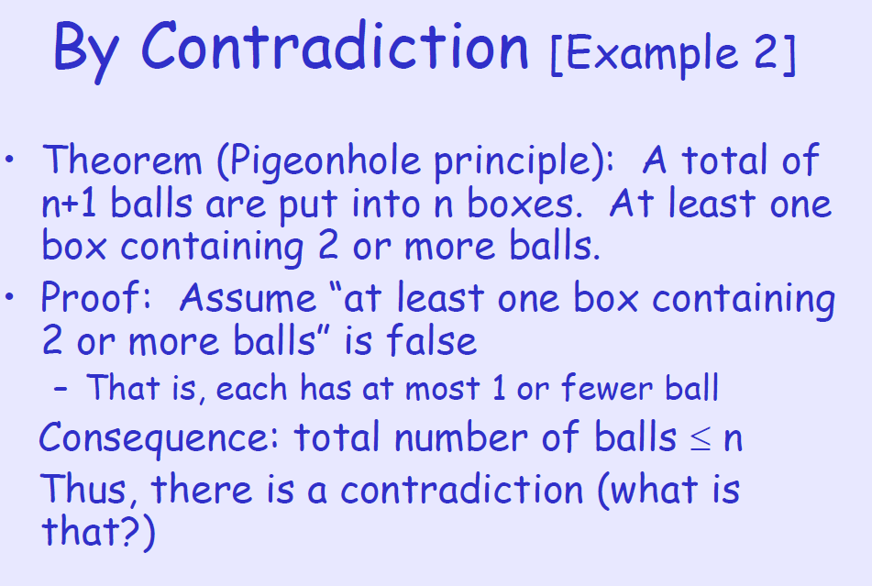

Slide 25
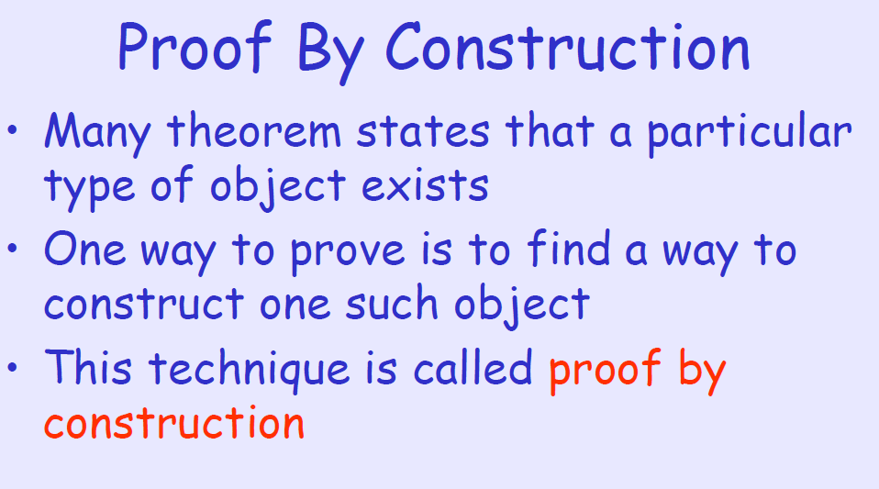

Slide 26
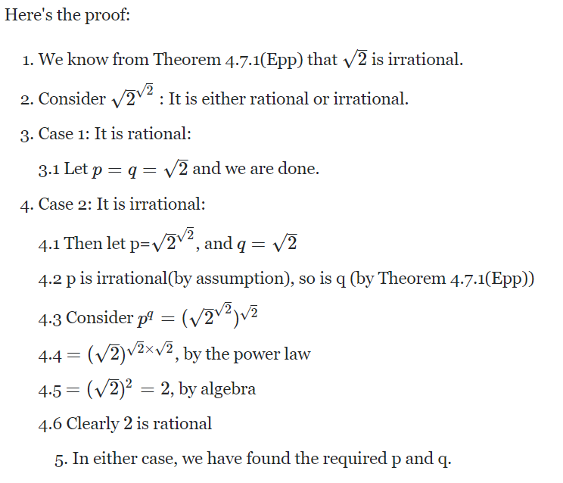

Slide 27
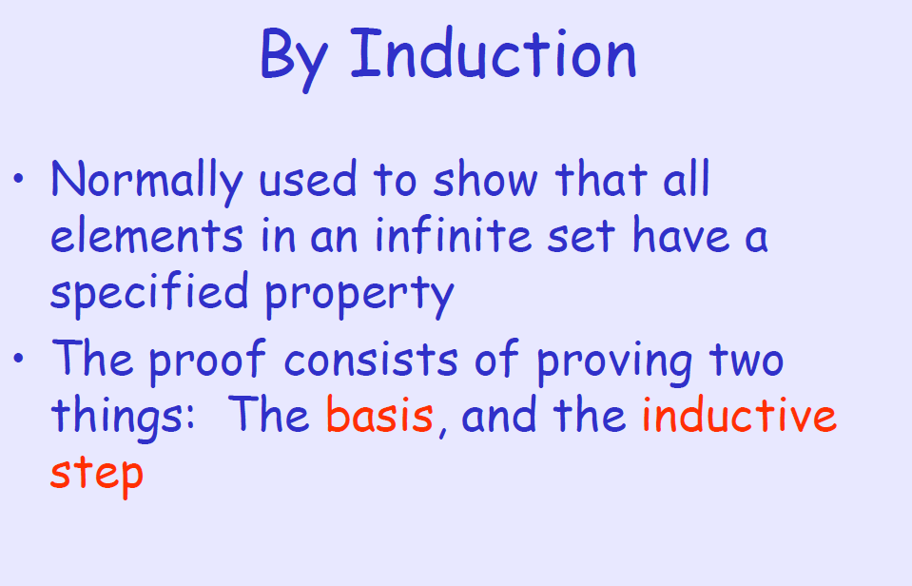

Slide 28
We consider only enumerable or countable sets with a least element [well ordered sets]
The base case: prove that the statement holds for the first natural number n. Usually, n = 0 or n = 1;
rarely, but sometimes conveniently, the base value of n may be taken as a larger number, or even as a negative number (the statement only holds at and above that threshold).
The step case or inductive step: assume the statement holds for some natural number n, and prove that then the statement holds for n + 1.

Slide 29
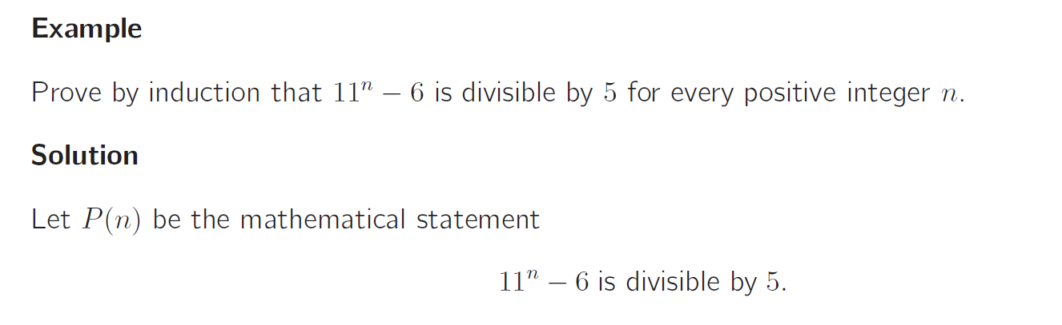
Example: Proof by Induction

Slide 30
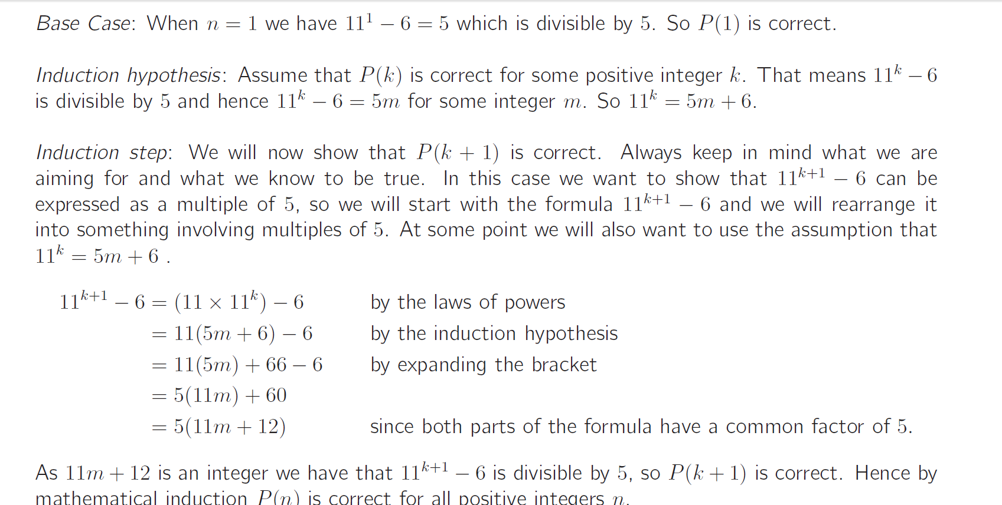
Example: Proof by Induction

Slide 31
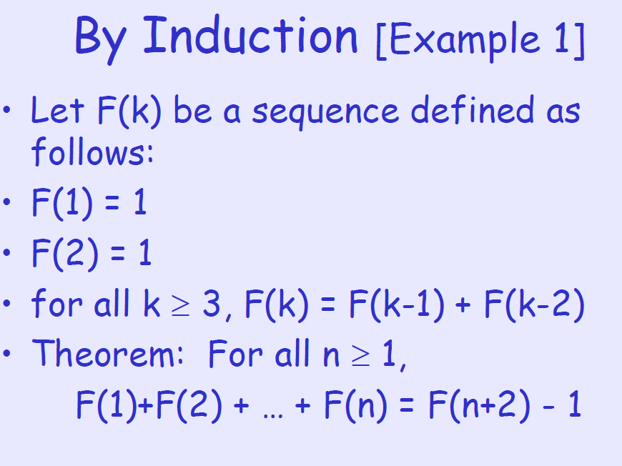

Slide 32
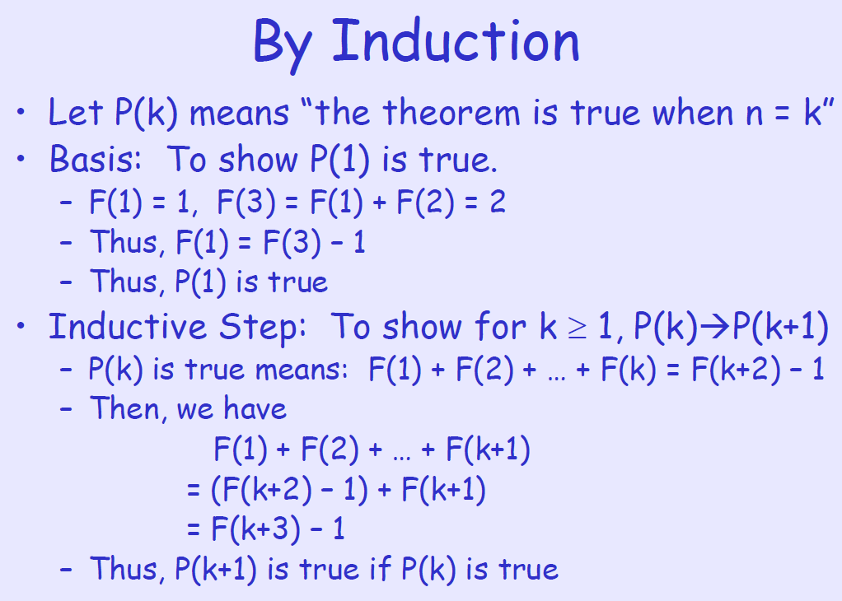

Slide 33
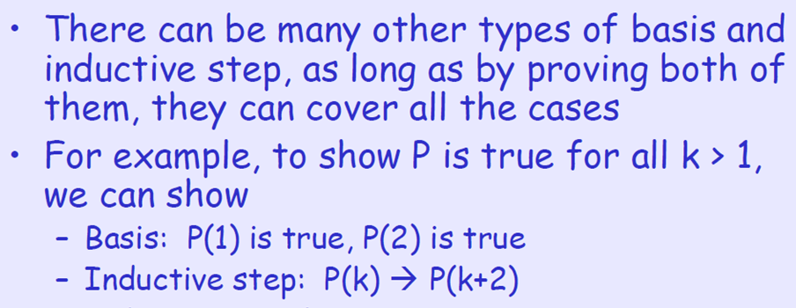
Variants

Slide 34
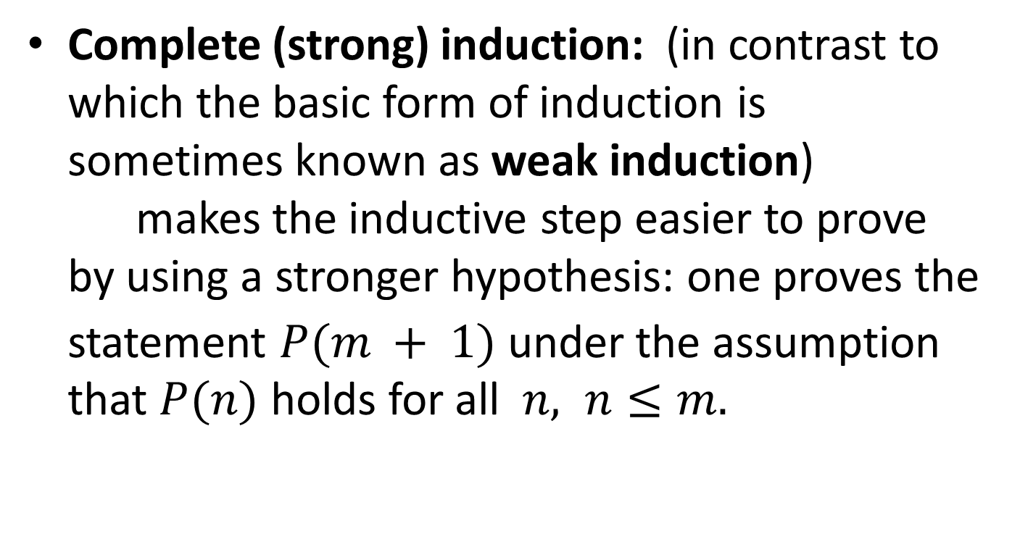
Variants

Slide 35
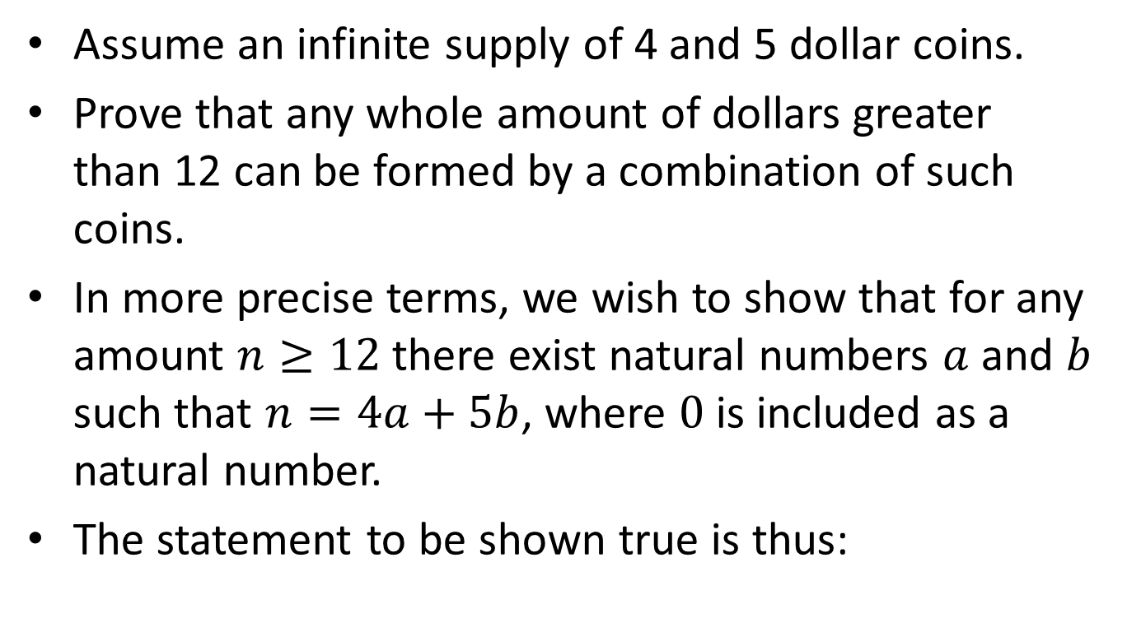

Example: forming dollar amounts by coins

Slide 36
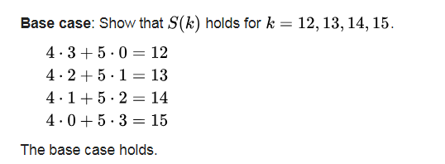
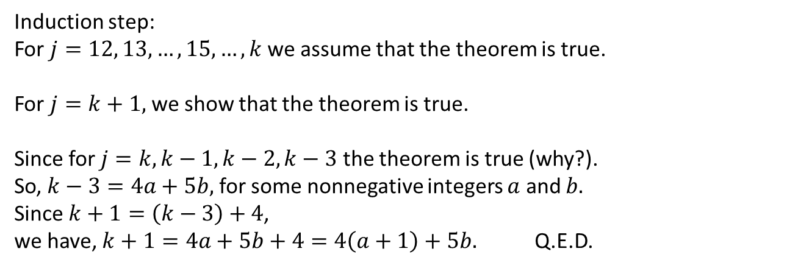

Slide 37
The following is not a valid proof by induction!

Slide 38
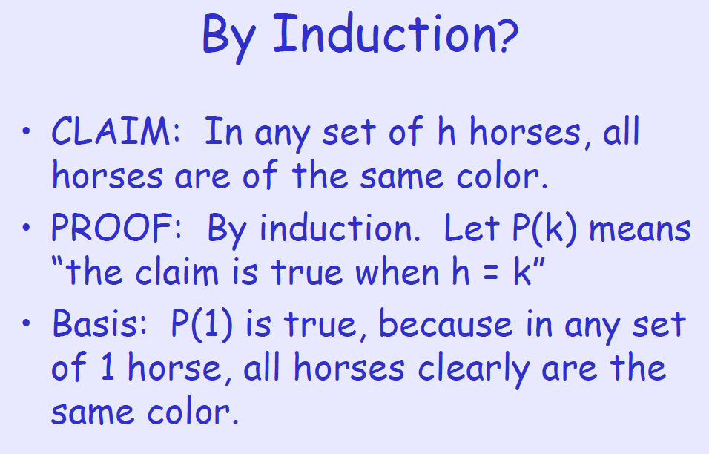

Slide 39
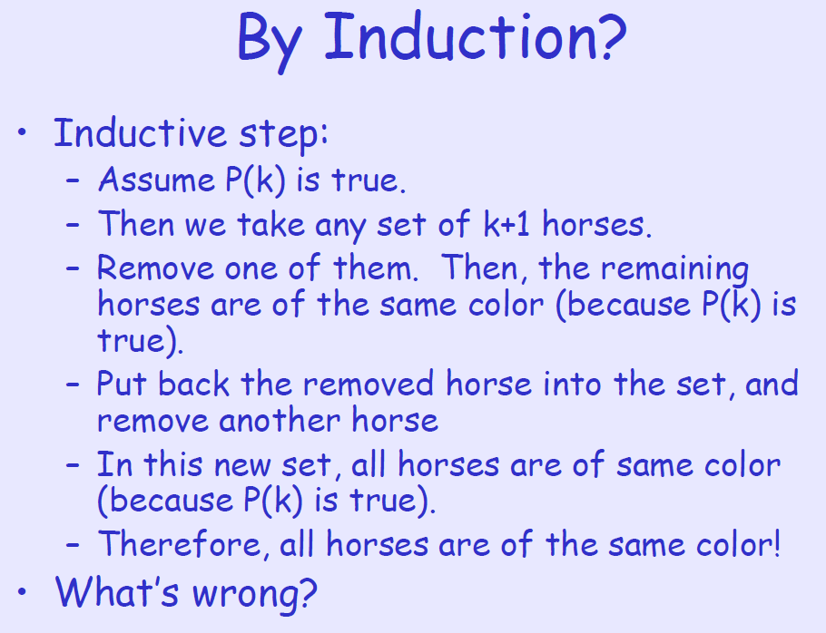

Slide 40
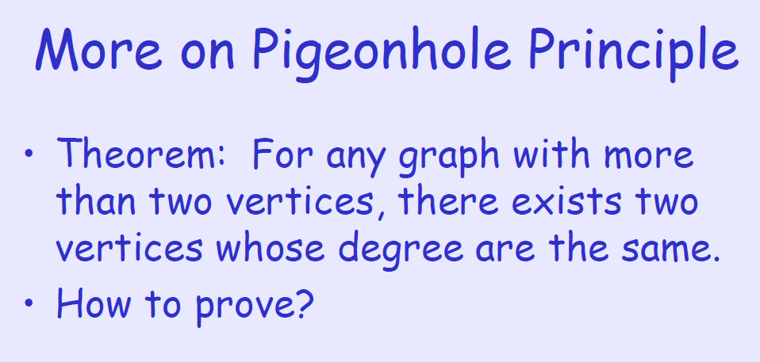

Slide 41
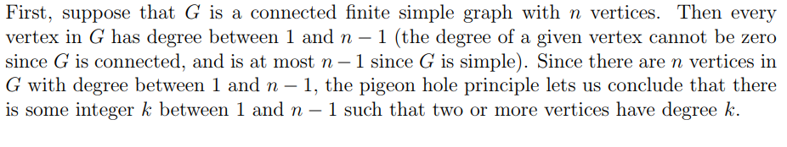
For connected graphs

Slide 42
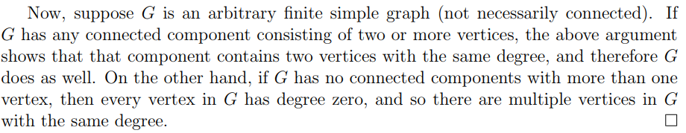
For arbitrary graphs

Slide 43
As we go, we see various proofs.
Proofs has to be formal.
You can not scribble something and expect the examiner to interpret the answer !!

Slide 44
General Advise
Use standard vocabulary, simple notation, and techniques described in the class.
Most numeric questions are toy problems, whose answer can be obtained by common sense (often simple trial and error method is enough).
You have to use the method(s) described in the classwork or in the text books. Otherwise you may not get marks.

