Slide 1
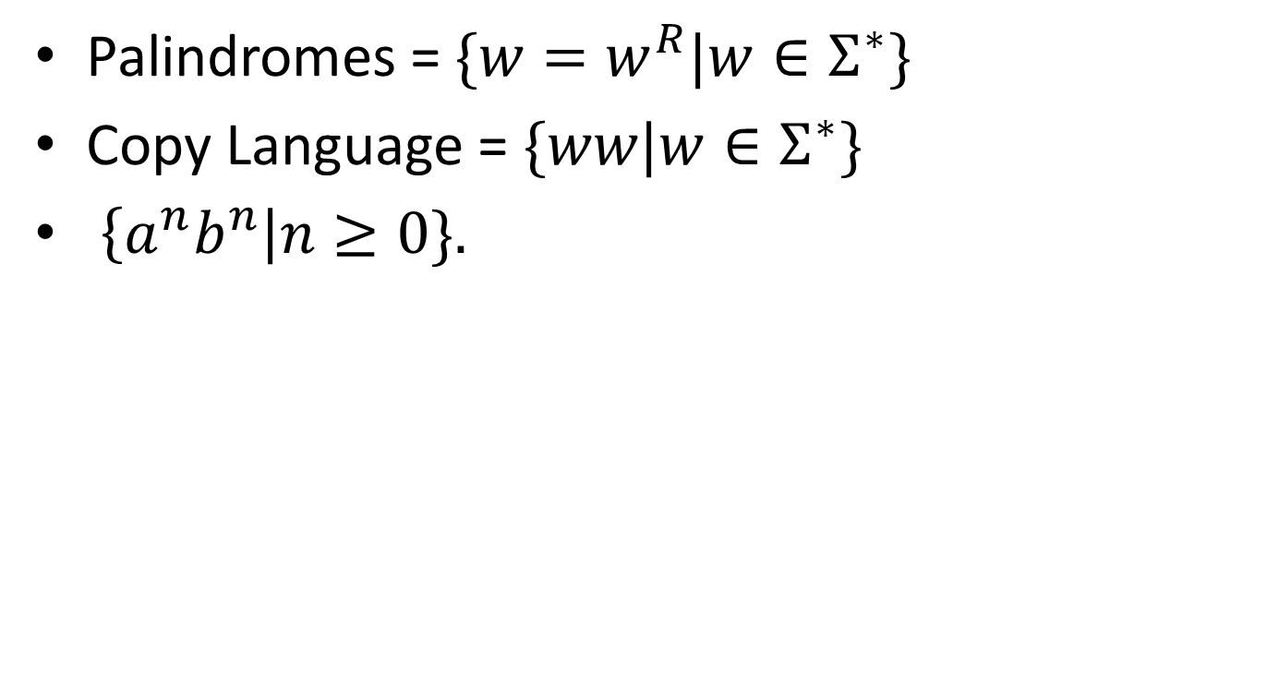
Some non-regular languages we already know are:

Slide 2
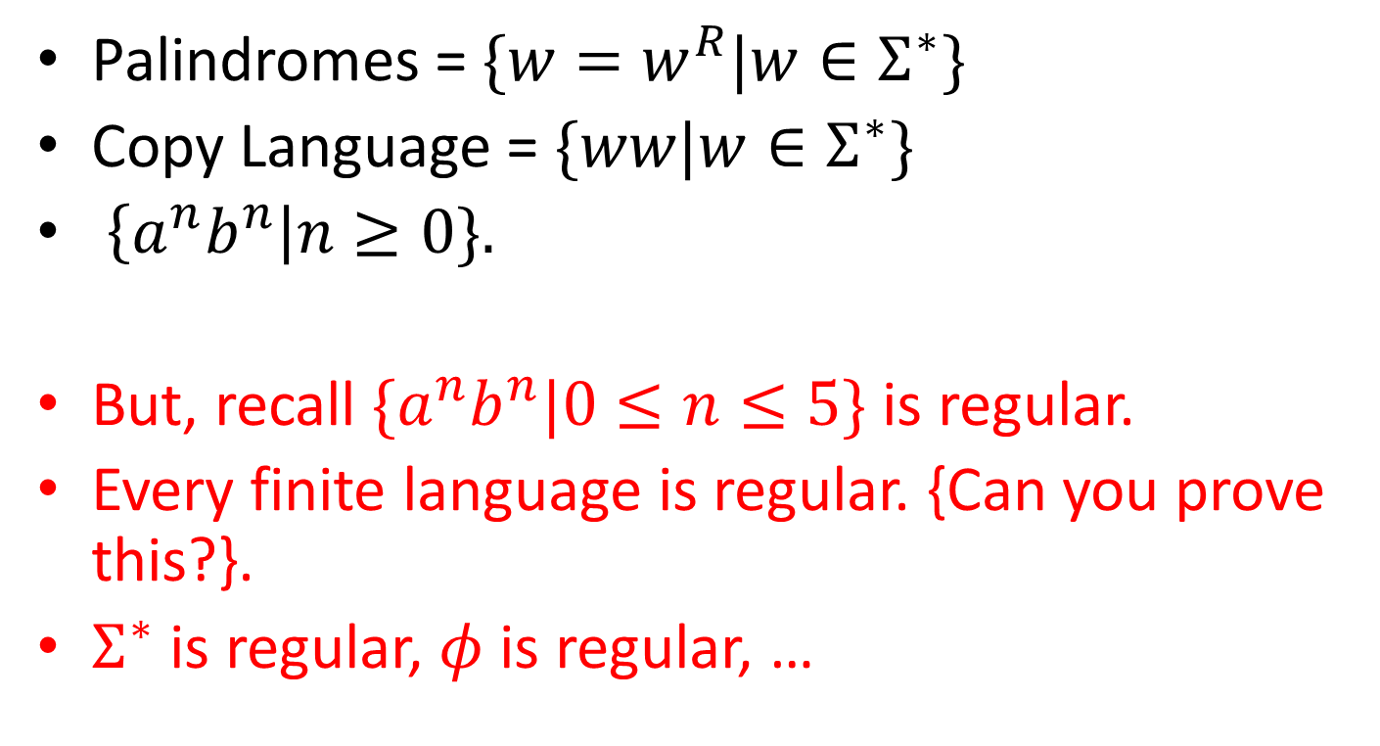
Some non-regular languages we already know are:

Slide 3
Regular Expressions

Slide 4
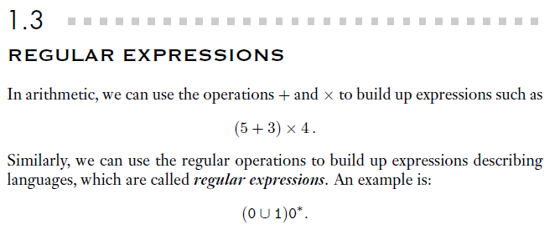
What are values of these expressions?

Slide 5
Where used
Very useful to describe a set of strings having certain patterns.
In UNIX, rm *.c 🡪 removes all files ending with .c
Lex, a tool used in compiler generators
grep, awk available utilities in UNIX use regular expressions.

Slide 6



Meaning …
0 means the language {0}
1 means {1}

Slide 7
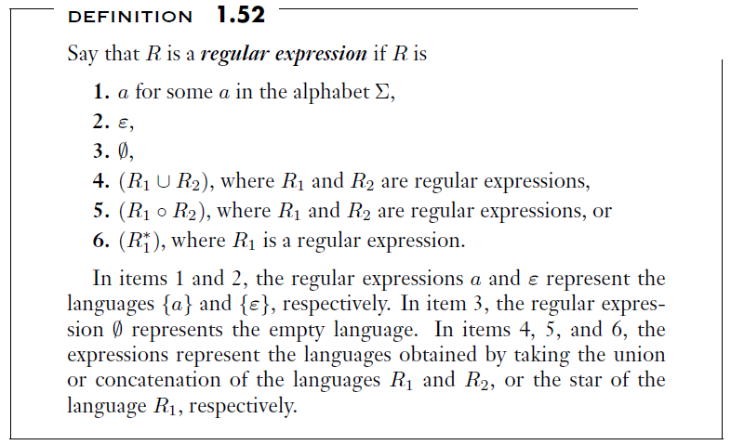
Inductive Definition

Slide 8

Don’t confuse between null string and null set

Slide 9
Precedence is *, ◦, U
So, aUb* is different from (aUb)*
aUb* = (a U (b)*)
aUb*c is same as aU(b*c)
Many authors use + for U
So, aUb = a+b But + is overloaded.
Sipser reserved the + to mean only one thing.

Slide 10



+ (positive closure)

Slide 11
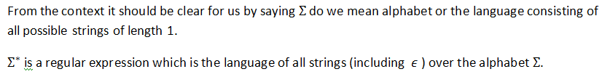
The value of a regular expression R is nothing but the language represented by R
When we want to distinguish between r.e. and the language represented by it. We use L(R) to mean language represented by R.

Slide 12


Slide 13
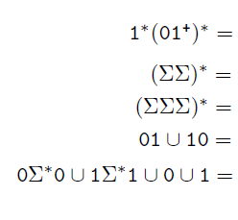
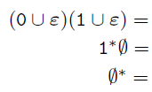
Can you describe the language?

Slide 14
Can you describe the language?

Slide 15

Can you describe the language?

Slide 16
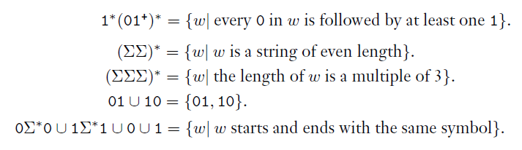
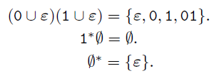

Slide 17
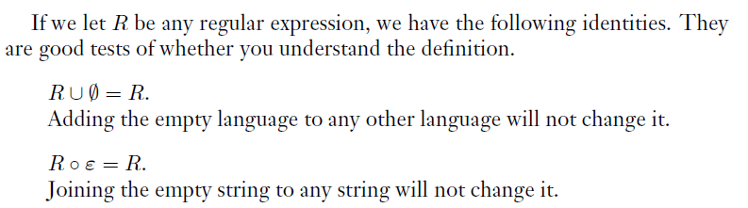
Understood?

Slide 18
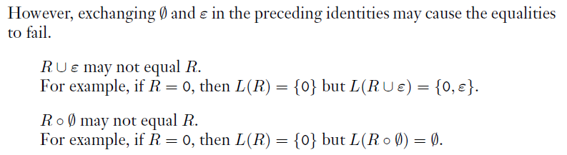
Understood?

Slide 19
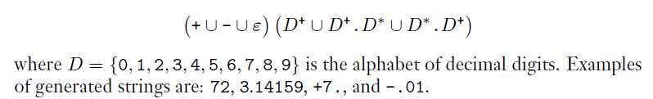
Compilers -- Tokens
Lexical Analysis
Automatic tools can be used (like Lex)
But , you need to describe what you want.
For Decimal Numbers:

Slide 20
Equivalence of RE with DFA/NFA
It is somewhat surprising to note that, RE can be used to describe any regular language.
This is not true for other higher level languages, like CFL {We can describe a CFL by a CFG, not by an expression}.
Now, how is that we prove this?

Slide 21
Proof has two directions
Given RE, show that we can build a DFA/NFA recognizing the language given by the RE.
Given DFA/NFA, show that we can convert this in to a RE.

Slide 22
To Show
Given RE, show that we can build a NFA recognizing the language given by the RE.
We use inductive definition of RE.

Slide 23
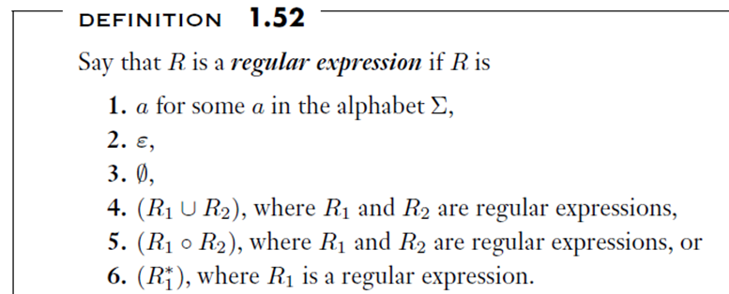
Inductive Definition of RE

Slide 24
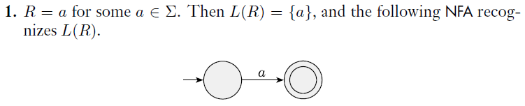
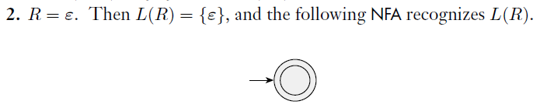
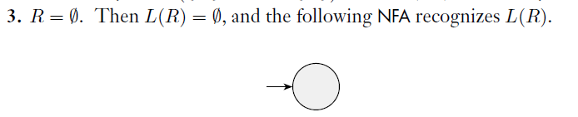
One should be able to do these formally !!

Slide 25
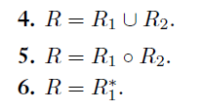
Use the construction proofs.

Slide 26
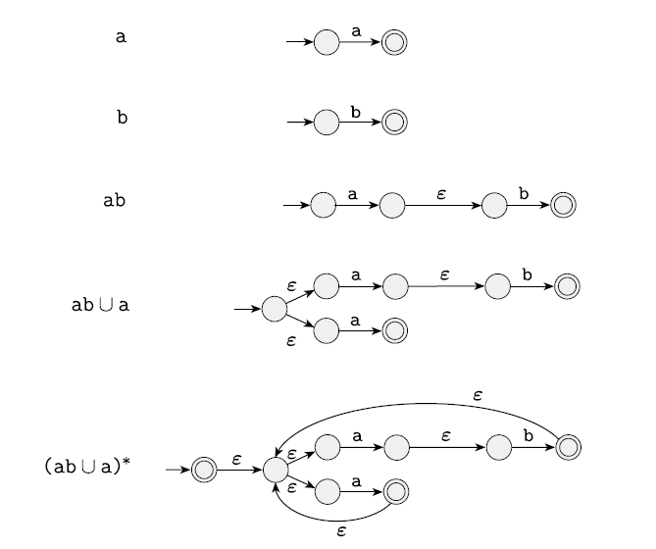

Slide 27
Equivalence between RE and DFA/NFA
The second part is,
Given DFA/NFA convert this to equivalent RE.
There are various ways for this.
The Ullman’s book gives a rigorous algorithm
Same thing in essence is achieved by the Sipser’s book in a different way.
We follow Sipser’s book.

Slide 28
DFA/NFA 🡺RE
Go for GNFA (Generalized Nondeterministic Finite Automata)
RE can be on arrows.

Slide 29
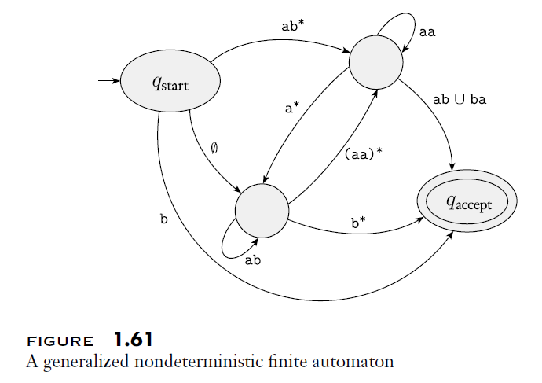

Slide 30
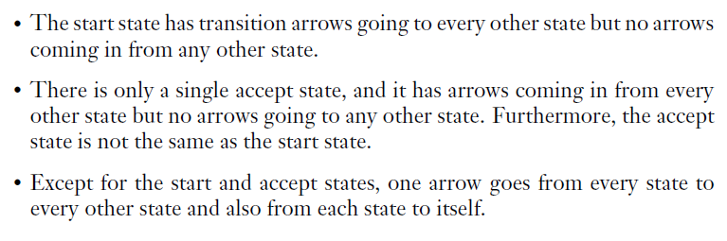
GNFA should -
For more details, consult the Sipser’s book.

Slide 31
What we do?
We convert the given DFA/NFA into a GNFA.
Then, progressively we remove all states, one by one, except for the start and accept states.

Slide 32
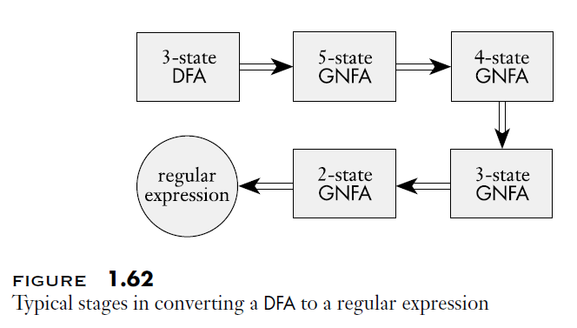
What we do?
For example we are given a 3 state DFA

Slide 33
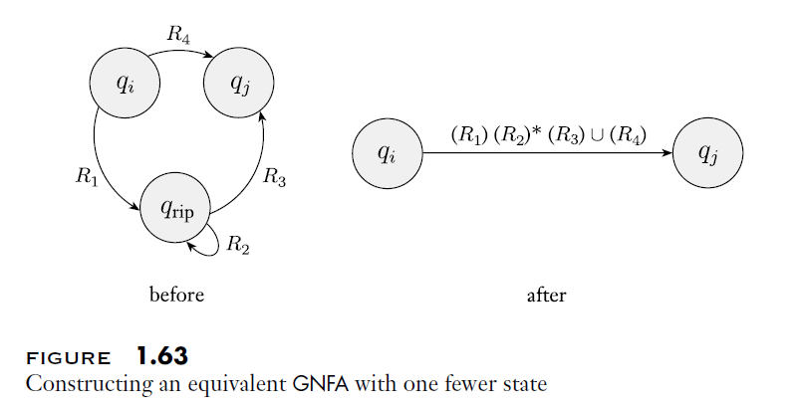

Slide 34
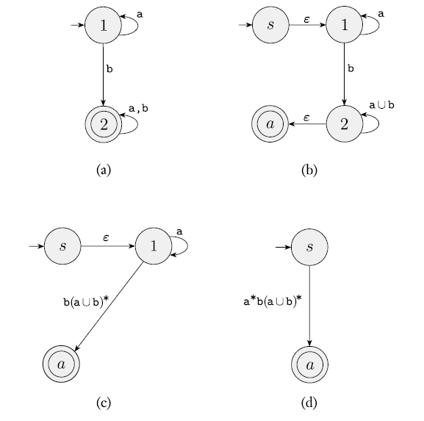

Example 1

Slide 35
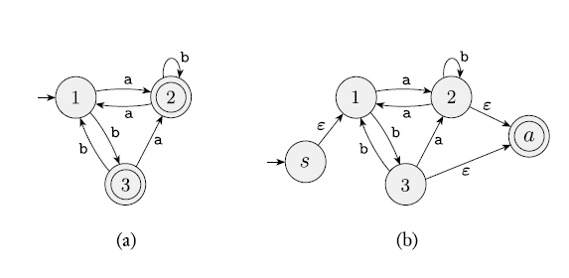
Example 2

Slide 36
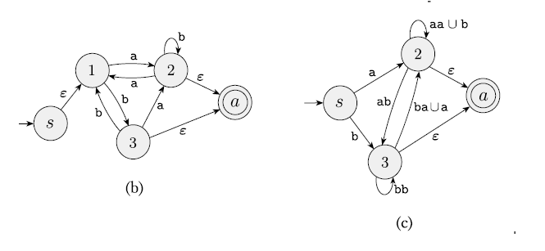
Example 2…

Slide 37
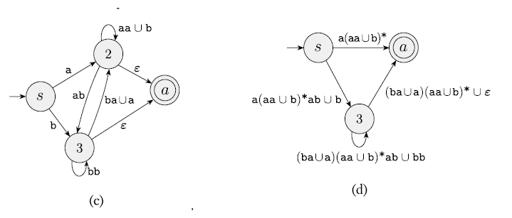
Example 2…

Slide 38
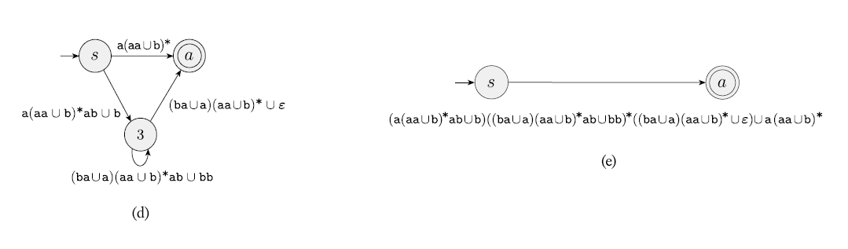
Example 2…

Slide 39
Laws concerning R.E.
We overload + to mean U also.
You have to live with this notational abuse between Sipser and Ullman.
a+b = a U b

Slide 40
Algebric Laws for Regular Expressions
Commutativity and Associativity
L + M = M + L (Remember, L U M = M U L)
(L + M) + R = L + (M + R) = L + M + R
(LM)R = L(MR) = LMR
Left distribution and right distribution
L(M + N) = LM + LN
(M + N)L = ML + NL

Slide 41
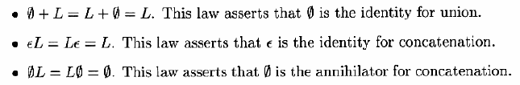
Identities and Annihalors

Slide 42
Idempotent Laws
L+L = L
(L*)* = L*

Slide 43
How to prove?
Inequality can be easily proved by a counter example.
But, equality, to be proved is cumbersome.
You can follow your set theory knowledge to deduct that from LHS, RHS is deductible.
These is an established simple way of doing this.

Slide 44
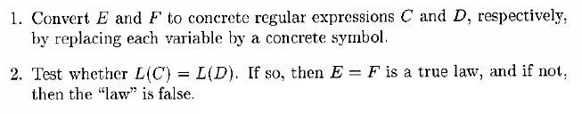
Assuming only three regular operators, viz., +, . * are only used.
To test whether E = F is true or false.
What do you mean by concrete r.e. ?

Slide 45
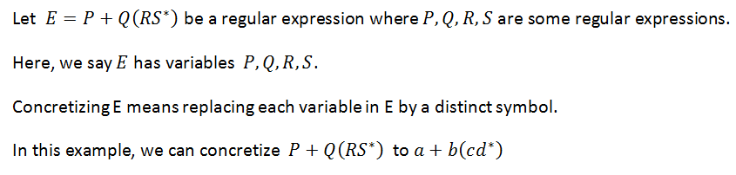
Concretizing a r.e.
E = R1 + R2(R3

Slide 46
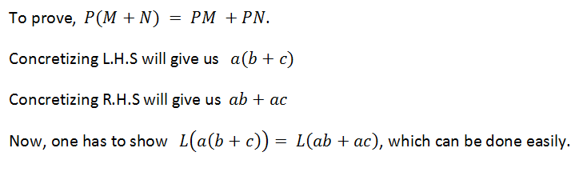

Slide 47
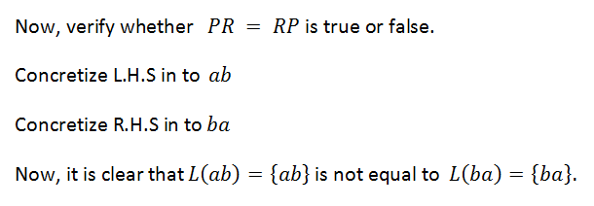

Slide 48
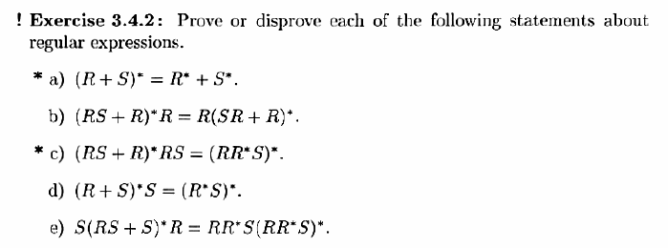

Slide 49

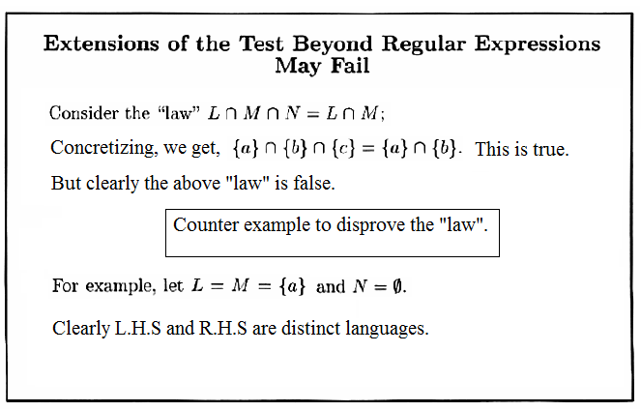
Don’t use operators beyond +,.,*
That is, stick to, regular operators only.

