Slide 1
Nonregular Languages

Slide 2
How to show that a given language is nonregular.
In some sense, we need to prove that No DFA is possible to recognize the language.
How we do this?

Slide 3
Some properties can help us
L is regular => L obeys “Pumping Lemma”
DFA must have finite number of states.
For the given L, we need infinite number of states in the DFA.
Myhill-Nerode Theorem (Gives a necessary and sufficient condition for regular languages).
There are other ways …

Slide 4
Pumping Lemma is useful to show that L is nonregular.
It cannot be used to show that L is regular.
Why?

Slide 5
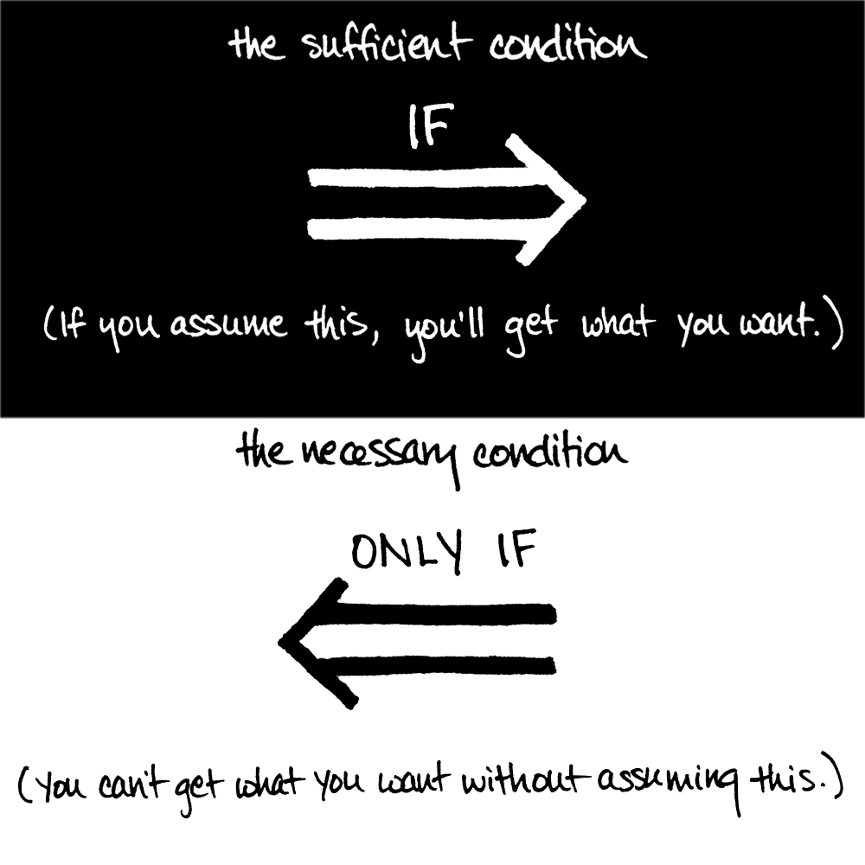

Slide 6
A => B ( A being true is a sufficient condition for B to be true)
If A is true, we know B is true.
If A is false, what about B?
A <= B (A being true is a necessary condition for B to be true)
If A is false, we know B is false.
If A is true, what about B?

Slide 7
A => B ( A being true is a sufficient condition for B to be true)
If A is true, we know B is true.
If A is false, what about B?
If B is false, then what about A?

Slide 8
L is regular => L obeys “Pumping Lemma”
If L fails to obey “Pumping Lemma” then L is nonregular.
Moral of the story: Never use Pumping Lemma to prove that L is regular.

Slide 9

Nonregular examples
But, the following is regular

Slide 10
Nonregular examples
But, the following is regular
http://www.cs.gordon.edu/courses/cps220/Notes/nonregular_languages
Follow the above URL for an answer to show D is regular.

Slide 11
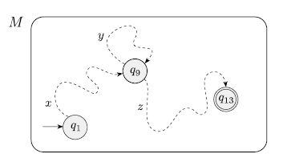
Pumping Lemma
In any DFA, if w = xyz is “long enough”, then such a loop must occur. Why?

Slide 12
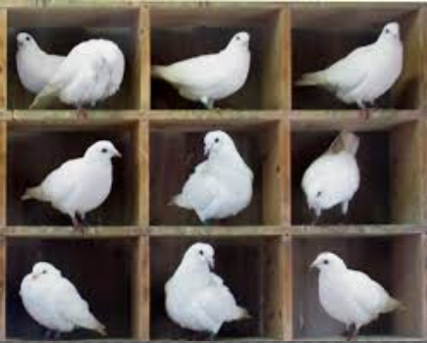
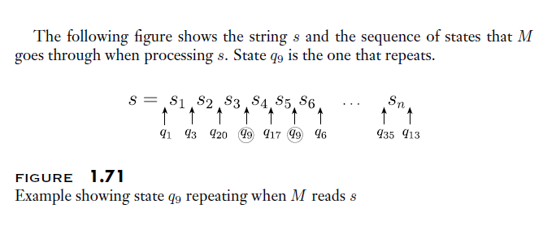
Pigeonhole Principle

Slide 13
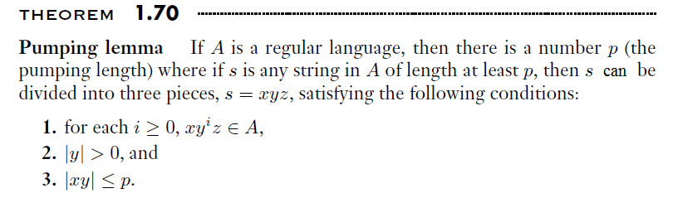
Pumping Lemma

Slide 14
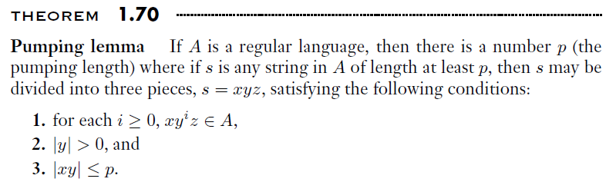
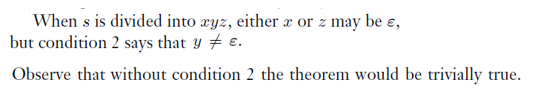

Slide 15
Negation of Pumping Lemma
There is a string w in L which of length atleast of the pumping length (p), where every division of w into xyz fails to satisfy at-least one of the following –
|y| ≠ 0
|xy| ≤ p
x y^{i} z is in L for all i in {0,1,2,…}.

Slide 16
Negation of Pumping Lemma (we simplify)
There is a string w in L which of length atleast of the pumping length (p), where every division of w into xyz that obeys
|y| ≠ 0
|xy| ≤ p
Fails to satisfy the following for at-least one i.
x y^{i} z is in L for all i in {0,1,2,…}.

Slide 17


Slide 18
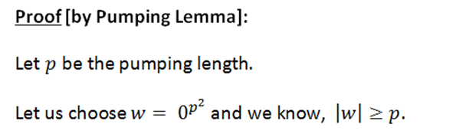

Slide 20


Slide 21
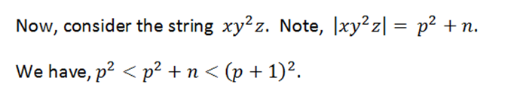

Slide 22
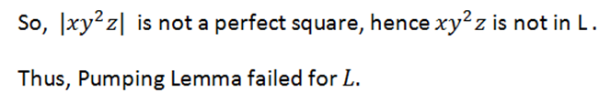

Slide 23
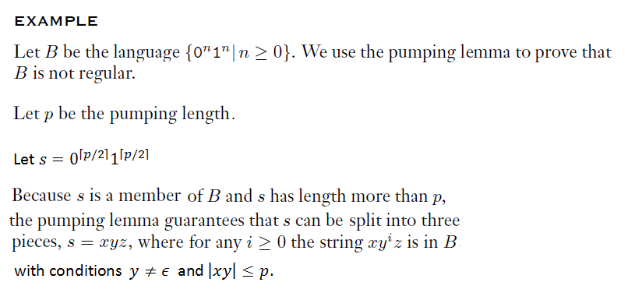
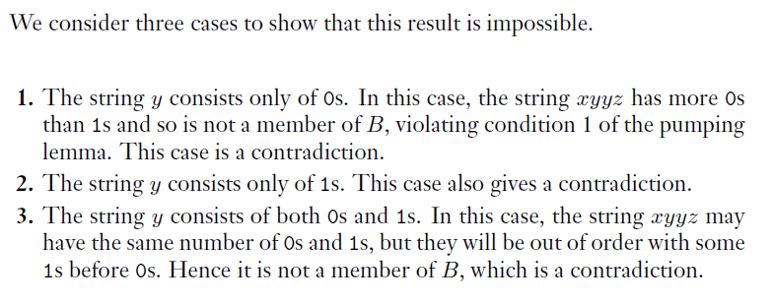

Slide 24
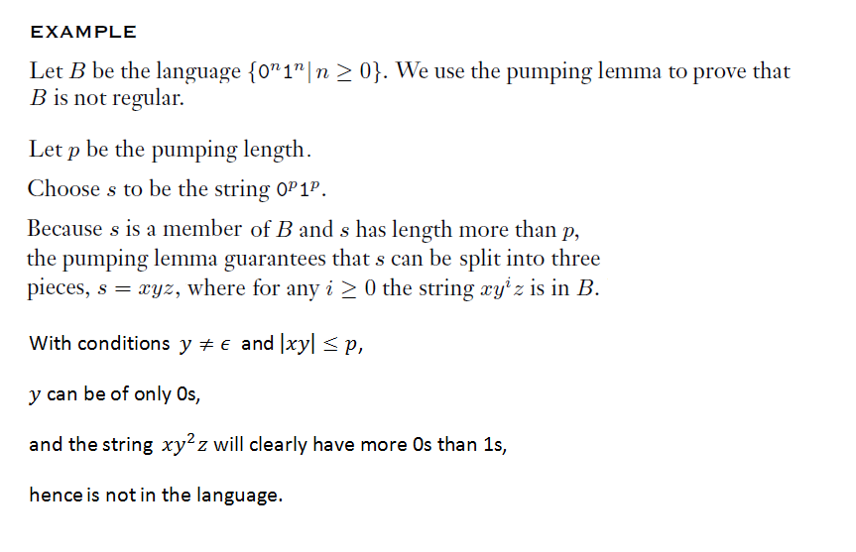
A good choice for the string

Slide 25
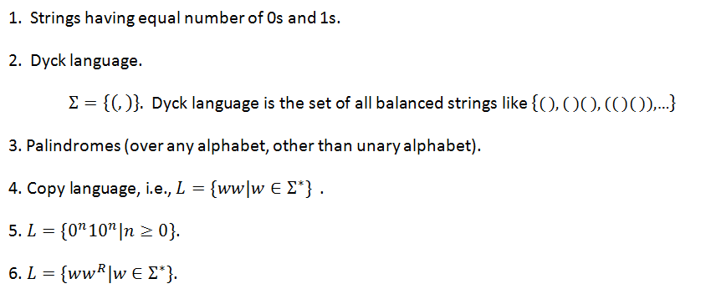
Following are all nonregular.
Can you prove for each of these that PL fails.

Slide 26
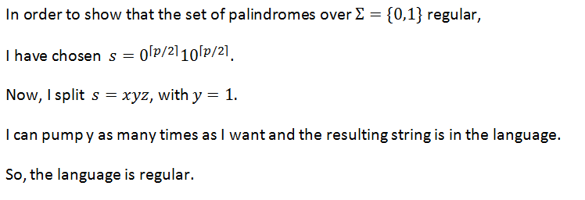
What is wrong?
There are two mistakes.

Slide 27

Mistakes.

Slide 28
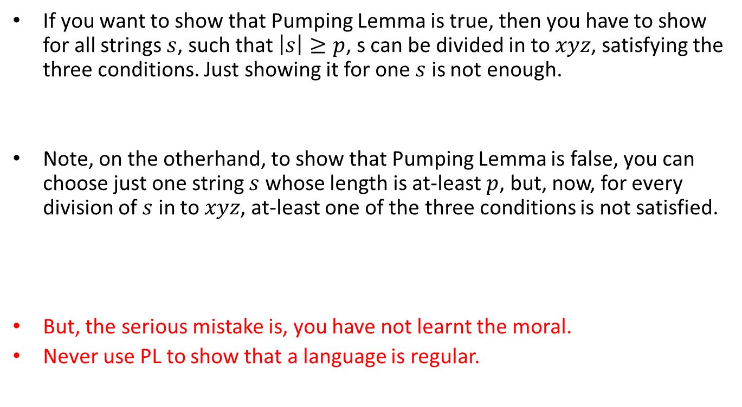
Mistakes.
If you want to show that Pumping Lemma is true, then you have to show for all strings $s$, such that $\left|s\right|≥p$, s can be divided in to $xyz$, satisfying the three conditions. Just showing it for one $s$ is not enough.
Note, on the otherhand, to show that Pumping Lemma is false, you can choose just one string $s$ whose length is at-least $p$, but, now, for every division of $s$ in to $xyz$, at-least one of the three conditions is not satisfied.
But, the serious mistake is, you have not learnt the moral.
Never use PL to show that a language is regular.

Slide 29

Set of primes – a nonregular language
Let $p$ be the pumping length.
Consider $s=0^{n}$ where $n$ is prime and let $n≥p$, represents a prime number.

Slide 30
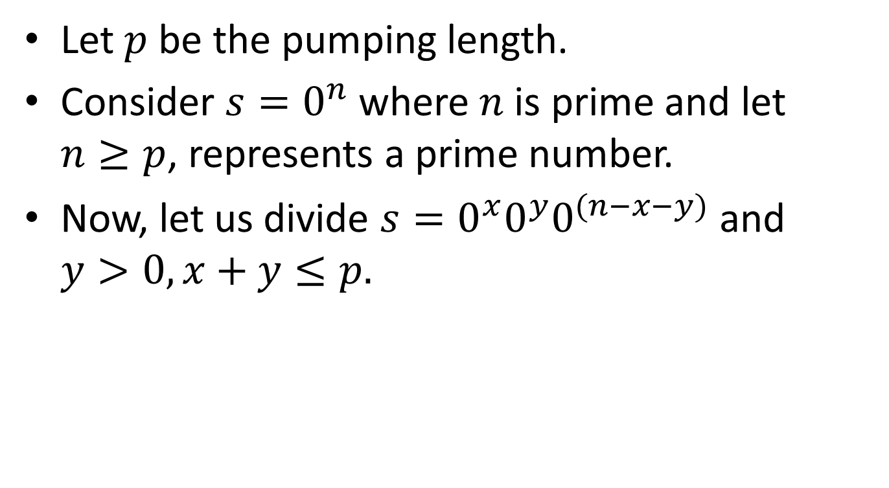
Set of primes – a nonregular language
Let $p$ be the pumping length.
Consider $s=0^{n}$ where $n$ is prime and let $n≥p$, represents a prime number.
Now, let us divide $s=0^{x}0^{y}0^{(n−x−y)}$ and $y>0, x+y≤p.$

Slide 31
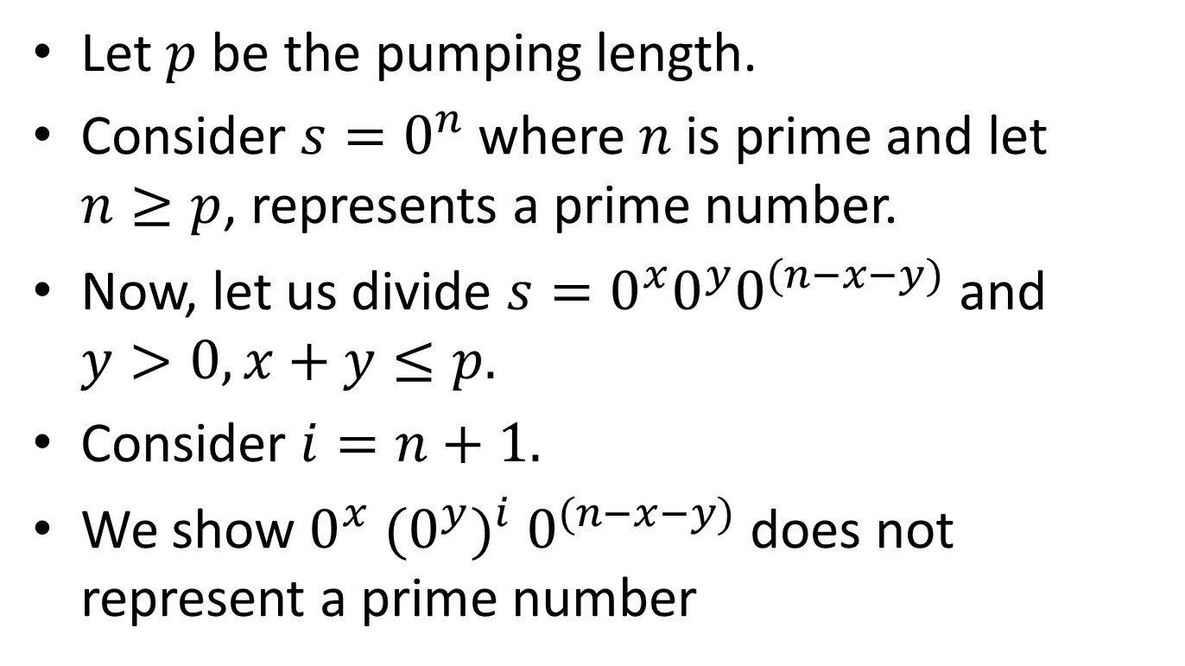
Set of primes – a nonregular language
Let $p$ be the pumping length.
Consider $s=0^{n}$ where $n$ is prime and let $n≥p$, represents a prime number.
Now, let us divide $s=0^{x}0^{y}0^{(n−x−y)}$ and $y>0, x+y≤p.$
Consider $i=n+1.$
We show $0^{x} {(0^{y})}^{i} 0^{(n−x−y)}$ does not represent a prime number

Slide 32

$0^{x} {(0^{y})}^{i} 0^{(n−x−y)} =0^{x+y\left(n+1\right)+n−x−y}$
$=0^{n(y+1)}$

Slide 33
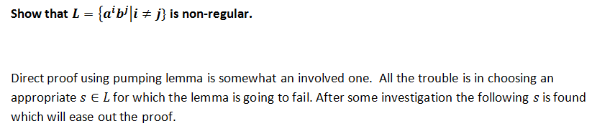

Slide 34
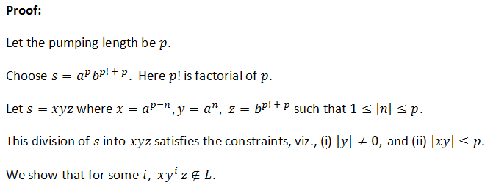

Slide 35
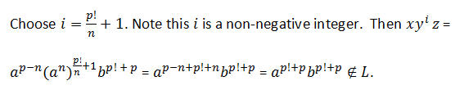

Slide 36

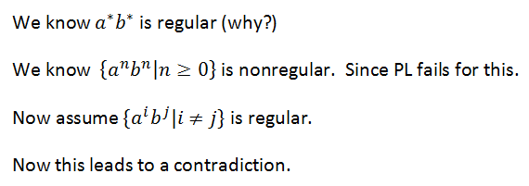
An easy way to show is nonregular

Slide 37
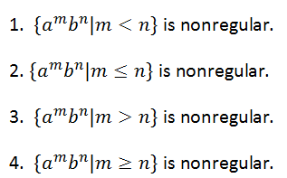
Can you prove these

Slide 38
Prove or disprove: “every finite language is regular”.
Prove or disprove: “every infinite language is nonregular”.

Slide 39
Prove or disprove: “every finite language is regular”.
True. We can build a NFA.
Prove or disprove: “every infinite language is nonregular”.
False. Counter example is: a*b*

Slide 40
Prove or disprove : “nonregular languages are closed under union”.

Slide 41
Prove or disprove : “nonregular languages are closed under union”.
False.
Counter example:

Slide 42
Prove or disprove : “nonregular languages are closed under intersection”.

Slide 43
Prove or disprove : “nonregular languages are closed under intersection”.
False.
Counter example:

Slide 44
Prove or disprove : “nonregular languages are closed under complementation”.

Slide 45
Prove or disprove : “nonregular languages are closed under complementation”.
True.
Proof: [by contradiction] using the fact that regular languages are closed under complementation.

Slide 46
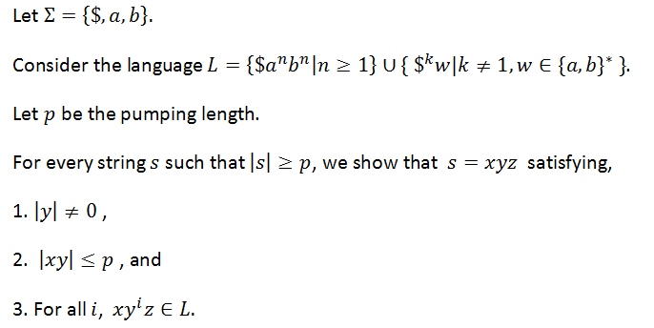
Example of nonregular language that satisfies the pumping lemma

Slide 47
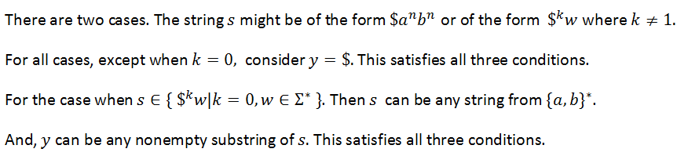
Example of nonregular language that satisfies the pumping lemma

Slide 48
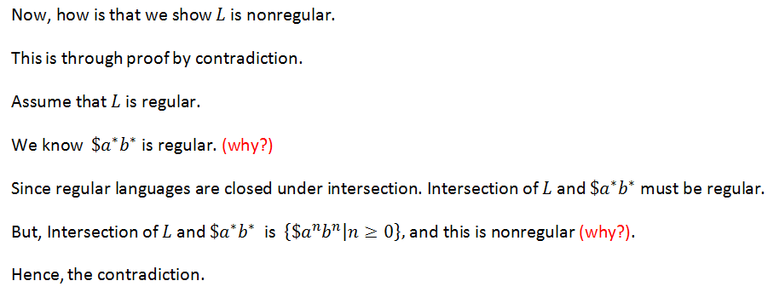
Example of nonregular language that satisfies the pumping lemma

Slide 49

Yet another language that is nonregular, but for which PL is satisfied.
This language is very similar to the previous one.
$L=\{a^{i}b^{j}c^{k}|\left(i=1\right)⇒(j=k)$}.

Slide 50
An Important Other way of showing that a language is nonregular
By using Myhill-Nerode Theorem
DFA or NFA for a regular language must have finite number of states.
If you show that infinite number of states are needed, then it is equivalent to showing that the language in nonregular.
Apart from this, Myhill-Nerode theorem has one important application, viz., minimization of a DFA.

Slide 51
Myhill-Nerode Theorem is much more than the Pumping Lemma
Myhill-Nerode theorem can be used to show that a language is regular also. Of course it can be used to show that a language is nonregular.
This gives a necessary and sufficient condition for a language being regular.
Note, the pumping lemma, on the otherhand can be used only to show that a language is nonregular.
Pumping lemma should not be used to show that a language is regular.

Slide 52
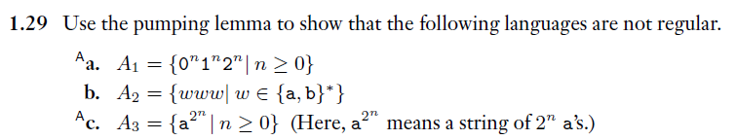
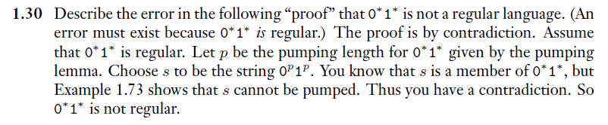
Reading Assignment – From Sipser’s book

