Slide 1
MINIMIZING DFAs
To have minimum number of states

Slide 2
IS THIS MINIMAL?
0
1
1
1
0
1
0
0

Slide 3
IS THIS MINIMAL?
NO
0
1
1
1
0
1
0
0

Slide 4
IS THIS MINIMAL?
0
1
1
0

Slide 5

THEOREM
For every regular language L, there exists a unique (up to re-labeling of the states) minimal DFA $M$ such that L = L(M)

Slide 6
NOT TRUE FOR NFAs
0
0
0
0
Because of this, minimization of NFA is complicated and is out of scope of current ToC course.

Slide 7
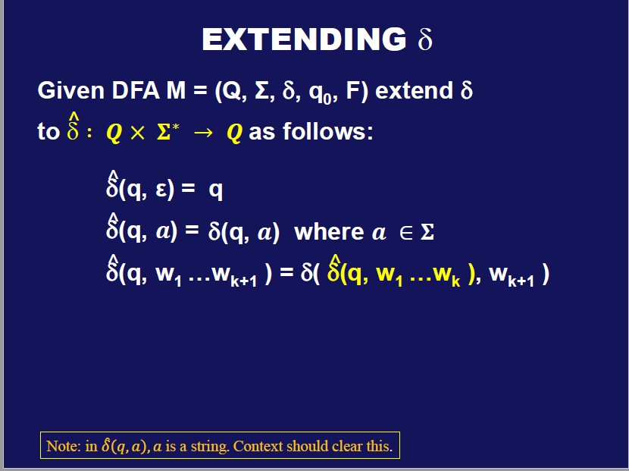

Slide 8

A string $w∈Σ^{∗}$distinguishes states $q1$ from $q2$ if
$$\hat{δ} \left(q1, w\right)∈ F ⇔ \hat{δ}(q2, w) ∉ F$$

Slide 9
q₁
1
0
0,1
1
q₀
q₂
0
0
1
q₃
ε distinguishes accept from non-accept states

Slide 10
Let M = (Q, Σ, δ, q₀, F) and let p, q, r ∈ Q
Definition :
(1) p is equivalent to q iff there is no w ∈ Σ* that distinguishes p and q,
(2) Otherwise p is not equivalent to q. In this case, we say p and q are distinguishable.

Slide 11
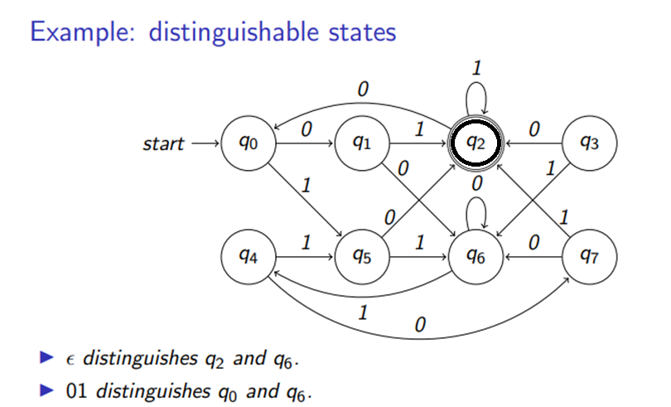

Slide 12
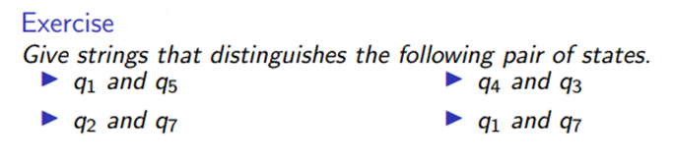

Slide 13

DFA Minimization, intuition
We can remove unreachable states (why and how to find unreachable states?)
If states $q_{0}$ and $q_{4}$ are equivalent, then, we can move all incoming transitions (arrows) from $q_{4}$ to $q_{0}$
Because of this $q_{4}$ becomes unreachable, hence can be removed.

Slide 14
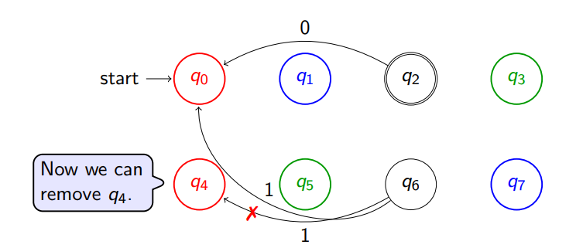

Let $q_{0} and q_{4} are equivalent$

Slide 15

But, how is that you know $q_{0} and q_{4} are equivalent$?

Slide 16
Let M = (Q, Σ, δ, q₀, F) and let p, q, r ∈ Q
Define the relation “~”:
p ~ q iff p is equivalent to q
p ~ q iff p is distinguishable from q
/
Proposition: “~” is an equivalence relation
p ~ p (reflexive)
p ~ q ⇒ q ~ p (symmetric)
p ~ q and q ~ r ⇒ p ~ r (transitive)

Slide 17
Let M = (Q, Σ, δ, q₀, F) and let p, q, r ∈ Q
Proposition: “~” is an equivalence relation
so “~” partitions the set of states of M into disjoint equivalence classes
[q] = { p | p ~ q }
Q
q
q₀

Slide 18
0
1
1
1
0
1
0
0

Slide 19
Algorithm MINIMIZE(DFA M)
Input: DFA M
Output: DFA M_{MIN} such that:
M ≡ M_{MIN}
M_{MIN} has no inaccessible states
M_{MIN} is irreducible
||
states of M_{MIN} are pairwise distinguishable
Theorem: M_{MIN} is the unique minimum

Slide 20
Algorithm MINIMIZE(DFA M)
(1) Remove all inaccessible states from M
(2) Apply Table-Filling algorithm to get
E_{M} = { [q] | q is an accessible state of M }
M_{MIN} = (Q_{MIN}, Σ, δ_{MIN}, q_{0 MIN}, F_{MIN})
Q_{MIN} = E_{M}, q_{0 MIN} = [q₀], F_{MIN} = { [q] | q ∈ F }
δ_{MIN}( [q], a ) = [ δ( q, a ) ]

Slide 21
TABLE-FILLING ALGORITHM
IDEA!
Make best effort to find pairs of states that are distinguishable.
Pairs leftover will help us.

Slide 22
TABLE-FILLING ALGORITHM
q₀
Base Case: p accepts and q rejects ⇒ p ~ q
q₁
/
q_{i}
q_{n}
q₀
q₁
q_{i}
q_{n}

Slide 23
TABLE-FILLING ALGORITHM
q₀
Base Case: p accepts and q rejects ⇒ p ~ q
q₁
/
q_{i}
X
X
X
X
q_{n}
X
q₀
q₁
q_{i}
q_{n}

Slide 24

TABLE-FILLING ALGORITHM
For base case, we put $X_{0}$ in the corresponding cell.
This states, that the two states are not equivalent.
q₀
Base Case: p accepts and q rejects ⇒ p ~ q
q₁
/
q_{i}
X₀
X₀
X₀
X₀
q_{n}
X₀
q₀
q₁
q_{i}
q_{n}

Slide 25
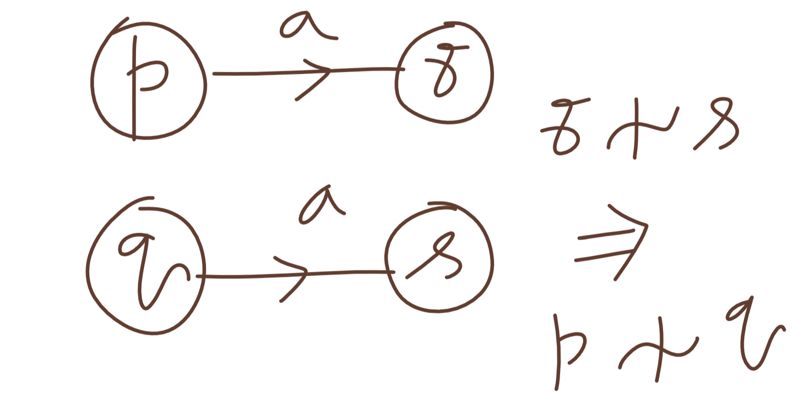

Slide 26
TABLE-FILLING ALGORITHM
For base case, we put $X_{0}$ in the corresponding cell.
This states, that the two states are not equivalent.
q₀
Base Case: p accepts and q rejects ⇒ p ~ q
q₁
/
Recursion:
q_{i}
X₀
X₀
X₀
a
X₀
p
r
⇒
p ~ q
~
/
/
q_{n}
X₀
a
q
s
q₀
q₁
q_{i}
q_{n}

Slide 27
q₁
q₂
q₃
X₀
X₀
X₀
q₀
q₁
q₂
0,1
1
0
0
0
1
q₀
q₁
q₂
q₃
1

Slide 28
q₁
q₂
X₁
X₁
q₃
X₀
X₀
X₀
q₀
q₁
q₂
0,1
1
0
0
0
1
q₀
q₁
q₂
q₃
1

Slide 29
q₁
X₂
q₂
X₁
X₁
q₃
X₀
X₀
X₀
q₀
q₁
q₂
0,1
1
0
0
0
1
q₀
q₁
q₂
q₃
1

Slide 30

Have you noticed the reason for putting symbols $X_{1}, X_{2}$
q₁
X₂
q₂
X₁
X₁
q₃
X₀
X₀
X₀
q₀
q₁
q₂
0,1
1
0
0
0
1
q₀
q₁
q₂
q₃
1

Slide 31
0
q₀
q₁
1
1
1
0
1
0
q₃
q₂
q₁
X₀
0
q₂
X₀
q₃
X₀
X₀
q₀
q₁
q₂

Slide 32
0
q₀
q₁
1
1
1
0
1
0
q₃
q₂
0

Slide 33
0
1
1
[q_{0,} q₃]
[q_{1,} q₂]
0

Slide 34
MINIMIZE
0
q₀
q₁
0
1
0
1
q₂
1

Slide 35
MINIMIZE
0
q₀
q₁
0
1
0
1
0
1
q₂
0
[q_{0,} q₁]
[q₂]
1
1

Slide 36
1
0
0,1
0
q₀
q₁
q₄
1
1
0
q₅
0
0,1
1
q₂
q₃

Slide 37
1
0
0,1
0
q₀
q₁
q₄
1
1
0
q₅
0
1
q₃

Slide 38
1
0
0,1
0
q₀
q₁
q₄
1
1
0
q₅
0
1
q₁
q₃
q₃
q₄
q₅
X₀
X₀
X₀
X₀
q₀
q₁
q₃
q₄

Slide 39
1
0
0,1
0
q₀
q₁
q₄
1
1
0
q₅
0
1
q₁
q₃
q₃
X₁
X₁
q₄
X₁
X₁
q₅
X₀
X₀
X₀
X₀
q₀
q₁
q₃
q₄

Slide 40
1
0
0,1
0
q₀
q₁
q₄
1
1
0
q₅
0
1
q₁
X₂
q₃
q₃
X₁
X₁
q₄
X₁
X₁
q₅
X₀
X₀
X₀
X₀
q₀
q₁
q₃
q₄

Slide 41
1
0
0,1
0
q₀
q₁
q₄
1
1
0
q₅
0
1
q₁
X₂
q₃
q₃
X₁
X₁
q₄
X₁
X₁
q₅
X₀
X₀
X₀
X₀
q₀
q₁
q₃
q₄

Slide 42
1
0
0,1
0
q₀
q₁
q₄
1
1
0
q₅
q₁
X₂
q₃
q₃
X₁
X₁
q₄
X₁
X₁
q₅
X₀
X₀
X₀
X₀
q₀
q₁
q₃
q₄

Slide 43
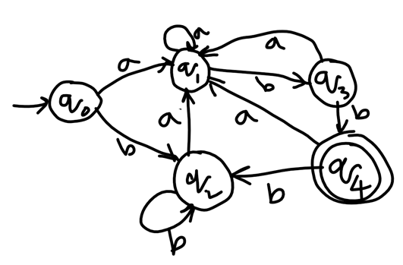

Slide 44
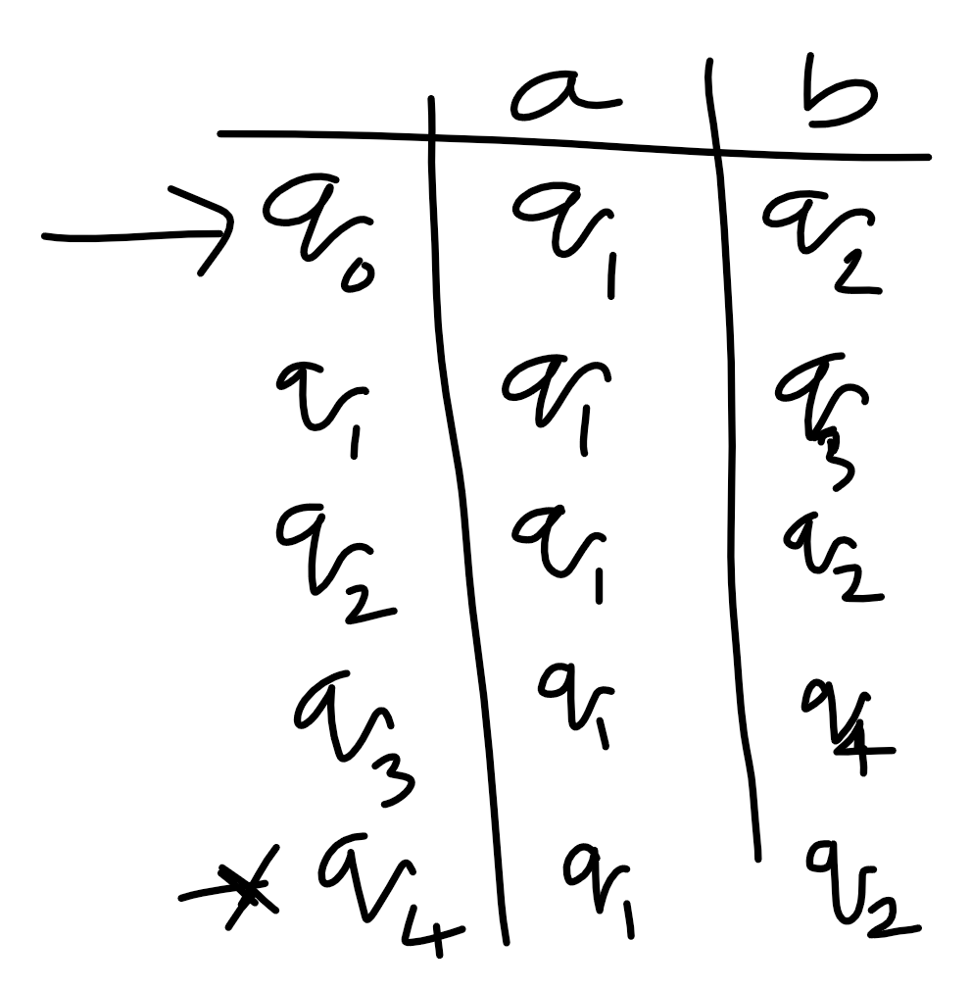

Slide 45
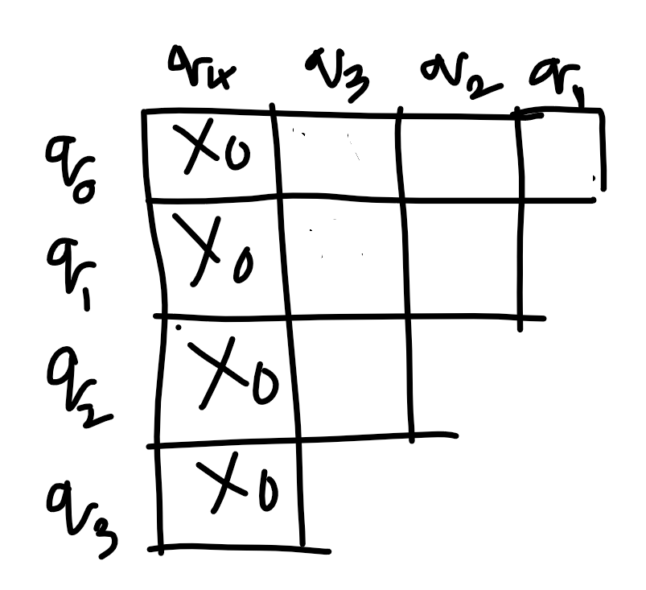

Slide 46
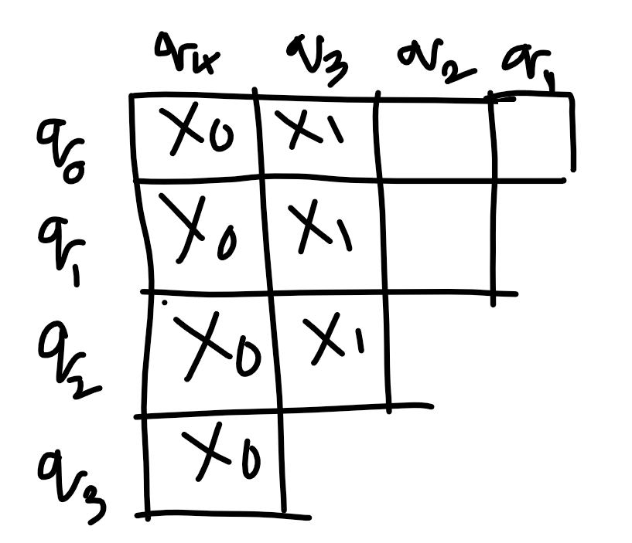

Slide 47
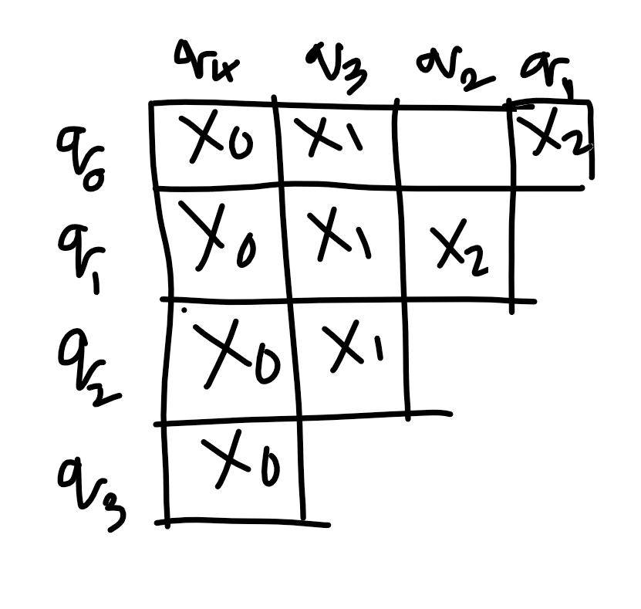

Slide 48
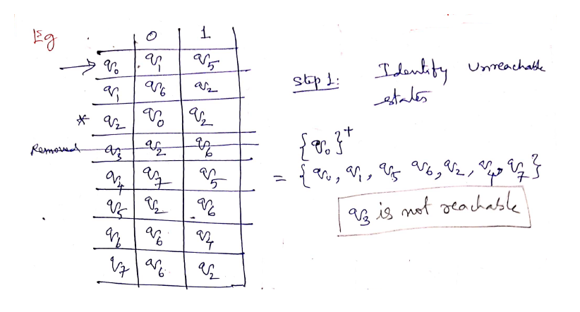

Slide 49
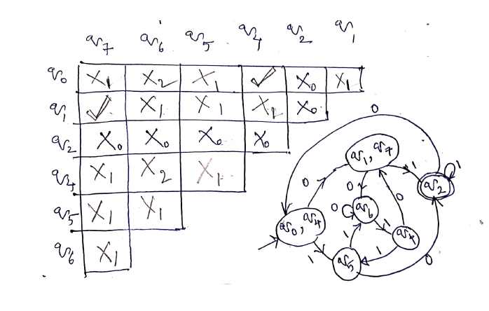

Slide 50
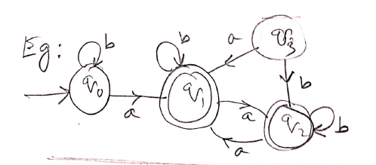

Slide 51


Slide 52
We get $q_{1}$ is equivalent to $q_{2}$ (how?)

Slide 53
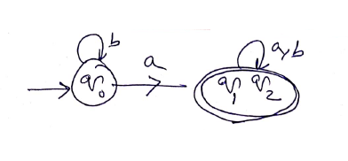
We get $q_{1}$ is equivalent to $q_{2}$ (how?)
Minimal DFA

Slide 54
How to prove that two DFAs are Equivalent

Slide 55
The following is an extract from the Ullman’s book.
Read that book for more information (Reading assignment)

Slide 56
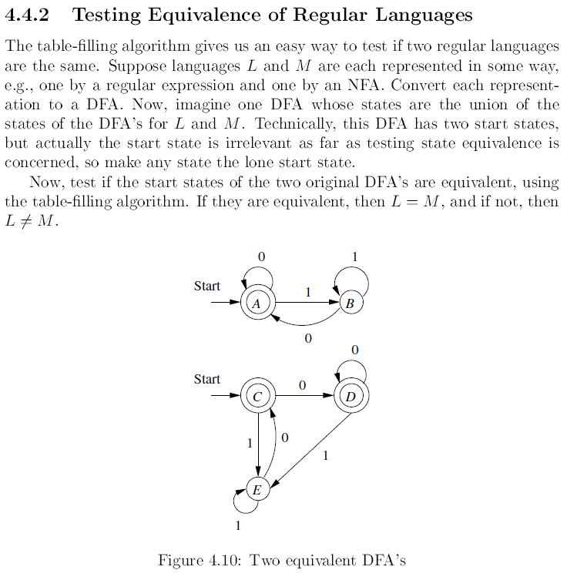

Slide 57
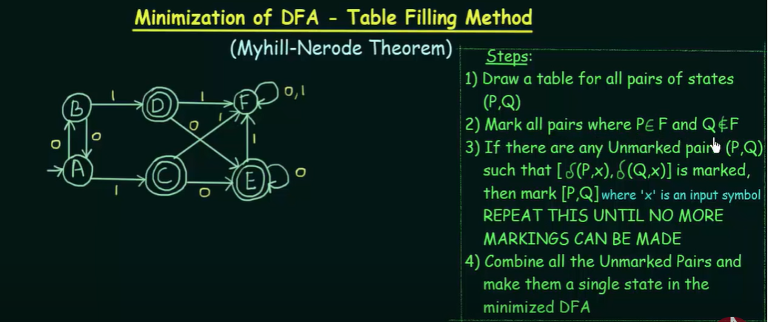
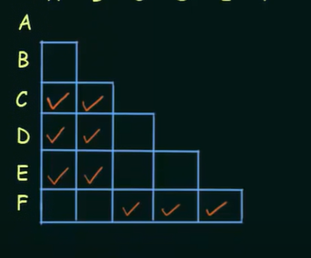
Minimization of DFA

Slide 58
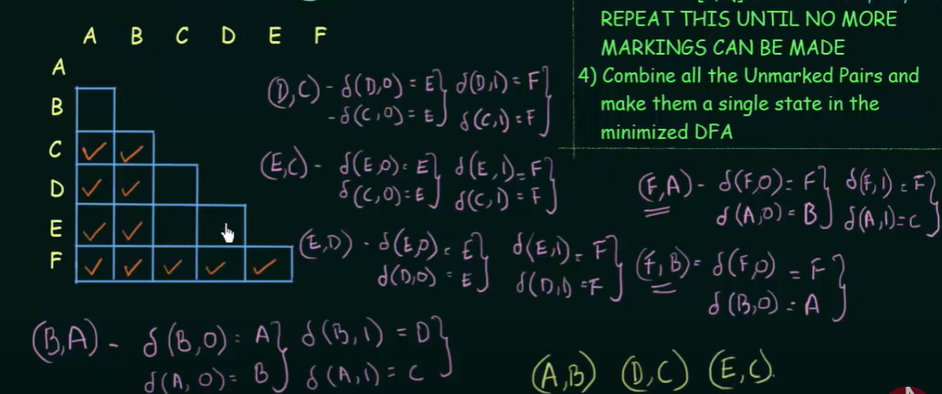

Slide 59
