Slide 1
Context Free Languages
Context Free Grammars

Slide 2
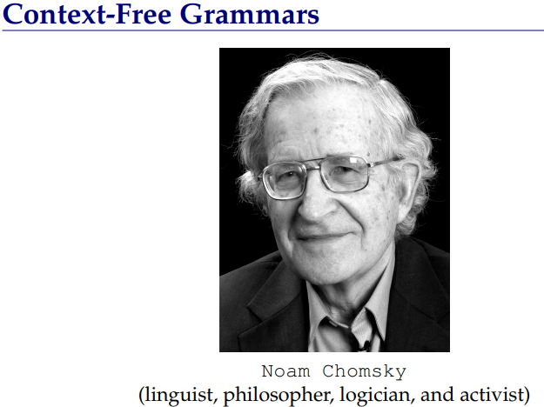
In the formal languages of computer science and linguistics, the Chomsky hierarchy is a hierarchy of classes of formal grammars. This hierarchy of grammars was described by Noam Chomsky in 1956.

Slide 3
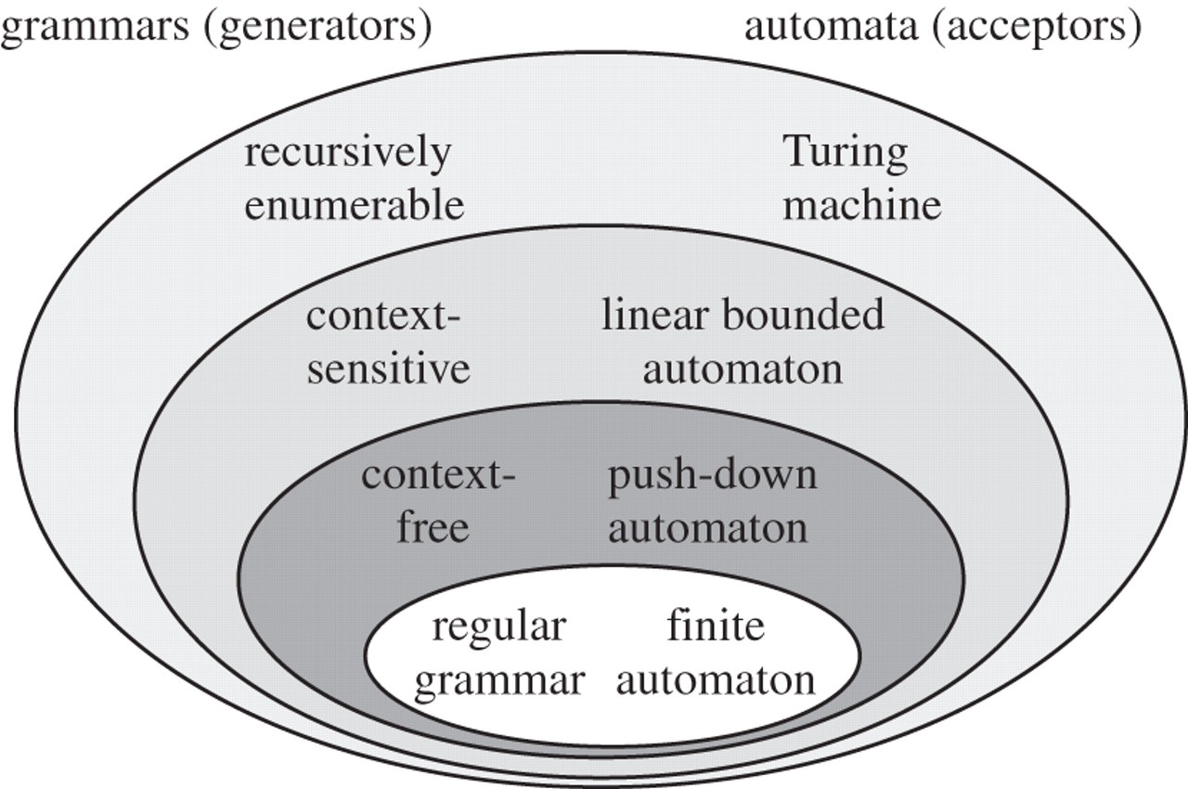
Chomsky Hierarchy

Slide 4
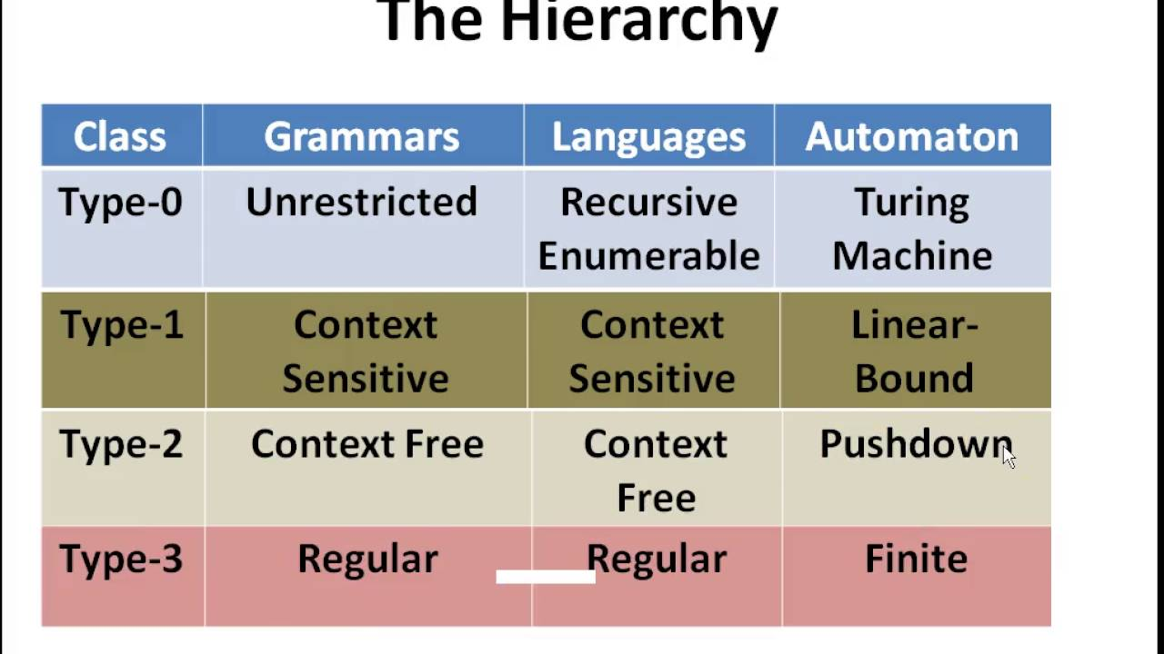

Slide 5
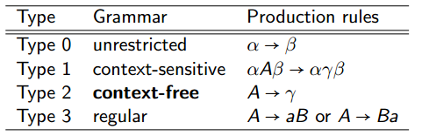
How production rules look like

Slide 6
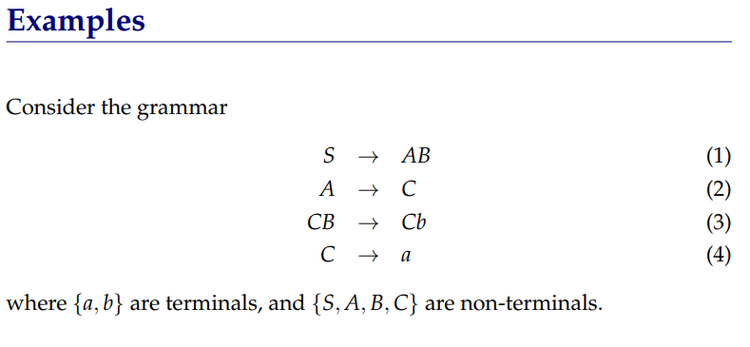
A grammar generates sentences (strings) in a language

Slide 7
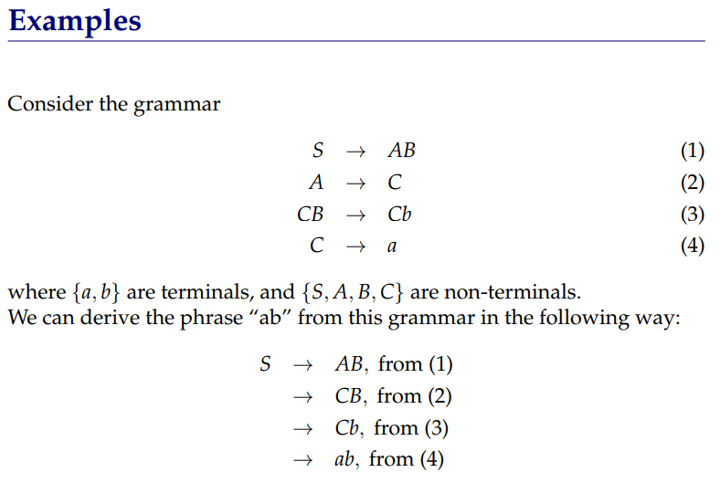

Slide 8
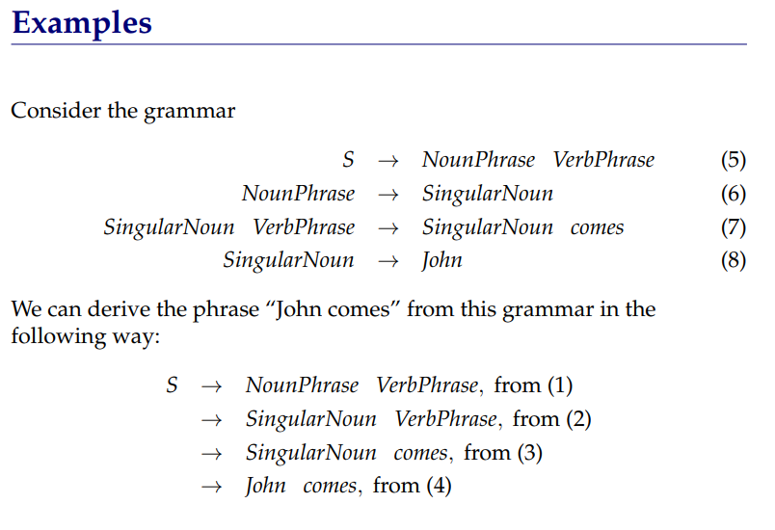

Slide 10
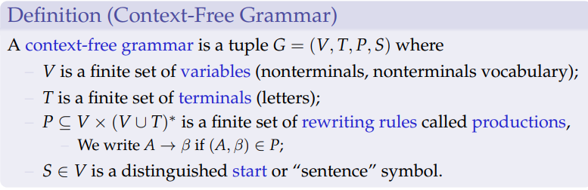

Slide 11
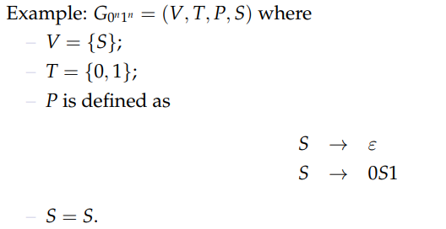

Slide 12

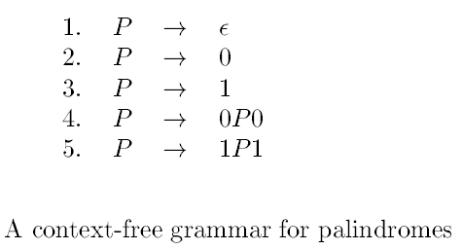
Palindromes

Slide 13
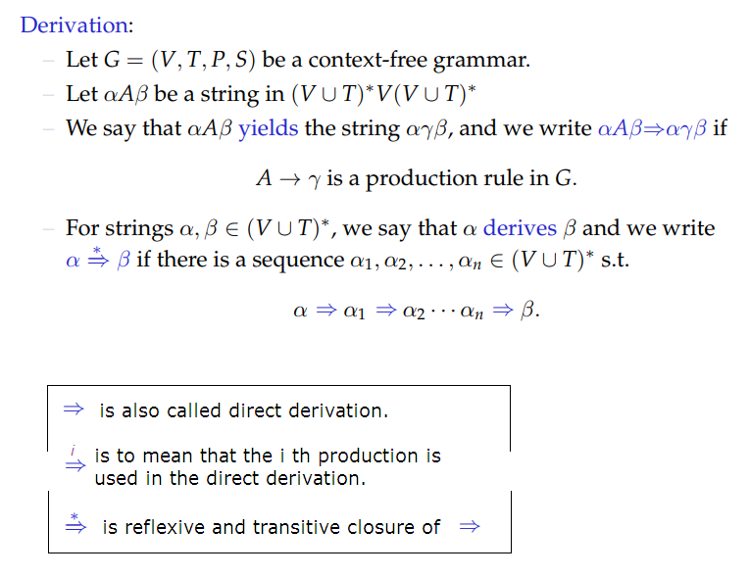
Derivation

Slide 14
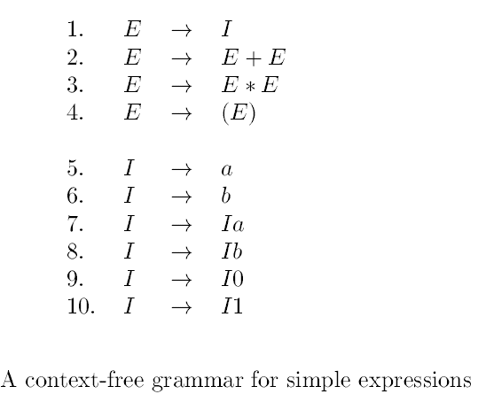

Slide 16

Can you find how the following is true.

Slide 17
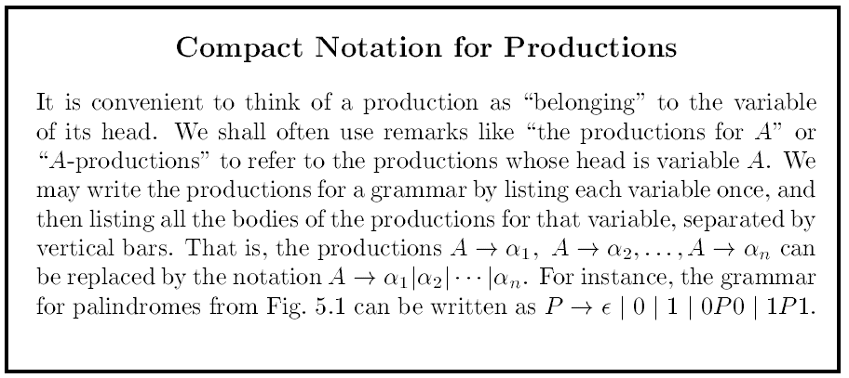

Slide 18

CFL Definition

Slide 19
Derivations are not unique.
So, to bring uniqueness, we define two special type of derivations, viz., leftmost and rightmost.

Slide 20
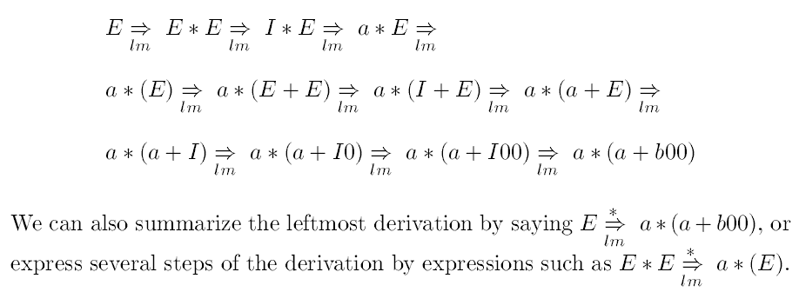

Slide 21
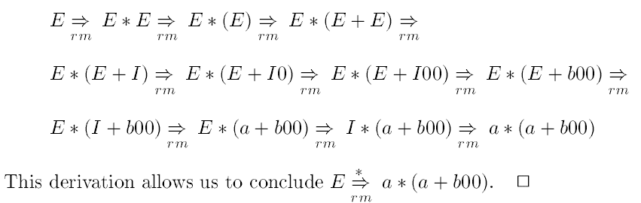

Slide 22
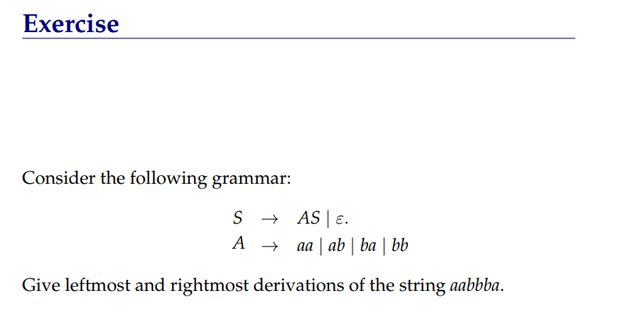

Slide 23


Slide 24

This proof has two parts ($⇒$ and $⇐$ )

Slide 25

This proof has two parts ($⇒$ and $⇐$ )
$\left(w=w^{R}\right)⇒w∈L(G_{pal}$)
$w∈L(G_{pal}$) $⇒\left(w=w^{R}\right)$

Slide 26
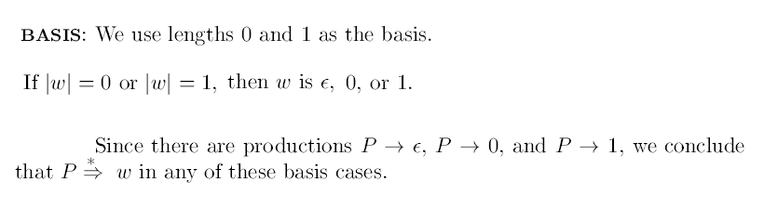

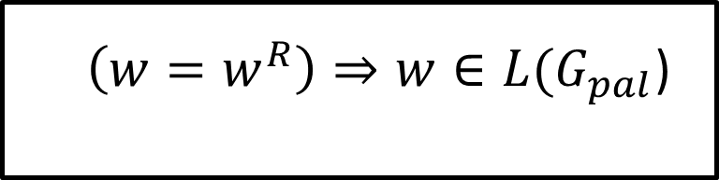
$\left(w=w^{R}\right)⇒w∈L(G_{pal}$)
Proof [ by induction on $\left|w\right|$ ]:
Note,$w∈L(G_{pal}$) is same $P\underset{⇒}{∗}$ $w$
Note, $\left(w=w^{R}\right)$means $w$ begins and ends with the same character.

Slide 28
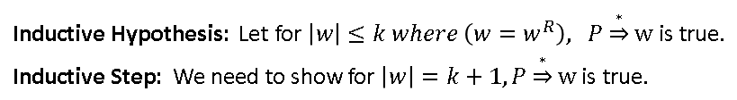

Slide 29
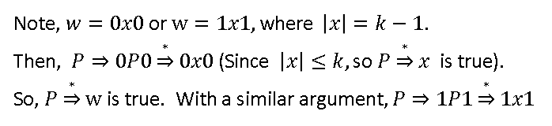

Slide 30

This completes our proof for : $\left(w=w^{R}\right)⇒w∈L(G_{pal}$)

Slide 31
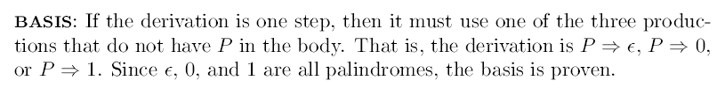


$w∈L(G_{pal}$) $⇒\left(w=w^{R}\right)$
Proof [by induction on number of steps in the derivation]:
Assume for n steps it is true.
Then, show for (n+1) steps it must be true.
Left as an exercise.

Slide 32
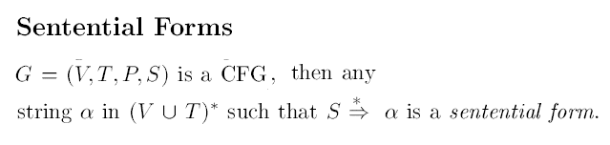

Slide 34
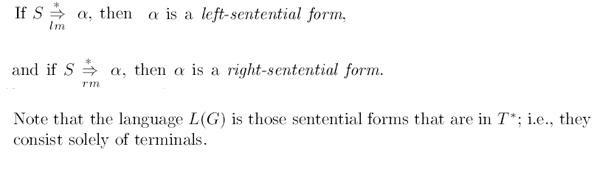

Slide 35
Is this sentential form left-sentential? Or right-sentential?

Slide 36
Is this sentential form left-sentential? Or right-sentential?
It is a sentential form. But neither left nor right.

Slide 37
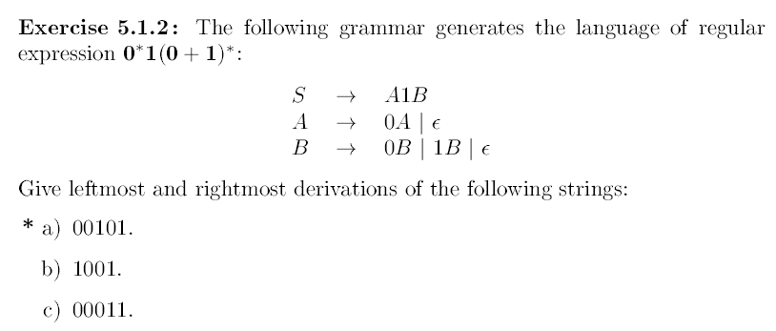
Note, the given grammar is not a regular grammar (even-though it generates a regular language).

Slide 38


Can you find $L(G)$?
$S→aS\left|bS\right|a|b|ε$

Slide 39

Can you find $L(G)$?
$S→aS\left|bS\right|a|b|ε$
Answer: All strings. $Σ^{∗}$

Slide 40

Can you find $L(G)$?
$S→S_{1}S|ε,$
$S_{1}→aS_{1}b|ab$

Slide 41
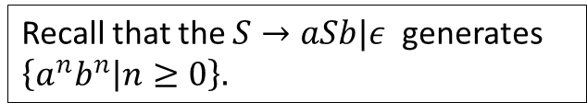
Can you find $L(G)$?
$S→S_{1}S|ε,$
$S_{1}→aS_{1}b|ab$
Recall that the $S→aSb|ε$ generates $\left\{a^{n}b^{n} | n≥0\right\}.$

Slide 42
Can you find $L(G)$?
$S→S_{1}S|ε,$
$S_{1}→aS_{1}b|ab$
Recall that the $S→aSb|ε$ generates $\left\{a^{n}b^{n} | n≥0\right\}.$
Starting from $S_{1}$ we get $\left\{a^{n}b^{n} | n≥1\right\}$

Slide 43
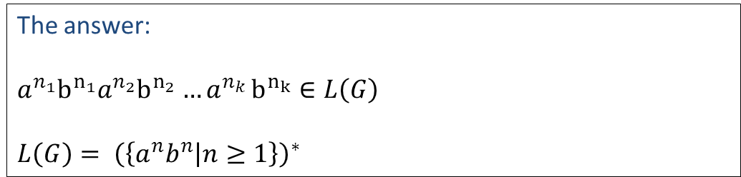
Can you find $L(G)$?
$S→S_{1}S|ε,$
$S_{1}→aS_{1}b|ab$
Recall that the $S→aSb|ε$ generates $\left\{a^{n}b^{n} | n≥0\right\}.$
Starting from $S_{1}$ we get $\left\{a^{n}b^{n} | n≥1\right\}$
The answer:
$$a^{n_{1}}b^{n_{1}}a^{n_{2}}b^{n_{2}}{…a}^{n_{k}}b^{n_{k}}∈L\left(G\right)$$
$$L\left(G\right)= {\left(\left\{a^{n}b^{n} | n≥1\right\}\right)}^{∗}$$

Slide 44

Can you find $L(G)$?
$$S→SS | \left[S\right] \left| \left(S\right) \right| [ ]|( )$$

Slide 45


Can you find $L(G)$?
$$S→SS \left| S \right| \left[S\right] \left| \left( \right) \right| [ ]$$
Set of all balanced parentheses with alphabet $\{ \left(, \right), \left[, \right] \}$

Slide 46

Can you find $L(G)$?
$S→aB|bA$
$B→b\left|bS\right|aBB$
$A→a|aS|bAA$

Slide 47
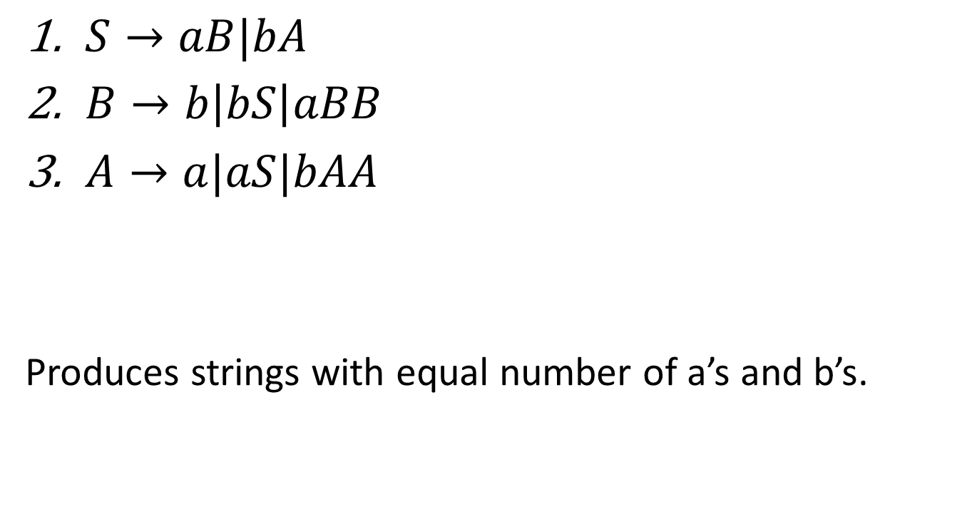
Can you find $L(G)$?
$S→aB|bA$
$B→b\left|bS\right|aBB$
$A→a|aS|bAA$
Produces strings with equal number of a’s and b’s.

Slide 48

Can you find $L(G)$?
$S→SaSbS|SbSaS|ε$

Slide 49
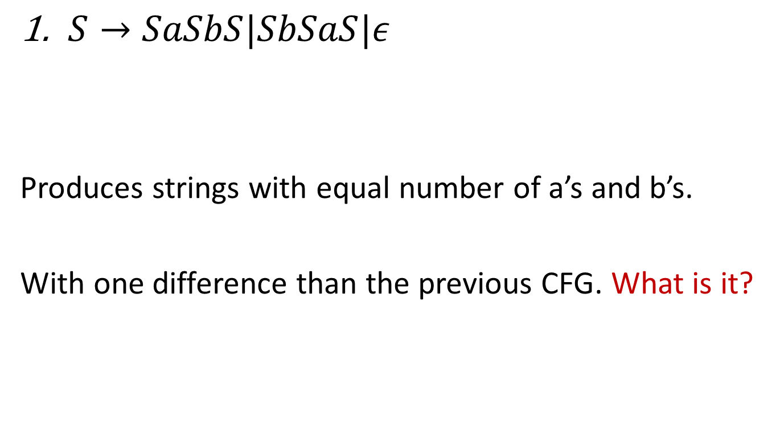
Can you find $L(G)$?
$S→SaSbS|SbSaS|ε$
Produces strings with equal number of a’s and b’s.
With one difference than the previous CFG. What is it?

Slide 50
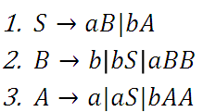

Can you find $L(G)$?
$S→SaSbS|SbSaS|ε$
Produces strings with equal number of a’s and b’s.
With one difference than the previous CFG. What is it?

