Slide 1
Parse tree and ambiguity

Slide 2
Parse tree representation of the derivation.
It is tree representation of the derivation.
For a given derivation, there is only one parse tree.
But, for a given parse tree, there may be many derivations.

Slide 3
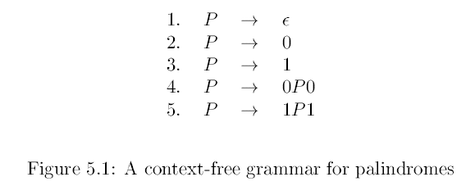
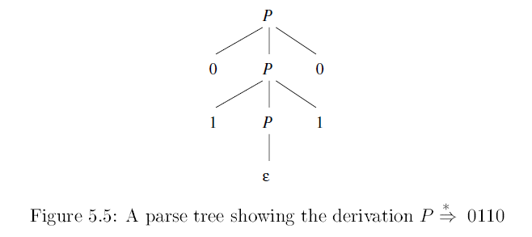

Slide 4
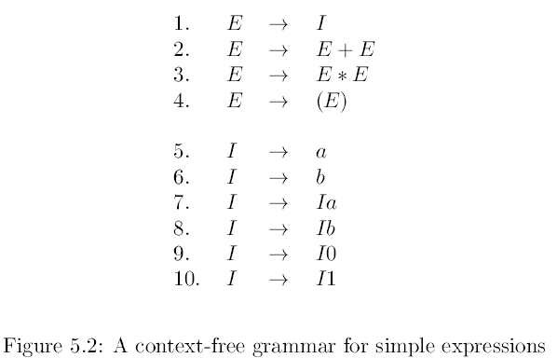
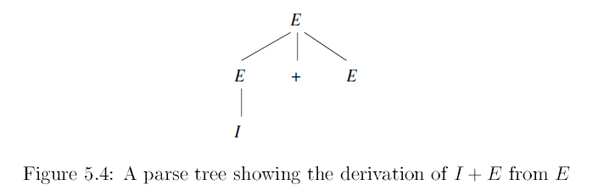

Slide 5
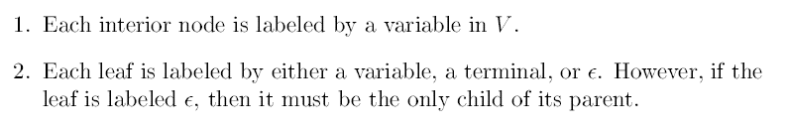
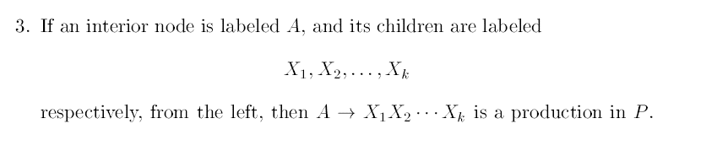

Slide 6
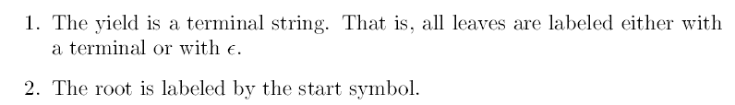

Slide 7
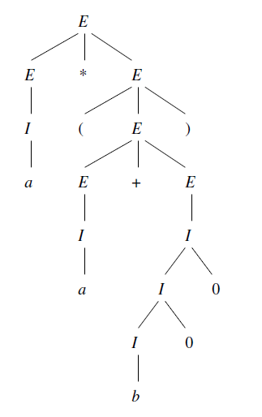


Parse tree for the yield

Slide 8
Parse tree representation of the derivation.
It is tree representation of the derivation.
For a given derivation, there is only one parse tree.
But, for a given parse tree, there may be many derivations.

Slide 9
For a given parse tree there is a unique leftmost derivation.
Similarly, for a given parse tree there is a unique rightmost derivation.

Slide 10
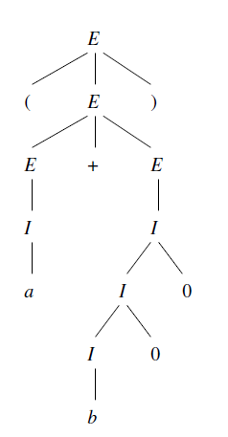
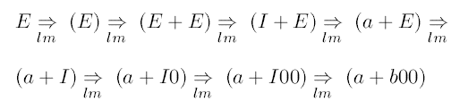
Can you find the rightmost derivation?

Slide 11
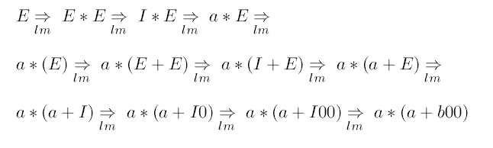
Can you find the rightmost derivation?

Slide 12
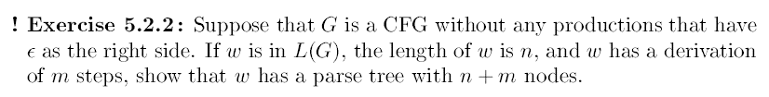
Can you do this?

Slide 13
Ambiguous grammar
The CFG is ambiguous, if there is a string in the language for which there are more than one parse tree.
This is equivalent to say, “there are more than one leftmost derivation for a string, hence the grammar is ambiguous”.
Similarly, with rightmost derivation

Slide 14
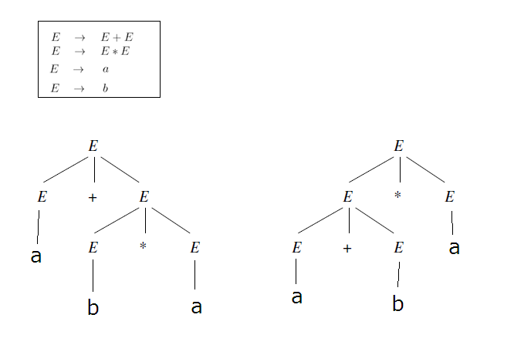
Two parse trees for the yield a+b*a

Slide 15
Can we remove the ambiguity?
Finding whether a given CFG is ambiguous or not is an undecidable problem !
There are some CFLs for which it is impossible to have an unambiguous CFG.

Slide 16
Can we remove the ambiguity?
Finding whether a given CFG is ambiguous or not is an undecidable problem !
There are some CFLs for which it is impossible to have an unambiguous CFG.
But, the situation is not so unpromising.
For many situations in practice, we can handcraft unambiguous CFG for a given ambiguous one.

Slide 17
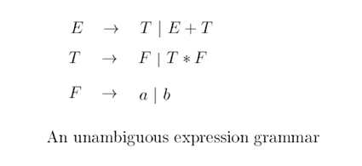
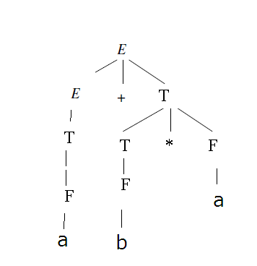
This
This is the only parse tree for a+b*a

Slide 18
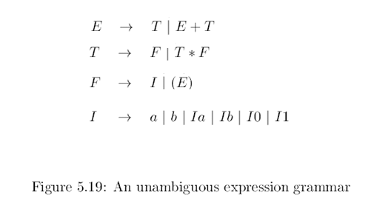
For an expression grammar, injecting precedence and associativity of operators can make them unambiguous.
This is ambiguous grammar.
Unambiguous CFG for the same CFL.

Slide 19
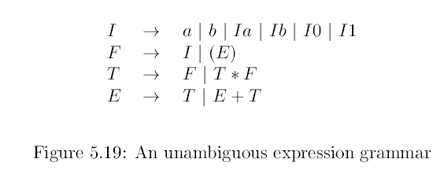
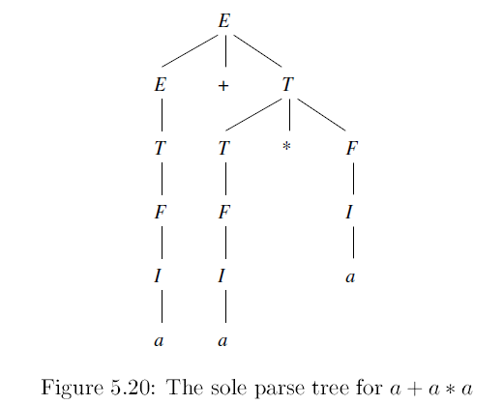

Slide 20
With above we get two parse trees for the same yield.

Slide 21
Inherent ambiguity
A CFL is said to be inherently ambiguous, if every CFG that generates the language is ambiguous.
Note, in this case we say CFL is ambiguous.
Earlier we said CFG is ambiguous.

Slide 22
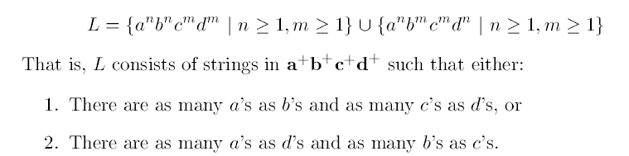
An example of ambiguous CFL

Slide 23
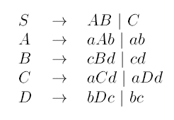
An example of ambiguous CFL
One CFG, for the CFL

Slide 24
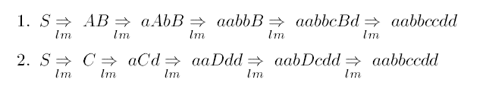
An example of ambiguous CFL
One CFG, for the CFL
Two leftmost derivations for the same string

Slide 25
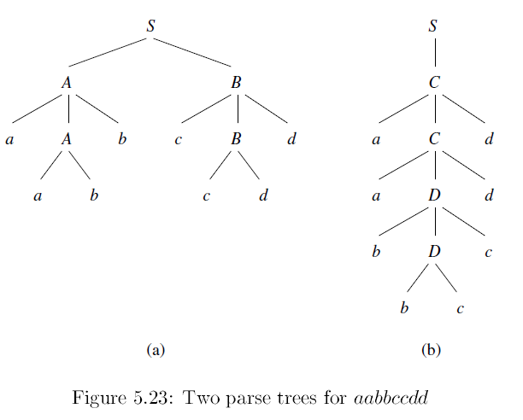
One CFG, for the CFL
Two leftmost derivations for the same string

Slide 26
How to understand that every CFG is ambiguous.
Proof is complicated.
But the essence is, the grammar has two parts one generating strings in each of the above union.
There are some strings that are common between these two parts. These can be generated from two ways.

Slide 27
