Slide 1
Streaming, in the interface
A continuous stream arrives, the interface hands the model one window at a time, and a second channel can join mid-stream without changing the call.

Slide 2
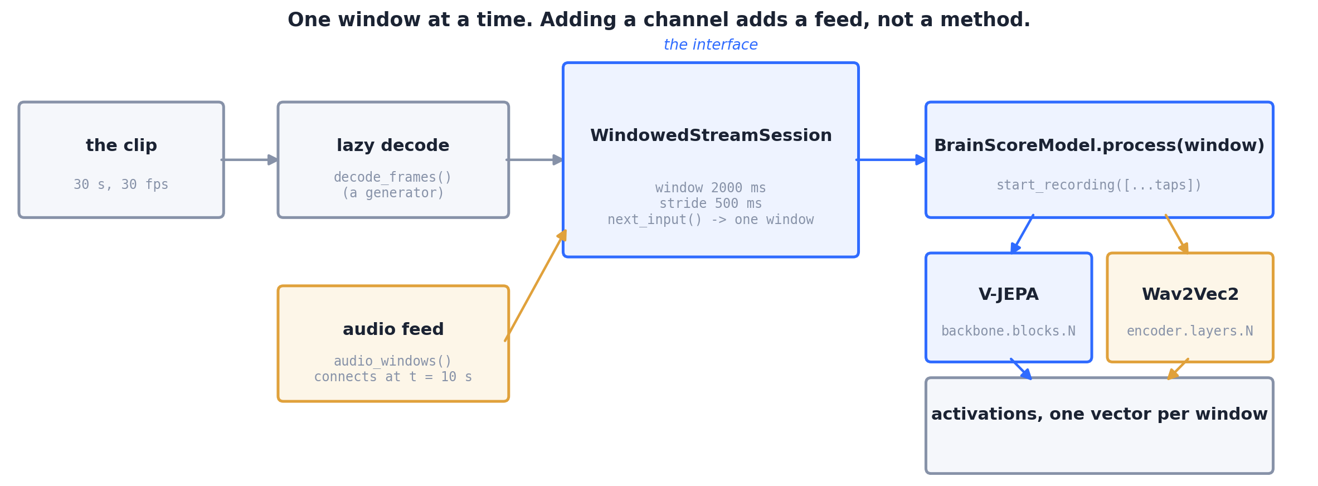
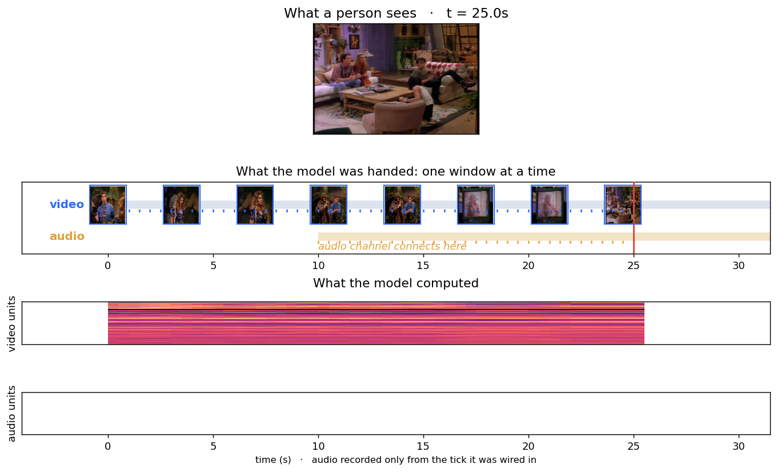
What the code does
Video tower V-JEPA v1, audio tower Wav2Vec2-base; 2000 ms windows, 500 ms stride; audio connects at t = 10 s.

Slide 3
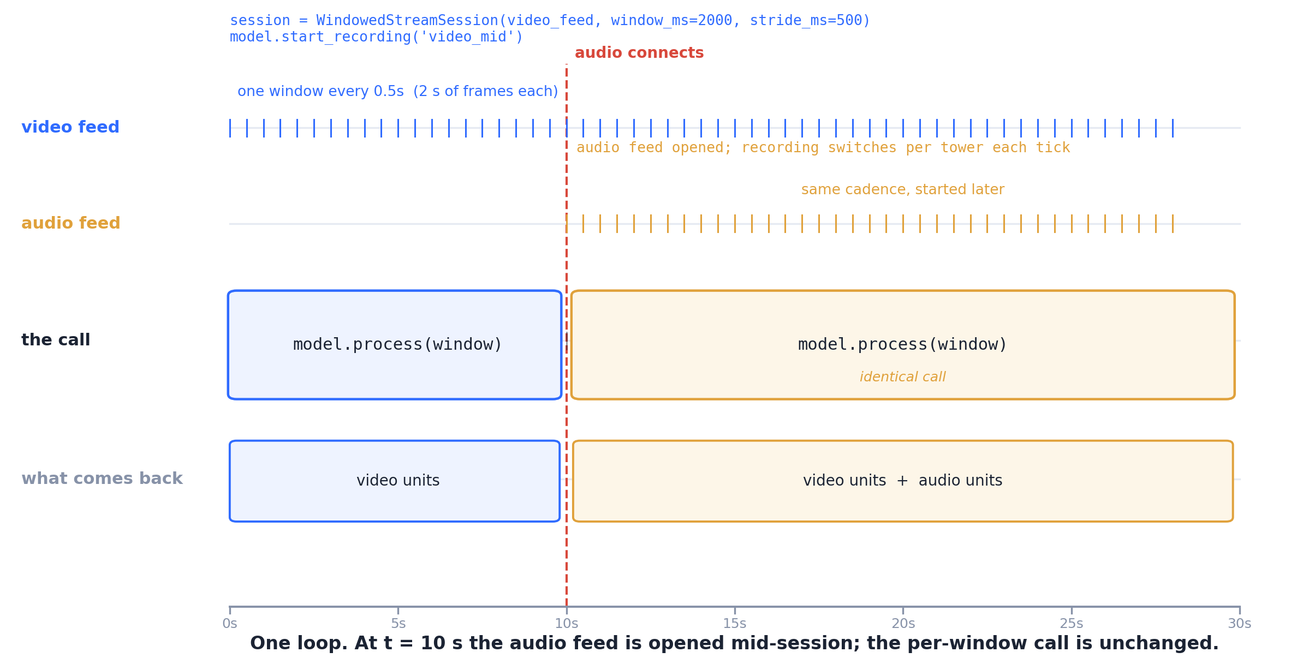
How it runs
The per-window call is the same before and after the second channel joins; only the recording list changes.

Slide 4
The actual code
# unified/scripts/render_streaming_representation.py
session = WindowedStreamSession(
decode_frames(video_path), fps=fps,
window_ms=2000, stride_ms=500,
record='video_mid',
window_to_stimuli=window_to_stimuli)
model.start_recording('video_mid')
_drive_neural_session_streaming(model, session)
# core/brainscore_core/streaming_helpers.py
# _drive_neural_session_streaming
event = session.next_input()
while event is not None:
stimuli = _one_row_stimuli(session, event, stream_index)
for channel, region in regions:
_start_recording(subject, region)
output = subject.process(stimuli)
session.emit(StreamEvent(
channel=channel, payload=output,
t_ms=event.t_ms))
event = session.next_input()
# mid-session, at tick 20 (t = 10 s)
if i >= CONNECT:
seg, sr, t_ms = next(audio_iter)
model.start_recording('encoder.layers.5')
a = model.process(audio_window)
model.start_recording('video_mid')
# 60 video windows, 40 audio windows.
These are the real functions, at the paths in their comments. Variables are shown with the values this run used (window_ms=2000, region='video_mid').

Slide 5
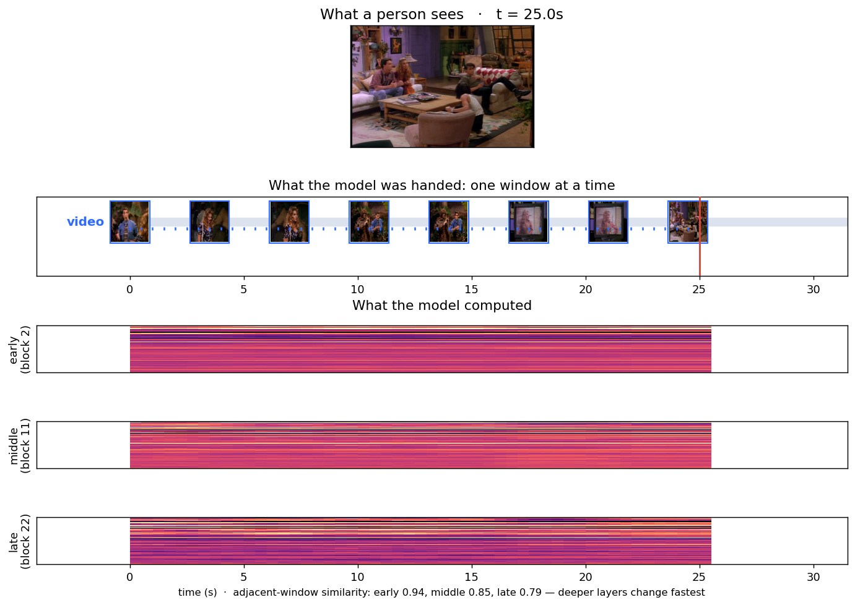
Backup: reading three depths at once
Three taps on the video tower, one shared forward pass. Measured adjacent-window similarity: 0.94 early, 0.85 middle, 0.79 late — deeper layers change fastest, which is the opposite of what we expected before looking.

Slide 6
What this does not claim
— Scoring still runs in batch. Batched delivery is the default on the perception and behavior paths, deliberately, for throughput and to reproduce existing scores exactly.
— The movie benchmarks are not streaming. They build a stimulus set and score it; this demo is the streaming path running alongside, not those benchmarks rewritten.
— No brain data is involved. The strips are the model's own units. Nothing here is a claim about cortex.
— Real-time is a separate step. Pacing against a wall clock, with an explicit policy for falling behind, is implemented but not shown here.

