Slide 1
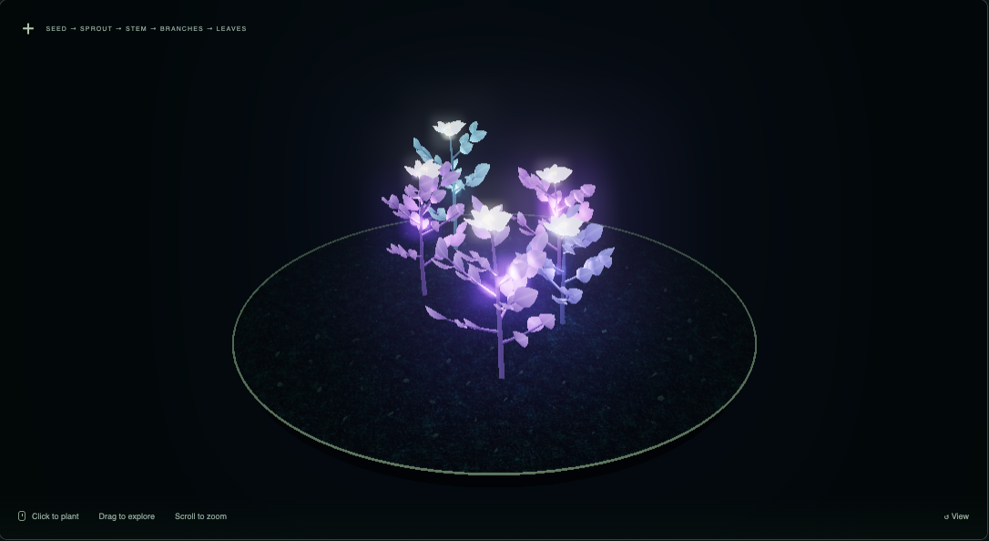
LUMINA GARDEN / ALPHA 04 / MID-CRIT
A small garden. A complete experience.
One alpha, three graphics pillars. Two technical challenges worth examining.
Build a bioluminescent garden
from seeds and simple rules.
PROCEDURAL GENERATION
Seeded geometry and bounded variation
ANIMATION
Staged growth + coherent wind
RENDERING
Emission, colored lights, bloom + day/night
01 / START
02 / GROW & SHAPE
03 / FINISH & RESTART
Menu + short control guide
Plant 1-5 seeds · wind · time of day
Mature garden summary · clean reset
Kartik Patel & Safa Akbar | Kartik: 0:00-0:25
1 / 4
Notes:
Kartik | 0:00-0:25 (25 seconds).
LuminaGarden is a small interactive garden built with Three.js and TypeScript. Our three pillars are procedural generation, animation, and rendering. We have created a new version with a complete loop: start, plant and shape the garden, finish, and restart. Also, we have added the wind and day/night effect on the enviornment. For this moment, however, we'll focus on two challenges: coherent plant animation and the cost of glow.
Point briefly at the loop; keep the overview short.

Slide 2
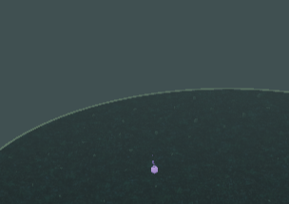
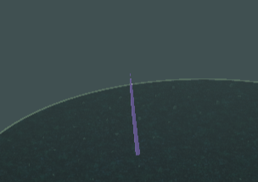
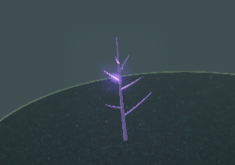
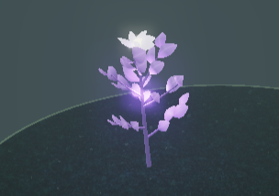
LUMINA GARDEN / ALPHA 04 / MID-CRIT
Challenge 1 / Grow structure in sequence.
A repeatable blueprint controls geometry; local timing makes each part emerge from its base.
WHY IT IS HARD
OUR APPROACH
EVIDENCE + TRADEOFF
Random branches can look incoherent.
Whole-model scaling reveals every part
at once instead of showing growth.
Seed → constrained blueprint → instances.
14 trunk segments; 5-8 branches.
3-5 leaves per branch; staggered reveal.
Same seed → same geometry.
300 seeds checked for finite bounds.
Intersections are not collision-resolved.
Local reveal: g = smoothstep(0, 1, clamp((progress - start) / (end - start)))
SPROUT
STEM
BRANCHES
LEAVES + BLOOM
Kartik Patel & Safa Akbar | Kartik: 0:25-1:45
2 / 4
Notes:
Kartik | 0:25-1:45 (80 seconds).
Our first challenge is making procedural plants grow in a believable order. Random branching can look incoherent, and scaling a complete model reveals everything at once. We use a seeded blueprint with bounded dimensions and staggered growth.
The equation converts the whole plant's progress into a growth amount for each part. Progress runs from zero to one, while start and end set that part's growth window. Subtracting start and dividing by end minus start puts us on the part's own timeline. Clamp keeps the value between zero and one. Smoothstep makes growth start and finish gently, and g is the final reveal amount. For example, a leaf scheduled between 60% and 80% is halfway revealed at 70%.
That amount extends each stem segment from its base or reveals a leaf or petal. These screenshots show the nine-second sequence. The same seed recreates the same blueprint; tests check 300 seeds. The rules do not prevent every leaf intersection.
Point along the stage images, then hand over to Safa.

Slide 3
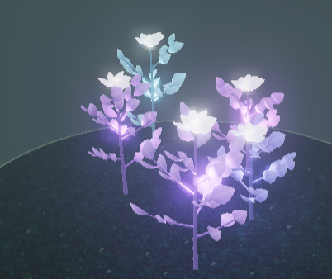
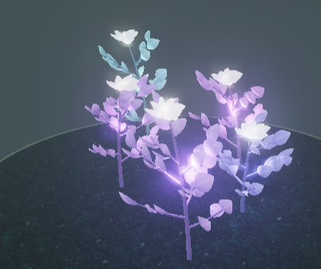
LUMINA GARDEN / ALPHA 04 / MID-CRIT
Challenge 1 / Keep wind and growth connected.
One deformation field keeps attachment positions coherent, including during staged growth.
Instance placement first.
Shared plant-space bend second.
x' = x + kx(t) · max(y, 0)^2
z' = z + kz(t) · max(y, 0)^2
Root stays anchored; tips move more.
Seed-derived phase varies the sway.
Normals: inverse-transpose Jacobian.
Light anchors: same analytic CPU field.
Mature organ matrices stay unchanged.
WIND 0% / SAME LAYOUT
WIND 100% / SAME LAYOUT
COHERENCE AT LOW CPU COST
Wind updates shader uniforms, not every organ matrix.
The same field deforms attached parts continuously.
Tradeoff: no inertia, collision response, or exact length conservation.
Kartik Patel & Safa Akbar | Safa: 1:45-3:10
3 / 4
Notes:
Safa | 1:45-3:10 (85 seconds).
Adding wind makes the first challenge harder. If we rotate each leaf or branch independently, attachment points can separate, especially during growth. Our solution is one continuous deformation in plant-local coordinates. We first place an instance, then bend its resulting position using the same height-squared field as every other part. A vertex at the root has zero displacement, and higher vertices move farther. Each plant gets a seed-derived phase.
Growth still updates the instance transforms. Wind runs in the vertex shader, so mature plants can sway without uploading all their organ matrices again. We also transform normals using the deformation's inverse-transpose Jacobian so lighting follows the bend. Point-light anchors use the same analytic field on the CPU.
The screenshots show the same five-plant layout with still and strong wind. This is a cheap, coherent visual approximation: it does not model inertia or preserve exact branch lengths. Those are deliberate limitations, not physical-simulation claims.

Slide 4
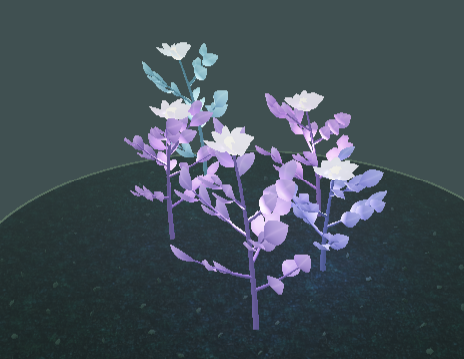
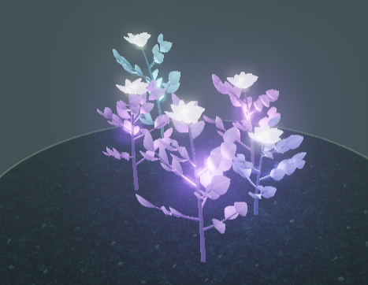
LUMINA GARDEN / ALPHA 04 / MID-CRIT
Challenge 2 / Glow within a real-time budget.
Emission, illumination, and bloom have different jobs; profiling has to include the complete frame.
Plants
Avg FPS
p95 ms
Calls
1
59.5
16.8
23
3
60.0
16.7
33
5
60.0
16.7
43
BLOOM OFF / EMISSION REMAINS
BLOOM ON / HALO RETURNS
EMISSION
POINT LIGHTS
BLOOM
M2 / Chrome 156 / 1086 × 594 / DPR 1
Wind 70%; daylight 15%; bloom control 0.65.
10s warm-up + 8s sampling at each level.
Slowest recorded frame: 83.4 ms (included).
One GPU; no GPU timer queries.
Five plants do not validate the original 20-plant target.
Bright plant surfaces
Colored light on soil
Screen-space halo
Daylight attenuates emission and bloom to avoid washout.
Instancing limits geometry draw calls.
FPS capped near 60 does not reveal spare headroom.
Kartik Patel & Safa Akbar | Safa: 3:10-4:30
4 / 4
Notes:
Safa | 3:10-4:30 (80 seconds).
The second challenge is producing convincing glow within a real-time budget. Emission makes a surface bright. A point light illuminates nearby soil. Bloom is a screen-space halo around bright pixels. The comparison switches bloom off and on while keeping emission. Day/night also adjusts emission and bloom to avoid the washed-out daytime result we found in visual review.
We measured actual animation-frame intervals with wind at seventy percent, daylight at fifteen percent, bloom enabled, and one point light per plant. Each level gets ten seconds of growth and warm-up followed by eight seconds of sampling. The table shows the measured averages and total draw calls, including post-processing. The slowest recorded frame was 83.4 milliseconds, so an average near sixty does not mean every frame met the target.
These results are specific to Chrome, this M2 GPU, and this viewport. Five plants do not validate the original twenty-plant target, and a sixty-FPS cap hides spare headroom. Our next work is broader profiling, light interaction, and plant families, with December seventh onward reserved for fixes and documentation.
Leave around thirty seconds of margin within the five-minute limit.

