Slide 1
Introduction to Data Science Shivay Lamba

Slide 2
Google Code-In Mentor with Tensorflow
Google Summer of Code Mentor with Jenkins
Linux Open Source Summit Scholarship Recipient
CEO at Develophowto And Sainox Technologies
About myself

Slide 3
Part 1: Introduction to Data Science
How this talk is divided
Part 2: Why use Python?
Part 3: Hands On Session

Slide 4
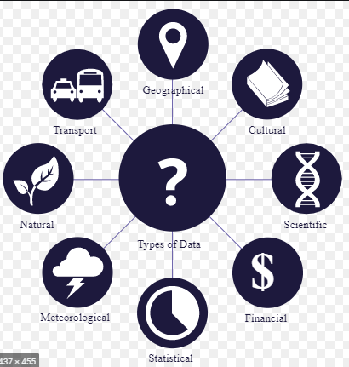

What is Data Science?
Data
&
Science

Slide 5
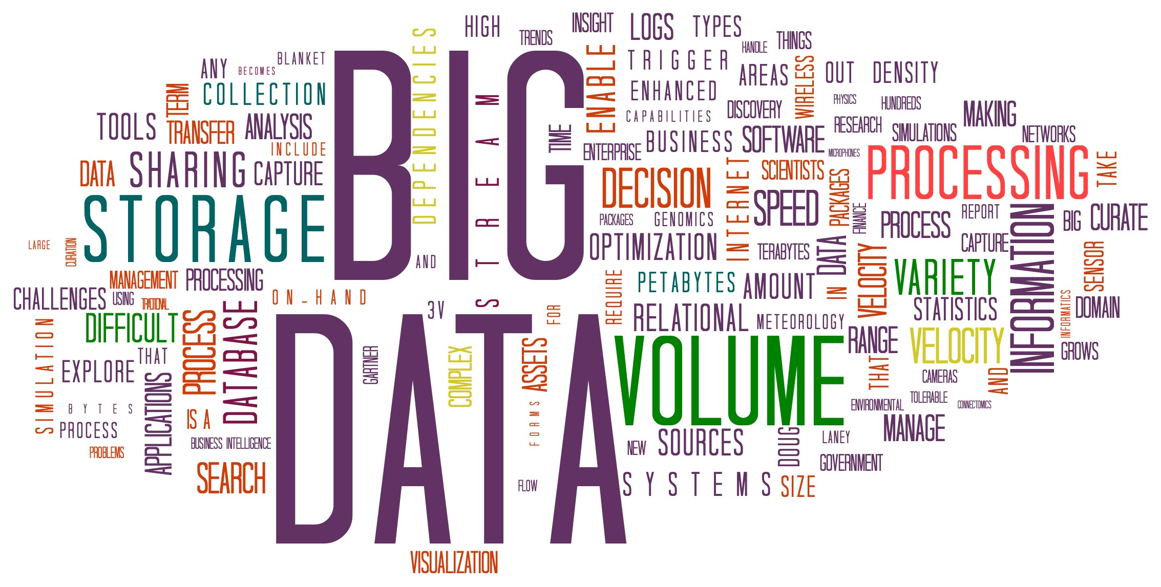

What is Data Science?
Extraction of knowledge from large volumes of data that are structured or unstructured.
It is a continuation of the fields data mining and predictive analytics

Slide 6
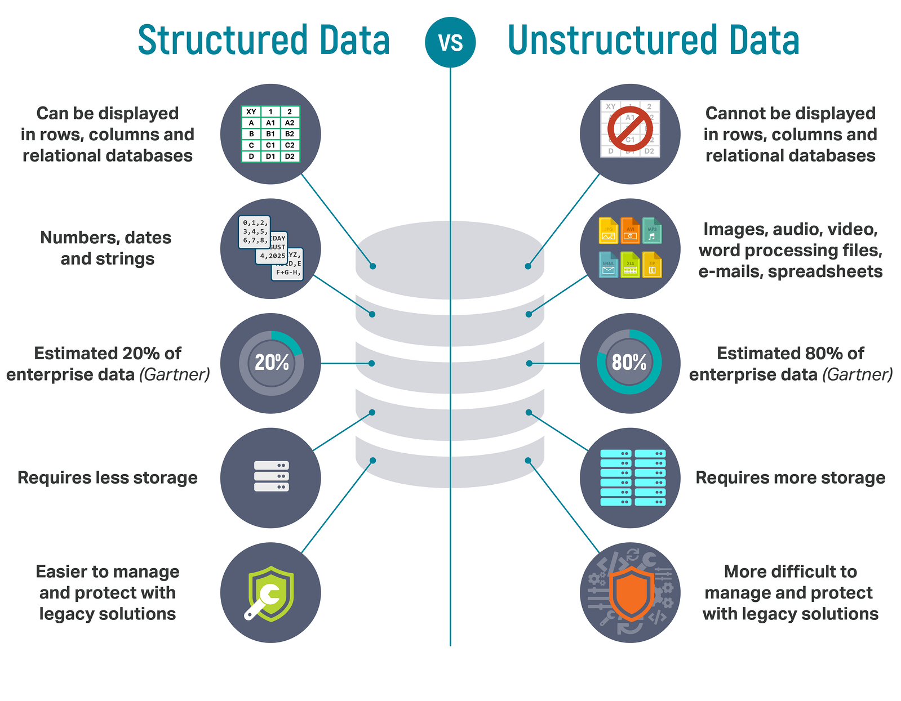
Difference Between Structured and Unstructured Data?
Extraction of knowledge from large volumes of data that are structured or unstructured.
It is a continuation of the fields data mining and predictive analytics

Slide 7
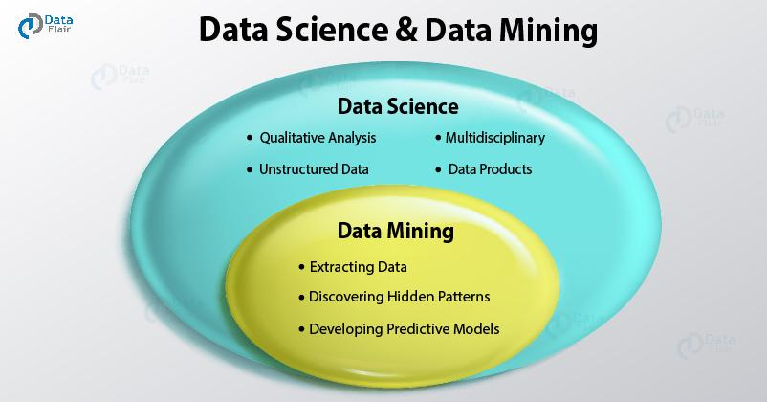
Essence of Data Mining
Extraction of knowledge from large volumes of data that are structured or unstructured.
It is a continuation of the fields data mining and predictive analytics

Slide 8
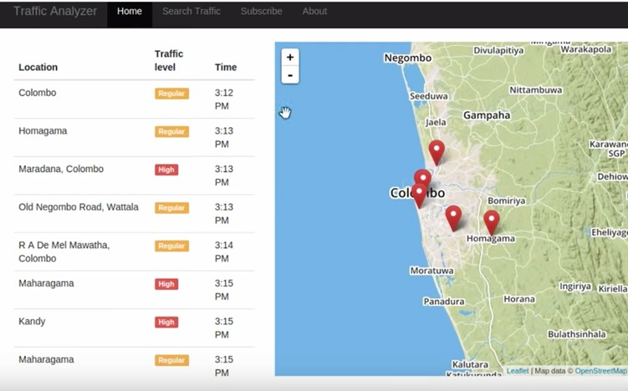
Some examples where Data Science might be used
Data as tweets
Extract time, location, and traffic level using NLP
Explore data
Model based on time, and it is a holiday
Predict traffic given a time and location.

Slide 9
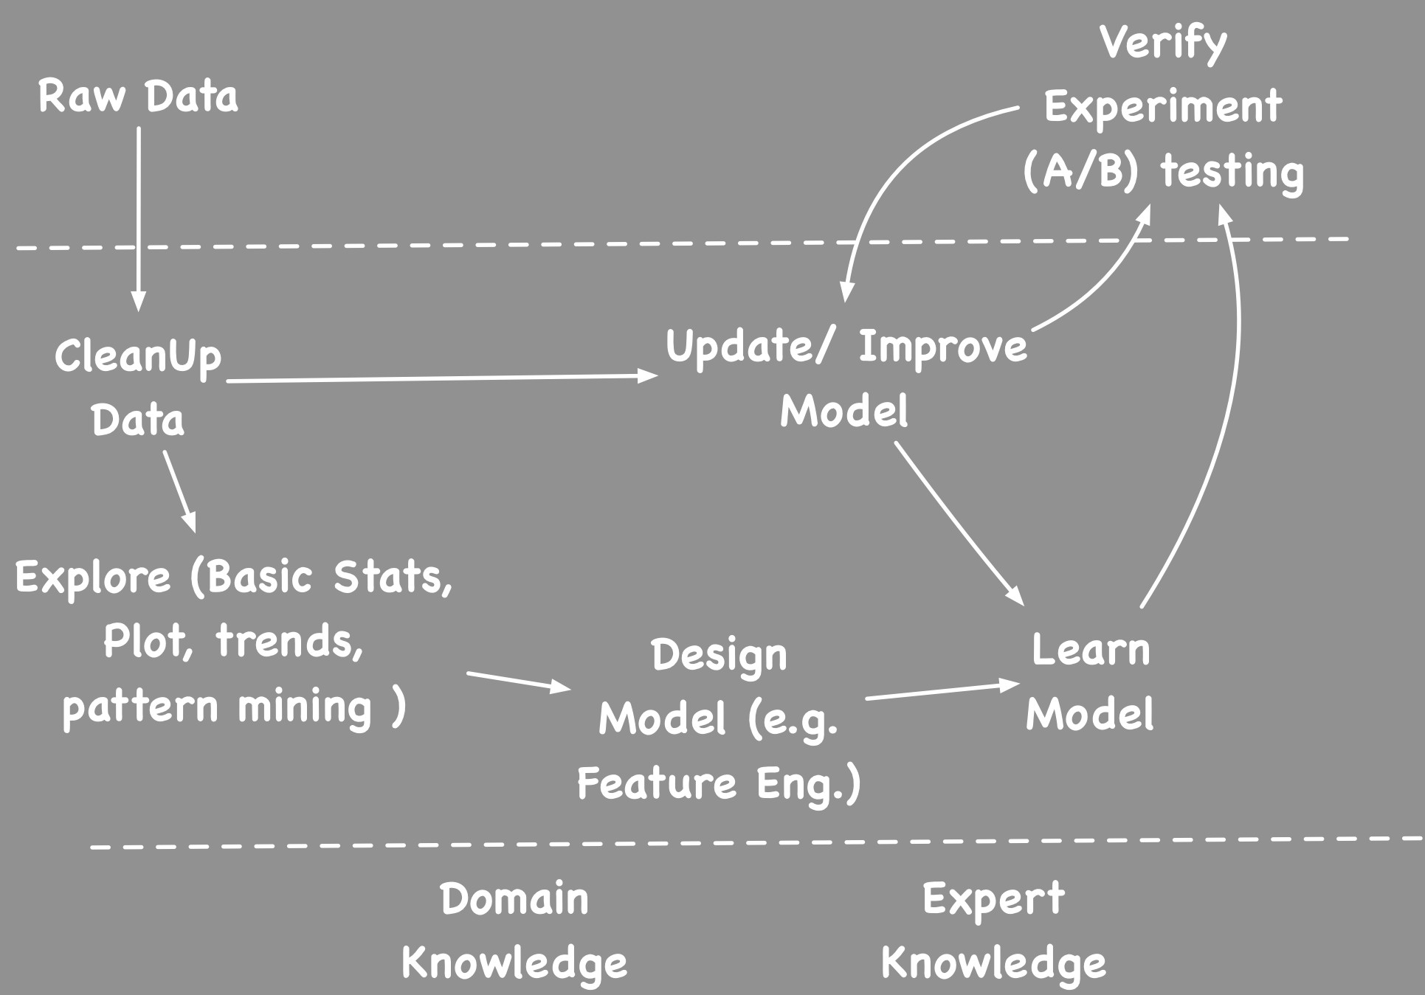
Data Science Pipeline
Extraction of knowledge from large volumes of data that are structured or unstructured.
It is a continuation of the fields data mining and predictive analytics

Slide 10
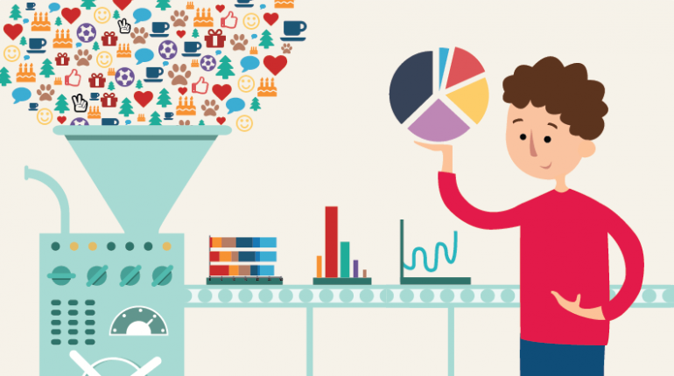
Data Cleaning
Real data is messay, often needs to cleaned up before useful.
Bad formats - ignore or treat like missing data
Missing Data - extrapolate or remove data line
Useless variables - remove
Wrong data - e.g. aaa, bbb, joe, some might be deliberate lie, or 99 may be a code for N/A

Slide 11
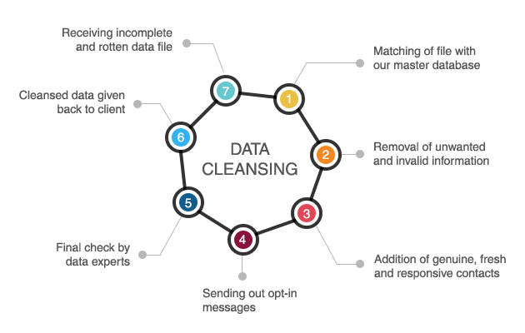
Data Cleaning
Transform variables ( date formats, String to int)
Create derived variables
Derive country from IP
age from ID card number
Normalize strings
e.g. stemm or use phonetic sounds
different spellings and nicknames ( William->Bill)
Feature value rescaling (e.g. most ML algorithms needs value to rescaled to 0-1 range).
Enrich (e.g. lookup and add age from profile)

Slide 12
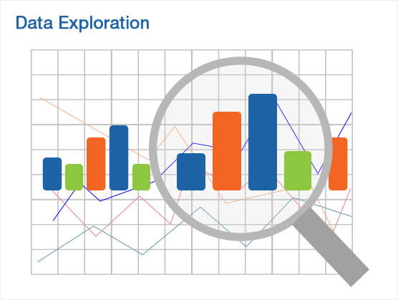
Data Exploration
Understand, and get a feel for what is expected (models => densities, constraints) and unexpected/ residuals (errors, outliers)
think what this is data about? domain, background,
how it is collected, what each fields mean and range of values.
head, tail, count, all descriptives (Mean, Max, median, percentiles .. ) - Five number Summary. Min. 1st Qu. Median Mean 3rd Qu. Max.
run a bunch of count/group-by statements to gauge if I think it's corrupt.

Slide 13
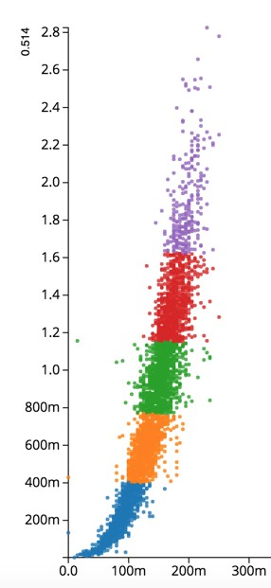
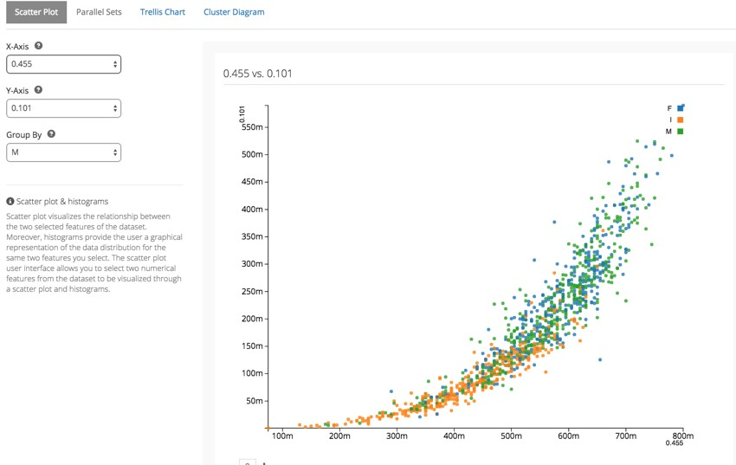
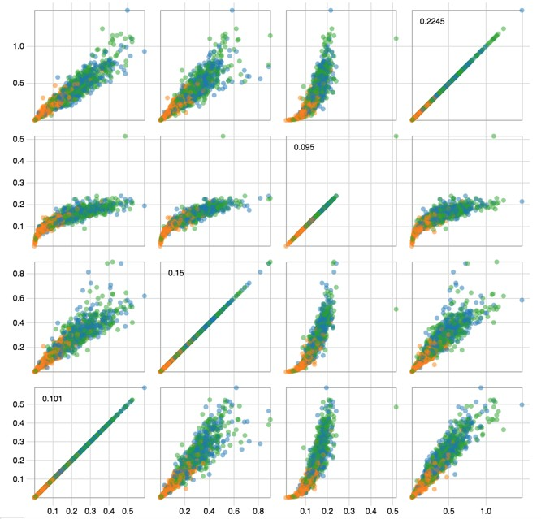
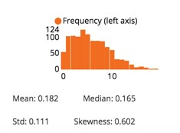
Data Exploration
Plot - take random sample and explore ( scatter plot)
e.g. Draw scatter plot or Trellis Plot
Find Dependencies between fields
Calculate Correlation
Dimensionality reduction
Cluster and look visualize clusters
Look at frequency distribution of each field and try to find a known distribution if possible.

Slide 14
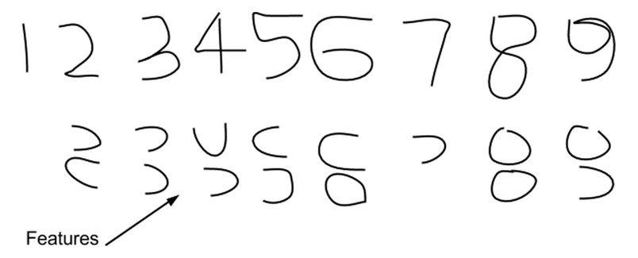
Feature Engineering
Feature engineering is the art of finding feature that leads simplest decision algorithm. ( Good features allow a simple model to beat a complex model.)
Best features may be a subset, or a combination, or transformed version of the features.
Manually pick by domain experts and trial and error.
Search the possible combinations by training and combining subsets (e.g. Random Forest)
Use statistical concepts like correlation and information criteria

Slide 15
Analysis
Goal of analysis is to extract knowledge
This knowledge usually come in one of the two forms
KPI (Key Performance Indicators)
Describe key measurement for what is being measured. (e.g. revenue per year, profit margin, revenue for sqft in retail, revenue per employer)
Models to describe or predict the data
e.g. Machine Learning models or Statistical models

Slide 16
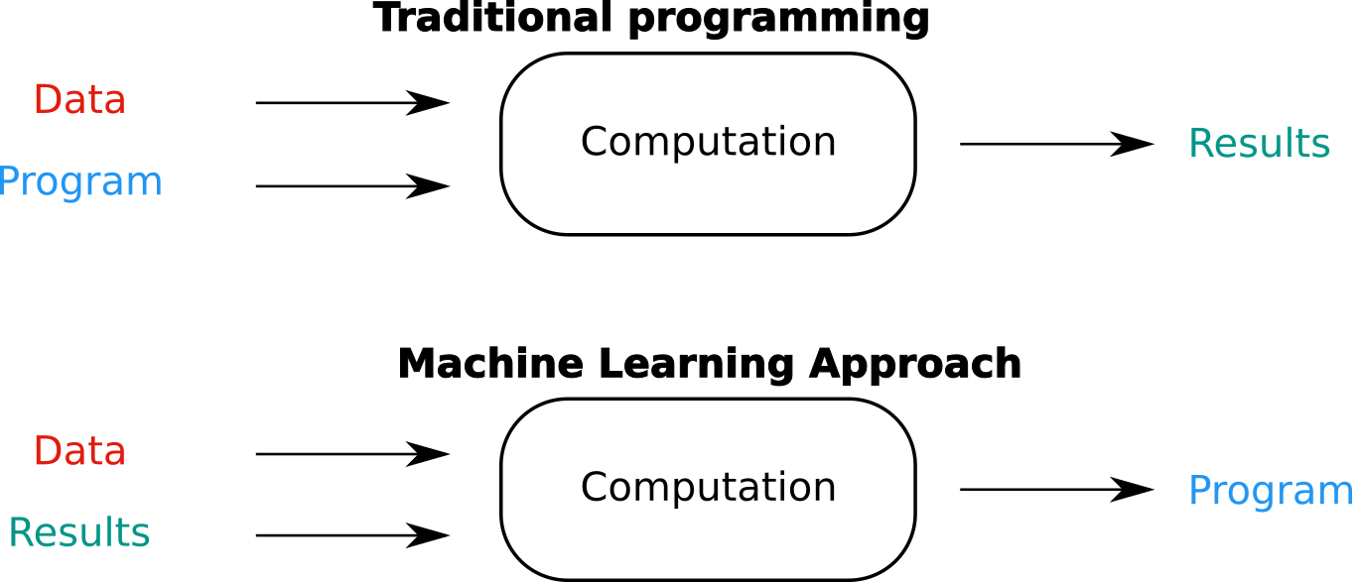
Machine Learning
Image credits: https://recast.ai/blog/machine-learning-algorithms/

Slide 17
Machine Learning
Blends ideas from statistics, computer science, operations research, pattern recognition, information theory, control theory and many other disciplines to design algorithms that find low-level patterns in data, make predictions and help make decisions (at scale).

Slide 18
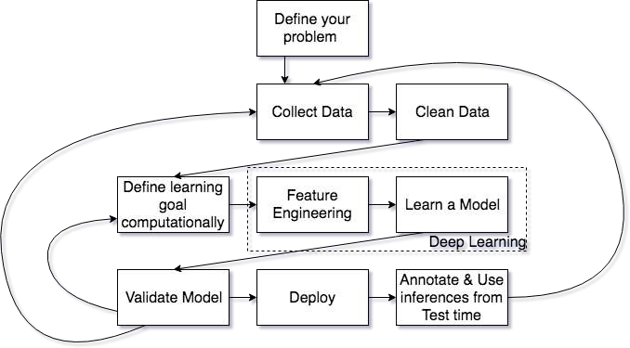
Typical Machine Learning Pipeline

Slide 19
➔Supervised Learning - some feedback is available
Common Taxonomy of ML methods
Completely Supervised Learning
Semi-Supervised Learning
Active learning
➔Reinforcement Learning
➔Unsupervised Learning - no explicit ground truths
➔Meta learning
➔...

Slide 20
Categories
Supervised Learning
Unsupervised Learning
Semi-Supervised Learning
Reinforcement Learning

Slide 21
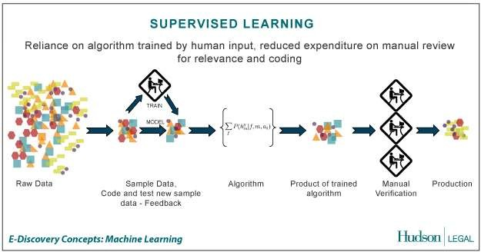
Supervised Learning
the correct classes of the training data are known
Credit: http://us.hudson.com/legal/blog/postid/513/predictive-analytics-artificial-intelligence-science-fiction-e-discovery-truth

Slide 22
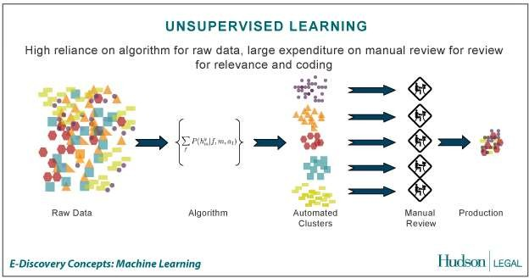
Unsupervised Learning
the correct classes of the training data are not known
Credit: http://us.hudson.com/legal/blog/postid/513/predictive-analytics-artificial-intelligence-science-fiction-e-discovery-truth

Slide 23
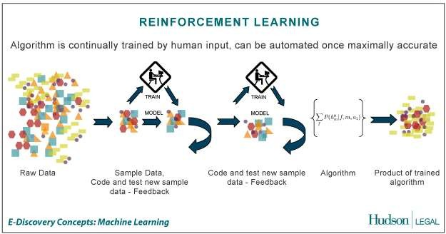
Reinforcement Learning
allows the machine or software agent to learn its behavior based on feedback from the environment.
This behavior can be learnt once and for all, or keep on adapting as time goes by.
Credit: http://us.hudson.com/legal/blog/postid/513/predictive-analytics-artificial-intelligence-science-fiction-e-discovery-truth

Slide 24
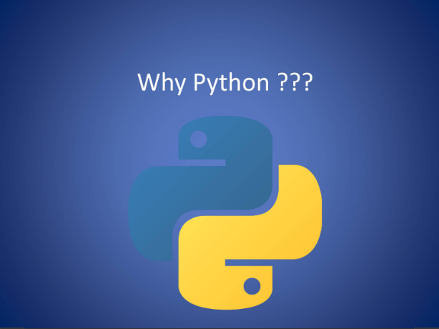
What is the need to use Python?

Slide 25
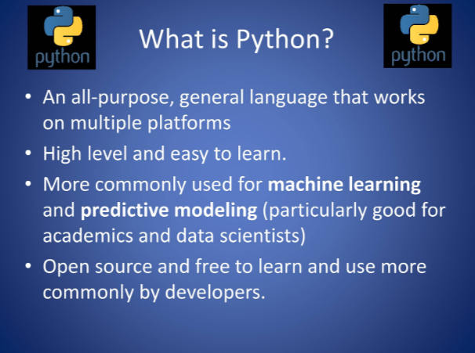
About Python

Slide 26
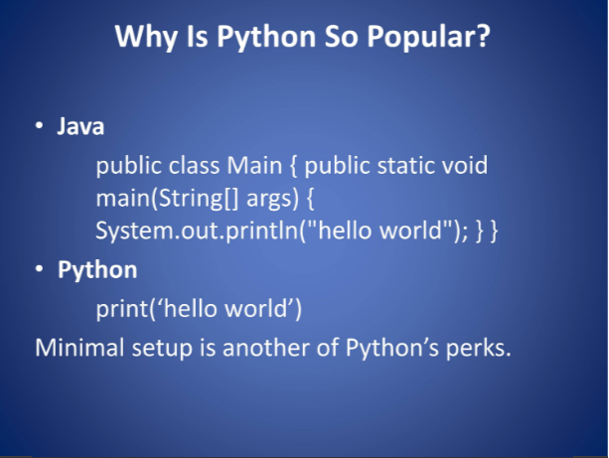
About Python

Slide 27
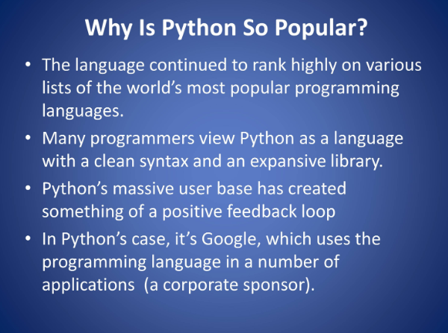
About Python

Slide 28
Connect with me:
Email: shivaylamba@gmail.com
Twitter: @howdevelop
github: @shivaylamba
linkedin: @shivaylamba

