Slide 1
Idea/Approach Details Ministry/Organization Name - Bajaj Fin Serv Problem Statement - Voice Prescription Team Name - Error_404 Team Leader Name - Parth Arora College Code - 1-3688291314

Slide 2
Idea / Approach details
Idea/Solution: Our application is a platform that provides the following features for a doctor:
Speech Recognition- The application aims to transcribe a conversation between a doctor and patient and upload key portions of it into a medical record using the Web Speech API.
Notifications - It would send the reminders to the patients regarding their regular checkups.
Automation- The app automatically creates a prescription and sends it to the patient via an email or an SMS. The adoption of such a voice-based application will help eliminate the errors as the prescription is created through voice commands rather than manual handwriting which may create confusion.
Previous prescription- The doctor can preview the previous medical history of any patient if required.
Auto order- The app also provides the facility to place an order of the medicines prescribed automatically which the users can either accept or decline.
Technology Stack:
Tells a browser how to display web content
Styles the content
Makes web pages interactive
Python web application framework for backend
Helpful framework for managing HTML and CSS
Used for developing android applications built on IntelliJ IDEA software

Slide 3
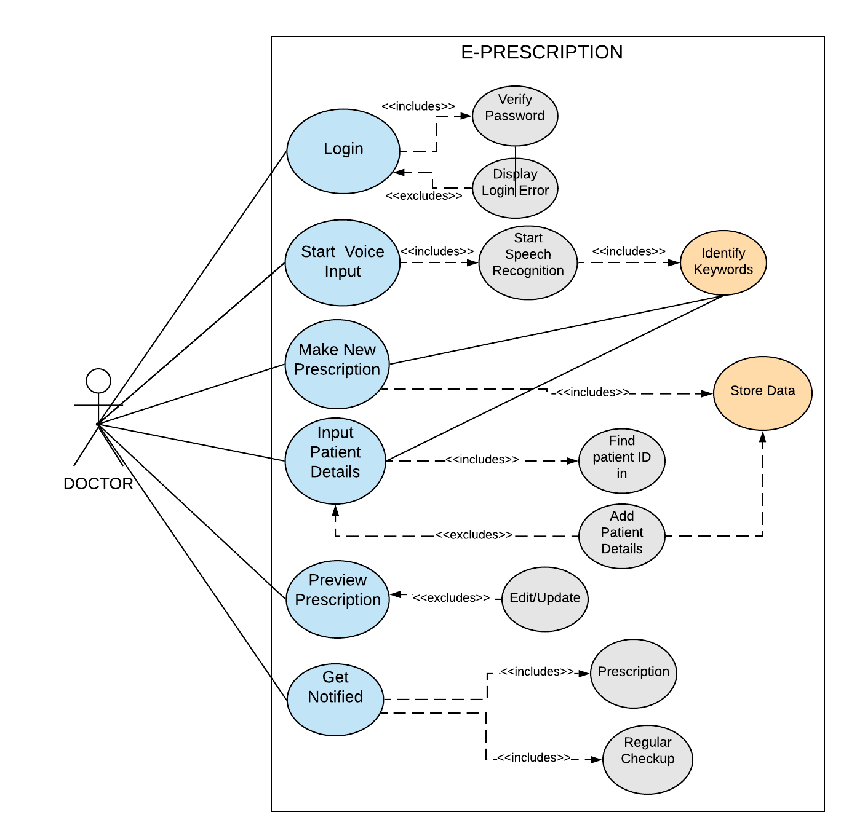
USE CASES:

Slide 4
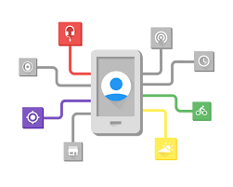
Idea / Approach details
Dependencies
Google APIs
Use:
This is used for speech to text conversion
Preference over other options:
Automation
Custom experience to user
Good efficiency
Personalization
Show Stopper
The possible unforeseen issues that could be detrimental to the users are:
Diverse voice patterns/accents of humans hence the doctor might need to adjust by slowing down or being more precise.
Even a simple cold can be a reason for difficulty in recognizing voice commands.
While systems are getting better, there is still a big difference in their ability to understand American or Scottish English.

