Slide 1

Statistics - Grade XI
Presenters:
Abhishek Basnet,
Anubhav Karn,
Bigyan Panthi
Creater: Kartika Nidhi

Slide 2
Structure of the Presentation
01
02
03
04
05
Statistics
Data and Visualization
Central Tendency
Introduction, History
And Application
Types of Data and Presentation of Data
Mean, Median and Mode
Dispersion
Assymmetry of Distribution
Standard Deviation, Variance and Variation
Skewness

Slide 3
Introduction to Statistics
01
Definition, History and Application

Slide 4
The word Statistics is originated from the Latin word ‘status’ which means a political state or government.
Originally it started as a tool for rulers and politicians to keep track of their people and taxes, eventually evolving into the rigrous mathematical science we use today to analyze and predict anything.
Although, the modern term for statistics was coined from German word ‘Statistik’.

Slide 5
Statistics is the branch of mathematics that deals with the collection, organization, analysis, interpretation, and presentation of data.
It is widely used in fields like science, business, finance, medicine, Enginerring and social sciences.
There are two main branches of statistics:
Descriptive Statistics: Organizes and summarizes data (mean, median, std, charts, etc.)
Inferential Statistics: Uses sample data to make predictions or conclusions.
This presentation is focused on Descriptive Statistics.

Slide 6
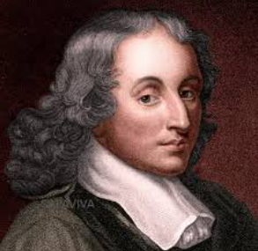
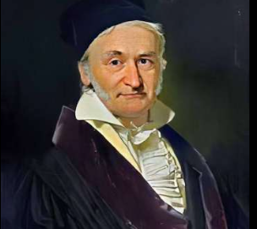
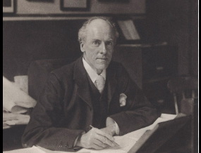

Blaise Pascal (1623-1662)
Probability Theory
Statistical Reasoning
Carl Friedrich Gauss(1777-1855)
Normal Distribution(Bell Curve)
Karl Pearson (1857-1936)
Modern Mathematical
Statistics
Correlation
Sir Ronald Fisher(1890-1962)
Father of Modern Statistics
Experimental
Design

Slide 7
1️⃣ Decision Making
Used to make informed decisions in business, government, daily life etc.
2️⃣ Data Analysis and Interpretation
Helps in summarizing large amounts of data into meaningful information (averages, percentages, graphs).
3️⃣ Planning and Forecasting
Used to predict future trends like population growth, sales, and weather conditions.
4️⃣ Research and Development
Helps scientists and researchers test hypotheses and draw conclusions.
5️⃣Performance Evaluation
Used to measure performance in education, sports, health, and industries.

Slide 8
Data And Visualization
02
Types and Presentation of Data

Slide 9
Types of Data
Quantitative
Includes Numerical Data
Eg: Sales in month
Qualitative
Includes Descriptive or Categorical Data
Eg: Brands of car
Discrete
Includes countable values
Eg: Number of cars
Continuous
Includes measurable values
Eg: Height of students

Slide 10
Representation of data
Tables
Bar
Pie
Used for comparison of large datasets
Used when comparing different categories of discrete data
Used to show percentage in comparison to whole
Line
Scatter
Histogram
Used for comparing two distributions and shapes
Used for continuous data and frequency distribution
Used for showing trends with time

Slide 11
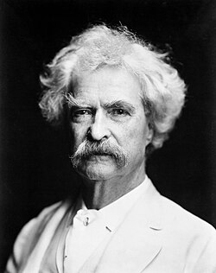
—Mark Twain
“There are three kinds of lies: lies, damned lies, and statistics.”
“झूटका तीन प्रकार हुन्छन्: झूट, घोर झूट, र तथ्याङ्क।”

Slide 12
Measure of Central Tendency
03
Concept of Mean, Median and Mode

Slide 13
Central Tendency and Central Value
“Measures of Central Tendency “are the statistical methods used to calculate the single value that attempts to describes/summarizes whole set of data by indetifying the central, middle, or most typical value within that set of data.
“Central Value” is a informal term that refers to any value that sits in the middle of a dataset.
The single central value obtained through measures of central tendency might not be same as central value but, generally/informally both terms are interchangeable.
“Mean, Median, Mode and Quartile” are all valid measures of central tendency, but under different conditions and composition of data.

Slide 14
Mean/Average
The mean is the most popular and well known measure of central tendency.
Mathematically, mean is equal to the sum of all the values in the data set divided by the number of values in the data set.
When to use Mean to calculate Central Tendency ?
Data is normally/uniformally distributed.
No outliers values (Outliers are extreme or atypical values that are notably different from rest of the data). Means are sensitive to outliers.
Data can be discrete or continuous but, not categorical.
The value of mean should remain least affected when removing one or few values from the dataset. Such mean is called good mean.

Slide 15
Median
The median is the middle/central value in distribution that divides distribution in half when the values are arranged in order(ascending or descending).
When to use Median to calculate Central Tendency ?
Data is skewed/asymmetrically distributed.
Outliers values (Outliers are extreme or atypical values that are notably different from rest of the data). Mdeian is less sensitive to outliers.
Data can be discrete or continuous but, not categorical.

Slide 16
Mode
The mode is the most commonly occurring value in a distribution.
When to use Mode to calculate Central Tendency ?
Data has few values that are occurring frequently.
Data can be discrete or continuous and even categorical.
But, mostly used for categorical and less used for continous data. As continuous data can have more than one mode.
It is less used when the mode value is itself an outlier.

Slide 17
Measure of Dispersion
04
Concept of Standard Deviation, Variation and Variance

Slide 18
Measures of Dispersion
“Measures of Dispersion “are the statistical methods used to calculate the single non-negative value that measures the variation or spread out or scattering of data in the distribution about a central value.
It explains how homogeneous/consistent or heterogeneous/inconsistent the data is.
There are two types of measure of dispersion.
Absolute Measure: Range, Variance, Standard Deviation and Mean Deviation are absolute measure of dispersion. These measures have same unit as of dataset.
Relative Measure: Coefficient of Range, Coefficient of Variation, Coefficient of Mean or Quartile Deviation are relative measure of dispersion. These measures are independent of unit of data and are expresssed in ratio or percentage.

Slide 19
What is consistent data ?
In statistics, consistent data means the data values are not highly scattered and follow a stable pattern, so teh observations are close to each other. This is usually indicated by low dispersion( low variance or standard deviation).
Why do we need consistent data ?
Consistent data allows accurate measurement of central values like mean, median and mode.
Consistent data helps to make more accurate predictions(inferrential statistics).
Consistent data often indicates that process or system is stable and controlled.
This stable and less certain characteristic of consistent data helps in decision making.

Slide 20
Standard Deviation
Standard deviation is defined as positive square root of the arithmetic mean of the squares of the deviations of the given observations from their arithmetic mean.
It measures the average distance of observations from the mean/central value.
What does standard deviation tell?
It tells about the variability/consistency of data.
If the value of SD is less, it implies the data is close to the central value. Hence less variable and more consistent.
If the value of SD is large, it implies the data is widely spread. Hence more variable and less consistent.

Slide 21
Variance
Variance is the average of the squared deviations of observations from the mean.
The square helps to give greater weight to larger deviations. Since larger deviations make the value of SD very small.
When does variance tell ?
It also explains the consistency of data.
It mostly explains the consistency of wide spreadout data and data with extreme values.

Slide 22
Coefficient of Standard Deviation
The coefficient of standard deviation is the ratio of standard deviation to the mean.
So, it describes the variability/spreadout of observations about mean in the dataset.
Coefficient of Variation(CV)
Coefficient of variation is the percentage form of coefficient of SD.
These both measures are relative measures and hence independent ot unit of dataset.
So they are mostly used to measure and explain the variabiliy/consistency of datasets with different units.
Although, relative measures are also calculated using absolute measures of dispersion. These measures can give us more meaningful insights which cannot be given by absolute measures.

Slide 23
Measure of Shape
05
Concept of Skewness and Symmetry of Data

Slide 24
Measures of Skewness
Skewness is the degree of asymmetry observed in a set of data, when the mean, median and mode falls at different position in the frequency distribution due to outliers. It tells the accumulation/clustering of data around the central value.
A frequency distribution is said to be symmetrical/zero-skewed if the frequencies are equally distributed on both the sides of the central value on the curve. It gives bell-shaped curve.
A distribution is said to be positively skewed when most of the frequencies are located on the left of the central value.
A distribution is said to be negatively skewed when most of the frequencies are lcoated on the right of the central value.

Slide 25
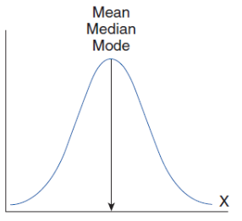
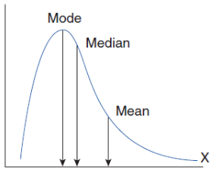
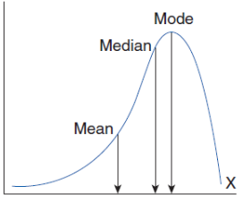
Positively Skewed
Skewness > 0
Mean > Median > Mode
Negatively Skewed
Skewness < 0
Mean < Median < Mode
Normal Distribution
Skewness = 0
Mean = Median = Mode
Although skewed data can be determined from the frequency distribution curve, the magnitude/extent of skewness is calculated by Karl Pearson’s Coefficient of Skewness.
Karl’s Pearson’s coefficient of skewness lies between -3 and 3.

Slide 26
What do we need to measure skewness?
It gives more clear picture of the overall data compared to central tendency value.
It also helps in studying the position of mean, median and mode.
Helps in detecting outliers and extreme values.
It also shows if observed valued are all concentrated at particular range.
For example: The skewness of income of employee of company is positively skewed, it implies that few of the employees earn higher compared to all other employees.

Slide 27
Thanks!
You are welcome to throw questions.
Anyone ?

