Slide 1
CIRCUIT-X
KRITI 2019
DIHING HOSTEL
PRESENTED BY –
KARTIKAEYA KUMAR
ANIMESH RENANSE
SANSKAR KUMAR

Slide 2
Identification of type and number of gates in the circuit.
Open cv Library used –
cv2.matchtemplate
Stored the number and type of gate in a variable and stored this variable along with the coordinates of the gate in a matrix called gate1.
Note -
Used similar approach to find start and end points of the whole circuit

Slide 3
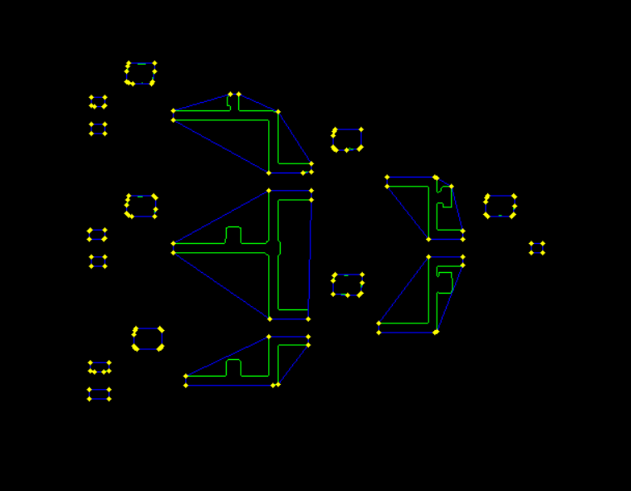
Marking the start and the endpoints of the wire connecting the gates
Intermediate wire detection –
Created mask, and then performed dilation on hsv image of circuit
End point detection –
First plotted contours on the dilated image using cv2.findcontours .
Extracted possible end points by drawing convex hull on the contour image by using cv2.convexHull function.

Slide 4
Algorithm used to find end points
Iterated through all the convex hulls returned by cv2.convexHull . At each point of a given contour , checked whether the point 10 pixels to the left or right of that point lies inside the rectangular region of a gate, using the coordinates retrieved from the matrix gate1. If found true, then the point is appended to a list.
Plotted the points in the list on the image to mark the endpoints of intermediate wires.

Slide 5
Algorithm used to deduce the structure of the circuit
On a given contour retrieved the endpoints and checked for which gate do they lie next to using the gate1 matrix . Thus deducing the interconnection between two gate. The structure of the whole circuit was stored in a numpy array called structure and was passed into the truth table generator function.

Slide 6
Algorithm used for the truth table generator function
Find Positions where input is present
Then find unique Initial Positions
Then from step 2, create all possible inputs
Put the corresponding inputs in the input columns of the initial inputs
Forward Pass over the matrix with the input as the current boolean states of each physical input
Initial Evaluation directly from input
INITIALIZE THE INPUT FOR THE NOT GATES
Initiate an Infinite While Loop:
PUT OUTPUT TO NEXT INPUTS
SIMILARILY, UPDATE THE input_loc BOOL TABLE
For long term memory, initiate a 'cache’
Check loop breaking condition, which is if the output 111 (Yellow) is reached
If not, then calculate next outputs
At this point, we have an output for the corresponding input.
Display the output

Slide 7
Thank You!!

