Slide 1
Capstone Project
Global Terrorism Analysis

Slide 2

Lets Stop The Terrorist Activities
Understanding problem statement
Understanding significant features of the data
Working on the Data Sanity
Taking out the best possible analysis
Making the results beneficial for a purpose
Presenting the best visualization of results

Slide 3
What is the actual data ?
So data is basically about the terrorist activities that are happening all around the world and the database contains all the vital information like what are the targets, who are the attackers, how frequent they attack, what weapons they use, what are their targets, reasons, demands an so on.
So we try to fund out the best possible information out of all the available columns so that we can make some constructive decisions that what needs to be done to put an end or control over such activities by following the pattern of bad elements and their activities

Slide 4
Significant features/columns :
Only relevant columns that will help us arrive at some conclusion have been kept and rest all are dropped with least significant relevance. Below are the selected columns:
'eventid', 'iyear', 'imonth', 'iday', 'country_txt', 'region_txt', 'provstate', 'city', 'latitude', 'longitude', 'attacktype1_txt', 'targtype1_txt', 'targsubtype1_txt', 'natlty1_txt', 'gname', 'weaptype1_txt', 'success', 'ransom', 'ransomamt', 'motive', 'month

Slide 5
Data Analysis Steps
Data Sanity : We made sure that there is not bad data present like null values or empty cells that can cause a bias or sound in our analysis.
Feature Selection : We chose the best relevant columns from the data that will help us provide with the ease of analysis without an interference of irrelevant data.
Data Deep Dive : We tried to understand the data more closely by knowing their size, data types and type on information they are storing
Data Analysis : We analysed the data with the best available methods and attributes to reach to a point where the resulted data makes sense to an individual
Data Visualization : We used good visuals to present the data to make it more easy for viewer to understand its significance

Slide 6
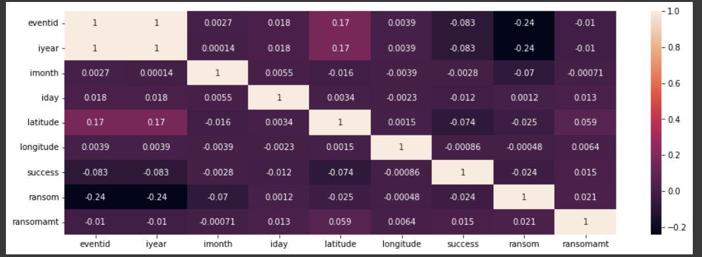
Finding correlation between the variables
Heatmap is the best possible way to understand the correlation and covariance of the features so that we can know ho closely some variables can help us reach a conclusion

Slide 7
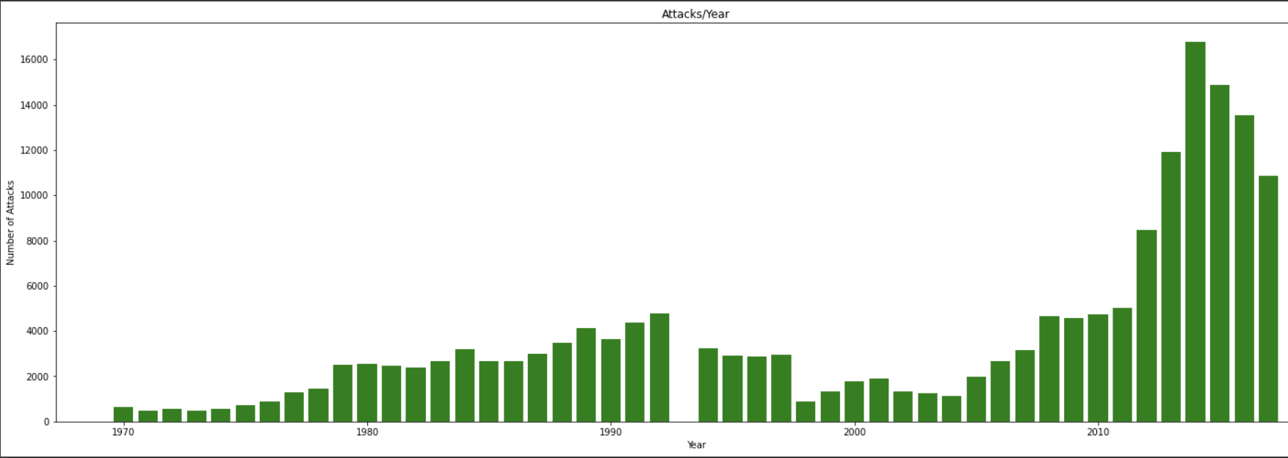
Checking the number of attacks per year

Slide 8
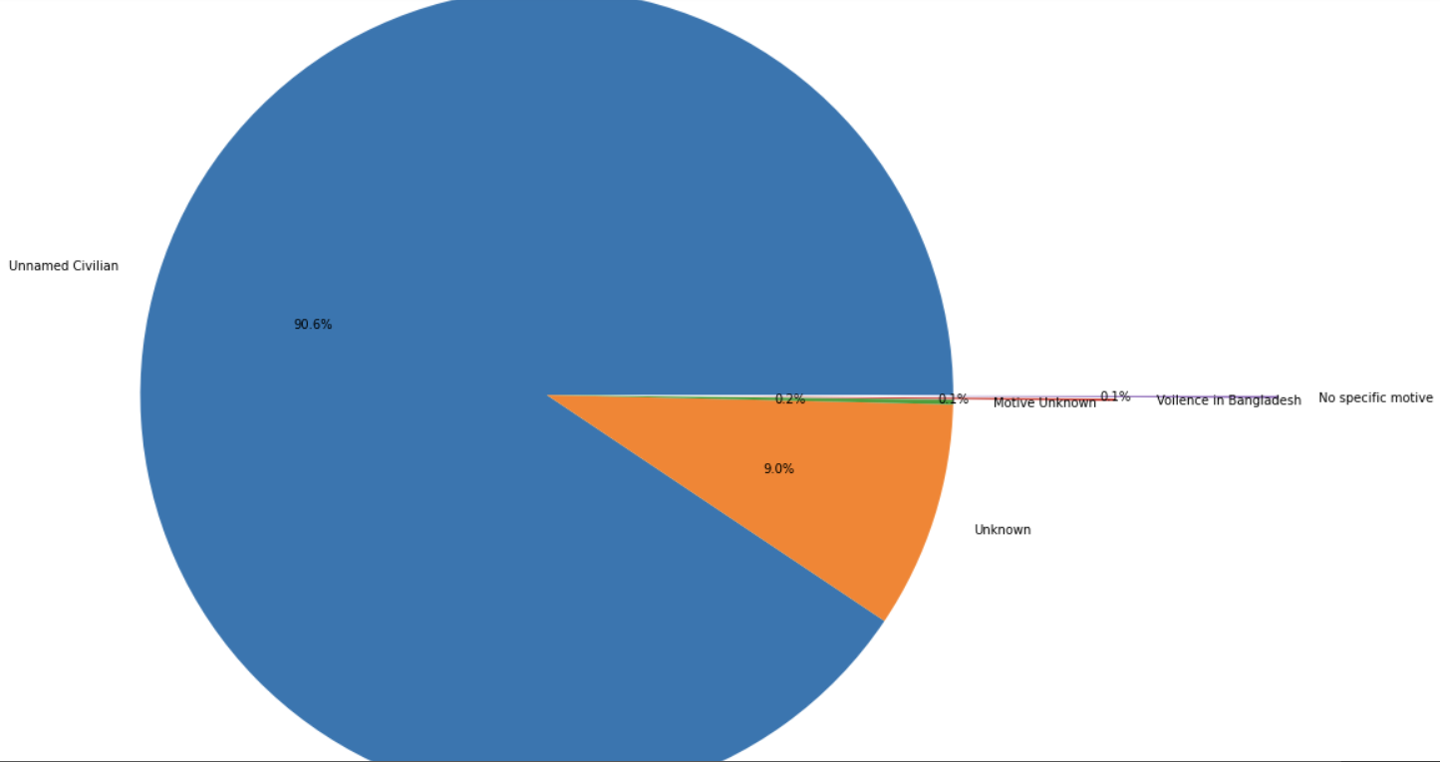
Checking the reason of attacks

Slide 9
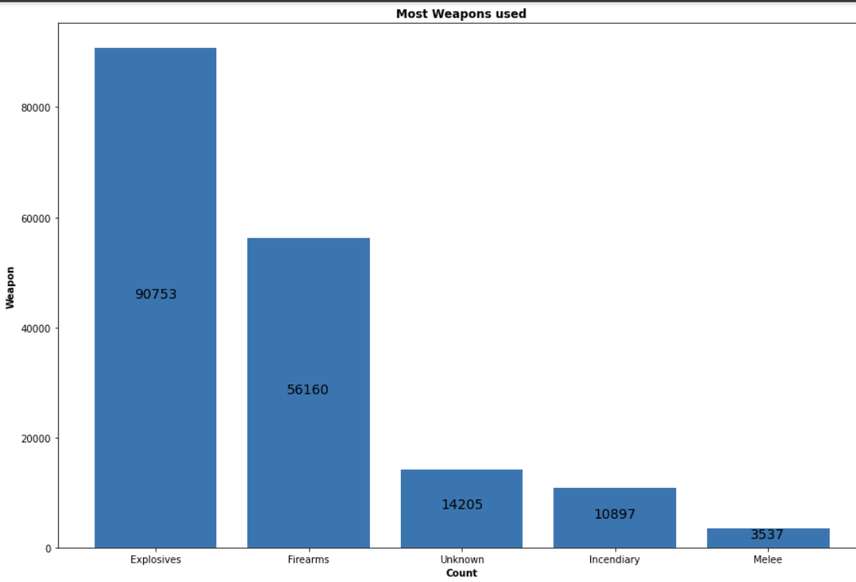
Top 5 weapons used for the attacks

Slide 10
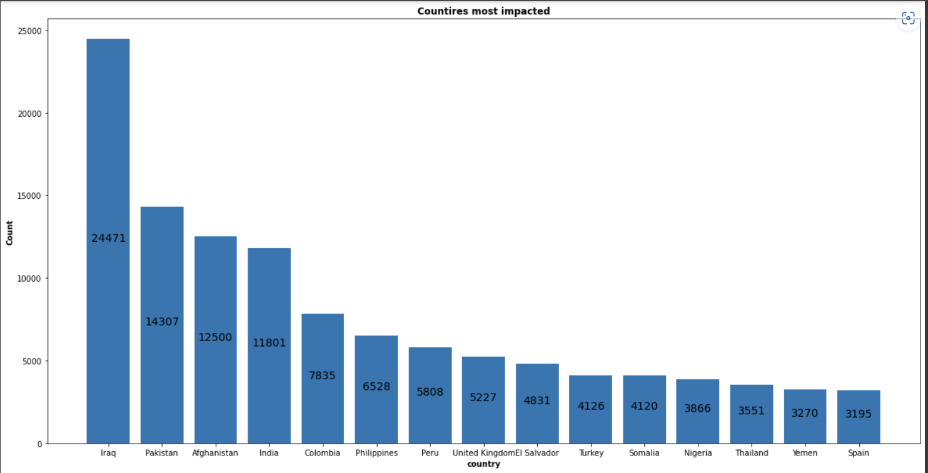
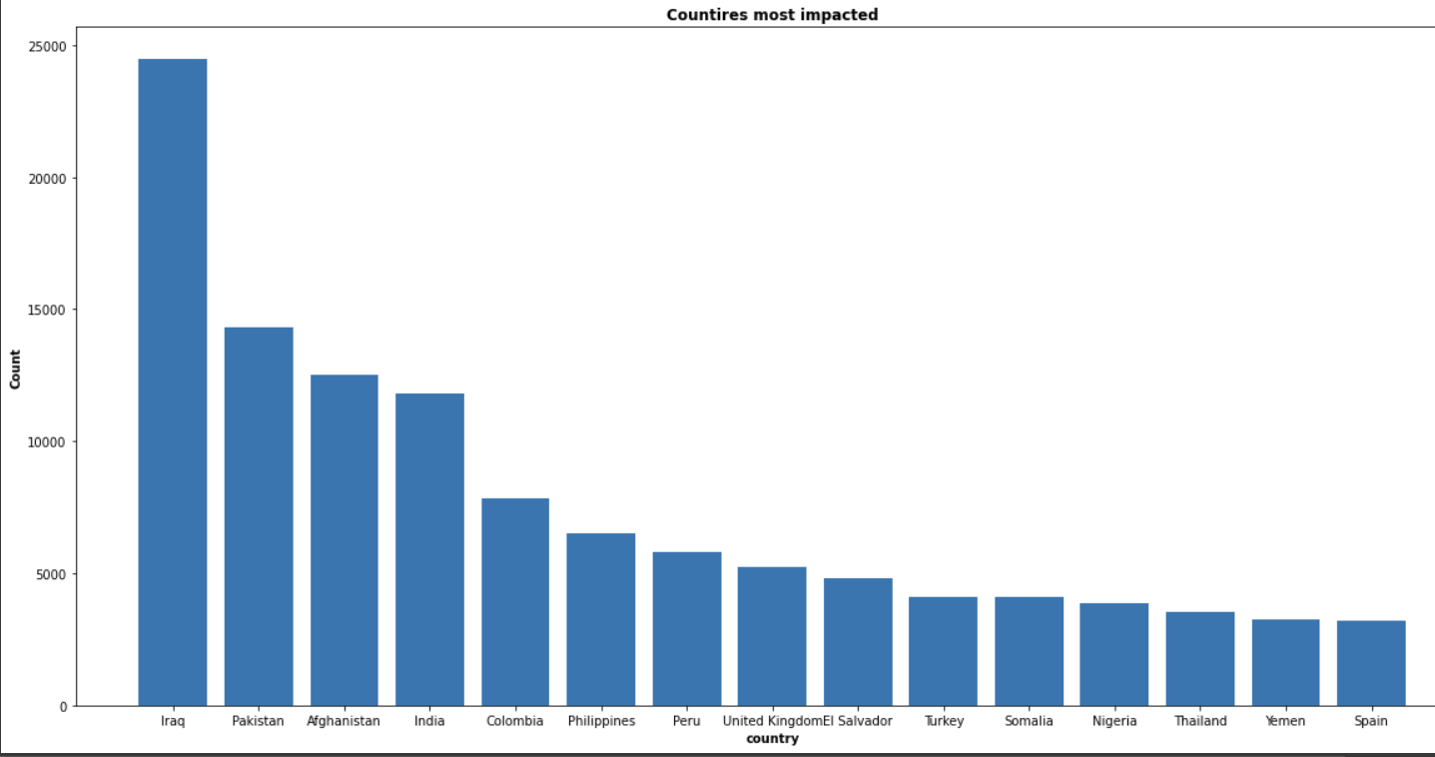
Countries impacted the most by terrorism

Slide 11
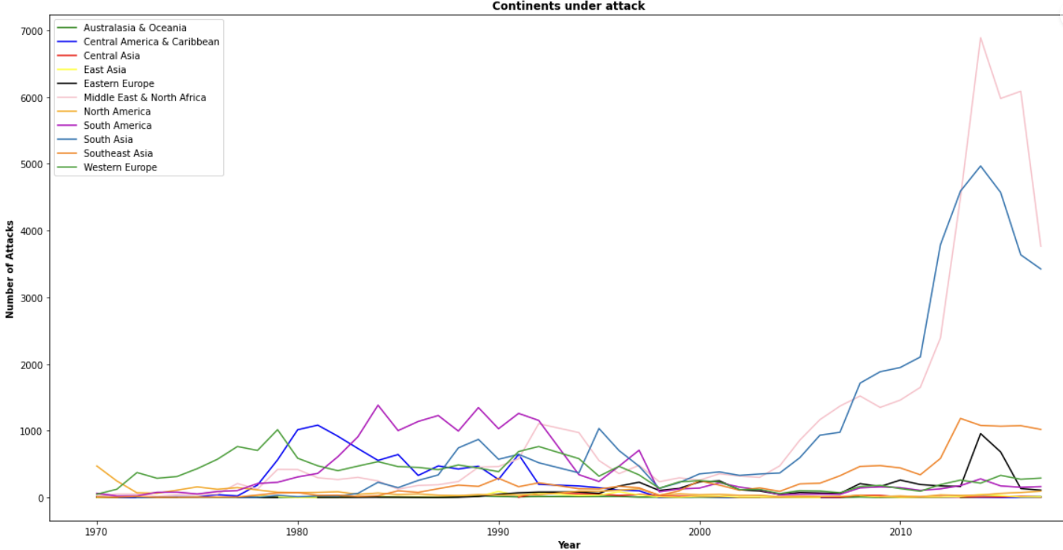
Attacks in the continents per year

Slide 12
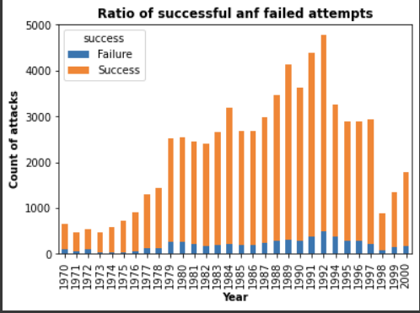
Failed and Successful attacks per year

Slide 13
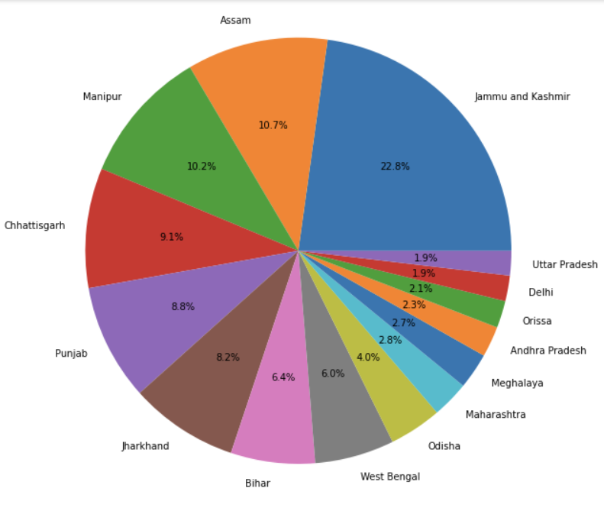
Maximum attacks in India state wise

Slide 14
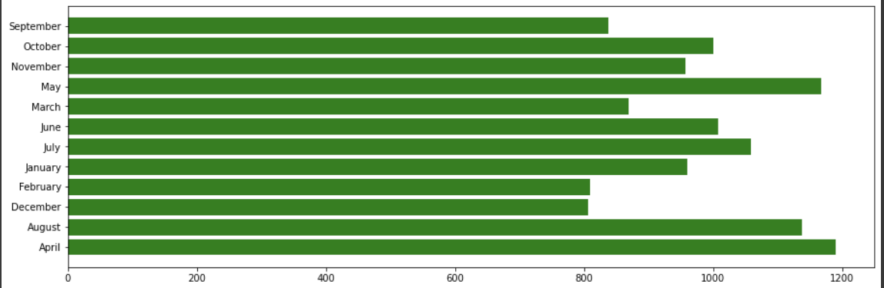
Which month India faced most attacks

Slide 15
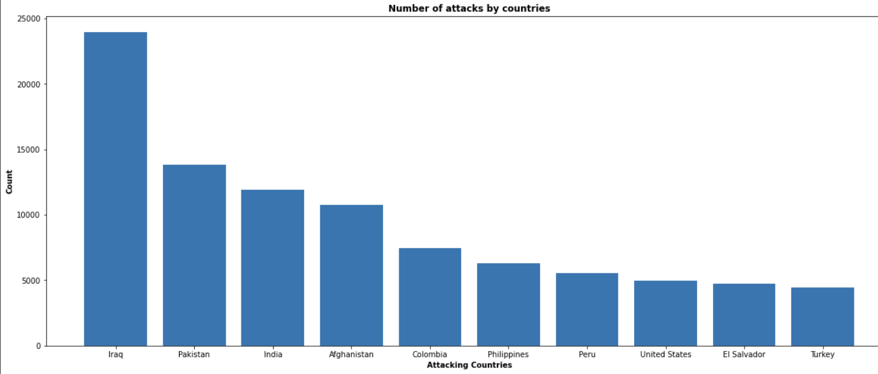
Top10 nationalities who attack the most
Which

Slide 16
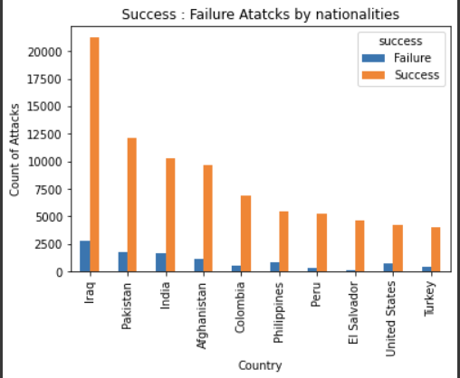
Successful/unsuccessful per nationalities

Slide 17
Conclusion
1.Asian countries has been most prominent in the attacks and creating terror activities especially Pakistan, Afghanistan.
2.Western countries have been impacted most by these attacks and suffered casualties
3. Most of the prominent reasons of the attack have been Political and Regional differences
4.When comes to the weapons then the explosives have been the most lethal and commonly used in all attacks
5. When it comes to highest success attack ratio then countries like Iraq, Afghanistan, Pakistan has been active because of being influenced by terrorist groups
6. When it comes to India then August, April and May have been the months seeing most number of attacks
7. States close to the border of other countries like Jammu and Kashmir, Assam, Manipur have been suffering the most in contrast to other states
8. Asia as a continent on a whole has suffered the most in terms of terrorist activities as they have increased exponentially year by year
Analyst
Kartikay Kaushal

Slide 18
Challenges
1. Making sure that no important feature is missed during the analysis that can make the results less impactful
2. Doing the data sanity in a way that it does not impact the actual data and its effectiveness during the analysis
3. Choosing the best visualization method for presenting the results in away that any layman can understand it

Slide 19
Q & A

