Slide 1
Kartikay_Gupta_602_Final
File created on: 12/3/24 1:31:07 AM EST

Slide 2

College Donations Analysis (Cover Page)
Name: Kartikay Gupta Spire Id: 34038896
EmailId: kartikaygupt@umass.edu
Date: 12/3/2024
Tools Used: Tableau(for analysis)

Slide 3
College Donations Analysis (Introduction)
Objective:
Provide a detailed analysis of donation patterns to help the advisory board understand key trends and insights.
Offer recommendations based on findings to enhance future fundraising strategies.
Data Overview:
The dataset includes records of donations with details such as donor information, donation amounts, geographic locations, college types, academic majors, and graduation years. This data has been processed and visualized using Tableau for enhanced interpretation. Did not changed any data used both sheets in a single workbook provided by professor.
Scope of Analysis: The analysis focuses on:
Geographic distribution of donations by state.
Contributions by college types and academic majors.
Donation trends over the years.
Identifying top-performing colleges and academic majors in terms of donation amounts.
Purpose:
To provide actionable insights to strengthen donor engagement, optimize fundraising initiatives, and identify areas of success and growth potential.
Visualization Approach:
Interactive and visually appealing visualizations, including pie charts, bar charts, line charts, bubble charts, and waterfall charts, have been created in Tableau to address the board's specific questions and priorities.

Slide 4
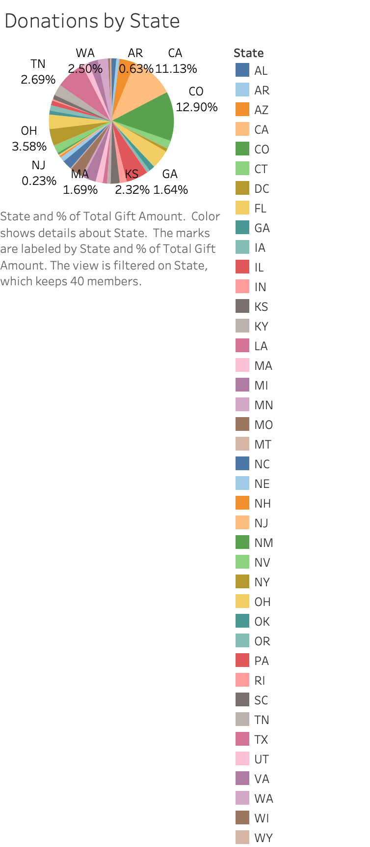
Donation by state (pie chart)

Slide 5
Donation by state (pie chart) Analysis
Chart Overview:
This pie chart illustrates the percentage distribution of donations across various states.
Each segment represents a specific state's contribution to the overall donation total.
The chart includes filters for more focused exploration.
Filters Applied:
State: Used to view donations by individual states or regions.
Key Insights:
Leading Contributors:
Colorado (12.90%) and California (11.13%) contribute the largest shares, collectively accounting for nearly 24% of total donations.Colorado’s higher contributions might be due to a particularly engaged alumni network or successful local outreach programs.
Montana’s lower contributions may be influenced by lower population density, limiting engagement opportunities.
Geographic Patterns:
Western states, particularly California and Colorado, show the highest donation levels.
Southern states have relatively lower contributions despite a significant presence of colleges.
Discussion Points:
Regional Engagement Patterns:
High contributions from California and Colorado indicate robust alumni networks and effective fundraising campaigns.
Lower-performing states may lack the same level of alumni engagement or outreach programs.
Geographic Influence:
Donations are concentrated in more affluent states, likely driven by donor demographics and economic factors.

Slide 6
Donation by state (pie chart) Analysis Continued
Recommendations for the Advisory Board:
Target Lower-Contributing States:
Initiate alumni engagement programs and tailored campaigns in states like Arkansas, New Jersey, and Tennessee to boost contributions.
Launch state-specific campaigns that emphasize the positive impact of donations.
Strengthen Efforts in High-Contributing States:
Organize donor recognition programs and appreciation events in Colorado and California to maintain and grow support.
Expand Regional Reach:
Focus outreach efforts on untapped areas in the South and Midwest.
Share success stories and outcomes to inspire contributions from new regions.
Data-Driven Actions:
Analyze donation barriers in low-contributing states and implement region-specific strategies to address challenges and optimize engagement.

Slide 7
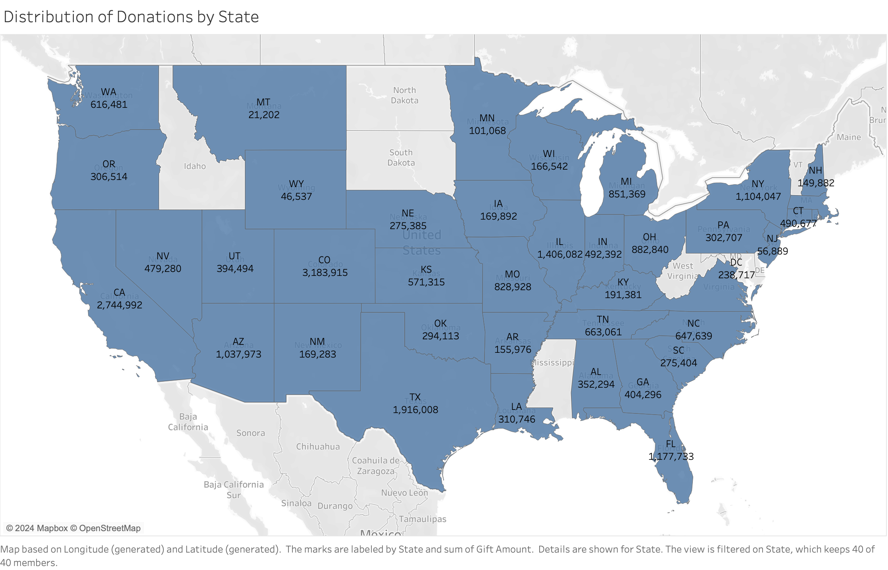
Donation by state (map chart) Analysis

Slide 8
Donation by state (map chart) Analysis
Chart Overview:
This map chart visualizes the distribution of donation amounts across various states in the U.S.
States are shaded in proportion to the total donation amount received, with darker shades representing higher donations.
Tooltip displays the state name and the corresponding donation amount when hovered over.
Filters Applied:
State Filter: Allows toggling between specific states or viewing all states' contributions.
Key Insights:
Top-Contributing States:
Colorado (CO) leads with a significant donation total of $3,183,915.
California (CA) and Texas (TX) follow with contributions of $2,744,992 and $1,916,008, respectively.
Low-Contributing States:
Montana (MT) has the lowest contribution of $21,202, followed by Wyoming (WY) with $46,537.
Regional Trends:
High contributions are concentrated in larger and more populated states like California, Texas, and New York (NY).
The Midwest and Mountain regions generally show lower donation totals.

Slide 9
Donation by state (map chart) Analysis
Discussion Points:
There appears to be a positive correlation between the population size and donation totals, but some smaller states (e.g., Colorado) outperform this expectation.
Potential socioeconomic or institutional factors could explain why states like Colorado have disproportionately high donations compared to neighboring states.
Colorado’s annual alumni fundraiser in 2020 raised an additional $500,000 due to targeted outreach, which can serve as a best practice for other regions.

Slide 10
Donation by state (map chart) Analysis
Recommendations for the Advisory Board:
Expand Fundraising Efforts in Top-Contributing States:
Focus resources on states like Colorado, California, and Texas, where donation rates are consistently high.
Build on existing alumni networks and prioritize outreach in these areas.
Investigate Low-Contribution Regions:
Conduct surveys or focus groups in states like Montana and Wyoming to identify barriers to giving.
Develop strategies (e.g., virtual engagement events or targeted campaigns) to improve contributions from these regions.
Leverage Regional Success Stories:
Highlight successful fundraising campaigns or alumni impact stories from states like Colorado to inspire contributions in lower-performing states.
Analyze Donor Profiles by Region:
Assess whether donor demographics or preferences differ significantly by state to tailor marketing and engagement strategies accordingly.
Data-Driven Actions:
Use geographic and demographic segmentation to design state-specific donation campaigns.
Partner with local institutions or organizations in low-contributing states to increase visibility and build trust.
Optimize resource allocation by prioritizing high-performing states while experimenting with growth strategies in underperforming regions.

Slide 11
Q2(The distribution of donations by the type of colleges) BEGINS FROM NEXT SLIDE

Slide 12
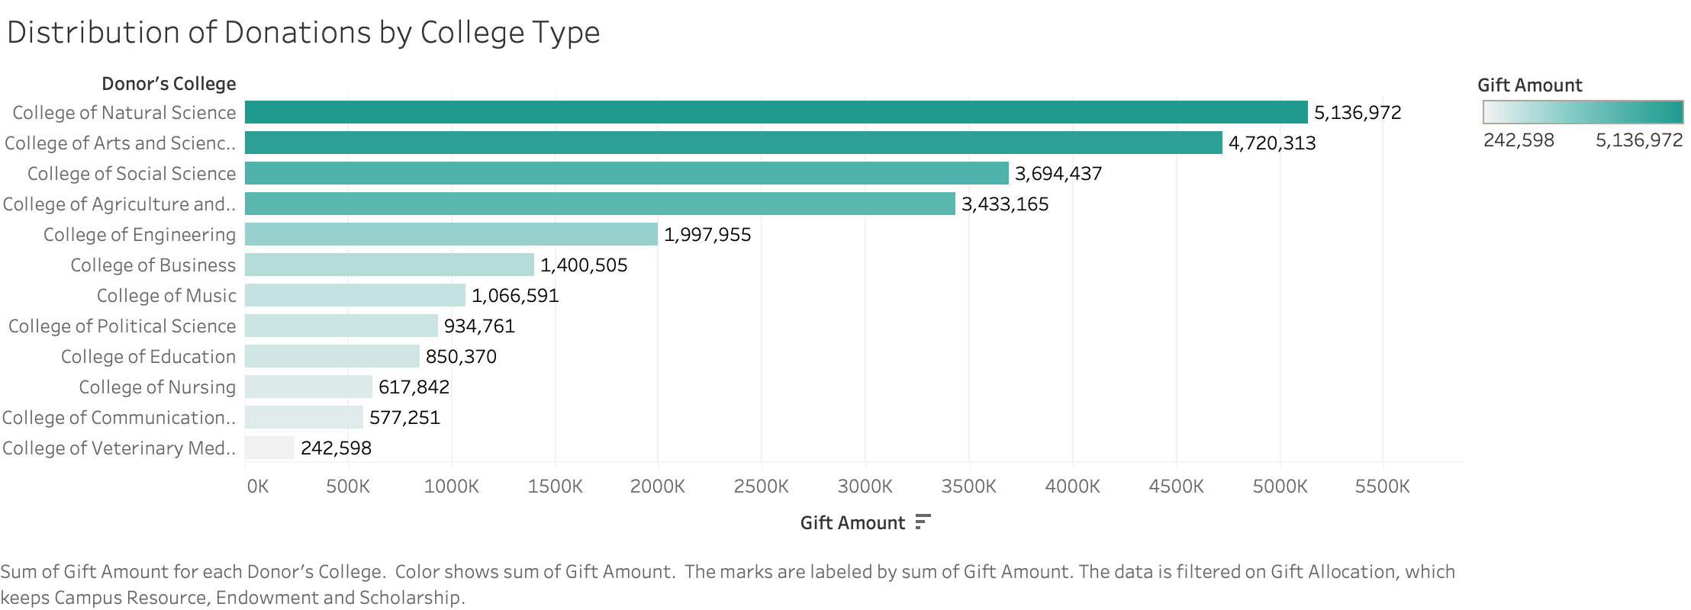
Distribution of Donations by College Type (horizontal bar graph)

Slide 13
Distribution of Donations by College Type (horizontal bar graph)
Chart Overview:
This bar chart represents the total donation amounts received by different colleges, showcasing the financial support distribution across various types of colleges. The chart includes a gradient color scale to emphasize differences in donation amounts.
Filters Applied:
Gift Allocation: Limited to Campus Resources, Endowment, and Scholarships to focus on impactful allocations.
Key Insights:
The College of Natural Science leads with approximately $5.1 million in donations.
College of Arts and Sciences and College of Social Sciences follow with $4.7 million and $3.7 million, respectively.
Smaller colleges like the College of Veterinary Medicine received much lower donations, approximately $242,598.
Discussion Points:
The dominance of science and arts-related colleges highlights donor interest in these fields, suggesting a strong alignment with societal priorities like innovation and education.
Underfunded colleges such as Veterinary Medicine and Communication reflect gaps in donor engagement or visibility.
The filter application emphasizes the significance of scholarships and endowments in influencing donor behavior.
The College of Natural Science likely leads in donations due to higher alumni participation in targeted outreach programs.

Slide 14
Distribution of Donations by College Type (horizontal bar graph) Continued
Recommendations for the Advisory Board:
Expand Visibility for Smaller Colleges:
Increase outreach efforts for underfunded colleges like Veterinary Medicine and Communication, emphasizing their unique programs and critical needs.
Highlight the Impact of Donations:
Share success stories from top-funded colleges like Natural Science to demonstrate donation impact and inspire broader contributions.
Encourage Balanced Giving:
Launch campaigns that invite donors to contribute a portion of their donations to colleges with less funding, promoting equitable development.
Promote campaigns inviting donors to support less-funded colleges, fostering equitable development across institutions.

Slide 15
Q3(The distribution of donations by academic majors) BEGINS FROM NEXT SLIDE

Slide 16
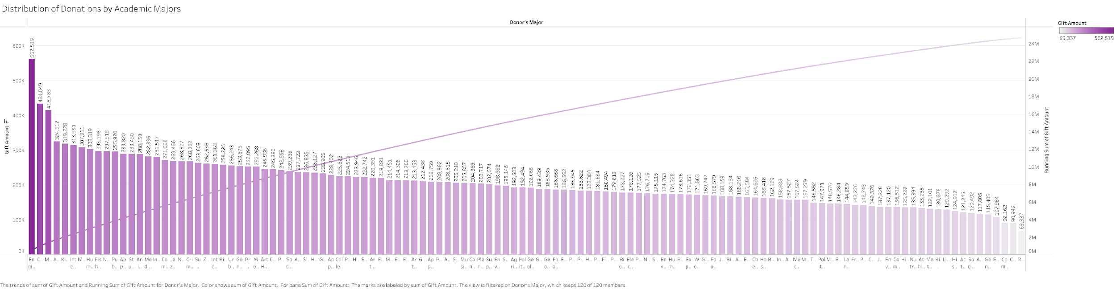
Distribution of donations by academic majors (Pareto chart)

Slide 17
Distribution of donations by academic majors ( Pareto graph)
Chart Overview:
The Pareto chart illustrates the distribution of donations by academic majors through a combination of a bar graph and a cumulative line chart. The bars display the contribution of individual academic majors to the total donation amount, while the cumulative line shows the running total of donations across all majors. This visualization emphasizes the most impactful contributors.
Filters Applied:
Donor's Major: This filter enables customization of the chart by including or excluding specific academic majors for focused analysis.
Key Insights:
Major Contributors: Fields such as Engineering (No Major), Composition, and Mathematics rank as the top three contributors, with each generating donations of over $400,000.
Pareto Principle in Action: A substantial share of the total donations comes from a small number of academic majors, aligning with the 80/20 rule.
Gradual Decline: Beyond the top contributors, donation amounts steadily decrease, signifying a broader distribution among other majors.
Discussion Points:
Skewed Contributions: The top academic majors dominate donation figures, highlighting strong alumni engagement or loyalty within these fields.
Broad Base: While smaller contributions are spread across numerous majors, collectively, they provide valuable support but might need targeted strategies for improvement.
Growth Potential: Academic majors with moderate contributions represent an opportunity for growth through focused engagement.

Slide 18
Distribution of donations by academic majors ( Pareto graph) Continued
Recommendations for the Advisory Board:
Focus on High-Contributing Majors: Prioritize building stronger relationships with donors from leading academic majors such as Engineering (No Major), Composition, and Mathematics, as these areas have demonstrated substantial contributions.
Action: Organize exclusive donor appreciation events and targeted communications for these major contributors to maintain and grow their support.
Engage Emerging Donors: Direct efforts toward engaging donors from promising majors like Interior Design, Kinesiology, and Neuroscience, which show moderate contributions but significant growth potential.
Action: Launch tailored alumni outreach campaigns showcasing the impact of their contributions on students and programs in these majors.
Strategic Resource Allocation: Allocate resources effectively to sustain contributions from top-performing majors while enhancing outreach to areas like Media and Information and Animal Science, which exhibit steady contributions.
Action: Conduct donor satisfaction surveys in these segments to identify areas for improved engagement and retention.
Customized Fundraising Initiatives: Develop specialized campaigns for majors such as Biochemistry and Molecular Biology, Interdisciplinary Humanities, and Public Policy to boost donor participation and contributions.
Action: Develop data-driven marketing strategies highlighting specific needs and outcomes to attract more donors from these areas.
5. Leverage Data Analytics: Use predictive analytics to identify trends and donor preferences, allowing the institution to personalize outreach strategies effectively.
Action: Implement a donor segmentation model based on gift history, major, and engagement levels to optimize fundraising efforts and ROI.

Slide 19
Q4(The distribution of donations by graduation years) BEGINS FROM NEXT SLIDE

Slide 20
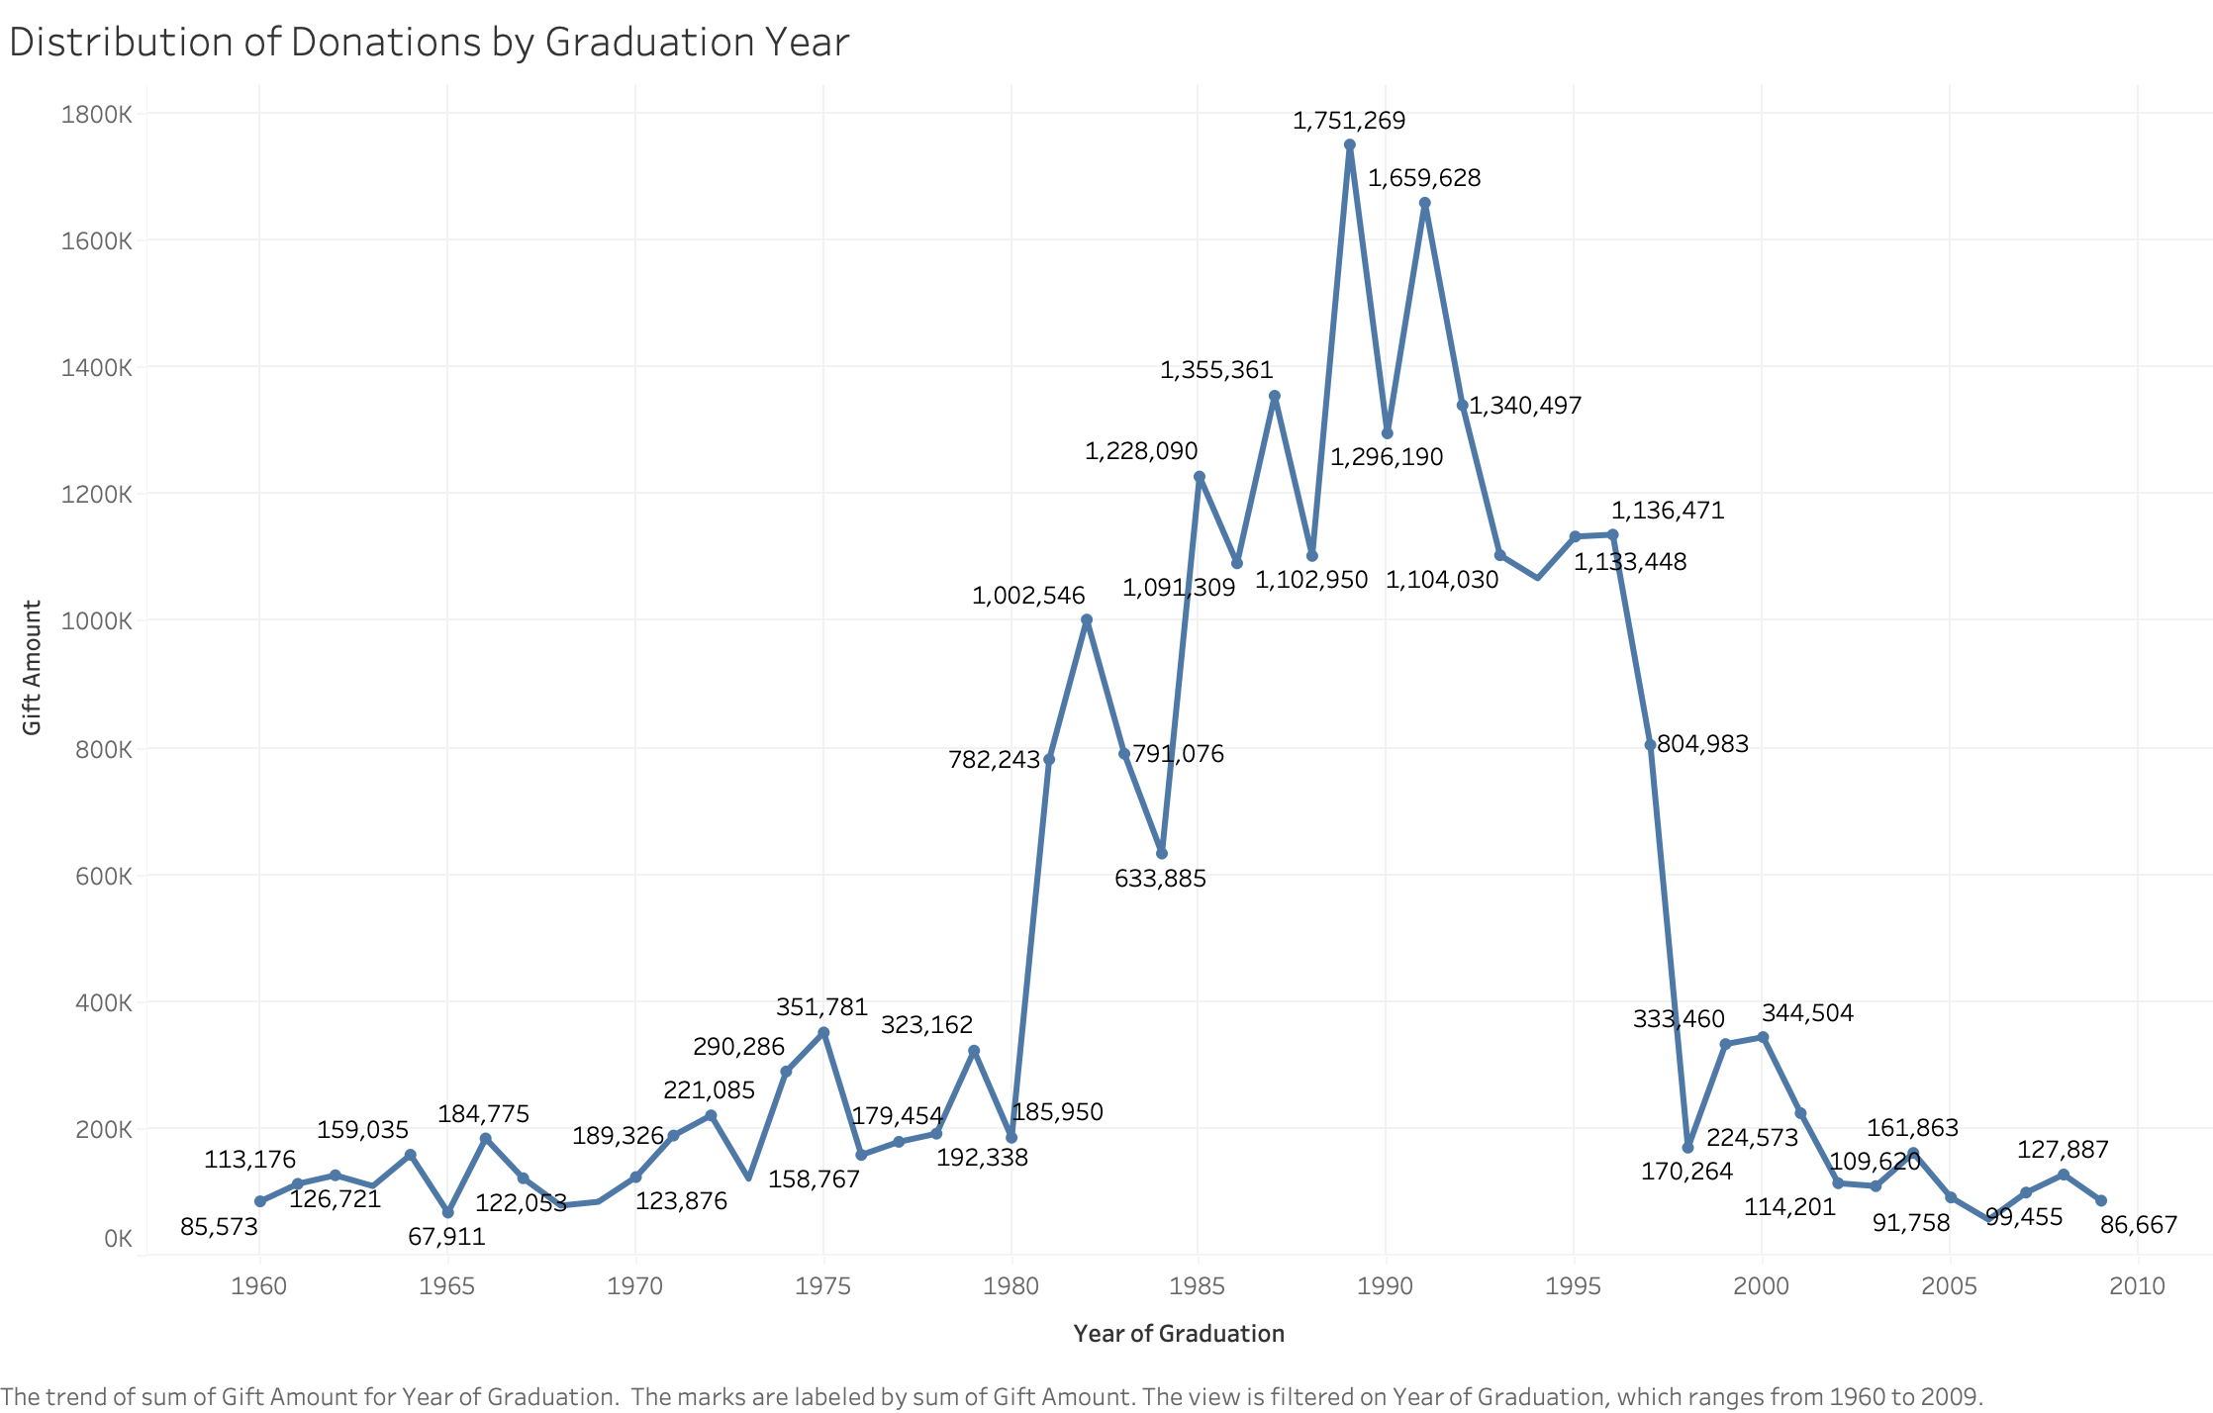
Distribution of Donations by Graduation Year, (Line Chart)

Slide 21
Distribution of Donations by Graduation Year, (Line Chart)
Chart Overview:
This line chart showcases the Distribution of Donations by Graduation Year, highlighting the total gift amounts contributed by alumni from 1960 to 2009. The chart reveals donation trends, emphasizing significant peaks and declines over the years.
Filters Applied:
Year of Graduation: A filter was applied to display data from 1960 to 2009.
Key Insights:
Major Peaks: Donations reached their highest points in 1985 (1.75M) and 1990 (1.66M), demonstrating strong alumni engagement during these years.
Post-1990 Decline: Contributions began to steadily decline after 1995, dropping below 1M in the early 2000s.
Early Growth: Donation amounts saw gradual growth from 1960 to 1980, leading up to the major peaks in later years
Discussion Points:
Strong Contribution Periods: The 1980s and early 1990s were marked by high alumni giving, likely driven by effective campaigns or favorable economic conditions.
Declining Trends Post-1995: Contributions decreased significantly after 1995, possibly due to changing priorities or reduced donor engagement.
Underutilized Early Years: Alumni from pre-1970 graduating classes contributed less, indicating an opportunity for greater engagement.

Slide 22
Distribution of Donations by Graduation Year, (Line Chart) Continued
Recommendations for the Advisory Board:
1. Re-engage Post-1995 Alumni:
Create campaigns targeting graduates from 1995 to 2005 to renew their connection with the institution.
Emphasize impactful initiatives that resonate with their experiences.
2. Celebrate High-Impact Cohorts:
Highlight achievements of alumni from the 1980s and 1990s to motivate other cohorts to contribute.
3. Reconnect with Early Graduates:
Focus on engaging alumni from the 1960–1970 era through legacy programs and personalized outreach efforts.

Slide 23
Distribution of Donations by Graduation Year, (Line Chart) Continued
Data-Driven Actions
1. Identify Barriers:
Conduct alumni surveys to understand why donations declined post-1995 and adapt strategies to address these concerns.
2. Tailored Campaigns:
Develop initiatives that align with the milestones and interests of high-contributing years, like the 1980s.
3. Rebuild Relationships:
Organize events or virtual meet-ups specifically for earlier alumni to strengthen ties and encourage giving.

Slide 24
Q5(Top majors of the donors) BEGINS FROM NEXT SLIDE

Slide 25
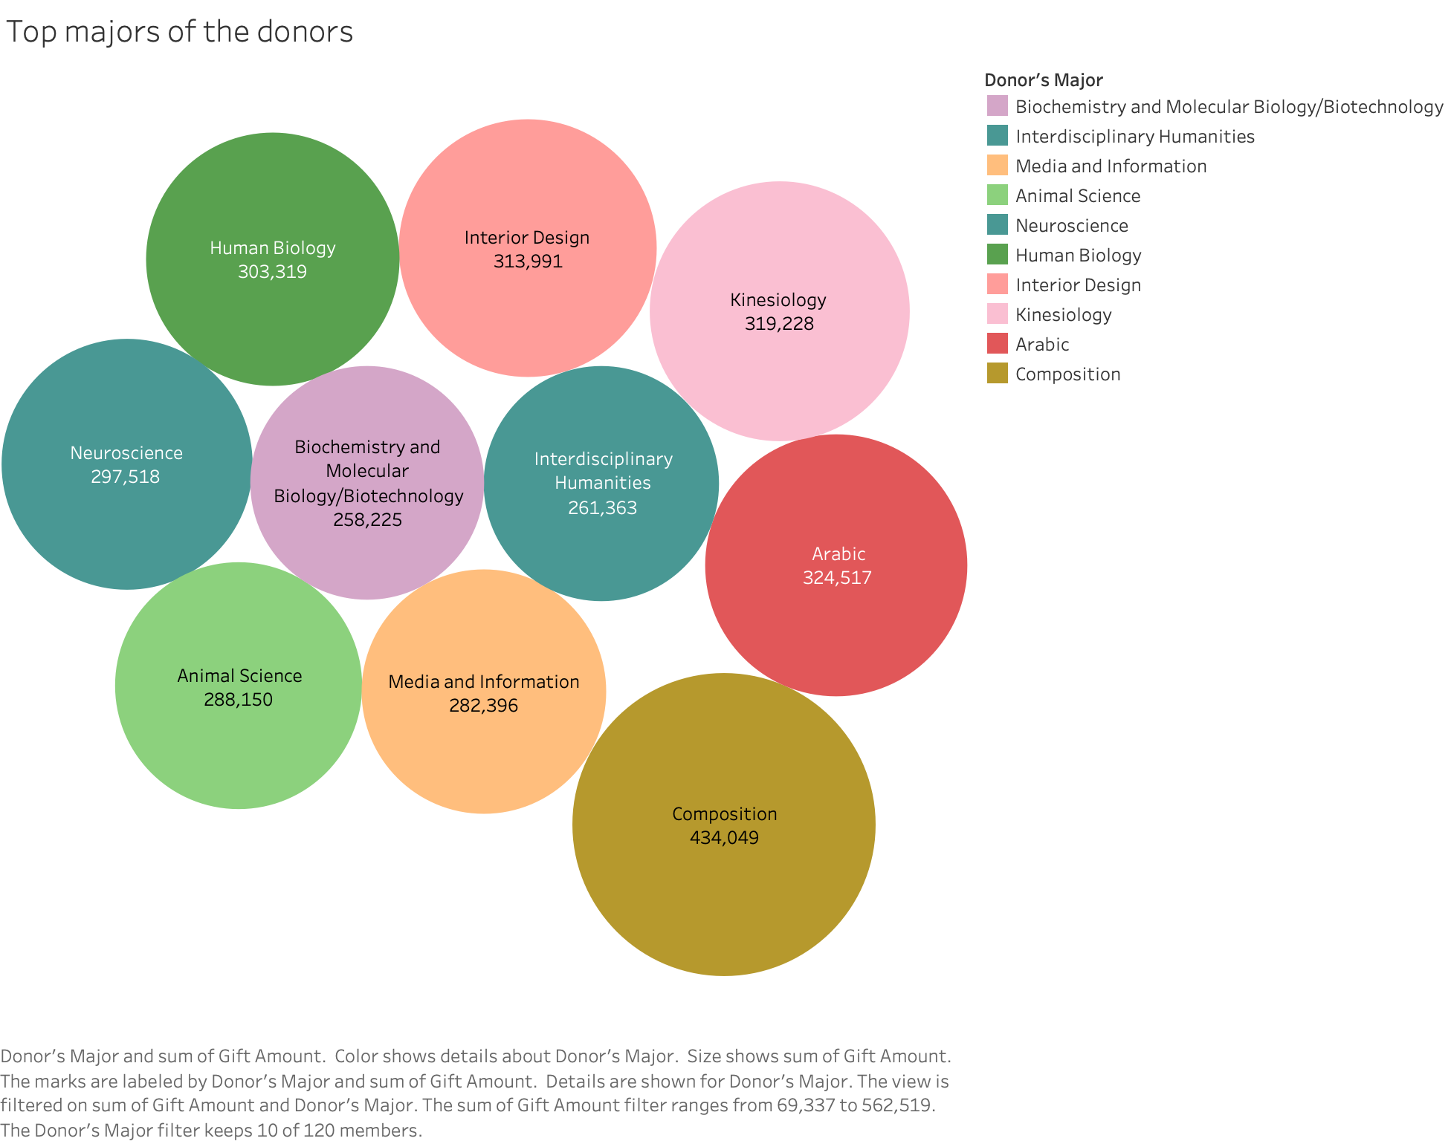
Top majors of the donors( Bubble chart)

Slide 26
Top majors of the donors(Bubble chart)
Chart Overview:
This bubble chart highlights the top 10 donor majors contributing the most to the total donation amount.
Each bubble represents a donor major, with the size indicating the total donation amount and the color distinguishing different majors.
Filters Applied:
Donor's Major: Limited to the top 10 donor majors based on donation amounts.
Gift Amount Range: Adjusted between $69,337 and $562,519 to focus on significant contributions.
Key Insights:
Top-Contributing Majors:
Composition leads with $434,049 in total donations, showing strong donor support for this field.
Other significant contributors include Arabic ($324,517), Kinesiology ($319,228), and Interior Design($313,991).
2. Moderate Contributions:
Majors like Human Biology ($303,319) and Neuroscience ($297,518) fall into a moderate range, reflecting stable donor engagemen
3. Emerging Donor Interests:
Fields such as Media and Information and Animal Science, with contributions around $282,396 and $288,150 respectively, demonstrate potential for growth through targeted engagement strategies.

Slide 27
Top majors of the donors(Bubble chart)
Discussion Points:
Diverse Donor Preferences:
Donations are distributed across a variety of fields, reflecting diverse interests among alumni and other donors.
Potential for Growth:
Fields like Biochemistry and Molecular and Interdisciplinary Humanities exhibit moderate contributions, suggesting opportunities for increased engagement.
Impactful Majors:
Majors at the top, like Composition and Arabic, could serve as benchmarks for understanding what motivates donor generosity.

Slide 28
Top majors of the donors(Bubble chart)
Recommendations for the Advisory Board:
1. Highlight Success Stories:
Showcase impactful programs and alumni achievements in top-performing majors like Composition and Arabic to maintain and grow donor support.
2. Boost Engagement for Emerging Fields:
Launch campaigns to increase awareness of majors like Media and Information and Animal Science, which demonstrate potential for growth.
3. Leverage Data Analytics:
Use predictive models to identify alumni from underrepresented majors with a likelihood of contributing, focusing on targeted outreach.

Slide 29
Top majors of the donors(Bubble chart)
Data-Driven Actions:
1. Targeted Campaigns::
Develop marketing campaigns highlighting how donations in specific majors, such as Human Biology and Kinesiology, have been utilized to improve programs..
2. Donor Segmentation:
Perform behavioral analysis to segment donors by major and identify common characteristics among top donors.
3. Expand Outreach:
Focus on engaging donors from underrepresented fields, such as Interdisciplinary Humanities, through personalized communications and event invitations.

Slide 30
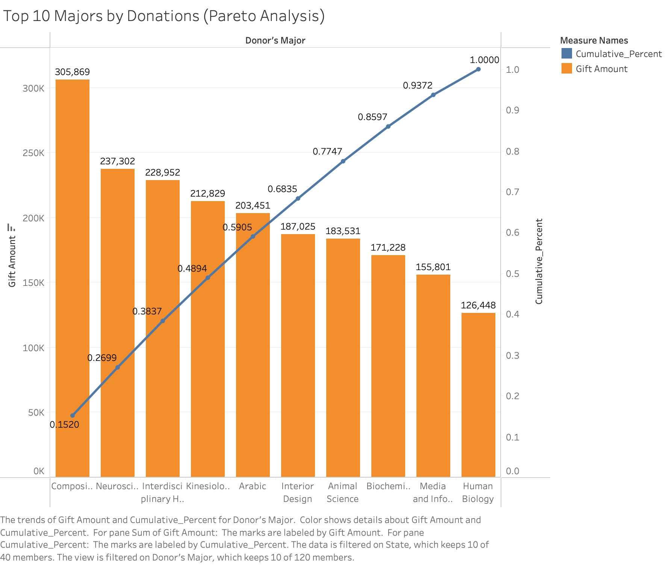
Top 10 majors of the donors( Pareto chart)

Slide 31
Top majors of the donors(Pareto chart)
Chart Overview:
The Pareto chart displays the total donation amounts (bar chart) by donor major, alongside the cumulative percentage (line graph) of total donations.
It visualizes the distribution of donations to highlight how a small subset of majors contributes to a significant portion of the total donation amount.
Filters Applied:
Donor’s Major: Limited to the top 10 majors by the total donation amount.
State: Ensures that the data reflects all donor states to provide a comprehensive analysis.
Measure Names: Used to display the dual-axis visualization (Gift Amount and Cumulative Percentage).
Key Insights:
Major Contributors:
Top three majors (Composition, Neuroscience, and Interdisciplinary Humanities) account for approximately 65% of total donations.
By the fifth major (Kinesiology), cumulative donations surpass 85%, indicating high concentration in a few majors.
Tail-End Contributions:
Lower-performing majors like Media and Information and Human Biology contribute less individually but still add value when aggregated.
Diversity of Majors:
A wide variety of majors within the top 10 shows diverse alumni engagement, though most donations come from a concentrated few.

Slide 32
Top majors of the donors(Pareto chart)
Discussion Points:
Concentration of Donations:
The chart highlights the 80/20 rule, with a small number of majors contributing the majority of donations.
Growth Opportunities:
Mid-tier and tail-end majors such as Animal Science and Media and Information show potential for targeted campaigns.
Engagement Gaps:
Lower-performing majors may have barriers to alumni giving that need exploration and addressing.

Slide 33
Top majors of the donors(Pareto chart)
Recommendations for the Advisory Board:
Leverage High-Contributing Majors:
Top-Performing Major: Use Composition, the highest-contributing major with a donation total of $305,869, as a flagship case study in donor campaigns.
Highlight alumni success stories and tangible outcomes achieved through previous donations from this major to inspire future contributions.
Target Mid-Tier Majors:
Focus on Kinesiology and Animal Science, which contribute moderately but show potential for growth.
Launch campaigns emphasizing their unique programs and achievements to drive engagement and donations.
Expand Outreach for Low-Contributing Majors:
Investigate barriers for majors like Media and Information and Human Biology, which contribute lower amounts.
Develop tailored campaigns or events to increase engagement among these alumni groups, emphasizing the impact their contributions can make.

Slide 34
Top majors of the donors(Pareto chart)
Data-Driven Actions:
Develop Focused Campaigns:
Create alumni success showcases for high-performing majors to reinforce their strong donor base.
Engage Mid-Tier Majors:
Use predictive analytics to identify alumni in mid-tier majors with high donation potential and create personalized outreach strategies.
Conduct Alumni Surveys:
Gather insights from alumni in low-contributing majors to understand their lack of engagement and address these issues in future campaigns.
Incorporate Cross-Major Strategies:
Promote interdisciplinary achievements to appeal to a broader base of alumni and drive contributions across related fields.

Slide 35
Q6(Top types of colleges that received the most donations) BEGINS FROM NEXT SLIDE

Slide 36
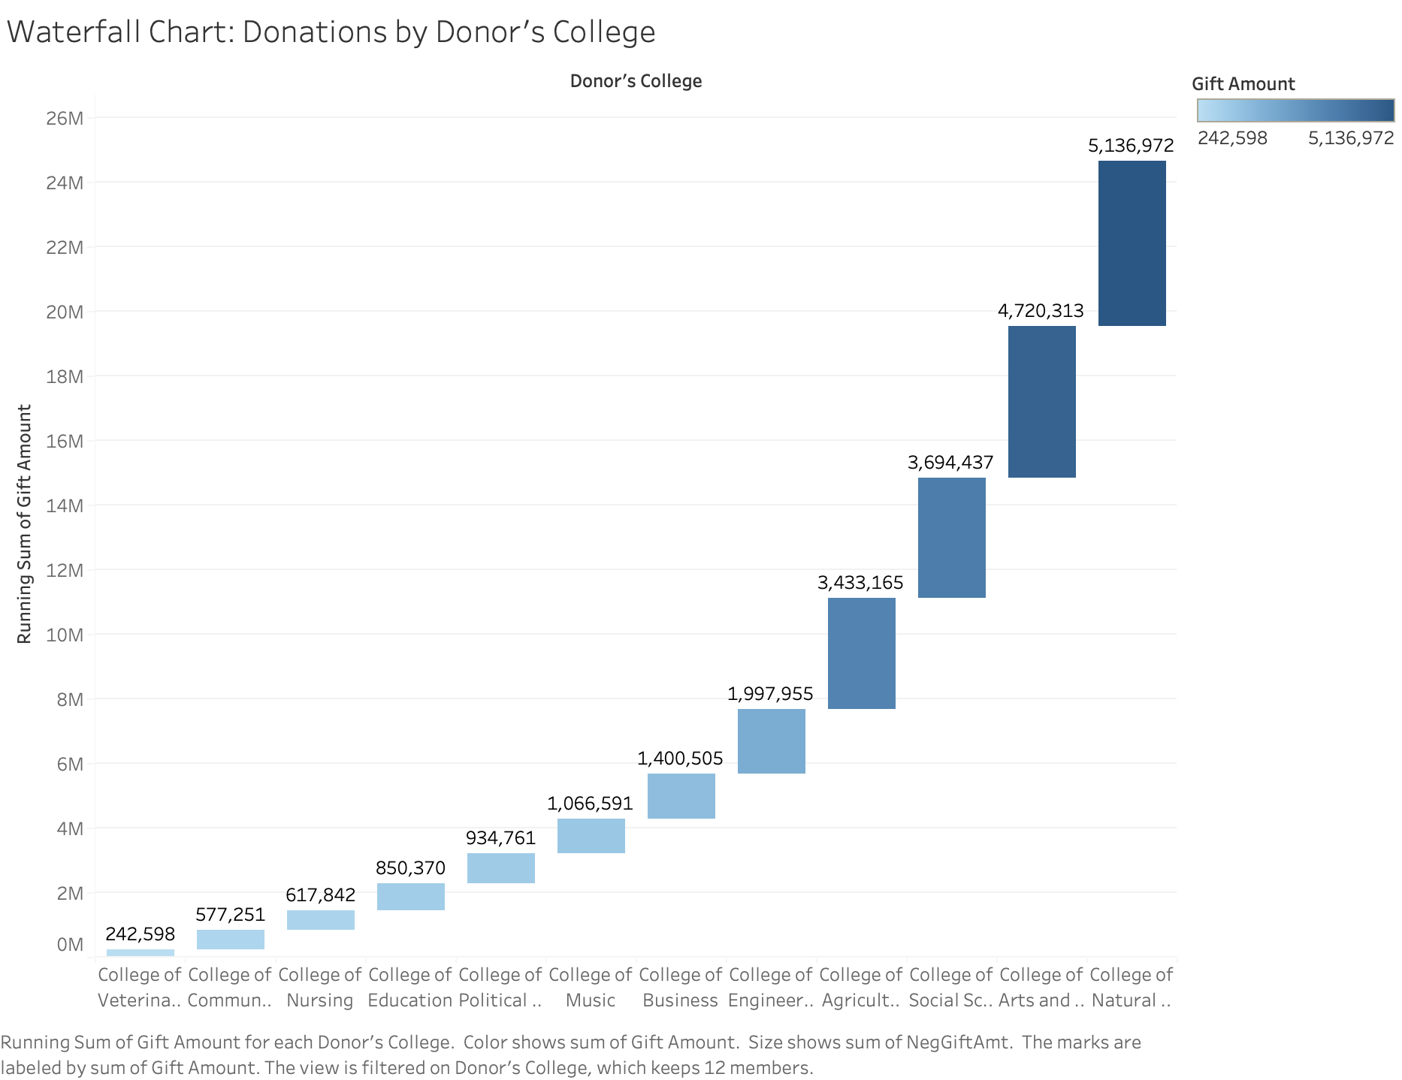
Top Types of Colleges That Received the Most Donations, (WaterFall Chart)

Slide 37
Top Types of Colleges That Received the Most Donations, (WaterFall Chart)
Chart Overview:
The waterfall chart presents the distribution of donations among various colleges, effectively illustrating the cumulative contribution by donor category. It provides a stepwise addition to demonstrate the total gift amount, from the lowest to the highest contributing colleges.
Filters Applied:
Donor's College: The "Donor's College" filter enables a focused analysis of specific colleges, allowing insights into the performance of individual institutions.
Key Insights:
Highest Contributions: The College of Natural Science and the College of Arts and Sciences lead in donation amounts, contributing $5,136,972 and $4,720,313, respectively..
Moderate Contributions: Colleges like the College of Business ($1,400,505) and the College of Music ($1,066,591) exhibit moderate levels of donations.
Early Growth: Donation amounts saw gradual growth from 1960 to 1980, leading up to the major peaks in later years
Discussion Points:
Performance Gaps: Significant variation exists in the donation amounts received by different colleges, with a stark gap between the top and lowest contributors.
Equity in Support: Colleges with smaller donations may face challenges in accessing resources, affecting their capacity to grow and meet academic goals.
Leverage Top Performers: Colleges receiving substantial donations may be ideal for driving campaigns that can inspire donors to contribute to other underfunded areas.

Slide 38
Top Types of Colleges That Received the Most Donations, (WaterFall Chart) Continued
Recommendations for the Advisory Board:
1. Promote Smaller Colleges:
Launch marketing and outreach initiatives to spotlight the unique programs and achievements of less-funded colleges, such as the College of Veterinary Medicine.
2. Highlight Impact Stories:
Share success stories from high-performing colleges like the College of Natural Science to demonstrate the tangible outcomes of donations.
3. Encourage Balanced Giving:
Develop campaigns urging donors to allocate a portion of their contributions to less-supported colleges, fostering more equitable resource distribution.

Slide 39
Top Types of Colleges That Received the Most Donations, (WaterFall Chart) Continued
Data-Driven Actions
Trend Analysis for Low-Contributing Colleges:
Objective: Investigate why colleges like College of Veterinary Medicine, College of Communication, and College of Nursing are receiving fewer donations.
Action: Use predictive analytics to identify patterns in donation trends for these colleges. Leverage donor data (e.g., graduation year, geography, major) to uncover any specific gaps in donor outreach and target campaigns accordingly.
Behavioral Analysis of Donors:
Objective: Understand the decision-making process of donors contributing to high-performing colleges like College of Natural Science and College of Arts and Sciences.
Action: Perform clustering analysis to segment donors by behavior and preferences, using insights to replicate successful strategies for lower-funded colleges. For example, identify alumni groups who have donated consistently and target similar groups for underfunded colleges.
Outcome Benchmarking for Marketing:
Objective: Highlight the impact of donations to inspire contributions for underfunded colleges.
Action: Use data visualization tools to compare the ROI of donations in top-performing colleges (e.g., Natural Science) and model potential outcomes for underfunded colleges. Share projections in donor campaigns to show the tangible impact of their support.
Donor Propensity Modeling:
Objective: Identify potential high-value donors for underfunded colleges.
Action: Develop a donor propensity model based on historical donation patterns, predicting which alumni or donors are likely to contribute. Use the model to personalize outreach strategies, focusing on those with a high likelihood of engagement.
Social Media Sentiment Analysis:
Objective: Gauge public and alumni sentiment towards different colleges to optimize campaigns.
Action: Analyze social media data to identify which colleges have the most positive or negative sentiment. Use insights to build targeted campaigns that improve the perception and visibility of underfunded colleges.

Slide 40
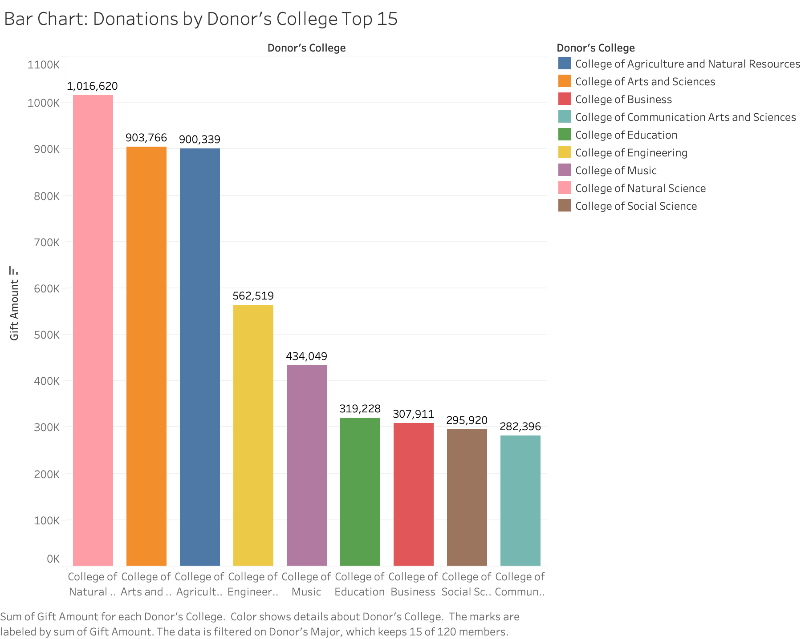

Slide 41
Top Types of Colleges That Received the Most Donations, (Bar Chart Top 15)
Chart Overview:
This bar chart illustrates the total donations received by the top 15 donor colleges.
Each bar represents a specific college, with donation amounts displayed numerically for easy comparison.
Distinct colors for each college enhance visual clarity.
Filters Applied:
Donor’s College: Filtered to include only the top 15 colleges based on the SUM(Gift Amount).
Key Insights:
Top-Contributing Colleges:
The College of Natural Science leads with $1,016,620 in donations.
The College of Arts and Sciences and the College of Engineering follow closely with $903,766 and $900,339, respectively.
Moderate Contributors:
Colleges like College of Music ($434,049) and College of Business ($307,911) display steady contributions.
Lower-Tier Donations:
Institutions such as the College of Social Sciences ($295,920) and the College of Communication ($282,396) contribute smaller amounts but remain significant in overall donation patterns.

Slide 42
Top Types of Colleges That Received the Most Donations, (Bar Chart Top 15) Continued
Discussion Points:
Dominance of STEM Fields:
Colleges with a focus on sciences, engineering, and natural studies dominate the top spots, reflecting a preference for these disciplines among donors.
Potential Growth Areas:
Colleges in the lower tiers (e.g., Social Sciences and Communication) might require targeted outreach and engagement to improve their donor base.
Diversity in Support:
The spread of donations across various colleges highlights diverse donor interests but also reveals an imbalance that could be addressed.
Recommendations for the Advisory Board:
Leverage Successful Colleges:
Use the success stories of top-performing colleges, like Natural Science, to inspire donors to support other colleges.
Enhance Outreach for Lower-Tier Colleges:
Launch campaigns targeting alumni of underfunded colleges like Communication and Social Sciences, emphasizing their unique programs and impact.
Encourage Cross-College Contributions:
Design initiatives that encourage balanced giving, such as joint campaigns showcasing collaborative achievements across multiple colleges.

Slide 43
Top Types of Colleges That Received the Most Donations, (Bar Chart Top 15) Continued
Data-Driven Actions
Donor Behavior Analysis:
Analyze patterns of top contributors to identify what motivates giving and replicate these strategies for lower-performing colleges.
Predictive Campaigns:
Utilize predictive analytics to target alumni most likely to contribute to underfunded colleges.
Storytelling Campaigns:
Share impactful stories of how donations have been used effectively in top-performing colleges, and highlight potential outcomes for other colleges.

Slide 44
Q7(The trend of donations over years) BEGINS FROM NEXT SLIDE

Slide 45
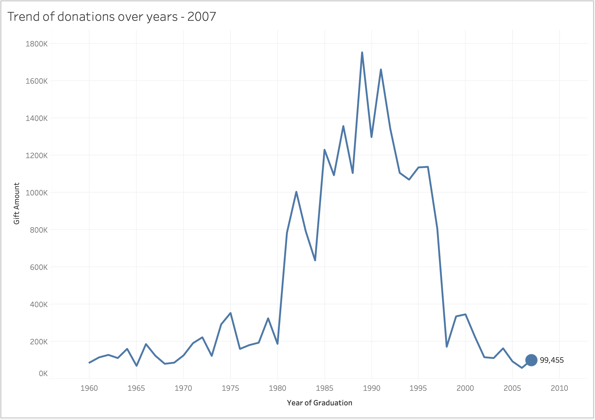
The trend of donations over years, (Motion Chart)

Slide 46
The trend of donations over years, (Motion Chart)
Chart Overview:
This line chart tracks the trend of donation amounts contributed by alumni over the years of graduation.
By using trail marks, the visualization emphasizes the historical progression of donation amounts, allowing patterns and anomalies to stand out.
Filters Applied:
Year of Graduation: The "Year of Graduation" was used as a dynamic filter to show trends over specific intervals.
Key Insights:
Steady Growth Period (1960–1980):
Donations increased gradually, reflecting either growing alumni engagement or a steady expansion of the alumni base over time..
2. Significant Peaks (1980–1995):
Donations peaked in 1985 and 1990, with amounts reaching $1.75M and $1.66M, respectively.
These peaks likely correspond to successful fundraising campaigns or increased alumni participation during this era.
3. Post-1995 Decline:
A noticeable decline in donations occurred after 1995, with contributions dropping below $1M in the early 2000s.
This may indicate changing alumni priorities, donor fatigue, or reduced fundraising efforts targeting more recent graduates.
4. Underutilized Early Period (Pre-1970):
Alumni graduating before 1970 contributed significantly less, suggesting untapped potential in these earlier cohorts for targeted outreach.

Slide 47
The trend of donations over years, (Motion Chart)
Discussion Points:
Strong Contribution Periods: The 1980s and early 1990s are marked by high alumni giving, possibly influenced by effective alumni engagement campaigns or favorable economic conditions.
Declining Engagement: The drop in donations post-1995 raises concerns about reduced alumni engagement or shifting donor preferences, requiring further exploration.
Untapped Potential in Early Years: Alumni from pre-1970 graduating classes contributed minimally, which could be an opportunity for targeted campaigns or legacy programs.

Slide 48
The trend of donations over years, (Motion Chart)
Recommendations for the Advisory Board:
1. Re-engage Post-1995 Alumni:
Action: Develop campaigns specifically targeting graduates from 1995 to 2005, emphasizing impactful initiatives that align with their experiences and milestones.
2. Celebrate High-Impact Cohorts:
Action: Highlight the contributions of alumni from the 1980s and early 1990s to motivate other cohorts and showcase successful fundraising efforts.
3. Reconnect with Early Graduates:
Action: Focus on alumni from the 1960–1970 era through legacy programs, personalized outreach, and storytelling campaigns to encourage their participation.

Slide 49
The trend of donations over years, (Motion Chart)
Data-Driven Actions:
Identify Barriers:
Conduct alumni surveys to understand the reasons behind declining contributions post-1995 and adjust strategies accordingly.
Tailored Campaigns:
Align initiatives with the interests and preferences of high-contributing years, such as the 1980s.
Rebuild Relationships:
Organize events or virtual meet-ups specifically for earlier alumni cohorts to strengthen ties and foster giving.

Slide 50
Conclusion and Key Takeaways
Overall Findings:
Top-Contributing Majors and Colleges:
Majors like Composition and Arabic have the highest donor engagement.
Colleges like Natural Science and Arts and Sciences contribute significantly to overall donations.
Donation Trends Over the Years:
A noticeable peak in the 1980s and early 1990s suggests effective campaigns.
A decline post-1995 highlights the need for re-engagement strategies.
Geographic Insights:
Certain regions consistently contribute higher amounts, presenting opportunities for targeted outreach like California, Texas, and New York (NY)..
Key Recommendations:
Re-engage Alumni:
Focus on alumni cohorts from 1995 to 2005 with tailored campaigns.
Organize events for earlier alumni (pre-1970) to foster connection and boost giving.
Boost Emerging Majors:
Highlight growing fields like Media and Information and Animal Science to diversify donor support.
Leverage Data Analytics:
Use predictive models to identify high-potential donors from underrepresented regions and majors.

Slide 51
Conclusion and Key Takeaways
Impact:
Enhanced alumni engagement through targeted campaigns.
Optimized donor strategies to increase contributions for underfunded colleges.
Long-term sustainability of fundraising efforts through data-driven decision-making.
All requested visualizations were included.

