Slide 1


Slide 2


S-Mail
Second Year Project Synopsis
Submitted by
ROLL | NAME
2301010166 | Tanvi Basist
2301010136 | Krish Punia
2301010137 | Kartikay Gautam
2301010138 | Gurnoor Kaur
Industry Mentor: Dr. Piyush Kumar
Faculty Mentor: Dr. Amar Saraswat
Notes:
New Courses replaced with New Programmes

Slide 3

Project Overview
S-Mail Handler is an AI-powered email management tool designed for customer support teams. It automates email categorization and provides insightful analytics, helping teams respond faster and improve efficiency. By streamlining email handling, it enhances customer service quality and decision-making.
Notes:
New Courses replaced with New Programmes

Slide 4
About the Problem
Customer support teams receive a huge number of emails every day. This makes it difficult to categorize and respond to them quickly. The process of manual email handling is time-consuming as it is not easy to prioritizing urgent queries.
This often leads to:- 1. Inconsistent response quality. 2. No insight for customer interactions. 3. Poor customer experience often caused by delayed responses. 4. High workload affecting the productivity of the support team. 5. Trend analysis being difficult without structured data.
Need for a Solution: 1. Automation of email categorization and priortization can save time. 2. Quick response time improves customer satisfaction.
Existing Solutions: 1. Conventional email clients with low levels of automation. 2. Basic filtering and tagging systems.
Notes:
New Courses replaced with New Programmes

Slide 5
Problem Statement
Customer support teams struggle with managing and responding to high volumes of emails, leading to delays, inefficiencies, and inconsistent responses. The lack of automation and intelligent categorization makes it difficult to prioritize urgent queries and provide timely support.
Why is it Important?
Delayed responses negatively impact customer satisfaction and brand reputation.
Manual processing increases workload and response time.
Lack of insights makes it hard to improve support efficiency.
Expected Impact of Solving This Problem
Faster response times through AI-powered email summarization and smart reply suggestions.
Improved efficiency by automating categorization and prioritization of emails.
Better decision-making with data-driven insights on customer queries.
Enhanced customer experience, leading to stronger client relationships and increased trust.
Notes:
New Courses replaced with New Programmes

Slide 6
Objectives
Main Goal To develop an AI-powered email management system that enhances customer support efficiency by automating email processing and providing insightful analytics.
Specific Objectives
Automate email categorization and prioritization to streamline query handling.
Summarize emails for quick review, reducing response time.
Provide data-driven insights to enhance decision-making in customer support.
Notes:
New Courses replaced with New Programmes

Slide 7
Methodology, Tools, and Techniques
Approach Taken to Solve the Problem
Integrate with the Gmail API to fetch emails in real-time.
Use Gemini model to analyze, categorize, and summarize emails.
Provide data analytics and insights to improve customer support efficiency.
Tools, Software, and Techniques Used
Email Integration: Gmail API for secure email access.
AI Processing: NLP-based models for summarization and prioritization using Rapid APIs or Gemini API.
Data Storage & Management: Efficient caching and storage system for handling email data using Redis.
Frontend & Backend Development: Using React with typescript for frontend development.
Justification for Chosen Methods
Using popular framework ensures faster troubleshooting and development.
Using established AI-models provide faster, accurate and trustable results than self deployed models.
Notes:
New Courses replaced with New Programmes

Slide 8
Methodology Flowchart
User
Emails
Insights
Gmail API
Gemini API
Notes:
New Courses replaced with New Programmes

Slide 9
Project Timeline
Stage 1: Planning & Requirement Gathering (1 Week)
Define project scope, collect requirements, and identify risks.
Stage 2: Design & Architecture (2 Weeks)
Develop system architecture, UI/UX design, and finalize tech stack.
Stage 3: Development (6-10 Weeks)
Implement backend (API integrations, AI models), and frontend (UI, email interaction).
Stage 4: Testing & Quality Assurance (2 Weeks)
Conduct unit, integration, and load testing; fix bugs.
Stage 5: Deployment & Launch (1 Week)
Deploy the app, monitor performance, and provide user training.
Notes:
New Courses replaced with New Programmes

Slide 10
Expected Results & Impact
Expected Results
1. Anticipated Outcomes:
The app will streamline email management, improve response efficiency with AI-generated summaries, and offer reply suggestions to enhance consistency.
2. Effectiveness in Solving the Identified Problem:
It will reduce email overload, ensure faster and more consistent responses, and optimize support team workflows.
3. Prototype or Working Model Deliverable:
A working prototype featuring a Gmail-type email dashboard but along with summarization and email analytics.
Impact
1. Contribution to the Field:
It introduces AI-driven automation for email management, enhancing productivity and operational efficiency in customer support.
2. Potential Benefits for Industries, Researchers, or Users:
Customer support teams will save time, businesses will improve response rates, and researchers can explore email communication patterns.
3. Future Scope & Possible Extensions:
Future extensions include supporting multiple email platforms such as outlook, multilingual capabilities, advanced AI features, and mobile app integration.
Notes:
New Courses replaced with New Programmes

Slide 11
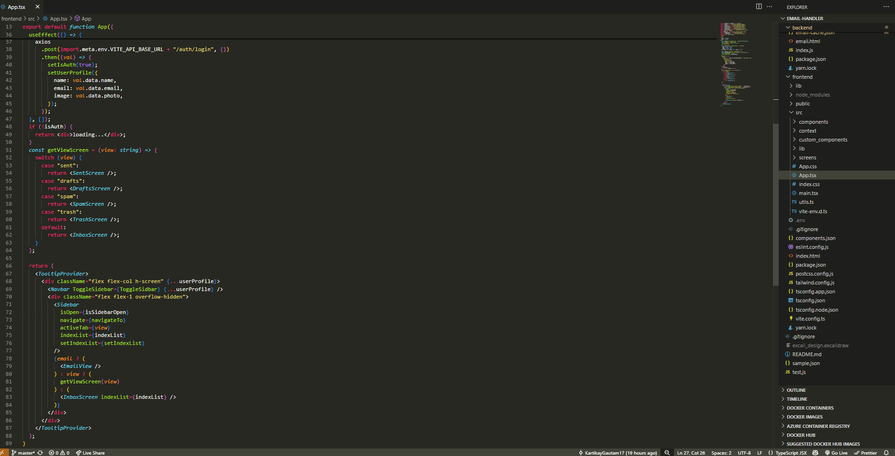
Code Snippets
Main App Layout

Slide 12
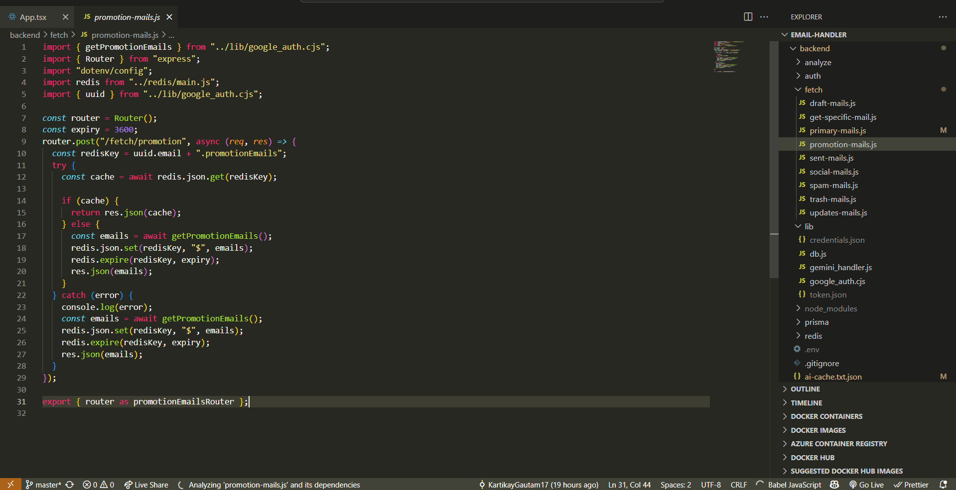
Code Snippets
REST API for fetching emails

Slide 13
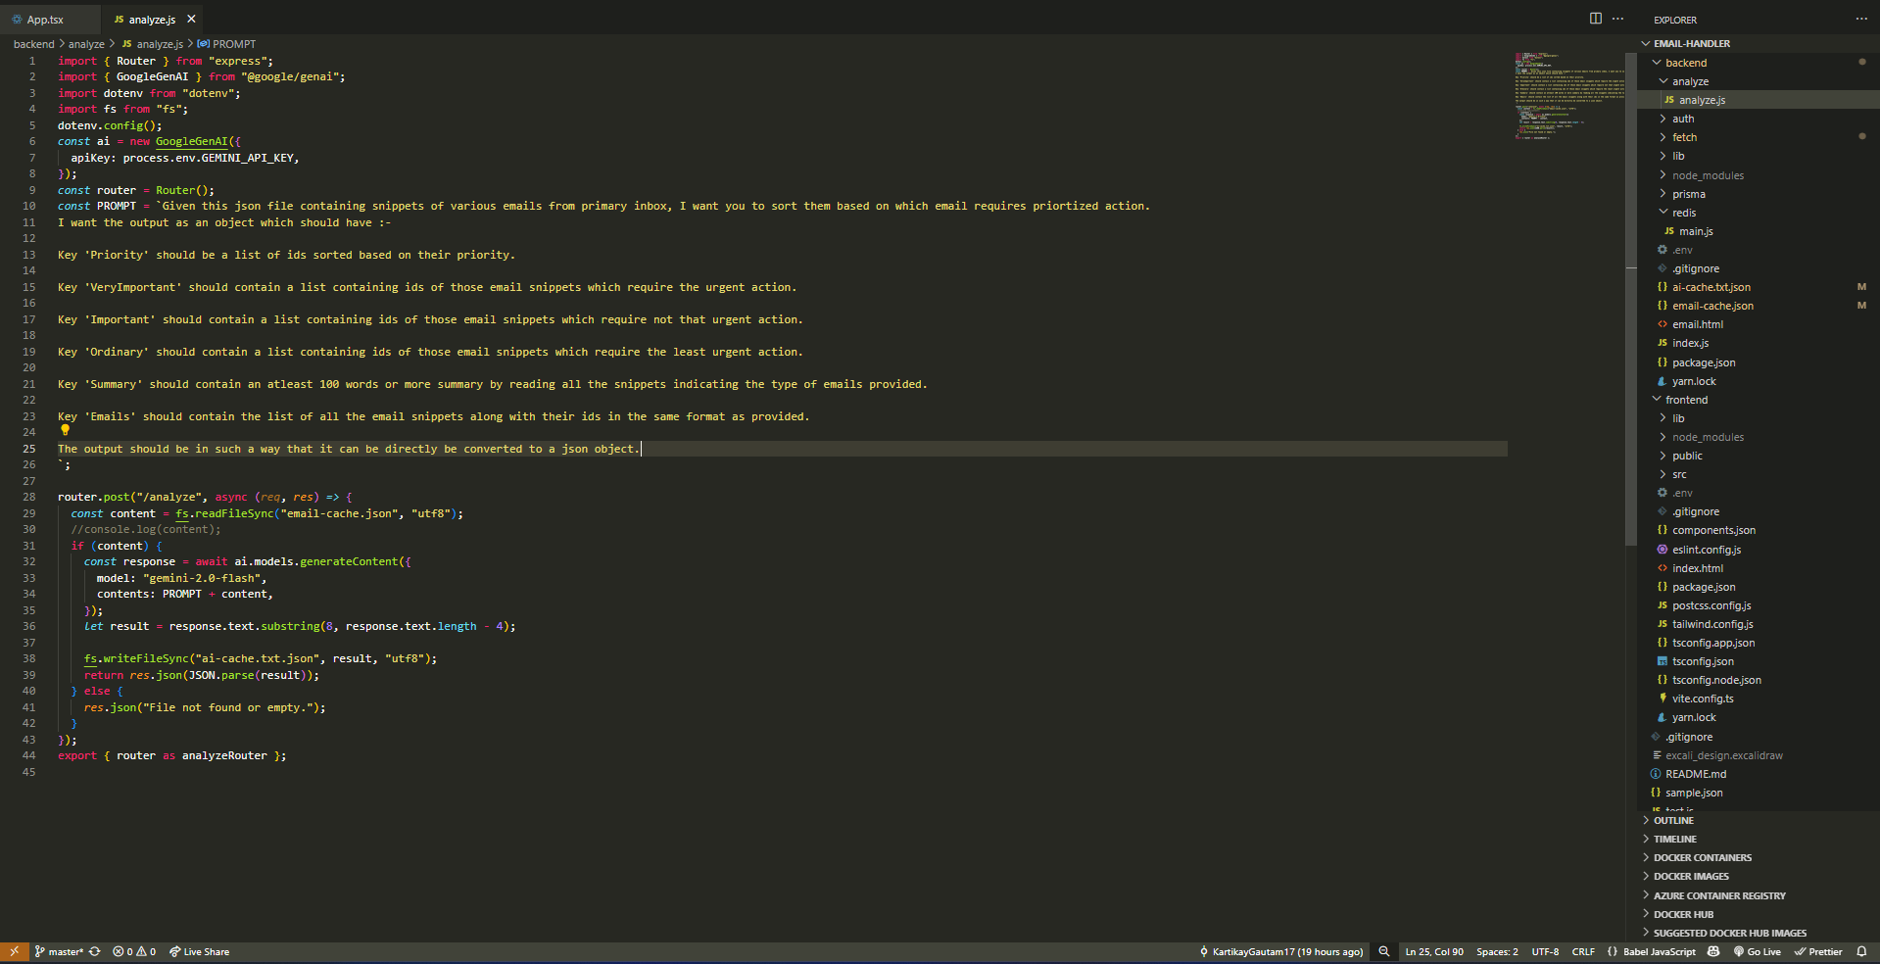
Code Snippets
REST API for fetching Gemini Response

Slide 14
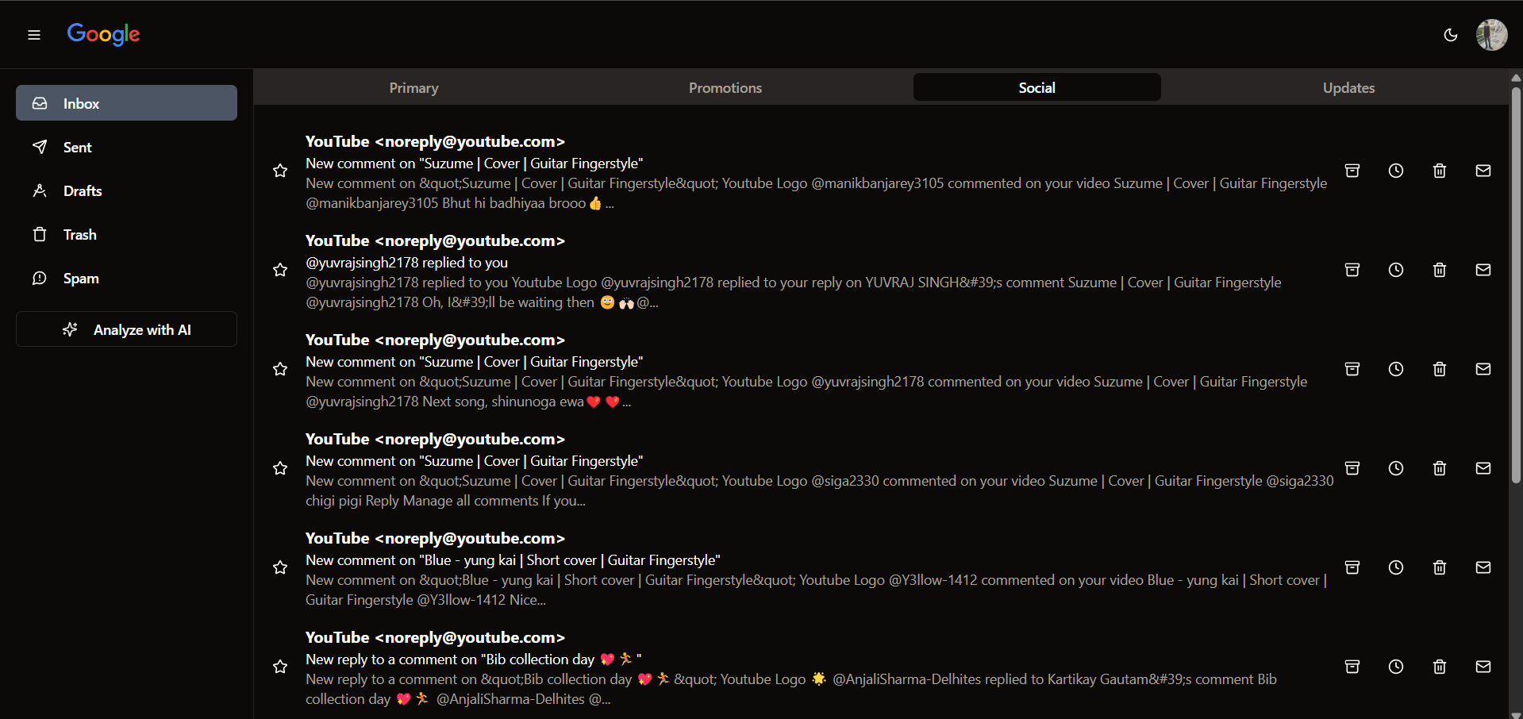
Results
Frontend

Slide 15
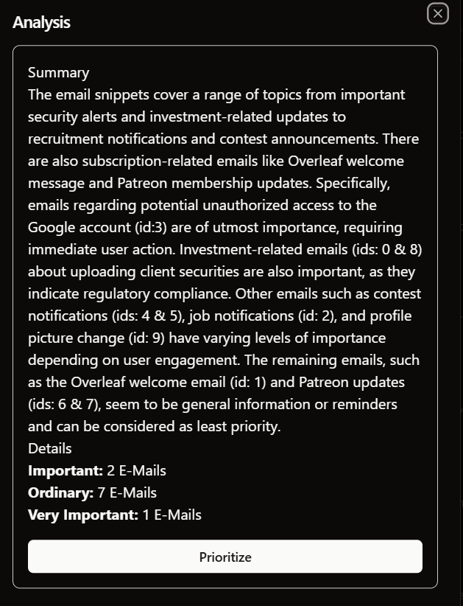
Results
Insight Feature

Slide 16
Future Work
The S-Mail Handler has the potential for continued growth and enhancement. One key area of future development is the integration of smart AI suggestions for writing emails.
Additionally, we can add prioritization and insightful feature to other email categories as well, including updates and social.
The above can make the project individual friendly as well.

Slide 17
References
Google Developers. (2023). Gmail API. Retrieved from https://developers.google.com/gmail/api
OpenAI. (2023). GPT-4: Language Models are Few-Shot Learners. Proceedings of the Conference on Neural Information Processing Systems (NeurIPS), 2023. Retrieved from https://arxiv.org/abs/2005.14165
Gemini, Inc. (2023). Gemini API for Text Analysis. Retrieved from https://www.geminiapi.com
Dufresne, M. (2020). AI-Powered Email Management Tools. TechCrunch. Retrieved from https://techcrunch.com
Notes:
New Courses replaced with New Programmes

Slide 18
THANK YOU

