Slide 1

Clustering Analysis of Synthetic Beverage Sales Data
An Integrated Unsupervised and Supervised Machine Learning Approach​
Machine Learning and Neural Networks (COMP-5011) ​Fall 2025
Lakehead University
Group Members :
Kartikay Malhotra - 1298395
Aung Myo Myint - 1305013
Instructor:
Dr. Saad Bin Ahmed

Slide 2
Introduction and Business Problem
  The Challenge: The beverage industry is highly competitive with dynamic customer preferences and seasonal trends.
  The Opportunity: Leverage large-scale sales data (8.9M+ transactions) for better decision-making.
  Project Goal: Use Machine Learning to:
    Discover hidden customer segments (Unsupervised Learning).
    Predict the segment of new customers (Supervised Learning).
  Business Value: Enable targeted marketing, optimized inventory, and personalized pricing.
2

Slide 3
Dataset Overview
  Source: Synthetic Beverage Sales Dataset from Kaggle (2024).
  Scale: ~8.9 million transactions from Nov 2022 - Nov 2023.
  Key Attributes:
    Categorical: Customer_Type (B2B/B2C), Product Category (Water, Juices, Soft Drinks, Alcoholic), Region (16 German states).
    Numerical: Quantity, Unit_Price, Discount, Total_Price.
    Temporal: Order_Date.
  Preprocessing: For computational efficiency, a 10% stratified random sample (899,991 records) was used, preserving the original data distributions.
3

Slide 4
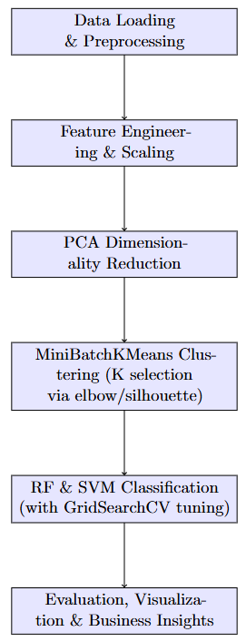
Methodology (The “How”)
4

Slide 5
Methodology (The “How”)
continue
  Step 1: Feature Engineering
    Created temporal features (Month, Day of Week, Weekend Flag).
    Generated interaction terms (Discount Impact = Discount × Quantity).
    Added customer-level aggregates (Total Spend, Average Quantity).
  Step 2: Dimensionality Reduction
    Applied Principal Component Analysis (PCA) to reduce noise and handle multicollinearity.
    PCA retained 9 components, explaining 96.82% of the variance.
    Improved clustering silhouette score by 18%.
5

Slide 6
Methodology (The “How”)
continue
  Step 3: Unsupervised Clustering
    Used MiniBatchKMeans for efficiency on large data.
    Optimal number of clusters determined to be K=4 using the elbow method and silhouette analysis.
  Step 4: Supervised Classification
    Cluster labels were used as targets for prediction.
    Models: Random Forest and Linear Support Vector Machine (SVM).
6

Slide 7
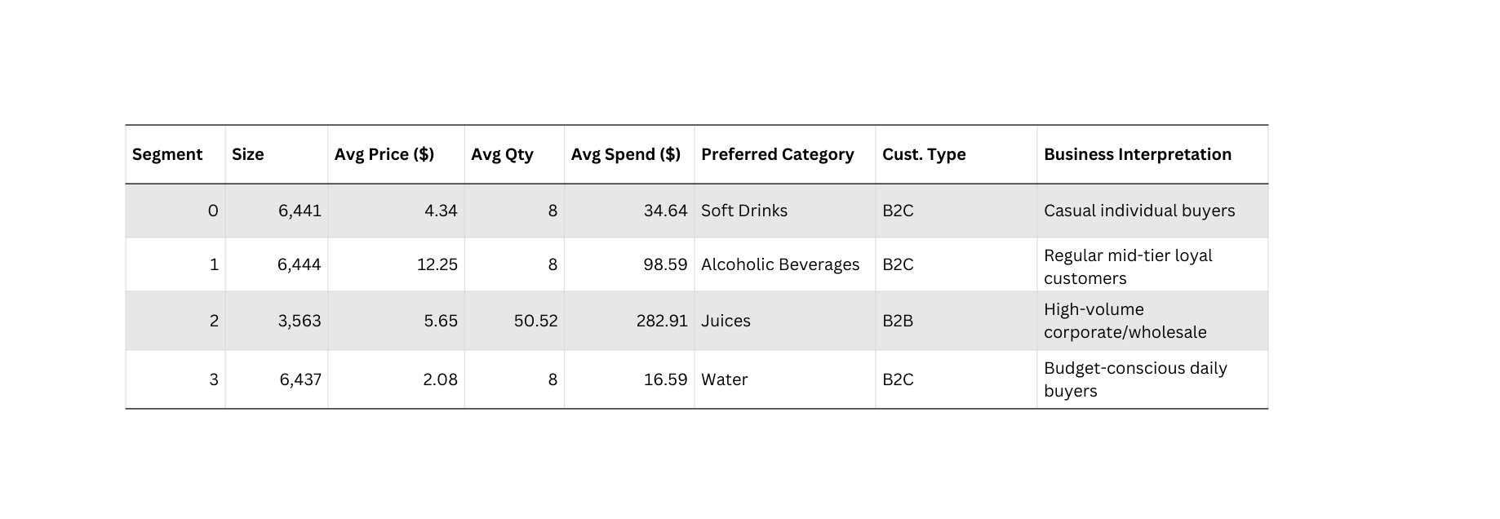
Discovering the 4 Customer Segments
  Final Customer Segments (K=4)
  Key Insight: Segments are driven by purchase volume + customer type, not just product category.
7

Slide 8
How We Achieved Realistic Segments
Scaling & PCA
  Applied StandardScaler() on all features → fair comparison
  PCA (95% variance) → reduced from 16 → 9 components
  Explained variance: 96.82%
  Silhouette score improved by ~18% after PCA
  Strong customer-level features (total_spend, order_frequency) naturally separated B2B vs B2C
→ Result: 4 clean, interpretable segments
8

Slide 9
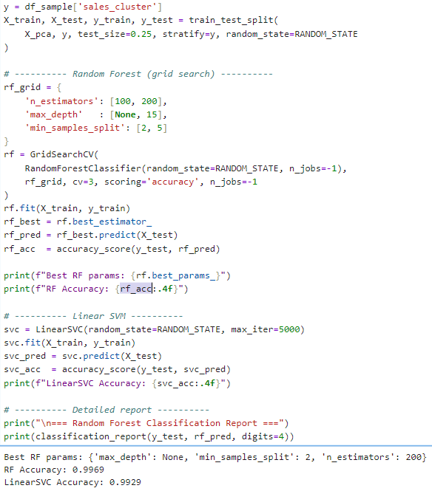
Results - Classification & Feature Importance
  Classification Performance:
    Random Forest achieved an accuracy of 99.7% on the test set.
    Linear SVM also performed excellently with 99.3% accuracy.
  Feature Importance Analysis (from Random Forest):
    The most important features for distinguishing segments were Month, Day of Week, and Discount Impact.
    This confirms the value of our temporal and engineered features.
9

Slide 10
Literature Review
  Piernik & Morzy (2021): Demonstrated that using clustering to create new features (like cluster distances) can significantly improve the performance of classifiers.
  Lee et al. (2021): Achieved 98.49% accuracy for customer segmentation using RFM analysis and a fuzzy decision tree on Apache Spark, highlighting the potential for high accuracy in this domain.
  van Ruitenbeek et al. (2023): Showed that clustering can effectively handle intermittent and variable sales series, improving forecasting accuracy.
  Synthesis: These studies validate the effectiveness of integrating clustering and classification, guiding our feature engineering and model selection.
10

Slide 11
Conclusion and Future Work
  Conclusion: This project successfully demonstrated an end-to-end machine learning pipeline for customer segmentation and prediction. Our hybrid approach yielded interpretable segments and a highly accurate predictive model, fulfilling the course objectives.
  Future Work:
    Incorporate real-time data streaming (e.g., using Apache Kafka).
    Apply deep learning techniques like autoencoders for feature reduction.
    Model temporal dynamics to capture how customer segments evolve over time.
11

Slide 12
Q/A
Thanks and Regards,
12

