Slide 1

DATA pioneers inventory -A Comprehensive Oracle SQL-Based Solution
By:
Anand Pandey Kartik taneja

Slide 2

Project topic
An inventory management system using oracle SQL developer to efficiently track and manage stock, customers, and orders in a retail environment.

Slide 3

Problem Statement
Many small and mid-sized businesses face inventory management challenges:
Stock shortages leading to lost sales and dissatisfied customers
Overstocking increasing storage costs and obsolescence risk
Order processing delays affecting customer satisfaction
Manual tracking causing errors and inefficient management

Slide 4

ObjectiveS
Develop a structured inventory system using Oracle SQL
Implement well-defined database schema with clear relationships
Ensure accurate tracking of products, customers, and orders
Optimize query performance for efficient data retrieval
Maintain data integrity using constraints and relationships

Slide 5
Business Problem and Solutions
1. Stock Shortages Issue: Businesses often experience stockouts, leading to missed sales and dissatisfied customers. Solution: The system tracks product quantities in real-time and triggers low-stock alerts, ensuring timely restocking.
2. OverstockingIssue: Overstocking leads to excess inventory that ties up capital and incurs storage costs. Solution: The system maintains optimal stock levels by analyzing sales trends and generating reorder recommendations.
3. Manual Inventory TrackingIssue: Manual inventory management is prone to errors and inefficiencies.
Solution: The DataPioneers_Inventory system automates inventory tracking, reducing human errors and ensuring accuracy.
4. Difficulty in Tracking Customer Orders Issue: Managing and tracking customer orders manually is cumbersome and error-prone.
Solution: The system stores detailed customer orders, allowing for easy retrieval, tracking, and management of past and current orders.
5. Inefficient Order Fulfillment Issue: Delays in processing and shipping orders lead to customer dissatisfaction.
Solution: The database tracks the order status, product availability, and shipping process, enabling faster and more efficient order fulfillment.
6. Lack of Integration Between Sales and InventoryIssue: Disconnected systems for sales and inventory can lead to inaccurate stock levels.
Solution: The system integrates sales and inventory, ensuring real-time updates to stock levels whenever a sale occurs.
7. Inaccurate Product Information Issue: Incorrect or outdated product data can lead to poor customer experience and operational inefficiencies.
Solution: The solution centralizes product information, making it easy to update product details such as prices, descriptions, and stock levels

Slide 6
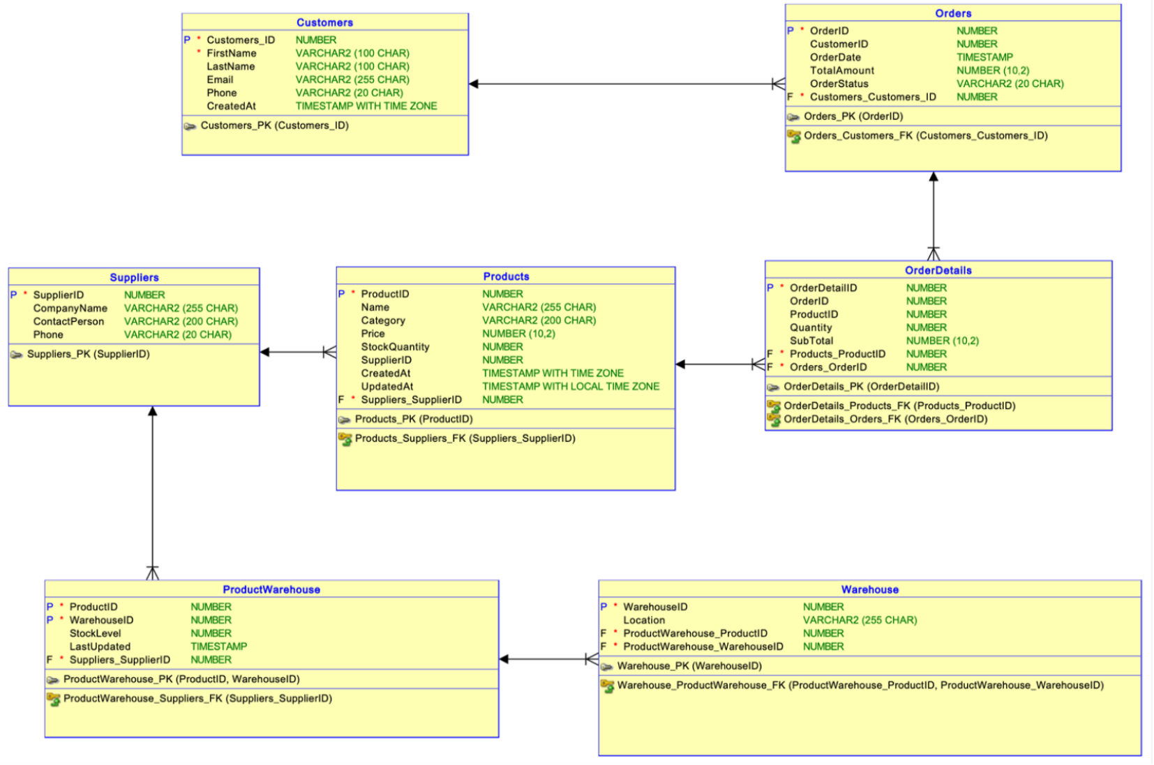
ER Diagram

Slide 7
Business Rules Implementation
Customer & Supplier Validation
First Name, Last Name, and Email must not be blank
Email must be unique across customers
Phone number must be at least 10 characters
Supplier names, contacts, and phone numbers mandatory
Product & Inventory Rules
Price must be positive and cannot exceed MRP (≤ 10000)
Stock quantity cannot be negative
Category must be specified and cannot be null
Stock is tracked per warehouse per product
Order Management Rules
Order quantity must be greater than zero
Total Amount must be greater than 0
Orders with unavailable stock are accepted as 'Backordered'
Once stock is replenished, backorders are automatically fulfilled

Slide 8
Order Processing flow
1. Customer Onboarding
Store customer information in the database
2. Place Order Customer places an order for multiple products
3. Check Availability
System checks stock levels across warehouses
4. Process Order
If stock > 0: Process immediately
If stock = 0: Mark as 'Backordered'
5. Automatic Backorder Fulfillment
Once stock is replenished, backorders are automatically fulfilled

Slide 9
Summary & Conclusion
The Data Pioneers Inventory Management System provides a robust foundation for efficient inventory tracking, order management, and business growth.
Key Achievements
Fully normalized database design
Robust business rule implementation
Automated backorder fulfillment
Comprehensive reporting views
Business Impact
Prevent stock shortages and overstocking
Improve order fulfillment efficiency
Better data-driven inventory decisions
Enhanced customer satisfaction

Slide 10

THANK YOU

