Slide 1
Hotel Booking Analysis: Insights & Recommendations
Data-Driven Strategies for Optimizing Revenue and Reducing Cancellations
Presented by Kartikesh Jadhao

Slide 2
Agenda
1. Introduction
2. Key Insights
3. Methodology
4. Recommendations
5. Conclusion

Slide 3
Introduction
This presentation provides an analysis of hotel booking data...
1. Introduction
This analysis explores hotel booking data to identify key trends, cancellation patterns, and pricing strategies, aiming to offer actionable insights to hotel management. Key areas of focus include:
Seasonal booking trends
Customer demographics and preferences
Factors affecting booking cancellations
Strategies to optimize pricing and reduce cancellations

Slide 4
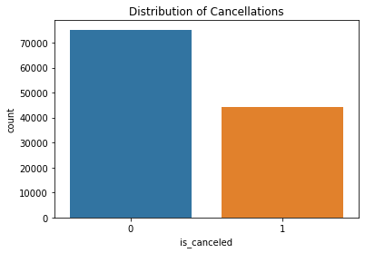
2. Key Findings
A. Seasonality in Bookings
Peak Booking Periods: Bookings increase significantly during holiday months (e.g., summer vacations and December).
High Cancellations During Peak Times: While more bookings are made in high seasons, cancellations also increase, indicating customer indecisiveness.

Slide 5
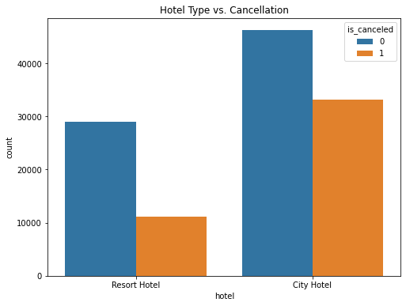
B. Distribution of Stays Across Hotel Types
Resort vs. City Hotels: Resort hotels attract more bookings during peak seasons, while city hotels see more steady, year-round bookings.
Cancellation Trends: Resort hotels show relatively fewer cancellations compared to city hotels, which see higher volatility.

Slide 6
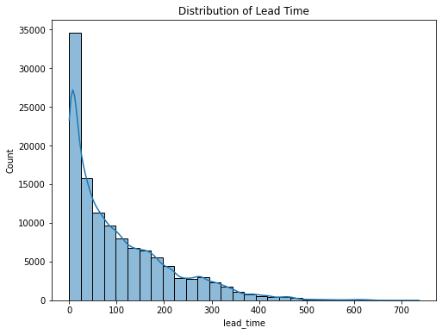
C. ADR (Average Daily Rate) Trends
Higher ADR in Resort Hotels: Resort hotels typically have a higher ADR, but this is accompanied by higher cancellation rates, suggesting possible price sensitivity.
Lead Time Impact: Bookings with longer lead times (early bookings) have a higher ADR but are more prone to cancellations.

Slide 7
D. Customer Type and Cancellation Rates
Transient Customers: Individual travelers are more likely to cancel their bookings than group or contract bookings.
Contract and Group Customers: These customers are more stable and less likely to cancel, making them valuable for long-term, predictable revenue.
E. Factors Driving Cancellations
Lead Time: Longer lead times are correlated with higher cancellation rates.
Deposit Policy: Bookings with no deposits are more likely to be canceled, highlighting the need for deposit-based incentives.
Special Requests: Customers with more special requests may have a higher likelihood of canceling, potentially due to unmet expectations.

Slide 8
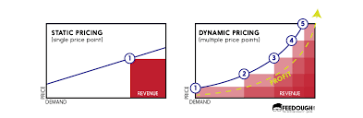
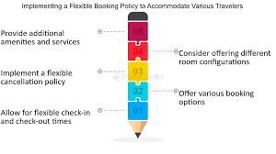
3. Recommendations
A. Pricing Strategies
Dynamic Pricing: Adjust ADR based on demand and seasonality. Offer promotions during off-peak periods to maintain occupancy.
Flexible Booking Options: Introduce flexible, refundable booking options at a slightly higher price, while maintaining non-refundable rates for price-sensitive customers.

Slide 9
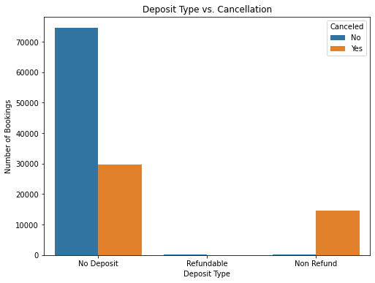
B. Cancellation Mitigation
Shorter Lead Time Offers: Encourage last-minute bookings with special offers to reduce the risk of cancellations.
Deposit Incentives: Encourage non-refundable or partially refundable deposits by offering a discount or added perks, such as free breakfast or late checkout.

Slide 10
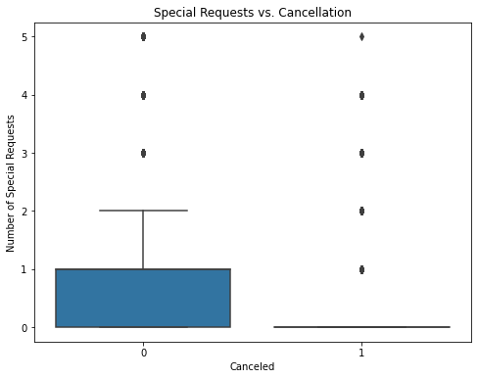
C. Customer Segmentation
Focus on Group and Contract Bookings: Expand corporate and event partnerships to leverage the stability of group bookings.
Special Promotions for Families and Transient Customers: Use loyalty programs and family-friendly packages to reduce cancellations and increase repeat business.

Slide 11
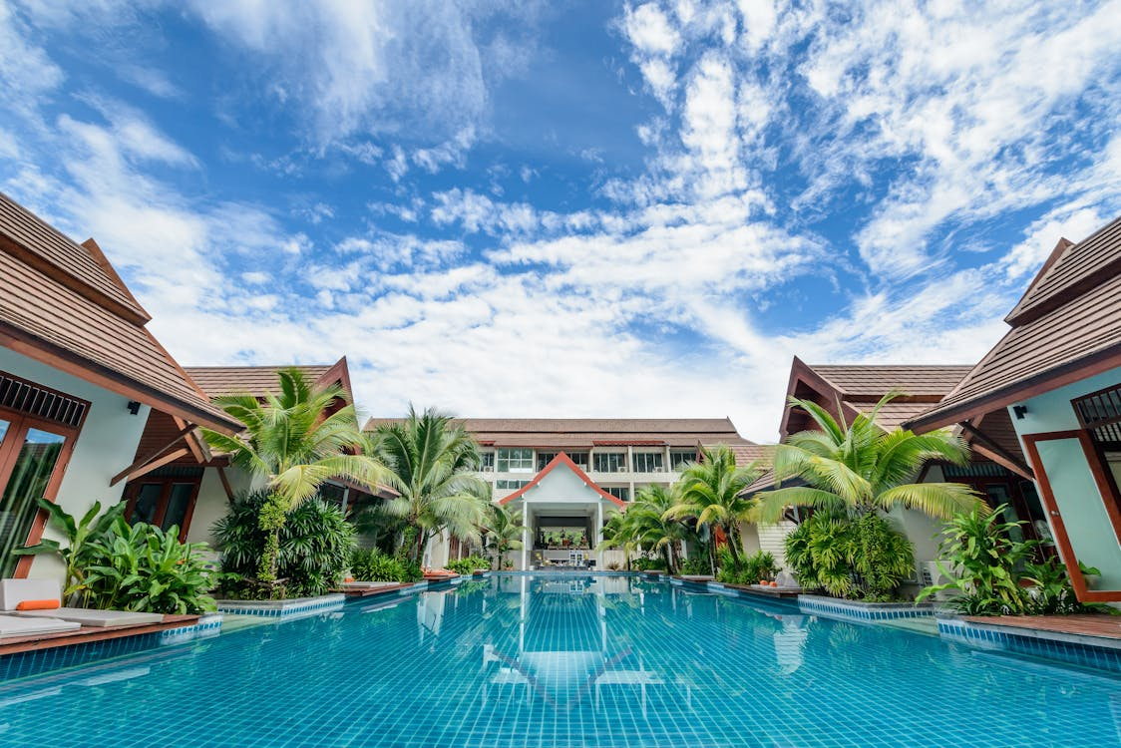
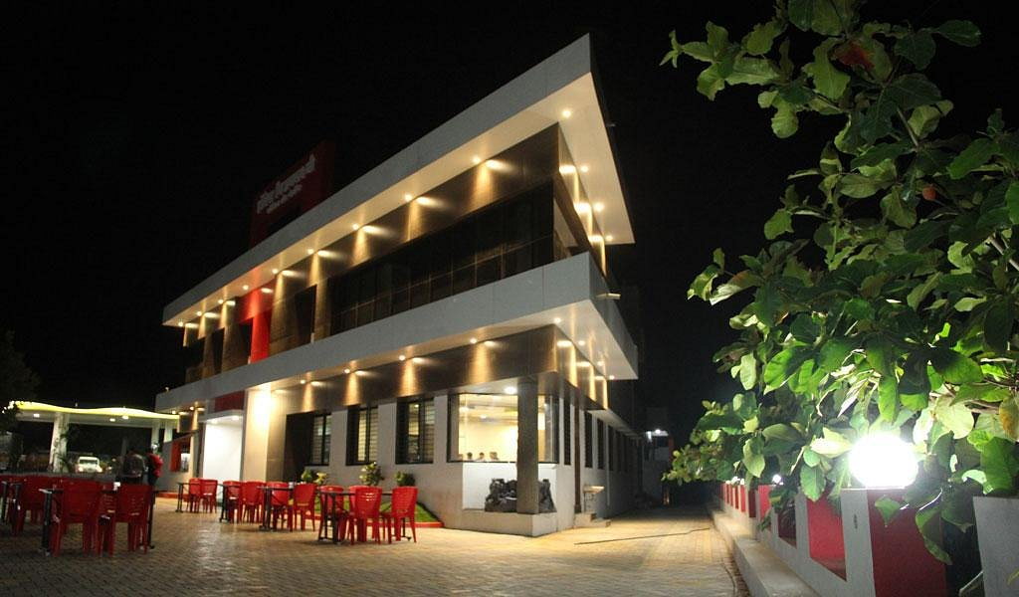
D. Marketing Focus
Tailored Campaigns: Promote resort hotels during peak seasons with early bird discounts and off-peak promotions. For city hotels, focus on business travelers with steady discounts throughout the year.
Proactive Customer Engagement: For high-risk bookings, automate follow-up communications with reminders, incentives, or upgrade offers to reduce cancellations.

Slide 12

Conclusion
Through careful analysis of booking trends, customer preferences, and cancellation drivers, this report provides actionable recommendations for pricing, customer engagement, and retention strategies. Implementing these will enhance the hotel’s ability to maximize revenue, minimize cancellations, and improve customer satisfaction.

Slide 13


