Slide 1

Executive Report: Nvidia Global Sales & Performance
End-to-end analysis of global sales, product performance, marketing ROI, and customer behavior using SQL queries and Power BI dashboards.

Slide 2
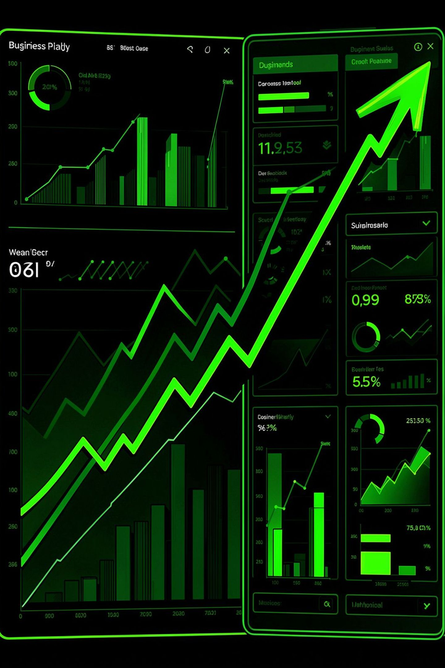
Headline Metrics
Total Net Revenue
Marketing Spend
$39.34 Billion
$4.15 Billion
Marketing ROI
Avg CSAT
8.49x overall
3.01 / 5.0

Slide 3
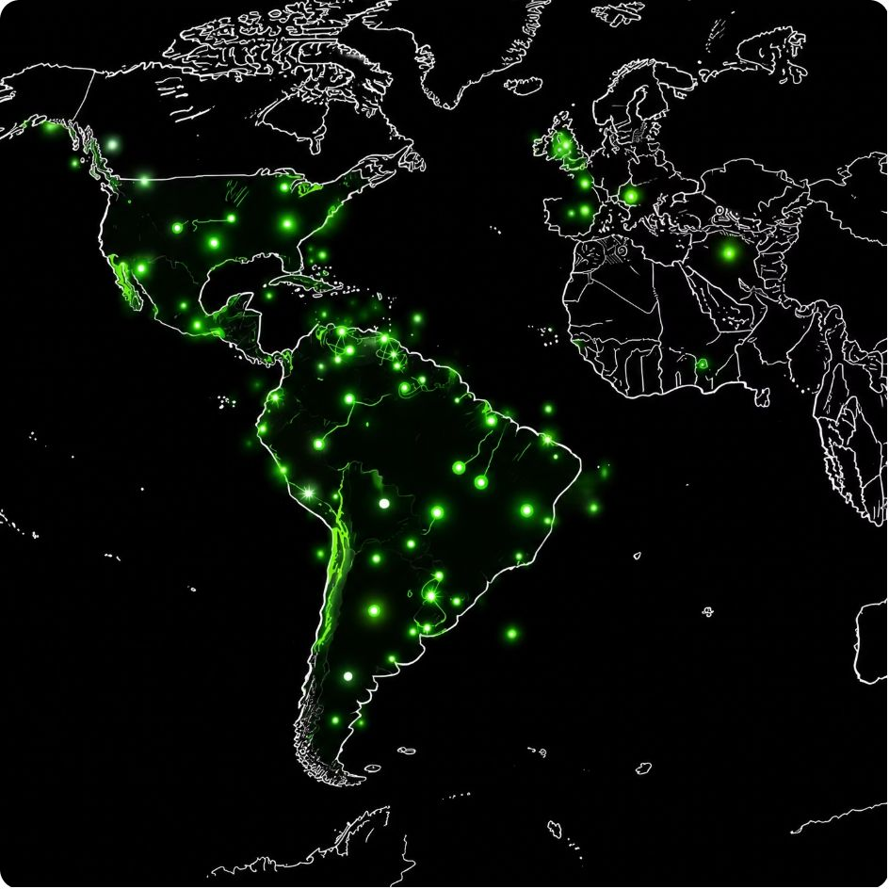
Regional Revenue Highlights
Top Regional Wins
AI in South America: $169.68M across 1,683 transactions
Data Center leader: Middle East at $168.92M
Global distribution: APAC, Europe, North America, South America, Middle East, Africa evenly spread

Slide 4


Product Performance: High-Value SKUs
Tesla V100 (OEM)
RTX 4090
Highest avg net revenue per order: $1,030,569.45; ASP $853.90.
Avg net revenue per order > $1,015,000 across Data Center, AI, Gaming.

Slide 5
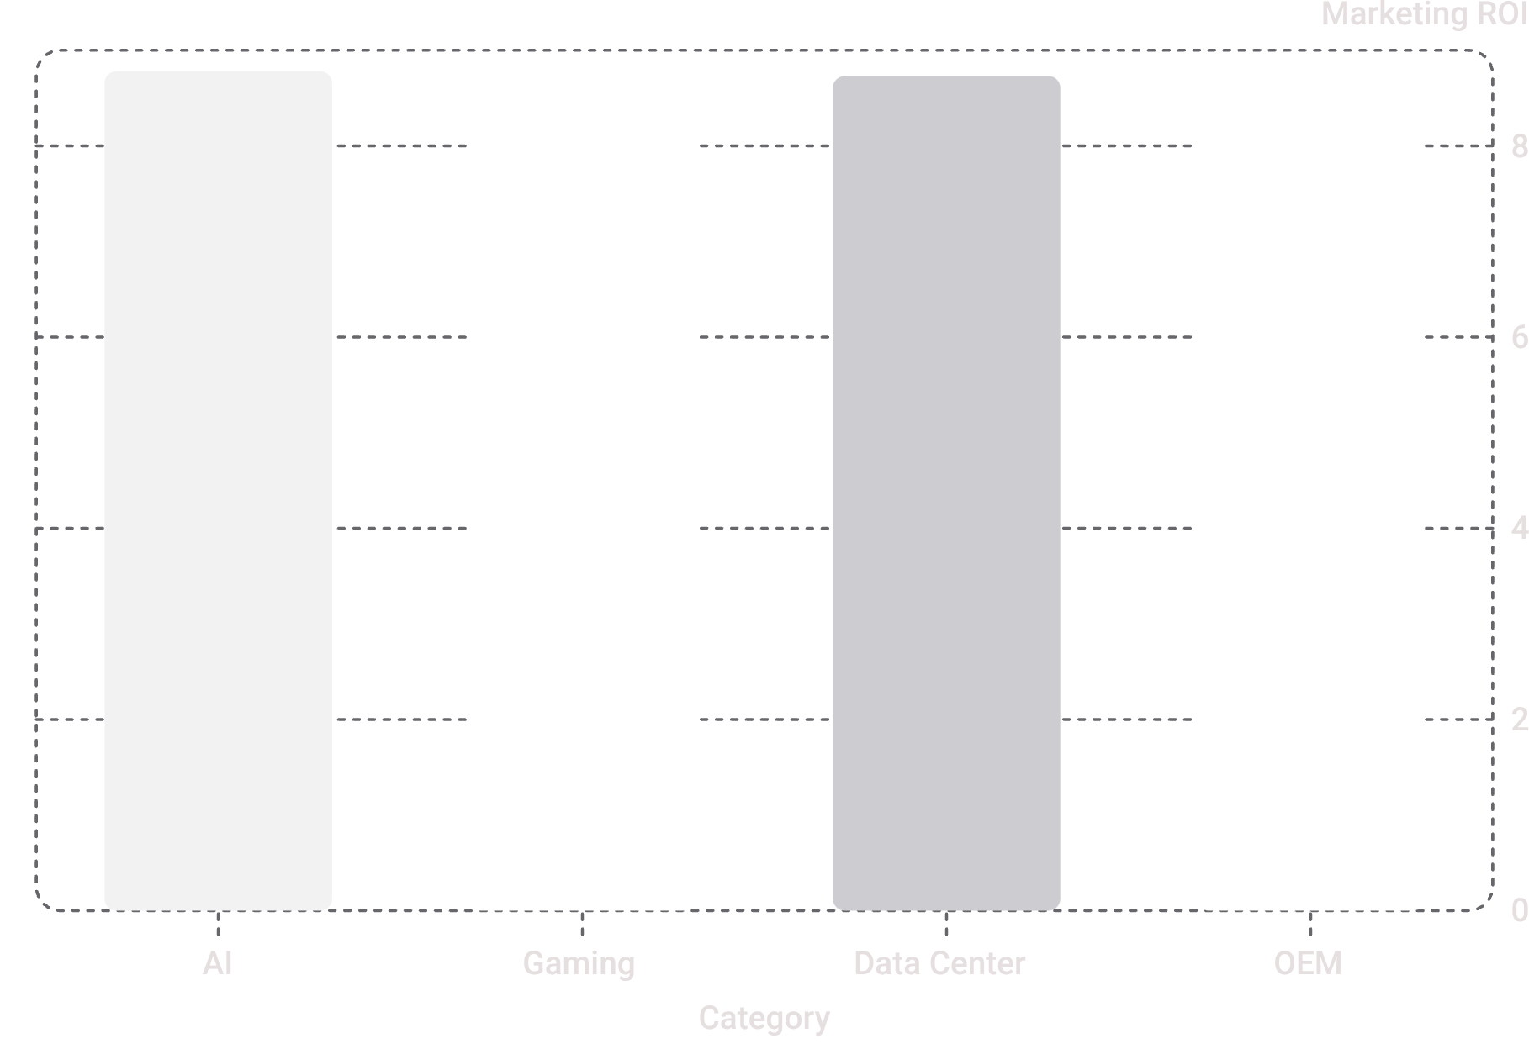
Marketing Efficiency by Category
Ad Effectiveness
Ad effectiveness values consistent across categories (~0.17–0.18). Marketing ROI remains steady, supporting continued spend efficiency.

Slide 6

Discount Tiers & Customer Outcomes
High Discount (15%+)
15,040 orders • Avg return rate 2.57% • CSAT 3.01
Medium Discount (5–15%)
16,798 orders (highest volume) • Avg return rate 2.56%
Impact
Higher discount tiers did not significantly alter CSAT or return rates.

Slide 7
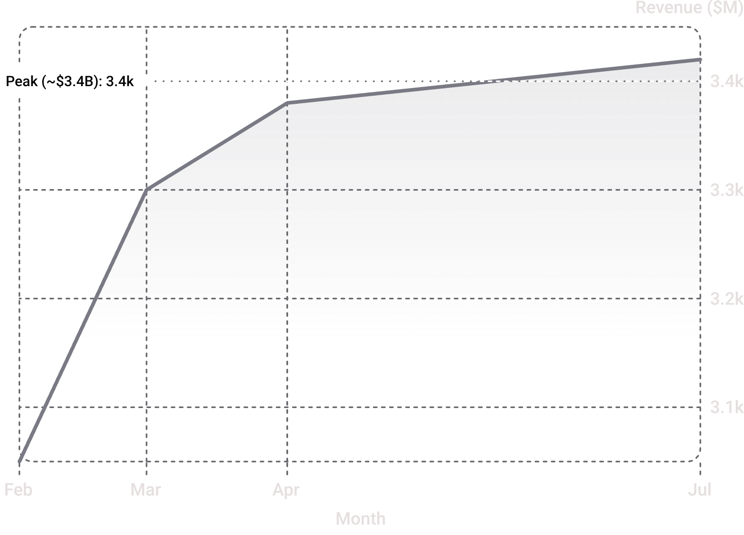
Seasonality & Monthly Trends
Peak demand spikes: April ($3.38B) and July ($3.42B). Major trough in February (~$3.05B) with rebound in March—opportunity to time marketing for momentum.

Slide 8




Customer Adoption & Retention
AI/ML Adoption
50% average adoption across customer segments.
Retention
Average customer retention rate ~70%.
CSAT
Avg CSAT 3.01 / 5.0 across Cloud Providers, Gamers, AI Researchers,
and Educational Institutions.

Slide 9

Strategic Recommendations
01
02
Shift Marketing to Peaks
Improve Post‑Sales Experience
Reallocate ad budgets toward Q2–Q3 (March–July) to capture seasonal momentum.
Prioritize post-sales support and driver/software updates to raise CSAT from 3.01.
03
Expand Enterprise Bundles
Scale RTX 4090 and Tesla V100 enterprise bundles in South America and Middle East.

Slide 10

Conclusion & Next Steps
Summary
Nvidia shows strong revenue ($39.34B) and efficient marketing (8.49x ROI). High-value SKUs and regional wins point to targeted growth opportunities.
Recommended Next Steps
Implement seasonal ad reallocation (Q2–Q3)
Invest in post-sales improvements to raise CSAT
Scale enterprise product bundles in high-performing regions

