Slide 1
OPENID CONNECT · OAUTH 2.0
Secure User Authentication
for Web Apps
with IBM Cloud App ID
A full-stack Node.js + Express application implementing production-grade identity, OAuth 2.0 / OpenID Connect sign-in, and protected session management.
OAuth 2.0
Node.js · Express
Passport.js
SECURE-AUTH · IBM CLOUD APP ID
01 / 07

Slide 2
THE PROBLEM
Passwords are the weakest link
1
2
3
Credential sprawl
Weak, reused passwords
No standard trust model
Every app that stores its own passwords is another breach surface and another reset-flow to maintain.
Users reuse the same password everywhere — one leaked database compromises many accounts.
Without OAuth 2.0 / OIDC, every team invents its own — inconsistent, and hard to audit.
PROJECT OBJECTIVE
Build a working reference app that hands identity off to IBM Cloud App ID, so this codebase never sees or stores a password — while still giving users a fast, branded sign-in and a protected, personalized dashboard.
SECURE-AUTH · IBM CLOUD APP ID
02 / 07

Slide 3
HOW IT WORKS
The trust chain
One signed, short-lived token — verified before your app ever sees the request.
USR
KEY
APP
User
IBM App ID
Your App
Signs in via IBM's hosted, encrypted login page
Issues a signed JWT (RS256) after verifying identity
Validates the token via Passport + WebAppStrategy
TLS 1.3 encrypted transport
JWKS-verified signed tokens
Zero passwords stored in-app
httpOnly session cookies
SECURE-AUTH · IBM CLOUD APP ID
03 / 07

Slide 4
UNDER THE HOOD
Technology stack
01
02
03
Node.js + Express
IBM Cloud App ID
Passport.js
Server runtime and routing for the app
Managed OAuth 2.0 / OIDC identity provider
WebAppStrategy handles the token exchange
04
05
06
EJS
express-session
Custom CSS design system
Server-rendered views for login & dashboard
Signed, httpOnly session cookies
Dark, trust-chain visual identity
SECURE-AUTH · IBM CLOUD APP ID
04 / 07

Slide 5
WHAT'S IMPLEMENTED
Features & security highlights
Application flow
Security controls
v
Full OAuth 2.0 / OIDC sign-in via IBM App ID
v
No passwords ever touch this codebase
v
Sign-up, sign-in & session verification flows
v
httpOnly, signed session cookies
v
Protected /dashboard route with live profile data
v
Tokens verified via JWKS (RS256)
v
Clean logout — clears local + IBM SSO session
v
Auto secure cookies in production (HTTPS)
SECURE-AUTH · IBM CLOUD APP ID
05 / 07

Slide 6
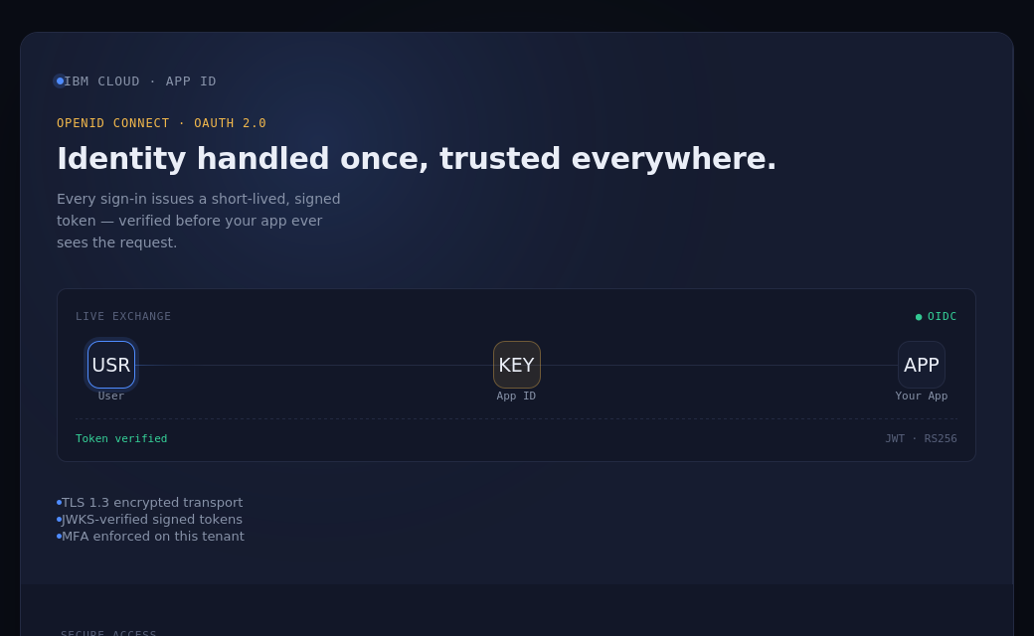
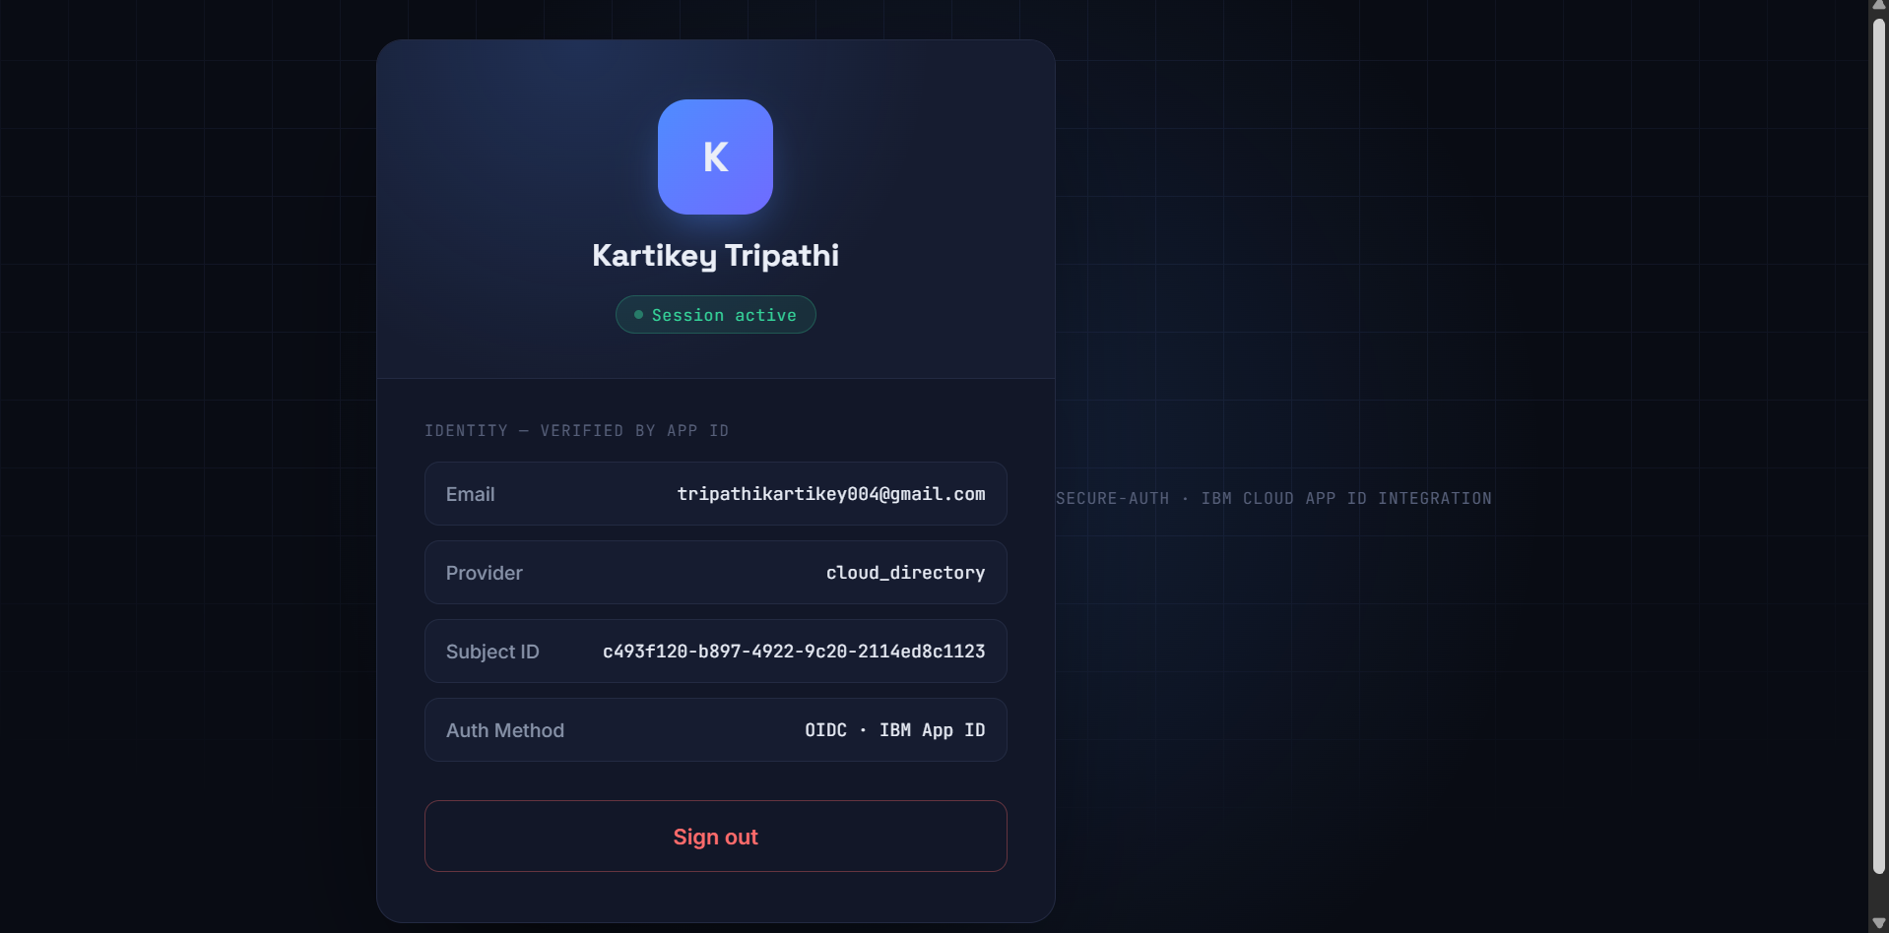
LIVE DEMO
It's running — end to end
Custom branded sign-in
Protected dashboard — verified session
End-to-End Authentication Successfully Verified ..
SECURE-AUTH · IBM CLOUD APP ID
06 / 07

Slide 7
PROJECT COMPLETE
Thank You.
Questions and feedback are welcome.
Built by Kartikey Ram Tripathi
Full source code, setup guide, and architecture notes are available in the GitHub repository below.
https://github.com/KartikeyRamTripathi/secure-auth-ibm-appid
SECURE-AUTH · IBM CLOUD APP ID
07 / 07

