Slide 1
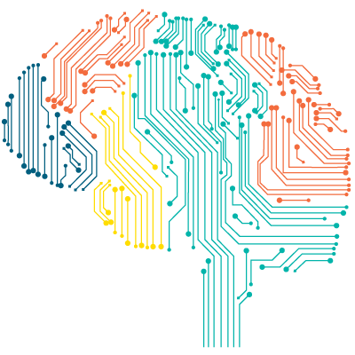
“Jarvis” AI Desktop Voice Assistant Using Speech Recognition.

Slide 2

Supervisor Name - JITESH PRADHAN
Submitted By –
KARTIKEYA MISHRA (171500157)
GOURAV SHARMA (171500112)
DEPARTMENT OF COMPUTER ENGINEERING APPLICATIONS
INSTITUE OF ENGINEERING AND TECHNOLOGY
GLA University
Mathura-281406, INDIA
2020

Slide 3
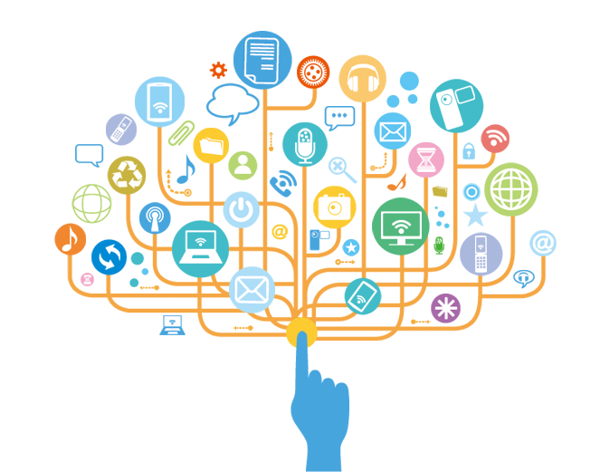
CONTENT
INTRODUCTION TO SPEECH RECOGNITION
MOTIVATION
ABOUT THE PROJECT
ADD UP
TECHNOLOGY USED
HARDWARE REQUIREMENT
CONCLUSION

Slide 4
INTRODUCTION TO SPEECH RECOGNITION
Speech Recognition which is also known as automatic speech recognition (ASR) and voice recognition recognizes the spoken words and phrases and converts them to a machine-readable format.
By converting spoken audio into text, speech recognition technology let users to control digital devices by speaking instead of using conventional tools such as keystrokes, buttons, keyboards etc.
Getting started involves three key actions:
Integrate
Manage
Analyse

Slide 5
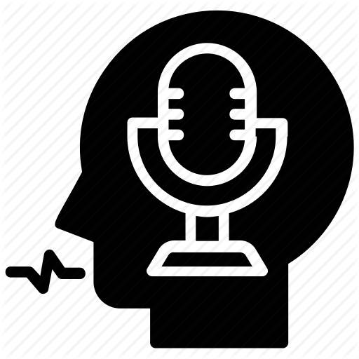
MOTIVATION
It is fast becoming a way to help bridge the gap in professional task management and daily activities
Through this project we are going to create our own voice assistant to achieve our daily activities easily
It is very Important for --
We can achieve our task very easily
Aiding the Visually- and Hearing-Impaired
Controlling Digital Devices
Speech recognition technology is already a part of our everyday lives, but for now is still limited to relatively simple commands. As the technology advances, researchers will be able to create more intelligent systems that understand conversational speech

Slide 6
ABOUT THE PROJECT
It is very important for Students to assess their daily activity application very easily using their voice
These kind of recommended systems help to write email to your friends with your voice.
This project mainly concentrates on the easiness of your task by providing you assistant, which can successfully complete your task just through your voice

Slide 7
ADD UP
1- Mail Services.
2- Digital Wellbeing

Slide 8
TECHNOLOGY USED:
“pyttsx5”
The major advantage of using this library for text-to-speech conversion is that it works offline.
“SAPI5”
The Speech Application Programming Interface or SAPI is an API developed by Microsoft to allow the use of speech recognition and speech synthesis within Windows applications.
Tkinter based GUI/Web Application

Slide 9
HARDWARE REQUIRED:
Personal computer
i3 Processor Based Computer Or Higher
Memory: 2 GB RAM(Minimum)

Slide 10
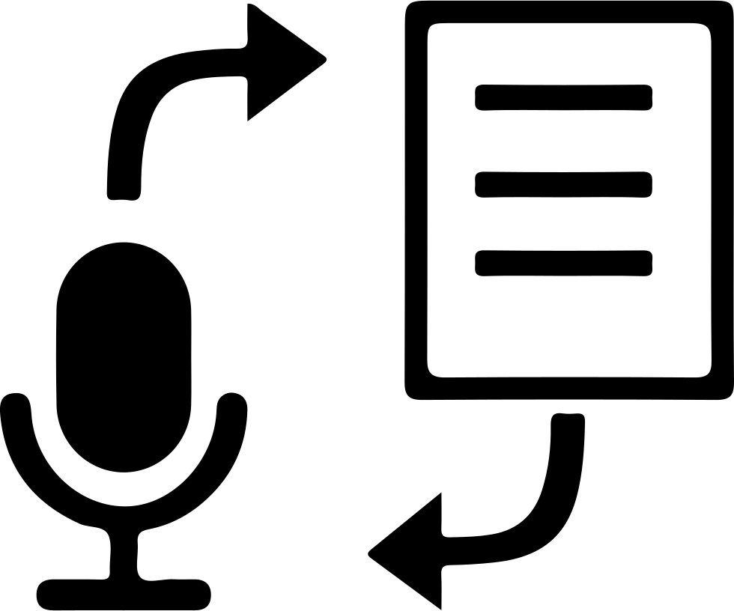
CONCLUSION
This project aims at developing a Tkinter based` UI application where the project mainly concentrates on the easiness of your task by providing you assistant, which can successfully complete your task just through your voice

Slide 11
Thank You

