Slide 1
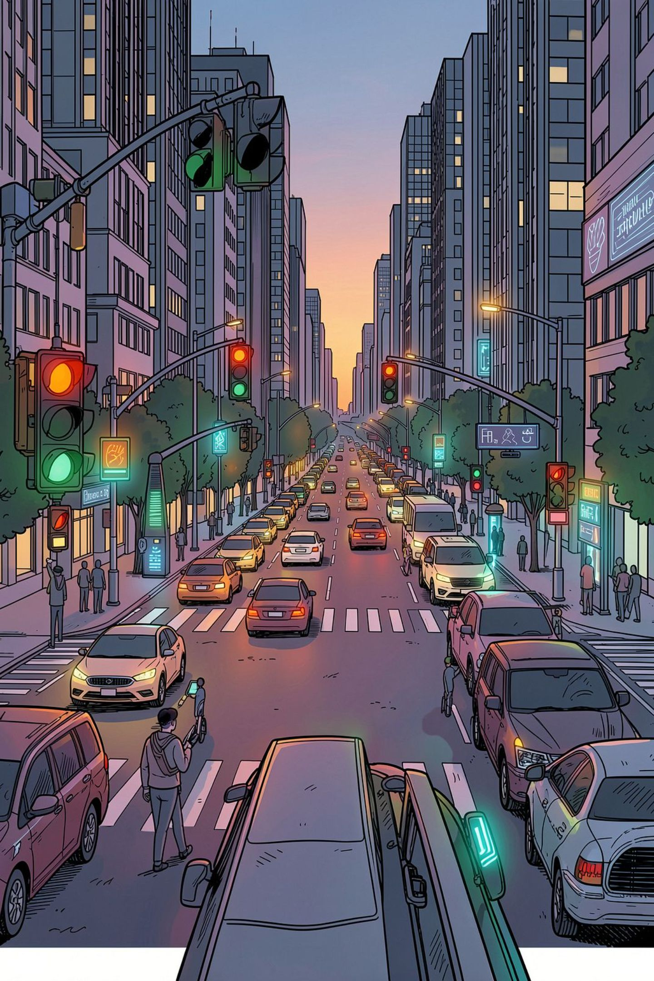
Traffic Accident Risk Prediction Using Machine Learning
CSD 403 – Predictive Analysis
Predicting accident risk levels using traffic, road, weather, and environmental factors — moving from descriptive traffic analysis to predictive machine learning.
Kartikeya Rai · Reg. No. 12320868 · Section K23TG

Slide 2

BACKGROUND
Traffic & Smart City Safety
Rising Urban Density
Dynamic Conditions
Rapid urbanization has intensified traffic density and road-safety challenges across growing cities.
Traffic conditions shift constantly based on time, weather, road state, and vehicle density.
From Descriptive to Predictive
Identifying accident risk in advance enables proactive traffic management — this project extends prior Traffic Pattern Analysis into a predictive ML problem.

Slide 3
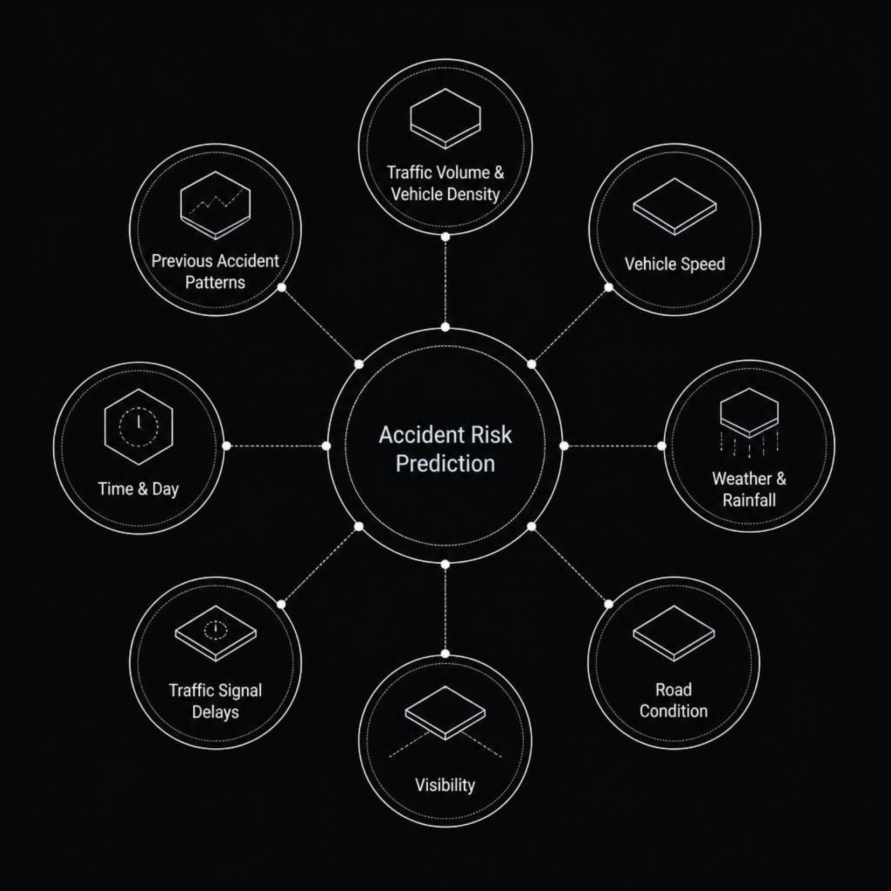
PROBLEM STATEMENT
What Makes Accidents Predictable?
Traffic accidents are influenced by a complex combination of factors. A machine-learning-based system is needed to analyze these signals and predict the risk level of an accident before it occurs.

Slide 4
OBJECTIVES
Project Objectives
Build a Classification Model
1
Develop an ML model to classify accident risk as Low, Medium, or High.
Identify Risk Factors
2
Determine which traffic and environmental features are most strongly associated with higher risk.
Preprocess & Engineer Features
3
Perform data cleaning, transformation, and feature engineering to prepare a robust dataset.
Compare Algorithms & Evaluate
4
Train multiple classifiers and evaluate using accuracy, precision, recall, F1-score, and confusion matrix.
Reusable Pipeline
5
Build a complete, modular ML prediction pipeline ready for deployment.

Slide 5
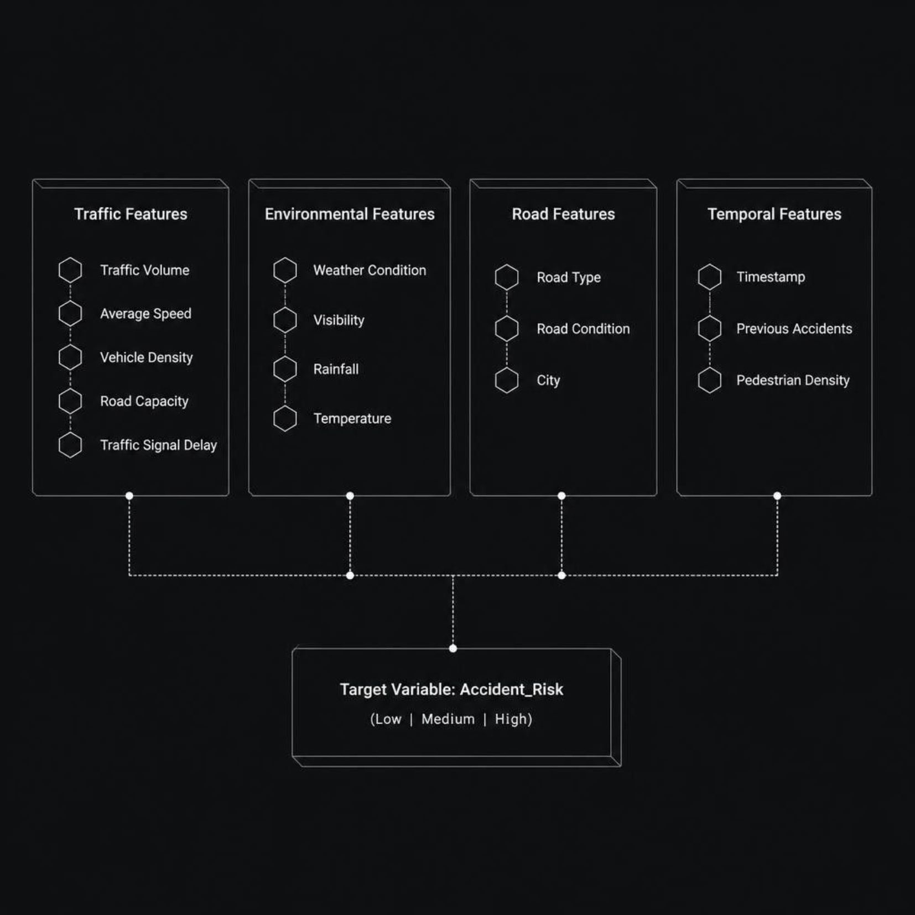
DATASET
Traffic Accident Risk Dataset
Planned dataset of approximately 5,000–10,000 records with 15 features across traffic, environment, and infrastructure dimensions.
Target Variable
Accident_Risk is a multi-class label derived from combined traffic and environmental conditions.
Low
Medium
High

Slide 6
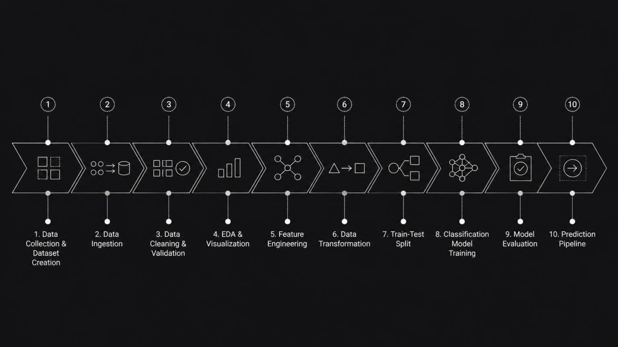
METHODOLOGY
Machine Learning Workflow
The pipeline follows a structured CRISP-DM-inspired approach, ensuring reproducibility and clean separation between data preparation, modeling, and deployment stages.

Slide 7

PROGRESS
Work Completed So Far
Unit 1 — Environment & Setup
Unit 2 — Logging & Exception Handling
Python environment configured with required libraries
Project folder structure and requirements.txt created
README and .gitignore configured
Git repository initialized with multiple commits
Custom logging module implemented and tested
Custom exception handling layer added
Data ingestion component created
Feature branch created; Pull Request merged into main
Both units completed with proper version control workflow — feature branches, PRs, and merged commits.

Slide 8
ROADMAP
Upcoming Development
01
02
03
Dataset Creation
Data Ingestion & Cleaning
EDA & Feature Engineering
Build the Traffic Accident Risk dataset with realistic traffic-environment relationships.
Implement ingestion component, perform validation, and handle missing or inconsistent values.
Conduct exploratory analysis, encode categorical variables, and engineer risk-relevant features.
04
05
Model Training & Comparison
Prediction Pipeline
Train multiple classifiers, compare performance, and select the best model.
Package the full workflow into a reusable, end-to-end prediction pipeline.

Slide 9
EXPECTED INSIGHTS
What We Expect to Investigate
These are expected areas of investigation — not final findings. The model has not yet been trained.
Weather & Visibility
Traffic Volume & Density
Whether poor weather and low visibility measurably increase accident risk.
How vehicle density and traffic volume correlate with higher-risk conditions.
Temporal Patterns
Road Conditions
Which hours and days of the week show elevated risk patterns.
How road type and surface condition influence accident probability.
Prior Accident History
Feature Importance
Whether previous accident records are a useful predictor of future risk.
Which features contribute most strongly to the model's predictions.

Slide 10
OUTCOME & FUTURE SCOPE
Expected Outcome & What Comes Next
Expected Deliverables
Future Scope
Trained multi-class accident risk model (Low / Medium / High)
Comparison of classification algorithms
Evaluation metrics: Accuracy, Precision, Recall, F1-score, Confusion Matrix, ROC-AUC
Complete, reusable ML prediction pipeline
Real-time traffic sensor & IoT integration
GPS-based accident-risk alerts
Geospatial risk mapping
Integration with smart-city traffic management systems
From analyzing traffic patterns → to predicting accident risk.

