Slide 1

Predict before they leave!
Employee Churn
Predict & Explain using HR Dataset and Exit Interviews with Python.

Slide 2



Cost of Employee Churn
Talent Pool
Customer Relationship
Training Cost

Slide 3
What factors are significant to predicting employee turnover?
Machine Learning
Scikit-learn package in python
Predict at high accuracy
IBM Data Set
Feature selection
Model selection
Model validation

Slide 4
Output – factors ranking

Slide 5
Are there any other factors that should be put into consideration?
Text Analysis
Speech Recognition
NLTK
Exit interviews
Transfer online and offline audio to text
Text analysis using n-gram analysis

Slide 6
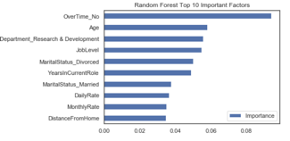
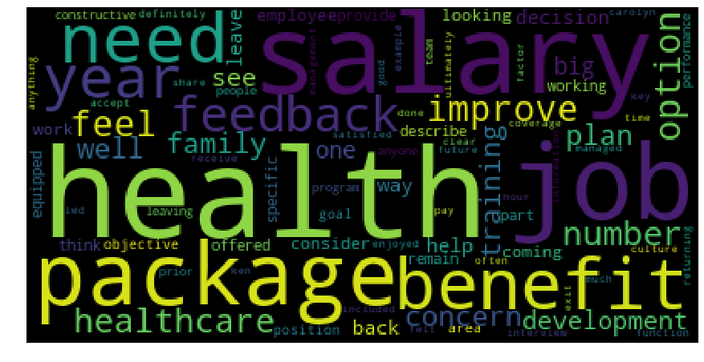
Output - Frequency Word-Cloud
Looking at both outputs side by side, we can now see a specific piece of pay and benefits not present in that first data set starts to emerge.

Slide 7



Business Applications
Benefits
Business Applications
Additional Opportunities
Predict employee churn
Design better retention plans
Improve employee satisfaction
Predicting customer churn
Evaluating product performance
Exploring industry trends
External resources
Such as Glassdoor and Indeed

Slide 8
Q & A
Local video link

Slide 9

Thank you

