Slide 1



RENT & RUN
CAR RENTAL SERVICE

Slide 2
TEAM MEMBERS WORKING ON PROJECT
Priyanshu Tiwari
Taneesha Sharma
Kartikeya Pandey
Shivendra Pratap Singh
Shashank Yadav

Slide 3
INTRODUCTION
RENT & RUN is a car rental service.
It is user- friendly, thus helping in better utilization of the resources. This project offers the best of services-both in terms man and machine.
It offers the online car rental service for travel agencies.
It offers the best of rates and include the different categories of cars from luxury to budget.
Rent & Run service will also provide vehicle insurance.

Slide 4
EXISTING SYSTEM
1. In the present system, organization hires a person for the booking and proper functioning.
2. The hired person keeps up and maintain the booking and transport details in papers
Problems in the current system:
1. It involves paperwork.
2. Updates, changes in details is tiresome.
3. Performance is affected and not up to mark.

Slide 5
PROPOSED SYSTEM
The proposed system solves the issues faced by the current system.
Benefits:
Data is centralized , so it will be recorded .
The updating and changes in details will be much easier.
Maintenance will get easier making it cost effective.
It supports multiple languages making it user friendly.
Also helpful for the user as they can track their car schedules effectively.

Slide 6
Some more benefits of the proposed system:
Login available for agents and recurring customers.
Instant booking confirmation through an email reminder.
Online payment available for any location.
Accept payments by credit , debit cards without any extra online charge.
User can have insurance by paying the extra charge.

Slide 7
HARDWARE SPECIFICATIONS
Hard Disk : 500 GB
RAM : 4GB
Processor : Pentium or Intel

Slide 8
SOFTWARE SPECIFICATIONS
Operating System :Windows, Linux, Android, iOS
User Interface : HTML, CSS, BOOTSTRAP
Client-side Scripting : JavaScript
Programming Language : PHP
Web Technologies. : JQUERY
Database : My SQL6
Database Connectivity : JDBC
Web Server : XAMPP/WAMPP/MAMP server

Slide 9
MODULES
This project contains three modules: Authentication module:
The user enter their details and if valid they will be entered into the system.
After entering they will be able access different modules.
If they don’t have a username and password , they will have to register first.
They are two types of users who are using the application: Admin and Customer.

Slide 10
LOGIN/REGISTERED : FLOWCHART

Slide 11
2. Admin module:
Admin can login with user-name and password.
After logging , he can start adding vehicles .
He can handle the situation where the vehicle is supposed to be replaced.
He will be able to collect the rent from the customer and view the booking details.

Slide 12
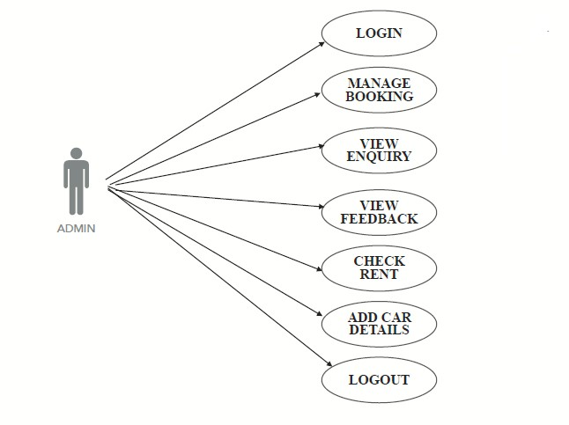
Admin: use case diagram

Slide 13
3.Customer module:
The customer can rent the car by logging in.
If they want to book the car, they need authentication.
They should create a new account to book car or if they already have an existing account, they should log in.
They can pay through their credit card, UPI details.

Slide 14
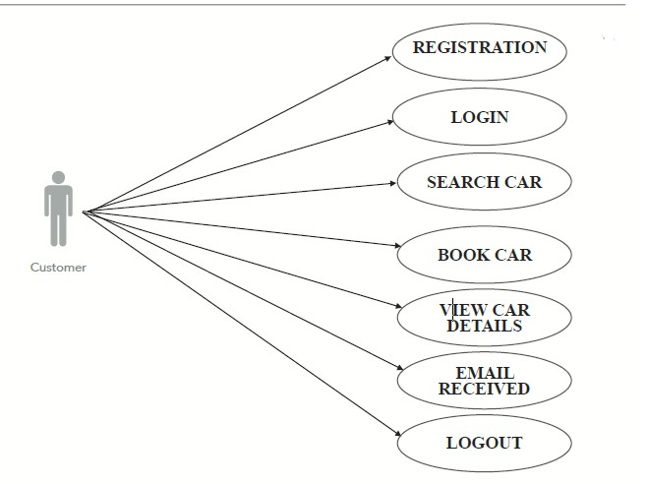
Customer: use case diagram

Slide 15
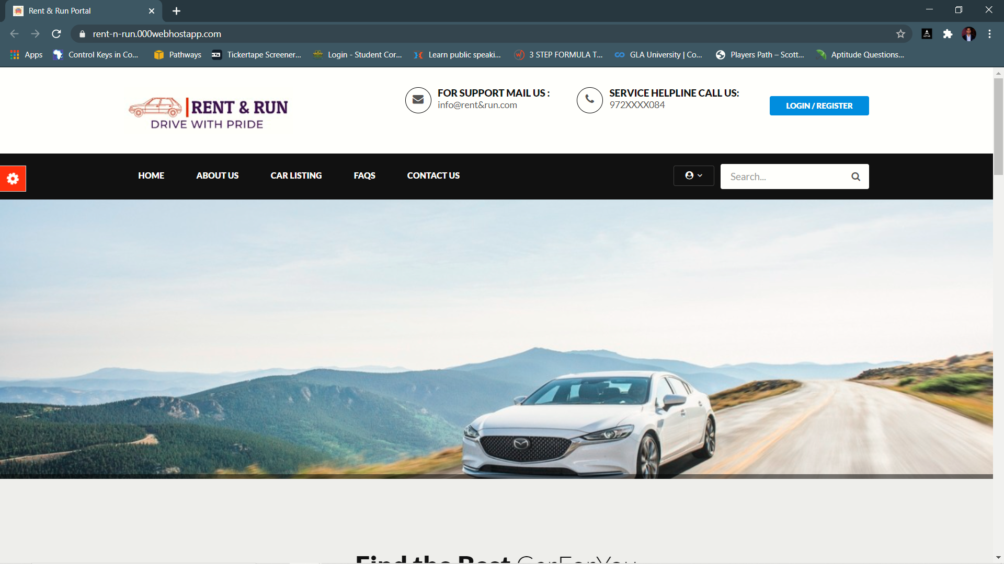
INPUT DESIGN
HOMEPAGE

Slide 16
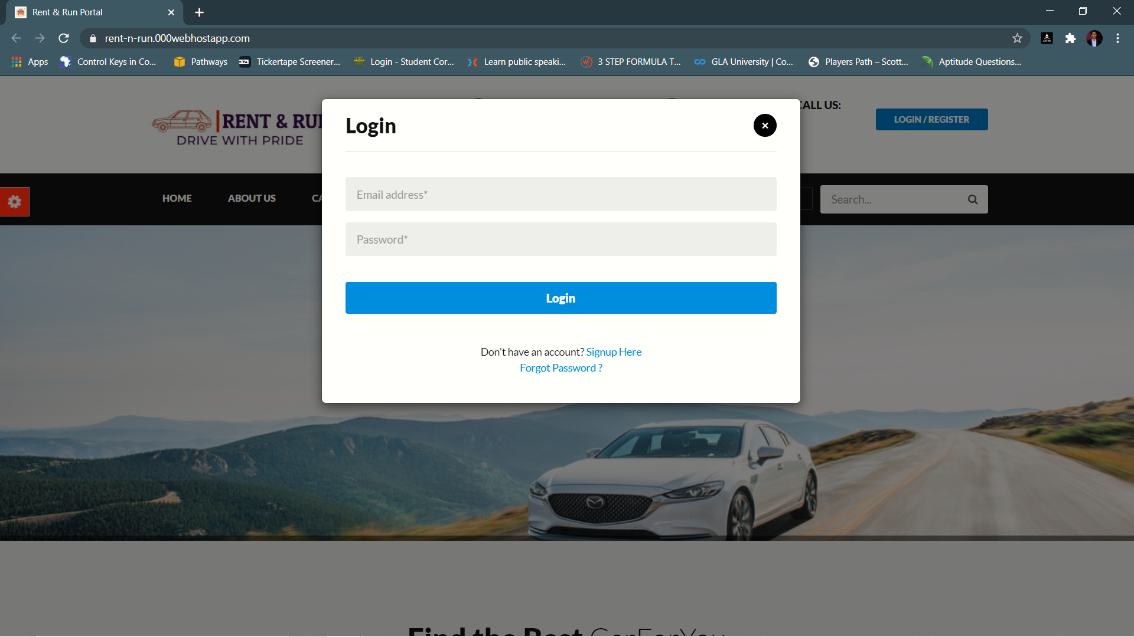
login page
.

Slide 17
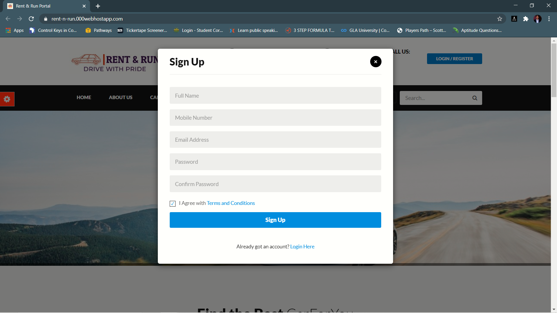
Sign-up page
.

Slide 18
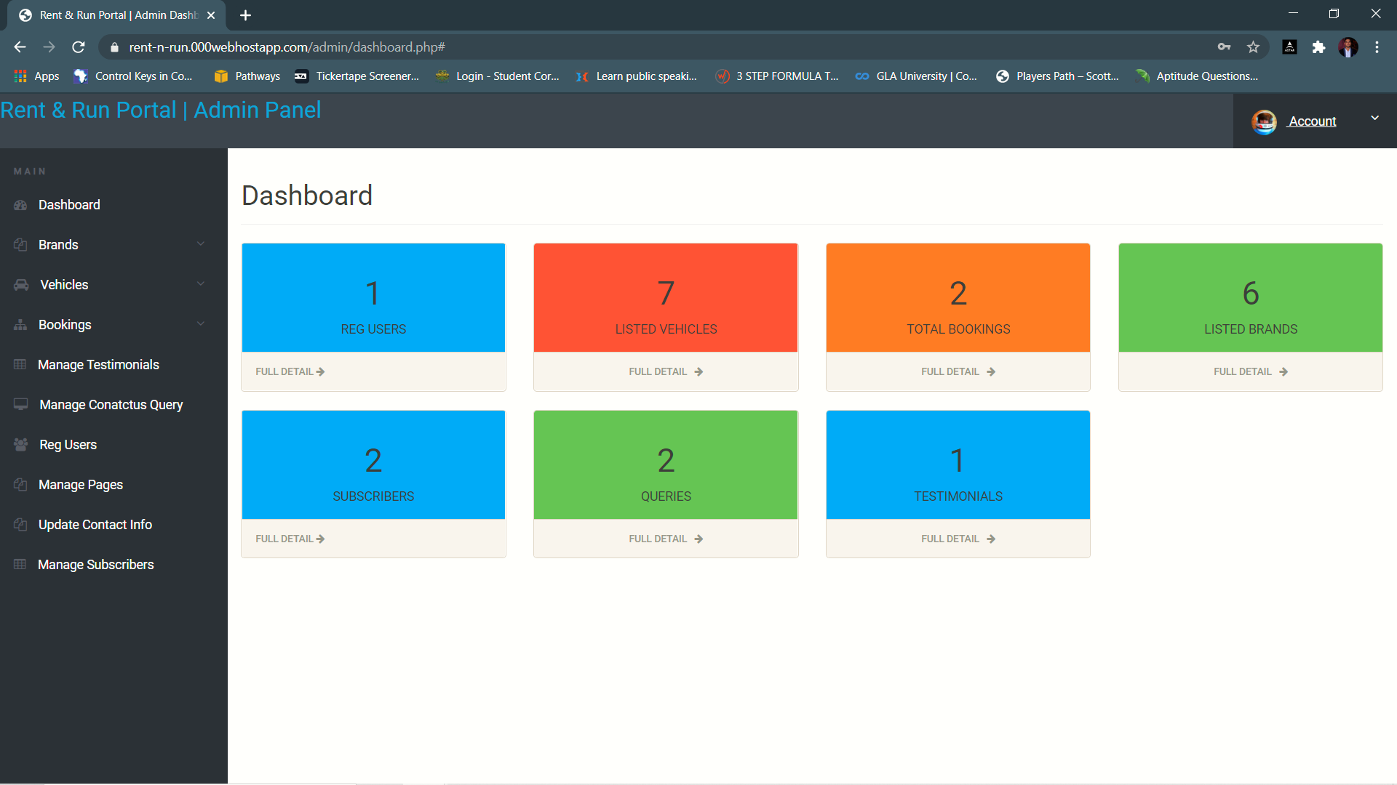
dashboard
.

Slide 19
CONCLUSION
Rent & Run is a web application, and it is restricted to only limited type of users.
In this application different type of users have been given access rights and they are restricted up to functionalities, so that data is maintained securely, and redundant data is prevented.
We are providing a good user interface.

Slide 20

Thank You

