Slide 1
Recruiter Intelligence
Candidate Ranker
We brutally torch keyword-stuffed resumes and surgically extract the exact 100 elite engineers you actually want.
CPU-only final ranker
100K candidate corpus
Honeypot-aware
Team Name
Kartikeya AI Recruiter
Problem Statement: Problem: Keyword filters are for dinosaurs. We aggressively rank top-tier talent by ruthless evidence.
Team Leader: Kartikeya Krishna Mishra
Generated for the Redrob AI/Data challenge idea submission template
01

Slide 2
The Blueprint of Domination
Redrob Candidate Ranker
Why our engine obliterates primitive keyword matching.
Core idea
1
Understand role intent
2
Read full candidate story
We rip apart the JD, then interrogate every candidate's history. If they lack hard proof, hunger, and ironclad integrity, they get axed.
Extract seniority, production ML, retrieval/ranking, evaluation, product context, location and availability needs.
Use title, history, skills, tenure, company context, activity and assessment signals — not only skill tokens.
3
Rank with evidence
4
Explain shortlist
Combine recruiter-fit, semantic fit, BM25-style evidence, career proof, behavior and risk penalties.
Emit top 100 with grounded reasons pulled from observable profile evidence and profile-integrity checks.
Keyword filters
Semantic retrieval
Recruiter heuristics
Risk controls
Trustworthy shortlist
The Kicker: We reward battle-tested engineers and mercilessly penalize posers stuffing resumes with buzzwords.
Legacy systems ask 'did they type the word?' We ask 'can this person actually ship code?'
02

Slide 3
Interrogating the JD & Exposing Candidates
Redrob Candidate Ranker
Extracting the raw truth, ignoring the fluff.
JD facets extracted
Candidate signals
Production retrieval
semantic search, vector/hybrid retrieval, ranking
Career proof
Skill depth
Behavior
Evaluation depth
NDCG, MRR, MAP, A/B tests, offline eval
Applied ML seniority
5–9 years, Python, production ownership
Integrity
Location
Product context
search, discovery, marketplace, candidate matching
The Kill Score = Hard Proof + Hunger - BS Risk
Behavioral readiness
active, open-to-work, notice period, response rate
The Apex Signal Hierarchy
Career evidence
Retrieval/ranking proof
Behavioral readiness
Location/seniority
Keyword overlap
03

Slide 4
The Execution Matrix
Redrob Candidate Ranker
Surgical retrieval, ruthless scoring, and ironclad rank fusion.
1
Parse
2
Prefilter
3
Score
4
Filter
5
Fuse
JSONL → profile text
100K → candidate pool
facet + career + behavior
honeypot and risk gates
rank fusion → top 100
Final scoring stack
Risk-aware fusion
Recruiter fit
22%
Final Score = technical fit × behavioral readiness − integrity penalties
Semantic facets
18%
BM25 evidence
14%
● Reciprocal rank fusion stabilizes disagreement across sub-rankers.
Teacher-style heuristic
18%
● Honeypot profiles are penalized before the top-100 cutoff.
Career proof
12%
● Explanations are generated from matched evidence, not imagined claims.
Behavior/location
16%
04

Slide 5
Receipts & Bulletproof Validation
Redrob Candidate Ranker
How we keep our decisions savage but perfectly auditable.
Every top pick comes with undeniable receipts:
✓
Supported claims only
Example explanation pattern
Reason uses title, skills, history and activity fields.
“Senior ML Engineer with 7.2 years in Noida; profile shows production semantic search, retrieval evaluation, vector search and marketplace ranking evidence. Behavioral signals indicate high readiness and no integrity flags.”
✓
Poser Annihilation System
Incinerates impossible timelines, pathetic AI keyword stuffing, and flat-out lies.
Integrity penalties
✓
Flawless Output Guarantee
Exactly 100 rows. No duplicates. Descending order of pure talent.
● Expert skill with tiny duration
● Career duration mismatch
● AI keyword stuffing without history
Zero Delusions
● Wrong-domain profiles masked by keywords
If they didn't do it, we don't invent it. Period.
● Research-only / tutorial-only evidence
05

Slide 6
The Meat Grinder Workflow
Redrob Candidate Ranker
From raw JD to an elite top 100 shortlist.
JD
Profiles
Features
Rankers
Fusion
CSV
role
requirements
100K
candidates
career + skill
behavior + risk
rule + semantic
BM25 + teacher
stable final
ranking
top 100
with reasons
Runtime behavior
22s
100
● Final evaluation command is deterministic: python rank.py --candidates candidates.jsonl --out submission.csv
observed full-corpus generation time in local run
ranked candidates emitted exactly
● No external API calls, no hosted models, no GPU dependency and no manual CSV editing.
06

Slide 7
The Engine Room
Redrob Candidate Ranker
A lethal, stripped-down architecture built for raw speed on CPU.
Input Layer
candidates.jsonl, JD facets, metadata config
Parsing & Normalization
profile text, titles, career spans, skill objects, behavioral fields
Feature Layer
role fit, evidence counts, seniority, tenure, readiness, integrity risk
Ranking Layer
rule ranker, semantic-style facets, BM25-style evidence, teacher heuristic, fusion
Output Layer
submission.csv, top_debug.jsonl, Streamlit sandbox
Design principle
Sophisticated ranking logic, but simple final execution: plain Python modules with one minimal dependency for fast JSONL parsing.
07

Slide 8
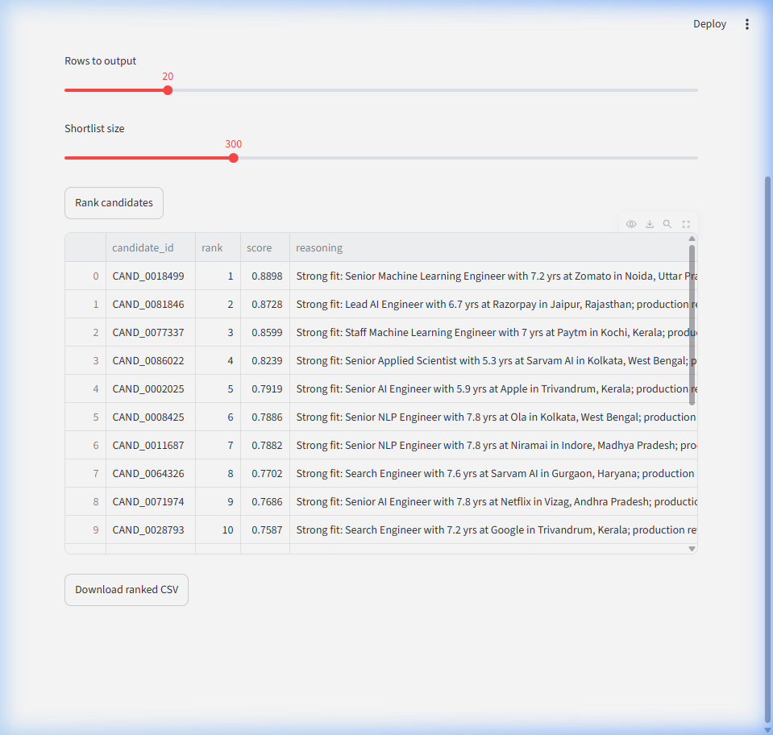
The Scoreboard
Redrob Candidate Ranker
Cold hard proof that our engine is wildly fast and bulletproof.
100K
100
0
~22s
candidate profiles processed
valid output rows
duplicates or missing fields
local CPU runtime
Top-100 title mix
Evidence coverage in top 100
Retrieval evidence
100%
Ranking/eval evidence
98%
RecSys/marketplace
92%
Production evidence
63%
Integrity penalty
0%
Insight: We extract actual search and NLP killers, leaving the prompt-kiddies in the dust.
08

Slide 9
Our Weaponry
Redrob Candidate Ranker
Tools hand-picked for maximum carnage and zero failure.
Python
Core ranking logic and reproducible CLI execution
orjson
Fast JSONL parsing for large candidate corpus
Streamlit
Optional sandbox to upload JSONL and preview ranked CSV
Hybrid Retrieval
JD facets + candidate evidence scoring without network dependency
Rank Fusion
Combines sub-rankers and reduces single-model failure risk
CSV Validator
Checks exact rows, ranks, schema, duplicates and score order
Why no heavy bloated LLMs in the final script?
Because relying on slow APIs is for amateurs. We pre-compute the heavy lifting so our final CLI is blindingly fast and strictly offline.
09

Slide 10
The Arsenal
Redrob Candidate Ranker
Everything you need to verify our dominance.
submission.csv
100 ranked candidates with score and grounded reasoning
Final run command
rank.py
Single command CPU-only ranker for challenge reproduction
python rank.py --candidates candidates.jsonl --out submission.csv --debug top_debug.jsonl
src/
Modular feature extraction, fusion and reasoning logic
top_debug.jsonl
Detailed audit trail for the top 100 candidate decisions
python validate_submission.py submission.csv
app.py
Streamlit sandbox for upload-and-rank demonstration
GitHub / Video / Demo
Add final repository URL and demo video link in submission_metadata.yaml before upload.
README.md
Approach summary, run commands and architecture notes
10

Slide 11
Built to shortlist the right people,
not the loudest keywords.
Recruiter-style reasoning • hybrid retrieval • behavioral readiness • honeypot-aware validation • CPU-only reproducibility
What if they use weird jargon?
What if they lie on their resume?
Can it survive the challenge constraints?
Our semantic engine sees right through the syntax to find the raw operational capability.
Our integrity penalties incinerate liars instantly.
Absolutely. No network, no GPUs, just pure optimized destruction.
You're Welcome.
11

