Slide 1

Jaypee University of Engineering & Technology, Guna (MP)
Project Name :- Connecting-JUET
Project Number :- 52
Project Guide: Project Members: Dr.Ratnesh Litoriya Ayush Srivastava (171B041)
Kartikey Chandra (171B058)
Shashwat Shukla (171b117)

Slide 2
Contents
Project Introduction
Motivation
Technology Used
Software Development Model
Use Case Diagram
Activity Diagram
Conclusion
Future Work
References

Slide 3
Introduction
It is a social media platform which helps users to connect with each other.
students and faculty both can register.
They can communicate by comments feature.
Stakeholders: User and Admin.
User can add friend, upload posts etc.
Admin has some extra privilege.

Slide 4
Motivation
Need of the project:
Social media websites are not student centered.
No control on Distracting Posts.
Huge Traffic in other social media websites.

Slide 5
Software Requirement :-
Browser: Chrome, Firefox, Safari, Opera, etc.
A code editor or IDE such as Visual Studio Code or Sublime text or Python IDLE.

Slide 6
Technology used
Frontend: HTML5, CSS3, Bootstrap, Javascript
Backend: Django.
Database: SQLite.
Version control : Github.
Platform used for hosting: Heroku

Slide 7
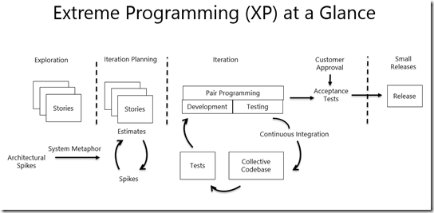
Software Development model
Agile Model:

Slide 8
Why XP
refactoring
construction of a unit test
pair programming
unit tests are executed daily

Slide 9
USE CASE DIAGRAM
SIGNUP
LOGIN
VIEW HOMEPAGE
UPDATE CHANGES
DELETE PROFILE
USER
ADMIN
CAN SEE ALL RECENT ACTIVITY
PROFILE PAGE
SEND & ACCEPT FRIEND REQUEST
CREATE POST
DELETE POST
LOGOUT

Slide 10
Activity Diagram For User Side
Login credentials
Invalid
Check
Valid
Home page
View profile
Create posts
Delete post
Check posts
See notifications
Send or receive friend request.
Logout

Slide 11
Activity Diagram For Admin Side
Login
Invalid
Check
Valid
Delete User Profile
Delete posts
Check recent activity
Logout

Slide 12
Customer Expectation
Website should be easy to interact.
Website should be student oriented.
Student should have all control of their profile.
Student could post their feeds.
User Interface should be simple.

Slide 13
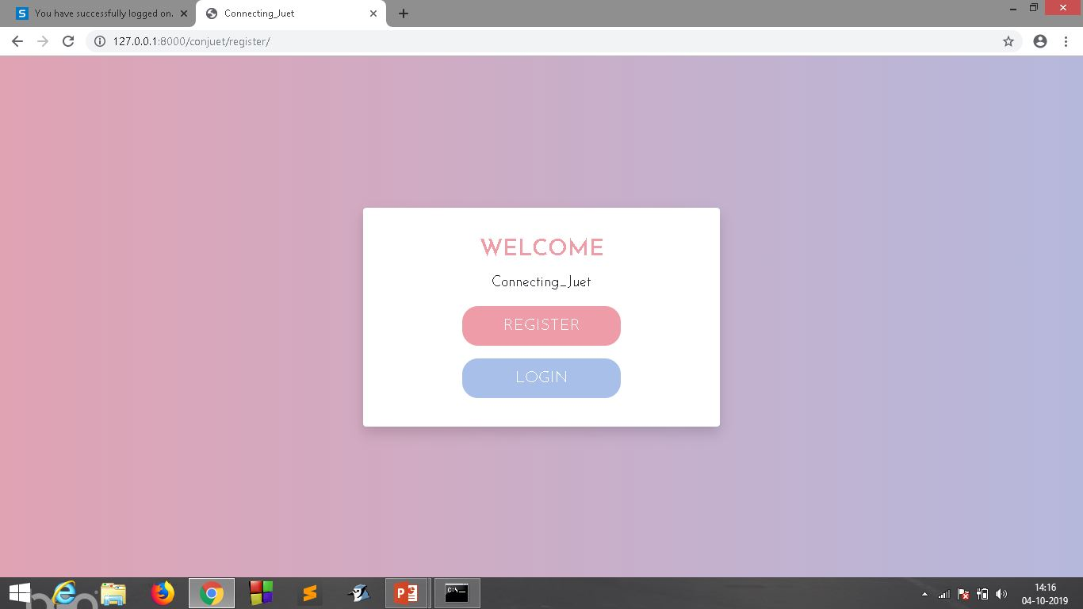
Conclusion
First Page

Slide 14
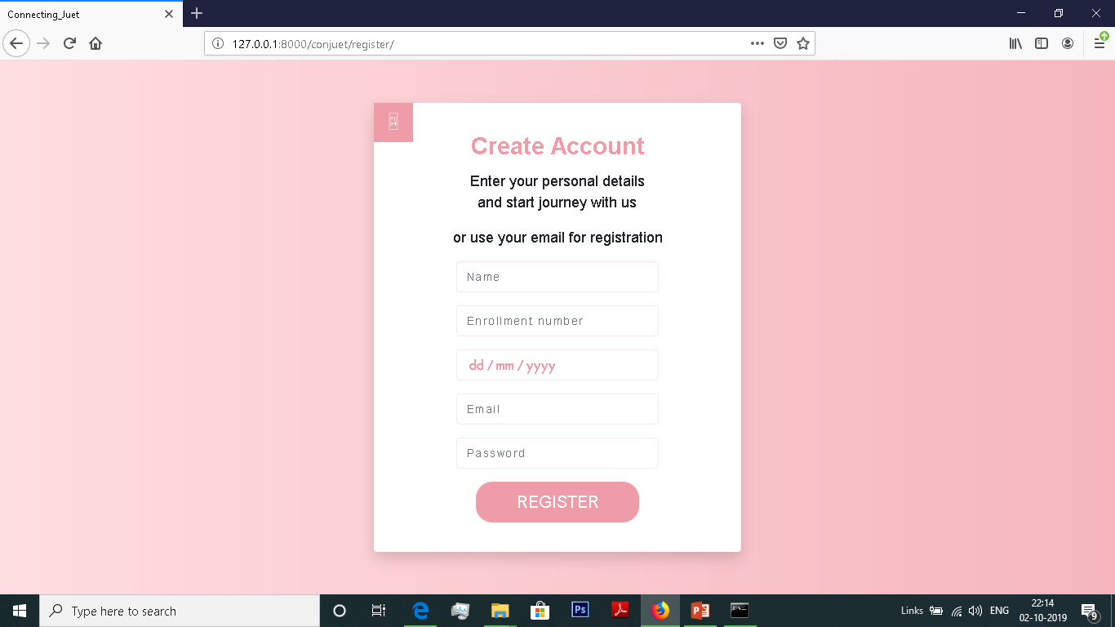
Implementation of Web Application
Register Page:

Slide 15
Registration
Your Enrollment number will be your Login id.
Your Password will be hashed.
Button will send a post request.

Slide 16
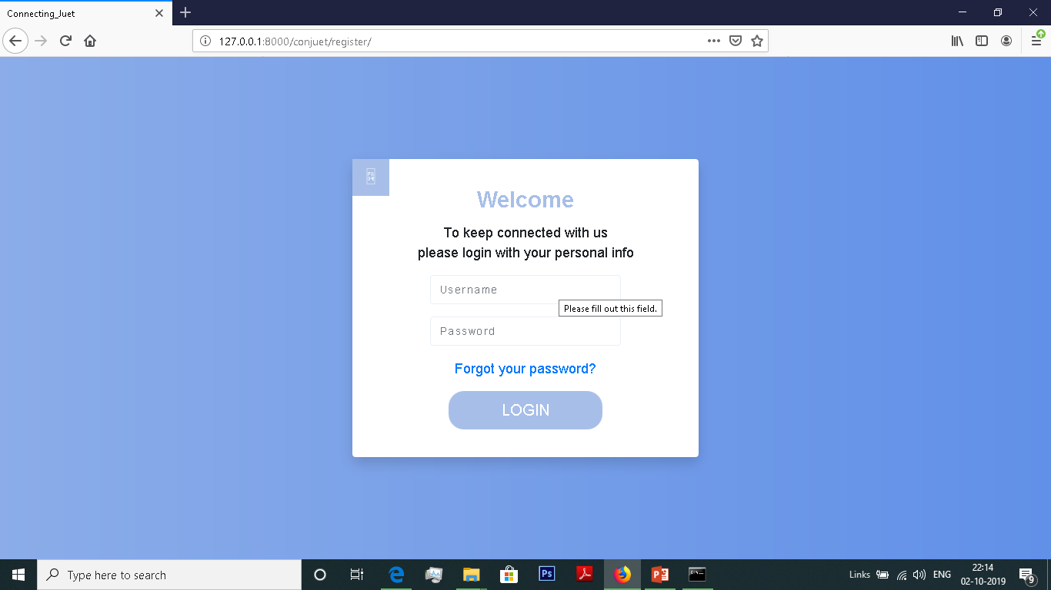
Login page:

Slide 17
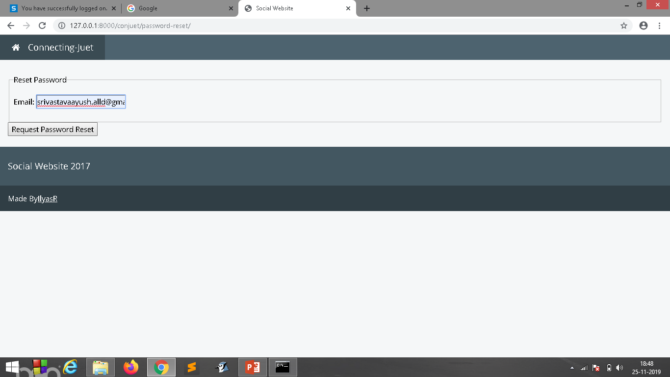
PASSWORD RESET :-

Slide 18
Password reset
You have to enter a registered email.
A link will be Generated to change password.
We can use link to Generate new password.

Slide 19
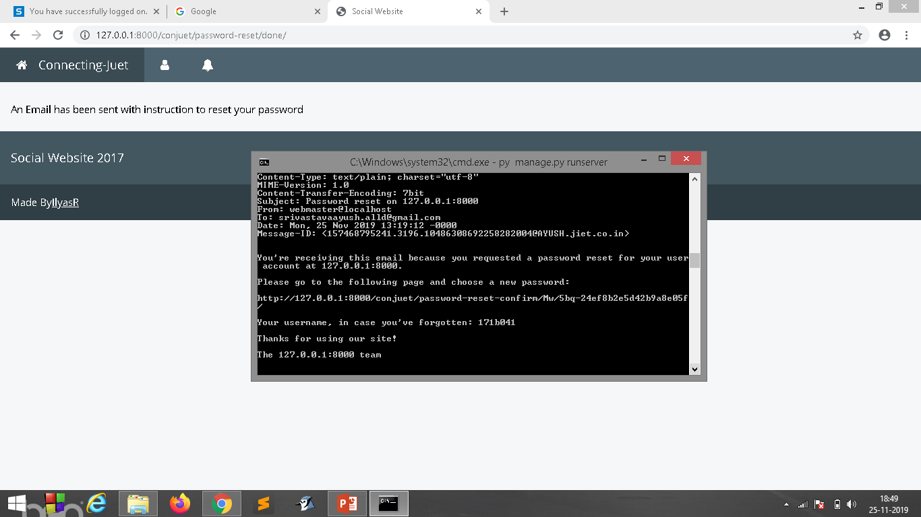

Slide 20
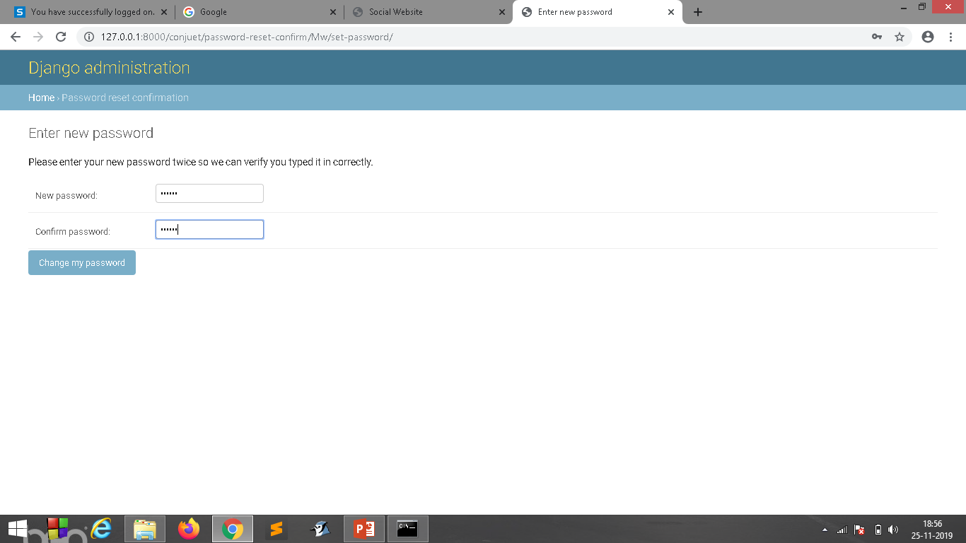
Change Password:-

Slide 21
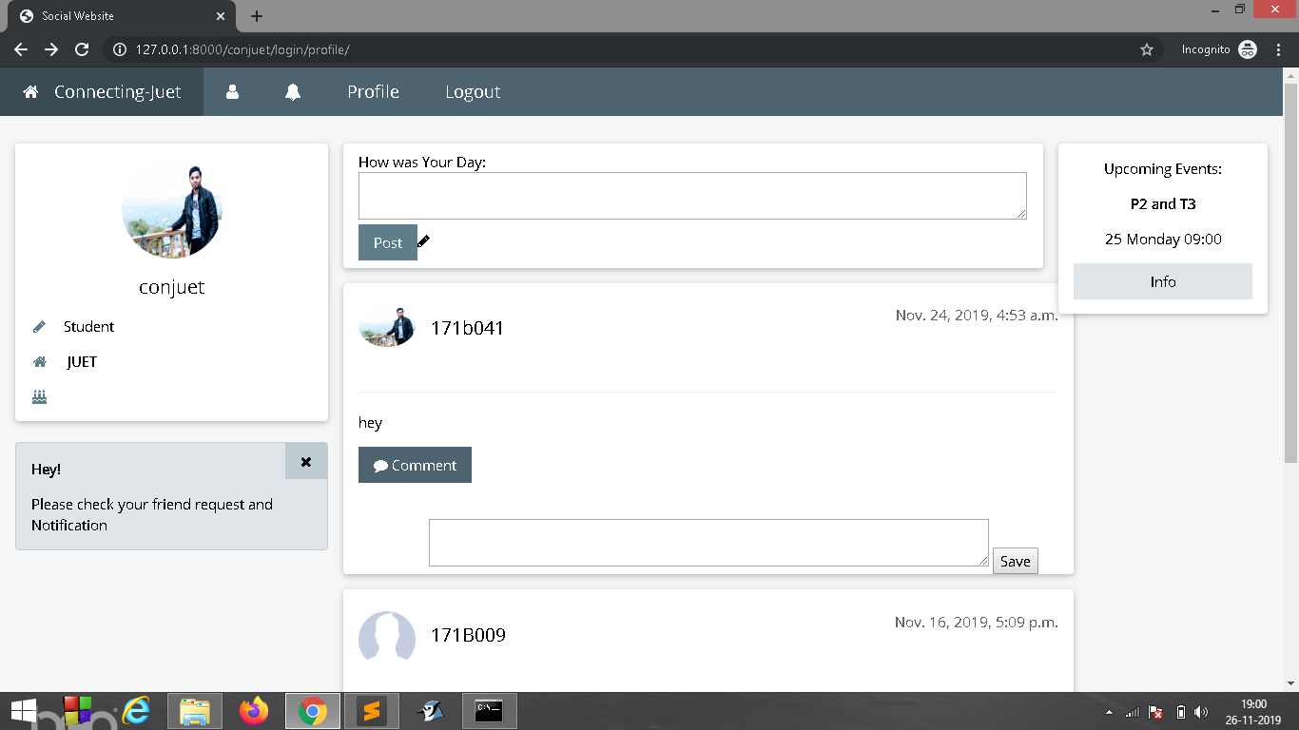
HOME PAGE:-

Slide 22
Profile Page
We can see our Friend’s post.
We also can Create a post or delete our post.
We can comment on any post.

Slide 23
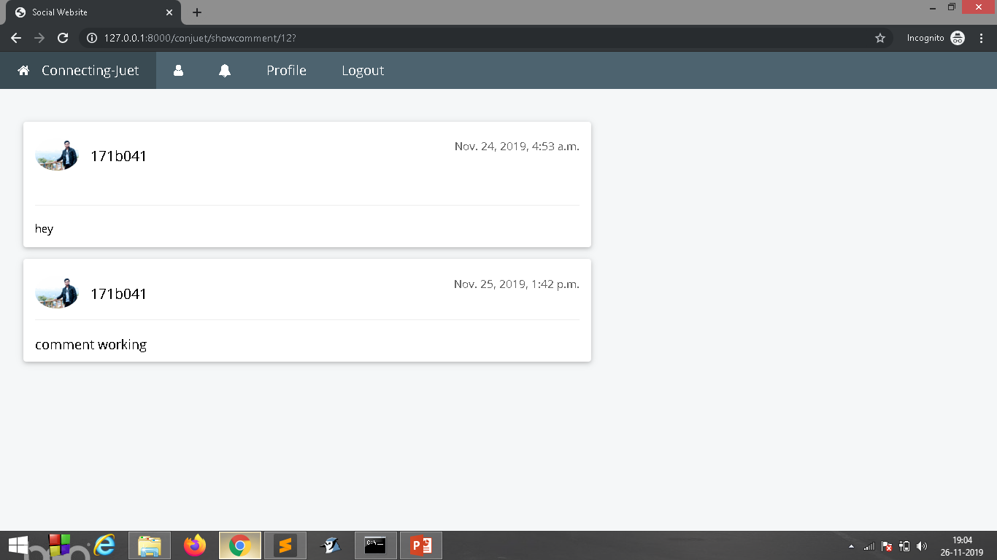
Comments:--

Slide 24
Need of comment feature

Slide 25
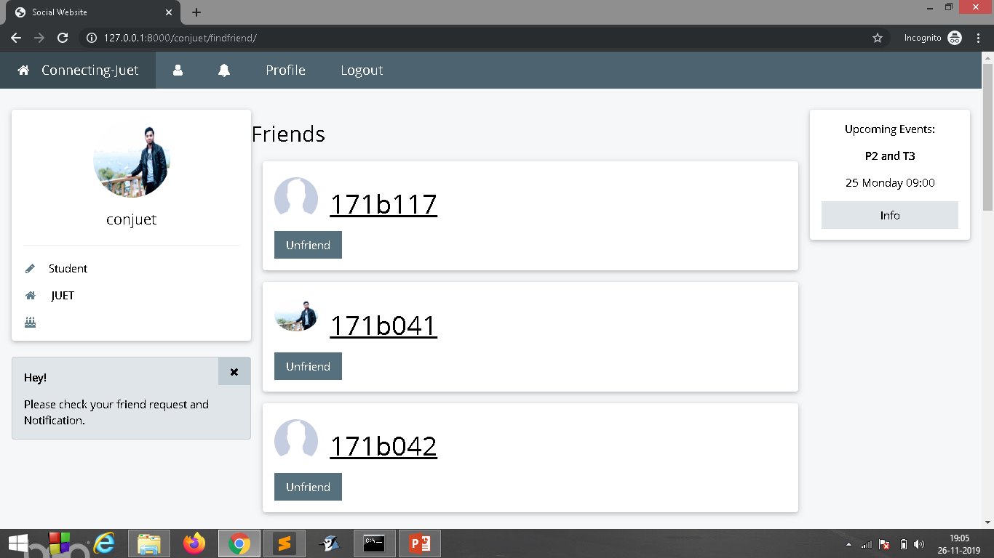
FIND FRIEND :-

Slide 26
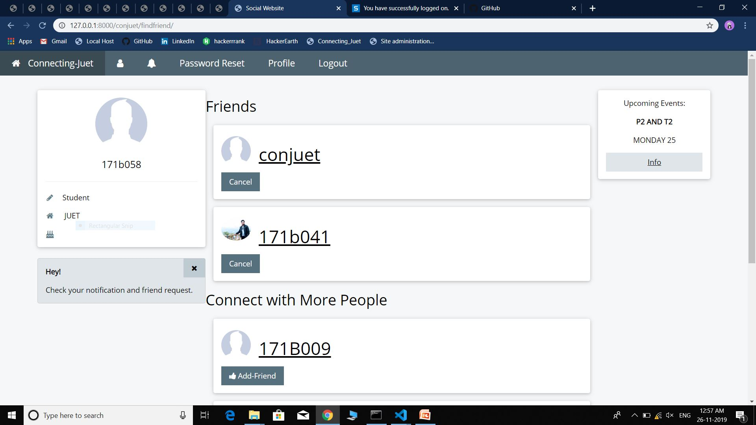
Request Send:--

Slide 27
Friends
We can send request to add friend.
We can unfriend any friend , reject or cancel request.
Only friend can see your post and comment on them.

Slide 28
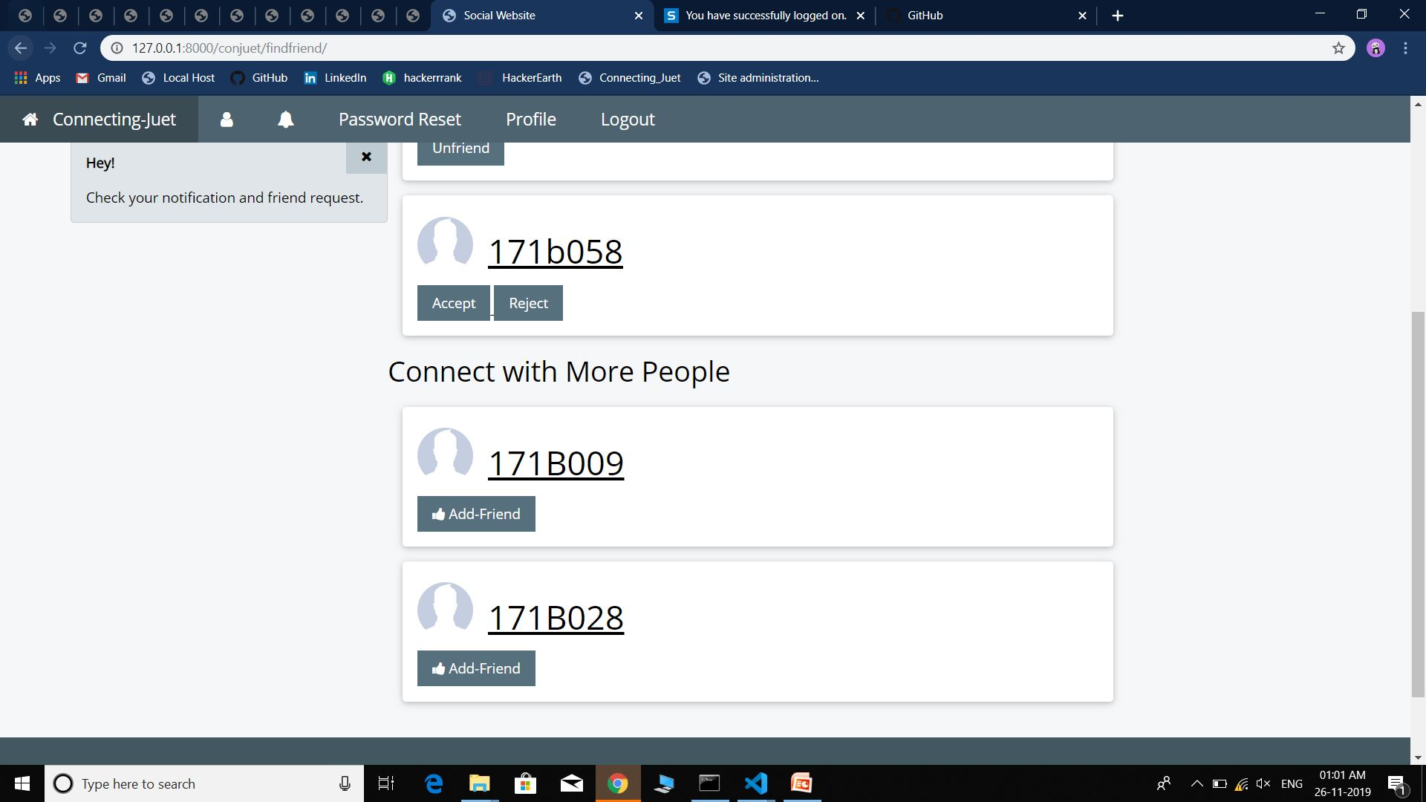

Slide 29
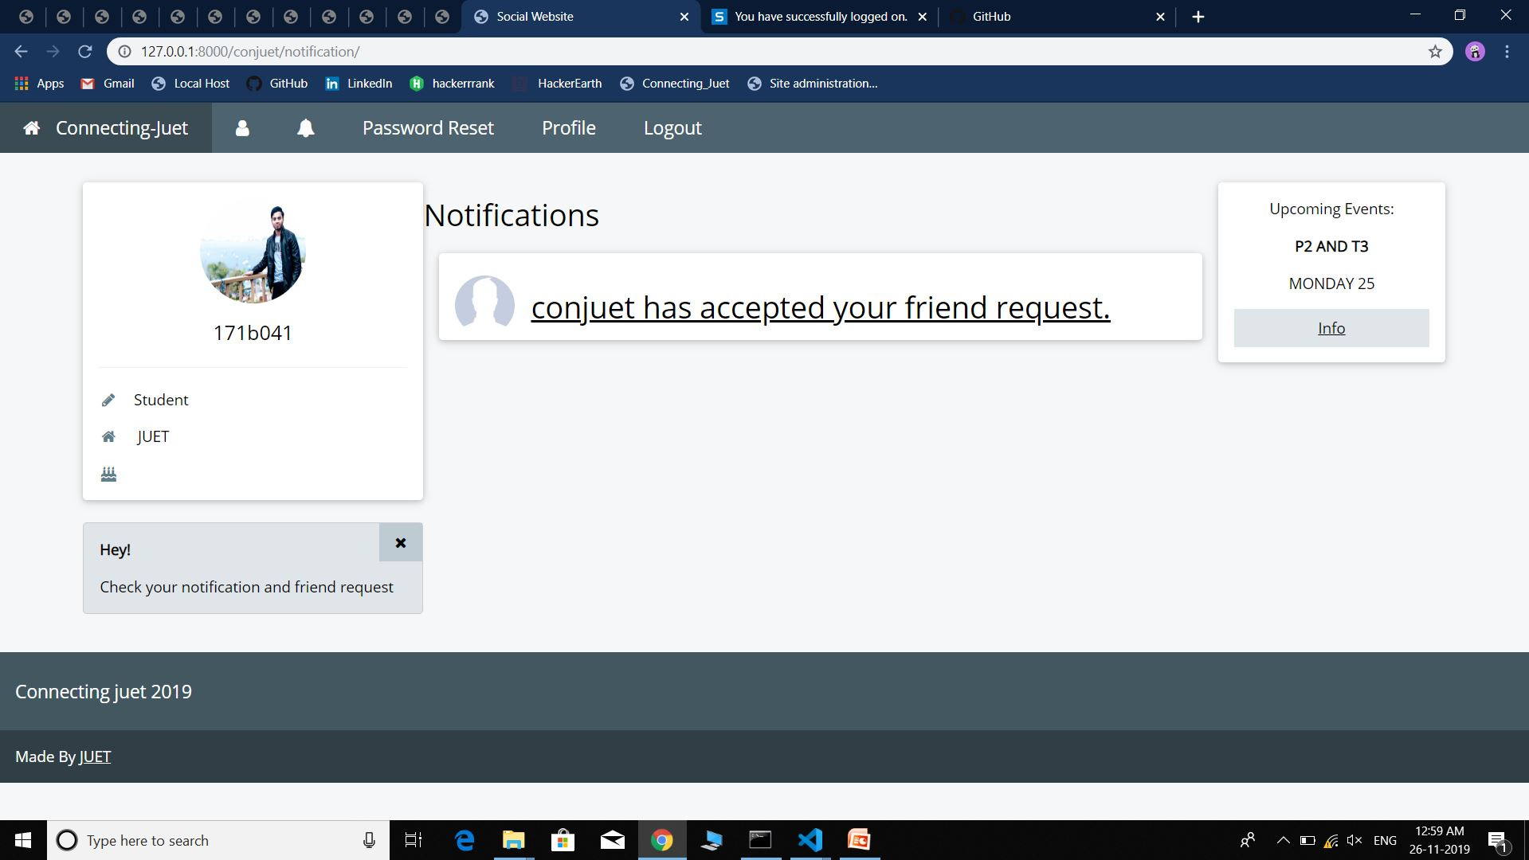
Notification:--

Slide 30
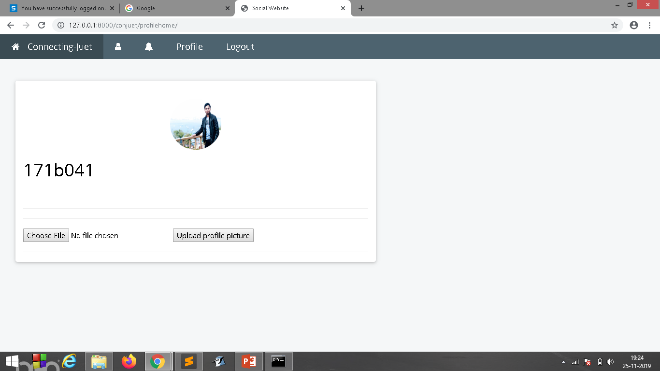
Profile page:-

Slide 31
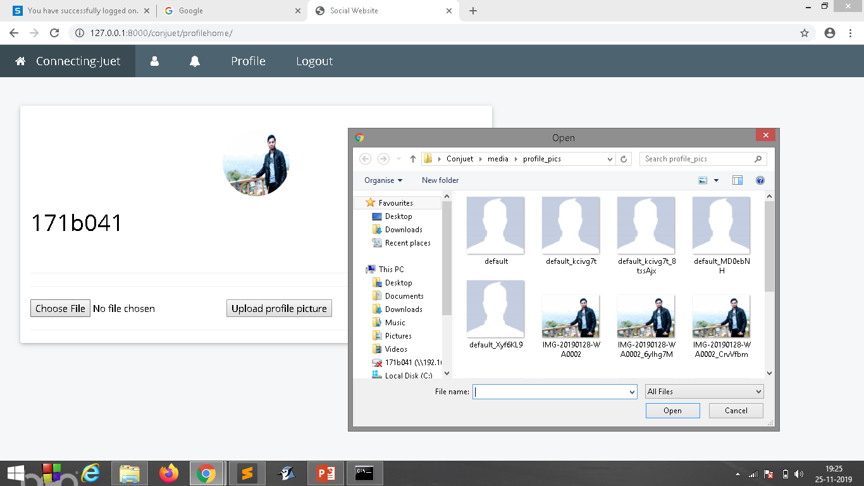

Slide 32
Future Work
User can Update their Information.
User can see post of their friend`s and admin.
User can Like Posts.
Speech to Text.

Slide 33
REFERENCES :
https://docs.djangoproject.com/en/2.2/
https://getbootstrap.com/
https://www.w3schools.com/css/
https://stackoverflow.com/
https://Quora.com/

Slide 34
THANK YOU!

