Slide 1

COURSE: B.Tech. SEMESTER: IIIrd By KARTIKEYEA SINGH (1900910100077) Department of Computer Science and Engineering
JSS MAHAVIDYAPEETHA
Mini Project / Internship Assessment
Subject Name: Mini project / Internship Assessment
Subject Code : KCS-354

Slide 2
Table of contents
Introduction
History and rules
Methodology used
Objective and project goal
Tools and technology used
Feature of the technology used
Societal Relevance and Impact of the Project
Future scope of the project
Screenshots of the project

Slide 3
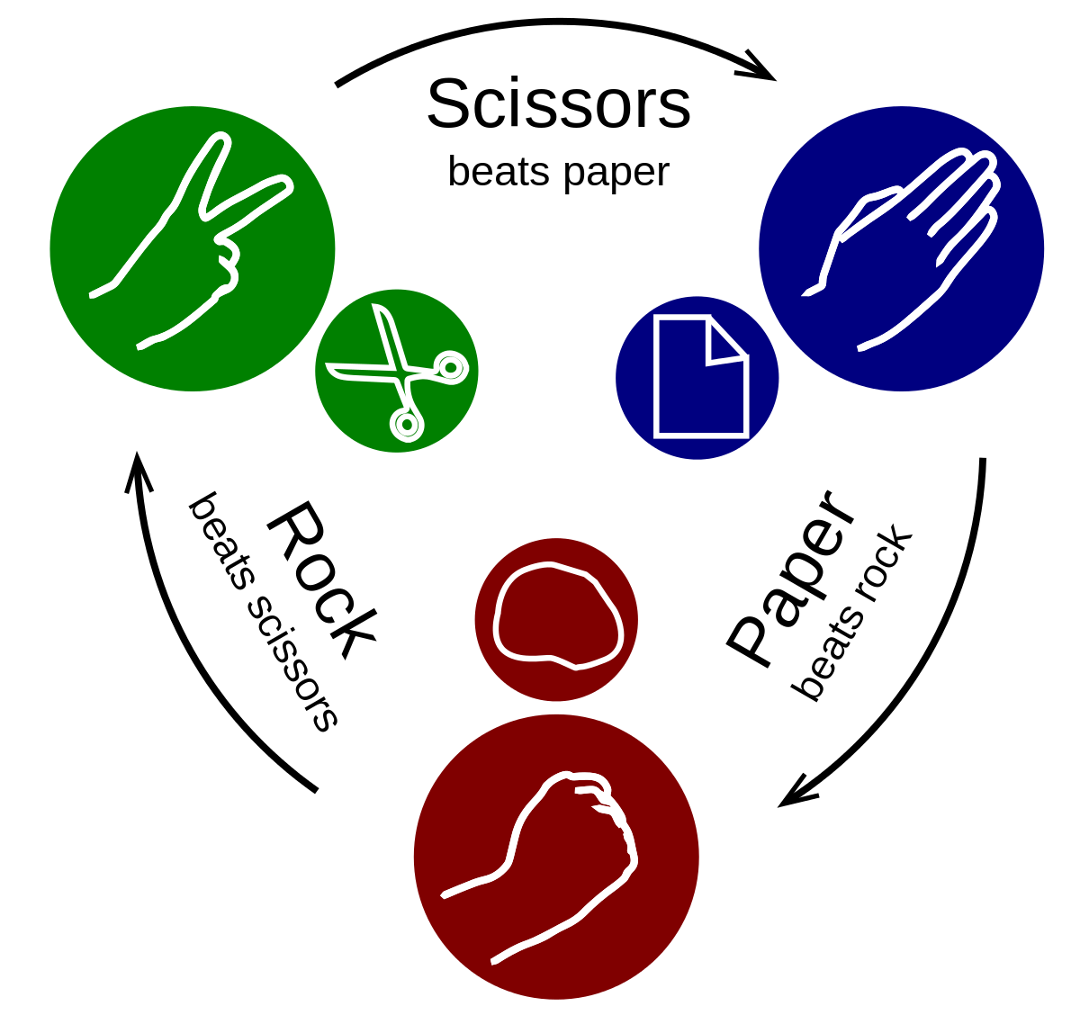
INTRODUCTION
Rock Paper Scissors is the classic ‘stone paper scissors’ game converted into a fun online single player game. Choose one of the three choices- and see if you can beat the computer. Will you procure or forfeit? The chance is random! In this game player and computer simultaneously select one of three shapes i.e. "rock" (a closed fist), "paper" (a flat hand), and "scissors" (a fist with the index finger and middle finger extended, forming a V).

Slide 4
History-
Rock paper scissors was first created in China at the time of Christ, but stayed there for hundreds of years. It wasn’t until the 1700 that it made its way over to Japan and was known as ‘Janken’ and then spread to west. This game was not just played to decide who should get a favour in a situation but also to remove the boredom.

Slide 5
Rules-
The rules remain the same as the original game: Rock breaks scissors, paper covers rock and scissors cut paper. If both players chose the same shape than that round is tied.

Slide 6

Methodology used in the project-

Slide 7
Objectives and project goal-
Objective of this project was to have an overview of the web development and learn its basic skills. A game was build using few web development languages. This gave me knowledge about the working of web pages and how they are created. Goal of the project was to construct a working web game which can be accessed through python and this was successfully achieved.

Slide 8
Tools & Technology Used
Sublime Text
HTML (Hyper Text Markup Language)
CSS (Cascading Style Sheets)
JavaScript
Python (using Anaconda Navigator)
Web Search

Slide 9
Features of the technology used
Sublime Text
Go to anything and any definition.
Multiple selections.
Command palette.
Powerful API and package ecosystem.
Cross platform.
Fast speed and better indentation.
HTML 5
Video and Audio tags.
It requires less effort to learn and use.
Placeholders.
It is platform independent.

Slide 10
CSS
The framework of a web page is better handeled.
It has better device compatibility.
Ability to Re-Position.
Style (CSS) kept separate from structure (HTML), means smaller file size.

Slide 11
JavaScript
Object-Centred Script Language.
Client edge Technology.
Validation of User's Input.
Else and If Statement.
Interpreter Centred.
Ability to perform In Built Function.
Case Sensitive format.
Light Weight and delicate.

Slide 12
Python (using anaconda navigator)
Compiled with latest python release (anaconda).
Python is object oriented language.
It is high level portable language.
New and wide range of packages.

Slide 13
Societal Relevance and Impact of the Project
As we know that there is a very large scope for web developers and programmers in today’s world, learning these skills can be very beneficial for people. From my project people will get to know how easy and interesting this topics are. This will spread awareness in society about the emerging fields and job opportunities in the IT sector.

Slide 14
Future Scope of the Project
This ‘Rock Paper Scissors’ game can be further improved by using more advanced graphics and can be customised for different devices and OS, then we can register this game on different app stores and do its monetization. In future, I will try to build more such games and then integrate them all together under one single app or website.

Slide 15
Screenshots of the project

Slide 16
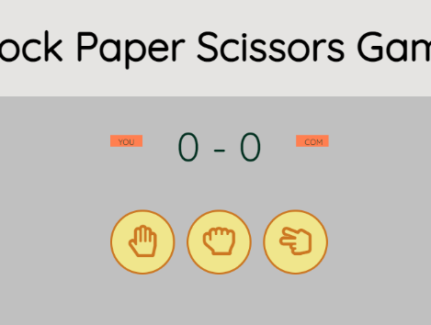
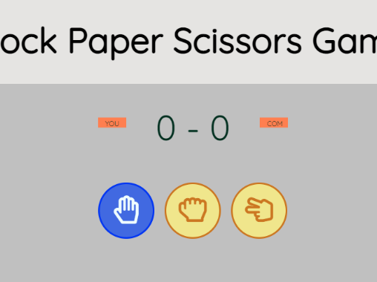
Game interface as it starts.
When mouse pointer is above any shape, icon turns blue.

Slide 17
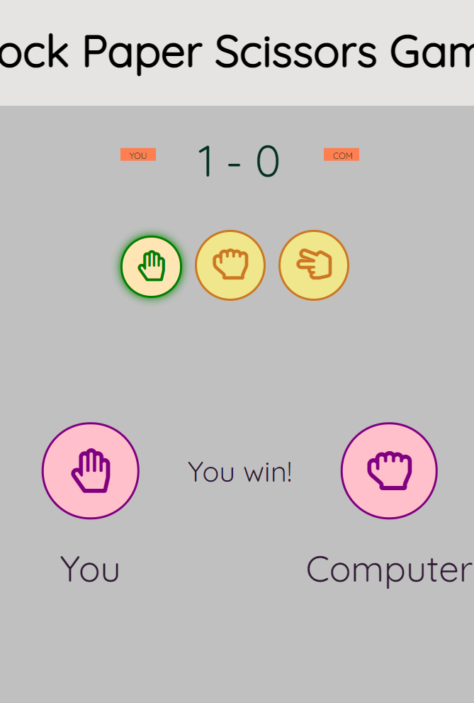
Interface indicating user wins.

Slide 18
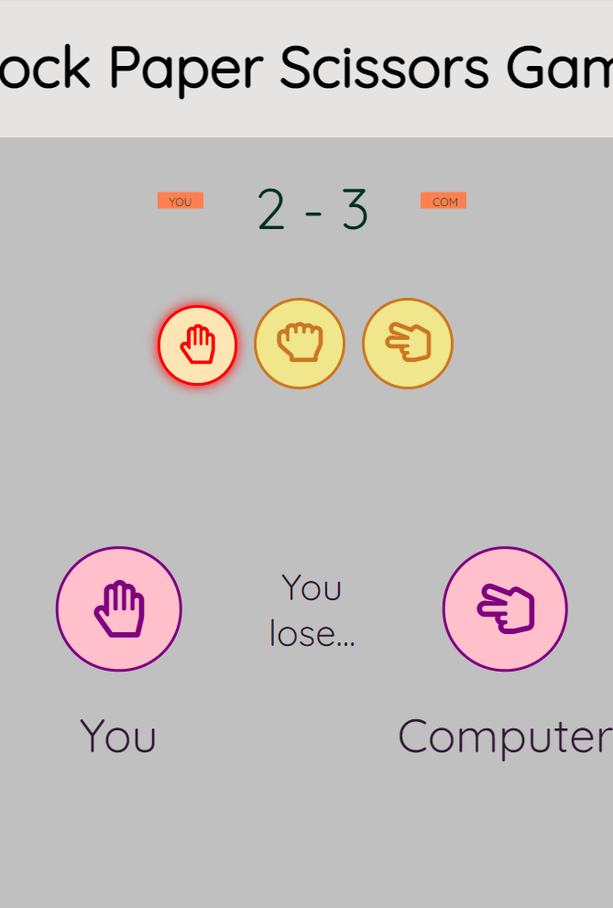
Interface when user loses.

Slide 19
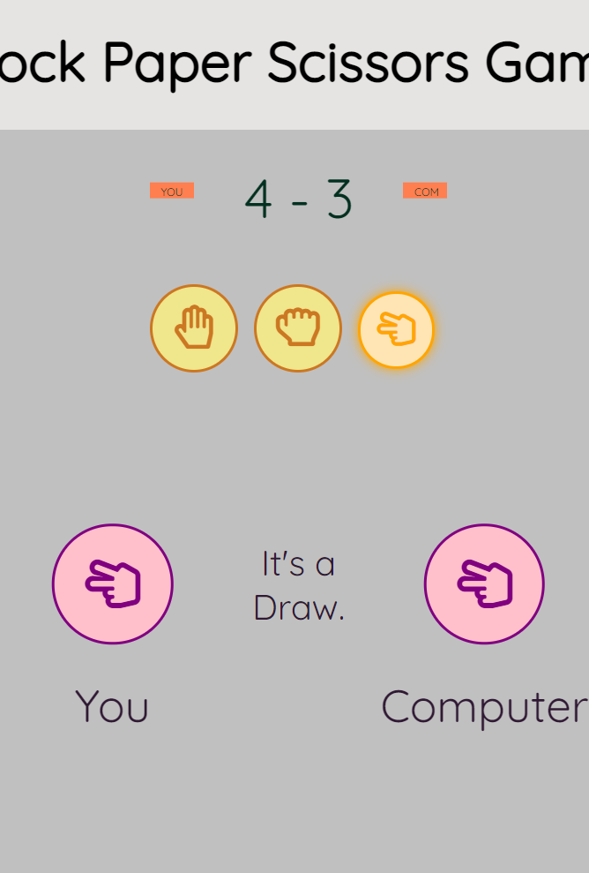
Interface showing a draw.

Slide 20
THANK YOU

