Slide 1

Sentiment Analysis
Guide Name: Mr. Jitendra Singh Team Member(s):
Kalash Karan Pratap Singh
Kartikey Vats

Slide 2
Table of Content
Introduction:
Literature Survey/ Study of existing work:
(This will describe the previous work which is done by the various authors/developers related to the project and already running project at any location. Take at least 5 previous work)
Problem Definition
Motivation: Describes need and significance of proposed work
Objective(s)
Proposed Methodology
(Methodology will include the steps to be followed to complete the project during the project development, Flowchart, Algorithm, etc.)
Result & Discussion
Screen shots of working module with proper description. Prepare short video if demonstration of working model takes comparatively longer time.
Conclusion and Future Scope
References (APA Format)
Plagiarism Report(first page only)
Research paper accepted or published/Patent filed /Certificate of participation in any event (*if any)

Slide 3
Introduction
Sentiment analysis involves analyzing the sentiment or emotion expressed in text data.
Our focus is on analyzing tweets from Twitter users to understand public sentiment on social media.
Understanding sentiment on platforms like Twitter is crucial for various applications, including market research, public opinion monitoring, and brand sentiment analysis.

Slide 4
Literature Survey/ Study of existing work:
Paper addresses the limitations of traditional polling methods by proposing innovative approaches that leverage tweet sentiment analysis for public opinion measurement. The first method relies solely on tweet sentiment analysis, outperforming established techniques. Additionally, a hybrid method combining public opinion polls and tweets provides more accurate and cost-effective estimation, demonstrated in the 2023 Greek national election, showcasing the potential of social media for public opinion estimation.
Paper explores sentiment analysis of ChatGPT responses using a dataset of 50,000 tweets. It aims to gauge user opinions on ChatGPT's performance. The analysis involves labeling tweet polarity and evaluating machine learning models to determine the most accurate sentiment prediction.
Paper introduces a novel task: predicting the prevalent sentiment among replies to tweets. It presents RETwEET, a dataset of annotated tweets and replies. Using a two-stage deep learning approach, sentiment in replies is predicted from original tweets, achieving promising results without manual labeling. The dataset and baseline implementation are accessible to the public.

Slide 5
Literature Survey/ Study of existing work:
The evolving landscape of public discourse, particularly on social media platforms like Twitter, has become pivotal in gauging public sentiment. This paper examines lexicon-based techniques for sentiment analysis on Twitter data, offering insights for researchers and stakeholders by comparing performance across various methods.
In today's booming e-commerce and tourism sectors, analyzing vast amounts of web data is crucial. This paper focuses on sentiment analysis, a method to classify web data like product reviews. Using diverse machine learning techniques, it evaluates classification models to determine the best performers, including linear (LDA), nonlinear (CART, KNN), and complex nonlinear (SVM, RF, C5.0) methods

Slide 6
Problem Definition
Problem Outline:-
Our project focuses on sentiment analysis of tweets from Twitter users. The project focuses on extraction of tweets from users, performing sentiment analysis on them and producing the required results
The primary goal is to determine the sentiment expressed in each tweet. The project after analyzing the tweets classifies them in three broad classes (positive, negative, or neutral) to visualize sentiments of users.

Slide 7
Problem Definition
Challenges:
Noisy data: Tweets may contain spelling errors, abbreviations, and slang.
Sarcasm and irony: Understanding the true sentiment behind sarcastic or ironic tweets.
Context: Interpreting sentiment in contextually ambiguous tweets.

Slide 8
Motivation
Analyzing sentiment on social media platforms like Twitter is crucial for several reasons:
Business insights: Understanding customer sentiment towards products and services.
Public opinion monitoring: Tracking public sentiment on important events, issues, or policies.
Brand management: Monitoring brand sentiment to maintain a positive reputation.

Slide 9
Motivation
Market research: Identifying trends and consumer preferences based on sentiment analysis of tweets.
Our project aims to provide a tool for sentiment analysis of tweets, contributing to these important applications.

Slide 10
Objective
Our project aims to achieve the following objectives:
Scraping tweets: Retrieve tweets from specified Twitter users' timelines using web scraping techniques.
Sentiment analysis: Perform sentiment analysis on the scraped tweets to classify them as positive, negative, or neutral.
Visualization: Visualize the results of sentiment analysis using interactive charts and word clouds for better understanding.

Slide 11
Proposed Methodology
Scrapping
Preprocessing
Sentiment Analysis
Visualization

Slide 12
Proposed Methodology
Scraping Tweets:
Utilize Selenium for web scraping to extract tweets from specified Twitter users' timelines.
In this, the program tries to extract tweets based on the number mentioned in project ,this is monitored by number of tweets and number of scrolls

Slide 13
Proposed Methodology
Preprocessing:
Perform text preprocessing techniques such as lowercase conversion, punctuation removal, tokenization, stopword removal, and lemmatization.
This part is where the most important process occurs, we need to standardise the extracted tweets to analyse them and remove the noise from the text.

Slide 14
Proposed Methodology
Sentiment Analysis:
Employ the trained model to perform sentiment analysis on the preprocessed tweet data.
The model is employed to denote the sentiments from the pre-processed tweets and categorise them into emotions (positive ,negative, neutral)

Slide 15
Proposed Methodology
Visualization:
Visualize sentiment analysis results using interactive charts (e.g., bar charts) and word clouds for better interpretation.
This is the last part used to provide a UI based output for the user of easily understand the sentiments ,the output is accompanied with a word cloud to denote the frequency of words.

Slide 16
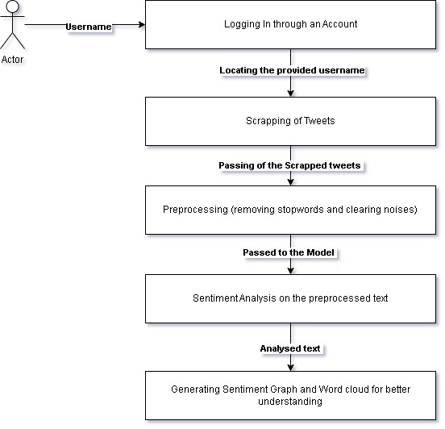
Proposed Methodology

Slide 17
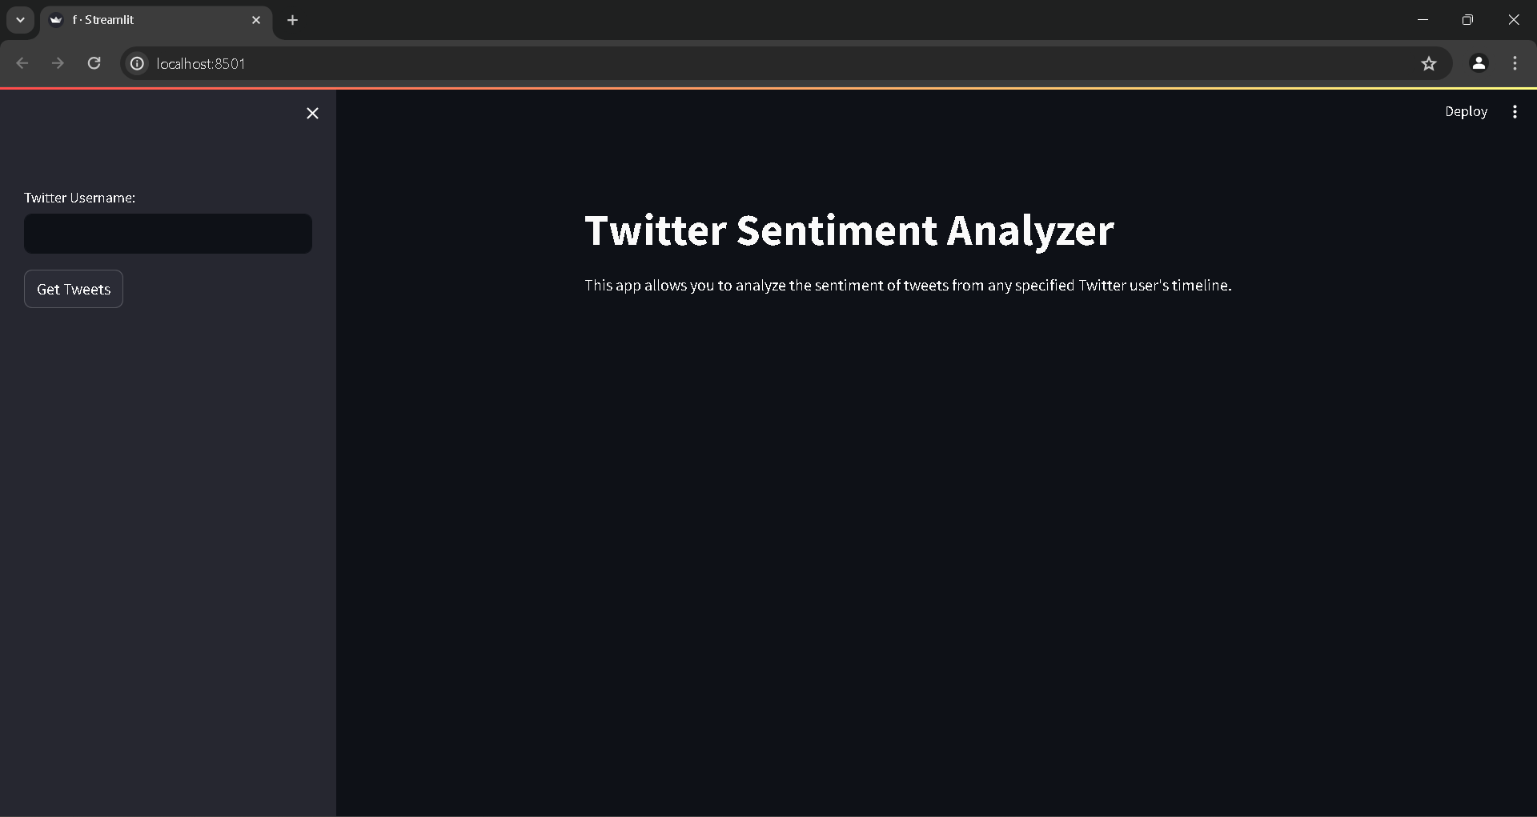
Result & Discussion
Start Page of Project

Slide 18
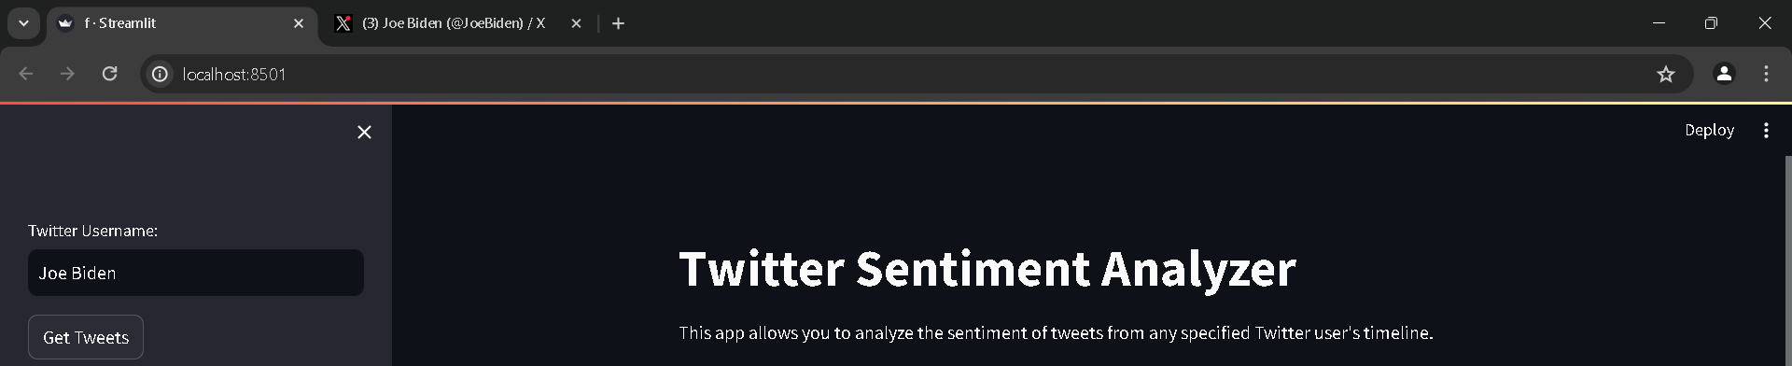
Result & Discussion
Entering Username for scrapping of tweets

Slide 19
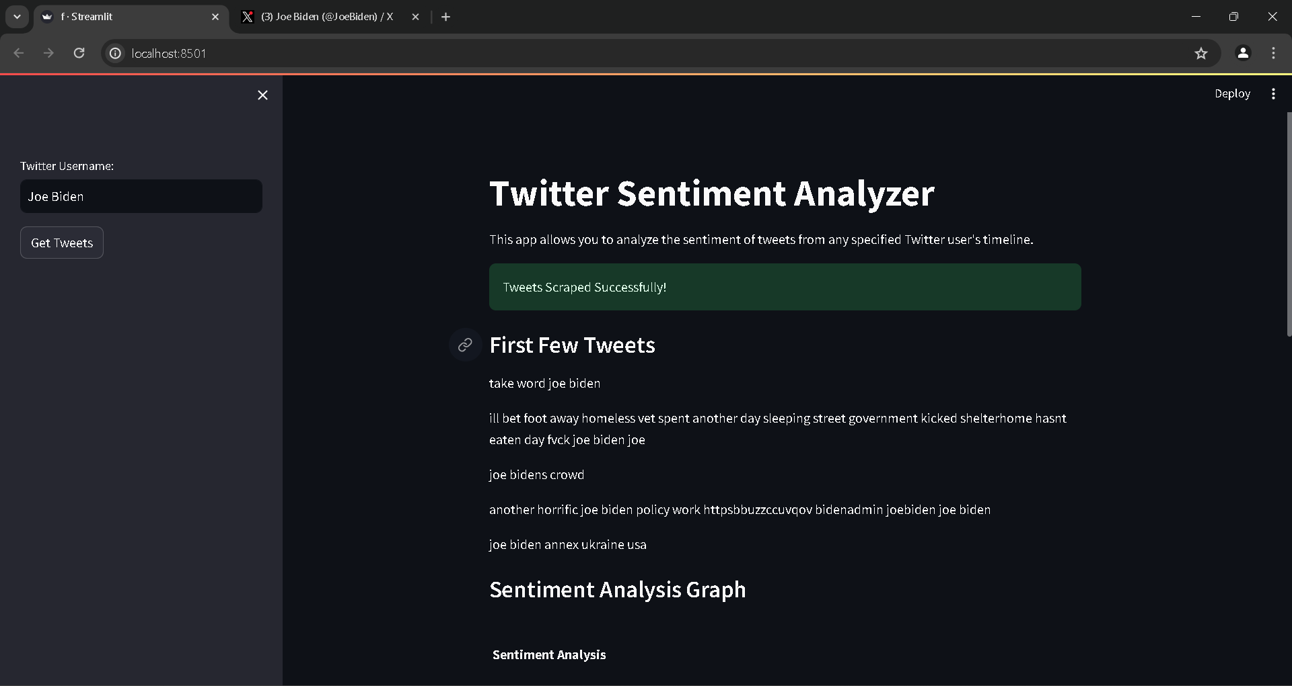
Result & Discussion
Recent tweets are mentioned

Slide 20
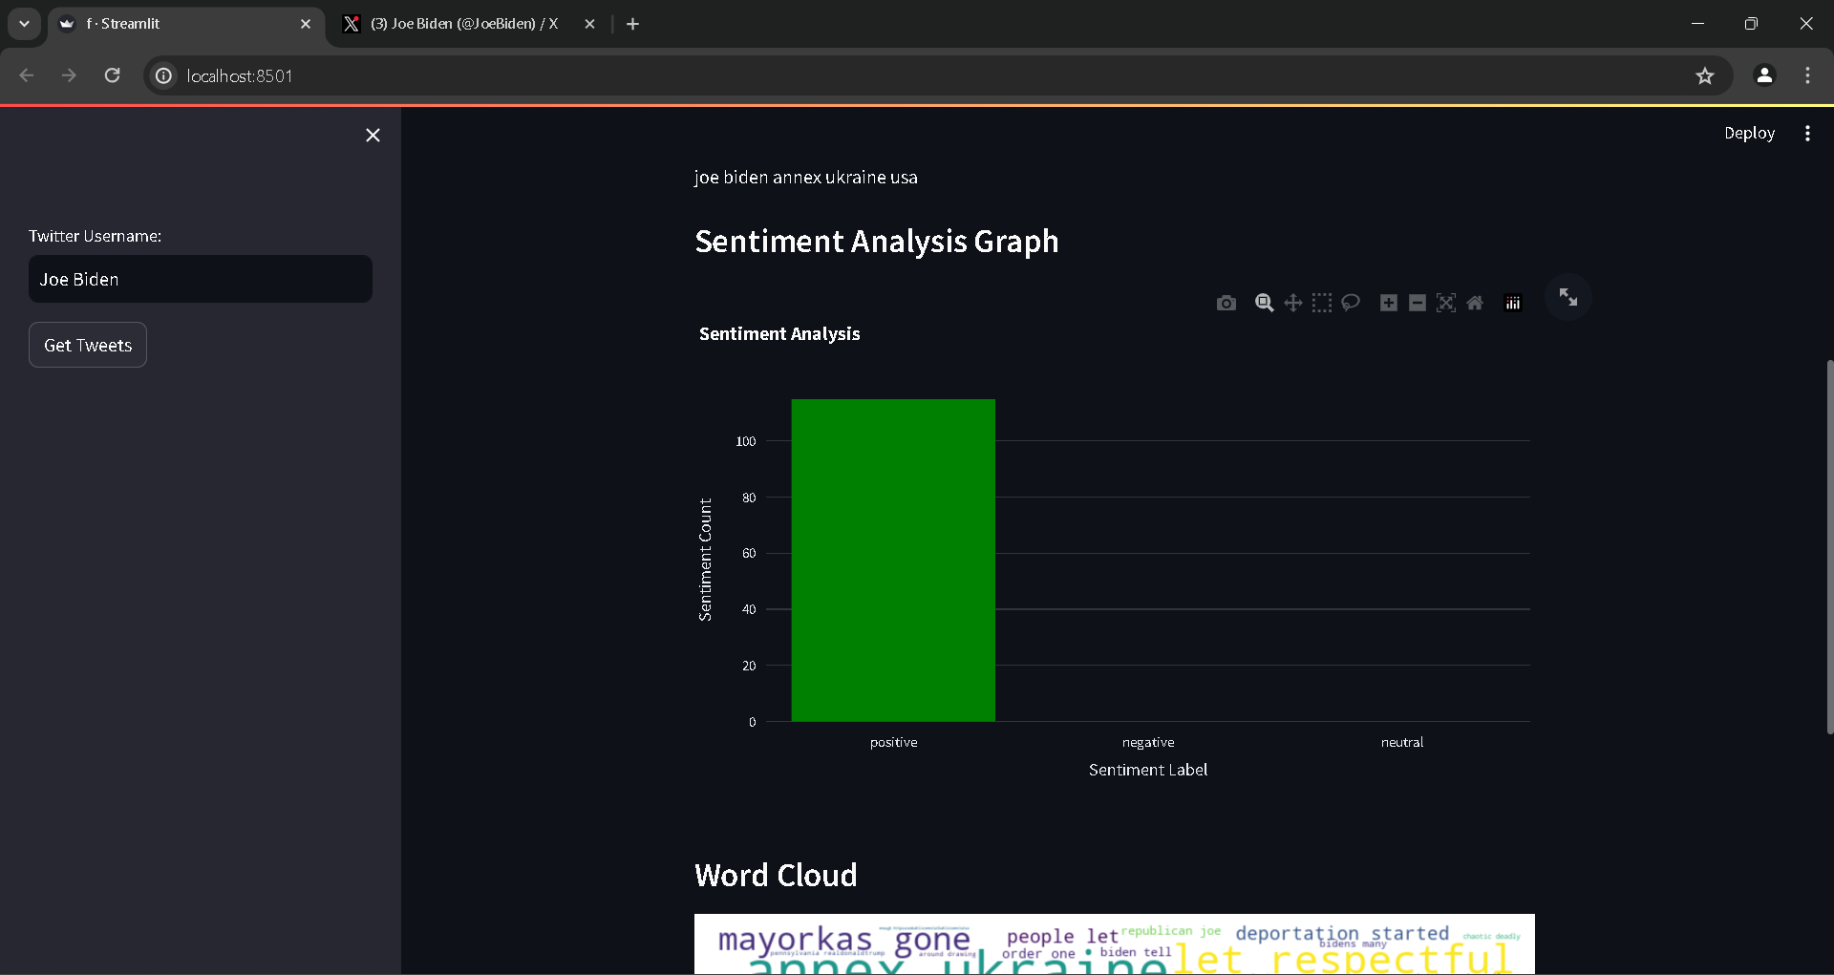
Result & Discussion
Sentiment Analysis Graph for the Scrapped Tweets

Slide 21
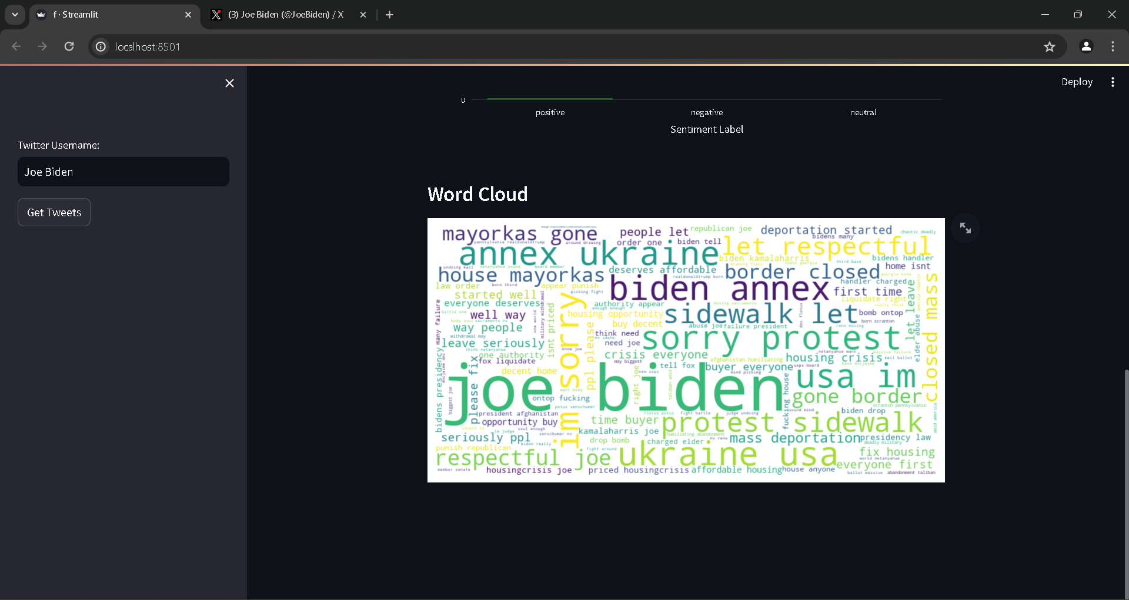
Result & Discussion
Word Cloud for the Scrapped Tweets denoting the Intensity of words

Slide 22
Conclusion and Future Scope
Models achieving high efficiency, but challenges remain with data variety and application problems.
Poor performance with expanding classes, untested accuracy for other topics, and terminology issues.
Further investigation needed to improve model performance, such as incorporating proximity to negation words.

Slide 23
Conclusion and Future Scope
Future Scope
Real-time sentiment polarity assignment to Twitter data.
Implement data processing algorithm on the cloud using NLP approaches.
Enables retrieval of real-time sentiment analysis for linguistic data within a cloud environment.

Slide 24
References
A. Tariyal, S. Goyal and N. Tantububay, "Sentiment Analysis of Tweets Using Various Machine Learning Techniques," 2018 International Conference on Advanced Computation and Telecommunication (ICACAT), Bhopal, India, 2018, pp. 1-5, doi: 10.1109/ICACAT.2018.8933612.
R. Sharma, D. Lowe, K. Somani and B. Galhotra, "A Study on Lexicon Based Techniques of Twitter Sentiment Analysis," 2022 8th International Conference on Advanced Computing and Communication Systems (ICACCS), Coimbatore, India, 2022, pp. 562-566, doi: 10.1109/ICACCS54159.2022.9785231.
A. Kaimakamidis and I. Pitas, "Political Tweet Sentiment Analysis for Public Opinion Polling," ICASSP 2024 - 2024 IEEE International Conference on Acoustics, Speech and Signal Processing (ICASSP), Seoul, Korea, Republic of, 2024, pp. 121-125, doi: 10.1109/ICASSP48485.2024.10448327.
N. Ugavekar and R. Gulwani, "ChatGPT Tweets Sentiment Analysis Using Machine Learning," 2023 1st DMIHER International Conference on Artificial Intelligence in Education and Industry 4.0 (IDICAIEI), Wardha, India, 2023, pp. 1-5, doi: 10.1109/IDICAIEI58380.2023.10406587.
S. T. Arasteh et al., "How Will Your Tweet Be Received? Predicting the Sentiment Polarity of Tweet Replies," 2021 IEEE 15th International Conference on Semantic Computing (ICSC), Laguna Hills, CA, USA, 2021, pp. 370-373, doi: 10.1109/ICSC50631.2021.00068.

Slide 25
THANK YOU

