Slide 1
Mutual Fund Analytics Capstone – Team Bluestock
End-to-End Data Engineering, Analytics and Power BI Dashboard
Kartikey | Bluestock Fintech | 6-Day Capstone

Slide 2
Problem Statement & Objectives
Problem: Investors lack centralized fund analytics.
Objectives:
• Build ETL pipeline
• Create SQLite star schema
• Analyze risk and returns
• Develop Power BI dashboards

Slide 3
Tech Stack
Python, Pandas, NumPy, SQLite, SQL, Power BI, Plotly, Git, Excel, Matplotlib

Slide 4
ETL & Data Pipeline
Raw Data → Python ETL → Data Cleaning → SQLite Database → Analytics → Power BI

Slide 5
EDA Highlights
NAV trends, SIP inflows, investor demographics, category analysis.

Slide 6
Performance Metrics
CAGR, Sharpe Ratio, Alpha, Beta, Sortino Ratio, Max Drawdown, Expense Ratio.

Slide 7
Fund Scorecard & Risk Metrics
VaR, CVaR, Rolling Sharpe Ratio and fund ranking scorecard.

Slide 8
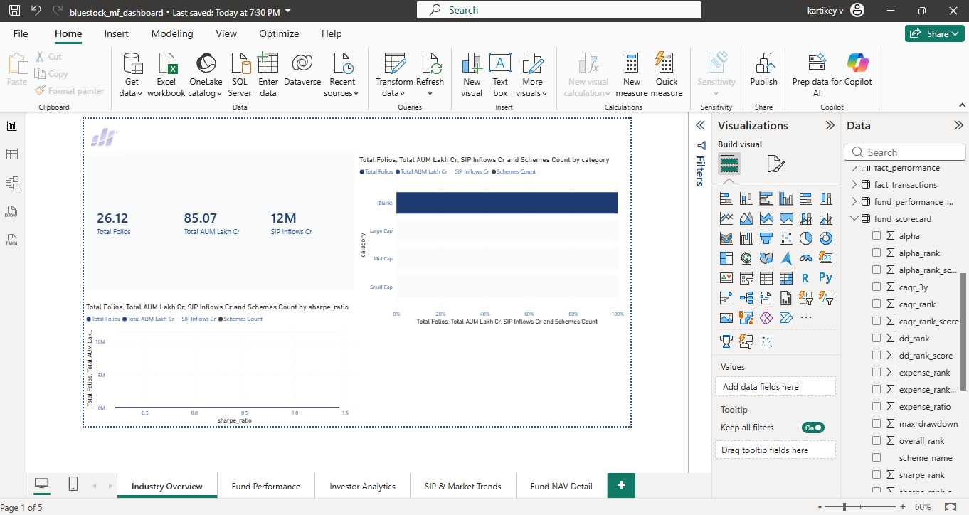
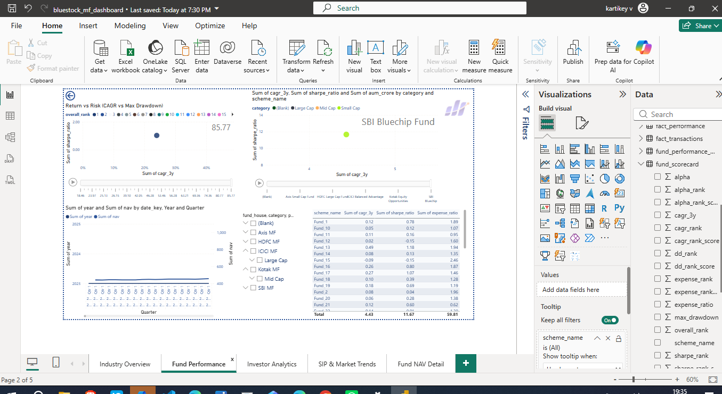
Power BI Dashboard – Page 1 & 2
Industry Overview and Fund Performance

Slide 9
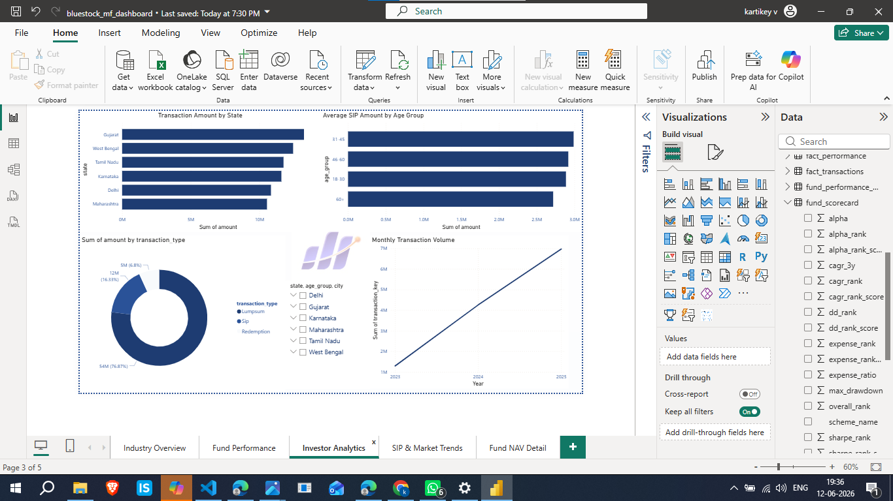
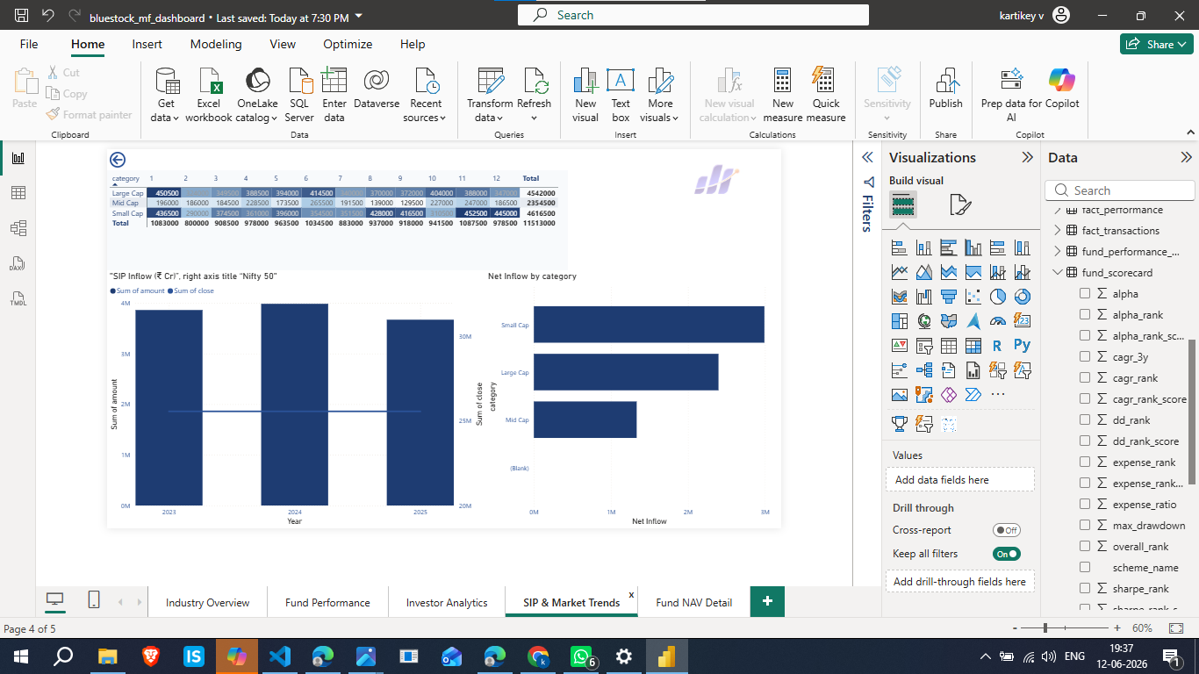
Power BI Dashboard – Page 3 & 4
Investor Analytics and SIP & Market Trends

Slide 10
Bonus Challenges
ETL Automation, Streamlit App, Monte Carlo Simulation, Efficient Frontier, Email Reports

Slide 11
Key Findings & Recommendations
SIP growth, risk-adjusted performance insights, investor behavior trends.

Slide 12
Thank You / Q&A
Questions and Discussion

