Slide 1
LAB -1
Basic Algorithm and Flowchart

Slide 2
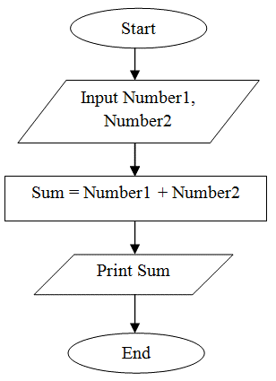
Calculate addition of two numbers.
FLOWCHART ALGORITHM
Step 1: Start
Step 2: Declare variables num1, num2 and sum.
Step 3: Read values for num1, num2.
Step 4: Add num1 and num2 and assign the result to a variable sum.
Step 5: Display sum
Step 6: Stop

Slide 3
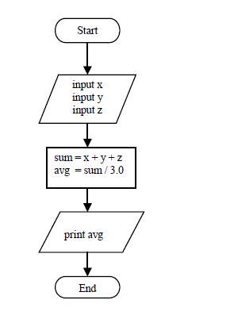
Calculate average of three numbers.
FLOWCHART ALGORITHM
Step 1: Start
Step 2: Declare variables num1, num2, num3, and average.
Step 3: Read values for num1, num2, and num3.
Step 4: Calculate the sum of num1, num2, and num3.
Step 5: Divide the sum by 3 and assign the result to the variable average.
Step 6: Display average.
Step 7: Stop

Slide 4
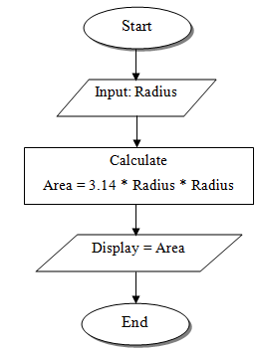
Find area of circle. (pie*r*r)
FLOWCHART
ALGORITHM
Step 1: Start
Step 2: Read radius
Step 3: Calculate area, area=3.14*radius*radius
Step 4: Print area
Step 5: Stop

Slide 5
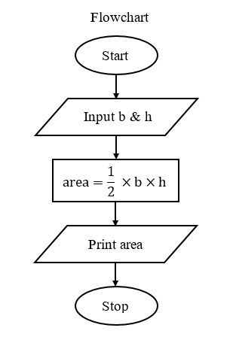
Find area of triangle. ((height*base)/2)
FLOWCHART
ALGORITHM
Step-1: Start.
Step-2: Input base and height of triangle in variable b & h.
Step-3: Calculate area = 1/2×b×h.
Step-4: Print value of area.
Step-5: Stop

Slide 6
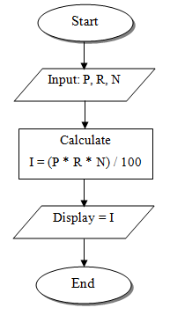
Calculate simple interest. (principal*roi*time period)/100.
FLOWCHART
ALGORITHM
Step 1: Start Step 2:Read Principal Amount, Rate and Time
Step 3: Calculate Interest using formula
SI= ((amount*rate*time)/100)
Step 4: Print Simple Interest Step 5:Stop

Slide 7
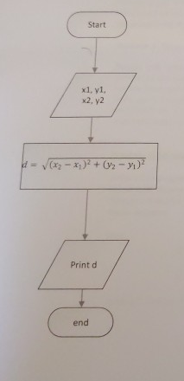
Calculate distance between two points.
FLOWCHART
ALGORITHM
Step 1: Start
Step 2: Declare variables x1, y1, x2, y2, and distance.
Step 3: Read the values of x1, y1, x2, and y2.
Step 4: Calculate the distance using the formula:
distance= sqrt((y2-y1)**2 + (x2-x1)**2)
Step 5: Display the distance.
Step 6: Stop

Slide 8
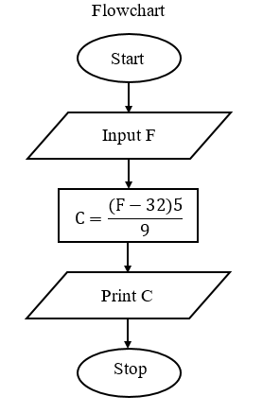
Convert temperature from Fahrenheit to Celsius. (Formula: c=(((f-32)*5))/9)
FLOWCHART
ALGORITHM
Step-1: Start.
Step-2: Input Fahrenheit temperature in variable F.
Step-3: Calculate C=((F-32)5)/9.
Step-4: Print value of C.
Step-5: Stop.

Slide 9
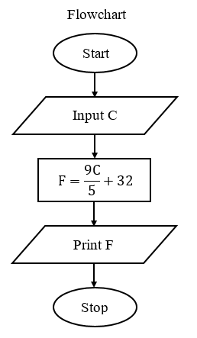
Convert temperature from Celsius to Fahrenheit
ALGORITHM
Step-1: Start.
Step-2: Input Celsius temperature in variable C.
Step-3: Calculate F=(9C/5)+32.
Step-4: Print value of F.
Step-5: Stop.

Slide 10
Lab -2
Intermediate Algorithm and Flowchart

Slide 11
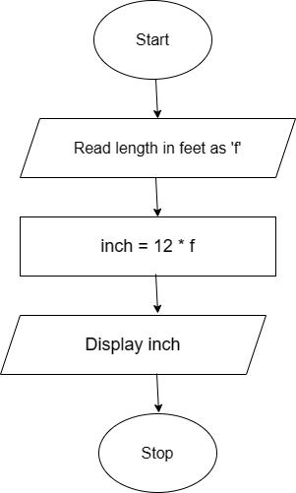
Convert given feet into inches. (feet*12)
ALGORITHM
FLOWCHART
Step 1: Start
Step 2: Declare variables feet and inches.
Step 3: Read the value of feet.
Step 4: Convert feet to inches using the formula: inches=feet×12
Step 5: Display the inches.
Step 6: Stop

Slide 12
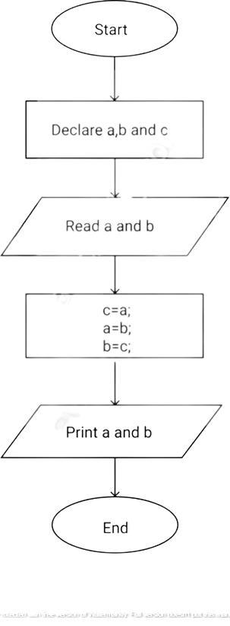
Swap two numbers. (Using temporary variable)
ALGORITHM
FLOWCHART
Step-1 : Start
Step-2 : Declare variables num1, num2, and temp.
Step-3 : Read the values of num1 and num2.
Step-4 : Assign the value of num1 to temp.
temp=num1
Step-5 : Assign the value of num2 to num1.
num1=num2
Step-6 : Assign the value of temp to num2.
num2=temp
Step-7 : Display the swapped values of num1 and num2.
Step-8 : Stop

Slide 13
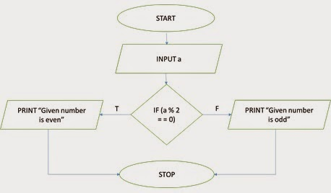
Check whether the given number is odd or even.
FLOWCHART
ALGORITHM
Step 1: Start
Step 2: Read a number to N
Step 3: Divide the number by 2 and store the remainder in R.
Step 4: If R = O Then go to Step 6
Step 5: Print “N is odd” go to step 7
Step 6: Print “N is even”
Step 7: Stop

Slide 14
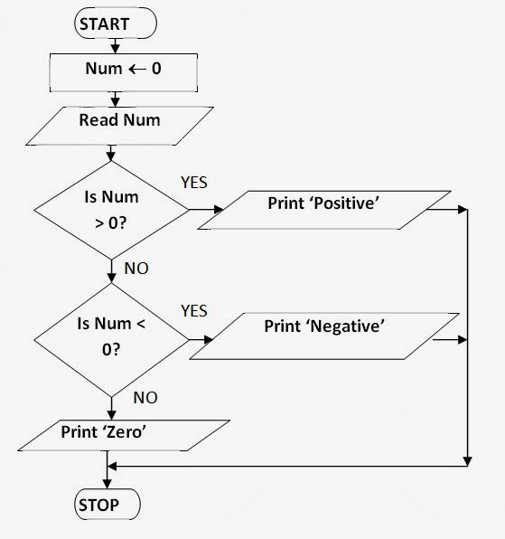
Check whether given number is positive or negative.
FLOWCHART
ALGORITHM
Step 1: Start
Step 2: Read a number N
Step 3: If N is equal to 0, go to step 6
Step 4: If N is greater than 0, go to step 5
Step 5: Print "N is positive", go to step 7
Step 6: Print "N is negative"
Step 7: Stop

Slide 15
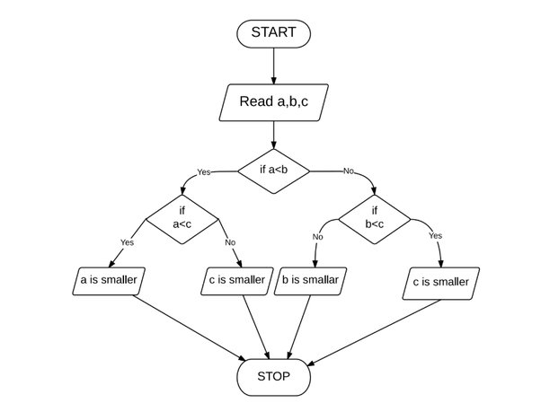
Find out smallest number from given three numbers.
FLOWCHART
ALGORITHM
Step 1: Start
Step 2: Read three numbers: A, B, C
Step 3: If A is less than B, go to step 5
Step 4: If B is less than C, then print B as the smallest, go to step 7
Step 5: If A is less than C, then print A as the smallest, go to step 7
Step 6: Print C as the smallest
Step 7: Stop

Slide 16
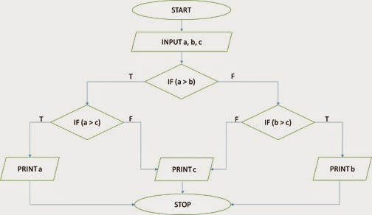
Find out largest number from given three numbers.
FLOWCHART
ALGORITHM
Step 1: Start
Step 2: Read three numbers: A, B, C
Step 3: If A is greater than B, go to step 5
Step 4: If B is greater than C, then print B
as the largest, go to step 7
Step 5: If A is greater than C, then print A as the largest, go to step 7
Step 6: Print C as the largest
Step 7: Stop

Slide 17
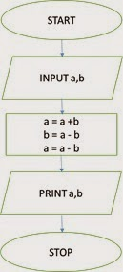
Swap two numbers without using temporary variable.
FLOWCHART
ALGORITHM
Step 1: Start
Step 2: Read two numbers: A, B
Step 3: A = A + B
Step 4: B = A – B
Step 5: A = A – B
Step 6: Print the swapped values: A, B
Step 7: Stop

Slide 18
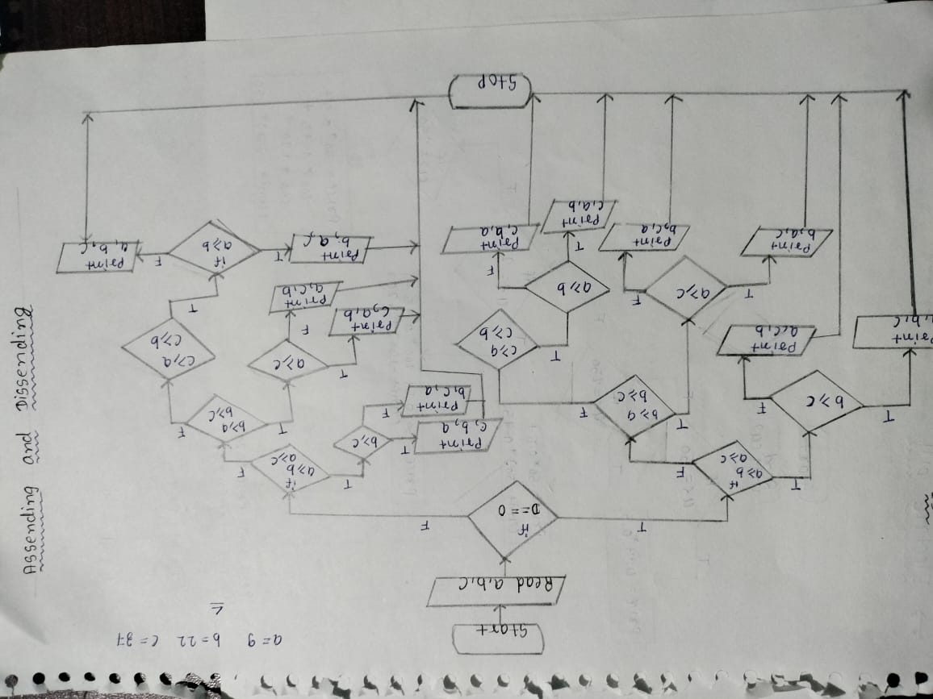
Accept three numbers from user and print them in ascending and descending order. (use only three conditions for each order)
FLOWCHART

Slide 19
Accept three numbers from user and print them in ascending and descending order. (use only three conditions for each order)
ALGORITHM
Step 1: Start
Step 2: Input three numbers: A, B, C
Step 3: If A >= B and A >= C, then
* Print A, B, C Go to step 9
Step 4: If B >= A and B >= C, then
* Print B, A, C Go to step 9
Step 5: If C >= A and C >= B, then
* Print C, A, B Go to step 9
Step 6: If A >= B and B >= C, then
* Print A, B, C Go to step 9
Step 7: If A >= C and C >= B, then
* Print A, C, B Go to step 9
Step 8: If B >= C and C >= A, then
Print B, C, A Go to step 9
Step 9 : Stop

Slide 20
LAB - 3
Advanced Algorithm and Flowchart

Slide 21
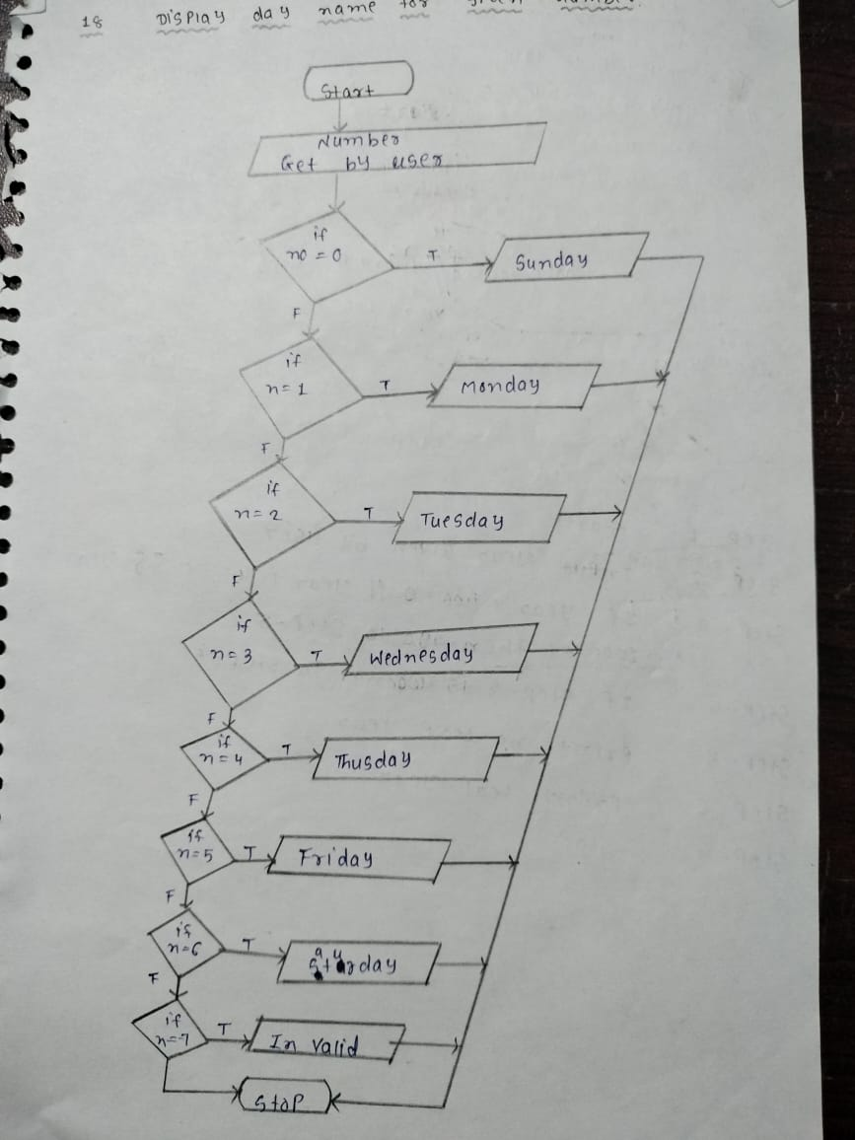
Display day name for the given number.
FLOWCHART
ALGORITHM
Step 1: Start
Step 2: Input the number (1-7) representing the day.
Step 3: If the number is 1, print "Monday".
Step 4: Else if the number is 2, print "Tuesday".
Step 5: Else if the number is 3, print "Wednesday".
Step 6: Else if the number is 4, print "Thursday".
Step 7: Else if the number is 5, print "Friday".
Step 8: Else if the number is 6, print "Saturday".
Step 9: Else if the number is 7, print "Sunday".
Step 10: Else, print "Invalid number. Please enter a number between 1 and 7.“
Step 11: Stop

Slide 22
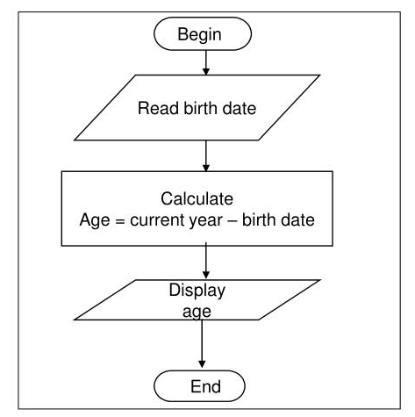
Calculate an age from current date to user’s birth date
FLOWCHART
ALGORITHM
Step 1: Start
Step 2: Read user birth date : bday
Step 3: calculate age using formula :
Age =Current_year - bday
Step 4: Display Age
Step 5: Stop

Slide 23
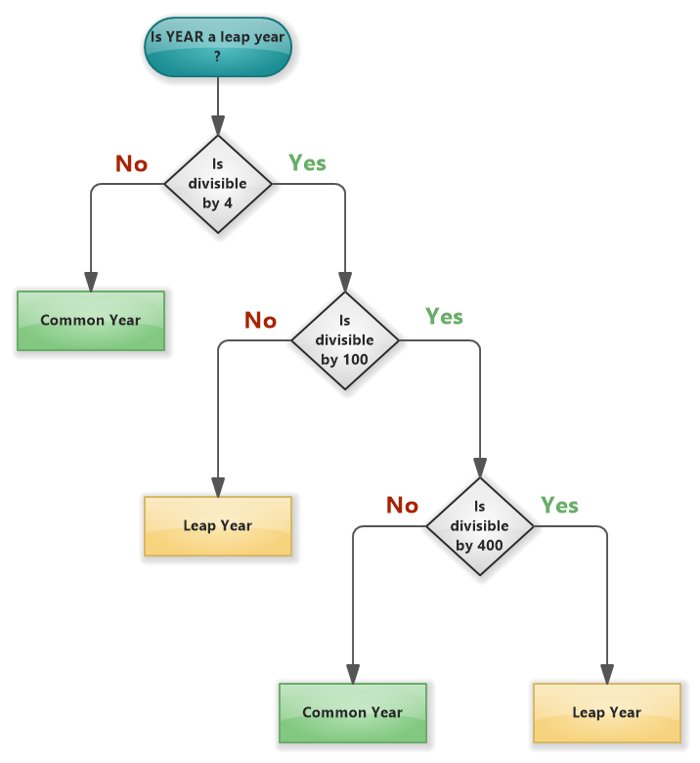
Check whether the given year is leap year or not. [If a year can be divisible by 4 but not divisible by 100 then it is leap year but if it is divisible by 400 then it is leap year].
FLOWCHART
ALGORITHM
Step 1: Start
Step 2: Input the year.
Step 3: If the year is divisible by 400, go to step 6.
Step 4: If the year is divisible by 100, go to step 7.
Step 5: If the year is divisible by 4, go to step 6.
Step 6:Print "Leap year".
Step 7:Print "Not a leap year".
Step 8:Stop

Slide 24
Evaluate the expressions using operator precedence.
a) 10 + 20 * 30
Multiplication (*) has higher precedence than addition (+).
First, calculate 20 * 30 = 600.
Then, add 10 + 600 = 610.
Result: 610
c) 5 * 4 / 4 % 3 d) 100 + 200 / 10 – 3 * 10
Multiplication (*), division (/), and modulus (%) have the same precedence and are evaluated left to right.
First, calculate 5 * 4 = 20.
Then, divide 20 / 4 = 5
.Finally, compute 5 % 3 = 2.
Result: 2
b) 100 / 10 * 100
Division (/) and multiplication (*) have the same precedence and are evaluated left to right.First,
calculate 100 / 10 = 10.
Then, multiply 10 * 100 = 1000.Result: 1000
d) (10 - 4) + (20 / (2 * 5)) * 3
Division (/) and multiplication (*) are evaluated first.
First, calculate 200 / 10 = 20.
Then, multiply 3 * 10 = 30.
Now,
perform the addition and subtraction from left to right: 100 + 20 = 120, 120 - 30 = 90.
Result: 90

Slide 25
Evaluate the expressions using operator precedence.
e) (10 - 4) + (20 / (2 * 5)) * 3
Parentheses () have the highest precedence and are evaluated first.
First, calculate 10 - 4 = 6.
Then, compute 2 * 5 = 10.
Divide 20 / 10 = 2.
Multiply 2 * 3 = 6.
Finally, add 6 + 6 = 12.
Result: 12
f) (3 + 8) % 35 - 28 / 7
Parentheses () are evaluated first.
First, calculate 3 + 8 = 11.
Then, compute 11 % 35 = 11 (since 11 is less than 35).
Next, divide 28 / 7 = 4.
Finally, subtract 11 - 4 = 7.
Result: 7

Slide 26
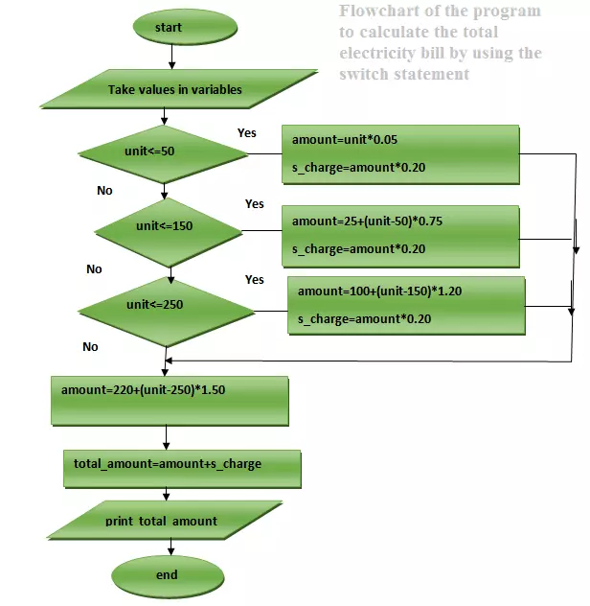
Input electricity unit charge and calculate the total electricity bill according to the given condition: - For 􀆒rst 50 units Rs. 0.50/unit , - For next 100 units Rs. 0.75/unit , - For next 100 units Rs. 1.20/unit ,- For unit above 250 Rs. 1.50/unit - An additional surcharge of 20% is added to the bill.
FLOWCHART
ALGORITHM
Step 1: Start
Step 2: Input the number of units used.
Step 3: If units <= 50, calculate total_bill = units * 0.50.
Step 4: Else if 50 < units <= 150, calculate total_bill = (50 * 0.50) + ((units - 50) * 0.75).
Step 5: Else if 150 < units <= 250, calculate total_bill = (50 * 0.50) + (100 * 0.75) + ((units - 150) * 1.20).
Step 6: Else, calculate total_bill = (50 * 0.50) + (100 * 0.75) + (100 * 1.20) + ((units - 250) * 1.50).
Step 7: Apply surcharge: total_bill = total_bill * 1.20.
Step 8: Output the total_bill.
Step 9: Stop

Slide 27
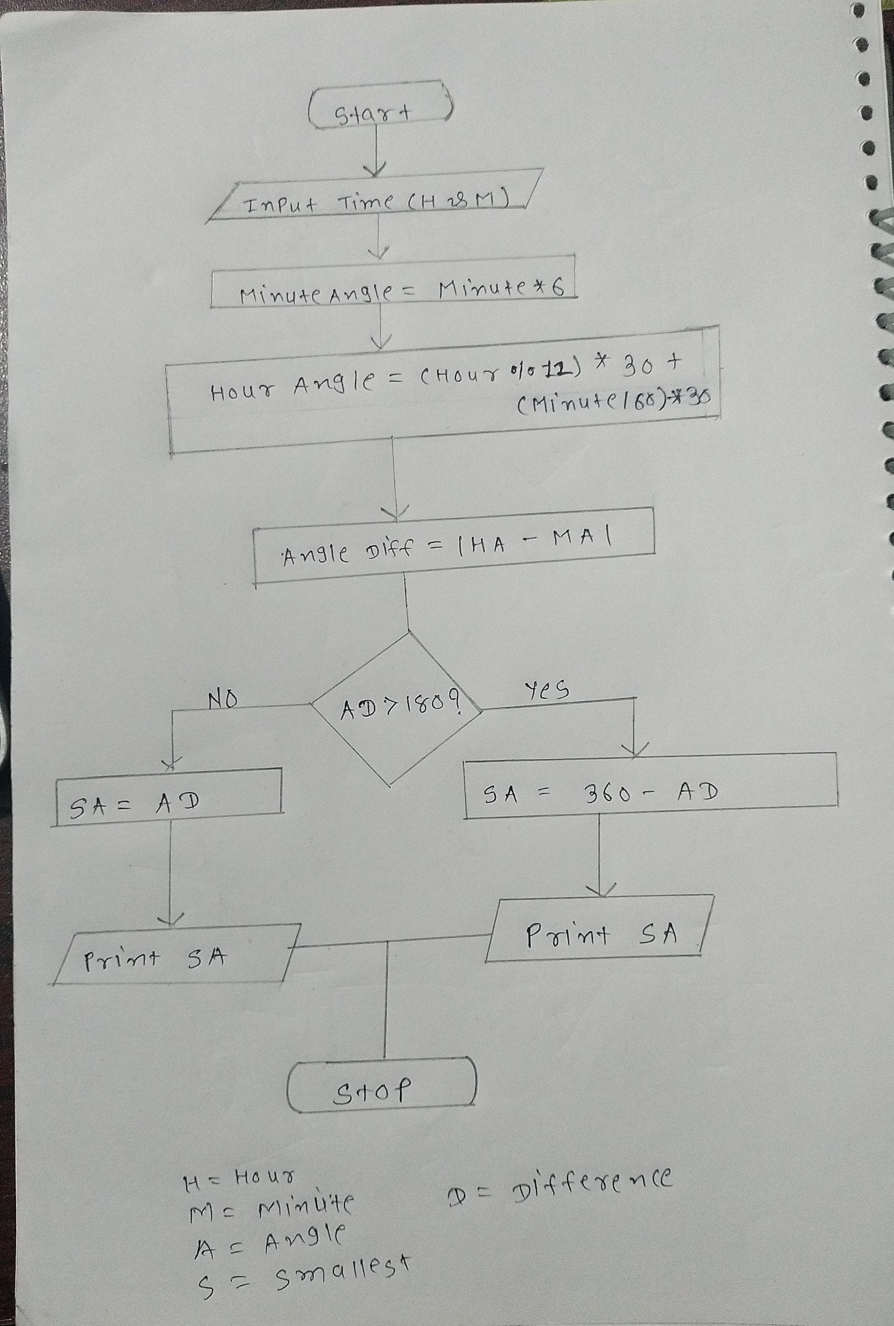
Calculate the angle between hour hand and minute hand
FLOWCHART
ALGORITHM
Step 1: Start
Step 2: Input the hour and minute values (hour, minute).
Step 3: Calculate the angle gained by each hour gained: hour_angle_per_hour = 30 degrees (360 degrees / 12 hours). Step 4: Calculate the angle gained by each minute gained: minute_angle_per_minute = 6 degrees (360 degrees / 60 minutes).
Step 5: Compute the angle of the hour hand from 12:00: hour_angle = (hour % 12) * hour_angle_per_hour + (minute / 60) * hour_angle_per_hour.
Step 6: Compute the angle of the minute hand from 12:00: minute_angle = minute * minute_angle_per_minute.

Slide 28
ALGORITHM
Step 7: Calculate the absolute difference between the hour hand angle and the minute hand angle: angle = abs(hour_angle - minute_angle).
Step 8: If angle > 180 degrees, adjust the angle to be the smaller angle between the two possible angles: angle = 360 - angle.
Step 9: Output the angle.
Step 10: Stop

