Slide 1


CPLAYER
BATCH-F

Slide 2
TEAM MEMBERS
BATCH-E
Presentation by:
KARTIK GUPTA
KAVIN RAJ A.D
RASIKA M
THOGATE ADVESH

Slide 3
SECTION DIVIDER
Introduction
Requirements
Objective
Project Overflow
Architecture
Application Flow
Tools/Technologies used

Slide 4
INTRODUCTION
Cplayer is an app where users can add his favorite players;
It is an online database and search engine that allows users to search for players and add the favorite player.

Slide 5
REQUIREMENTS:
Register user, login and logout
Search a player by name
View player statistics
Add a player to favourite list
should be able to see favourite players

Slide 6


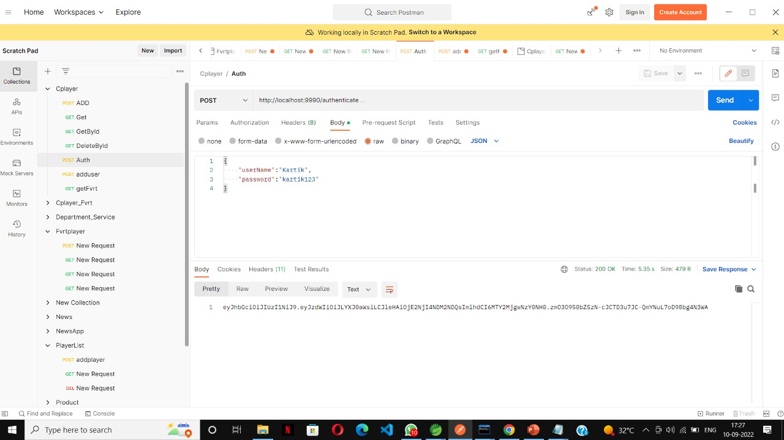


Objective:

Slide 7
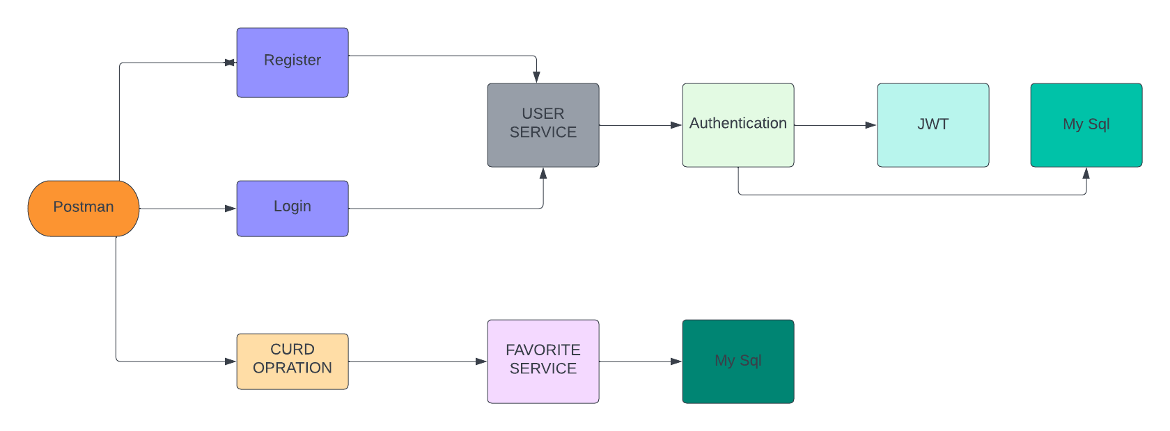
PROJECT OVERFLOW

Slide 8


ARCHITECTURE
Authentication API
JWT validator
MySql
Login/Register
POST Request
Token generated
Postman
POST /GET
UserService API
Get Favorite
MySql
POST,GET

Slide 9


APPLICATION FLOW
Postman
Search
Login
Register
Add to Favorite
Favorite

Slide 10


TOOLS/TECHNOLOGIES USED

Slide 11
THANK YOU
ww.lucernepublishing.com

