Slide 1

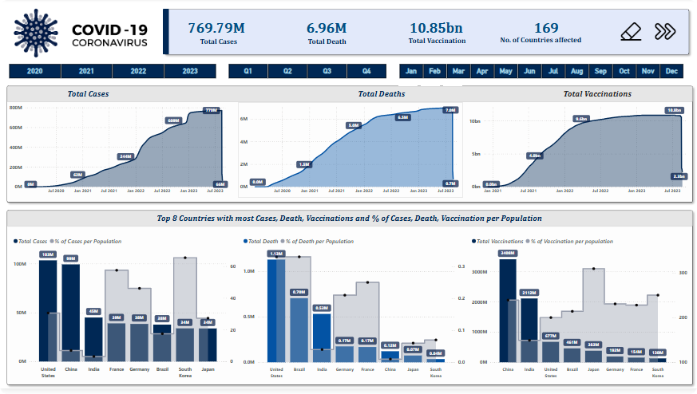
COVID-19 Analysis Dashboard
Hello, I am Kartik Jangir. This presentation offers an overview of the COVID-19 Analysis Dashboard project. We'll discuss its functionality, real-world applications, and key features.

Slide 2




Project Workflow
Data Acquisition
Gathering data from reliable sources.
Data Processing
Cleaning and transforming the data.
Visualization
Creating interactive charts and maps.
The project follows a structured workflow. This ensures data accuracy and reliability. Regular updates keep the dashboard current.

Slide 3
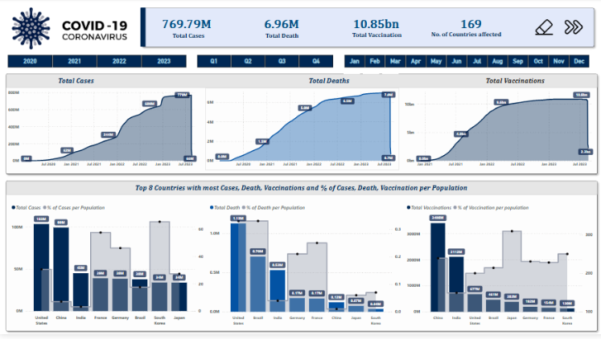
Dashboard Overview
Visualizing Pandemic Data
The dashboard offers comprehensive insights into the COVID-19 pandemic. It aggregates data from various sources. It also presents it in an accessible format.
Interactive maps
Dynamic charts
Key metrics
This helps stakeholders understand the pandemic's progression. Interactive elements allow for detailed exploration.

Slide 4

Real-World Problem #1
Resource Allocation
The dashboard aids in efficient resource allocation. This helps identify hotspots and predict future needs.
Hospital beds
Medical supplies
Vaccination efforts
It helps governments and healthcare organizations to make informed decisions. It optimizes the distribution of essential resources.

Slide 5

Real-World Problem #2
Policy Making
Informed policy-making is crucial during a pandemic. The dashboard provides insights. It enables evidence-based decisions.
Lockdown measures
Social distancing
Travel restrictions
This ensures public health measures are effective. Also, they are proportionate to the risk.

Slide 6



Key Features
Filtering
Allows detailed data analysis
Historical Data
Tracks pandemic progression
Alerts
Notifies outbreaks
The dashboard is packed with useful features. These enhance usability and analytical power. They provide timely updates.

Slide 7


DAX Queries
--Total Cases Total Cases = SUM(Cases[New Cases]) --Total Deaths Total Deaths = SUM(Deaths[New Deaths])
The dashboard leverages powerful DAX queries. They perform complex calculations and aggregations. These metrics provide deeper insights.

Slide 8
Thank You

