Slide 1



Project Presentation
NextTo: A Hyperlocal Deals Marketplace
Leah Chakarmakal | R23EF117 | B.Tech CSE, 7th Sem, Section [to fill]
Faculty guide: Dr Chaithra M H Phase-1 (about 80% complete)
REVA Internship Opportunities (RIO) | 14 November 2026
Aligned with the UN Sustainable Development Goals
Notes:
30 seconds. NextTo is a hyperlocal deals marketplace: merchants publish time-bound offers, nearby customers pay by UPI, receive a single-use QR voucher and redeem it in person. This covers Phase-1 (about 70% complete).

Slide 2
Problem Statement and Literature Gaps
Problem and users
Gap in existing work
Problem: cafes, salons and bakeries have idle capacity but no trustworthy way to sell time-limited offers to people nearby.
Users: consumers who want nearby deals, merchants who want footfall, admins who need control and an audit trail.
Success: a purchase journey that never double-charges, never double-redeems and can be audited end to end (21-step journey and 77 tests pass).
Gap 1: no reviewed work combines vouchers, single-use QR redemption and appointments in one marketplace.
Gap 2: recommenders need history or social graphs that a new platform does not have.
Gap 3: fraud-model results come from public datasets, not a live gateway round trip.
My module (Deals, Discovery and Vouchers) addresses Gaps 1 and 2: the deal approval workflow, ranking that works with no history, single-use QR redemption and appointment booking.
UN SDGs:
Project Presentation | Leah Chakarmakal | R23EF117
Notes:
About 1 min. State the problem in two sentences, then the three gaps found in the 10 IEEE papers. Our work covers gaps 1 and 2; the ML fraud model (gap 3) is Phase-2.

Slide 3
Literature Survey
Paper (author, year) | Approach | Strength | Limitation
Vas et al., 2023 | Conceptual hyperlocal marketplace with all stakeholder roles | Defines the full stakeholder set (shopper, merchant, admin) | No data model, security or payment design
Satrio et al., 2022 | Customer interviews to find MVP features (36 buyers, 35 sellers) | Evidence-based feature priorities | Generic local commerce; no QR redemption
Tong et al., 2017 | Logistic regression with time decay for location recommendation | Works with missing location; measured F1 | Low absolute F1; needs history
Lingareddy et al., 2025 | DQN + XGBoost UPI fraud detection | 98.7% accuracy, 1.2% false positives | Public data only, not live UPI
Also reviewed: Chang 2010, Kohli 2024, de O. Junior 2022, Sharma 2015, Lin 2018, Cecil 2024 (10 IEEE papers in total).
Project Presentation | Leah Chakarmakal | R23EF117
Notes:
About 1 min. Four of the ten papers: Vas (the hyperlocal concept), Satrio (MVP features), Tong (location recommendation with sparse data), Lingareddy (UPI fraud). Each is strong in its area but none combines vouchers, QR redemption and appointments, which leads into the gap.

Slide 4
Requirements
ID | Requirement | Type | Priority
R1 | Buy a deal: idempotent order, stock reserved, signed payment callback | Functional | High
R2 | Signed single-use QR voucher; redeemed once by the owning merchant | Functional | High
R3 | Nearby deals ranked by distance, category, recency, urgency | Functional | High
R4 | Email + password sign-up; role carried in the JWT | Functional | High
R5 | Merchants submit deals; admin approval before going live | Functional | High
R6 | Refund request, admin decision, voucher frozen meanwhile | Functional | Medium
R7 | Appointment booking with capacity-guarded slots | Functional | Medium
R8 | Reward points credited at redemption; reviews and tips | Functional | Medium
R9 | Append-only audit log of financial and admin changes | Non-functional | Medium
R10 | Voucher validation well under 200 ms | Non-functional | Medium
R11 | Payment provider and fraud scorer are swappable | Non-functional | Medium
R12 | One API contract for phone-width and admin screens | Non-functional | Medium
Project Presentation | Leah Chakarmakal | R23EF117
Notes:
About 1 min. Twelve requirements: eight functional, four non-functional. The IDs reappear in the design traceability and in the test table. They group the original FR-C/M/A/D/P identifiers from the requirements document.

Slide 5
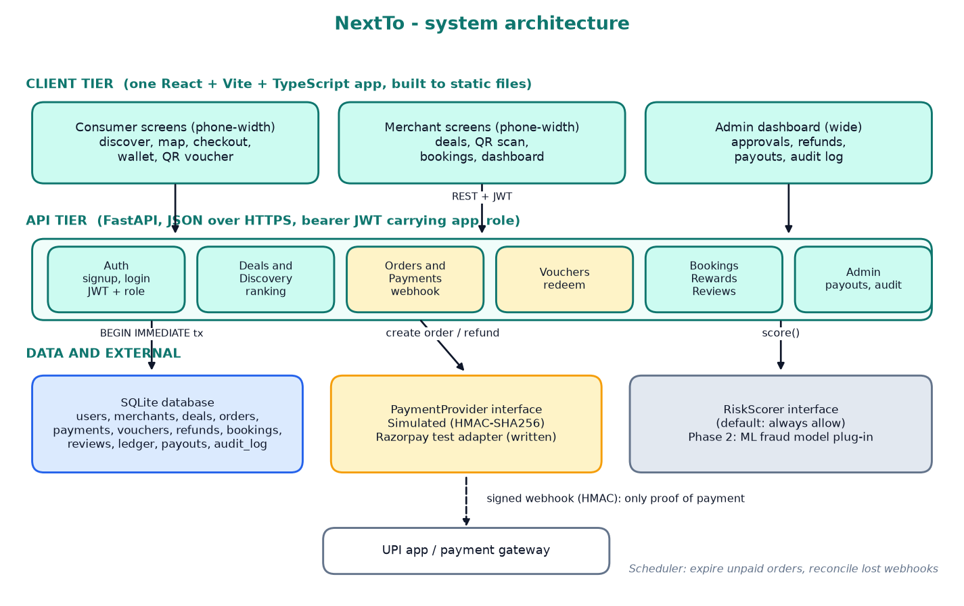
System Design
Why this design
Modular API on FastAPI + SQLite instead of microservices: one developer, same domain split, runs anywhere. Supabase / PostgreSQL is the Phase-2 migration.
Webhook is the only proof of payment: HMAC-signed, de-duplicated, amount-checked. Clients never write payment or voucher state.
Every money / stock / voucher change runs in one BEGIN IMMEDIATE transaction.
Project Presentation | Leah Chakarmakal | R23EF117
Notes:
About 1 min. Left to right: React web app (phone-width for consumers and merchants, wide for admin), FastAPI domain modules sharing one JWT login, SQLite. PaymentProvider and RiskScorer are interfaces, so a gateway or an ML fraud model is replaceable in one class. Rejected alternative: separate microservices.

Slide 6
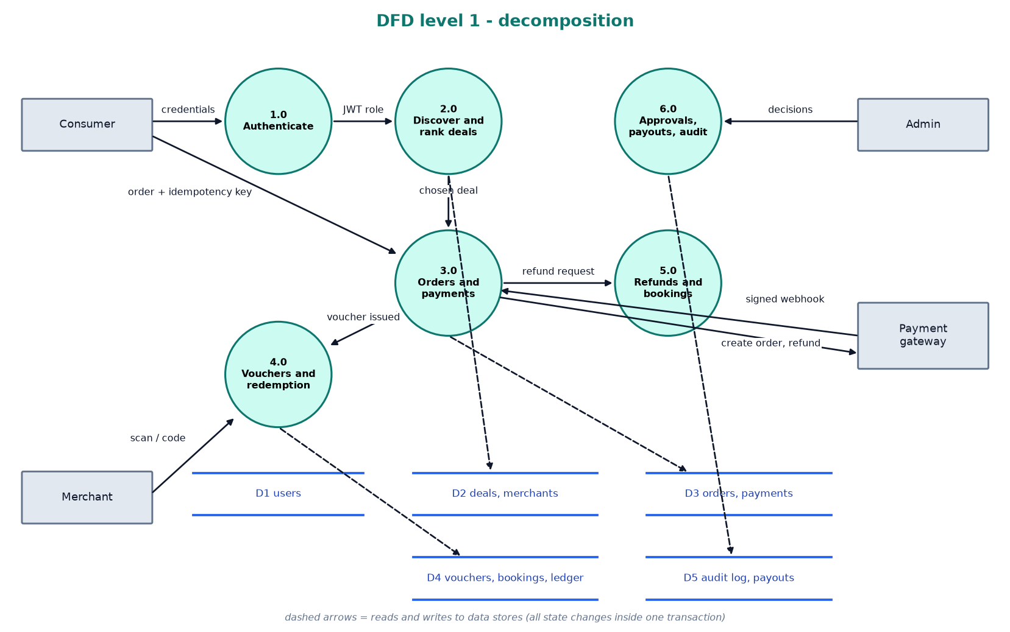
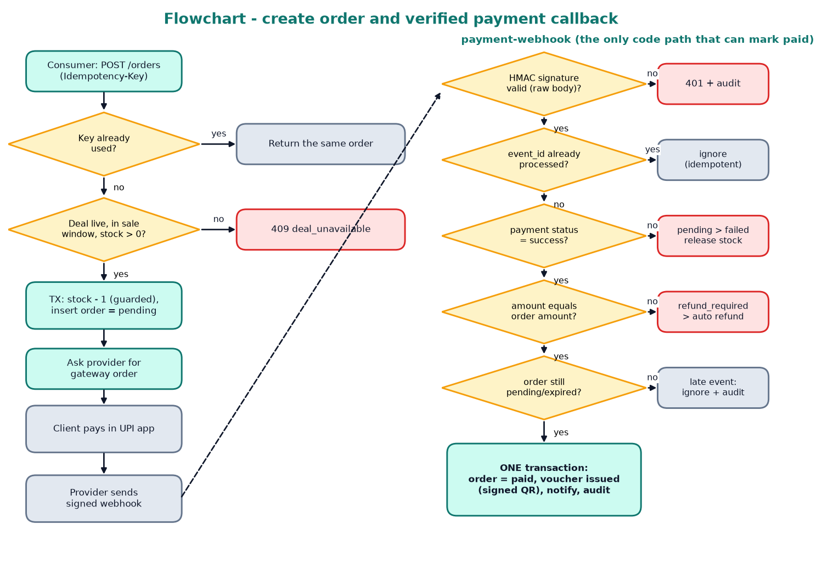
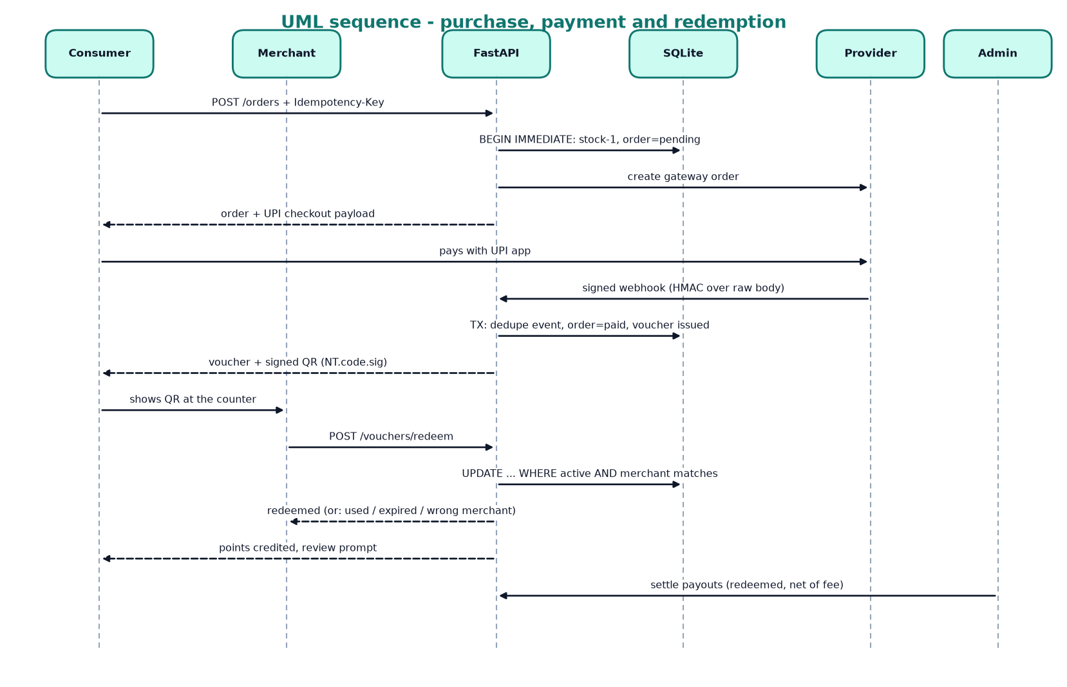
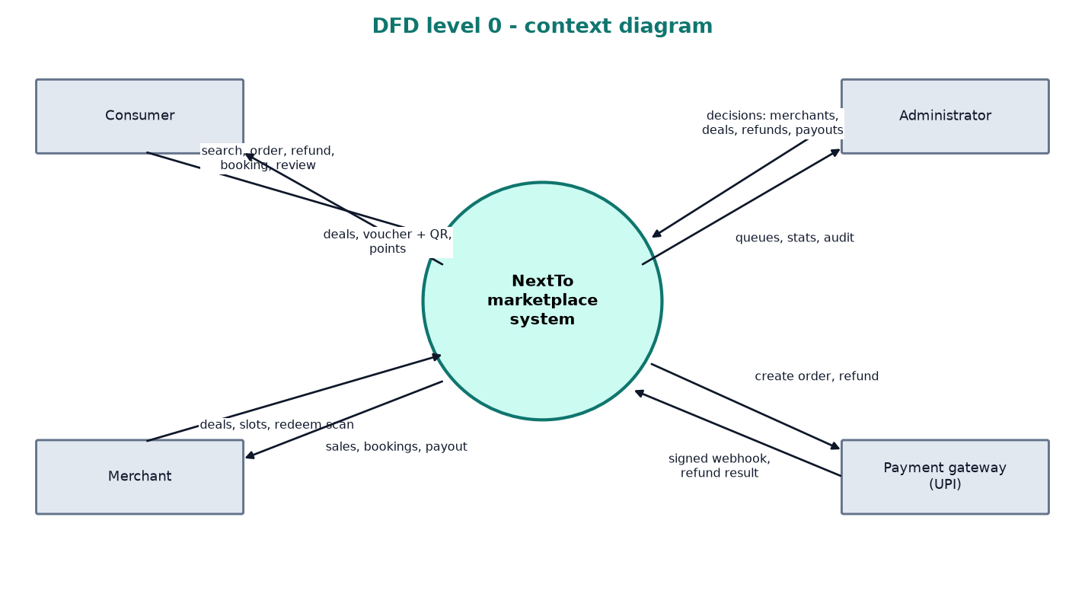
Detailed Design: Flowchart, UML, DFD
Flowchart: create order and verified payment callback (R1)
UML sequence: purchase, payment, redemption (R1, R2). Class / ER diagram in the report
DFD level 1 (top) and level 0 (below), R1 to R9
Each design element traces back to a requirement ID (R1, R2, ...). Full-size diagrams: Section 2.2 and Appendix A of the report.
Project Presentation | Leah Chakarmakal | R23EF117
Notes:
About 1.5 min. Flowchart: create_order then verified payment callback. Sequence: shopper, API, provider, merchant. DFD: level 0 shows the external entities, level 1 the processes and data stores. Class / ER diagram is in the report (Figure 2.3). Each traces to R-IDs; mapping table is Section 2.4 of the report.

Slide 7
Implementation Progress
Week 8: Core implementation (orders, signed callback, vouchers, refunds)
target about 30% | actual: 30%
Week 10: Complete, refine, debug (FastAPI + SQLite backend)
target about 55% | actual: 55%
Week 14: Consolidation (Phase-1) (React UI, tests, report)
target about 70% | actual: 80%
Working: W8 Node prototype, 69 tests > W10 auth, ranking, reservation, redemption, refunds, bookings, payouts > W14 three role UIs, 77 tests, 21-step journey. Hosted on Vercel + Render; Android APK built.
Project Presentation | Leah Chakarmakal | R23EF117
Notes:
About 1 min. Honest completion: the Week 8 prototype was a Node app with an in-memory store (69 tests). In Week 10 it was rebuilt on FastAPI + SQLite. By Week 14 the React consumer, merchant and admin screens are integrated and 74 automated tests plus a 21-step end-to-end journey pass. Not built: live gateway keys, native apps, push/email, CI, pilot.

Slide 8
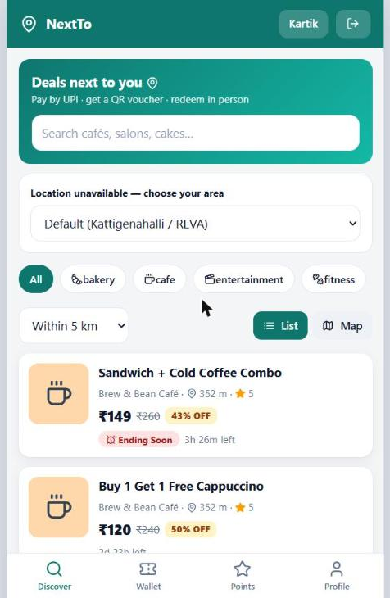
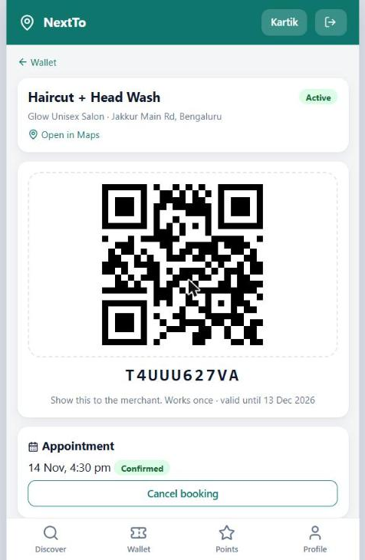
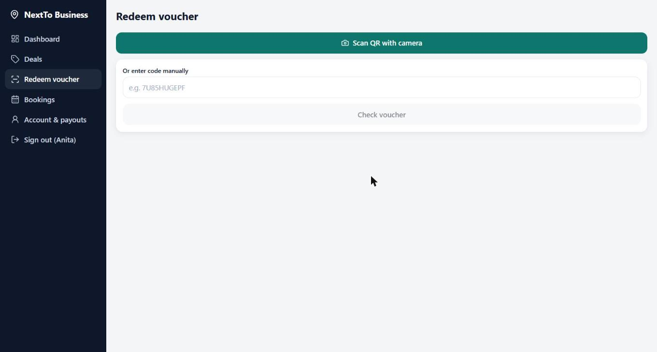
Key Features and Demo
Discover: ranked deals, location fallback
Wallet: signed single-use QR voucher
Merchant: scan or type code to redeem
How I built it
Improvement I made
Deal workflow in routers/merchant.py and routers/admin.py; ranking in ranking.py; redemption in services.redeem_voucher; booking in services.create_booking; map, deal cards and QR scanner in the React pages.
Nearby search: SQL bounding box first, then haversine + score on the survivors only, instead of scoring every deal.
Project Presentation | Leah Chakarmakal | R23EF117
Notes:
About 2 min. Demo or screenshots: discovery with ranking, the QR voucher, merchant redemption. How built: services.py holds each transactional rule; the QR payload is NT.code.signature. Improvement: the nearby search filters in SQL before scoring (median search 6.3 ms; redemption median 9.1 ms against the 200 ms target).

Slide 9
Testing
77
77
0 / 4
automated tests designed
passed
failing now / bugs fixed
Test ID | Input | Expected | Actual | Result
T1 | POST /orders, stock 5, price 100 | Pending order, stock 4 | Pending order, stock 4 | Pass
T2 (boundary) | 6 buyers race for the last unit | Exactly 1 order, stock 0 | 1 order, 5 rejected, stock 0 | Pass
T3 (negative) | Webhook with a wrong signature | 401, order stays pending | 401, pending, no voucher | Pass
T14 (boundary) | 5 simultaneous scans of one voucher | Exactly 1 redeemed | 1 redeemed, 4 refused | Pass
Project Presentation | Leah Chakarmakal | R23EF117
Notes:
About 1 min. 74 automated pytest tests, all passing (about 37 s), plus the 21-step end-to-end journey. Table shows a normal case, two boundary cases and a negative case. Four bugs were found and fixed (next slide). Line coverage was not measured yet: a coverage report is a Phase-2 item.

Slide 10
Debugging and Integration
Before
Look-up, then an awaited risk check, then insert. Two requests with the same Idempotency-Key could both pass the look-up and create two orders.
After
Re-check inside BEGIN IMMEDIATE, then insert. UNIQUE(consumer_id, idempotency_key) is the last guard. Tests T2 and T4 pass.
Module-1 + Module-2 integration
Connection: Module-1 (orders, webhook, refunds) and Module-2 (deals, ranking, vouchers) share one database transaction: payment confirmation takes the stock and issues the voucher that Module-2 later redeems.
Integration bugs: stock decremented at payment (could oversell); points tied to payment; double tap created two orders.
Resolved: reserve stock at order creation with a 10-minute expiry; credit points at redemption; one idempotency key per checkout screen.
Root cause and fix
Symptom: duplicate orders on a retry.
Root cause: look-up and insert were not one atomic step.
Fix: serialised transaction plus a unique constraint.
Project Presentation | Leah Chakarmakal | R23EF117
Notes:
About 1.5 min. Bug story: two requests with one idempotency key both passed the look-up because an await sat between check and insert. Found at the Week 8 review. Fixed with a BEGIN IMMEDIATE re-check and a UNIQUE constraint. Other bugs fixed: late payment after expiry (now auto-refunded), double scan (one conditional UPDATE), unverified merchants seeing 403 boxes. Before/after screenshots can be added from the report appendix.

Slide 11
My Contribution and Phase-2 Plan
My contribution
Pending work (about 20%) | Approach | Target week
Personalised ranking | Add a category-affinity term once purchase history exists | Phase 2
Native QR scanning and push alerts | Reuse the API in Expo apps | Phase 2
Usability test and pilot with 5 merchants | Onboard shops near campus; survey; measure redemption rate | Week 16
Coverage and UI tests for discovery and redemption | pytest-cov, browser tests for scan and booking flows | Week 16
Week 2: literature survey support and requirements for discovery and vouchers.
Week 6: detailed design of the deal workflow, ranking and redemption.
Week 8: deals, vouchers and bookings modules in the prototype.
Weeks 10 to 14: ranking and map discovery, deal builder and approvals, QR redemption, bookings, merchant and consumer screens, tests.
Team: Leah Chakarmakal: Deals, Discovery and Vouchers (deal workflow, ranking, redemption, bookings, rewards) and the consumer/merchant screens. Kartik Jarali: Orders and Payments and backend core.
Project Presentation | Leah Chakarmakal | R23EF117
Notes:
About 1 min. Personally: requirements and survey (Week 2), system and detailed design (Weeks 4 and 6), prototype (Week 8), consolidated backend, UI, tests and documentation (Weeks 10 to 14). The remaining 30%: live payment gateway test, CI, coverage and load testing in Weeks 15 and 16; PostgreSQL migration, native apps, notifications, pilot and ML fraud scoring in Phase 2.

Slide 12
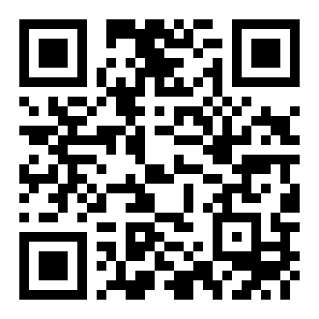
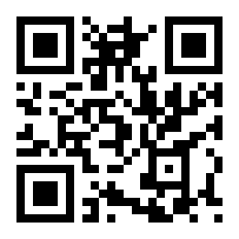
Learnings and Thank You
Hardest problem and what I learnt
Hardest problem: keeping money, stock and vouchers correct under retries and concurrency without PostgreSQL functions.
What worked: serialised write transactions, guarded conditional UPDATEs decided by row count, unique constraints as the last guard, and tests that use real threads.
Next time: start on PostgreSQL with row locks, add coverage and load tests early, and test the real payment gateway before the demo.
Thank you. Questions?
Leah Chakarmakal | R23EF117 | Live demo: nextto.vercel.app | Android app: nextto.vercel.app/NextTo.apk | Code: github.com/Kartikjarali010/next-to
Android app (APK)
Open the web app
Project Presentation | Leah Chakarmakal | R23EF117
Notes:
About 30 sec plus viva. Viva topics: why FastAPI + SQLite and what Supabase would change; how each diagram maps to code; the ranking score and the single-UPDATE redemption; the idempotency race bug; what is left for Phase-2.

