Slide 1
2D/3D Geometric Transformations
CS485/685 Computer Vision
Dr. George Bebis

Slide 2
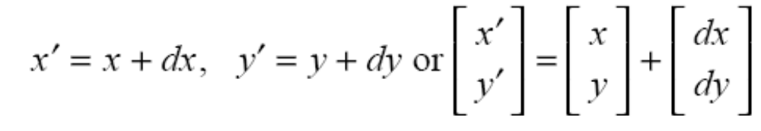
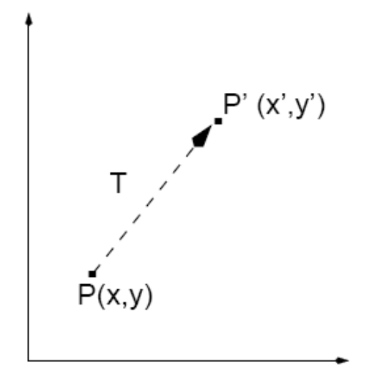
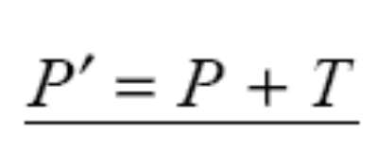
2D Translation
Moves a point to a new location by adding translation amounts to the coordinates of the point.
or
or

Slide 3
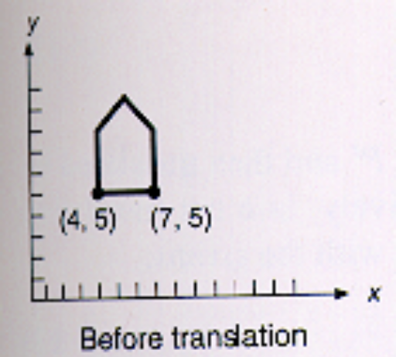
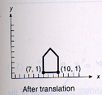
2D Translation (cont’d)
To translate an object, translate every point of the object by the same amount.

Slide 4
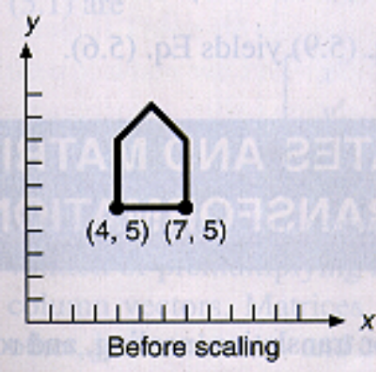
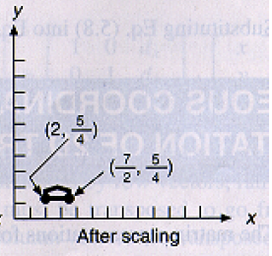
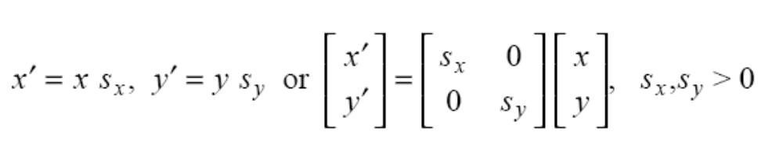
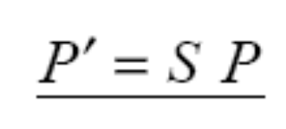
2D Scaling
Changes the size of the object by multiplying the coordinates of the points by scaling factors.
or
or

Slide 5
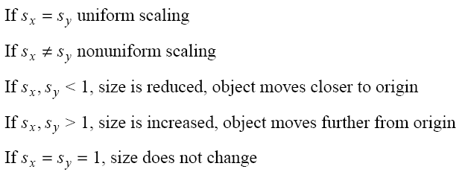
2D Scaling (cont’d)
Uniform vs non-uniform scaling
Effect of scale factors:

Slide 6
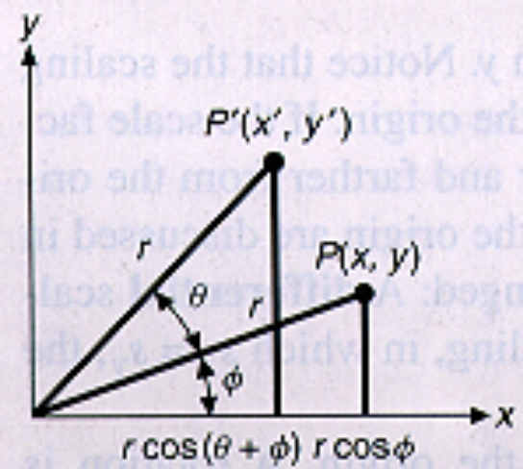
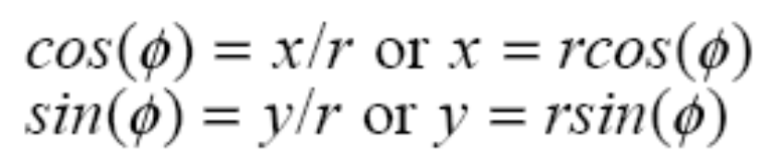
2D Rotation
Rotates points by an angle θ about origin
(θ >0: counterclockwise rotation)
From ABP triangle:
C
B
A
From ACP’ triangle:

Slide 7
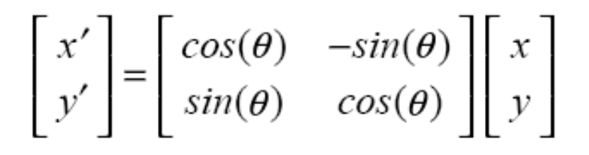
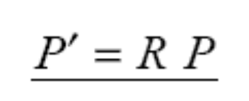
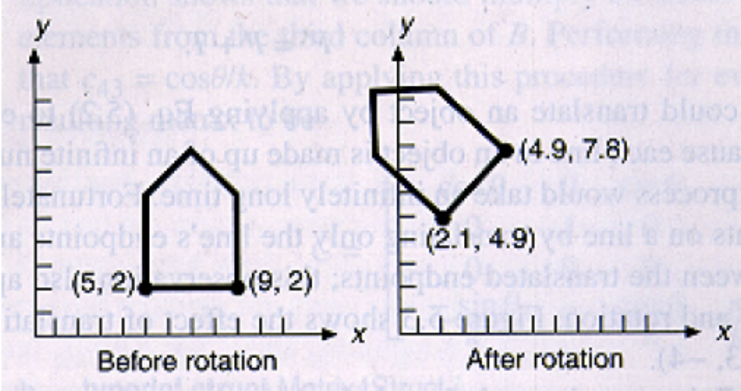
2D Rotation (cont’d)
From the above equations we have:
or
or

Slide 8
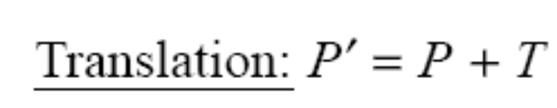
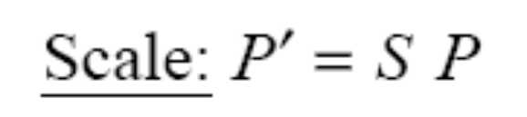
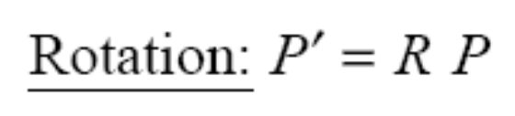
Summary of 2D transformations
Use homogeneous coordinates to express translation as
matrix multiplication

Slide 9
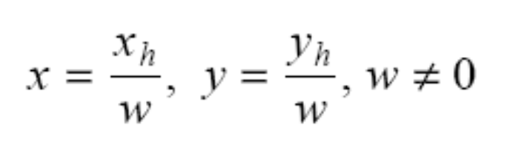

Homogeneous coordinates
Add one more coordinate: (x,y) → (x_{h}, y_{h}, w)
Recover (x,y) by homogenizing (x_{h}, y_{h}, w):
So, x_{h}=xw, y_{h}=yw,
(x, y) → (xw, yw, w)

Slide 10
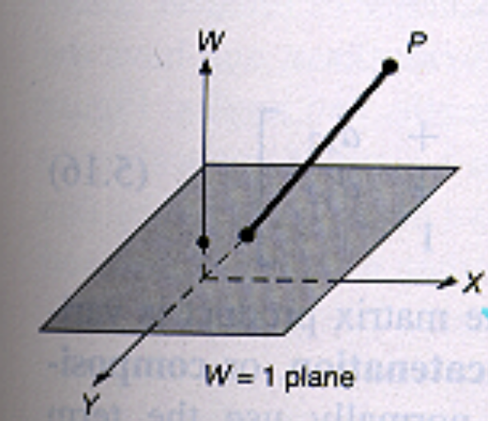
Homogeneous coordinates (cont’d)
(x, y) has multiple representations in homogeneous coordinates:
  w=1 (x,y) → (x,y,1)
  w=2 (x,y) → (2x,2y,2)
All these points lie on a
line in the space of
homogeneous
coordinates !!
projective
space

Slide 11
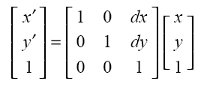

2D Translation using homogeneous coordinates
w=1

Slide 12
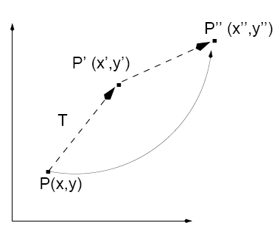
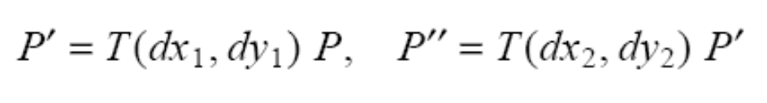
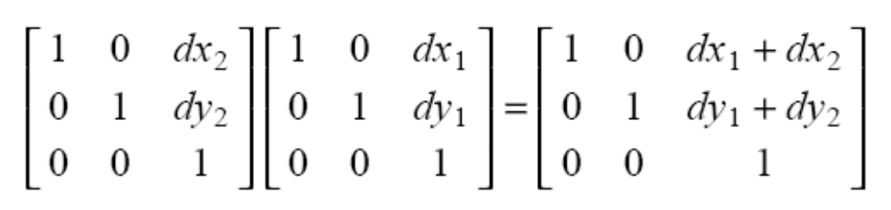
2D Translation using homogeneous coordinates (cont’d)
Successive translations:

Slide 13
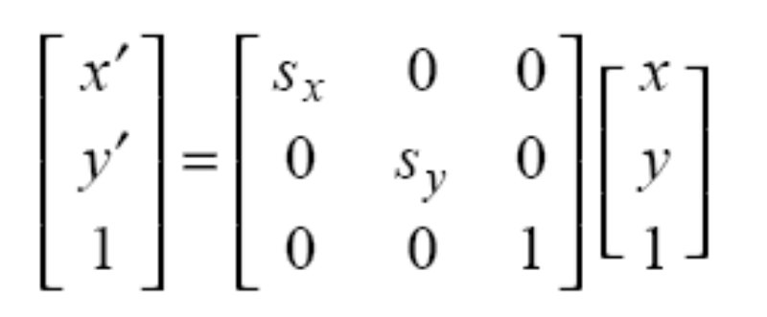
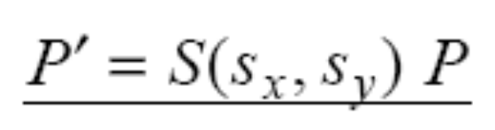
2D Scaling using homogeneous coordinates
w=1

Slide 14

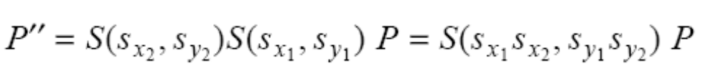
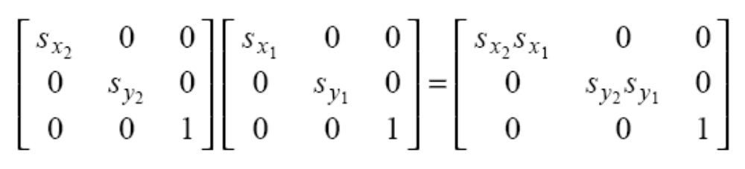
2D Scaling using homogeneous coordinates (cont’d)
Successive scalings:

Slide 15
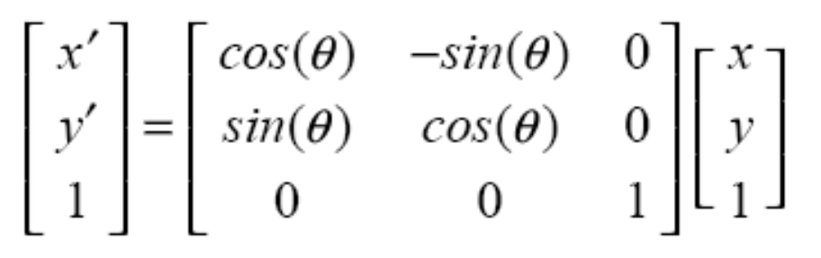
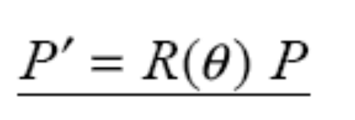
2D Rotation using homogeneous coordinates
w=1

Slide 16
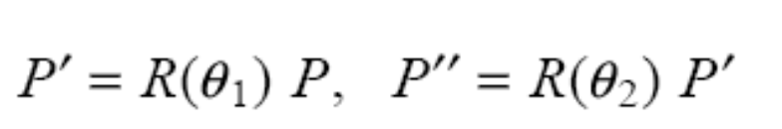
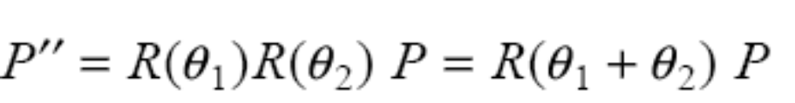
2D Rotation using homogeneous coordinates (cont’d)
Successive rotations:
or

Slide 17
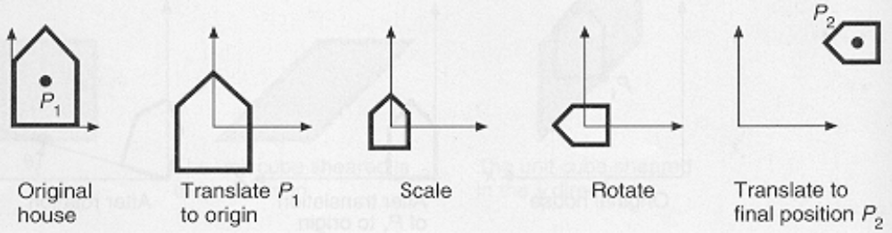

Composition of transformations
The transformation matrices of a series of transformations can be concatenated into a single transformation matrix.
* Translate P₁ to origin
* Perform scaling and rotation
* Translate to P₂
Example:

Slide 18
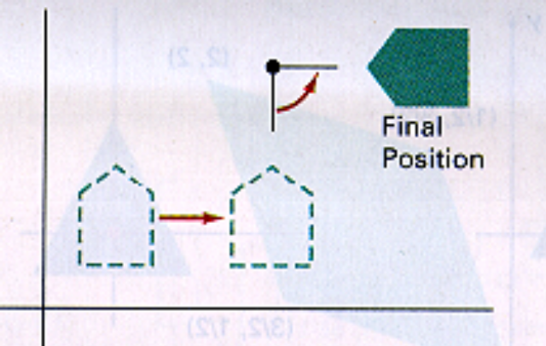
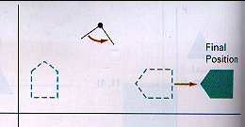
Composition of transformations (cont’d)
Important: preserve the order of transformations!
translation + rotation
rotation + translation

Slide 19
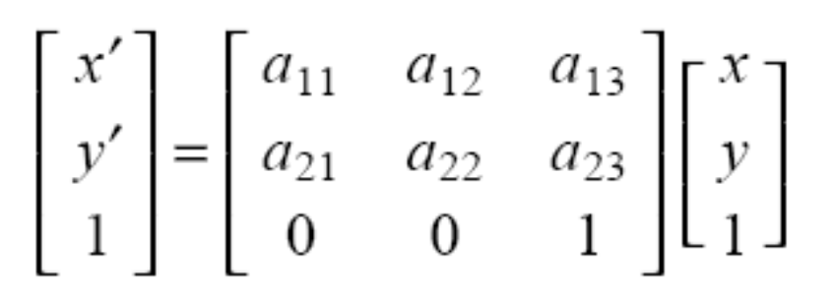
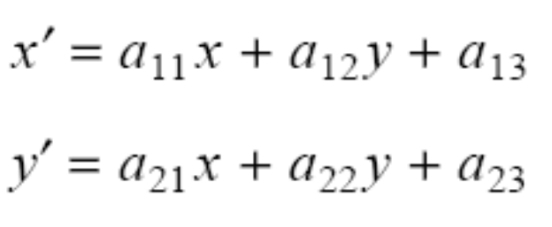
General form of transformation matrix
rotation, scale
translation
Representing a sequence of transformations as a single transformation matrix is more efficient!
(only 4 multiplications and 4 additions)

Slide 20

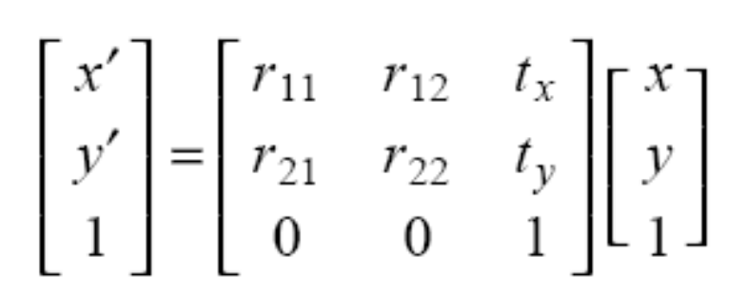
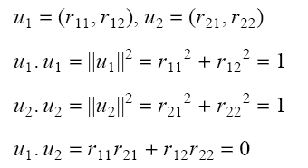
Special cases of transformations
Rigid transformations
  Involves only translation and rotation (3 parameters)
  Preserve angles and lengths
upper 2x2 submatrix is ortonormal

Slide 21
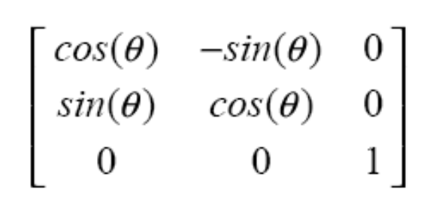
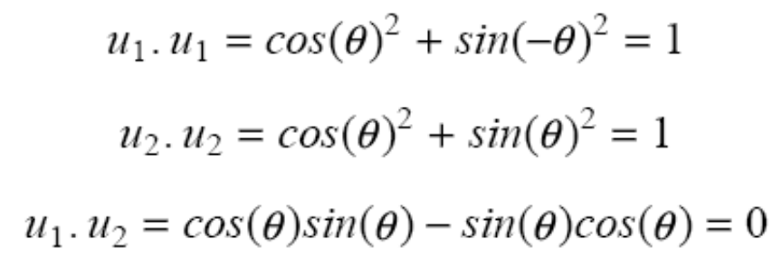
Example: rotation matrix

Slide 22

Special cases of transformations
Similarity transformations
  Involve rotation, translation, scaling (4 parameters)
  Preserve angles but not lengths

Slide 23

Affine transformations
Involve translation, rotation, scale, and shear
(6 parameters)
Preserve parallelism of lines but not lengths and angles.

Slide 24
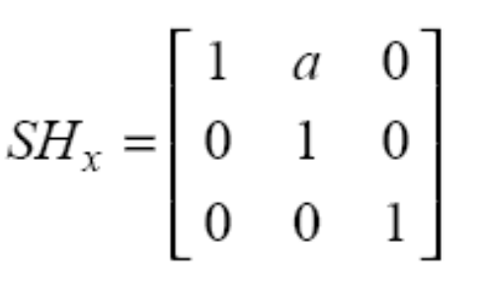
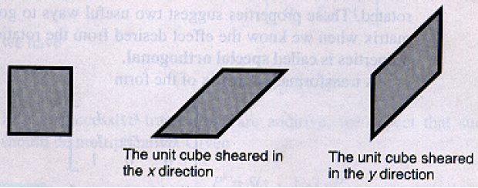
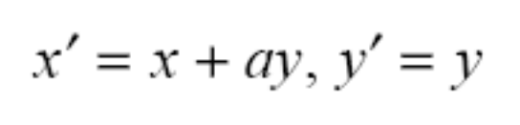
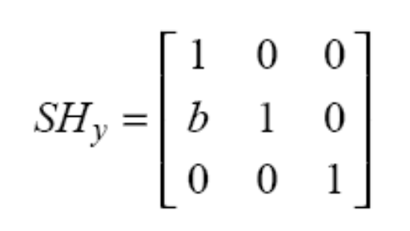

2D shear transformation
changes object
shape!
Shearing along x-axis:
Shearing along y-axis

Slide 25
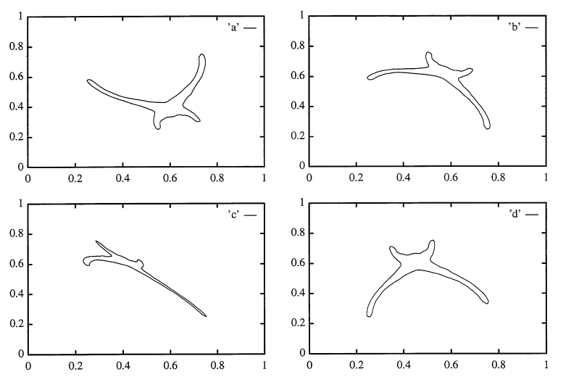
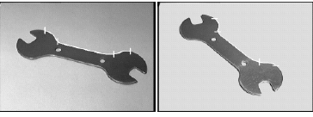
Affine Transformations
Under certain assumptions, affine transformations can be used to approximate the effects of perspective projection!
affine transformed object
G. Bebis, M. Georgiopoulos, N. da Vitoria Lobo, and M. Shah, " Recognition by learning
affine transformations", Pattern Recognition, Vol. 32, No. 10, pp. 1783-1799, 1999.

Slide 26
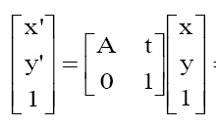
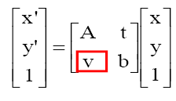

Projective Transformations
affine (6 parameters)
projective (8 parameters)

Slide 27
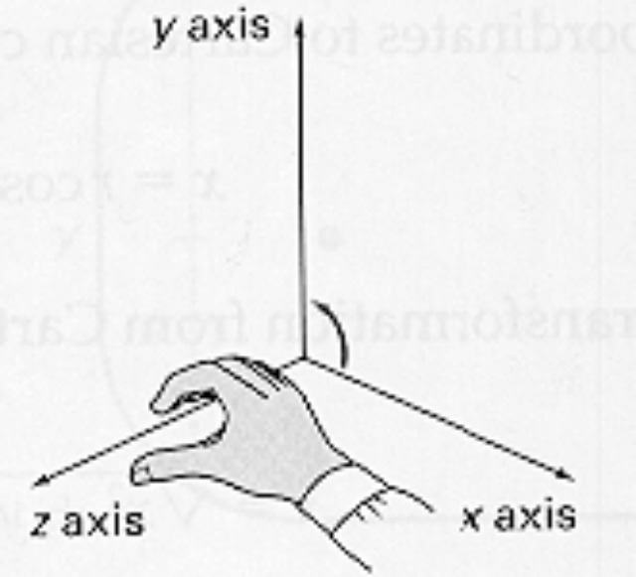

3D Transformations
Right-handed / left-handed systems

Slide 28



3D Transformations (cont’d)
Positive rotation angles for right-handed systems:
(counter-clockwise rotations)

Slide 29

Homogeneous coordinates
Add one more coordinate: (x,y,z) → (x_{h}, y_{h}, z_{h},w)
Recover (x,y,z) by homogenizing (x_{h}, y_{h}, z_{h},w):
In general, x_{h}=xw, y_{h}=yw, z_{h}=zw
(x, y,z) → (xw, yw, zw, w)
Each point (x, y, z) corresponds to a line in the 4D-space of homogeneous coordinates.

Slide 30


3D Translation

Slide 31



3D Scaling

Slide 32




3D Rotation
Rotation about the z-axis:

Slide 33




3D Rotation (cont’d)
Rotation about the x-axis:

Slide 34




3D Rotation (cont’d)
Rotation about the y-axis

Slide 35

Change of coordinate systems
Suppose that the coordinates of P₃ are given in the xyz coordinate system
How can you compute its coordinates in the R_{x}R_{y}R_{z} coordinate system?
  (1) Recover the translation T and
  rotation R from R_{x}R_{y}R_{z} to xyz.
  that aligns R_{x}R_{y}R_{z} with xyz
  (2) Apply T and R on P₃ to compute
  its coordinates in the R_{x}R_{y}R_{z} system.

Slide 36
(1.1) Recover translation T
If we know the coordinates of P₁ (i.e., origin of R_{x}R_{y}R_{z}) in the xyz coordinate system, then T is:
1 0 0 –P_{1x}
0 1 0 –P_{1y}
0 0 1 –P_{1z}
0 0 0 1
T=
u_{y}
u_{x}
u_{x}

Slide 37

(1.2) Recover rotation R
u_{x}, u_{y}, u_{z} are unit vectors in the xyz coordinate system.
r_{x}, r_{y}, r_{z} are unit vectors in the R_{x}R_{y}R_{z} coordinate system
  (r_{x}, r_{y}, r_{z} are represented in the xyz coordinate system)
Find rotation R: r_{z} →u_{z} , r_{x}→u_{x}, and r_{y}→ u_{y}
R
u_{y}
u_{x}
u_{x}

Slide 38


Change of coordinate systems: recover rotation R (cont’d)
u_{z}=
u_{x}=
u_{y}=

Slide 39


Change of coordinate systems: recover rotation R (cont’d)
Thus, the rotation matrix R
is given by:

Slide 40



Change of coordinate systems: recover rotation R (cont’d)
Verify that it performs the correct mapping:
r_{x} → u_{x}
r_{y} → u_{y}
r_{z} → u_{z}

