Slide 1
A Cocktail Approach for Travel Package Recommendation
By: G.KARTIK KUMAR ,
MD.SALMAN KHAN
Under the guidance of: Mr. S.SRINIVAS

Slide 2
ABSTRACT
In this paper, we first analyze the characteristics of the existing travel packages and develop a tourist-area-season topic (TAST) model.
This TAST model can represent travel packages and tourists by different topic distributions, where the topic extraction is conditioned on both the tourists and the intrinsic features (i.e., locations, travel seasons) of the landscapes.
Then, based on this topic model representation, we propose a cocktail approach to generate the lists for personalized travel package recommendation.

Slide 3
EXISTING SYSTEM
Travel data are much fewer and sparser than traditional items, such as movies for recommendation, because the costs for a travel are much more expensive than for watching a movie.
Every travel package consists of many landscapes (places of interest and attractions), and, thus, has intrinsic complex spatio-temporal relationships. For example, a travel package only includes the landscapes which are geographically colocated together.

Slide 4
EXISTING SYSTEM
Also, different travel packages are usually developed for different travel seasons. Therefore, the landscapes in a travel package usually have spatial temporal autocorrelations.
Traditional recommender systems usually rely on user explicit ratings. However, for travel data, the user ratings are usually not conveniently available.

Slide 5
DISADVANTAGES OF EXISTING SYSTEM
Recommendation has a long period of stable value.
To replace the old ones based on the interests of the tourists.
A values of travel packages can easily depreciate over time and a package usually only lasts for a certain period of time

Slide 6
PROPOSED SYSTEM
In this paper, we aim to make personalized travel package recommendations for the tourists.
Thus, the users are the tourists and the items are the existing packages, and we exploit a real-world travel data set provided by a travels for building recommender systems.
we develop a tourist-area-season topic (TAST) model, which can represent travel packages and tourists by different topic distributions.
In the TAST model, the extraction of topics is conditioned on both the tourists and the intrinsic features (i.e., locations, travel seasons) of the landscapes.
Based on this TAST model, a cocktail approach is developed for personalized travel package recommendation by considering some additional factors including the seasonal behaviors of tourists, the prices of travel packages, and the cold start problem of new packages.

Slide 7
ADVANTAGES OF PROPOSED SYSTEM
Represent the content of the travel packages and the interests of the tourists.
TAST model can effectively capture the unique characteristics of travel data.
The cocktail recommendation approach performs much better than traditional techniques.

Slide 8
MODULES:
User Module.
Server Module.
Package recommendations.
TAST Model

Slide 9
User Module
In this module, Users are having authentication and security to access the result from the system. Before accessing or searching the details user should have the account in that otherwise they should register first.

Slide 10
Server Module
In this module, provide the detailed information about the unique characteristics of travel package data. We aim to make personalized travel package recommendations for the tourists. Thus, the users are the tourists and the items are the existing packages, and we exploit a real-world travel data set provided by a travel company in China for building recommender systems.

Slide 11
Package recommendations
We collect some unique characteristics of the travel data. First, it is very sparse, and each tourist has only a few travel records. The extreme sparseness of the data leads to difficulties for using traditional recommendation techniques, such as collaborative filtering. For example, it is hard to find the credible nearest neighbours for the tourists because there are very few co-travelling packages.

Slide 12
TAST Model:
First, it is necessary to determine the set of target tourists, the travel seasons, and the travel places. Second, one or multiple travel topics ( e.g.,“The Sunshine Trip”) will be chosen based on the category of target tourists and the scheduled travel seasons. Each package and landscape can be viewed as a mixture of a number of travel topics. Then, the landscapes will be determined according to the travel topics and the geographic locations.

Slide 13
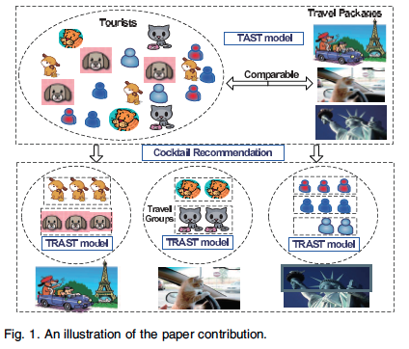
TRAST MODEL

Slide 14
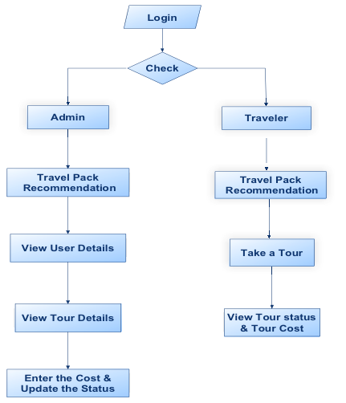
DATA FLOW DIAGRAM:

Slide 15
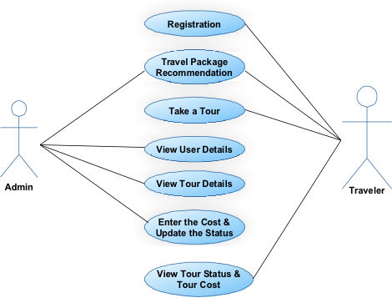
USE CASE DIAGRAM:

Slide 16
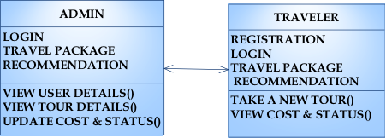
CLASS DIAGRAM:

Slide 17
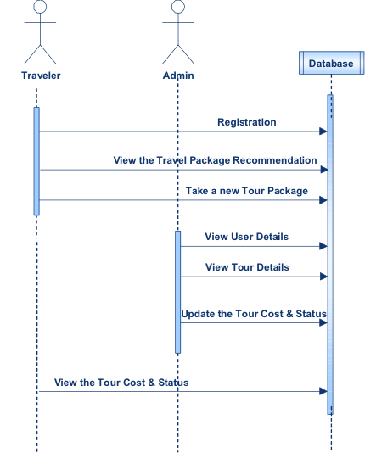
SEQUENCE DIAGRAM:

Slide 18
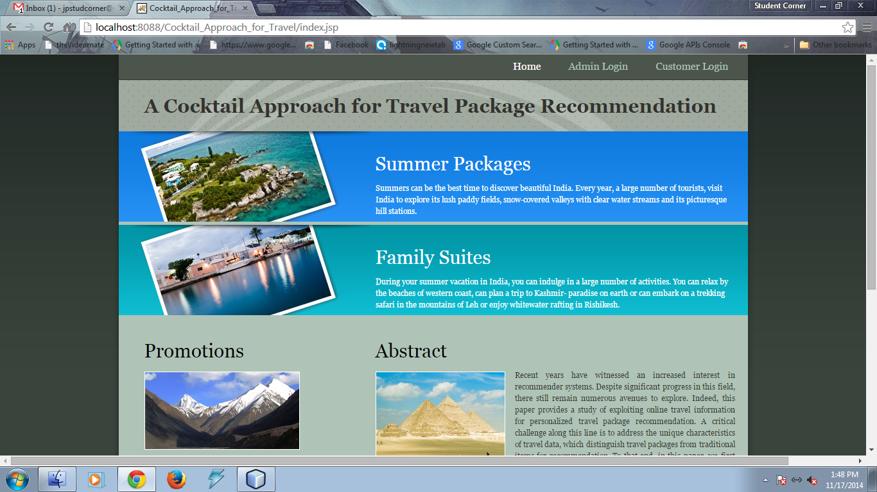

Slide 19
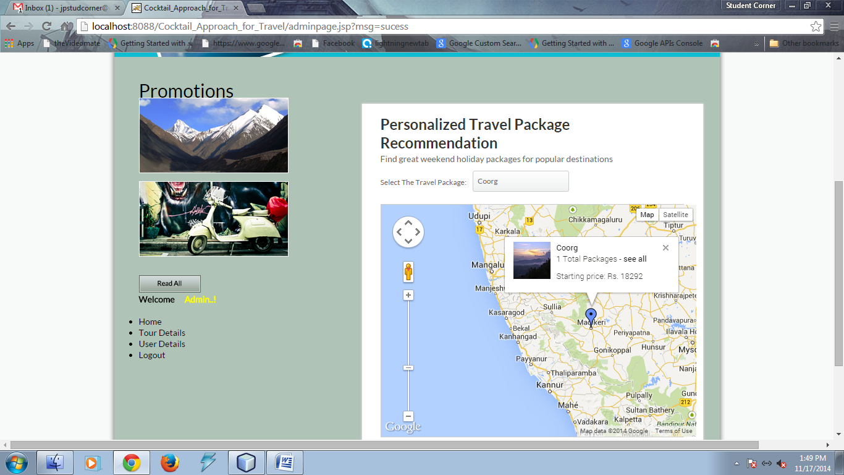

Slide 20
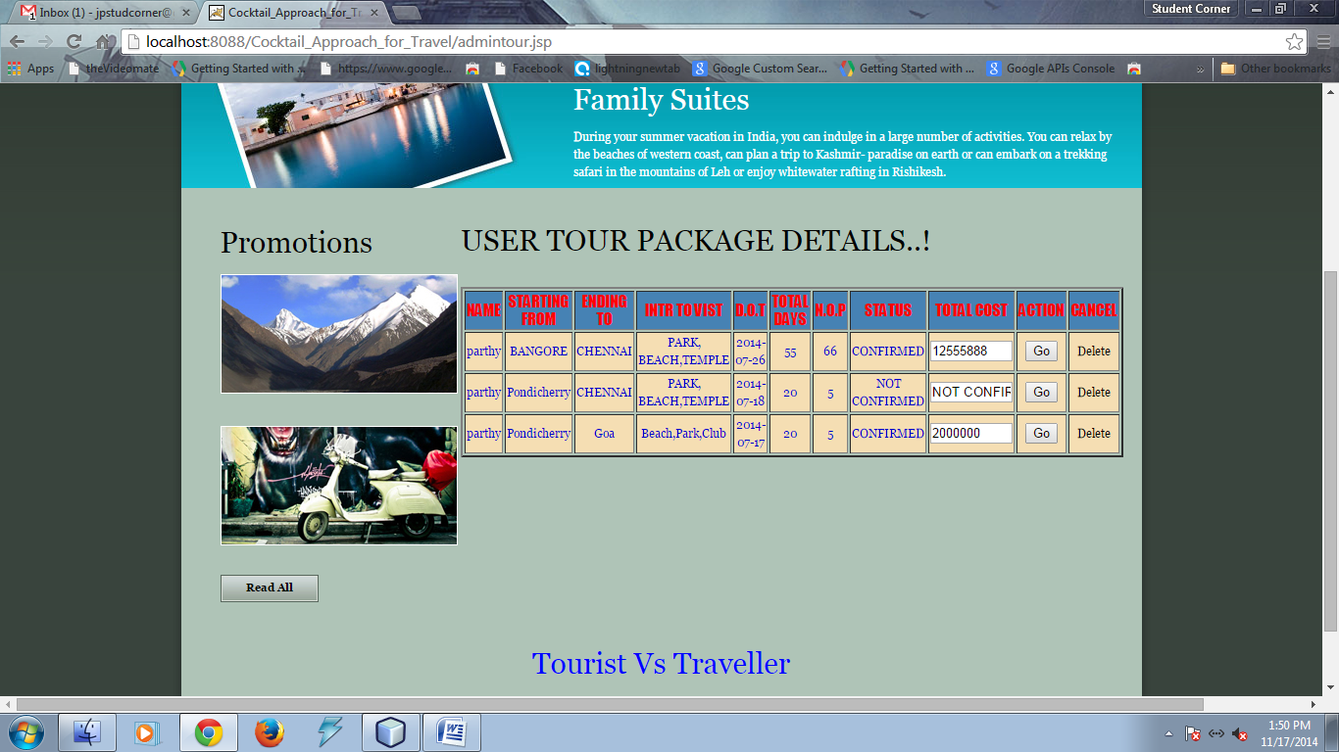

Slide 21
HARDWARE REQUIREMENTS
System : Pentium IV 2.4 GHz.
Hard Disk : 40 GB.
Floppy Drive : 1.44 Mb.
Monitor : 15 VGA Colour.
Mouse : Logitech.
Ram : 512 Mb.

Slide 22
SOFTWARE REQUIREMENTS
Operating system : Windows XP/7.
Coding Language : JAVA/J2EE
IDE : Netbeans 7.4
Database : MYSQL

Slide 23
REFERENCES
Qi Liu, Enhong Chen, Hui Xiong, Yong Ge, Zhongmou Li, and Xiang Wu ,“A Cocktail Approach for Travel Package Recommendation”, IEEE TRANSACTIONS, VOL. 26, NO. 2, FEBRUARY 2014.

