Slide 1
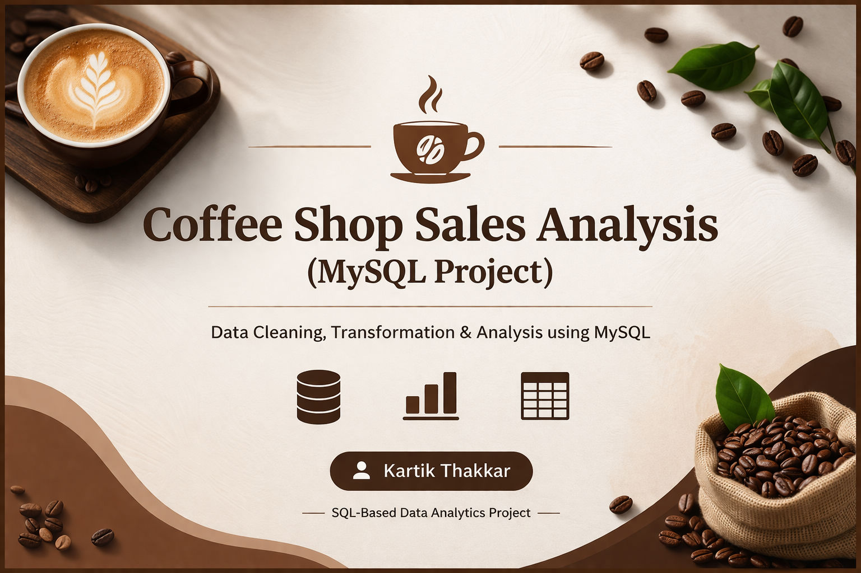

Slide 2

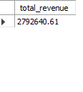

Query1. Total Revenue

Slide 3
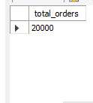

Query 2. Total Orders

Slide 4
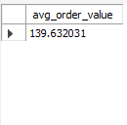

QUERY 3. Average Order Value

Slide 5
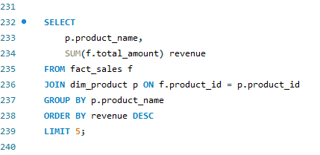
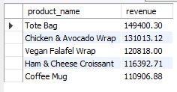
QUERY 4. Top 5 Products

Slide 6
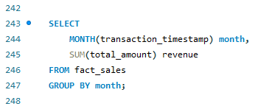
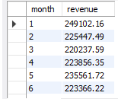
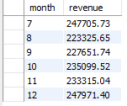
QUERY 5.Monthly Revenue

Slide 7
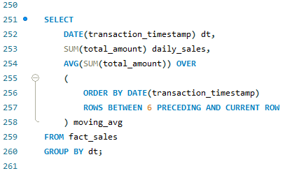
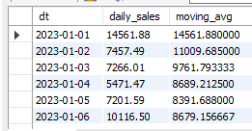
QUERY 6.Moving Average (7 days)

Slide 8
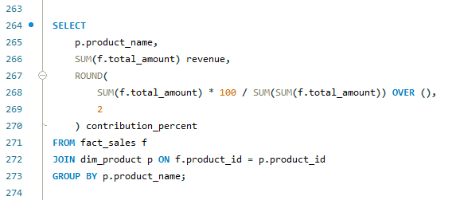
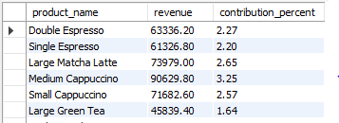
QUERY 7.Product Contribution %

Slide 9
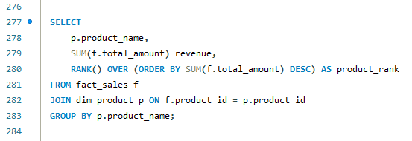
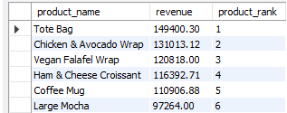
QUERY 8.Top Products with Ranking

Slide 10
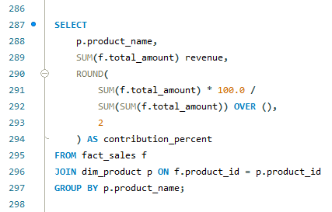
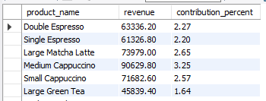
QUERY 9.Revenue Contribution %

Slide 11
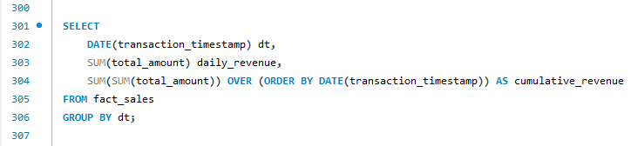
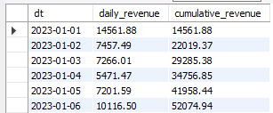
QUERY10.Running Revenue Trend

Slide 12
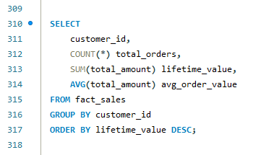
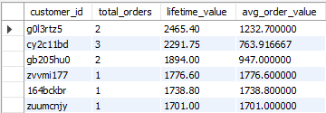
QUERY 11.Customer Lifetime Value (CLV)

Slide 13
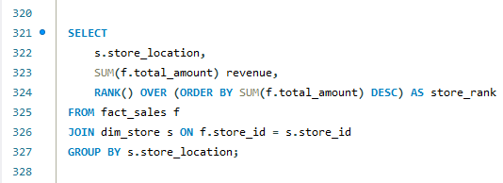
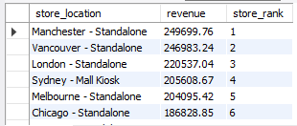
QUERY 12. Store Performance Ranking

Slide 14
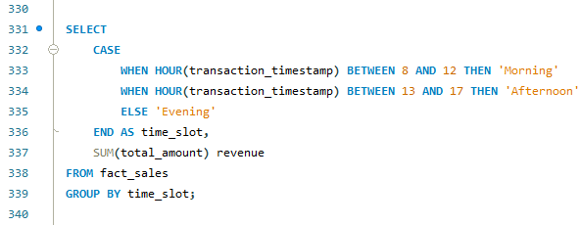
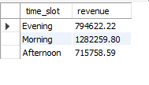
QUERY13.Peak vs. Off-Peak Sales

Slide 15
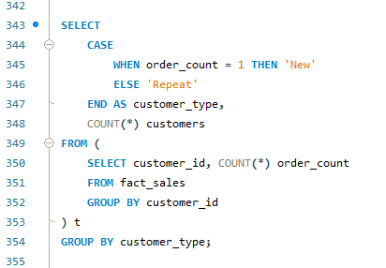

QUERY 14. Repeat vs. New Customers

Slide 16
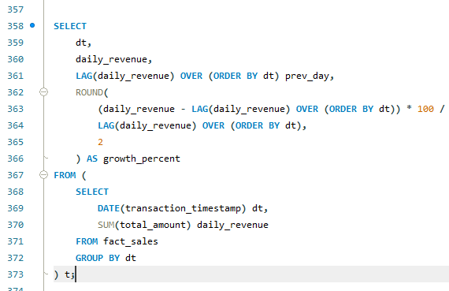
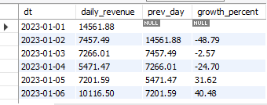
QUERY 15. Revenue Growth %

Slide 17
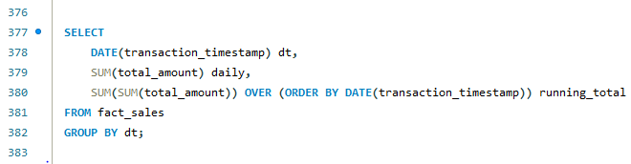
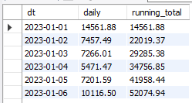
QUERY 16. Running Total Revenue

Slide 18
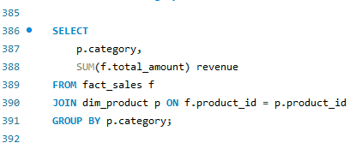
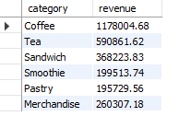
QUERY 17.Product Category Revenue

Slide 19
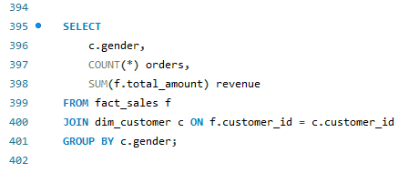
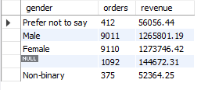
QUERY 18.Customer Segmentation (Gender)

Slide 20
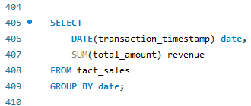
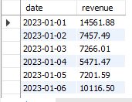
QUERY 19.Daily Revenue

Slide 21
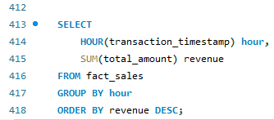
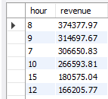
QUERY 20.Peak Sales Hour

Slide 22
Project Overview & Key Insights
• Performed end-to-end sales analysis using SQL
• Developed KPIs: Revenue, Orders, AOV, CLV
• Identified top-performing products and categories
• Analyzed customer behavior (new vs repeat, gender segmentation)
• Discovered peak sales hours and seasonal trends
• Built insights for business growth and decision-making

Slide 23
Thank You
Coffee Shop Sales Analysis Project
Created by: Kartik Thakkar
For queries or collaboration, feel free to connect.
⭐ If you like this project, give it a star on GitHub!

