Slide 1

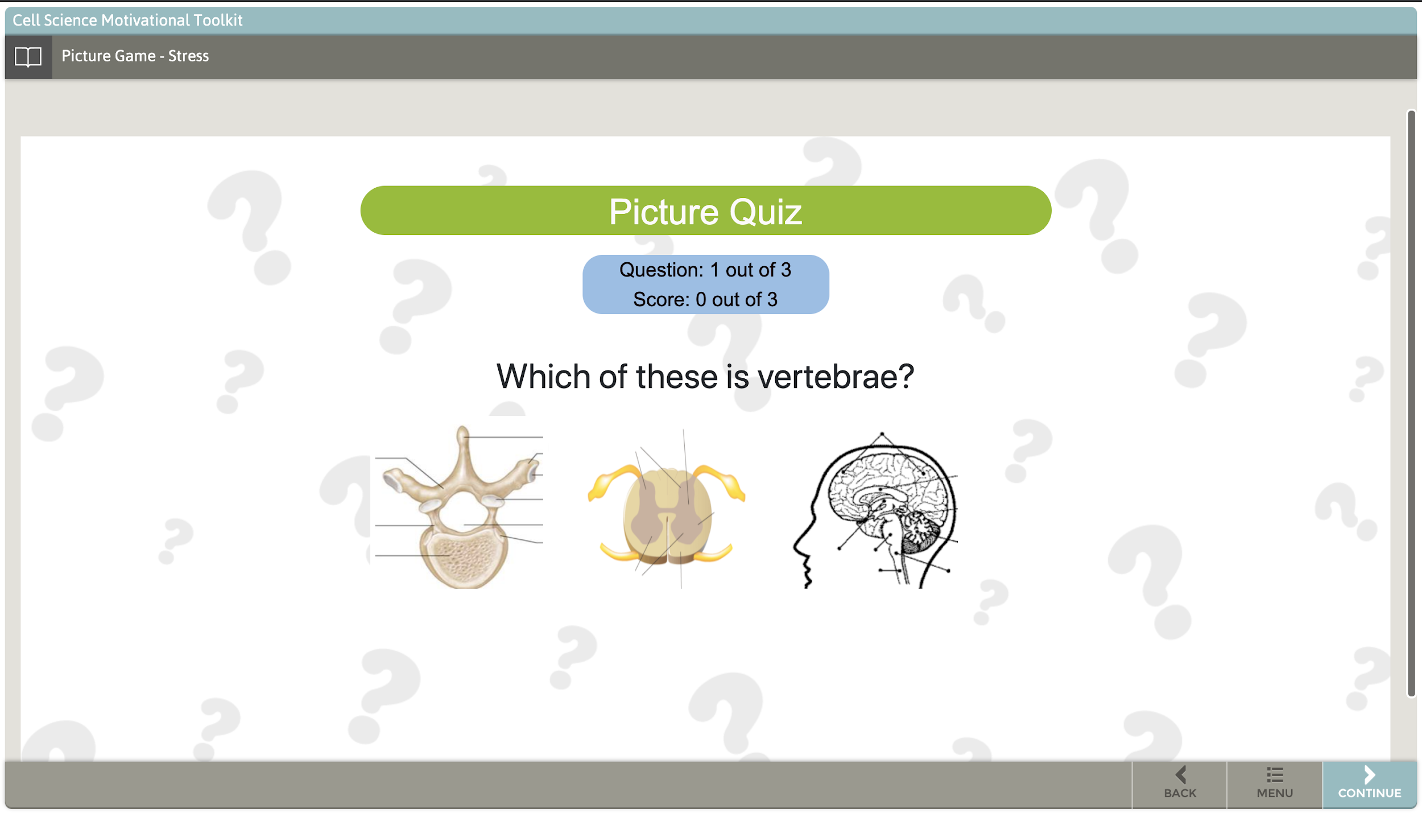
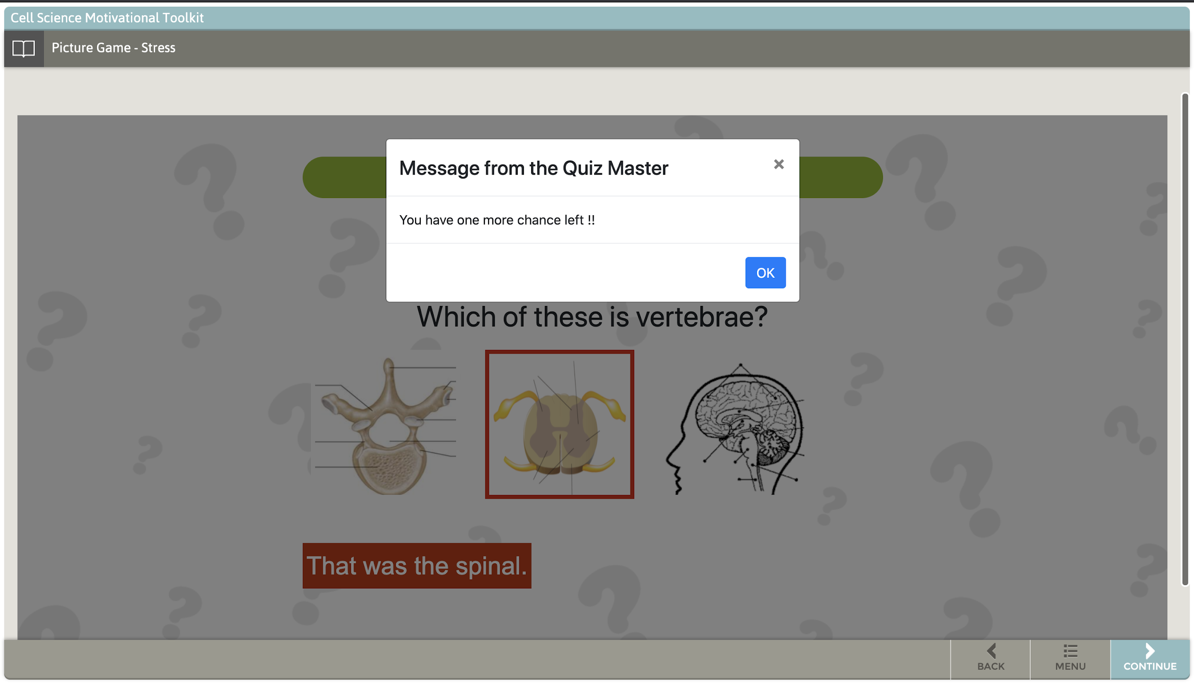
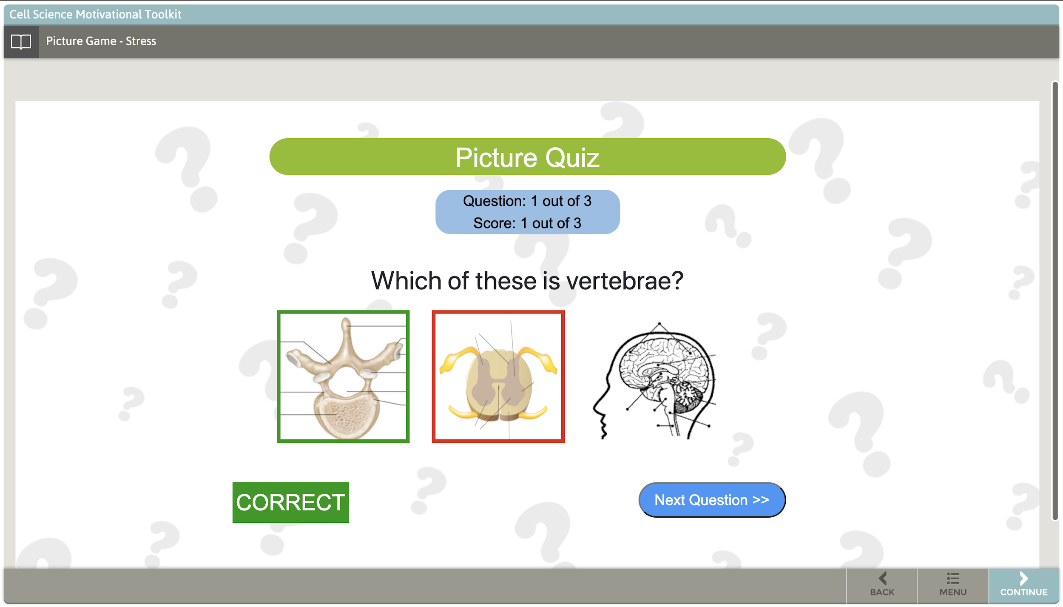
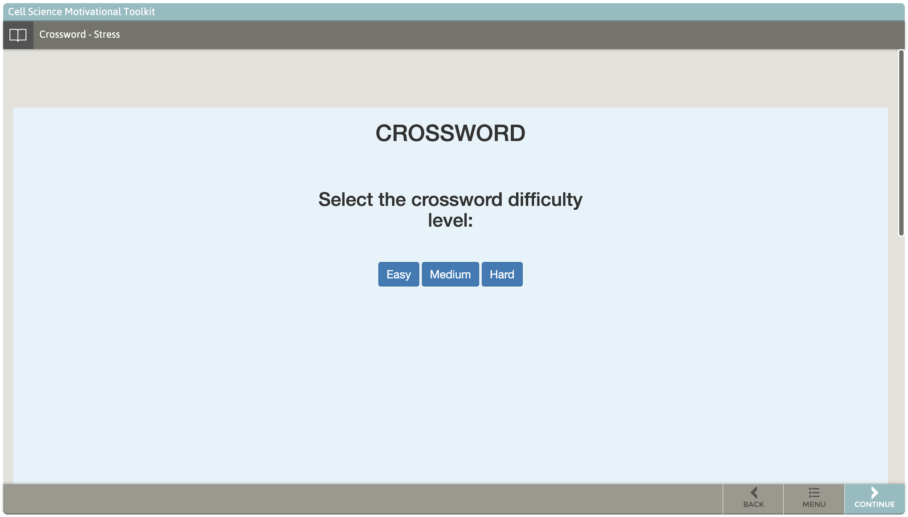
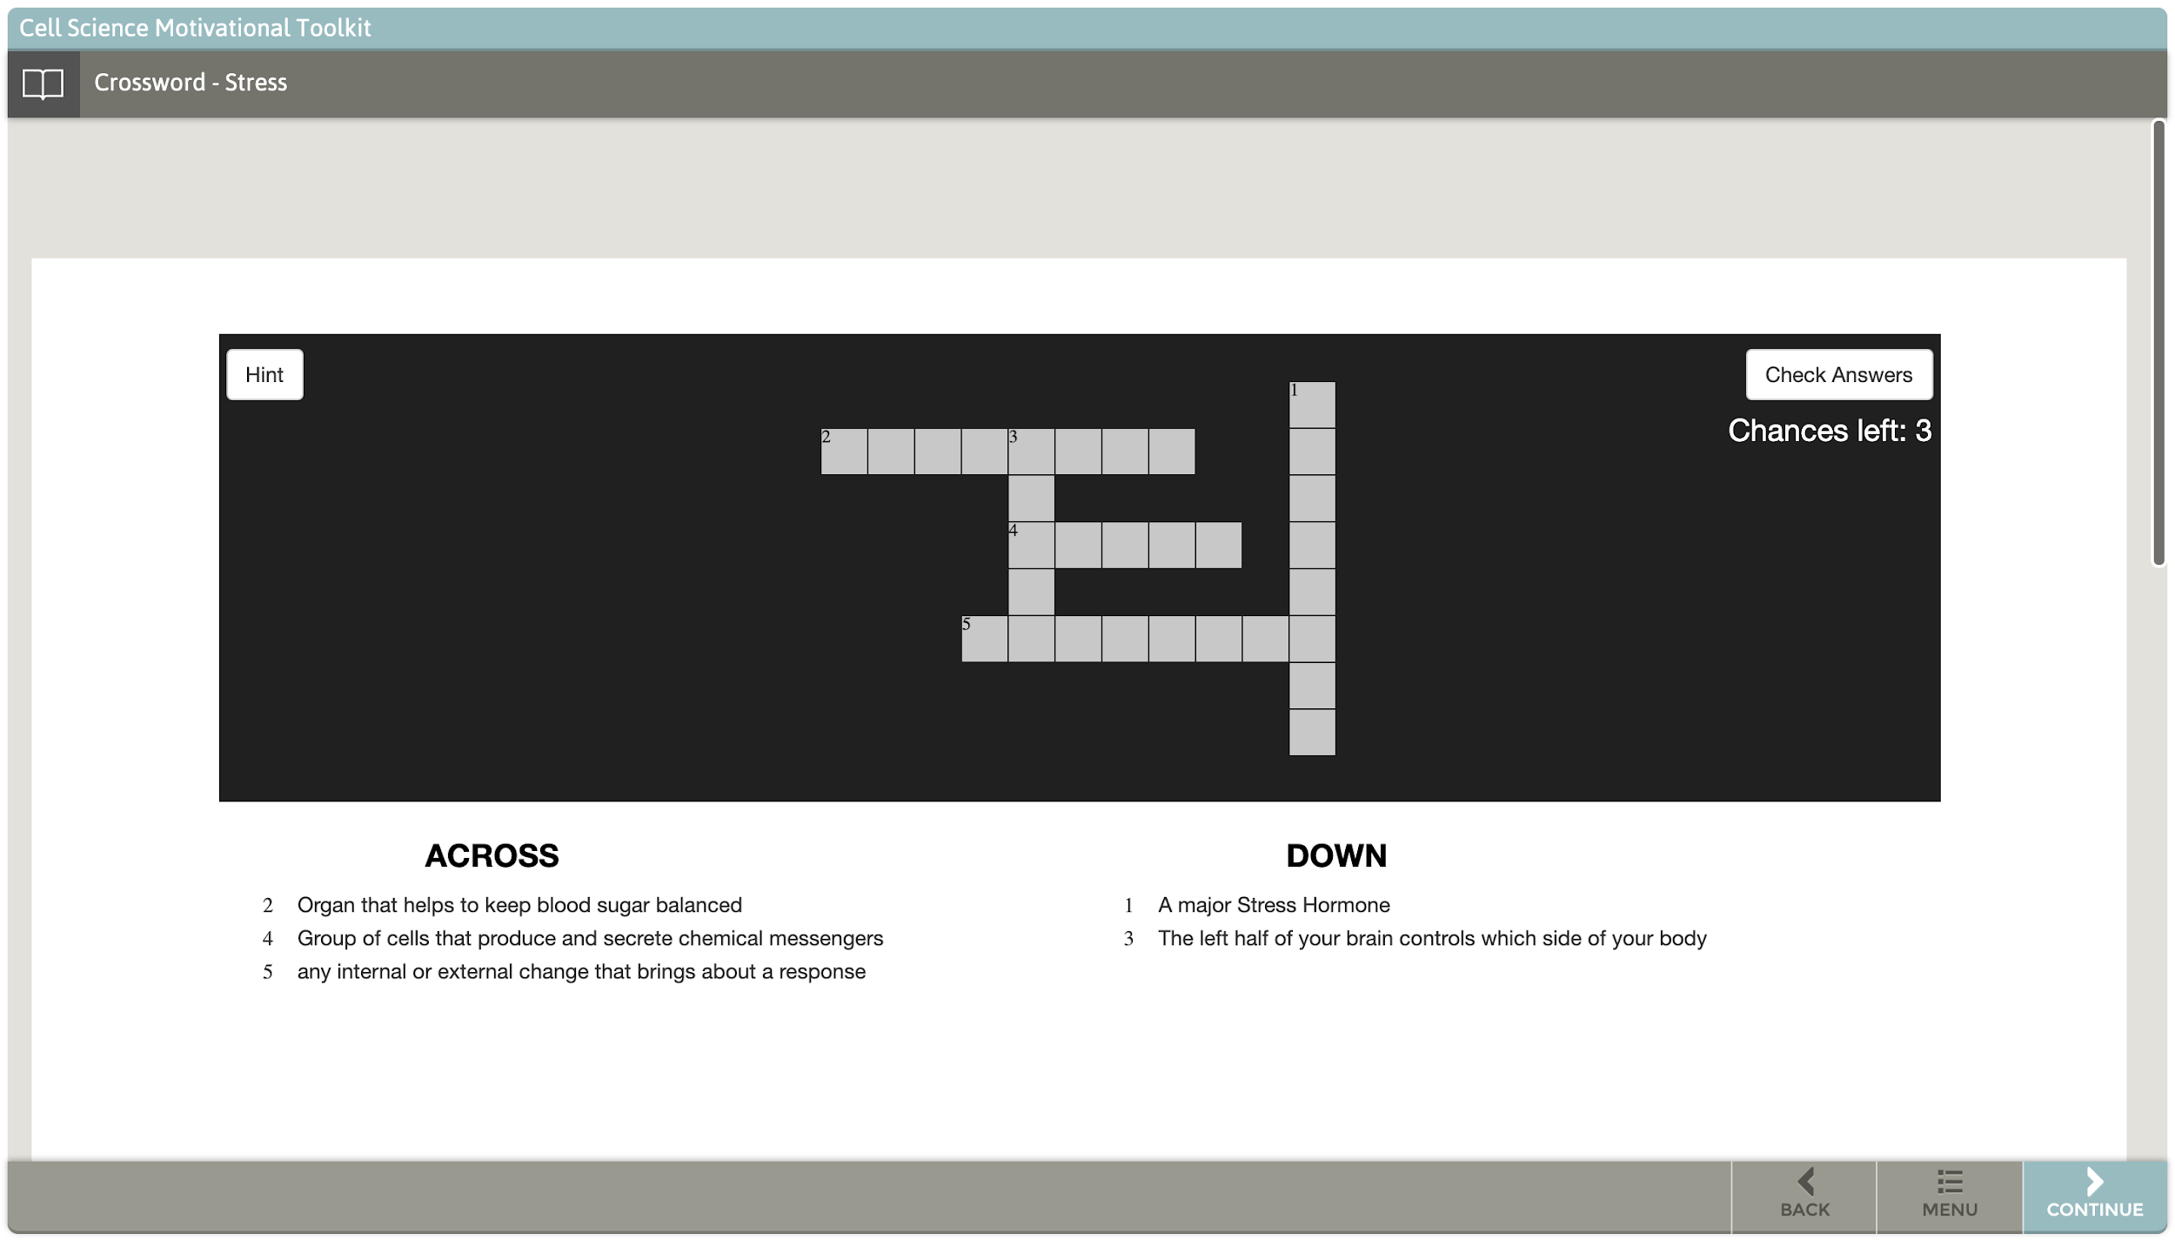
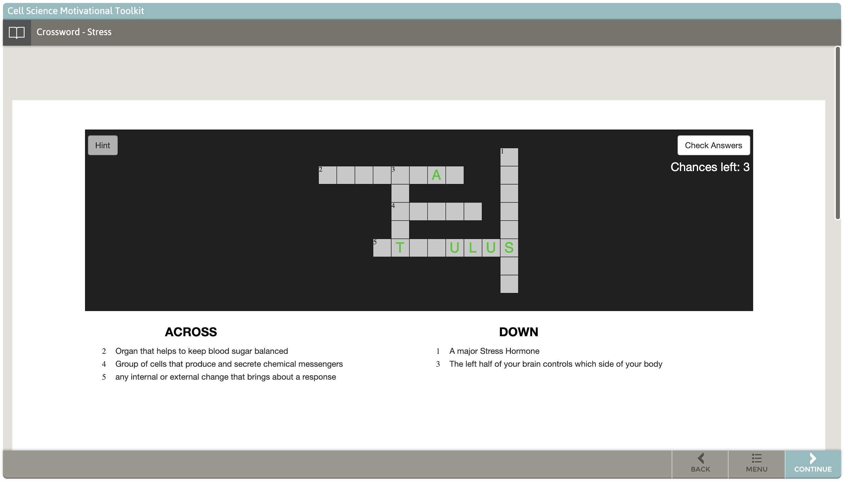
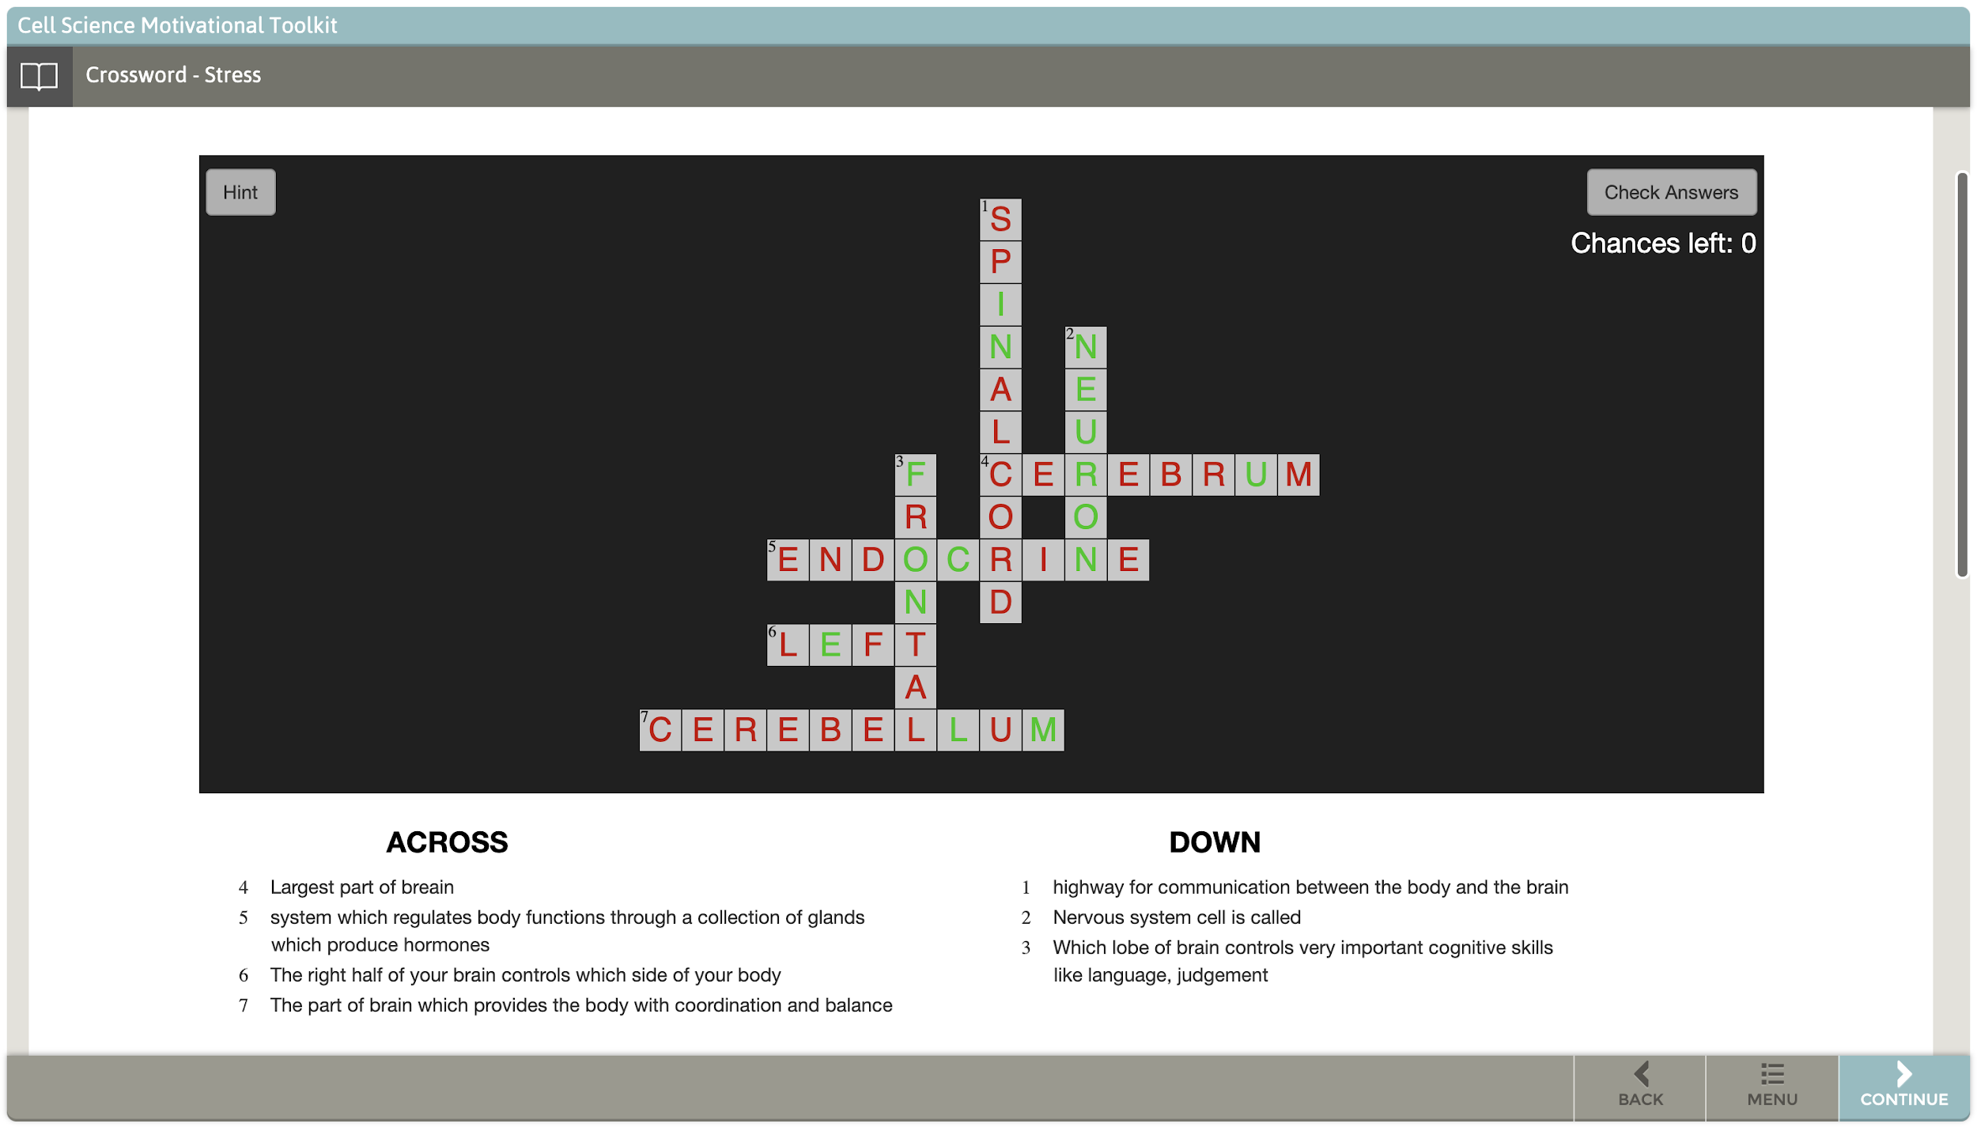
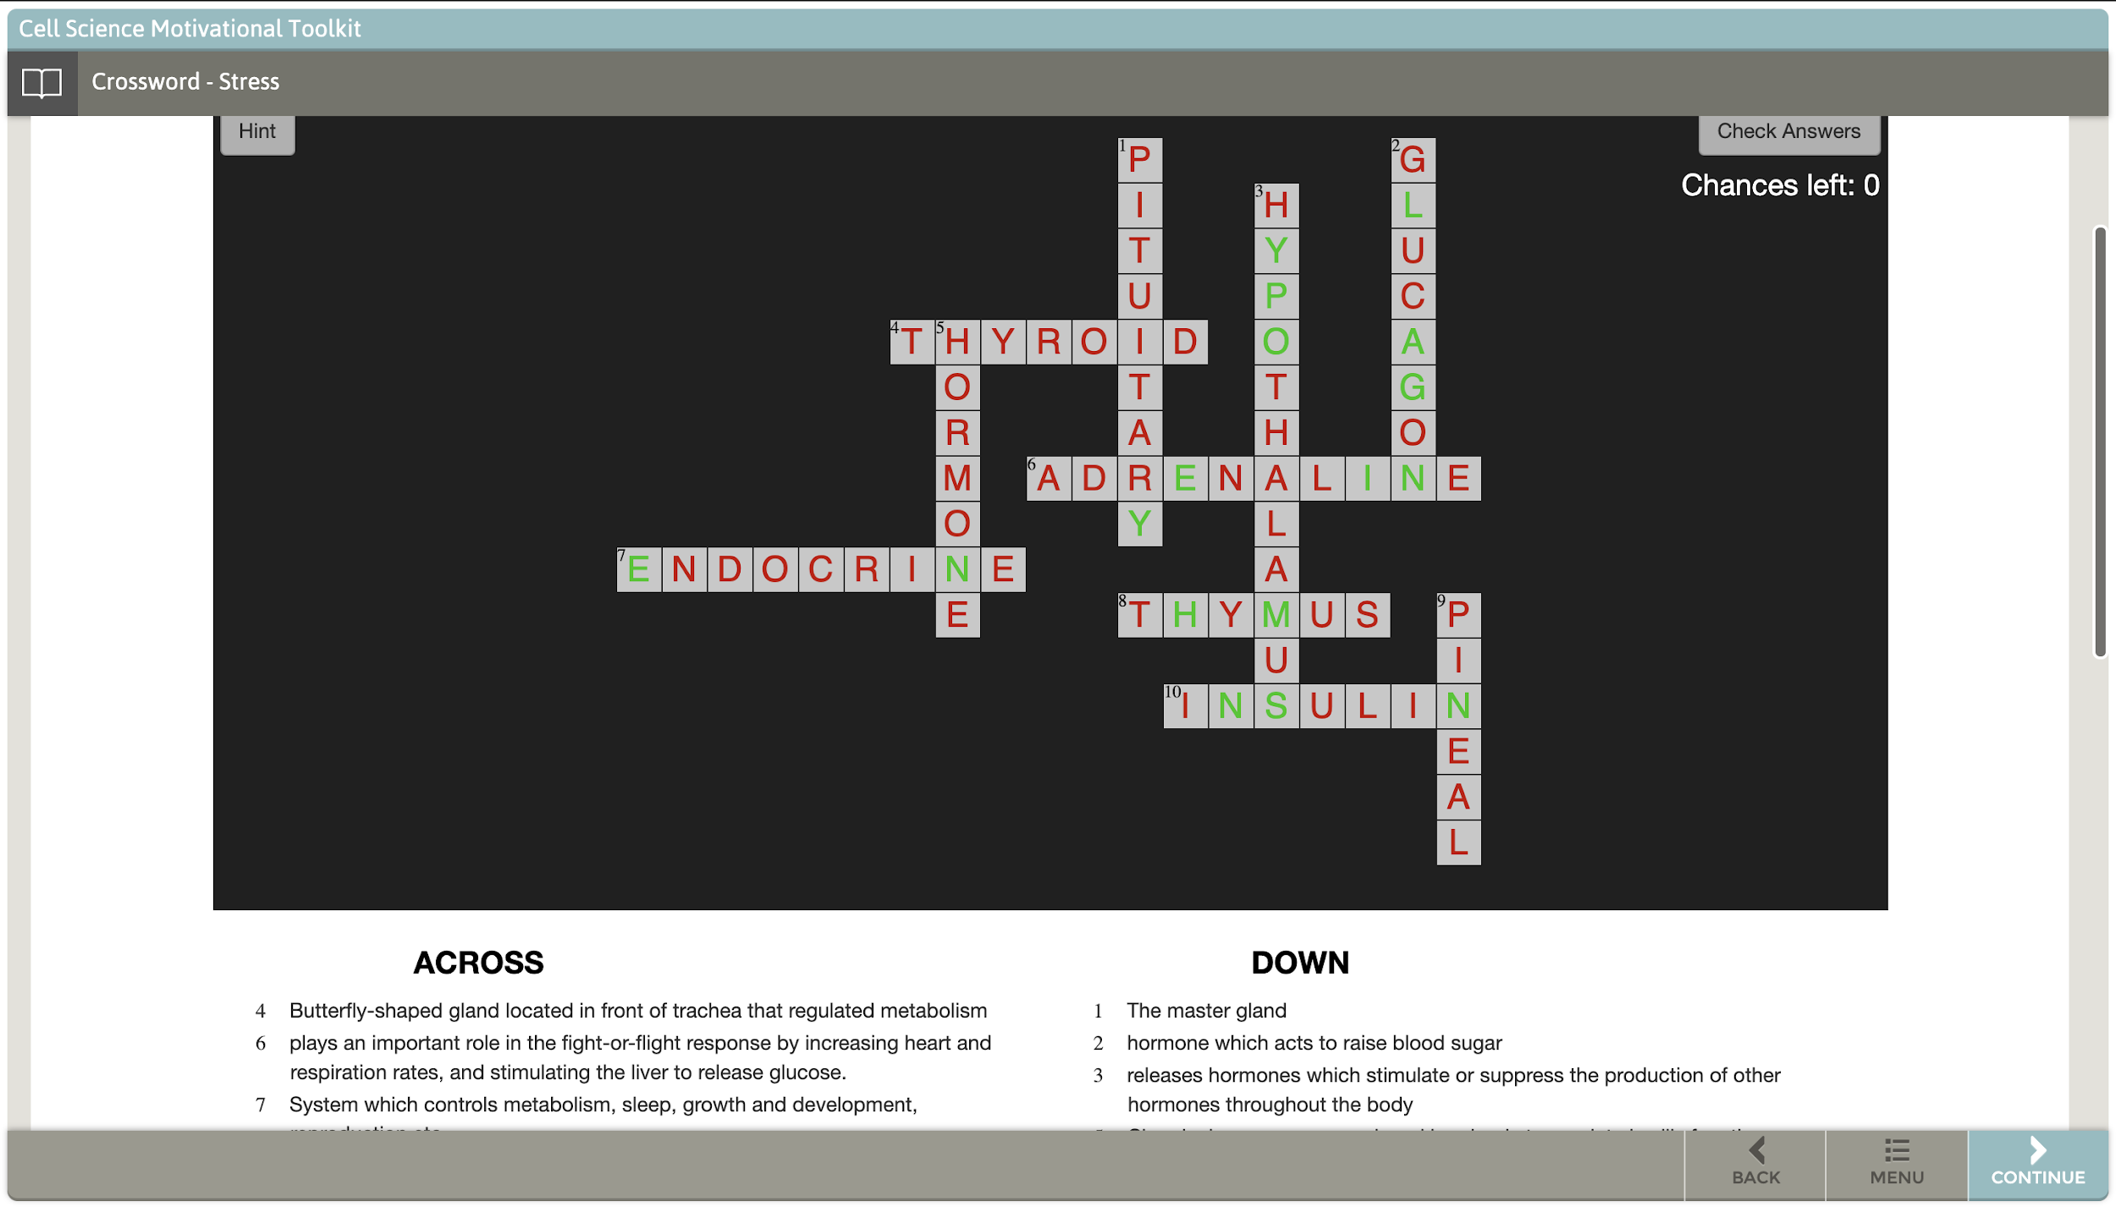
Stress Learning Games
Anushka Waingankar, Flavia Ratto, Jagadish Kumaran Jayagopal, Kartik Venkataraman,
Laxman Balaji Balasubramanian, Lokheshkumar Alagarsamy, Rishabh Singla
Dept. of Computer Science and Engineering, Texas A&M University
Introduction
User Interface
The primary objective of Stress learning games is to develop games which can reinforce learning of stress concepts for middle school students. These games would facilitate students to identify, describe and easily memorize the tough biological terminologies, their visual representations, and their purposes.
Veterinary Medical & Biomedical Sciences department of Texas A&M University were our customers and we worked in coordination with them to accomplish the expected deliverables.
Two user-interactive games were developed and deployed on FTP server under five modules namely Cell Biology, Ecology, Stress, Infectious Diseases and Clinical Trials. Both the games work well in Chromebook and tablet screens.
Fig. (1): Game Picture Quiz: Demo on PC: Displaying the first Question
Fig. (2): Game Picture Quiz: Demo on PC: First attempt on the first question is wrong.
User Stories
Developed 2 new games to reinforce learning concept of stress
Made the game data configurable using JSON
Fig. (3): Game Picture Quiz: Demo on PC: Correct answer on the second attempt
Fig. (4): Game Crossword: First page of the game asking to choose difficulty level
Developed a scoring system, hint system and set difficulty levels for the games
Deployed picture quiz and crossword game on FTP server and StepStone authoring system (providing module ID, path ID and step ID to Dan)
Solved frame resize and CORS issue and tested both games on all browsers
Tested if the user could give input from the oncscreen keypad
Fig. (5): Game Crossword: Demo on PC: Easy Level Game Initial display
Fig. (6): Game Crossword: Demo on PC: If you press button Hint, it gives you some characters for the answers
For the crossword game, showed the number of chances left on the screen itself instead of a window popup.
Collected content for crossword and picture quiz game for all the five modules namely Cell Biology, Ecology, Stress, Infectious Diseases and Clinical Trials. Test both the games on all the browsers.
Deployment and Testing
Fig. (7): Game Crossword: Demo on PC: When you lose all the chances, all the answers pop up in the game
Fig. (8): Game Crossword: Demo on PC: Example of a hard difficulty level game (It has more number of questions)
Deployment: The games were built using JavaScript, HTML, CSS and Bootstrap. Embedding environment was StepStone authorizing system and after testing the deployment on FTP server.
Challenges Faced:
CORS issue for picture quiz: CORS issue popped up because of a JSON file which was considered as the resource from another domain. Changing the JSON file to a JS file which exports a JSON object we can include the JS file as a module. Now, the JSON object can be used by importing the JS file into the controller JS file
Frame resizing issue for crossword game: The FTP server renders the HTML content in an iframe. We gave a minimum height attribute to the index page according to the other html pages and deployed it again and the games works on PC browsers and tablet screens.
Testing: Both the games are tested and worked well in Chromebook and tablet screens. We even deployed the two games across all the five modules, and they test in all the browsers.
Conclusion
Game Database: Out of the two games, picture Quiz can be parameterized and for the Crossword the input data or questions are hard coded.
Our games work well on Laptops and IPads, but has some issues working on mobile due to a well known iframe issue.
While implementing game database, we were not allowed to add JSON files without significantly altering the structure of our code. This was because JavaScript does not have permission to read local files without a specialized framework like NodeJS, due to a security feature called CORS (cross origin resource sharing) policy, which is kept in place to prevent websites from gaining access to local computer files without permission. Therefore, we decided to export game data to separated JavaScript files as alternative.
While deploying applications to FTP server, the root of mini-apps must be in the “apps” folder, moreover, each step could load only one single mini-app (Even though it is able to deploy multiple mini-apps to the folder). While doing this, we change the name of the folder in the JSON file that points to the mini-app so that StepStone can get access to these mini-apps correctly.
The browser is caching assets (i.e., HTML, CSS, JavaScript files) and does not re-fetch files. We need some cache-busting strategies in order for so that the contents can be freshly loaded to StepStone every time we access to the web.
For future work, both the games which are deployed in Stepstone will be deployed on Vetmed Website also.

