Slide 1
Context Based Search Engine
A3
Under the guidance of
Dr. U. P. Kulkarni
Team
Adhiraj S [2SD14CS005]
Guruprasad G [2SD14CS037]
Madhusoodan P [2SD14CS054]
Anarghya J [2SD14CS128]

Slide 2
Content
Objective
Motivation
Requirements
Design
Architecture
How things work
Environment, Languages, Tools

Slide 3
Objective
To build a context based search engine which takes a query string from user and produces the search results in the descending order of context relevance.
context: will be dealt later.

Slide 4
Motivation
Easier access to relevant information on the web is the order of the day
Challenge is to seek relevant information in the Web which is the warehouse of large volume of data
Relevance?
Appropriate and connected information.

Slide 5
Literature Survey
[1] “The Anatomy of a Large-Scale Hypertextual Web Search Engine” by Sergey Brin and Lawrence Page 1998. This discusses the prototype of the Google search engine.
[2] “Google : Datastructures and Algorithms” by Petteri Huuhka 2010, Department of Computer Science, University of Helsink, Explains the DataStructure that google search engine uses is described in brief.

Slide 6
Requirements (Functional)
R1. A system which communicates with Content-Retrieval system and getting the web-content.
R2. Categorizing the retrieved content on the context.
R3. Storing the categorized webcontent in easy-to-retrieve way (Indexing)
R4. Query Processing processing the user inputted query.
R4.1. Spell check and unwanted symbol omission.

Slide 7
Requirements (Functional)
R5. Fetching the results for the query given by the user and presenting links to the user.
R6. A system which periodically probes all the applications* and records their heartbeats.
R6.1. Implement the heartbeat probing system for each of the application in the system.
* applications: applications in the system.

Slide 8
Requirements (Non-Functional)
NR1. A generic communication protocol for use between any module.
NR2. A webserver which creates a Result generation module `RGEN` for every query submitted.
NR3. Maintaining a proxy-to-original link lookup table.

Slide 9
Design
Some names used in the system
FFC: A system which retrieves the docs from crawlers and categorizes them.
DMGR: Datamanagers.
RGEN: Result Generators.
WS: Web Server.
A[2|3].Master : An application managing the slaves run by A[2|3]

Slide 10
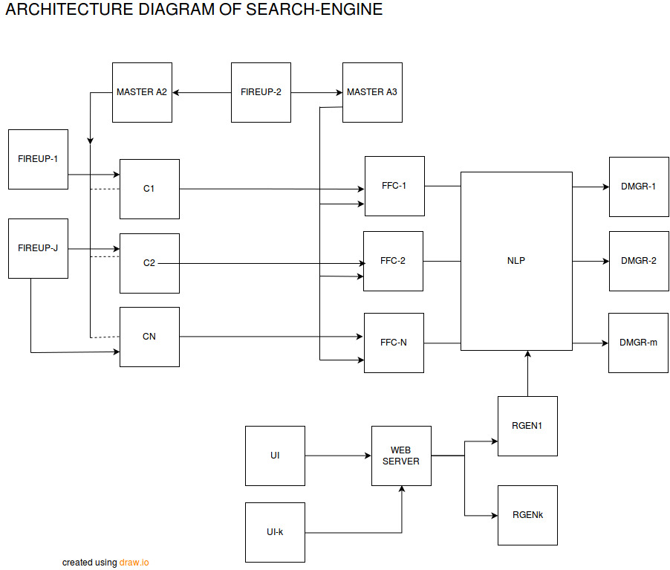
Architecture

Slide 11
How things work

Slide 12
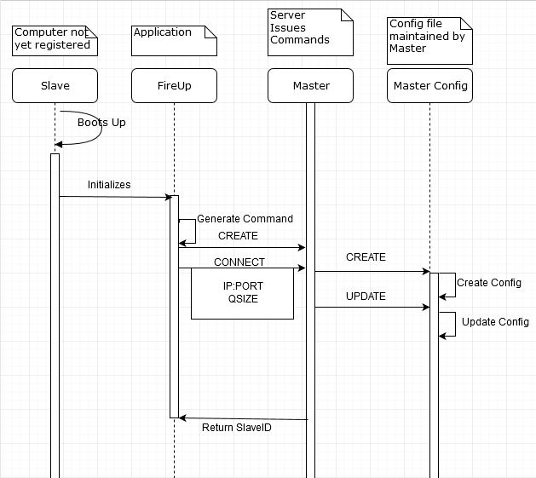
S1. Booting up

Slide 13
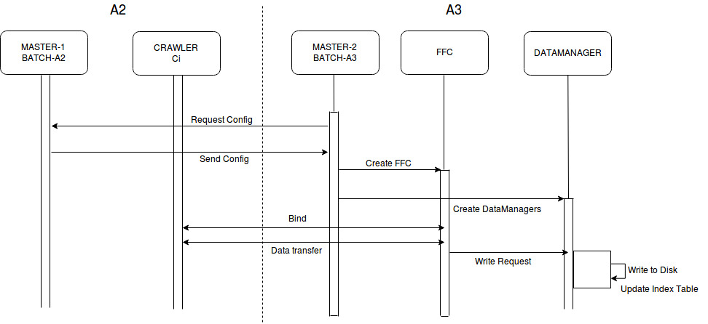
S2. Content Retrieval

Slide 14
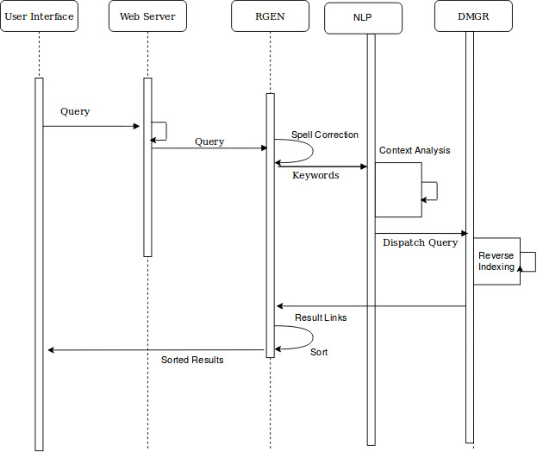
S3.
Query Processing

Slide 15
`Fireup` application to boot the system
A software installed in all systems which acts as proxy for human operator.
It helps in managing the processes distributed across the machines.

Slide 16
Languages, Tools, Environment
Environment
Linux Box with (bare minimum)
2GB RAM
20GB HD
Languages
C++, Java, Python
Tools
draw.io, make, github (VCS)

Slide 17
Protocol used for communication
Using a generic protocol for communication between the applications in the system.

Slide 18
Thank you.

