Slide 1


GeoSys
A decision Support System for The Sustainable Development Goals.
Presented by the iCreate4Africa.

Slide 2
PROBLEM
The lack of reliable geospatial data used for planning, achieving and implementing the targets of the SDGs.
For example Statistics from the Ministry of Health show that malaria is still the leading cause of death in Uganda, accounting for over 27% of deaths. The statistics also show that Uganda has the world's highest malaria incidence, with a rate of 478 cases per 1,000 population per year.

Slide 3

SOLUTION
An intelligent tool that maps and visualizes geospatial data about households in relation to other factors that influence sustainable development.
Demonstrate Application

Slide 4
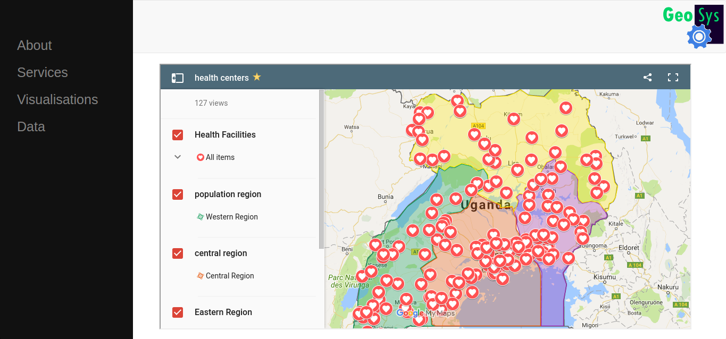

Slide 5



CUSTOMERS
Government
Non government Agencies
Research personals and agencies
Media Houses
MEDIAHOUSES

Slide 6




COMPETITORS
Uganda Bureau Of Statistics mostly collects static data that is not geo coordinated.
DATA.UG has no aspect of data intelligence and detail visualization.
GeoGecko is a GIS company that mainly creates static maps that are represented on posters.

Slide 7
REVENUE MODELS
Data, up to date and comprehensive data is unique and extremely valuable.
Freemium model with consistent 2% conversion from free to Paid plans.
Highly targeted advertising, mobile and web distributions
Research

Slide 8

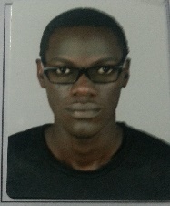


TEAM
Albert Emurwon – Data Scientist & Co-Founder Info-Code Uganda
Sidney Nkoba – Computer Scientist & Software Developer.
Peter Ogwok Baguma – GIS & Business Analyst.
Lincoln Karuhanga – Student of Software Engineering.

Slide 9
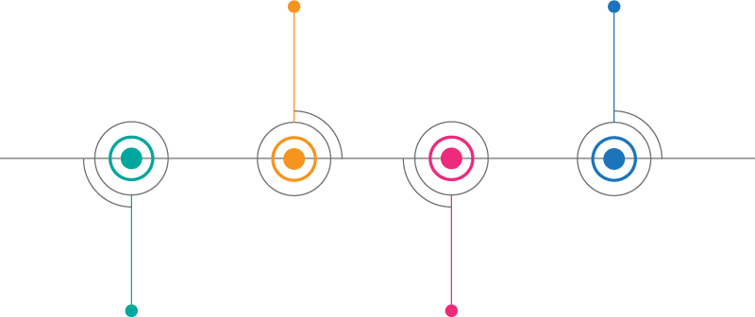
TIMELINE
Establish key
partners
Launch final
Web Application
JULY - AUGUST
OCTOBER
SEPTEMBER
NOVEMBER
Application Development,
Data Collection & Validation
Pilots & testing

Slide 10
Funding
$200,000.0
To Build this Geo Data intelligence Platform.

Slide 11





+256 70 118 5895
iCreate4Africa
iCreate4Africa
#iCreate4Africa

