Slide 2
Module 1 Financial Statement Analysis: An Introduction

Slide 3
What is Financial Analysis?
The process of examining a company’s performance in the context of industry and economic environment to arrive at a decision or recommendation.
The financial analysts must determine which information is needed and how to use it.
Debt: Ability to pay interest and repay principal
Equity: Ability to pay dividends and grow share price
Ability to earn Return on Capital (ROC) > Cost of Capital
Evaluate past & current performance and financial position ➢ Form expectations of the future.

Slide 4
financial reporting and financial statement analysis
Financial Reporting
Providing financial information about an entity to enable users to make decisions
Financial information includes financial statements and other types of reports
Eg. President’s letter and supplementary schedules in annual report; Reports filed with government agencies; News releases and management forecasts; CSR report etc.
Financial Statement Analysis
Using financial information to assess prior performance and likely future performance to make decisions
Typical decision: capital allocation

Slide 5
Scope of Financial Statement Analysis?
Evaluating an equity investment for inclusion in a portfolio.
Evaluating a merger or acquisition candidate.
Evaluating a subsidiary or operating division of a parent company.
Deciding whether to make a venture capital or other private equity investment.
Determining the creditworthiness of a company that has made a loan request.
Extending credit to a customer.
Examining compliance with debt covenants or other contractual arrangements.
Assigning a debt rating to a company or bond issue.
Valuing a security for making an investment recommendation to others.
Forecasting future net income and cash flow.

Slide 6
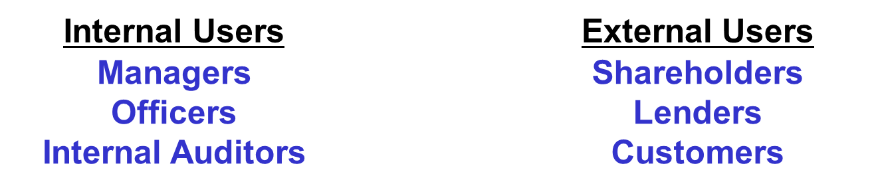
Purpose of Analysis
Financial statement analysis helps users make better decisions.
What do internal users use it for?
Planning, evaluating and controlling company operations.
What do external users use it for?
Assessing past performance and current financial position and making predictions about the future profitability and solvency of the company as well as evaluating the effectiveness of management

Slide 7
Company Performance Analysis
An examination of performance may include:
Profitability
Ability to generate positive cash-flows
Note: Profit ≉ Cash-Flow
Profit = Income - Expenses, and recognition is independent from when cash is actually received / paid

Slide 8
Example: Profit Vs. Cash-Flow
Sennett Designs (SD) sells furniture on a retail basis. SD began operations during December 2019 and sold furniture for $250,000 in cash. The furniture sold by SD was purchased on credit for $150,000 and delivered by the supplier during December. The credit terms granted by the supplier required SD to pay the $150,000 in January for the furniture it received during December. In addition to the purchase and sale of furniture, in December, SD paid $20,000 in cash for rent and salaries.
How much is SD’s profit for December 2019 if no other transactions occurred?
Profit = Sales Price - COGS - Rent and Salaries = $250,000 - $150,000 - $20,000 = $80,000
2. How much is SD’s cash flow for December 2019?
Cash Flow = Cash received from the customer - Cash paid for rent and salaries = $250,000 - $20,000 = $230,000
3. If SD purchases and sells exactly the same amount in January 2020 as it did in December, and under the same terms, how much will the company’s profit and cash flow be for the month of January?
Cash flow will also be $80,000

Slide 9
Importance of Cash-Flow
Cash-Flow is important as need to pay:
Employees
Suppliers
Returns to providers of capital
Flexibility in funding investment and accessing business opportunities.
Profits may provide information about future Cash Flow.

Slide 10
FINANCIAL STATEMENTS
Statement of Financial Position
Statement of Comprehensive Income
Statement of Changes in Equity
Statement of Cash Flows
Notes

Slide 11
Statement of financial position
Statement of Financial Position (the Balance Sheet):
Assets = Liabilities + Owners’ equity
Assets − Liabilities = Owners’ equity
Point in Time

Slide 12
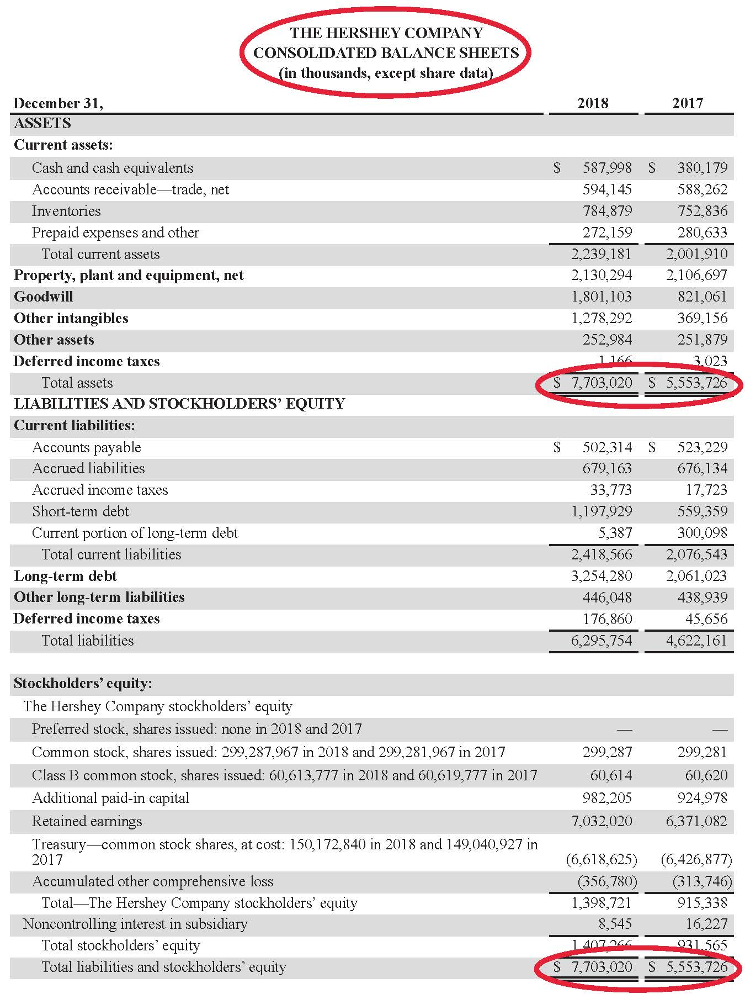
Consolidated Balance sheet: Hershey
Total assets $ 7,703,020 $ 5,553,726
Total liabilities and shareholders’ equity $ 7,703,020 $ 5,553,726

Slide 13
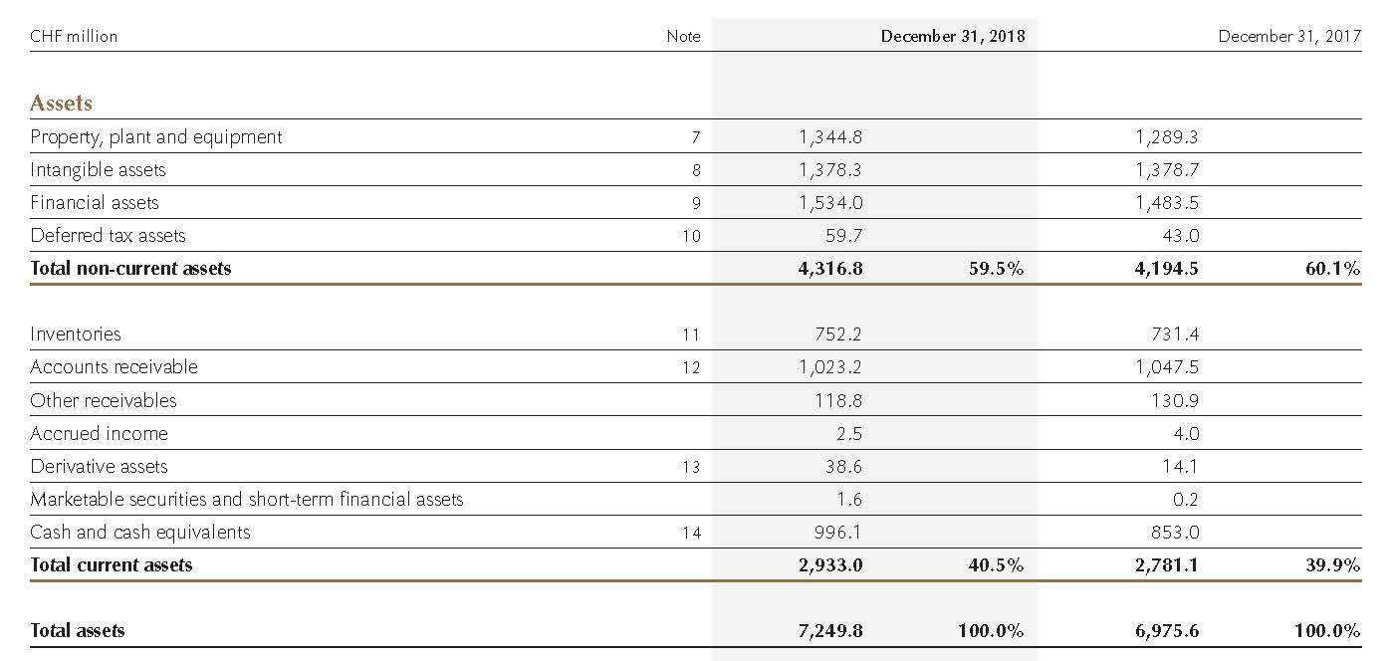
Assets: Lindt & Sprüngli Group

Slide 14
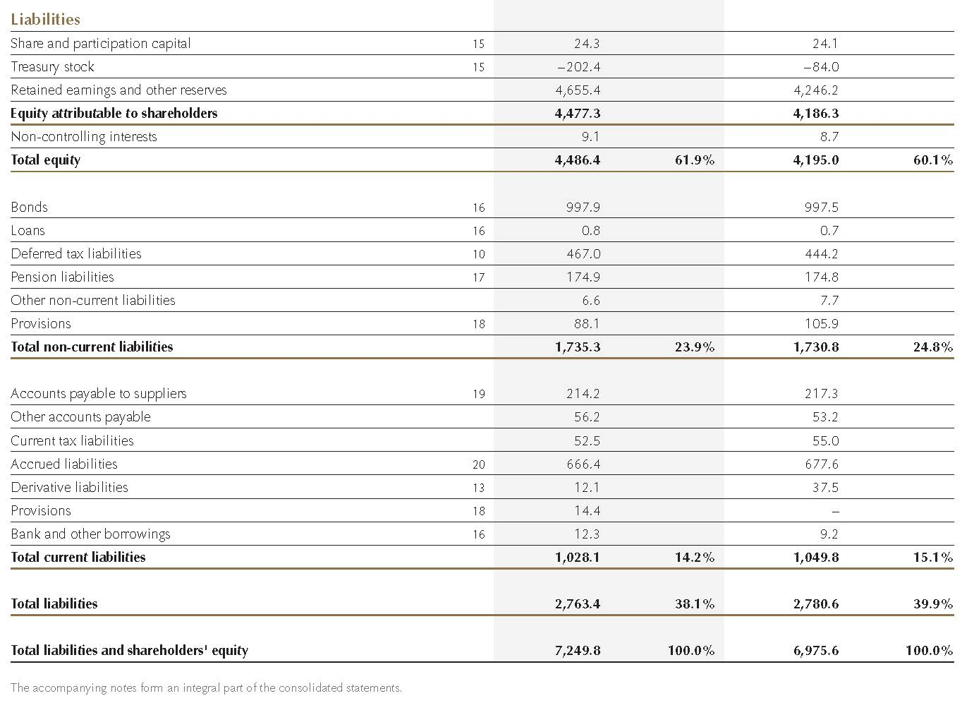
Liabilities: Lindt & Sprüngli Group

Slide 15
FINANCIAL STATEMENTS: statement of comprehensive income
Also known as the income statement, statement of earnings, or profit and loss statement.
Comprehensive income: All items that affect owners’ equity but are not the result of transactions with shareholders.
Comprehensive income = Net income + Other comprehensive income.
OCI: items of income that bypass the income statement (eg. Gains/losses on available for sale securities)
Presentation permitted:
Single statement of comprehensive income
Two consecutive statements
Net Income = Income – Expenses
Period of time.

Slide 16
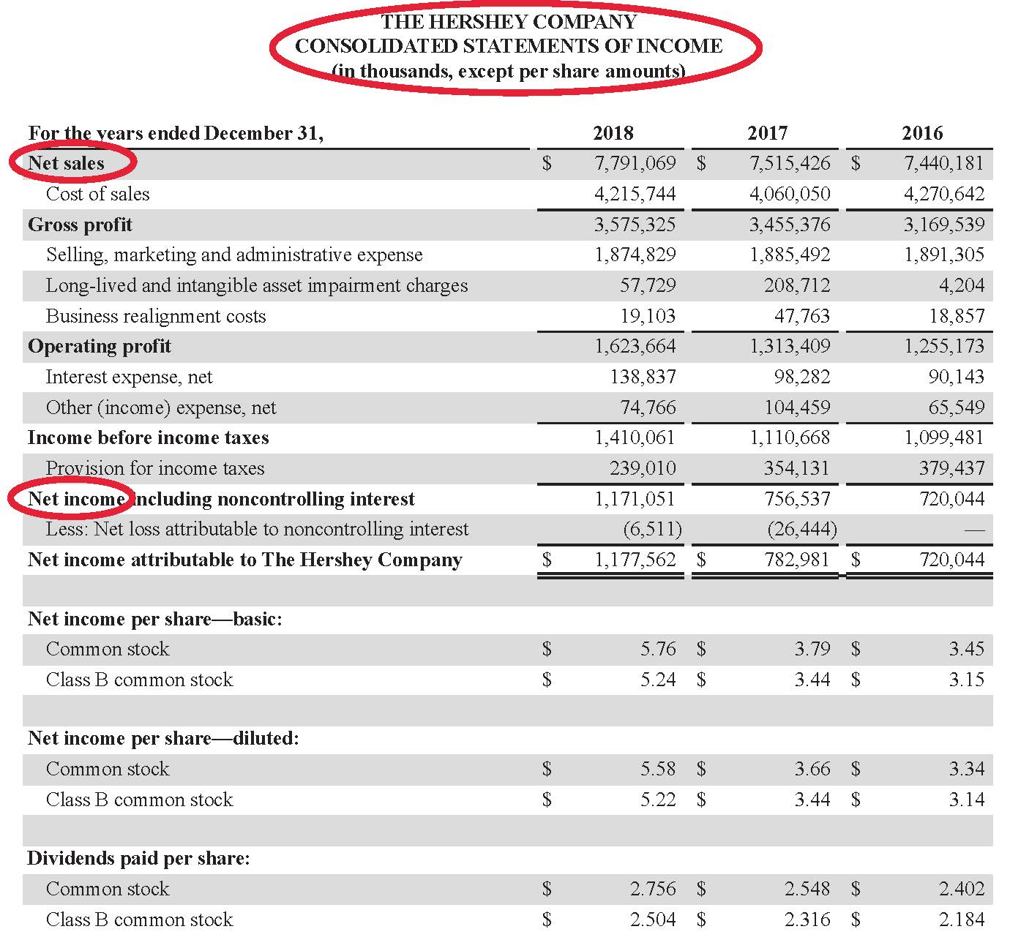
Consolidated Statements of Income: Hershey

Slide 17
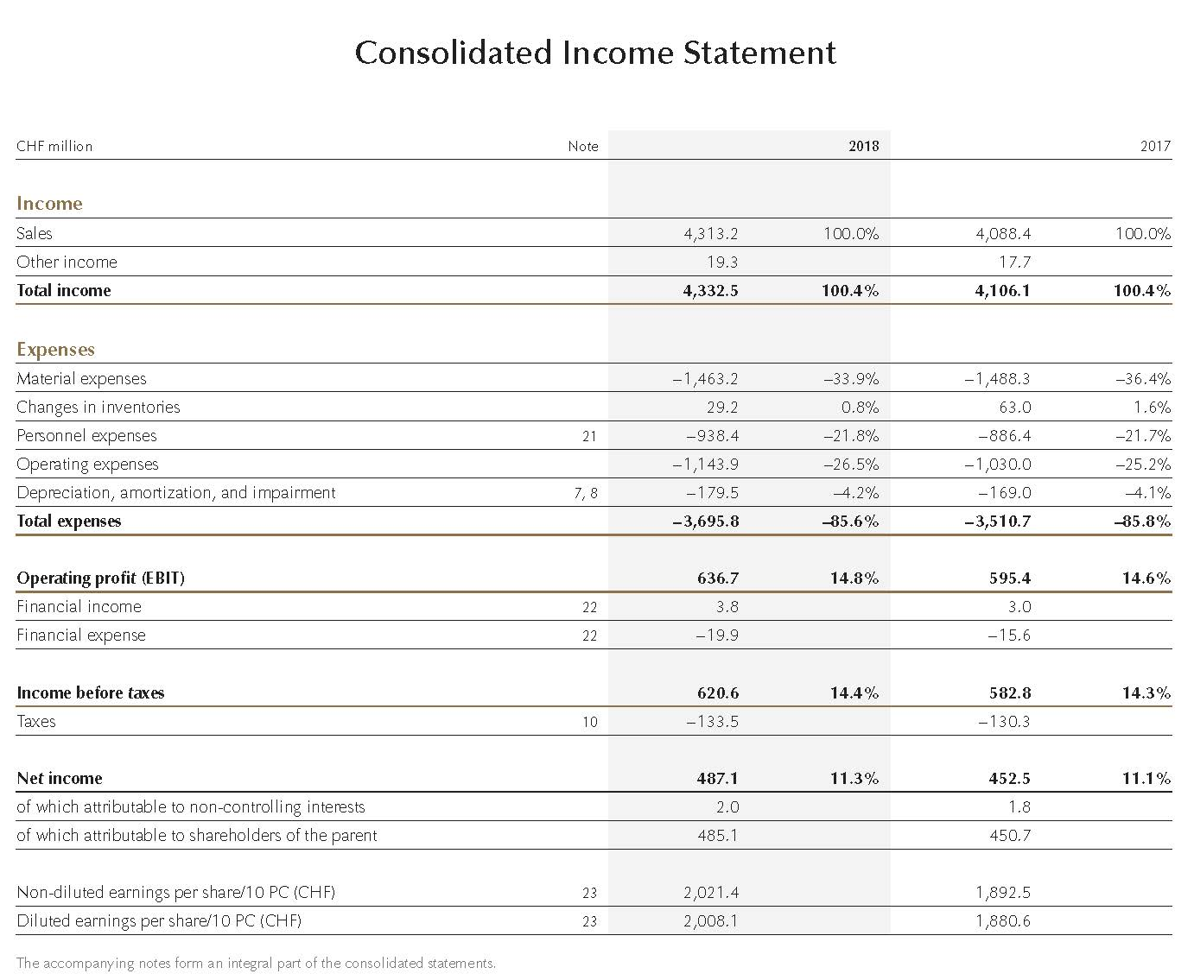
Consolidated Income Statement: Lindt & Sprüngli Group

Slide 18
Statement of Comprehensive Income: Lindt & Sprüngli Group

Slide 19
FINANCIAL STATEMENTS: statement of changes in equity
Also known as statement of changes in owners’ equity or statement of shareholders’ equity.
Period of time
Beginning equity + Changes in equity = Ending equity
Beginning equity+ Comprehensive income-Net payout=Ending equity
Net payout=cash dividends + stock purchases -share issues
Basic components of owners’ equity are paid-in capital and retained earnings.
Beginning common stock + Issuances – Repurchases = Ending common stock
Beginning retained earnings + Net Income – Dividends = Ending retained earnings

Slide 20
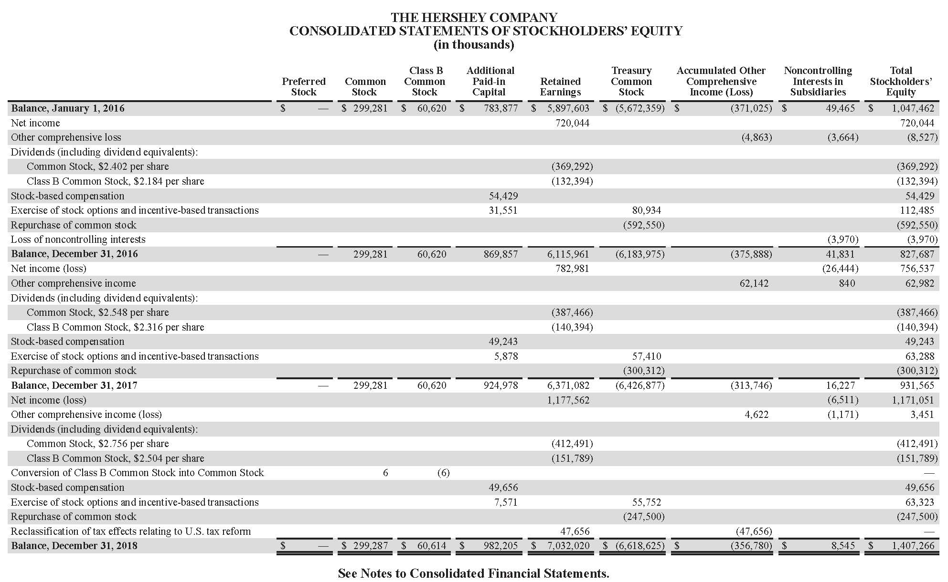
Consolidated statements of Shareholders’ equity: Hershey

Slide 21
FINANCIAL STATEMENTS statement of CASH FLOWS
Period of time
Beginning Cash + Changes in cash = Ending cash
Changes in cash from:
Operating
Investing
Financing

Slide 22
Consolidated Statements of Cash Flows: Hershey
Portions omitted

Slide 23
ACCOMPANYING NOTES
The notes (also sometimes referred to as footnotes) that accompany the four financial statements are required and form an integral part of the statements.
Notes include information on:
Significant accounting choices (policies, methods, and estimates).
Explanatory detail about line items on the face of the financial statements.
Other disclosures, such as commitments and contingencies.
Based on notes disclosures, analysts can understand whether accounting choices are similar for the companies being compared. If the policies differ, an analyst can often make necessary adjustments so that the financial statement data used are more comparable.

Slide 24
Management Commentary or MD&A
A narrative report that provides a context within which to interpret the financial position, financial performance, and cash flows of an entity.
Provides explanations of the amounts in the financial statements.
Provides information on a company’s prospects.
Provides management with an opportunity to explain its objectives and its strategies for achieving those objectives.
Encompasses reporting that jurisdictions may describe as management’s discussion and analysis (MD&A), operating and financial review (OFR), or management’s report.

Slide 25
Contents of Management Commentary
The IFRS practice statement Management Commentary states that the management commentary should include information that is essential to an understanding of:
the nature of the business;
management’s objectives and its strategies for meeting those objectives;
the entity’s most significant resources, risks, and relationships;
the results of operations and prospects; and
the critical performance measures and indicators that management uses to evaluate the entity’s performance against stated objectives.
In the United States, the SEC requires listed companies to provide an MD&A and specifies the content. Management must highlight any favorable or unfavorable trends and identify significant events and uncertainties that affect the company’s liquidity, capital resources, and results of operations.

Slide 26
Auditor’s reports
Financial statements presented in companies’ annual reports are generally required to be audited (examined) by an independent accounting firm in accordance with specified auditing standards.
An audit report is a written opinion on the financial statements prepared by the independent auditor.
Objectives of the independent auditor in conducting an audit:
To obtain reasonable assurance about whether the financial statements as a whole are free from material misstatement (whether due to fraud or error), enabling the auditor to opine on whether the statements are prepared in accordance with applicable financial reporting framework.
To report on the financial statements.

Slide 27
Types of Auditor’s reports
Unqualified audit opinion: “Clean” opinion. States that the financial statements give a “true and fair view” (international) or are “fairly presented” (international and U.S.) in accordance with applicable accounting standards. This opinion is the one that analysts would like to see in a financial report.
Other types of opinions:
Qualified audit opinion: One in which there is some scope limitation or exception to accounting standards. Exceptions are described in the audit report with additional explanatory paragraphs so that the analyst can determine the importance of the exception.
Adverse audit opinion: Issued when an auditor determines that the financial statements materially depart from accounting standards and are not fairly presented. Generally, an analyst would not bother analyzing these statements.
Disclaimer of opinion: Issued when the auditors are unable to issue an opinion for some reason, such as a scope limitation.

Slide 28
information sources besides annual financial statements
Annual report or proxy statement: Management compensation and governance information
Interim reports: (Unaudited) financial statements with updated information on a company’s performance and financial position since the last annual period
Press releases, particularly earnings announcements, and conference calls
Presentations to analysts
External data sources for information on:
the economy
the industry
the company and peer (comparable) companies
Regulatory context, where applicable
Direct experience of the company’s products and services

Slide 29
steps in financial statement analysis
Phase
1. Articulate the Purpose and Context of the Analysis
2. Collect Data
3. Process Data
4. Analyze/Interpret the Processed Data
5. Develop and Communicate Conclusions and Recommendations
6. Follow-Up

Slide 30
summary
Financial statements include:
statement of financial position (balance sheet);
statement of comprehensive income;
statement of changes in equity;
statement of cash flows; and
notes.
Analysts use various information sources in financial statement analysis besides annual financial statements (e.g., MD&A, earnings announcements, external data sources, and direct experience).
Steps in financial analysis:
articulate purpose and context,
collect data,
process data,
analyze data,
develop and communicate conclusions and recommendations, and
follow-up.

