Slide 2
Module 3 Understanding income statements

Slide 3
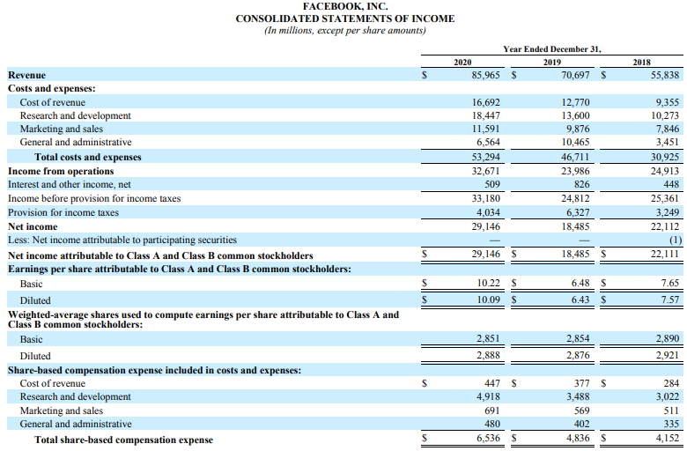
What is the Income Statement?
Income statement of Facebook 2020

Slide 4
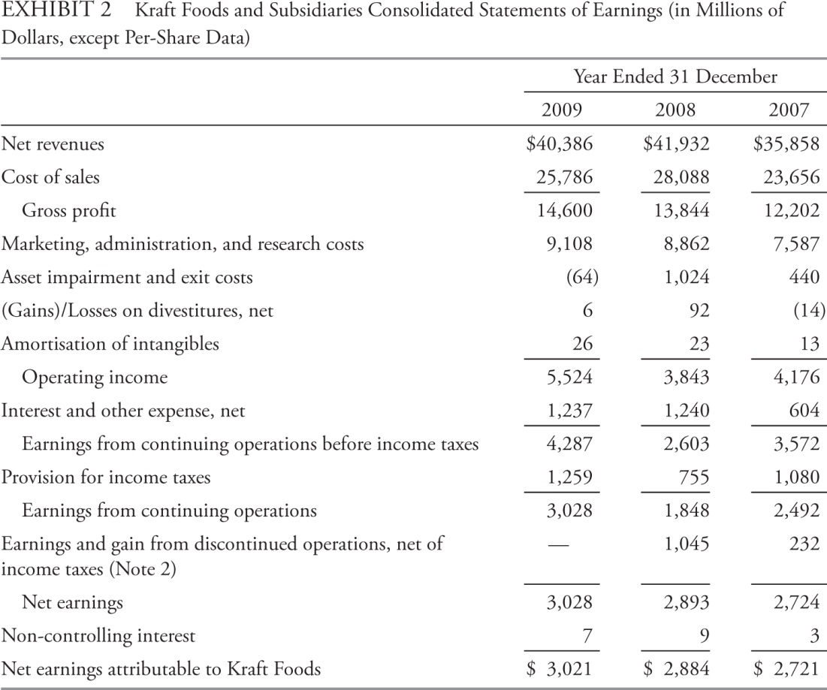
Components of the Income Statement
Revenue or Net Revenue
Expenses
May appear as +ve or -ve numbers.
May be categorized by either nature or function
Operating Profit / EBIT
Minority interests
Net Income (the “bottom line”)

Slide 5
Revenue Recognition
A fundamental principle of accrual accounting is that revenue is recognized (reported on the income statement) in the period in which it is earned.
Revenue recognition can occur independently of cash movements—for example, in the case of the
sale of goods and services on credit or
receipt of cash in advance of providing goods and services

Slide 6
When to recognize revenue
The entity recognizes revenue when it is able to satisfy performance obligations by transferring control to the customer.
Factors to consider in assessing whether a customer has obtained control at a point in time include:
The entity has a present right to payment.
The customer has legal title.
Customer has physical possession.
Significant risks and rewards of ownership have passed.
Customer has accepted the asset

Slide 7
Special case: long-term contract 1
Question: Builder Co (Builder) enters into a contract to construct a commercial building for a customer. Builder identifies various goods and services to be provided such as pre-construction engineering, construction of the building’s components, plumbing, electrical wiring and interior finishes. Should Builder treat each specific item as a separate performance obligation to which revenue should be allocated?
How to identify the various goods and services as either a single performance obligation or multiple performance obligation?
Can the customer benefit from the good or service on its own or together with other readily available resources?
the seller’s ‘promise to transfer the good or service to the customer is separately identifiable from other promises in the contract’
Answer: The builder can’t treat each specific item as a separate performance obligation because it is the building which the customer has contracted, not the separate goods or services. Each specific item is accounted for together as a single performance obligation.

Slide 8
Special case: long-term contract 2
Question: Builder’s contract specifies consideration of $1 million and total costs of $700,000. Builder incurs costs of $420,000 in year 1. Assuming that costs incurred provide an appropriate measure of contract progress, how much revenue should Builder recognize in year 1?
Answer: For performance obligations satisfied over time, revenue is recognized over time by measuring progress towards satisfying the obligation. Measurement is based on input method or an output method. Builder has incurred 60% of total expected costs and hence will recognize $600,000 revenue in year 1.

Slide 9
Special case: long-term contract 3
Question: Assume that the contract price is $1 million plus a bonus of $200,000 if the building is complete within 2 years. Builder only has limited experience of this type of construction and external factors (e.g. the weather) could cause delays. Builder’s expected total costs are $700,000. Builder incurs $420,000 costs in year 1. Assuming that costs incurred provide an appropriate measure of progress towards contract completion, how much revenue should be recognized in year 1?
Variable consideration can only be included in the contract price if it will not be reversed in the future. The bonus cannot be recognized in year 1 because the non-reversible conclusion cannot be reached due to Builder’s limited experience and potential delays resulting from factors beyond its control.

Slide 10
Special case: long-term contract 4
Question: Assume the facts from the previous example. At the start of year 2, Builder and Customer agree to changing the building floor plan and modify the contract. Consideration increases by $150,000 (originally 200,000) and the allowable time for achieving the bonus is extended by 6 months. Builder expects its costs to increase by $120,000 (originally 700,000 in total, incurs 420,000 cost in year 1). Given the extension to the deadline, Builder concludes the bonus can now be achieved. How does Builder account for this change in the contract?
Answer: This is not a new contract but a modification to the existing contract. Hence, a catch-up adjustment will be needed. Builder’s total revenue is now $1.35 million and contract progress is now 51.2% (420,000/820,000=51.2%). So, the modified revenue recognition is 1.35*51.2%=691,200. An additional $91,200 (691,200-600,000) revenue is recognized as a cumulative catch-up adjustment on the date of the contract modification.

Slide 11
Special case: long-term contract 5
Question: A company operates a website enabling customers to purchase goods from various suppliers. Customers pay the company in advance and orders are non-refundable. The supplier delivers the goods directly to the customer and the company receives a commission of 10%. Should the company report total revenues equal to 100% of the sales amount (gross) or total revenues equal to 10% of the sales amount (net)?
Answer: Revenues are reported gross if the company is acting as principal or net if the company is acting as agent. In this example, the company is acting as agent because it is not primarily responsible for fulfilling the contract, does not take any inventory risk or credit risk, does not have discretion in setting the price and receives compensation in the form of a commission. The company therefore records the net amount of the revenue (i.e. its commission).

Slide 12
general principles of Expense recognition
In general, a company recognizes expenses in the period in which it consumes (i.e., uses up) the economic benefits associated with the expenditure.
Matching principle: Costs are matched with revenues.
COGS can always match?
Period costs: Expenditures that less directly match revenues, are reflected in the period when a company makes the expenditure or incurs the liability to pay. Eg. Administrative expenses.
Other expenditures create assets that will result in future benefits over a number of accounting periods (eg. PPE). The expenditures are allocated systematically with the passage of time (e.g., depreciation).

Slide 13
specific expense recognition applications: Inventory
Inventory Cost Flow
Beginning
Inventory
Goods
Available
for
Sale
Ending
Inventory
Goods
Purchased
Cost of
Goods Sold
Balance Sheet
Income Statement

Slide 14
specific expense recognition applications: Example
Inventory Purchases
First quarter 2,000 units at $40 per unit
Second quarter 1,500 units at $41 per unit
Third quarter 2,200 units at $43 per unit
Fourth quarter 1,900 units at $45 per unit
Total 7,600 units at a total cost of $321,600
Inventory sales during the year: 5,600 units at $50 per unit
What are the revenue and expense for these transactions during the year? (Assume that the company does not expect any returns)
Assume the company specifically identifies that:
the 5,600 units sold were those purchased in the 1st and 2nd quarter plus 2,100 of the units purchased in the 3rd quarter and
the 2,000 remaining units were 100 of those purchased in the 3rd quarter plus the 1,900 purchased in the 4th quarter.

Slide 15
specific expense recognition applications: Example Solution
Revenue = $280,000
(5,600 units times $50 per unit)
Cost of Goods Sold
The 5,600 units that were sold were specifically identified
as follows:
From 1st quarter: 2,000 units at $40 per unit $80,000
From 2nd quarter: 1,500 units at $41 per unit $61,500
From 3rd quarter: 2,100 units at $43 per unit $90,300
Total cost of goods sold $231,800
Ending inventory
From the 3rd quarter: 100 units at $43 per unit $4,300
From the 4th quarter: 1,900 units at $45 per unit $85,500
Total remaining (or ending) inventory cost $89,800
Total available for sale

Slide 16
specific expense recognition applications: Example
Inventory Purchases
First quarter 2,000 units at $40 per unit
Second quarter 1,500 units at $41 per unit
Third quarter 2,200 units at $43 per unit
Fourth quarter 1,900 units at $45 per unit
Total 7,600 units at a total cost of $321,600
Inventory sales during the year 5,600 units at $50 per unit.
Revenue and expense for these transactions during the year?
Assume the company does not specifically identify the units, but instead uses the weighted average cost method of inventory costing.

Slide 17
specific expense recognition applications: Example solution
Revenue = $280,000
(5,600 units times $50 per unit)
Average cost per unit =
Total cost of goods available divided by total units available =
$321,600/7,600 units = $42.3158 per unit
Cost of goods sold =
5,600 units at $42.3158 per unit $236,968
Ending inventory =
2,000 units at $42.3158 per unit $84,632
Total available for sale

Slide 18
specific expense recognition applications: Example 1
Inventory Purchases
First quarter 2,000 units at $40 per unit
Second quarter 1,500 units at $41 per unit
Third quarter 2,200 units at $43 per unit
Fourth quarter 1,900 units at $45 per unit
Total 7,600 units at a total cost of $321,600
Inventory sales during the year: 5,600 units at $50 per unit.
What are the revenue and expense for these transactions during the year?
Assume the company does not specifically identify the units, but instead uses the FIFO (first in, first out) method of inventory costing.

Slide 19
specific expense recognition applications: Example 1 solution
Inventory Purchases
First quarter 2,000 units at $40 per unit
Second quarter 1,500 units at $41 per unit
Third quarter 2,200 units at $43 per unit
Fourth quarter 1,900 units at $45 per unit
Total 7,600 units at a total cost of $321,600
Using the FIFO method of inventory costing:
FIFO to determine COGS: 2,000 from 1st quarter at $40 per unit + 1,500 from 2nd quarter at $41 per unit + 2,100 from 3rd quarter at $43 per unit
COGS = $231,800

Slide 20
specific expense recognition applications: Example Solution
Revenue = $280,000
(5,600 units times $50 per unit)
Cost of Goods Sold
The 5,600 units that were sold were specifically identified
as follows:
From 1st quarter: 2,000 units at $40 per unit $80,000
From 2nd quarter: 1,500 units at $41 per unit $61,500
From 3rd quarter: 2,100 units at $43 per unit $90,300
Total cost of goods sold $231,800
Ending inventory
From the 3rd quarter: 100 units at $43 per unit $4,300
From the 4th quarter: 1,900 units at $45 per unit $85,500
Total remaining (or ending) inventory cost $89,800
Total available for sale

Slide 21
specific expense recognition applications: Example 2
Inventory Purchases
First quarter 2,000 units at $40 per unit
Second quarter 1,500 units at $41 per unit
Third quarter 2,200 units at $43 per unit
Fourth quarter 1,900 units at $45 per unit
Total 7,600 units at a total cost of $321,600
Inventory sales during the year: 5,600 units at $50 per unit.
What are the revenue and expense for these transactions during the year?
Assume the company does not specifically identify the units, but instead uses the LIFO method of inventory costing.
Assume the company reports under U.S. GAAP (not permitted under IFRS) and uses the LIFO (last in, first out) method of inventory costing.
LIFO is not allowed under IFRS.

Slide 22
specific expense recognition applications: Example 2 solution
Inventory Purchases
First quarter 2,000 units at $40 per unit
Second quarter 1,500 units at $41 per unit
Third quarter 2,200 units at $43 per unit
Fourth quarter 1,900 units at $45 per unit
Total 7,600 units at a total cost of $321,600
Using the LIFO method of inventory costing:
LIFO to determine COGS: 1,900 from 4th quarter at $45 per unit + 2,200 units at $43 per unit + 1,500 units at $41 per unit
COGS = $241,600

Slide 23
specific expense recognition applications: Example Solution
Revenue = $280,000
(5,600 units times $50 per unit)
Cost of Goods Sold
The 5,600 units that were sold were specifically identified
as follows:
From 4th quarter: 1,900 units at $45 per unit $85,500
From 3rd quarter: 2,200 units at $43 per unit $94,600
From 2nd quarter: 1,500 units at $41 per unit $61,500
Total cost of goods sold $241,600
Ending inventory
From the 1st quarter: 2000 units at $40 per unit $80,000
Total remaining (or ending) inventory cost $80,000
Total available for sale

Slide 24
Summary Table on Inventory Costing Methods
Method | Description | COGS when prices are rising relative to the other two methods | Ending Inventory when prices are rising relative to the other two methods
FIFO | Assumes that earliest items purchased were sold first | Lowest | Highest
LIFO | Assumes most recent items purchased were sold first | Highest* | Lowest*
Average Cost | Averages total costs over total units available | Middle | Middle
*Assumes no LIFO layer liquidation. LIFO layer liquidation occurs when the volume of sales exceeds the
volume of other purchases in the period so that some sales are assumed to be from existing, relatively low-priced
inventory rather than from more recent purchases.

Slide 25
Issues in Expense Recognition
Doubtful Accounts
Estimate of how much revenue will be uncollectible.
Warranties
Recognise an expense at the time of the sale recognition, and update the expense over the life of the warranty.
Depreciation & Amortization
Process of systematically allocating costs of long-lived assets over the period during which the assets are expected to provide economic benefits.

Slide 26
non-recurring items and changes in accounting standards
Separating non-recurring from recurring items of income and expense can help an analyst assess a company’s future earnings.
Discontinued operations should be reported separately.
Unusual or infrequent items may be reported separately.
Changes in accounting policies/standards.

Slide 27
Earnings Per Share
Basic EPS: Earnings available to common shareholders divided by weighted average number of shares outstanding
Basic EPS = (Net income – Preferred dividends) Weighted average number of shares outstanding
Diluted EPS: the EPS that would result if all dilutive financial instruments were converted into shares; the ‘if-converted’ method.
Diluted EPS = (Net income + After-tax interest on convertible debt – Preferred dividends)/(Weighted average number of shares outstanding + Additional common shares that would have been issued at conversion)

Slide 28
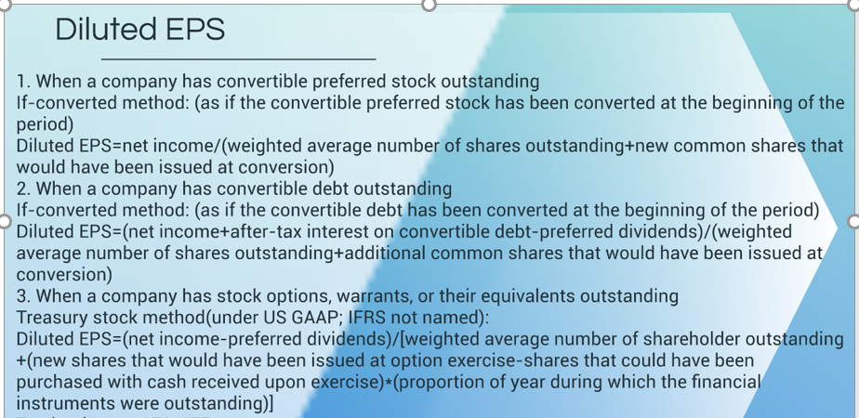
Diluted EPS

Slide 29
EPS: EXAMPLE 1 Weighted average no.
For the year ended 31 December 2020, Company X has net income of $5,000,000. The company declared and paid $400,000 of dividends on preferred stock. The company also had the following common stock information:
Shares outstanding on 01 January 2020 1,000,000
Shares issued on 01 April 2020 200,000
Shares repurchased on 01 October 2020 (100,000)
Shares outstanding on 31 December 2020 1,100,000
What is the company’s weighted average number of shares outstanding?
What is the company’s basic EPS?

Slide 30
EPS: Example 2 Convertible Preferred Stock
Assume a company has the following:
net income of $1,750,000
an average of 500,000 shares of common stock outstanding
20,000 shares of convertible preferred outstanding
no other potentially dilutive securities
Each share of preferred pays a dividend of $10 per share, and each is convertible into five shares of the company’s common stock.
Calculate the company’s basic and diluted EPS.
Diluted EPS
= Net income/(Weighted average number of shares outstanding + New shares issued at conversion)

Slide 31
 | Basic EPS | Diluted EPS Using If-Converted Method
Net income | $1,750,000 | $1,750,000
Preferred dividend | – 200,000 | 0
Numerator | $1,550,000 | $1,750,000
Weighted average number of shares outstanding | 500,000 | 500,000
If converted | 0 | 100,000
Denominator | 500,000 | 600,000
EPS | $3.10 | $2.92

Slide 32
EPS: Example 3 Convertible debt
Assume a company has the following:
net income of $750,000
an average of 690,000 shares of common stock outstanding
$50,000 of 6% convertible bonds outstanding that are convertible into a total of 10,000 shares
no other potentially dilutive securities
An effective tax rate is 30%
Calculate the company’s basic and diluted EPS.
Diluted EPS
= (Net income + After-tax interest on convertible debt – Preferred dividends)/(Weighted average number of shares outstanding + Additional common shares that would have been issued at conversion)

Slide 33
 | Basic EPS | Diluted EPS Using If-Converted Method
Net income | $750,000 | $750,000
After-tax cost of interest | 0 | 2,100
Preferred dividend | – 0 | 0
Numerator | $750,000 | $752,100
Weighted average number of shares outstanding | 690,000 | 690,000
If converted | 0 | 10,000
Denominator | 690,000 | 700,000
Earnings per share (EPS) | $1.09 | $1.07

Slide 34
EPS: Example 4 Stock Options
Assume a company reported net income of $2.3 million for the year ended 30 June 2018 and has the following:
an average of 800,000 common shares outstanding
30,000 options with an exercise price of $35 outstanding
no other potentially dilutive securities
Over the year, its market price averaged $55 per share.
Calculate the company’s basic and diluted EPS.
Diluted EPS
= (Net Income – Preferred dividends)/(Weighted average number of shares outstanding + New shares issued at option exercise – Shares that could have been purchased with cash received upon exercise)

Slide 35
Calculate Denominator
800,000 | Weighted average number of shares outstanding
+ 30,000 | New shares issued at option exercise
– 19,091 | Shares that could be purchased with cash received upon exercise, calculated as $1,050,000 ($35 for each of the 30,000 options exercised) divided by average market price of $55 per share = 19,091 shares
= 810,909 | Shares
30,000 – 19,091 = 10,909

Slide 36
 | Basic EPS | Diluted EPS Using Treasury Stock Method
Net income | $2,300,000 | $2,300,000
Numerator | $ 2,300,000 | $2,300,000
Weighted average number of shares outstanding | 800,000 | 800,000
If exercised and treasury shares purchased | 0 | 10,909
Denominator | 800,000 | 810,909
EPS | $2.88 | $2.84

Slide 37
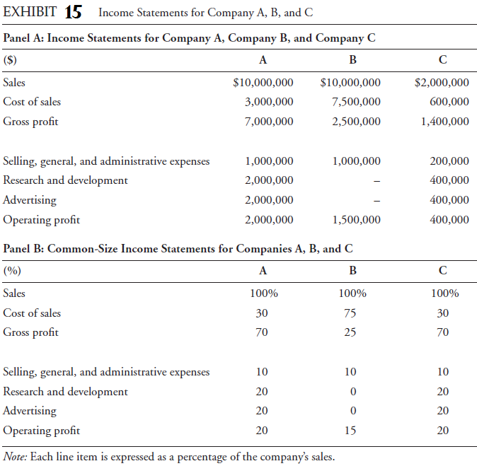
Common-Size Analysis
Performed by stating each line item on the income statement as a % of revenue.
Facilitate comparison across time, and across companies.

Slide 38
Income Statement Ratios
Net profit margin = Net income/Revenue
Net profit margin measures the amount of income that a company was able to generate for each dollar of revenue.
Higher level of net profit margin indicates higher profitability (generally more desirable).
Net profit margin can also be found directly on the common-size income statements.
Also referred to as “return on sales.”
Profitability ratios found directly on the common-size income statement.
Gross profit margin = Gross profit/Revenue.
Operating profit margin = Operating profit/Revenue
Pretax profit margin = Pretax profit/Revenue
Net profit margin

Slide 39
Summary
Income statement shows how much revenue the company generated during a period and what costs it incurred in connection with generating that revenue.
Accounting issues relate primarily to timing (revenue recognition, expense recognition, non-recurring items).
The income statement also presents EPS (earnings per share), an important metric.
Tools for income statement analysis include common-size analysis and profitability ratios.
Comprehensive income includes net income and other comprehensive income.
As of the beginning of 2018, revenue recognition standards have converged.

