Slide 2
Module 4 Understanding Balance sheet & Cash Flow Statements

Slide 3
balance sheet contents
The balance sheet is also known as the statement of financial position or statement of financial condition.
The balance sheet discloses, at a specific point in time:
what an entity owns (or controls),
what it owes, and
what the owners’ claims are.
Assets = Liabilities + Owners’ Equity

Slide 4
balance sheet elements
Assets (A): resources controlled by the company as a result of past events and from which future economic benefits are expected to flow to the entity.
Liabilities (L): obligations of a company arising from past events, the settlement of which is expected to result in a future outflow of economic benefits from the entity.
Equity (E): represents the owners’ residual interest in the company’s assets after deducting its liabilities.

Slide 5
current and non-current assets and liabilities
Balance sheet must distinguish between and present separately
current and non-current assets
current and non-current liabilities
Exception to the current and non-current classifications requirement, under IFRS:
Current and non-current classifications are not required if a liquidity-based presentation provides reliable and more relevant information.
In a liquidity-based presentation, all assets and liabilities presented in order of liquidity.
Liquidity-based presentation are often used by banks.
Classified balance sheet: Balance sheet with separately classified current and non-current assets and liabilities.

Slide 6
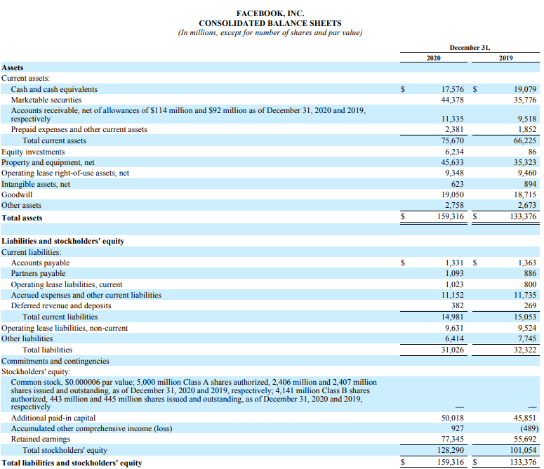
Balance sheet: example facebook

Slide 7
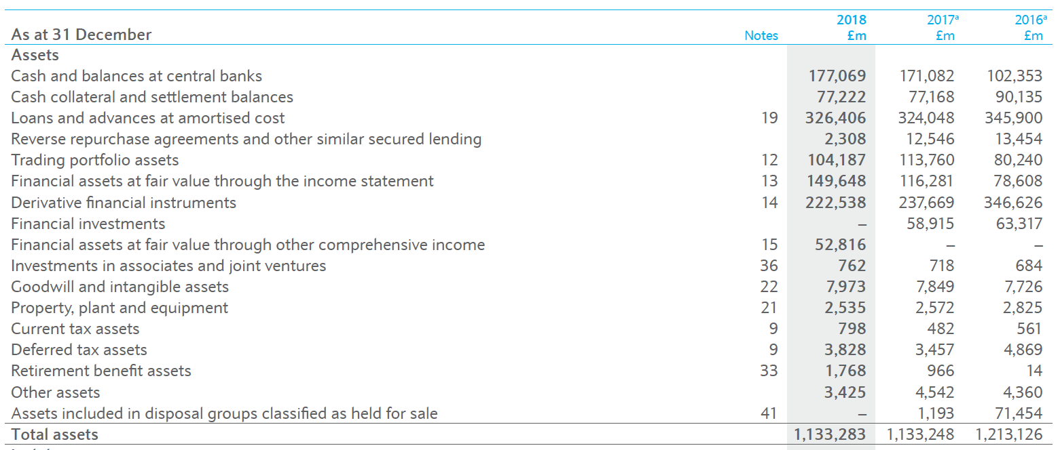
Balance sheet: example Barclays plc (assets)
Barclays' Annual Report

Slide 8
current and non-current assets and liabilities
Current assets: Assets expected to be sold, used up, or otherwise realized in cash within one year or one operating cycle of the business, whichever is greater, after the reporting period.
Non-current assets: Assets not classified as current. Also known as long-term or long-lived assets.
Current liabilities: Liabilities expected to be settled within one year or within one operating cycle of the business.
Non-current liabilities: All liabilities not classified as current.
Working capital: The excess of current assets over current liabilities.

Slide 9
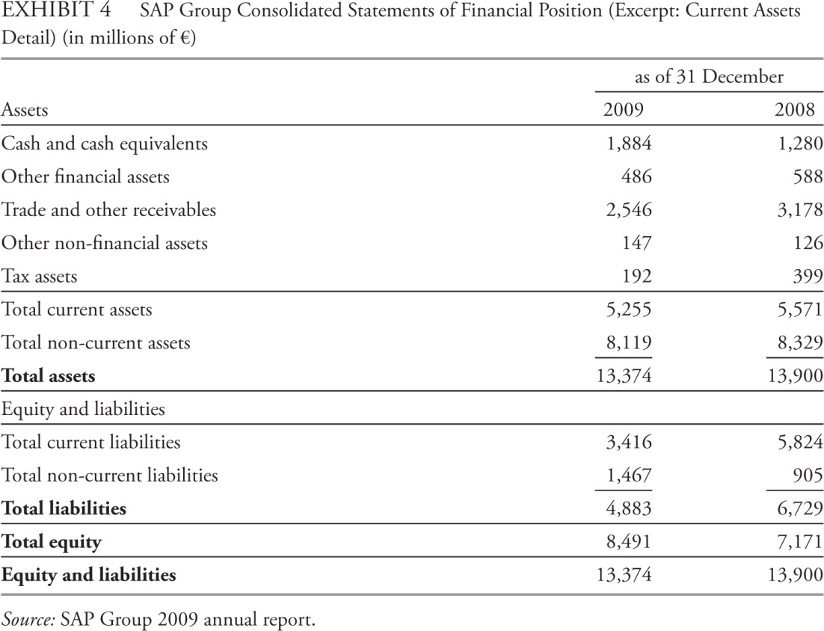
Current Assets
Presented in order of liquidity.
Cash and cash equivalents
Marketable securities
Trade / Account receivables
Inventories
Other

Slide 10
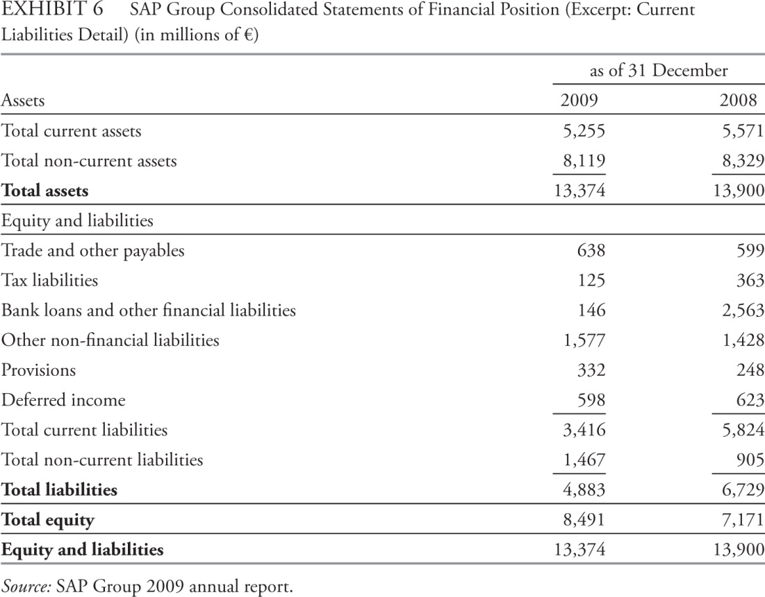
Current Liabilities
Trade / Accounts Payable
Notes Payable
Income Taxes Payable
Accrued Expenses
Deferred Income / Unearned Revenue

Slide 11
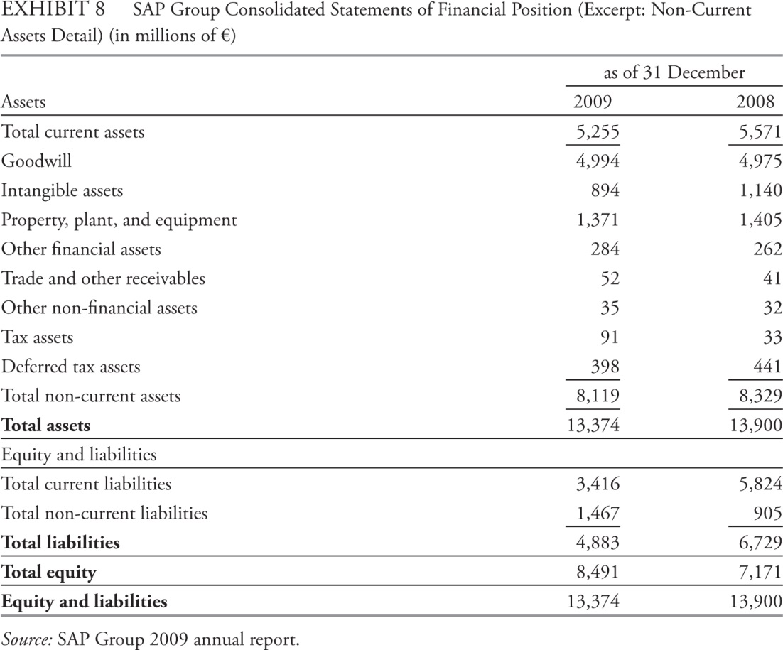
Non-Current Assets
Property, Plant, and Equipment (PPE)
Investment Property
Intangible Assets
Goodwill
Organisation capital
Financial Assets
Held-to-maturity
Held-for-trading
Depreciation / Depletion v. Impairment

Slide 12
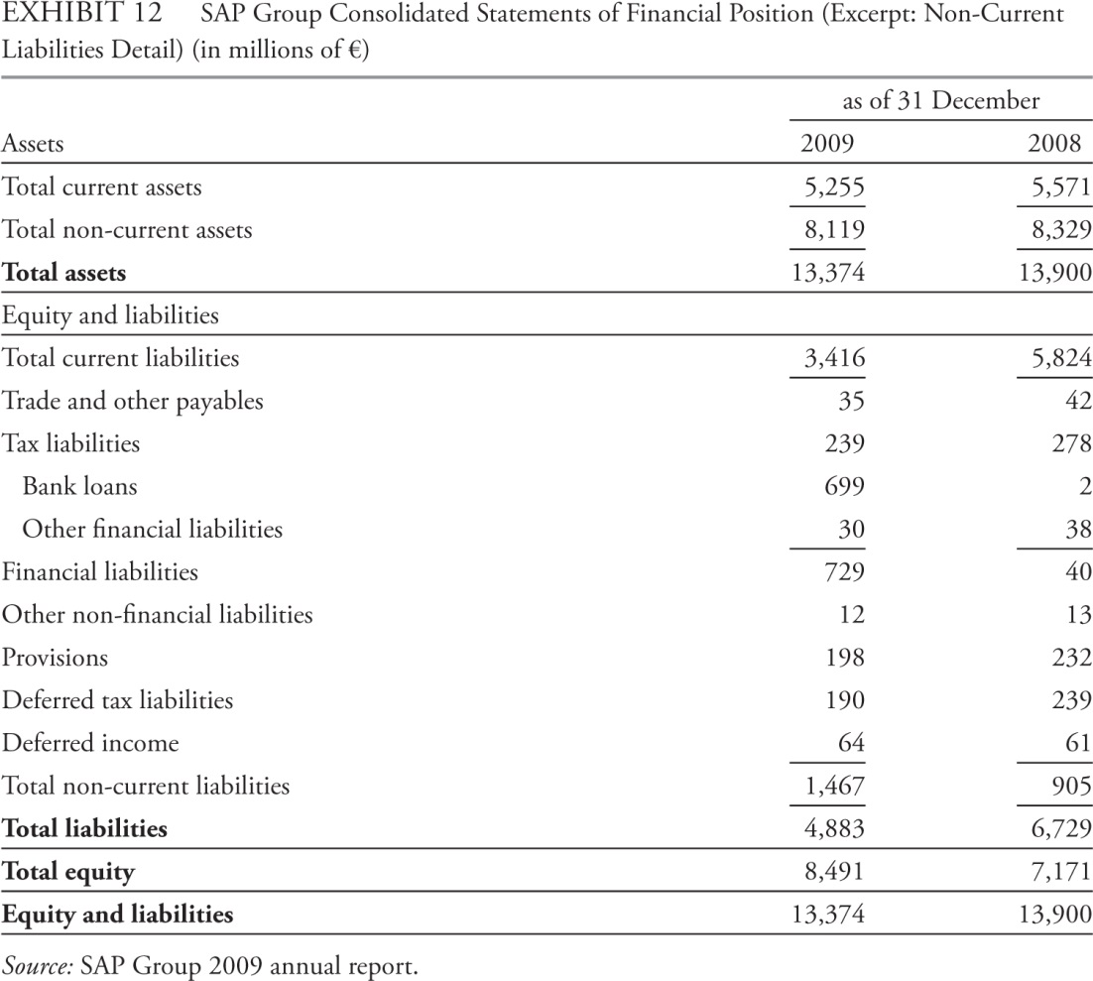
Non-Current Liabilities
Unearned Revenue
Long-Term Financial Liabilities
Deferred Tax Liabilities
(due to time difference between income for tax purpose and financial statement purpose (taxable income vs. reported income)

Slide 13
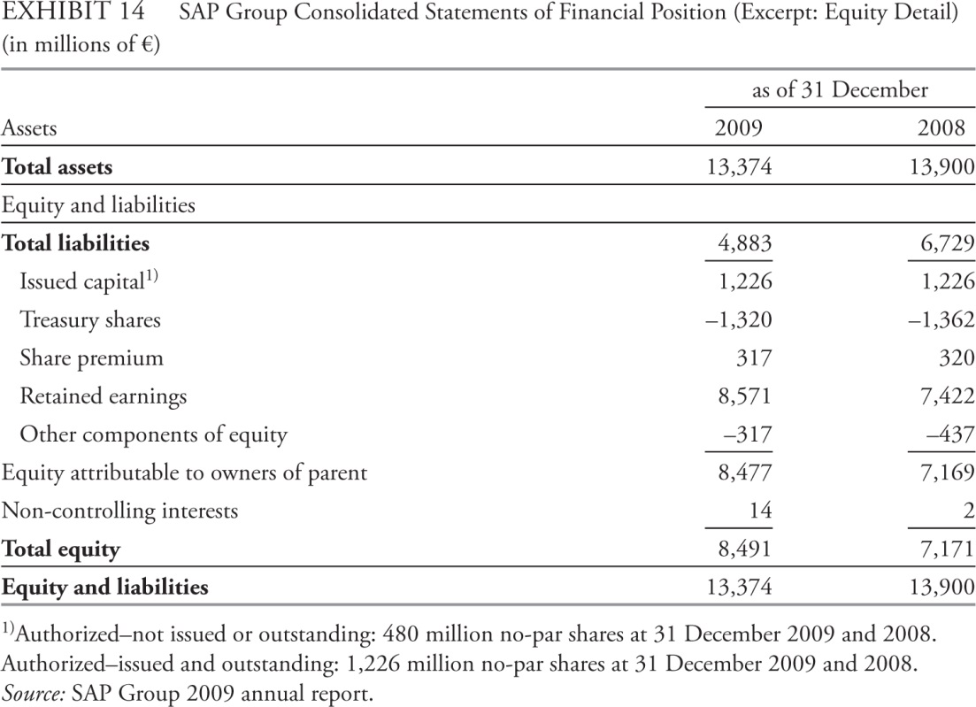
Equity
Equity: Owners’ residual claim on assets of company.
Funds invested in company
Capital Contributed
Preferred shares
Treasury shares
Retained earnings
Accumulated other comprehensive income / other reserves
Non-controlling / minority interest

Slide 14
Analysis of balance sheets
Liquidity
A company’s ability to meet its short-term financial commitments.
Assessment focus: The company’s ability to convert assets to cash and to pay for operating needs.
Solvency
A company’s ability to meet its financial obligations over the longer term.
Assessment focus: The company’s financial structure and its ability to pay long-term financing obligations.
Analytical Tools
Common-size analysis.
Balance sheet ratios.

Slide 15
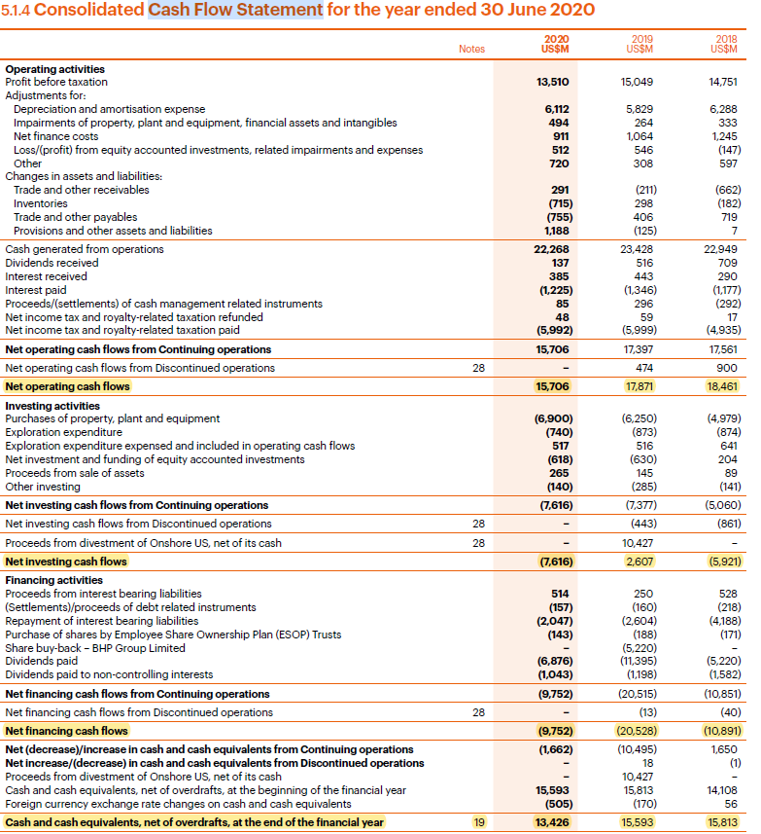
What is the Cash-Flow Statement?
Presents information about a company’s cash receipts and cash payments during an accounting period.
Cash generated (or used) in operating activities and cash provided (or used) by investing and financing activities.
Possible for a company with a healthy income statement to go bankrupt.
Net increase (decrease) in cash should be reflected in the balance-sheet.

Slide 16
Classification of activities on the statement of cash flows
Operating activities: Deliver or produce goods for sale and provide services. Examples:
Receive cash from customers
Pay cash to suppliers
Pay cash for operating expenses.
Investing activities: Buy or sell long-term assets and other investments. Examples:
By or sell property, plant, and equipment (PP&E);
By or sell other companies’ securities.
Financing activities: Obtain or repay capital. Examples:
Borrow from creditors and repay the principal
Issue or repurchase stock
Pay dividends

Slide 17
Classification of cash flows under IFRS vs. U.S. GAAP
Item | IFRS | U.S. GAAP
Interest received Interest paid Dividends received Dividends paid | Operating or investing Operating or financing Operating or investing Operating or financing | Operating Operating Operating Financing
Bank overdrafts | Considered part of cash equivalents | Not considered part of cash and cash equivalents; classified as financing.
Taxes paid | Generally operating, but a portion can be allocated to investing or financing | Operating

Slide 18
Indirect vs. direct method for presenting operating cash flows
Indirect method
Begins with net income and adjusts to operating cash flows.
Arguments for:
Clearly shows the reasons for differences between net income and operating cash flows.
Mirrors forecasting approach that begins with forecast of income, then derives cash flows.
Direct method
Shows each cash inflow and outflow related to receipts and disbursements.
Arguments for:
Provides information on the specific sources of operating cash receipts and payments.
The analyst gets more information from a direct-format than only the net result (net income) which is useful.

Slide 19
Indirect vs. direct method for presenting operating cash flows
Indirect method
IFRS permit.
U.S. GAAP permit.
Used by the majority of companies, whether reporting under IFRS or U.S. GAAP.
Direct method
IFRS encourage.
U.S. GAAP encourage, but requires a reconciliation of net income to cash flow from operating activities.

Slide 20
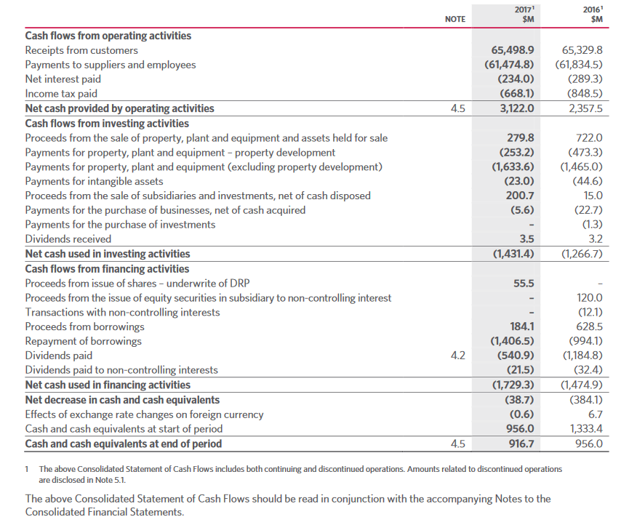
DIRECT METHOD EXAMPLE- Woolworths

Slide 21
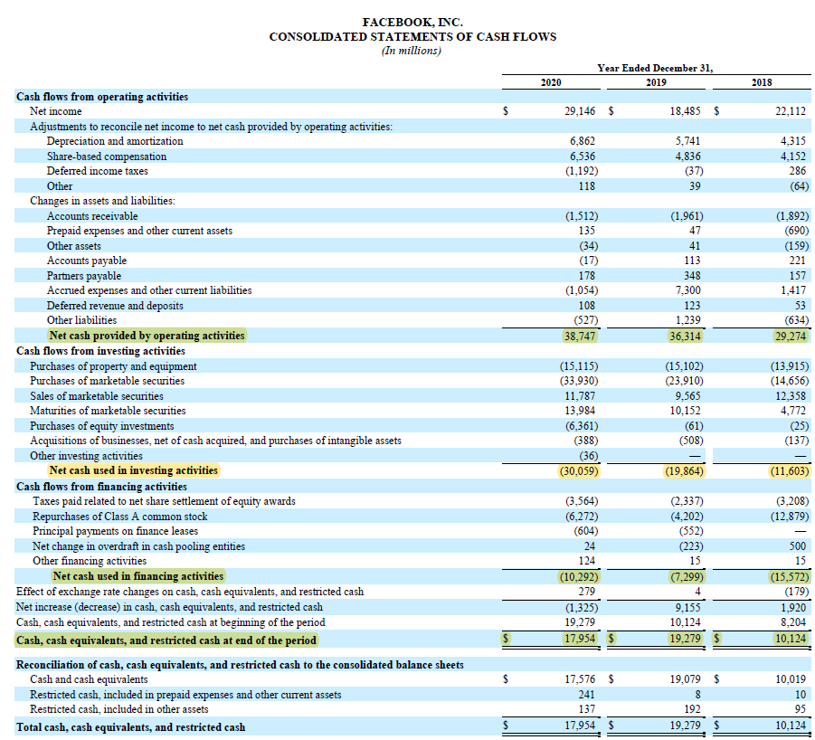
Indirect method example- Facebook

Slide 22
Operating Activities: Indirect method
1. Net income
2. any non-operating activities: gain/loss from sources that not typically activity of the business (minus/plus)
3. any non-cash expenses (plus)
4. changes in operating working capital: increases/decreases in the current operating asset and liability accounts (-net increase in a current operating asset account/+net decrease in a current operating asset account; +net increase in a current operating liability account/-net decrease in a current operating liability account)

Slide 23
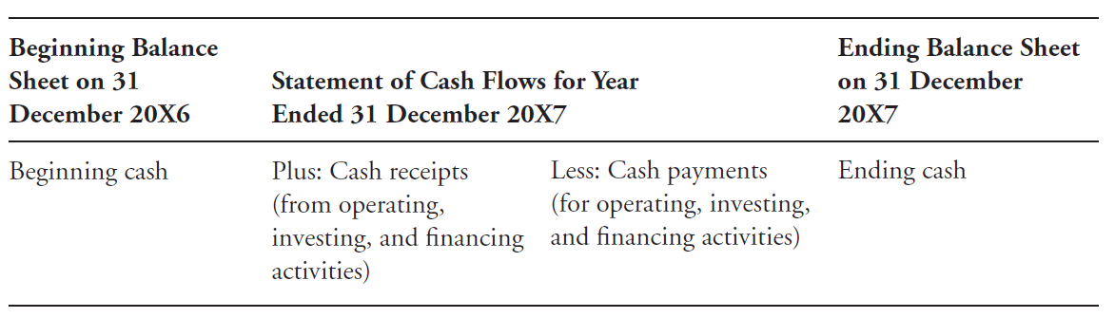
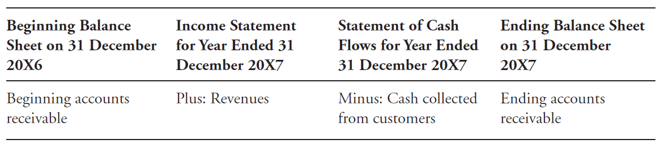
Linkage of cash flow statement with balance sheet and income statement
Linkage with balance sheet
Linkage with income statement

Slide 24
Direct method

Slide 25
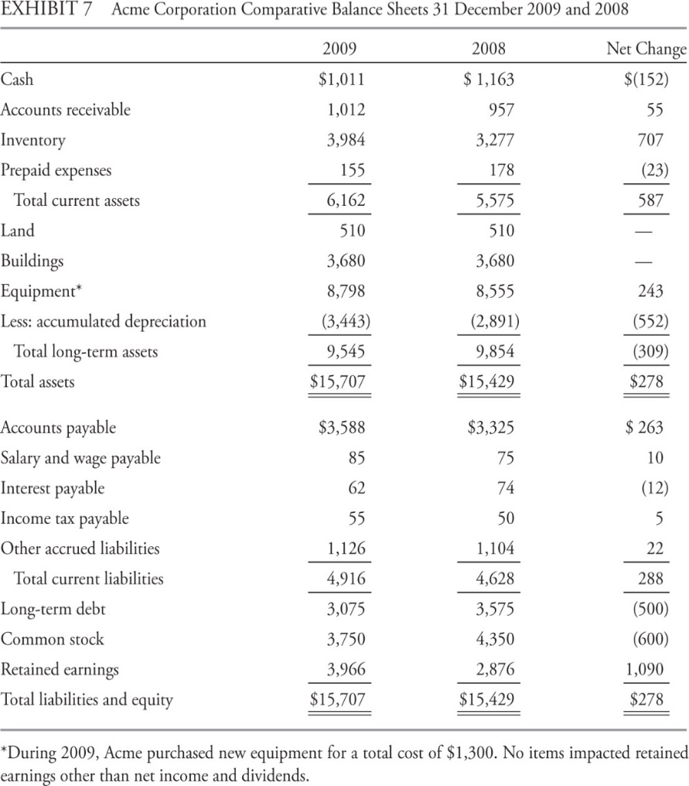
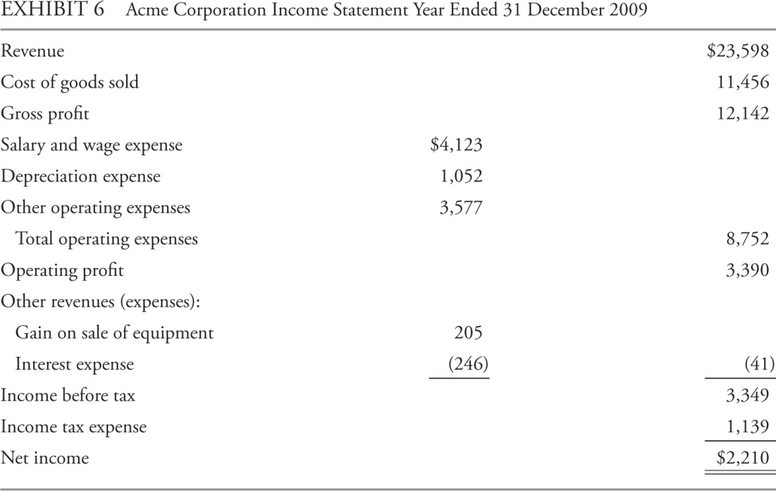
Preparing the Cash-Flow Statement

Slide 26
Operating Activities: Cash Received from Customers
Method 2
Beginning accounts receivable | $957
Plus: revenue | $23,598
Minus: ending accounts receivable | ($1,012)
Cash received from customers | $23,543
Method 1
Revenue | $23,598
Less: Increase in accounts receivable | ($55)
Cash received from customers | $23,543
Revenue(sales)-increase in accounts receivable
Revenue(sales)+decrease in accounts receivable

Slide 27
Operating Activities: Cash Paid to Suppliers
Cash paid to suppliers
Cost of goods sold | $11,456
Plus: Increase in inventory | $707
Equals purchases from suppliers | $12,163
Less: Increase in accounts payable | ($263)
Cash paid to suppliers | $11,900
1. Inventory Account
Beginning inventory | $3,277
Plus: purchases | $12,163
Minus: cost of goods sold | ($11,456)
Ending inventory | $3,984
2. Cash to Suppliers
Purchases from suppliers | $12,163
Less: Increase in accounts payable | ($263)
Cash paid to suppliers | $11,900
3. Accounts Payable Account
Beginning accounts payable | $3,325
Plus: purchases | $12,163
Minus: cash paid to suppliers | ($11,900)
Ending accounts payable | $3,588
*purchases from supplier: cost of goods sold+increase in inventory(-decrease in inventory)
*the amount paid for it: purchases from supplier-increase in accounts payable(+decrease in accounts payable)

Slide 28
Financing Activities
Long-term debt:
Reduced from previous year, indicating repaid.
Cash outflow.
Common stock:
Reduced from previous year, indication share repurchase.
Cash outflow.

Slide 29
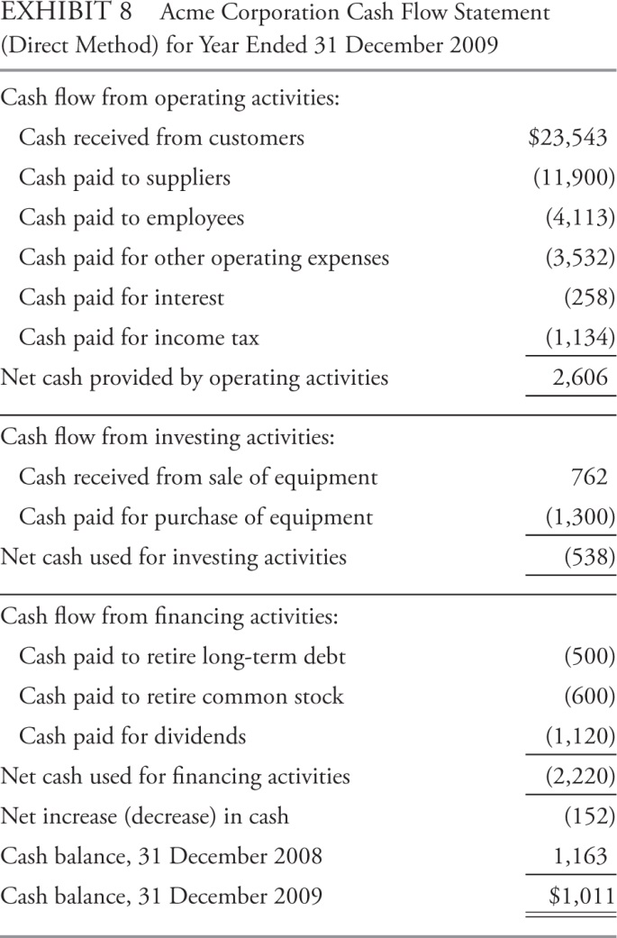
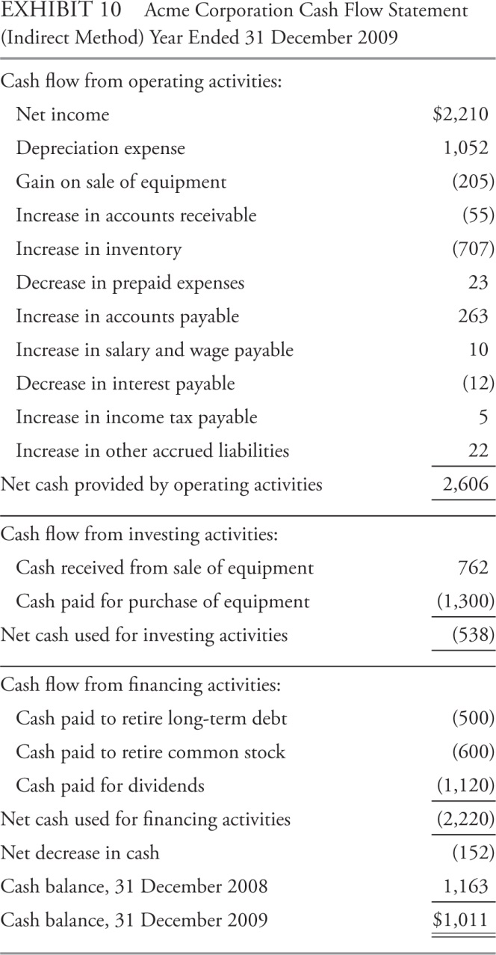
Comparison of Direct & Indirect Cash-Flow Statement

Slide 30
Cash flow statement analysis
Evaluation of the sources and uses of cash
Common-size analysis
Calculation of free cash flow measures and cash flow ratios.

Slide 31
Evaluation of the Sources and Uses of Cash
1. Evaluate where the major sources and uses of cash-flow between operating, investing, and financing activities:
what are the major sources and uses of cash flow?
Is operating cash flow positive and sufficient to cover capital expenditures?
2. Evaluate the primary determinants of operating cash flow.
What are the major determinants of operating cash flow?
Is operating cash flow higher or lower than net income, why?
How consistent are operating cash flow?—earning quality.
3. Evaluate the primary determinants of investing cash flow.
4. Evaluate the primary determinants of financing cash flow.

Slide 32
Free Cash Flow
Free Cash Flow to the Firm (FCFF): Cash flow available to the company’s suppliers of capital (debt and equity).
After all operating expenses (including taxes) have been paid.
After all operating investments have been made for fixed capital and working capital.
Free Cash Flow to Equity (FCFE): Cash flow available to the company’s common stockholders.
After all operating expenses (including taxes) have been paid.
After borrowing costs (principal and interest) have been paid.
After all operating investments have been made for fixed capital and working capital.

Slide 33
Compute FCFF
Interest, a cash flow available to one of the capital providers, which has been deducted from net income, so it must be added back.
Net Income
+ Non-cash charges
– Working capital investment
+ Interest expense × (1 – Tax rate)
– Fixed capital investments
= FCFF

Slide 34
FCFF can also be computed from cash flow from operating activities
CFO already has added non-cash items to net income and deducted working capital investment
Net Income
+ Non-cash charges
– Working capital investment
= Cash from operating activities
+ Interest expense × (1 – Tax rate)
– Fixed capital investments
= FCFF

Slide 35
Compute FCFE
Net Income
+ Non-cash charges
– Working capital investment
=Cash from operating activities
– Fixed capital investment
+ Net new borrowing (or minus net debt repayments)
= FCFE
Positive FCFE means that the company has an excess of operating cash flow over amounts needed for capital expenditures and repayment of debt.

Slide 36
Summary (BS)
Balance Sheet: what an entity owns (or controls), what it owes, and what the owners’ claims are at a specific point in time.
Balance sheets usually present current and non-current assets and liabilities.
Accounting issues relate primarily to measurement (historical cost versus fair value).
Tools for balance sheet analysis include common-size analysis and balance sheet ratios.
Balance sheet ratios indicate liquidity and solvency.

Slide 37
Summary (CF)
The cash flow statement provides information about a company’s cash receipts and cash payments during an accounting period.
Cash flows are categorized as operating, investing, and financing.
Compared with U.S. GAAP, IFRS provide companies with more choices in classifying some cash flow items as operating, investing, or financing activities.
The operating activities section of the statement of cash flows can be presented using the direct method or the indirect method.
Two approaches to developing common-size cash flow statements are the total cash inflows/total cash outflows method and the percentage of net revenues method.
Cash flow ratios measure a company’s profitability, performance, and financial strength.

