Slide 2
Module 5 Financial Analysis Techniques & Application

Slide 3
steps in financial statement analysis
Phase
1. Articulate the Purpose and Context of the Analysis
2. Collect Data
3. Process Data
4. Analyze/Interpret the Processed Data
5. Develop and Communicate Conclusions and Recommendations
6. Follow-Up

Slide 4
Analytical Tools
The following tools allow for comparison of companies that differ in size / geographic location:
Ratio Analysis
Common-Size Financial Statements
Graphs
Evaluations require comparison:
Cross-section
Time-series

Slide 5
Financial ratios
Ratios
Express one number in relation to another.
Standardize financial data in terms of mathematical relationships expressed as percentages, times, or days.
Facilitate comparisons—trends and across companies.
Ratios are interrelated.
No comprehensive list of ratios and computation often differs.

Slide 6
ratio analysis
How profitable was Company X?
15.26%
A ratio is NOT the answer (except sometimes on an exam).
A ratio is an indicator—for example, an indicator of relative activity, profitability, liquidity, solvency.

Slide 7
Ratio Analysis - Insights & Limitations
Financial ratios provide insights into:
Microeconomic relationships within a company that help analysts project earnings and free cash flow.
Company’s financial flexibility.
Management’s ability.
Changes in the company and/or industry over time.
Comparability with peer companies or industry.
Limitations:
Heterogeneity or homogeneity of a company’s operating activities.
Judgement and consistency.
Use of alternative accounting methods.

Slide 8
Categories of Financial Ratios
Category | Description
Activity | Activity ratios. How efficient are the firm’s operations and the firm’s management of assets?
Liquidity | Liquidity ratios. How well is the firm positioned to meet short-term obligations?
Solvency | Solvency ratios. How well is the firm positioned to meet long-term obligations?
Profitability | Profitability ratios. How and how much is the firm achieving returns on its investments?
Valuation | Valuation ratios. How does the firm’s performance or financial position relate to its market value?

Slide 9
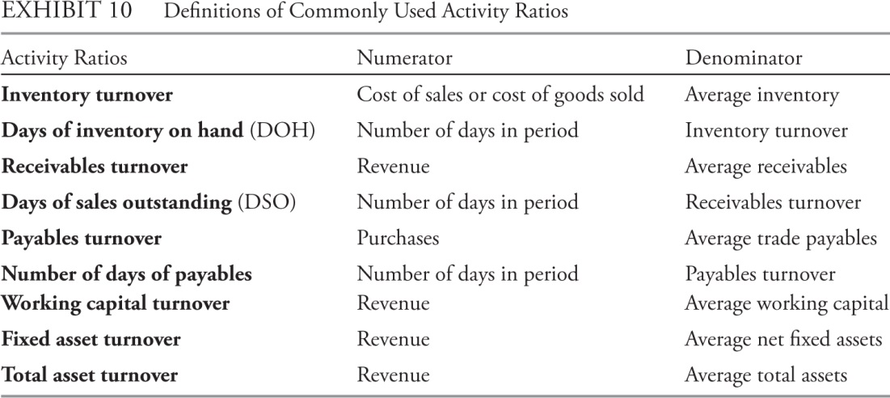
Ratio Analysis - Activity Ratios
Also known as asset utilisation or operating efficiency ratios.
How efficiently does the company utilize assets?

Slide 10
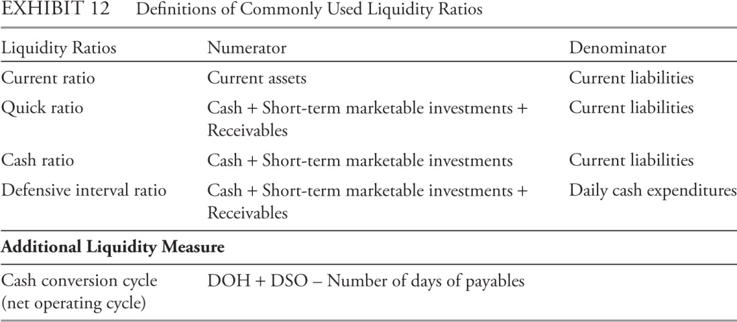
Ratio Analysis - Liquidity Ratios
Liquidity analysis
Cash-flows
Ability to meet short-term obligations

Slide 11
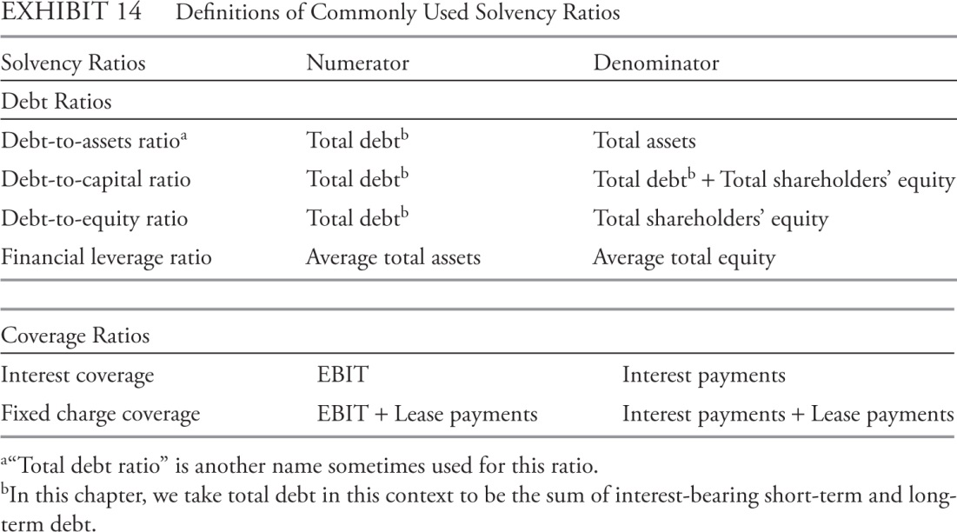
Ratio Analysis - Solvency Ratios
Solvency: ability to fulfil long-term debt obligations.
Operating leverage: use of fixed costs in conducting business
Financial leverage: use of debt financing in capital structure

Slide 12
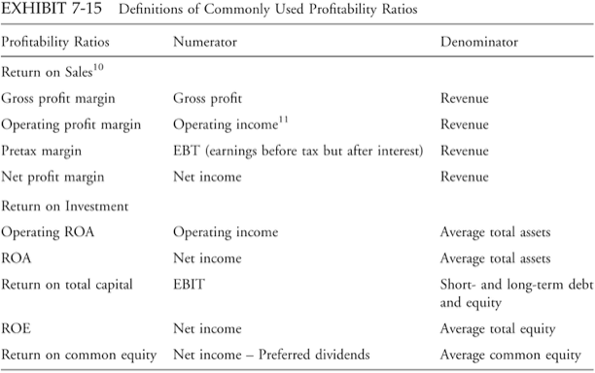
Ratio Analysis - Profitability Ratios
Profitability:
Ability to generate profit on capital invested
Reflects company’s competitive position and quality of management

Slide 13
DuPont Analysis: Decompose ROE
ROE = | Net income
 | Average equity
= | Net income | × | Average assets
 | Average assets |  | Average equity
= | ROA | × | Leverage

Slide 14
DuPont Analysis: Decompose ROE (con’t)
A company can increase its ROE
With a business strategy, by increasing its ROA and/or
With a financial strategy, by increasing its use of leverage as long as returns on the incremental investment exceed the cost of borrowing.
ROE = | ROA | × | Leverage

Slide 15
DuPont Analysis: Decompose ROE (con’t)
ROA = | Net income
 | Average assets
ROA = | Net income | × | Revenue
 | Revenue |  | Average assets
In other words,
ROA can
be thought
of as:
Profit margin × Turnover (efficiency)

Slide 16
DuPont Analysis: Decompose ROE (con’t)
ROE = | Profit margin | × | Turnover | × | Leverage
ROE = | Net income | × | Revenue | × | Average assets
 | Revenue |  | Average assets |  | Average equity

Slide 17
DuPont Analysis: Decompose ROE (con’t)
What was the source of the firm’s return on equity?
To what extent
. . . was it derived from selling a high margin product or keeping expenses low—deriving more profits from each $1 of sales? (return on sales, net profit margin)
. . . was it derived from generating higher sales from a lower investment in assets? (efficient use of assets, also known as turnover or efficiency)
. . . was it derived from investing a lower amount of equity—by using more debt in its capital structure? (financial leverage)

Slide 18
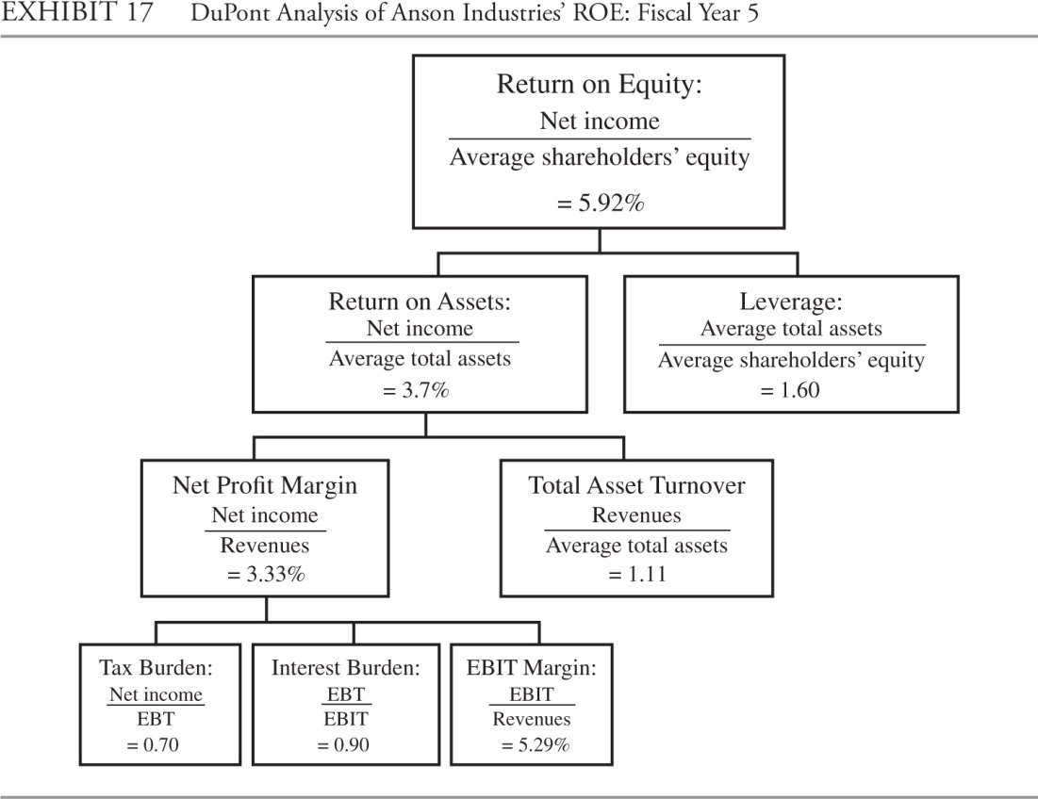
DuPont Analysis: Decompose ROE (con’t)

Slide 19
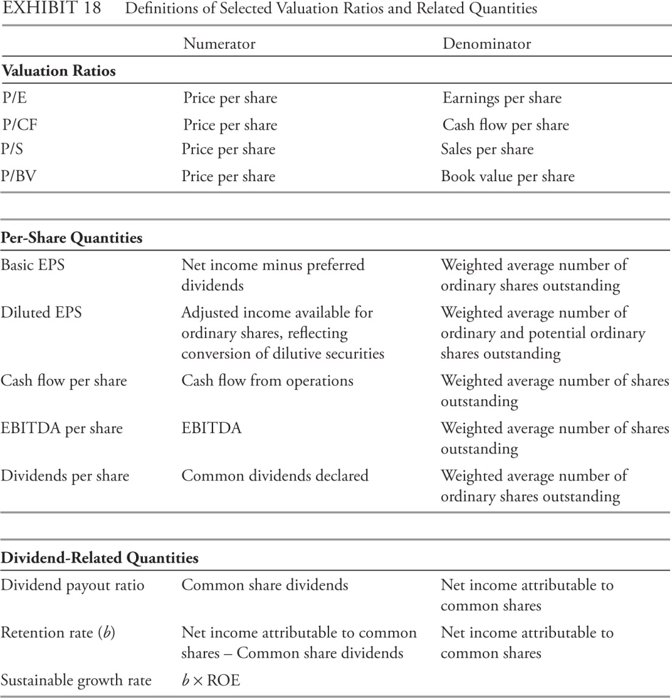
Valuation Ratios

Slide 20
Common-size Analysis
Common-size analysis: Express financial data, including entire financial statements, in relation to a single financial statement item or base.
Vertical common-size
Balance sheet: Each item as a percent of total assets.
Income statement: Each item as a percent of total net revenues.
Cash flow: Each line as a percent of sales, assets, or total in and out.
Highlights the composition.
Horizontal common-size
Percentage increase or decrease of each item from the prior year or showing each year relative to a base year.
Highlights changes in items.

Slide 21
Common-size Balance Sheet Example
Vertical common-size balance sheet
Assets | Company 1 % of Total Assets | Company 2 % of Total Assets
Cash | 38 | 12
Receivables | 33 | 55
Inventory | 27 | 24
Fixed assets net of depreciation | 1 | 2
Investments | 1 | 7
Total Assets | 100 | 100

Slide 22
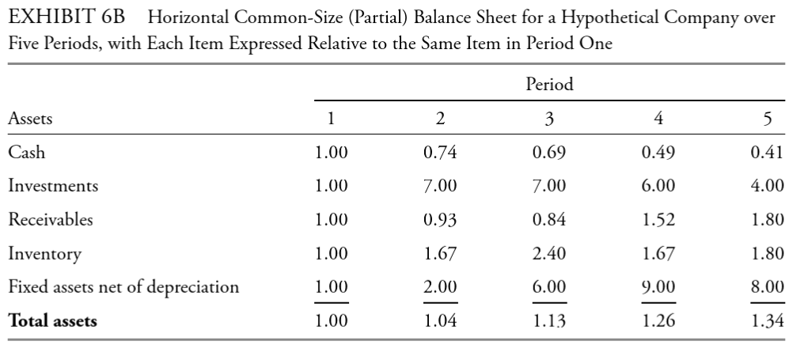
Common-size Balance Sheet Example
Horizontal common-size balance sheet

Slide 23
The use of graphs as an analytical tool
Graphs facilitate comparison of performance and financial structure over time.
Graphs provide the analyst with a visual overview of the trends in a business.
Graphs may also be used effectively to communicate the analyst’s conclusions regarding financial condition and risk management aspects.
In general,
pie graphs are most useful to communicate the composition of a total value;
Line graphs are useful when the focus in on the change in amount for a limited number of items over a relatively longer time period;
When the composition and the amounts, as well as their change over time, are all important, a stacked column graph can be used.

Slide 24
Example 1: PIE CHART

Slide 25
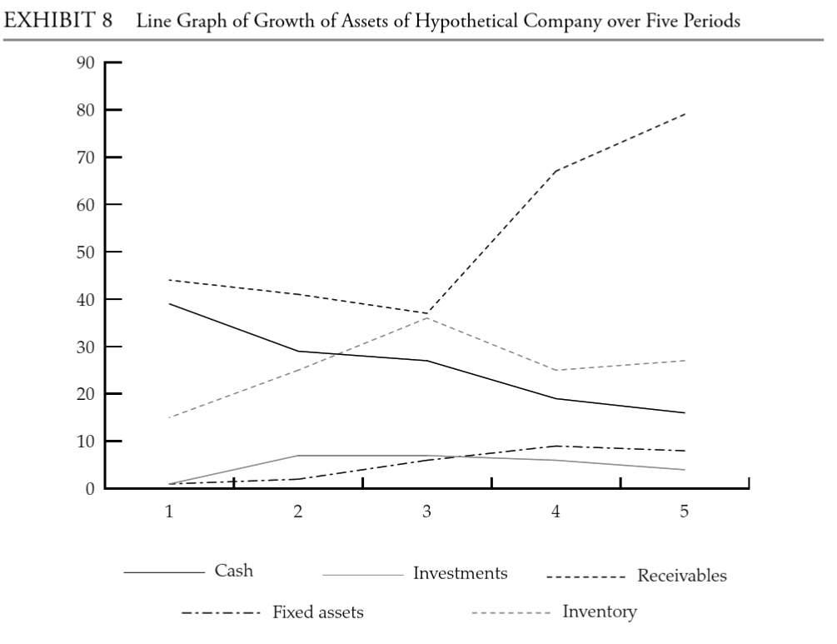
Example 2: Line graph

Slide 26
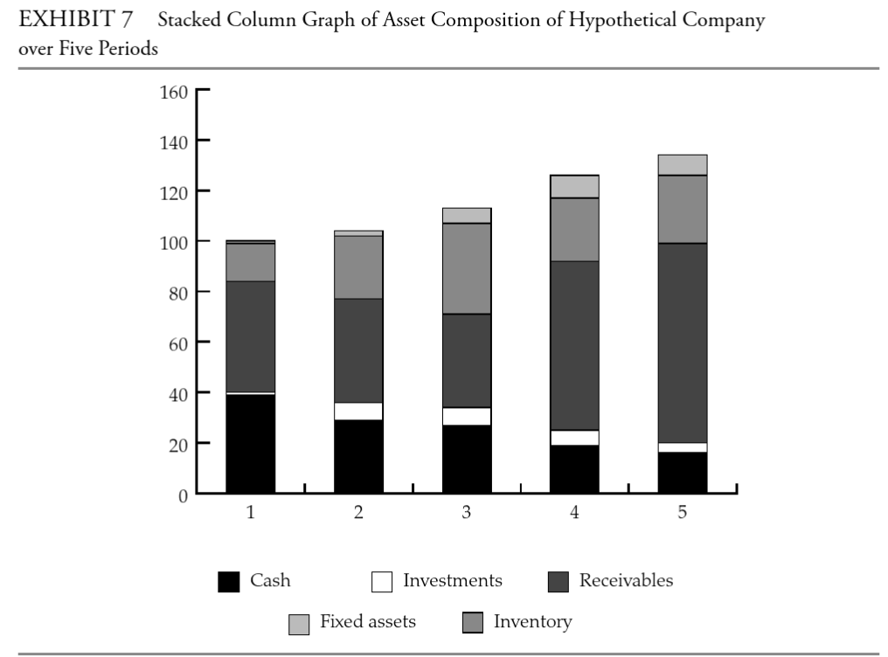
Example 3: stacked column graph

Slide 27
Application of financial analysis
Equity analysis
Credit analysis
Business and geographic segments
Evaluating past financial performance
Model building and forecasting

Slide 28
Equity Analysis
The steps of the valuation process:
Understanding the business and the existing financial profile.
Forecasting company performance.
Selecting the appropriate valuation model.
Valuation ratios
DCF
RE
AEG
Converting forecasts to a valuation.
Making the investment decision.

Slide 29
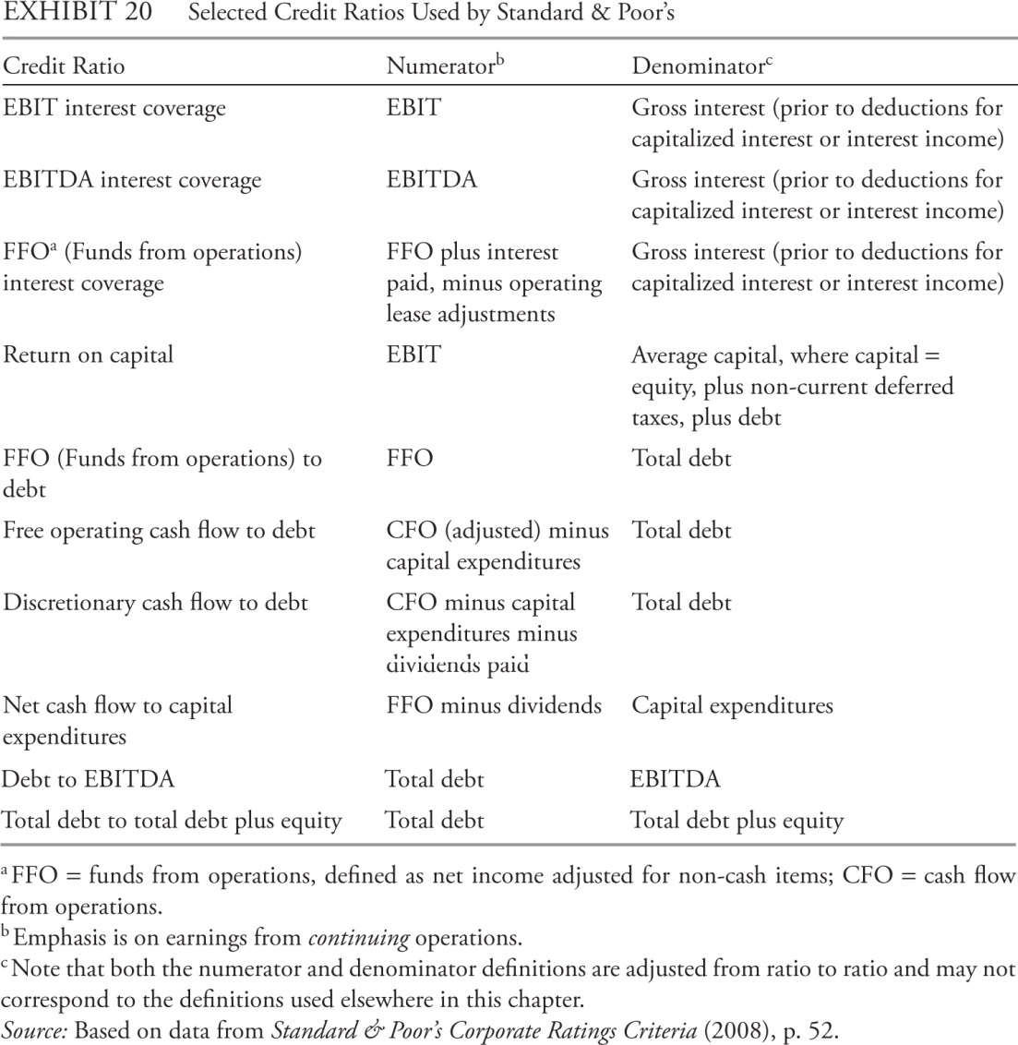
Credit Analysis
Credit risk: Risk of loss caused by failure to make a promised payment.
Credit analysis may relate to credit risk in a particular transaction or to overall creditworthiness.
Credit ratings agencies assess and communicate the probability of default by an issuer on obligations.
Business risk and financial risk.
Qualitative: industry’s growth prospects, technological change, and competitive environment; operational effectiveness, strategy governance, risk management practice etc;
Quantitative: Profitability, leverage, cash flow adequacy and liquidity.

Slide 30
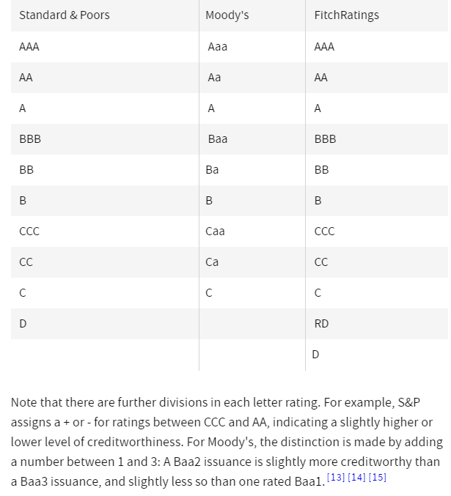
Credit ratings scale: highest to lowest
Summary from Investopedia

Slide 31
Ratio Analysis - Segments
To understand in detail the company as a whole, analyst often need to evaluate the performance underlying business segments (subsidiary companies, operating units, or simply operations in different geographic areas).
Although companies are not required to provide full financial statements for segments, they are required to provide segment information under both IFRS and US GAAP.
A company must report separate information for an operating segment when segment constitutes 10% or more of total segment operating revenue, costs, or profits

Slide 32
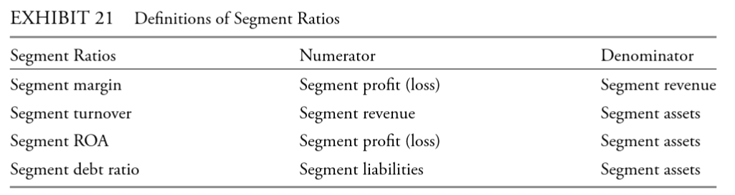
Segment ratios

Slide 33
Evaluating past financial performance
Cross-sectional analysis: to understand the comparability of companies for a market-based valuation.
Time-series analysis: provide a basis for a forward-looking analysis of the company.
Both can provide information for evaluating the quality and performance of a company’s management.
Address not only what happened, but also why it happened.

Slide 34
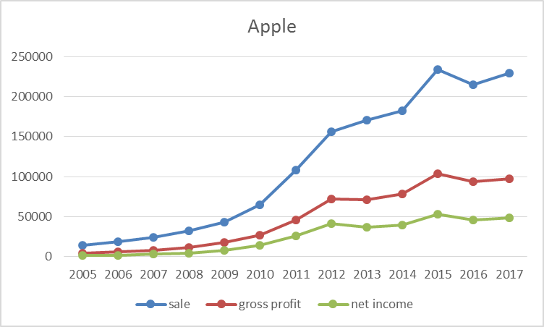
Evaluation of a company’s past performance: Apple

Slide 35
Evaluation of a company’s past performance: Apple
How have sales and gross margin changed over time?

Slide 36
Evaluation of a company’s past performance: Apple
How has the company’s product mix changed since the introduction of the iPad in 2010, and what might this change suggest for an analyst in evaluating Apple’s profitability over time and its ability to maintain that profitability?

Slide 37
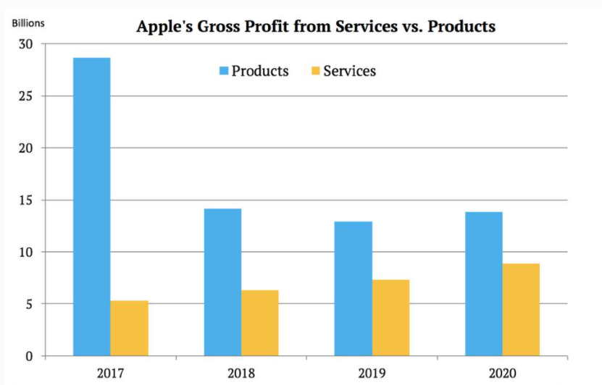

Slide 38
Model Building and Forecasting
Analyst’s can build an earnings model to forecast future performance.
Forecasts should not be limited to a single point estimate. For example:
Sensitivity Analysis: range of possible outcomes if one specific assumption is changed.
Scenario Analysis: changes in key financial quantities that result from given events that involves more dimensions.
Simulation: computer generated sensitivity/scenario analysis based on probability models for the factors that drive outcomes.

Slide 39
model building: examples of possible uses of ratios
Sales forecast (percent change from horizontal common-size income statement)
Gross profit (gross profit margin)
Assets (days receivable, days payable, PP&E turnover)
Operating profit (operating profit margin)
Liabilities (leverage ratios)
Expenses (from common-size income statement)
Cash flow

Slide 40
SALES FORECASTING
Top-down approach:
Industry sales projected on the basis of some macroeconomic indicator, such as growth in real gross domestic product (GDP).
Regression analysis can be used to establish the parameters of such relationships.
Company-level market share is projected based on historical market share and a forward-looking assessment of the company’s competitive position.
The company’s sales are then estimated as the projected market share multiplied by projected total industry sales.
Bottom-up approach:
For each of a company’s major products or segments, project changes in volume and changes in price.
Individual company’s projections can be aggregated to produce total industry projections, if needed.

Slide 41
Summary
Graphics facilitate comparisons, and regressions quantify statistical relationships.
Common-size analysis expresses financial data, including entire financial statements, in relation to a single financial statement item or base.
Ratios, which express one number in relation to another, facilitate comparisons—trends and cross-sectional.
A ratio is an indicator of
Activity
Profitability
Liquidity
Solvency

