Slide 2
Module 6 Financial Reporting Quality

Slide 3
Background
High profile (identified) financial scandal around the world (e.g., Enron, Worldcom, Lehman brothers etc.) The 10 worst corporate accounting scandals of all time
Lehman Brothers Scandal
Survey results (E&Y, 2013: 3000 participants from 36 countries across Europe, the Middle East, India and Africa):
20% respondents seen manipulation
42% directors and seniors managers were aware of irregular reporting of their own company
20% companies manage earnings (169 CFOs)

Slide 4

Financial Reporting Quality
Financial reporting quality relates to the accuracy with which a company’s reported financials reflect its operating performance and to their usefulness for forecasting future cash flows.
It reflects the extent to which financial statements reflect the underlying economic performance of a company.
High-quality reporting provides decision-useful information
Manipulation in often referred to (politely) as earning management
Garbage in – garbage out

Slide 5
Earnings Quality
Earning quality is the quality of reported results.
Earnings that are considered to be higher quality:
When they exhibit persistence (i.e. when the reported level of earnings can be expected to be sustained or continued).
When they are unbiased - neither too conservative nor too aggressive.
When the they can provide a sufficient return on the company’s investment.
Sustainable earnings enable better forecasts of future cash-flows or earnings.

Slide 6
Earnings Quality (con’t)
Sustainable earnings are earnings that can be repeated (sustained) in the future and which can grow.
Otherwise called
Core Earnings
Persistent Earnings
Unsustainable earnings are otherwise called
Unusual Items
Transitory Earnings
Understand that sustainable earnings is the base from which growth can take place, so growth analysis starts with the identification of sustainable earnings

Slide 7
financial reporting quality versus quality of reported results
Financial Reporting Quality
Decision-useful information
Faithful representation of economic reality
Compliant with standards
Quality of Reported Results (aka “Earnings Quality”)
Sustainable activity
Adequate returns
Increases the company’s value

Slide 8
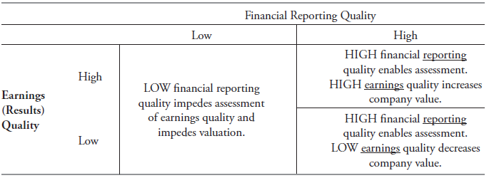
Financial Reporting Quality and Earnings Quality are interrelated

Slide 9
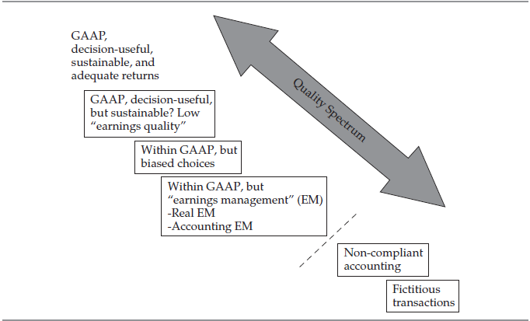
Quality Spectrum of Financial Reports

Slide 10
Quality Spectrum of Financial Reports
Excerpt from Toyota Motor Corporation’s Consolidated Financial Results
“Consolidated vehicle unit sales in Japan and overseas decreased by 37 thousand units, or 1.6%, to 2,232 thousand units in FY2014 first quarter …compared with FY2013 first quarter…
“…operating income increased by ¥310.2 billion, or 87.9%, to ¥663.3 billion in FY2014 first quarter compared with FY2013 first quarter. The factors contributing to an increase in operating income were the effects of changes in exchange rates of ¥260.0 billion...

Slide 11
Quality Spectrum of Financial Reports: Bias
Biased accounting choices, assumptions, estimates:
“Aggressive” choices increase a company’s reported performance and financial position in the current period.
“Conservative” choices decrease current reported performance but may increase future reported.
Biased presentation choices:
Obscure unfavorable information and/or
Emphasize favorable information.

Slide 12
Conservative VS Aggressive Accounting
Aggressive accounting is the use of accounting standards to create financial statements that present a rosier picture of a company than is actually the case.
Creates sustainability issue
Conservative accounting is the use of accounting standard that recognize expenses and liabilities as soon as possible when there is uncertainty about the outcome, but to only recognize revenues and assets when they are assured of being received.
No sustainability issue
Big Bath Accounting:The strategy of manipulating a company's income statement to make poor results look even worse. The big bath is often implemented in a bad year to enhance artificially next year's earnings. The big rise in earnings might result in a larger bonus for executives.
‘Earning smoothing’: conservative choice to underestimate earnings in period performing good plus aggressive when struggling to smoothing the earnings.

Slide 13
Quality Spectrum of Financial Reports: Earnings Management
Earnings management: deliberate actions to influence reported earnings.
Real earnings management, for example: Defer R&D expenses into the next quarter in order to meet earnings targets.
Accounting earnings management, for example: Change accounting estimates in order to meet earnings targets.

Slide 14
Quality Spectrum of Financial Reports: Noncompliant Accounting
Enron (2001) used special purpose entities to understate debt and overstate profits and cash flow.
WorldCom (2002) capitalized certain expenditures to understate expenses and thus overstate earnings and operating cash flow.
New Century Financial (2007) reserved minimal amounts for loan repurchase losses for subprime mortgages.

Slide 15
Quality Spectrum of Financial Reports: Fictitious Transactions
Equity Funding Corp. (1970s) created fictitious revenues and even fictitious policy holders.
Crazy Eddie’s (1980s) reported fictitious inventory as well as fictitious revenues supported by fake invoices.
Parmalat (2004) reported fictitious bank balances.

Slide 16
motivations potentially associated with low financial reporting quality
Mask poor performance (e.g., declining profitability or lower profitability than competitors).
Meet or beat market expectations (e.g., analysts’ forecasts and/or management’s guidance).
Increase stock price, if only temporarily.
Increase credibility with market participants.
Enhance reputation with customers and suppliers.
Increase compensation that is linked to reported earnings.
Avoid violation of debt covenants.

Slide 17
Conditions conducive to issuing low-quality financial reports
Opportunity
Motivation
Rationalization

Slide 18
mechanisms that discipline financial reporting quality
Regulatory Authority
Auditors
Private Contracting
Registration requirements
Disclosure requirements
Auditing requirements
MD&A
Regulatory review of filings
Enforcement mechanism

Slide 19
mechanisms that discipline financial reporting quality
Regulatory Authority
Auditors
Private Contracting

Slide 20
mechanisms that discipline financial reporting quality – potential limitations
Regulatory Authority
Auditors
Private Contracting
Info provided by company
Opinion based on sampling
Expectations gap
Company pays audit fees

Slide 21
mechanisms that discipline financial reporting quality
Regulatory Authority
Auditors
Private Contracting

Slide 22
Companies’ Presentation choices
What information to present—beyond required disclosures?
Operating metrics (“eyeballs,” clicks, users)
Pro forma measures (a.k.a. non-GAAP or non-IFRS measures)
Eg. Roblox
How to present the information?
Emphasize the positive aspects of performance.
Include “boilerplate” and excessive or irrelevant detail.

Slide 23
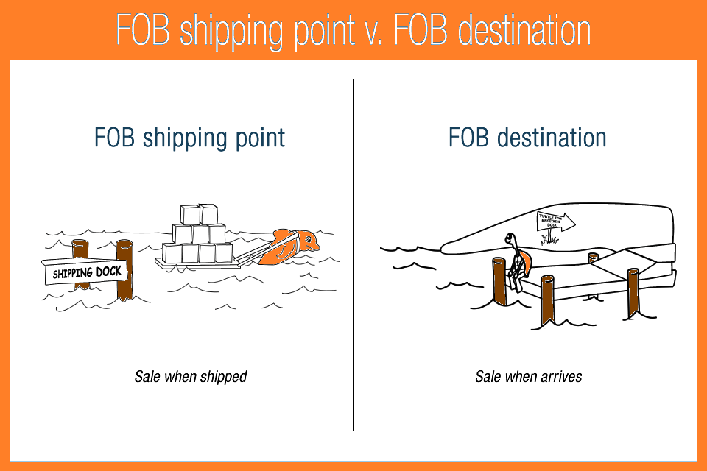
Accounting choices
Choices exist among accounting methods and estimates, including the following:
Revenue recognition
Timing (FOB shipping point vs. FOB destination)
Amounts (eg. bill-and-hold; barter transaction; related party transaction)
Expense recognition
Inventory cost flow
Capitalizing versus expensing
Depreciation method and estimates
Allowances for realization of assets

Slide 24
Accounting Choices: Inventory cost flow assumptions
Trade-offs exist, and investors should be aware of how accounting choices affect financial reports.
FIFO (first-in-first-out) cost assumption:
More current costs are included in ending inventory on the balance sheet.
Older costs are included in cost of sales on the income statement.
Weighted-average cost assumption:
A blend of old and new costs in inventory on the balance sheet—not as current as with FIFO.
A blend of old and new costs in cost of sales on the income statement—more current than with FIFO.
LIFO (last-in-first-out) cost assumption (only allowed under US GAAP):
More current costs are included in COGS in income statement
Older costs are included in the ending inventory on the balance sheet.

Slide 25
Accounting Choices: Inventory cost flow assumptions Example
 | Units | Cost per Unit | Total Cost
Purchase 1 | 5 | $100 | $500
Purchase 2 | 5 | 150 | 750
Purchase 3 | 5 | 180 | 900
Purchase 4 | 5 | 200 | 1,000
Purchase 5 | 5 | 240 | 1,200
Cost of goods available for sale |  |  | $4,350
A company starts operations with no inventory at the beginning of a fiscal year and makes five purchases of goods for resale, as shown in the table. During the period, the company sells, at $250 each, all of the goods purchased except for five units.
What are the ending inventory and cost of goods sold if the company uses the FIFO, LIFO & Weighted average method of inventory costing?

Slide 26
Accounting Choices: Inventory cost flow assumptions Example
 | Units | Cost per Unit | Total Cost
Purchase 1 | 5 | $100 | $500
Purchase 2 | 5 | 150 | 750
Purchase 3 | 5 | 180 | 900
Purchase 4 | 5 | 200 | 1,000
Purchase 5 | 5 | 240 | 1,200
Cost of goods available for sale |  |  | $4,350
FIFO:
COGS=500+750+900+1,000=3150
Ending inventory=1,200

Slide 27
Accounting Choices: Inventory cost flow assumptions Example
 | Units | Cost per Unit | Total Cost
Purchase 1 | 5 | $100 | $500
Purchase 2 | 5 | 150 | 750
Purchase 3 | 5 | 180 | 900
Purchase 4 | 5 | 200 | 1,000
Purchase 5 | 5 | 240 | 1,200
Cost of goods available for sale |  |  | $4,350
LIFO:
COGS=750+900+1,000+1,200=3850
Ending inventory=500

Slide 28
Accounting Choices: Inventory cost flow assumptions Example
 | Units | Cost per Unit | Total Cost
Purchase 1 | 5 | $100 | $500
Purchase 2 | 5 | 150 | 750
Purchase 3 | 5 | 180 | 900
Purchase 4 | 5 | 200 | 1,000
Purchase 5 | 5 | 240 | 1,200
Cost of goods available for sale |  |  | $4,350
Weighted average:
Average cost per unit=4,350/25=174
Ending inventory=5*175=870
COGS=20*174=3,480

Slide 29
Accounting Choices: Inventory cost flow assumptions Example
Cost Flow Assumption | FIFO | LIFO | Weighted Average
COG available to sale | 4,350 | 4,350 | 4,350
COGS | (3,150) | (3,850) | (3,480)
Ending inventory (5 units) | 1,200 | 500 | 870
Sales | 5,000 | 5,000 | 5,000
COGS | 3,150 | 3,850 | 3,480
Gross profit | 1,850 | 1,150 | 1,520
Gross profit margin | 37.0% | 23.0% | 30.4%

Slide 30
Accounting choices: Capitalizing vs. expensing an expenditure
Business have two options when adding a cost to their financial statement. They can either expense it (benefit only the current period) or capitalize it (benefit future periods).
Expense it: it is added on the income statement and subtracted from the business revenue to determine the profit.
Capitalise it: it is going to count towards capital expenditures. It will be accounted for on the entity’s balance sheet as an asset. In this case, the income statement will only feature the appropriate depreciation of the asset.
Example: Company A has $4000 revenue and $3000 in expense, also incurred $500 in repair and maintenance costs for its machines.
Worldcom Scandal

Slide 31
Accounting choices: Depreciation method and estimates
Straight line method
Same amount of depreciation expense each year
Accelerated method (double declining balance method)
Greater depreciation expense recognition in the earlier part of an asset life
Unit of production method
Allocates depreciation expense based on unit of use or production

Slide 32
Analytical procedures to detect warning signs: revenue recognition (1 of 2)
Examine the accounting policies note for a company’s revenue recognition policies.
Consider whether the policies make it easier to prematurely recognize revenue
Recognizing revenue immediately upon shipment of goods
Bill-and-hold arrangements
Consider estimates and judgments required by the policies
Barter transactions can be difficult to value properly
Rebate programs involve many estimates
Multiple-deliverable arrangements require allocation of revenue and timing of revenue recognition for each item or service

Slide 33
Analytical procedures to detect warning signs: revenue recognition (2 of 2)
Look at revenue relationships.
Compare a company’s revenue growth with its primary competitors or its industry peer group and understand the reasons for major differences.
Superior management or products and services?
Revenue quality?
Compare accounts receivable with revenues:
Examine the trend in receivables as a percentage of total revenues.
Examine the trend in receivables turnover for unusual changes and seek an explanation if they exist.
Compare a company’s days sales outstanding (DSO) or receivables turnover with that of relevant competitors or an industry peer group.
Examine asset turnover.

Slide 34
Analytical procedures to detect warning signs: inventory
Look at inventory relationships.
Compare a company’s inventory growth—relative to sales growth—with its primary competitors or its industry peer group and understand the reasons for major differences.
Examine trend in inventory turnover:
Poor inventory management?
Obsolescence? Future write-offs?
Overstated current gross and net profits?
If company uses LIFO (allowed under US GAAP), note whether LIFO liquidations occurred.

Slide 35
Analytical procedures to detect warning signs: Long-lived assets
Examine the company’s accounting policy note for its capitalization policy for long-term assets, including interest costs, and for its handling of other deferred costs.
Compare the company’s policy with industry practice.
If the company’s policy is an outlier, cross-check asset turnover and profitability margins with others in the industry.

Slide 36
Analytical procedures to detect warning signs: operating cash flow Versus net income
Pay attention to the relationship of cash flow and net income.
If net income is consistently higher than operating cash flow, it can signal accrual accounting policies that shift revenue to current period and/or current expenses to later periods.
Construct a time series of cash generated by operations divided by net income. If the ratio is consistently below 1.0 or has declined repeatedly, there may be problems in the company’s accrual accounts.

Slide 37
Other potential warning signs: areas that might suggest further analysis
Depreciation methods and useful lives compared with those of its peers.
Fourth-quarter surprises routinely occurring.
Presence of related-party transactions.
Nonoperating income or one-time sales included in revenue.
Classification of expenses as “nonrecurring.”
Gross/operating margins out of line with competitors or industry, an ambivalent signal.

Slide 38
Evaluating the Quality of Financial Reports
Understand company and industry.
Learn about management.
Identify important accounting areas.
Compare:
Current year’s report with prior year’s report
Accounting policies with competitors’ policies
Ratios with competitors’ ratios
Check for warning signs.
Review segment results.
Use quantitative predictors of misreporting.

Slide 39
Quantitative Tool to Assess the Likelihood of Misreporting—Beneish Model
M-score = Score indicating probability of earnings manipulation. Higher M-scores (i.e., less negative numbers) indicate an increased probability of earnings manipulation.
DSR (days sales receivable index); GMI (gross margin index); AQI (asset quality index); SGI (sales growth index); DEPI (depreciation index); SGAI (sales, general, and administrative expenses index); LEVI (leverage index).
An M-score of less than -1.78 suggests the company will not be a manipulator; while an M-score of greater than -1.78 signals the company is likely to be a manipulator.

Slide 40
summary
Financial reporting quality can be thought of as spanning a continuum.
Reporting quality pertains to the information disclosed whereas results quality (commonly referred to as earnings quality) pertains to the earnings and cash generated by the company’s actual economic activities.
Motivations to issue lower-quality financial reports include masking poor performance, boosting the stock price, increasing personal compensation, and/or avoiding violation of debt covenants.
Mechanisms that discipline financial reporting quality include the free market and incentives for companies to minimize cost of capital, auditors, contract provisions, and enforcement by regulatory entities.
Examples of accounting choices that affect earnings and balance sheets include revenue recognition, inventory cost flow assumptions, estimates of realizability of assets (such as accounts receivable and deferred tax assets), depreciation method, estimated salvage value, and useful life of depreciable assets.
Warning signals of potential accounting manipulation should be evaluated cohesively, not on an isolated basis.

Slide 41
Summary (con’t)
Potential problems that affect the quality of financial reporting broadly include revenue and expense recognition on the income statement; classification on the statement of cash flows; and the recognition, classification, and measurement of assets and liabilities on the balance sheet.
Typical steps involved in evaluating financial reporting quality include
an understanding of the company’s business and industry;
comparison of the financial statements in the current period and the previous period;
evaluation of the company’s accounting policies compared with those of other companies in the same industry;
financial ratio analysis;
examination of the statement of cash flows with particular focus on differences between net income and operating cash flows;
perusal of risk disclosures; and
review of management compensation and insider transactions.

