Slide 2

Equity Valuation 1
FNCE2003 Business Analysis for Investment

Slide 3
Financial Statement Analysis
How Financial Statement are Used in Valuation
Chapter: 03
Financial Statement Analysis and Security Valuation, 5/e, McGraw-Hill, 2013 -by Stephen H. Penman

Slide 4
Learning Outcomes
After completing this seminar, and the associated readings, you will be able to do the following:
Explains how financial statements are used in valuing firms
Understand the Difference Between:
Simple Valuation Schemes
Stock Screening, and
Fully Fledged Fundamental Analysis
How one converts a forecast to a valuation

Slide 5
Valuation Schemes
Simple approaches:
Use limited information
Minimize information analysis (and thus the cost). But they lose precision.
Fundamental analysis:
Use detailed information and
Involves considerable effort; and Costly.
Simple methods:
Method of Comparables
Screening on Multiples
Asset-Based Valuation

Slide 6
The Method of Comparables: Comps
Identify comparable firms that have similar operations to the firm whose value is in question (the “target”).
Identify measures for the comparable firms in their financial statements – earnings, book value, sales, cash flow – and calculate multiples of those measures at which the firms trade.
Apply these multiples to the corresponding measures for the target to get that firm’s value.

Slide 7
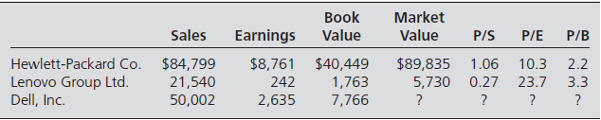
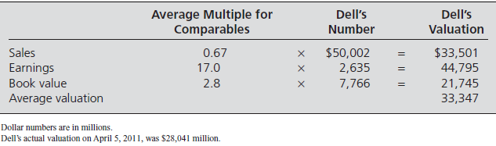
The Method of Comparables: Hewlett Packard, Lenovo, and Dell 2011
Avr p/s = (1.06+.27)/2
= 0.67
https://www.macroaxis.com/invest/ratio/DELL--Market-Capitalization
28,041 VS 33,347 – cheap?

Slide 8
How Cheap is this Method?
Conceptual Problems:
Circular reasoning: Price is ascertained from price (of the comps)
Does not tell us value independently of market prices
Violates the tenet: “When calculating value to challenge price, don’t put price into the calculation”
If the market is efficient for the comparable companies....Why is it not for the target company ?
If the comps are mispriced, exercise is doubtful!
Implementation Problems:
Finding the comparables that match precisely
Different accounting methods for comps and target
Different prices from different multiples
What about negative denominators?
Applications:
IPOs; firms that are not traded (to approximate price, not value)

Slide 9
Screening on Multiple
Screening on multiple is referred to as fundamental screening because multiples price fundamental features of the firm.
Stocks are screened for buying and selling on the basis of their relative multiples.
Basic assumption: similar firms should have similar multiples (market must be efficient). If firms trade at different multiples, they may be relatively mispriced.
Glamour stocks/growth stock: stock with high multiple
Contrarian stocks/ value stocks: stock with low multiple. Value is deemed to be higher relative to their price.

Slide 10
How Multiple Screening Works
1. Identify a multiple on which to screen stocks.
2. Rank stocks on that multiple, from highest to lowest.
3. Buy stocks with the lowest multiples and (short) sell stocks with the highest multiples.

Slide 11
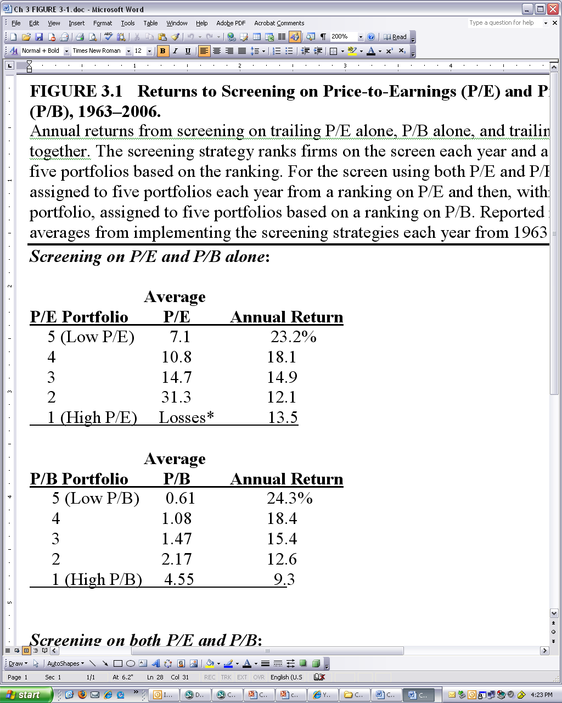
Fundamental Screening: Returns to P/B Screening (1963-2006)

Slide 12
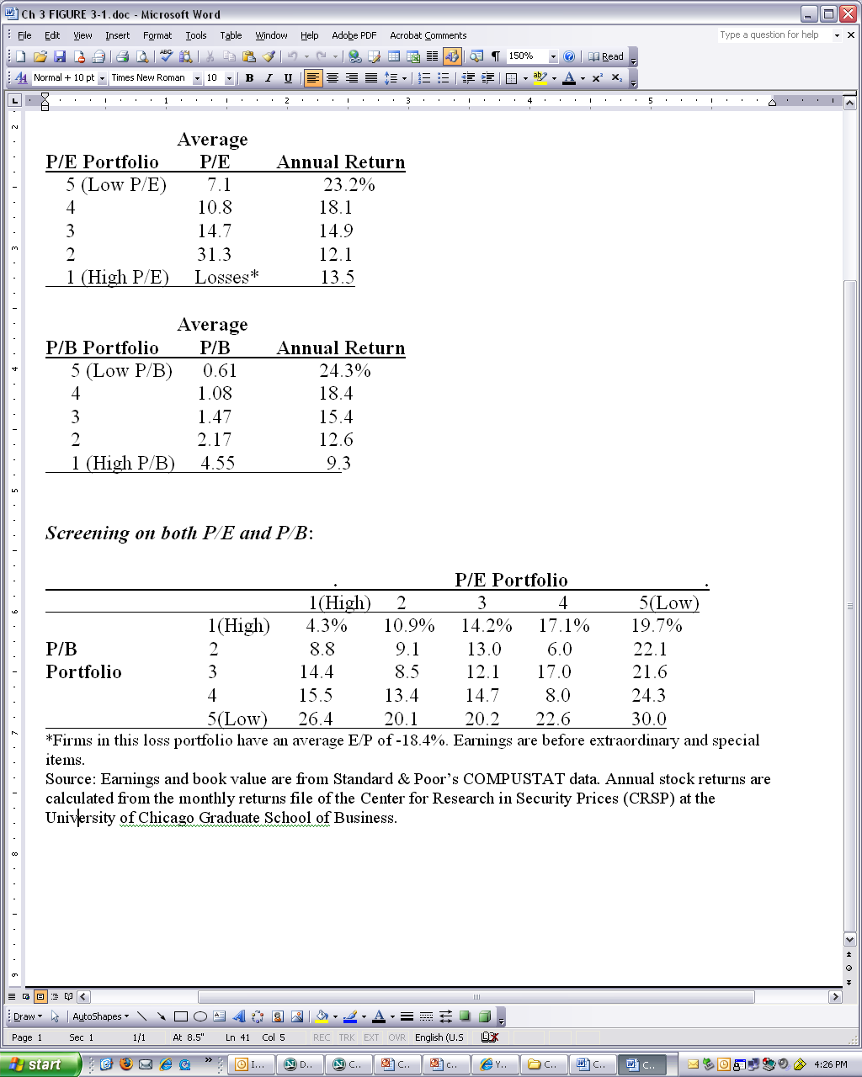
Two-way Screening: Returns to Screening on Both P/E and P/B (1963-2006)

Slide 13
Problems with Screening
No guarantee that history will replicate in future.
You could be loading up on a risk factor:
You need a risk model
You are in danger of trading with someone who knows more than you
You need a model that anticipates future payoffs
You are trading on a small amount of information;
Ignore information at your peril.

Slide 14
Technical Screens
Price screens: Buy (sell) stocks whose price have dropped (increased) a lot relative to the market.
Small stock screens: Buy stocks with low Mcap.
Neglected stocks screens: Buy stock that are not followed by many analysts.
Seasonal screens: Buy stock at a certain time of the year.
Momentum screens: Buy stock that have had increases in stock price.
Insider trading screens: follow the trading of the insider.
Fundamental Screens: identify positions based on fundamental indicators of the firm’s operations relative to price
Price/Earnings (P/E) ratios
Market/Book Value (P/B) ratios
Price/Cash Flow (P/CF) ratios
Price/Dividend (P/D) ratios
Any combination of these methods is possible

Slide 15
Asset Based Valuation
Values the firm’s assets and then subtracts the value of debt:
The balance sheet does this calculation, but imperfectly.
Asset-based valuation attempts to redo the balance sheet by:
getting current market values for assets and liabilities listed on balance sheet
identifying omitted assets and assigning a market value to them
Problems with this approach:
Getting the value of operating assets when there is no market for them
Identifying value in use for a particular firm (liquidation value vs replacement cost)
Getting the value of intangible assets (brand names, R&D)
Getting the value of “synergies” of assets being used together
Applications:
“Asset-base” firms such as oil and gas and mineral products
Calculating liquidation values

Slide 16
Fundamental Analysis
Fundamental analysis involves analysing information, forecasting payoffs from that information, and arriving at a valuation based on those forecasts.
This technique uses a broader set of information.

Slide 17
The Process of Fundamental Analysis
Step 5 - Trading on the Valuation
Outside Investor
Compare Value with Price to BUY, SELL, or HOLD
Inside Investor
Compare Value with Cost to ACCEPT or REJECT Strategy
Step 4 - Convert Forecasts to a Valuation
Step 3 - Forecasting Payoffs
Measuring Value Added
Forecasting Value Added
Step 1 - Knowing the Business
The Products
The Knowledge Base
The Competition
The Regulatory Constraints
Strategy
Step 2 - Analyzing Information
In Financial Statements
Outside of Financial Statements
A valuation model guides the process
Forecasting is at the heart of the process and a valuation model specifies what is to be forecasted (Step 3) and how a forecast is converted to a valuation (Step 4). What is to be forecasted (Step 3) dictates the information analysis (Step 2)

Slide 18
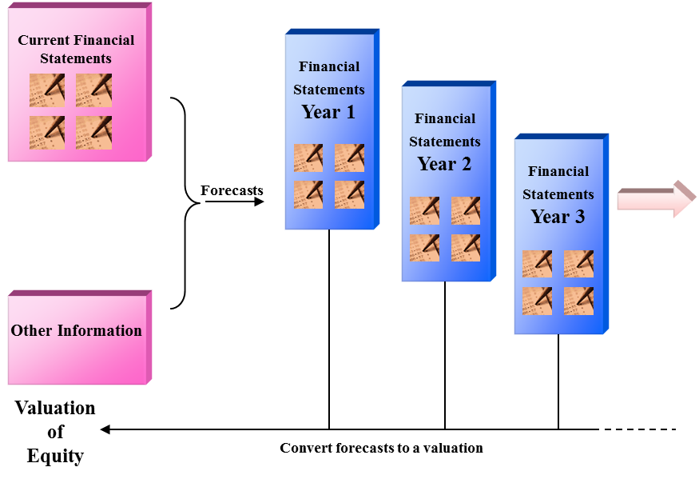
How Financial Statements are Used in Fundamental Analysis
The analyst forecasts future financial statements and converts
forecasts in the future financial statements to a valuation.
Current financial statements are used to extract information for forecasting.

Slide 19
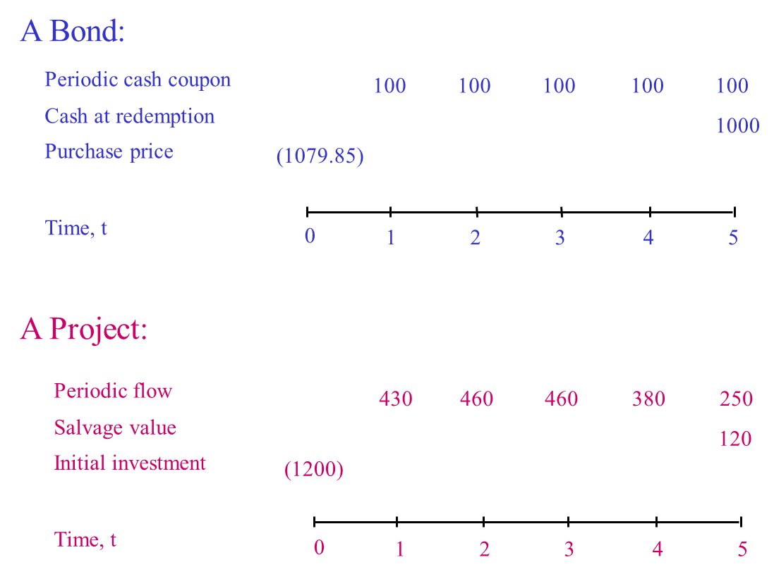
Two Terminal Investments: A Bond and a Project

Slide 20
The Valuation Model: Bonds
r_{D} is (one plus) the required return on the debt
Valuation issue: What is the Discount rate r_{D ?}

Slide 21
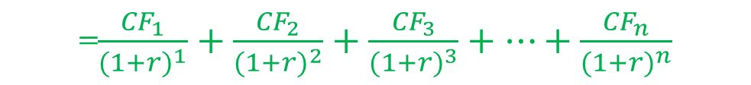
The Valuation Model: A Project
=$\frac{{CF}_{1}}{{(1+r)}^{1}}+\frac{{CF}_{2}}{{(1+r)}^{2}}+\frac{{CF}_{3}}{{(1+r)}^{3}}+…+\frac{{CF}_{n}}{{(1+r)}^{n}}$
r_{P} is (one plus) the required return (hurdle rate) for the project
Valuation Issues:
How are cash flows forecasted?
What is the discount rate?

Slide 22
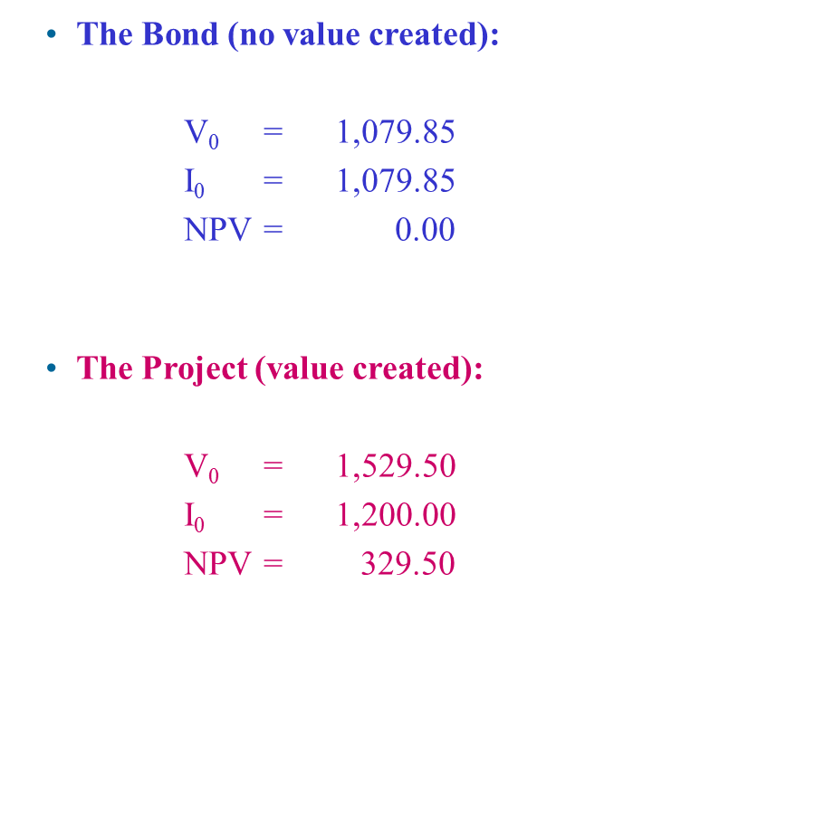
Value Creation: V₀ > I₀

Slide 23
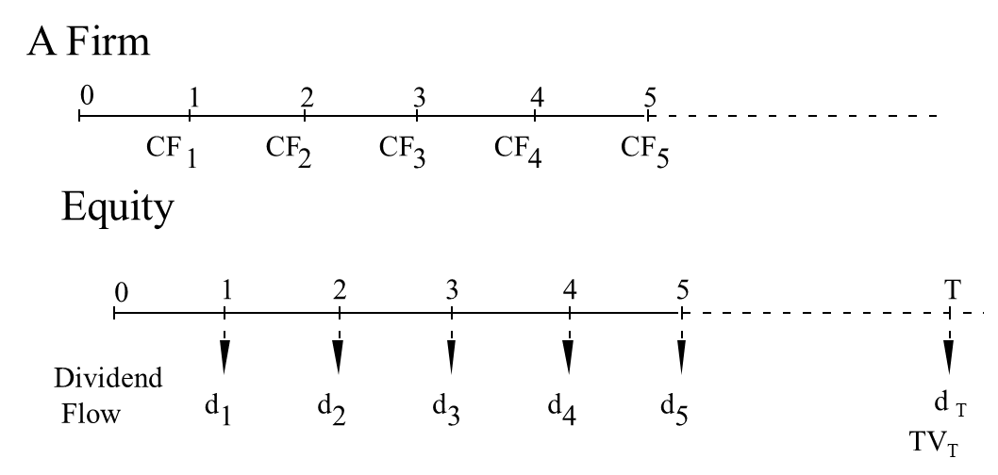
Valuation Models: Going Concerns
The terminal value, TV_{T} is the price payoff, P_{T} when the share is sold
Valuation issues :
The forecast target: dividends, cash flow, earnings?
The time horizon: T = 5, 10, ?
The terminal value?
The discount rate?

Slide 24
Criteria for Practical Valuation
To be practical, we require:
1. Finite horizon forecasting
Forecasting over infinite horizons is impractical
2. Validation
Whatever we forecast must be observable ex post, so
the forecast can be verified for its accuracy.
3. Parsimony
Information gathering & analysis should
be straightforward
The fewer pieces of information, the better

Slide 25
Financial Statement Analysis
Cash Accounting, Accrual Accounting, and Discounted Cash Flow Valuation
Chapter: 04
Financial Statement Analysis and Security Valuation, 5/e, McGraw-Hill, 2013 -by Stephen H. Penman

Slide 26
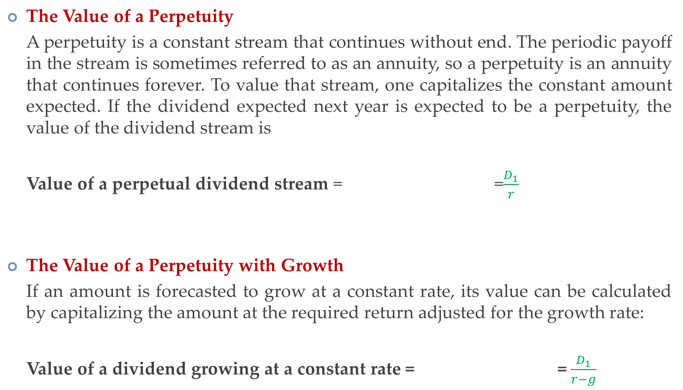
Some Financial Math: The Value of a Perpetuity and a Perpetuity with Growth
The Value of a Perpetuity
A perpetuity is a constant stream that continues without end. The periodic payoff in the stream is sometimes referred to as an annuity, so a perpetuity is an annuity that continues forever. To value that stream, one capitalizes the constant amount expected. If the dividend expected next year is expected to be a perpetuity, the value of the dividend stream is
Value of a perpetual dividend stream = =$\frac{D_{1}}{r}$
The Value of a Perpetuity with Growth
If an amount is forecasted to grow at a constant rate, its value can be calculated by capitalizing the amount at the required return adjusted for the growth rate:
Value of a dividend growing at a constant rate = = $\frac{D_{1}}{r−g}$

Slide 27
Cash Flows Within a Firm: Free Cash Flow
Free cash flow is cash flow from operations that results from investments minus cash used to make investments.
Cash flow from operations (inflows)
Cash investment (outflows)
Free cash flow
Time, t
C₁
C₂
C₃
C₄
C₅
I₁
I₂
I₃
I₄
I₅
C₁-I₁
C₂-I₂
C₃-I₃
C₄-I₄
C₅-I₅
1
2
3
4
5
FCFF=CFO-CapEx (cash flow statement; CapEx normally includes fixed and tangible assets only)

Slide 28
Free Cash-Flow
FCFF (computed from Net Income)
FCFF = NI + NCC + Int(1 - Tax rate) - FCInv - WCInv
FCFF (computed from Operating Cash-Flow)
FCFF = CFO + Int(1 - Tax rate) - FCInv
FCFE = CFO - FCInv + Net borrowing
Where NI = Net Income,
NCC = Non-Cash Charges (e.g. depreciation),
Int = Interest expense,
FCInv = Capital expenditures,
WCInv = Working capital expenditures

Slide 29
The Discounted Cash Flow (DCF) Model

Slide 30
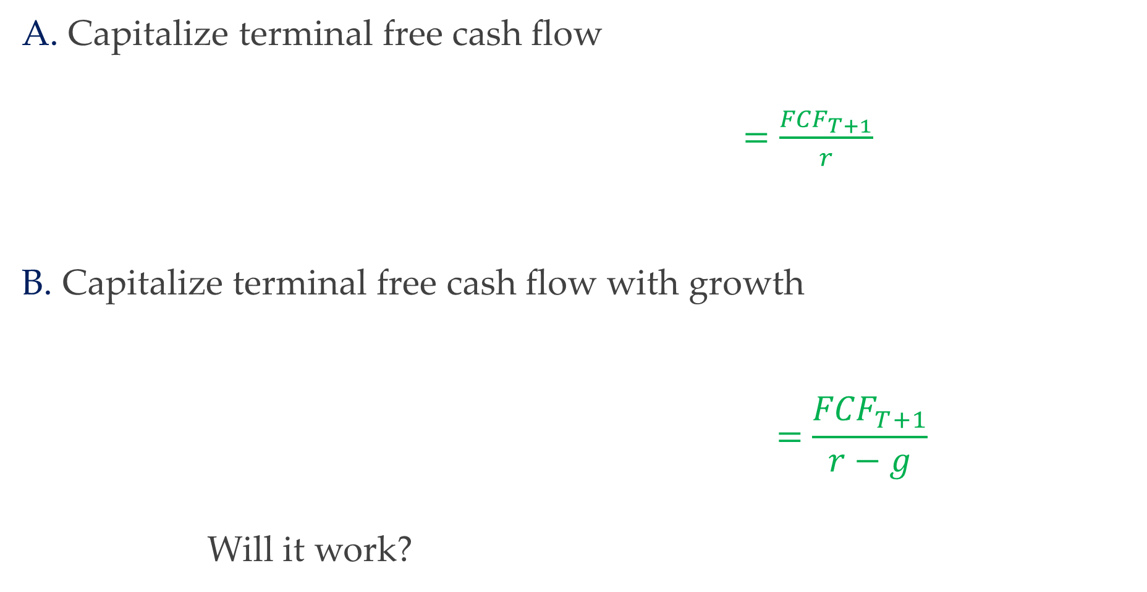
The Continuing Value for the DCF Model
A. Capitalize terminal free cash flow
$=\frac{{FCF}_{T+1}}{r}$
B. Capitalize terminal free cash flow with growth
$$=\frac{{FCF}_{T+1}}{r−g}$$
Will it work?

Slide 31
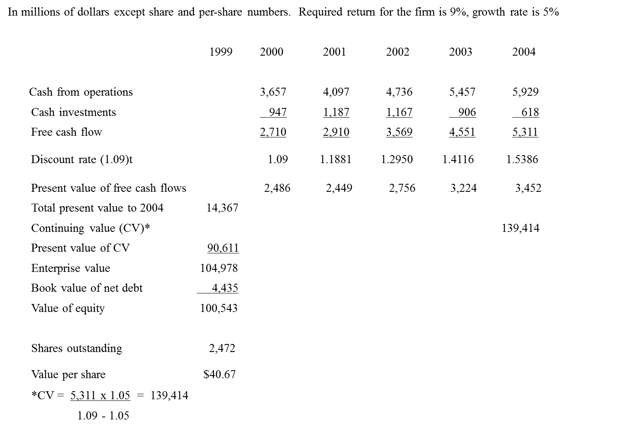
DCF Valuation: The Coca-Cola Company
Present value of CV = 139,414 = 90,611
1.5386

Slide 32
Steps for a DCF Valuation
Here are the steps to follow for a DCF valuation:
Forecast free cash flow to a horizon
Discount the free cash flow to present value
Calculate a continuing value at the horizon with an estimated growth rate
Discount the continuing value to the present
Add 2 and 4
Subtract net debt

Slide 33
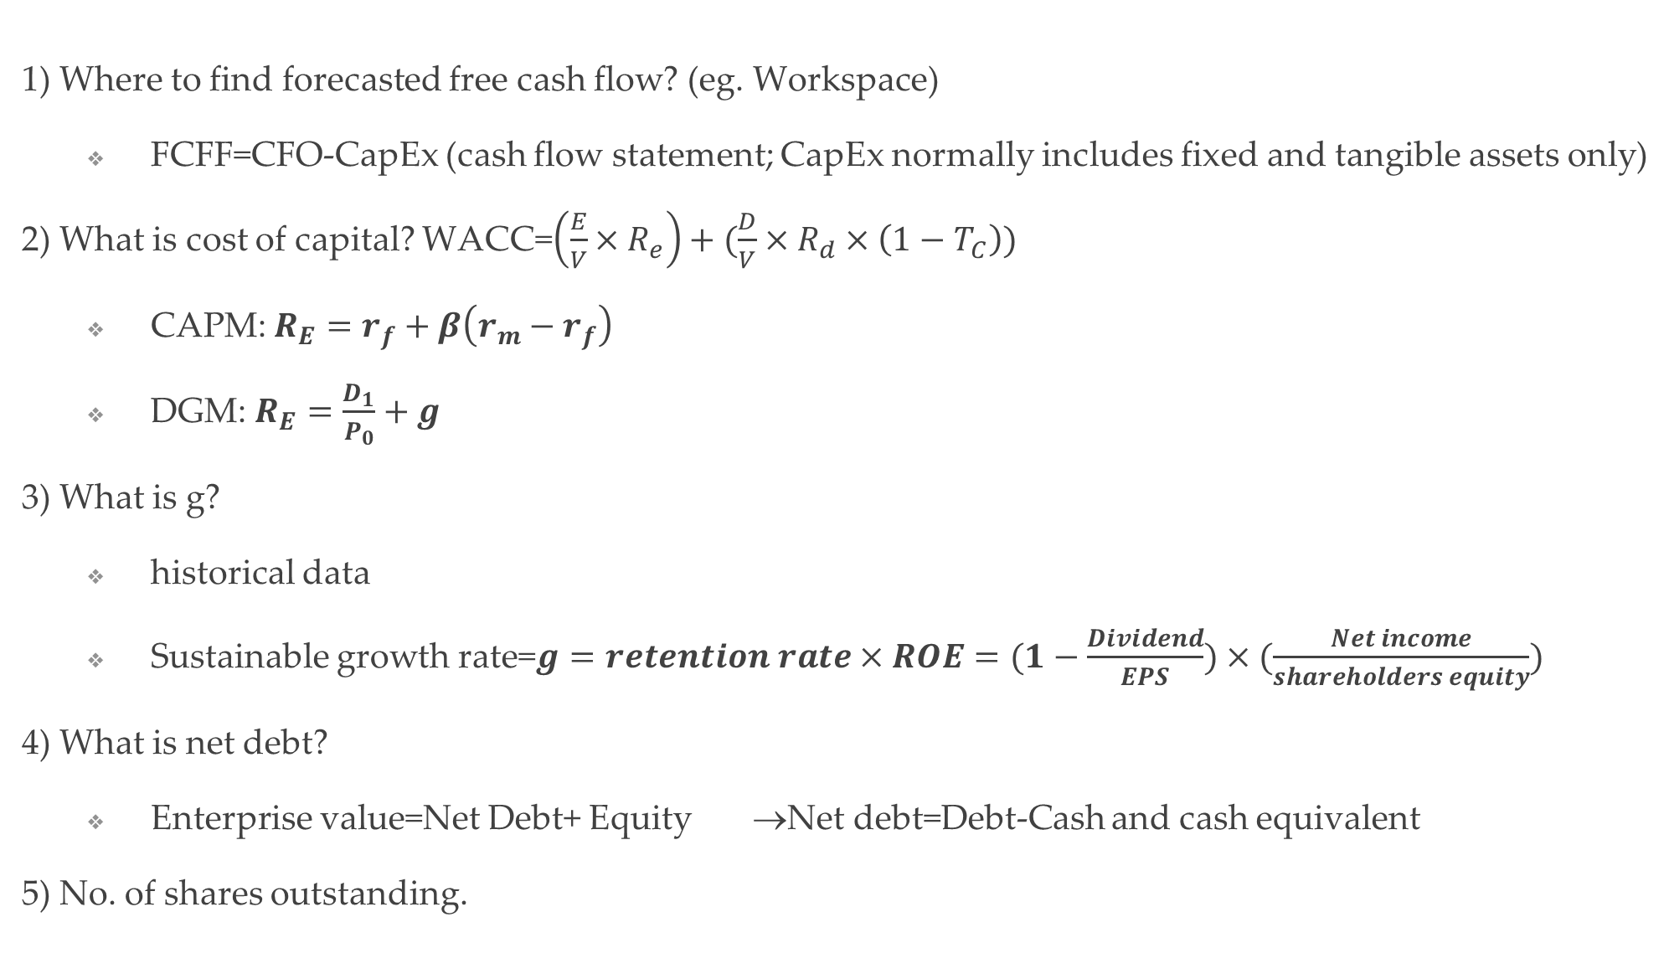
Evaluation in reality
1) Where to find forecasted free cash flow? (eg. Workspace)
FCFF=CFO-CapEx (cash flow statement; CapEx normally includes fixed and tangible assets only)
2) What is cost of capital? WACC=$\left(\frac{E}{V}×R_{e}\right)+(\frac{D}{V}×R_{d}×\left(1−T_{C}\right))$
CAPM: $R_{E}=r_{f}+β\left(r_{m}−r_{f}\right)$
DGM: $R_{E}=\frac{D_{1}}{P_{0}}+g$
3) What is g?
historical data
Sustainable growth rate=$g=retention rate×ROE=(1−\frac{Dividend}{EPS})×(\frac{Net income}{shareholders equity})$
4) What is net debt?
Enterprise value=Net Debt+ Equity →Net debt=Debt-Cash and cash equivalent
5) No. of shares outstanding.

Slide 34
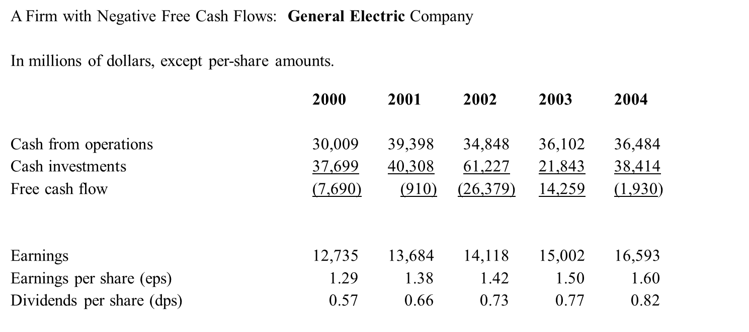
Will DCF Valuation Always Work?
GE earned one of the highest stock returns from 1993 -2004… BUT, FCF are negative!
FCF negative as CFO<CFI … more investment >> more growth?
FCF does not indicate value addition

Slide 35
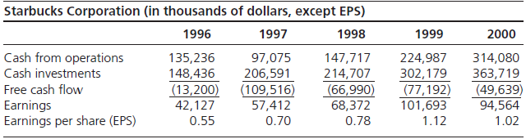
Will DCF Valuation Work for Starbucks?
During 1996-2000, stock price of Starbucks more than doubled.
BUT, FCF – negative!
In FCF – investment is treated as bad, rather than good
Needs more longer forecast horizon to capture expected cash inflows.
In DCF analysis cash receipts from investments are recognized in periods after the investment is made.

Slide 36
DCF Valuation and Speculation
Formal valuation aims to reduce our uncertainty about value and to discipline speculation
The most uncertain (speculative) part of a valuation is the continuing value. So valuation techniques are preferred if they result in a smaller amount of the value attributable to the continuing value
DCF techniques can result in more than 100% of the valuation in the continuing value: See General Electric and Starbucks

Slide 37
Why Free Cash Flow is Not a Value-Added Concept
Cash flow from operations (value added) is reduced by investments (which also add value): investments are treated as value losses
Value received is not matched against value surrendered to generate value
A firm reduces free cash flow by investing and increases free cash flow by reducing investments:
Free cash flow is partially a liquidation concept!!

Slide 38
Discounted Cash Flow Analysis: Advantages and Disadvantages
Advantages
Easy concept: cash flows are “real” and easy to think about; they are not affected by accounting rules
Familiarity: is a straight application of familiar net present value techniques
Disadvantages
Suspect concept:
free cash flow does not measure value added in the short run; value gained is not matched with value given up.
free cash flow fails to recognize value generated that does not involve cash flows
investment is treated as a loss of value
free cash flow is partly a liquidation concept; firms increase free cash flow by cutting back on investments.
Forecast horizons: typically requires forecasts for long periods; terminal values for shorter periods are hard to calculate with any reliability
Not aligned with what people forecast: analysts forecast earnings, not free cash flow; adjusting earnings forecasts to free cash forecasts requires further forecasting of accruals
38
When It Works Best
When the investment pattern is such as to produce constant free cash flow or free cash flow growing at a constant rate.

