Slide 1
Weighted Average Cost of Capital (WACC)

Slide 2
The Equity Cost of Capital
The cost of equity is the return that equity investors require on their investment in the firm.
The Capital Asset Pricing Model (CAPM) is a practical way to estimate the equity cost of capital.
The cost of capital of any investment opportunity equals the expected return of available investments with the same beta.
Risk Premium for Security i

Slide 3
The Debt Cost of Capital
The expected return is required by the firm’s creditors. This is the cost of capital that the firm must pay on its debt.
Yields versus Returns
Yield to maturity is the return a bondholder will earn from holding the bond to maturity and receiving its promised payments.
If there is little risk the firm will default, yield to maturity is a reasonable estimate of investors’ expected rate of return.
If there is significant risk of default, yield to maturity will overstate investors’ expected return.

Slide 4
The Debt Cost of Capital (cont’d)
So the expected return of the bond is
r_{d} = y - pL
= Yield to Maturity – Prob(default) X Expected Loss Rate
The importance of the adjustment depends on the riskiness of the bond.

Slide 5
Cash and Net Debt
Some firms maintain high cash balances.
Cash is a risk-free asset that reduces the average risk of the firm’s assets.
Because the risk of the firm’s enterprise value (D + E) is what we’re concerned with, leverage should be measured in terms of net debt.
Net Debt = Debt – Excess Cash and short-term investments

Slide 6
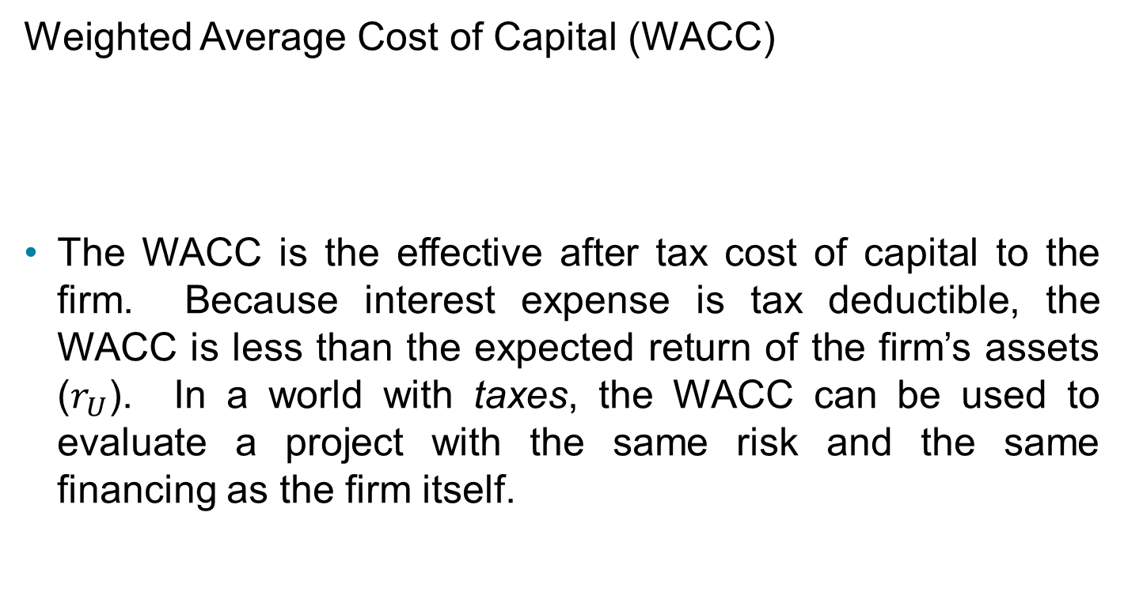
The Weighted Average Cost of Capital
Weighted Average Cost of Capital (WACC)
The WACC is the effective after tax cost of capital to the firm. Because interest expense is tax deductible, the WACC is less than the expected return of the firm’s assets ($r_{U}$). In a world with taxes, the WACC can be used to evaluate a project with the same risk and the same financing as the firm itself.

Slide 7
WACC IN ASSESSMENT 2
Cost of debt is given, i.e. 6% (before tax)
You have to calculate the cost of equity using CAPM. Do your own research for beta, risk-free rate, and market return.
If the figures you obtained suggest you can’t use CAPM (e.g. market return is negative), you could make your assumption for market return, but you still have to show your original findings.
When calculating the weights, you could use book value instead of market value just to simplify this assessment.
You need to have a higher WACC compared with the growth rate. Again, you might end up with an assumption, but you need to show your original findings.

